Slide 1
Efficient Beam Selection for Hybrid Beamforming
Date: 2015-09-14
Authors:

Slide 2
Abstract
Beam selection for hybrid beamforming for 11ay is investigated. Optimal beam selection requires a number of computations that scale exponentially with the number of RF chains, which may be infeasible in practice. We investigate the performance of an efficient beam selection algorithm that works by matching transmit-receive antenna array pairs one by one, which reduces the search time significantly. For a simulated indoor scenario, beam selection with the proposed method shows minimal performance loss compared to exhaustive search.

Slide 3
Outline
Introduction
Hybrid Beamforming
Beam Selection
Simulation Results
Summary and Conclusions

Slide 4
Introduction
With MIMO included in 11ay, more than one antenna array per device will be allowed to be active.
Beam selection is a necessary first step, where each antenna array needs to identify its best beam to use for transmitting or receiving.
The number of beam combinations grows exponentially with the number of antenna arrays.
With more than one antenna array on the transmit and/or receive side, beam selection becomes significantly more complex.
Hence, efficient beam selection methods are of interest for 11ay.

Slide 5
Hybrid Beamforming
RF
RF
H
BB
BB
RF
RF
Hybrid Beamforming [1]: Beamforming done in two stages.
Coarse (Analog) Beamforming: Optimal sectors or antenna weights are selected.
Fine (Digital) Beamforming: Baseband precoding/combining is done.
During analog beamforming, one set of beams is selected to form the effective (baseband) channel matrix H to be used for the fine beamforming stage.
Once H is known, traditional MIMO techniques apply [2].

Slide 6
Analog Beamforming Stage
RF
RF
H
BB
BB
RF
RF
2x2 MIMO example:
Beams are selected from a codebook.
A codebook is a collection of antenna weight vectors.
i₁ : beam index for the first transmit array
i₂ : beam index for the second transmit array
j₁ : beam index for the first receive array
j₂ : beam index for the second receive array
H=H(i₁, i₂, j₁, j₂)
- Ideally, the set of all possible H’s should be checked to find the optimal beams.

Slide 7

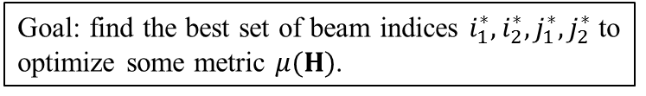
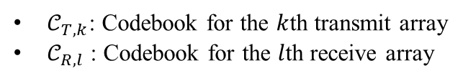
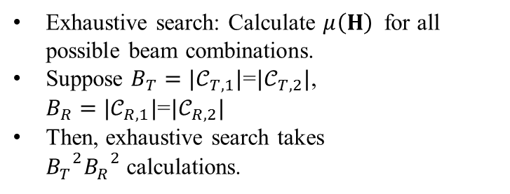
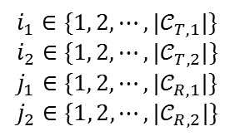
Exhaustive Search for Beam Selection
$𝒞_{T,k}$: Codebook for the $k$th transmit array
$𝒞_{R,l}$ : Codebook for the $l$th receive array
RF
RF
H
$$i_{1}∈\{1, 2, ⋯, |𝒞_{T,1}|\}$$
$$i_{2}∈\{1, 2, ⋯, |𝒞_{T,2}|\}$$
$$j_{1}∈\{1, 2, ⋯, |𝒞_{R,1}|\}$$
$$j_{2}∈\{1, 2, ⋯, |𝒞_{R,2}|\}$$
BB
BB
RF
RF
2x2 MIMO example:
Beams are selected from a codebook.
i₁ : beam index for the first transmit array
i₂ : beam index for the second transmit array
j₁ : beam index for the first receive array
j₂ : beam index for the second receive array
$$H=\left[\begin{matrix}h_{11}\left(i_{1},j_{1}\right) & h_{12}\left(i_{2},j_{1}\right) \\ h_{21}\left(i_{1},j_{2}\right) & h_{22}\left(i_{2},j_{2}\right)\end{matrix}\right]$$
Goal: find the best set of beam indices $i_{1}^{∗},i_{2}^{∗}, j_{1}^{∗},j_{2}^{∗}$ to optimize some metric $μ(H)$.
Exhaustive search: Calculate $μ\left(H\right)$ for all possible beam combinations.
Suppose $B_{T}=|𝒞_{T,1}|$=$|𝒞_{T,2}|$, $B_{R}=|𝒞_{R,1}|\text{=}|𝒞_{R,2}|$
Then, exhaustive search takes ${B_{T}^{}}^{2}{B_{R}^{}}^{2}$calculations.
H=H(i₁, i₂, j₁, j₂)

Slide 8
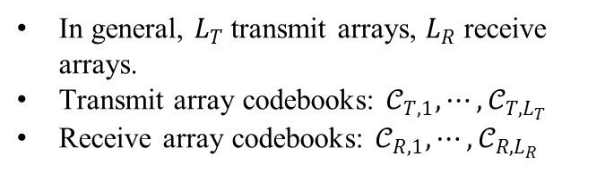
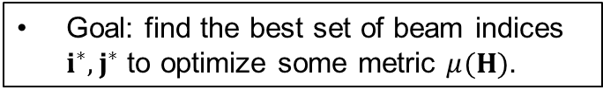
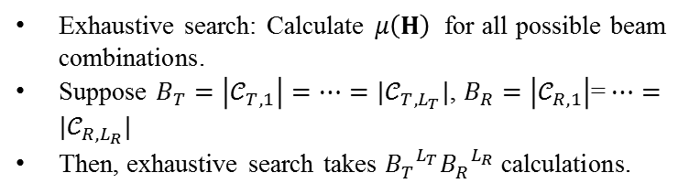
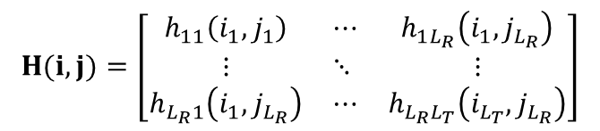
Exhaustive Search for Beam Selection
$$H(i,j)=\left[\begin{matrix}h_{11}\left(i_{1},j_{1}\right) & ⋯ & h_{1L_{R}}\left(i_{1},j_{L_{R}}\right) \\ ⋮ & ⋱ & ⋮ \\ h_{L_{R}1}\left(i_{1}, j_{L_{R}}\right) & ⋯ & h_{L_{R}L_{T}}\left(i_{L_{T}}, j_{L_{R}}\right)\end{matrix}\right]$$
RF
RF
H
BB
BB
BB
Goal: find the best set of beam indices $i^{∗},j^{∗}$ to optimize some metric $μ(H)$.
RF
RF
Exhaustive search: Calculate $μ\left(H\right)$ for all possible beam combinations.
Suppose $B_{T}=\left|𝒞_{T,1}\right|=⋯=|𝒞_{T,L_{T}}|$, $B_{R}=\left|𝒞_{R,1}\right|\text{=}⋯=|𝒞_{R,L_{R}}|$
Then, exhaustive search takes ${B_{T}^{}}^{L_{T}}{B_{R}^{}}^{L_{R}}$calculations.
In general, $L_{T}$transmit arrays, $L_{R}$ receive arrays.
Transmit array codebooks: $𝒞_{T,1},⋯,𝒞_{T,L_{T}}$
Receive array codebooks: $𝒞_{R,1},⋯,𝒞_{R,L_{R}}$
Exponential in the number of antenna arrays!

Slide 9
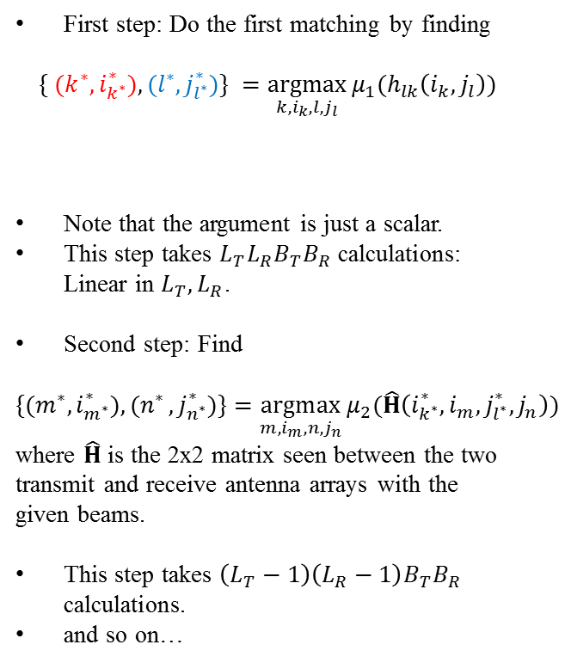
Pairwise Search for Beam Selection
First step: Do the first matching by finding
$$\{ {(k}^{∗},i_{k^{∗}}^{∗}),(l^{∗},j_{l^{∗}}^{∗})\} =\underset{k,i_{k},{l,j}_{l}}{argmax}{μ_{1}(h_{lk}\left(i_{k}, j_{l}\right))}$$
Note that the argument is just a scalar.
This step takes $L_{T}L_{R}B_{T}B_{R}$ calculations: Linear in $L_{T}, L_{R}$.
Second step: Find
$${\{(m}^{∗},i_{m^{∗}}^{∗}){,(n}^{∗},j_{n^{∗}}^{∗})\}=\underset{m,i_{m},n,j_{n}}{argmax}{μ_{2}(\hat{H}\left(i_{k^{∗}}^{∗}, i_{m},j_{l^{∗}}^{∗},j_{n}\right))}$$
where $\hat{H}$ is the 2x2 matrix seen between the two transmit and receive antenna arrays with the given beams.
This step takes $\left(L_{T}−1\right)\left(L_{R}−1\right)B_{T}B_{R}$ calculations.
and so on…
RF
RF
H
BB
BB
BB
Transmit array,
and its beam
Receive array,
and its beam
RF
RF
Exhaustive search takes too much time.
A faster (but suboptimal) way is to go pair-by-pair. For example, first find the array pair which gives you the strongest signal. Then keep matching arrays one pair at a time.

Slide 10
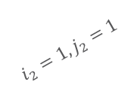





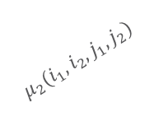

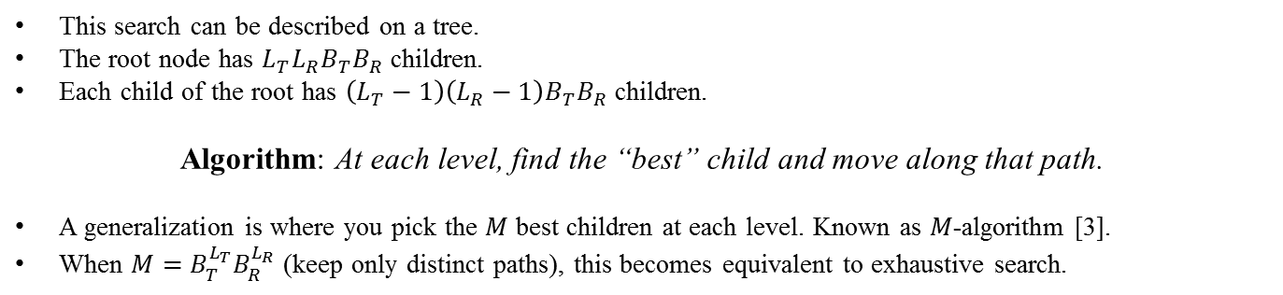

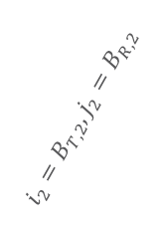
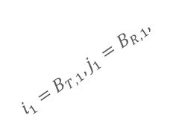

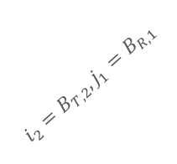
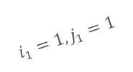

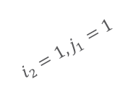

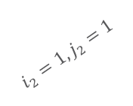

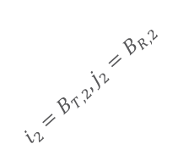



Pairwise Search for Beam Selection
First level
$$μ_{1}(i_{1},j_{1})$$
$$i_{1}=1, j_{1}=1$$
$$i_{1}=B_{T,1}, j_{1}=B_{R,1},$$
$i_{2}, j_{2}$ combinations
$i_{1}, j_{2}$ combinations
$$⋯$$
$$⋯$$
$$⋯$$
$$⋯$$
$i_{2}, j_{1}$ combinations
$$i_{2}=1, j_{2}=1$$
Second level
$$μ_{2}(i_{1},i_{2},j_{1},j_{2})$$
$$i_{2}=B_{T,2}, j_{2}=B_{R,2}$$
$$i_{2}=1, j_{2}=1$$
$$i_{2}=1, j_{1}=1$$
$$⋯$$
$$i_{2}=B_{T,2}, j_{2}=B_{R,2}$$
Example for $L_{T}=2, L_{R}=2$
$$⋯$$
$$μ_{2}(i_{1},i_{2},j_{1},j_{2})$$
$$i_{2}=B_{T,2}, j_{1}=B_{R,1}$$
$$⋯$$
$$⋯$$
This search can be described on a tree.
The root node has ${L_{T}L_{R}B}_{T}B_{R}$ children.
Each child of the root has $\left(L_{T}−1\right)\left(L_{R}−1\right)B_{T}B_{R}$ children.
Algorithm: At each level, find the “best” child and move along that path.
A generalization is where you pick the $M$ best children at each level. Known as $M$-algorithm [3].
When $M=B_{T}^{L_{T}}B_{R}^{L_{R}}$ (keep only distinct paths), this becomes equivalent to exhaustive search.

Slide 11
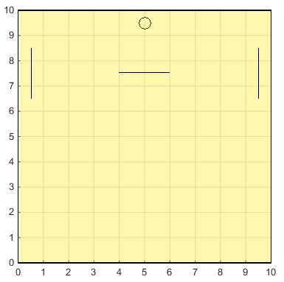
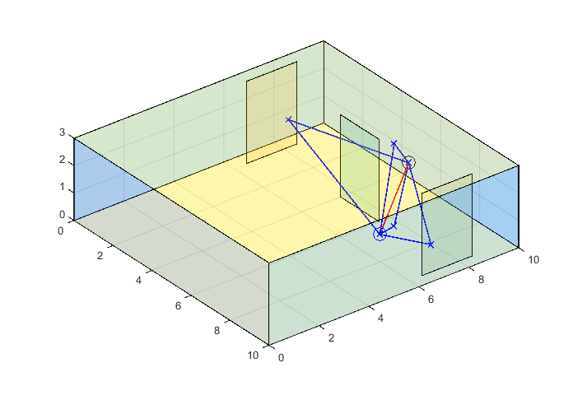
Simulation Details
Receiver fixed at one location.
Several transmitter locations tested.
Both transmitter and receiver have two antenna arrays → 2x2 MIMO.
Antenna arrays are 1x8 linear arrays placed on a line. Rx, Tx antenna array separation: 30 cm, 5 cm, respectively.
For each transmitter location, full channel matrix (16x16) is generated by ray tracing.
Room with reflectors and blockages:
Rx
Tx

Slide 12
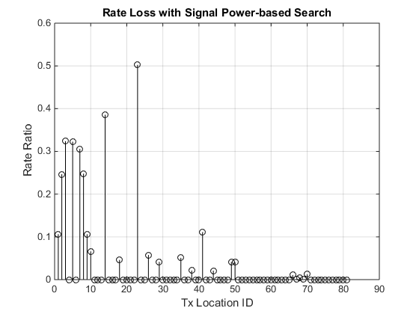
(Pairwise) SNR-based Search
Room with reflectors and blockages:
SNR-based Search: At both levels, use signal power as the metric.
Readily available, just the norm of the channel coefficient. Most direct, baseline method.
In more than half of the locations, this search finds the same beams with exhaustive search, so no performance loss.
Some loss at mostly distant locations.
Rx
Tx
10
1
2
3
9
81 Tx locations.
For each location, beams are found both with exhaustive search and pairwise search.
Once the beams are fixed, rate calculation is done assuming optimal baseband precoding (using SVD) with joint water filling across subcarriers and layers subject to a total power constraint.
Rate loss shown as percentage of the rate achieved with the optimal beams found by exhaustive search.

Slide 13
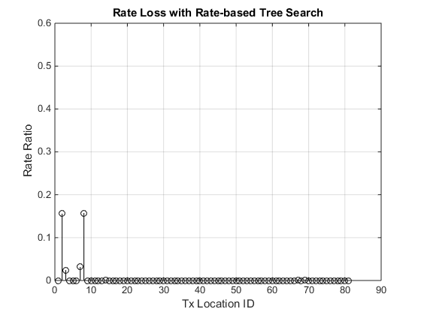
(Pairwise) Rate-based Tree Search
Rate-based Tree Search: Match the first pair using signal power, then calculate the rate to match the second pair.
With this change, in almost all locations, the same beams with exhaustive search are found.
This comes at the expense of a more complex calculation in the second level, however the number of calculations is still linear in the number of arrays.
Room with reflectors and blockages:
Rx
Tx
10
1
2
3
9
SNR-based Search does not use the rate as the metric in any of the levels.
In the locations with performance loss, we noticed SNR-based Search and exhaustive search usually share one beam pair, but differ on the other.
In order to improve performance, we keep the same metric for the first level, but calculate the rate in the second level.
Rate loss shown as percentage of the rate achieved with the optimal beams found by exhaustive search.

Slide 14
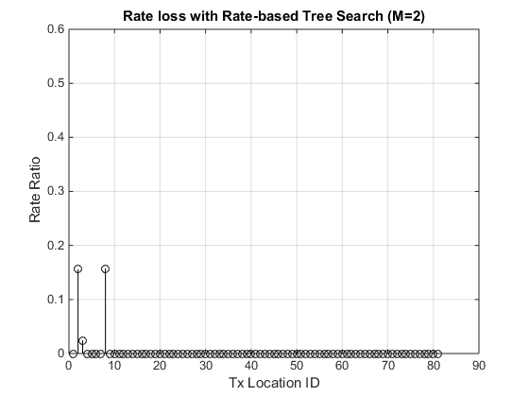
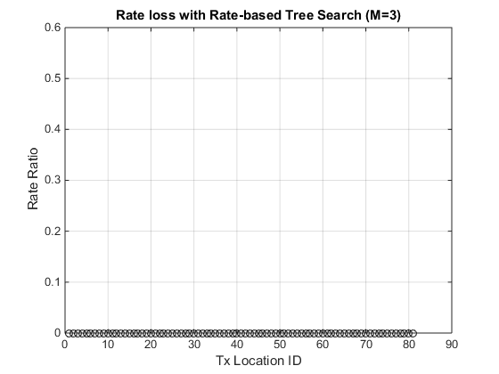
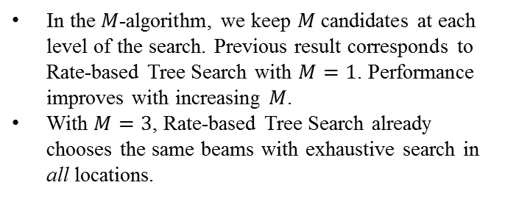
(Pairwise) Rate-based Tree Search
Room with reflectors and blockages:
Rx
Tx
10
1
2
3
9
In the $M$-algorithm, we keep $M$ candidates at each level of the search. Previous result corresponds to Rate-based Tree Search with $M=1$. Performance improves with increasing $M$.
With $M=3$, Rate-based Tree Search already chooses the same beams with exhaustive search in all locations.
Rate loss shown as percentage of the rate achieved with the optimal beams found by exhaustive search.

Slide 15
Summary and Conclusions
Optimal beam search becomes computationally complex in a MIMO scenario.
A suboptimal search where transmit-receive antenna arrays are matched pairwise is an efficient alternative to exhaustive search.
For a simulated indoor scenario, a pairwise search based on only signal power results in comparable performance.
Furthermore, performance of the pairwise search can be improved by changing the metric used to match array pairs, or increasing the number of candidates kept in each array pair matching.

Slide 16
References
11-14/0606r0, “Next Generation 802.11ad: 30+ Gbps WLAN”
11-15/0334r1, “MIMO Framework”
J. B. Anderson and S. Mohan, “Sequential Coding Algorithms: A Survey and Cost Analysis,” IEEE Transactions on Communications, vol.32, no.2, pp.169-176, Feb. 1984.

