Slide 1
High Efficiency in Accessing the Medium
Date: 2015-09-14

Slide 2
Abstract
This presentation outlines an approach to reducing medium access overhead, by providing 11ax devices with predictable and unique backoff slots.

Slide 3
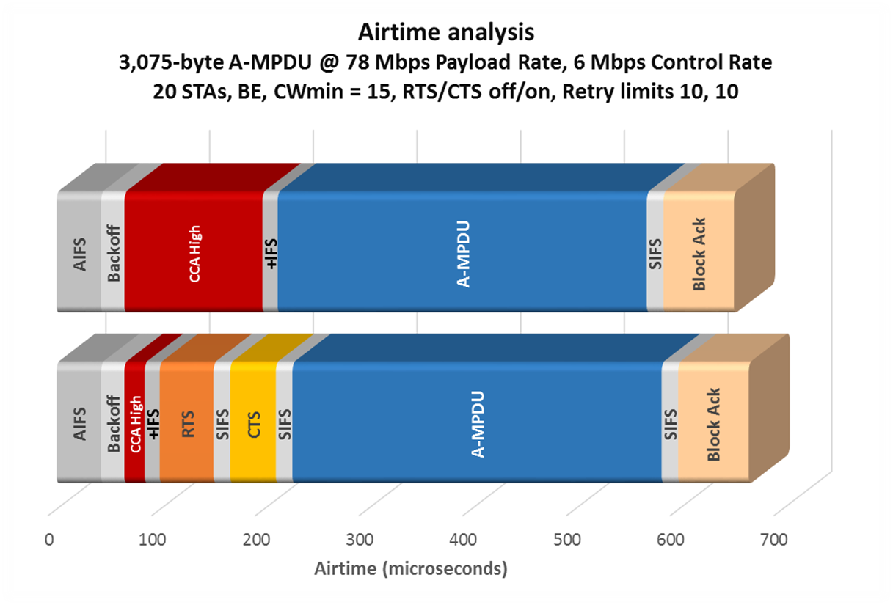
Motivation—I
Cf. [1]
AIFS
Backoff
CCA
+IFS
. . .
43
22
133
15
AIFS
Backoff
CCA
+IFS
RTS
SIFS
CTS
SIFS
A-MPDU
SIFS
BA
43
23
20
15
52
15
44
16
356
16
68

Slide 4

Motivation
Baseline EDCA medium access overhead = the lower of the two quantities shown
Both quantities are usually significant [1]
It is possible to achieve much lower medium access overhead than either of these, by re-using well-proven components that are already part of the protocol

Slide 5
Approach
Arrange matters so that each STA may obtain a unique backoff slot
Two phases:
Build a roster
Use the roster

Slide 6
Building a roster*—I
① AP initiates a roster (setup mode):
NAV set for legacy devices (say 1 ms)
AP
* There are many ways to do this
STA
STA receives CTS
Marks its slot as assigned
Sends no data
AP marks slot as assigned
Doesn’t have to note assignee
Roster initiation:
Roster number
Roster length
Current NAV
STA selects random slot within roster length, sends RTS

Slide 7
Building a roster—II
② AP continues a previously initiated roster (still setup mode):
NAV set for legacy devices (say 1 ms)
AP
…
…
STA
STA received no CTS last time
(collision)
Or couldn’t send RTS last time
(chosen slot too soon after
another device’s RTS)
Or NAV expired before chosen
slot reached
Roster continuation:
Roster number
Roster length
Current NAV
Bitmap of assigned slots
Offset within roster length
STA selects random
unassigned slot within roster length, sends RTS

Slide 8
Building a roster—III
③ AP compresses the roster (still setup mode):
NAV set for legacy devices (enough to cover)
AP
AP:
Roster number
Bitmap of assigned slots
New roster number
STAs:
Map old nth assigned slot to new slot n

Slide 9
Using a roster—I
④ AP invokes a roster (now in usage mode):
NAV set for legacy devices (say 5 ms)
AP
…
…
If the assigned slot is reached
within TXOP, STA may transmit
Other devices set NAV and
freeze countdown as usual
Depicted STA will have frozen
its own countdown for each
preceding transmission by
others
STA
Roster invoked:
Roster number
Roster length
Current NAV
Offset within roster length
STA / traffic stream uses its assigned slot(s) modulo offset within roster length

Slide 10
Using a roster—II
⑤ AP invokes a roster (now in usage mode):
NAV set for legacy devices (say 5 ms)
AP
…
…
Total loss is limited to one slot
time
(AP may mark that slot as
unused if repeatedly empty)
STA
Roster invoked:
Roster number
Roster length
Current NAV
Offset within roster length
STA / traffic stream reaches assigned slot but has no data
—just don’t transmit

Slide 11
Using a roster—III (hidden nodes*)
* Non-OBSS for now
⑥ AP invokes roster with bitmap of protection policy (usage mode):
NAV set for legacy devices (say 5 ms)
AP
STA
Roster invoked:
… all as before
Bitmap of slots that are
required to use protection
Each participating STA reads protection bitmap and allows additional CTS* + SIFS
Reads duration from AP’s response

Slide 12
(Diagnosing hidden nodes)
One way is to use the roster itself (extra setup step, if needed):
NAV set for legacy devices (say 3 ms)
AP
…
…
STA
Roster diagnostics:
Roster number
Roster length
Current NAV
Bitmap of slots to respond
Each participating STA sends response (e.g. NDP) at its assigned turn
Each participating STA reports at its assigned turn a bitmap of NDPs it heard

Slide 13
Example format
AP roster initiation / invocation:
NAV set for legacy devices (say 1-5 ms)
AP
CTS-To-Self
SIFS
RI
SIFS
Roster initiation:
Roster number
Roster length
Current NAV
(Not necessarily at same data rate as CTS-to-self)

Slide 14
STA processing for new slots—I
CTS-To-Self
SIFS
RI
SIFS
Slot time
(if AP bitmap signaled 0)
First slot:
STA
CTS time + SIFS + slot time
(if AP bitmap signaled 1)

Slide 15
STA processing for new slots—II
A-MPDU / Block Ack
VIFS + slot time
(if AP bitmap signaled 0)
Later slot:
STA
(after a busy slot)
VIFS + CTS time + SIFS + slot time
(if AP bitmap signaled 1)
VIFS = Vestigial IFS, say 4 μs: for CCA, Rx-to-Tx and Tx-to-Rx turnaround times

Slide 16
Using a roster—IV (external hidden nodes)
⑦ Accounting for external hidden nodes (now in usage mode):
NAV set for legacy devices (say 5 ms)
AP
…
…
STAs
Each STA does CCA during each VIFS
and unused slot
Does not use a slot if it falls less than
AIFS after any unexpected CCA high
CTS-to-self:
Mirror the full NAV
Sent by first n STAs, n signaled by AP
Can be simultaneous; cf. SFD

Slide 17
Other considerations
Unused slots: Appendix A
Legacy fairness: Appendix B
Fairness and traffic prioritization within roster: Appendix C
Roster compared to baseline EDCA: Appendix D
Roster compared to PSMP: Appendix E
Downlink and multi-user transmissions: Appendix F
Numerical example: Appendix G

Slide 18
Straw poll
Do you agree to add the following text to the 11ax SFD?
“The 11ax specification shall include one or more modes of operation that reduce contention and arbitration overhead, without polling.”
Yes
No
Abstain

Slide 19
References
[1] IEEE doc. 11/15-0xxxr0, “High Efficiency in Accessing the Medium”, S. Coffey, D.Z. Liu (Realtek), September 2015
[2] IEEE doc. 11/15-0341r2, “Empirical Measurements of Channel Degradation Under Load”, C. Lukaszewski, L. Li (Aruba Networks), March 2015
[3] “Designing Very High Density Best Practices and Test Results”, C. Lukaszewski (Aruba Networks), Wireless LAN Professionals Conference (WLPC) Dallas 2015

Slide 20
APPENDIX

Slide 21

Appendix A: Unused slots
Option A: AP marks unused slots as to-be-ignored in a RI bitmap
Option B: Slots deemed reassigned to AP if unused n consecutive times
AP
×
×
×
A: bitmap in RI
B: counter in RI
May be used to adapt to traffic flow that stops, and to calibrate number of slots needed for a traffic flow that continues

Slide 22
Appendix B: Legacy fairness
Compensate outside the roster
Roster devices give up appropriate number of TXOPs after roster
AP
×
×
STA had two TXOPs in data phase . . . so gives up next two after
So in principle it is possible to have strict fairness with legacy.
More generally the AP may adjust policy to calibrate advantage of HE devices.

Slide 23
Appendix C: Fairness and traffic prioritization within roster
Roster provides guaranteed slots rather than probabilistic advantage
  AP may grant higher priority traffic more slots
  AP is free to accept or reject requests to be added to any given roster, and/or maintain multiple rosters for different purposes
    Roster for mini-TXOPs (e.g., max 200μs)
    Roster reserved for high-priority traffic
AP may commence new roster usage phase at any offset
  May for example begin new roster usage phase where previous usage of that roster ended
  So rosters may be used in a way that preserves relative assignments

Slide 24
Appendix D: Roster compared to baseline EDCA
EDCA in which all STAs happen to choose different backoff slots:
  No losses due to collisions; a best case
Roster:
  No collisions; but now no need for AIFS, or for RTS/CTS; (group the BAs?)
AIFS
A-MPDU
SIFS
BA

Slide 25
Appendix E: Roster compared to PSMP
“An AP may transmit a recovery frame (called a PSMP recovery frame) during a PSMP-UTT when both of the following conditions are met:
  The CS mechanism (…) indicates that the medium is idle at the TxPIFS slot boundary (…) after the start of the PSMP-UTT, and
  The PSMP-UTT duration is longer than the total duration of the PSMP recovery frame plus PIFS”
    ―REVmc D3.0, Section 9.29.2.3, P 1386 LL 11-16
  Roster allows all participating devices to infer release of the possible TXOP from one idle slot time, without further frames: lower (and minimal) overhead
“A STA that has frames to send that are valid for transmission within the PSMP-UTT shall start transmission without performing CCA and regardless of NAV at the start of its PSMP-UTT”
  ―REVmc D3.0, Section 9.29.2.3, P 1385 LL 55-57
  Roster devices perform CCA

Slide 26
Appendix F: Downlink and multi-user transmissions
Downlink transmissions may be added to any roster
  The AP needs only assign to itself the appropriate slots
  Marking the slots as assigned in roster initiation frames is enough
MU-MIMO transmissions (DL or UL) may also be added to any roster
  With UL MU-MIMO, an inferred release of the allocated time if uplink transmission does not commence soon after the trigger frame
  Modified (shorter) trigger frames could be used as position within roster is sufficient to identify STAs

Slide 27
Appendix G: Numerical example
24 competing STAs, all BE, no hidden nodes
At any given time 12 of the STAs will have traffic to transmit—which 12 varies constantly
A-MPDUs are all 400 μs, including preambles
AP chooses to limit roster durations to 4 ms
EDCA: access overhead 43 + 25 + 121 + 12 = 201 μs per successful Tx
Roster:
  Approx. (44 + 16 + 52+ 16) / 8 = 16 μs invocation, amortized over successful Tx’s
  < 10 μs setup, amortized over reuses
  < 13 μs from unused slots (VIFS + slot time)
  < 10 μs from terminating the roster (60-70 μs / 8)
  = 49 μs―75 % reduction—28% throughput improvement
  The assumptions were conservative and greater % gains can easily be derived

