Slide 1
UL OFDMA-based Random Access Procedure
Date: 2015-09-14
Authors:
Name | Affiliation | Address | Phone | Email
Chittabrata Ghosh | Intel | 2200 Mission College Blvd., Santa Clara, CA 95054, USA | +1-415-244-8904 | chittabrata.ghosh@intel.com
Robert Stacey |  |  |  | robert.stacey@intel.com
Eldad Perahia |  |  |  | eldad.perahia@intel.com
Shahrnaz Azizi |  |  |  | shahrnaz.azizi@intel.com
Po-Kai Huang |  |  |  | po-kai.huang@intel.com
Qinghua Li |  |  |  | quinghua.li@intel.com
Laurent Cariou |  |  |  | laurent.cariou@intel.com
Xiaogang Chen |  |  |  | xiaogang.c.chen@intel.com
Rongzhen Yang |  |  |  | rongzhen.yang@intel.com
Yaron Alpert |  |  |  | yaron.alpert@intel.com
Avi Mansour |  |  |  | avi.mansour@intel.com

Slide 2
Authors (continued)
Name | Affiliation | Address | Phone | Email
Albert Van Zelst | Qualcomm | Straatweg 66-S Breukelen, 3621 BR Netherlands |  | allert@qti.qualcomm.com
Alfred Asterjadhi |  | 5775 Morehouse Dr. San Diego, CA, USA |  | aasterja@qti.qualcomm.com
Bin Tian |  | 5775 Morehouse Dr. San Diego, CA, USA |  | btian@qti.qualcomm.com
Carlos Aldana |  | 1700 Technology Drive San Jose, CA 95110, USA |  | caldana@qca.qualcomm.com
George Cherian |  | 5775 Morehouse Dr. San Diego, CA, USA |  | gcherian@qti.qualcomm.com
Gwendolyn Barriac |  | 5775 Morehouse Dr. San Diego, CA, USA |  | gbarriac@qti.qualcomm.com
Hemanth Sampath |  | 5775 Morehouse Dr. San Diego, CA, USA |  | hsampath@qti.qualcomm.com
Menzo Wentink |  | Straatweg 66-S Breukelen, 3621 BR Netherlands |  | mwentink@qti.qualcomm.com
Richard Van Nee |  | Straatweg 66-S Breukelen, 3621 BR Netherlands |  | rvannee@qti.qualcomm.com
Rolf De Vegt |  | 1700 Technology Drive San Jose, CA 95110, USA |  | rolfv@qca.qualcomm.com
Sameer Vermani |  | 5775 Morehouse Dr. San Diego, CA, USA |  | svverman@qti.qualcomm.com
Simone Merlin |  | 5775 Morehouse Dr. San Diego, CA, USA |  | smerlin@qti.qualcomm.com
Tevfik Yucek |  | 1700 Technology Drive San Jose, CA 95110, USA |  | tyucek@qca.qualcomm.com
VK Jones |  | 1700 Technology Drive San Jose, CA 95110, USA |  | vkjones@qca.qualcomm.com
Youhan Kim |  | 1700 Technology Drive San Jose, CA 95110, USA |  | youhank@qca.qualcomm.com

Slide 3
Authors (continued)
Name | Affiliation | Address | Phone | Email
Ron Porat | Broadcom |  |  | rporat@broadcom.com
Matthew Fischer |  |  |  | mfischer@broadcom.com
Sriram Venkateswaran
Tu Nguyen
Vinko Erceg
Kiseon Ryu | LG Electronics | 19, Yangjae-daero 11gil, Seocho-gu, Seoul 137-130, Korea | +82-1023566164 | kiseon.ryu@lge.com
Jinyoung Chun |  |  |  | jiny.chun@lge.com
Jinsoo Choi |  |  |  | js.choi@lge.com
Jeongki Kim |  |  |  | jeongki.kim@lge.com
Suhwook Kim |  |  |  | suhwook.kim@lge.com
Hyeyoung Choi |  |  |  | hy0117.choi@lge.com
Dongguk Lim |  |  |  | dongguk.lim@lge.com
Eunsung Park |  |  |  | esung.park@lge.com
Jinmin Kim |  |  |  | jinmin1230.kim@lge.com
HanGyu Cho |  |  |  | hg.cho@lge.com

Slide 4
Authors (continued)
Name | Affiliation | Address | Phone | Email
Phillip Barber | Huawei | The Lone Star State, TX |  | pbarber@broadbandmobiletech.com
Peter Loc |  |  |  | peterloc@iwirelesstech.com
Le Liu |  | F1-17, Huawei Base, Bantian, Shenzhen | +86-18601656691 | liule@huawei.com
Jun Luo |  | 5B-N8, No.2222 Xinjinqiao Road, Pudong, Shanghai |  | jun.l@huawei.com
Yi Luo |  | F1-17, Huawei Base, Bantian, Shenzhen | +86-18665891036 | Roy.luoyi@huawei.com
Yingpei Lin |  | 5B-N8, No.2222 Xinjinqiao Road, Pudong, Shanghai |  | linyingpei@huawei.com
Jiyong Pang |  | 5B-N8, No.2222 Xinjinqiao Road, Pudong, Shanghai |  | pangjiyong@huawei.com
Zhigang Rong |  | 10180 Telesis Court, Suite 365, San Diego, CA 92121 NA |  | zhigang.rong@huawei.com
Rob Sun |  | 303 Terry Fox, Suite 400 Kanata, Ottawa, Canada |  | Rob.Sun@huawei.com
David X. Yang |  | F1-17, Huawei Base, Bantian, Shenzhen |  | david.yangxun@huawei.com
Yunsong Yang |  | 10180 Telesis Court, Suite 365, San Diego, CA 92121 NA |  | yangyunsong@huawei.com
Zhou Lan |  | F1-17, Huawei Base, Bantian, SHenzhen | +86-18565826350 | Lanzhou1@huawei.com
Junghoon Suh |  | 303 Terry Fox, Suite 400 Kanata, Ottawa, Canada |  | Junghoon.Suh@huawei.com
Jiayin Zhang |  | 5B-N8, No.2222 Xinjinqiao Road, Pudong, Shanghai | +86-18601656691 | zhangjiayin@huawei.com

Slide 5
Authors (continued)
Name | Affiliation | Address | Phone | Email
Hongyuan Zhang | Marvell | 5488 Marvell Lane, Santa Clara, CA, 95054 | 408-222-2500 | hongyuan@marvell.com
Yakun Sun |  |  |  | yakunsun@marvell.com
Lei Wang |  |  |  | Leileiw@marvell.com
Liwen Chu |  |  |  | liwenchu@marvell.com
Jinjing Jiang |  |  |  | jinjing@marvell.com
Yan Zhang |  |  |  | yzhang@marvell.com
Rui Cao |  |  |  | ruicao@marvell.com
Sudhir Srinivasa |  |  |  | sudhirs@marvell.com
Saga Tamhane |  |  |  | sagar@marvell.com
Mao Yu |  |  |  | my@marvel..com
Edward Au |  |  |  | edwardau@marvell.com
Hui-Ling Lou |  |  |  | hlou@marvell.com
Thomas Derham | Orange |  |  | thomas.derham@orange.com
Brian Hart | Cisco | 170 W Tasman Dr, San Jose, CA 95134 |  | brianh@cisco.com
Pooya Monajemi |  |  |  | pmonajem@cisco.com

Slide 6
Authors (continued)
Name | Affiliation | Address | Phone | Email
Fei Tong | Samsung | Innovation Park, Cambridge CB4 0DS (U.K.) | +44 1223 434633 | f.tong@samsung.com
Hyunjeong Kang |  | Maetan 3-dong; Yongtong-Gu Suwon; South Korea | +82-31-279-9028 | hyunjeong.kang@samsung.com
Kaushik Josiam |  | 1301, E. Lookout Dr, Richardson TX 75070 | (972) 761 7437 | k.josiam@samsung.com
Mark Rison |  | Innovation Park, Cambridge CB4 0DS (U.K.) | +44 1223 434600 | m.rison@samsung.com
Rakesh Taori |  | 1301, E. Lookout Dr, Richardson TX 75070 | (972) 761 7470 | rakesh.taori@samsung.com
Sanghyun Chang |  | Maetan 3-dong; Yongtong-Gu Suwon; South Korea | +82-10-8864-1751 | s29.chang@samsung.com
Yasushi Takatori | NTT | 1-1 Hikari-no-oka, Yokosuka, Kanagawa 239-0847 Japan |  | takatori.yasushi@lab.ntt.co.jp
Yasuhiko Inoue |  |  |  | inoue.yasuhiko@lab.ntt.co.jp
Yusuke Asai |  |  |  | asai.yusuke@lab.ntt.co.jp
Koichi Ishihara |  |  |  | ishihara.koichi@lab.ntt.co.jp
Akira Kishida |  |  |  | kishida.akira@lab.ntt.co.jp
Akira Yamada | NTT DOCOMO | 3-6, Hikarinooka, Yokosuka-shi, Kanagawa, 239-8536, Japan |  | yamadaakira@nttdocomo.com
Fujio Watanabe |  | 3240 Hillview Ave, Palo Alto, CA 94304 |  | watanabe@docomoinnovations.com
Haralabos Papadopoulos |  |  |  | hpapadopoulos@docomoinnovations.com

Slide 7
Authors (continued)
Name | Affiliation | Address | Phone | Email
James Yee | Mediatek | No. 1 Dusing 1st Road, Hsinchu, Taiwan | +886-3-567-0766 | james.yee@mediatek.com
Alan Jauh |  |  |  | alan.jauh@mediatek.com
Chingwa Hu |  |  |  | chinghwa.yu@mediatek.com
Frank Hsu |  |  |  | frank.hsu@mediatek.com
Thomas Pare | Mediatek USA | 2860 Junction Ave, San Jose, CA 95134, USA | +1-408-526-1899 | thomas.pare@mediatek.com
ChaoChun Wang |  |  |  | chaochun.wang@mediatek.com
James Wang |  |  |  | james.wang@mediatek.com
Jianhan Liu |  |  |  | Jianhan.Liu@mediatek.com
Tianyu Wu |  |  |  | tianyu.wu@mediatek.com
Russell Huang |  |  |  | russell.huang@mediatek.com
Bo Sun | ZTE | #9 Wuxingduan, Xifeng Rd., Xi’an, China |  | sun.bo1@zte.com.cn
Kaiying Lv |  |  |  | lv.kaiying@zte.com
Yonggang Fang |  |  |  | yfang@ztetx.com
Ke Yao |  |  |  | yao.ke5@zte.com.cn
Weimin Xing |  |  |  | xing.weimin@zte.com.cn

Slide 8
Authors (continued)
Name | Affiliation | Address | Phone | Email
Joonsuk Kim | Apple | Cupertino, CA | +1-408-974-5967 | joonsuk@apple.com
Aon Mujtaba |  |  |  | mujtaba@apple.com
Guoqing Li |  |  |  | guoqing_li@apple.com
Eric Wong |  |  |  | ericwong@apple.com
Chris Hartman |  |  |  | chartman@apple.com

Slide 9
Abstract
In this contribution, we propose the procedure for the selection of resource units that are allocated for random access in a Trigger frame for random access (TF-R)

Slide 10
UL MU features in 11ax PAR and SFD
In the 11ax PAR [1],
This project may include the capability to handle multiple simultaneous communications in both the spatial and frequency domains, in both the UL and DL.
We have introduced the random access mechanism with Trigger frames using OFDMA [2]
The spec shall define a Trigger frame that allocates resources for random access. [3]
In this contribution, we introduce the random access procedure of resources allocated in TF-R

Slide 11
Terminology and Parameters
Random access RU
An RU allocated for random access
CWO
Contention Window for UL-OFDMA
CWOmin, CWOmax
Min and max values for CWO
UL-OFDMA Backoff (OBO) Count
A counter maintained by the STA that determines the random access RU the STA utilizes

Slide 12
UL OFDMA-based Random Access Procedure
When an STA has a frame to send, it initializes it’s OBO to a random value in the range 0 to CWO
For an STA with non-zero OBO value, it decrements its OBO by 1 in every RU assigned to AID value TBD within the TF-R
For an STA, its OBO decrements by a value, unless OBO=0, equal to the number of RUs assigned to AID value TBD in a TF-R
OBO for any STA can only be 0 once every TFR
An STA with OBO decremented to 0 randomly selects any one of the assigned RUs for random access and transmits its frame

Slide 13
Illustration of UL-OFDMA Random Access Procedure
TF-R
(random access)
TF-R
(random access)
Trigger Frame
(no random access)
STA 1 OBO = 10
STA 2 OBO = 4
STA 3 OBO = 0
STA 1 OBO = 7
STA 2 OBO = 1
RU 1 AID X
RU 1 AID X
Contention in frequency
RU 2 AID X
STA 1 OBO = 9
STA 2 OBO = 3
RU2 AID X
STA 1 OBO = 6
STA 2 OBO = 0
RU 3 AID X
STA 1 OBO = 8
STA 2 OBO = 2
1 RU slot
STA 2 wins RU 2 access, selects RU 1 for Tx
STA 3 wins RU 1 access, selects RU 3 for Tx
STA 1, STA 2, and STA 3 have UL data to send
Backoff Counts (BOs) for STA 1, STA 2. and STA 3 are 11, 5, and 0, respectively
STA 3 wins contention in first TFR, randomly selects RU 3 in the TFR
STA 2 wins contention at RU 2 in second TFR, randomly selects RU 1 in the TFR
STA 1 does not decrement its OBO

Slide 14
Parameters Used for Performance Analysis
Random access parameters
Number of STAs = [1, 2, 4, 8, 16, 32]
Number of RUs/TF-R = [4, 8]
CWOmin = [1, 2, 4, 8, 16, 32]
CWOmax = [32]

Slide 15
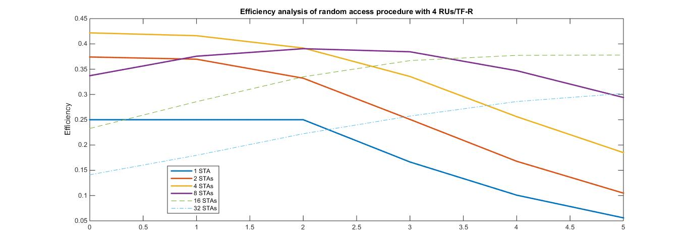
Efficiency Analysis of Random Access Procedure with 4 RUs/TF-R
1 2 4 8 16 32
CWO_{min}

Slide 16
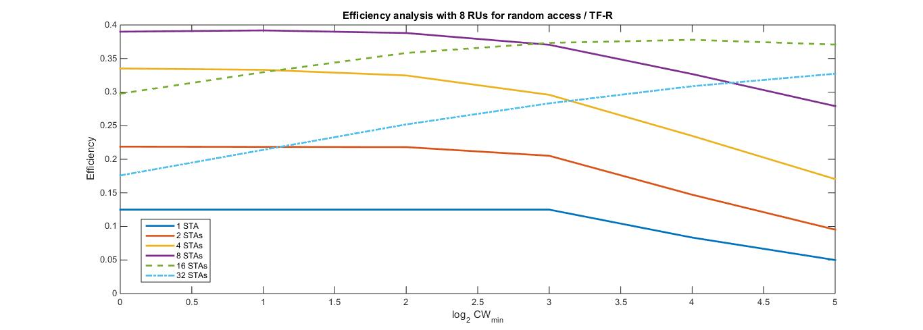
Efficiency Analysis of Random Access Procedure with 8 RUs/TF-R
1 2 4 8 16 32
CWO_{min}

Slide 17
Summary
In this presentation, we proposed the procedure of selecting RUs allocated for random access in a TF-R
We have provided analytical results of the proposed random access procedure

Slide 18
References
[1] IEEE 802.11-14/0165r1 “802.11 HEW SG Proposed PAR”
[2] IEEE 802.11-15/0875r1 “Random Access with Trigger frames using OFDMA”
[3] IEEE 802.11-15/0132r2 “Specification Framework for Tax”

Slide 19
Straw-poll 1
Do you agree to include the random access procedure illustrated in Slide 12 to the spec framework?
Yes:
No:
Abstain

