Slide 1
Overview and discussion about the next steps for 802.11ay channel modeling
Date: 2015-09-15
Authors:

Slide 2
Abstract
In this presentation, the next steps for the channel modeling for 60 GHz indoor and outdoor scenarios are discussed. To find a useful model it is necessary to find out which approach is the best to combine the measurement and modeling for 802.11ay. Some challenges for the extension of the existing channel models to mmWave and broadband signals are demonstrated.

Slide 3
Outline
Motivation
Requirements for the 802.11ay channel model
Channel Models
Challenges in the modeling development
Conclusion

Slide 4
Motivation
ISM-band at 60 GHz
  Unlicensed and wide bandwidth available (up to 7 GHz)
  WLAN/WiGig (802.11ad) and WPAN (802.15.3c)
Advanced system concepts → define measurement and modelling requirements
  Massive MIMO/pencil beamforming → large spatial bandwidth
  Adaptive or switched selection beamforming to mitigate shadowing
  Channel bonding → large bandwidth
Propagation channel
  Double directional measurements are needed to characterized the full channel
  Polarization is an important aspect
  High dynamic range are essential to measure the different propagation effects
Channel characterization for different usage cases

Slide 5
Requirements for the TG.ay channel model
High bandwidth up to 4 GHz
Full polarimetric description
Full 3D channel model description
Antenna independent model
  DoA and DoD
  Beamforming capability
  MIMO capability
Time evolution
  Beam Tracking
Spatial consistency
  Multi user capability
Proper distinction between deterministic and stochastic channel contributions

Slide 6
Empirical Channel Models
Basic Properties
  Parameters extracted from the measurements (based on measurements)
  HRPE (High Resolution Parameter Estimation) necessary to remove the antenna pattern from the model parameters
  Approved procedure such in WINNER, COST and ITU models
Open issues for broadband mmWave channel models
  No HRPE algorithms for the current mmWave measurements are available (Antenna element spacing smaller than λ/2 required)
  No broadband effects are included
  The channel is more deterministic due to directive antennas and bandwidth
  Long measurement time for directional measurements because there are no measurement arrays current available
  Consequently fewer measurement points with too high opening angles of the antennas for a statistical analysis

Slide 7
Deterministic Channel Models (1)
Deterministic Model
  Based on fix geometry (Building, rooms or scenarios)
  Analysis mostly applied to particular situations
  A popular modeling method is ray tracing (map based models)
The idea of a simple ray tracing model in 802.11ay
  How to extract the parameters for transmission, reflection and diffraction? (effective roughness model)
  How to include broadband effects?
  From measurements but it requires to meet some conditions
    Unambiguous assignment of the coefficients to geometry and materials
    Separation of the individual effects

Slide 8
Usage of the 60 GHz Entrance Hall Measurements to Extract Parameters for the Ray Tracer

Slide 9
Dual Polarimetric Ultra-Wideband Channel Sounder (DP-UMCS)
TX Module
PA min. 23 dBm
RX Module
Step
Attenuator
LNA
Gain : 35 dB
H Pol.
CH 1
UWB Sounder TX
0 – 3.5 GHz
3.5 GHz - 10.5 GHz
H Pol.
Switch
UWB Sounder RX
0 – 3.5 GHz
3.5 GHz - 10.5 GHz
56 - 66 GHz
56 - 66 GHz
V Pol.
Step
Attenuator
CH 2
LNA
Gain : 35 dB
V Pol.
PA min.
23dBm
Multiplier
X8
Multiplier
X8
Optical link
7 GHz
Oscillator
Optical link
7 GHz BW up to 10 GHz measurable bandwidth
Maximum excess delay of 606 ns (180 m) in CS version 1
Dual polarization measurement capability
25 dB AGC (Automatic Gain Control) with 3.5 dB steps
High instantaneous dynamic range: up to 75 dB
Multi-Link and Massive MIMO capabilities
Double directional measurements (with 1 TX and 2 RX)

Slide 10
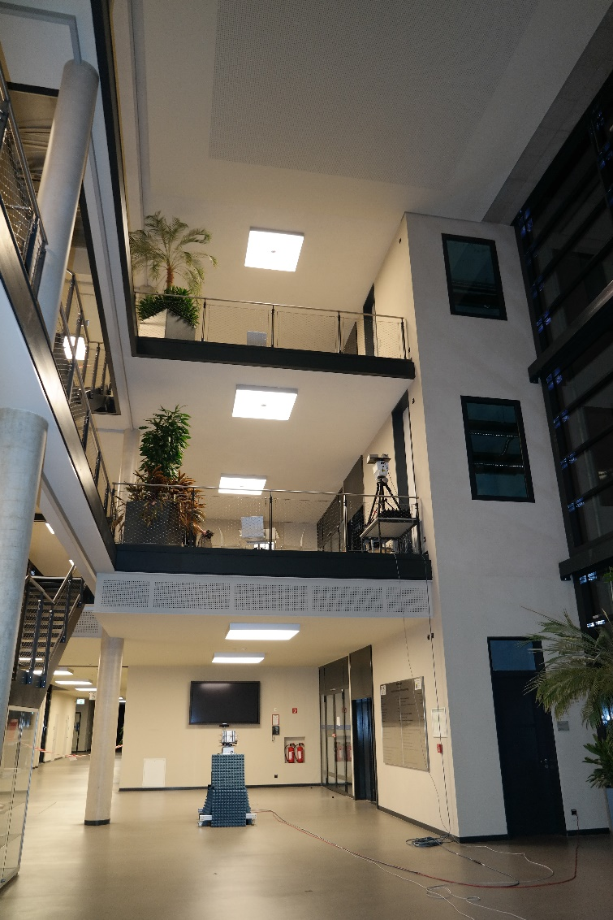
Entrance Hall Scenario
Dimensions:
7 x 25m x 9m
Class and metal
3 different floors

Slide 11
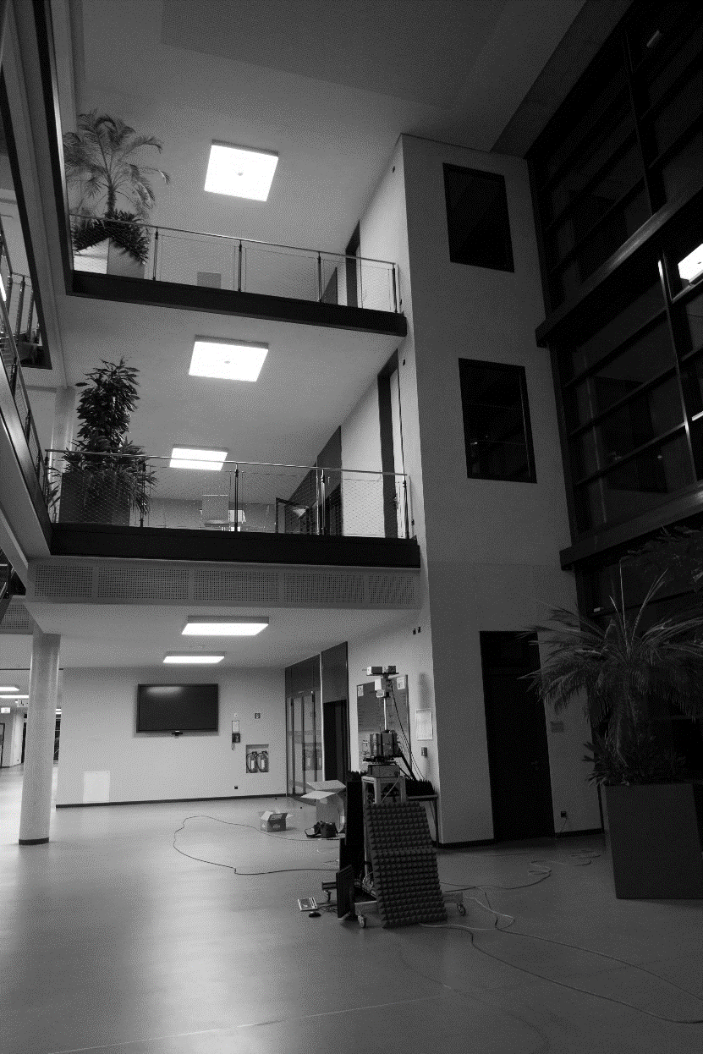
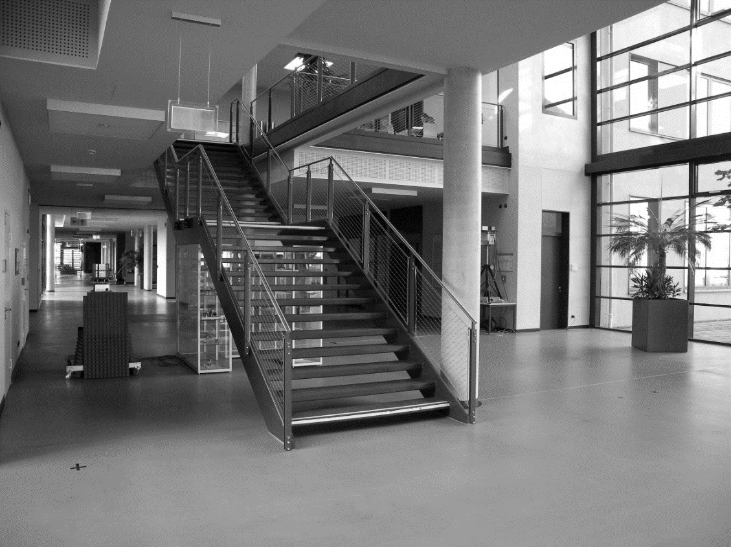
Entrance Hall Scenario
Entrance Hall of Zuse – Bau at TU Ilmenau
1 Tx Positions (1 Tx in the ground floor)
9 Rx Positions (all in the ground floor)
Tx 1
Rx 14
Rx 10
Rx 4
Rx 9
Rx 2
Rx 3
Rx 1
Rx 2
Rx 1

Slide 12
Measurement Set-Up
Static access point scenario
Tx:
  Located on the side of the wall
  Height from ground 2.5 m
  30°HPBW of the antenna
Rx:
  Located at several points in the hall
  Height 1.4m
  30°HPBW of the antenna
Scanning at Tx and Rx stage via positioners
Tx: Azimuth -90°... 30° 90° Elevation -90°…30°…90°
Rx: Azimuth -180°…30°…150°
-
2.8m
5m
Rx 1
+
Azimuth 0°
C
Rx 9
Rx 2
5m
Rx 3
A
-
Rx 10
5m
Tx X
Azimuth 0°
+
B
Rx 4
Rx 14
Rx 12
Rx 13

Slide 13

Data Pre-processing
No Calibration
Noise floor estimation and removal
Samples lower than the noise floor + 10dB are set to zero
$$h_{i,j,k,l}^{x,y}\left\{\begin{aligned}h_{i,j,k,l}^{x,y} if 10\log_{10}{{\left(\left|h_{i,j,k,l}^{x,y}\right|\right)}^{2}>NF_{dB}+10 dB } \\ 0 a.o.c.\end{aligned}\right.$$

Slide 14
Power Angular Profile at Tx
At single Rx beam

Slide 15
Power Angular Profile at Rx
Power Angular Profile at Rx for different Polarizations

Slide 16
Power Delay Profile at single Rx and single Tx beam
Power Delay Profile at Rx for different Polarizations
Notes:
Several peaks, hard to identify where they come from (to know what material is it) or if it is a single / double bounce, etc

Slide 17
Deterministic Channel Models (2)
To extract parameters for the ray tracer from the last 60 GHz entrance hall measurement campaign
It doesn't work because the beamwidth of the used antenna is high → 30°HPBW
We cannot separate the geometrical structures
We need a better 3D map of the scenario and a high gain antenna
  This increases the measurement time to several days per measurement point by the current measurement setup

Slide 18
Physical-Statistical Models
(GBSCM, Hybrid Model)
Combinations of deterministic and statistical model
  Widely accepted at standardization (3GPP, ITU,….)
  Extensions possible
Next steps in the development 60 GHz channel model
  Extension of a 3GPP model to the new requirements for mmWave broadband systems
  Combined parametrization from ray tracing and measurements
  Future perspective:
    measurements with dual polarized antenna arrays
    Development of a HRPE for mmWave broadband systems

Slide 19
Conclusion/Discussion
An overview on the different channel model types
  All this models can be used as the basis for the extension to mmWave and broadband signals
  A simple ray racing model may be good for indoor but not for outdoor?
  The most promising solution is a physical-stochastically model (GBSCM)
    Parametrization with ray tracing and measurements
Next Steps
  Extension of the calibration → AGC calibration for dual pol. waveguide systems
  Outdoor: Above roof top to street level measurements
  Development of an HRPE for broadband signals and antenna spacing greater than λ/2
  Analysis of broadband effects in the channel and modeling methods
  Extension of the current physical-stochastically models
Notes:
5G systems at mm-wave require SNR optimisation → and this will be only done with dual polarisation

