Slide 1
Cost/Benefit Analysis of SR Techniques
(a.k.a. Grand Unified Theory of Spatial Reuse)
Date: 2015-09-13
Authors:

Slide 2
Abstract
Significant time in TGax and SGhew has been devoted to three SR techniques (CCAT / RX sensitivity adjustment, BSS coloring & TPC) but we are having trouble converging on any decision.
Our indecisiveness may be due in part to a lack of a common view of how to leverage these features, their benefits and their limitations.
To help break the logjam, we propose a conceptual model of cell structure with “payoff regions” to better apply a cost/benefit analysis.
This contribution summarizes the specific goals, strengths and weaknesses of each SR technique, along with a cost/benefit analysis of each at a system level.
We offer a critical assessment of problems with the DSC proposal, and ideas for mitigating.
We propose a holistic, cohesive framework that combines all 3 SR techniques to do different jobs in a single unified solution.

Slide 3
PART 1:
PROPOSED “PAYOFF REGION” MODEL OF CELL STRUCTURE

Slide 4
Cost/Benefit Evaluation Framework for SR
A cost/benefit analysis of SR techniques requires a clear definition of the breakeven point.
In addition, certain SR techniques have useful benefits even when SR is not being attempted. We require a common cell model to evaluate these.
In [1], we modeled the interference-limited structure of an SR-BSS during simultaneous TX, with a focus on the “rate radius limit” of specific data rates. That approach is a good framework.

Slide 5
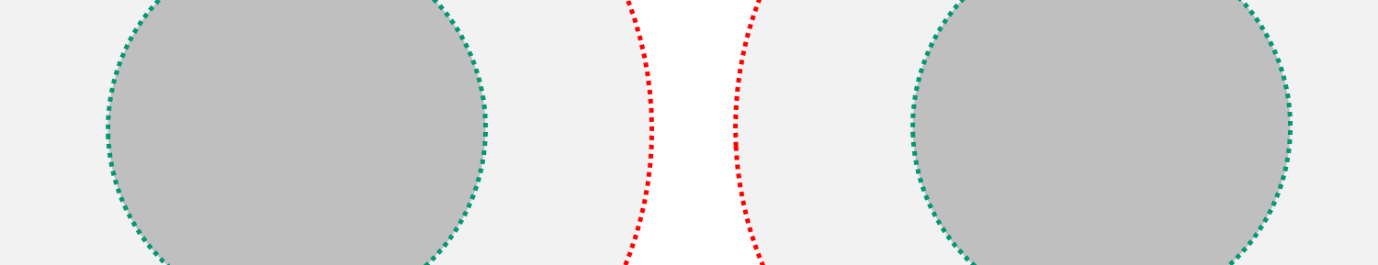
SR Payoff Region and Breakeven Point
MCS4 Limit
MCS0 Limit
SR Case
Ch X
Ch Y
Ch Z
Ch X
SR “Payoff” Region
SR “Out of the Money” Region
SR “Payoff” Region
The MCS4 rate limit during SR operation is the SR breakeven point.
  For any MCS8-limited channelization, this is 50% of MCS8
  For all MCS9 channelizations, it is only 45% of MCS9 (below breakeven)
Below MCS4, it is always better to defer (no payoff).
SR should only be attempted for MCS4 and up.
How do the AP/STA know they are inside this limit? (harder than it looks)

Slide 6
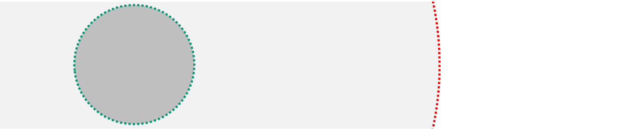
Payoff Regions – Non-SR Case
MCS4
Limit
Roam
Threshold
MCS0
Limit
RXS
Limit
-82 dBm
Non-SR Case
-70 to -80 dBm
-90 dBm
SR “Payoff” Region
Deferral “Payoff”
Region
Ignore / “Tail Clip”
Payoff Region
If SR is not being attempted then “classic” cell structure applies.
Everything outside the SR payoff region is the “deferral payoff region” unless tail clipping is being attempted.
The “ignore region” exists if the RXS threshold is set to a medium-low value to block distant traffic (more than 3-4 “hops” from MyBSS).
  Tail clipping may occasionally cause SR, but that is not the primary purpose.

Slide 7
PART 2:
SR TECHNIQUE INVENTORY & COST/BENEFIT ANALYSIS

Slide 8
Summary of Spatial Reuse Techniques Considered in TGax So Far
Technique | Definition | Major Variants | How Threshold Chosen | Applied at
RX Sensitivity Tuning | Use artificially-high RXS setting ( > -82 dBm) to convert OBSS frames into noise, increasing CCA idle frequency. (a.k.a. “earmuffs”, CCA Tuning) | Static | Operator selected (how?) | AP
 |  | Dynamic (DSC) | AP_RSSI – Constant Margin | STA
Technique | Definition | Major Variants | How Threshold Chosen | Applied at
RX Sensitivity Tuning | Use artificially-high RXS setting ( > -82 dBm) to convert OBSS frames into noise, increasing CCA idle frequency. (a.k.a. “earmuffs”, CCA Tuning) | Static | Operator selected (how?) | AP
 |  | Dynamic (DSC) | AP_RSSI – Constant Margin | STA
BSS Coloring | Use BSS identifier early in frame (e.g. SIG field) to allow receiver to determine MyBSS, and reset CCA to idle if not. | RX-Only vs. RX+TX | Threshold optional; operator selected if used | All nodes
Technique | Definition | Major Variants | How Threshold Chosen | Applied at
RX Sensitivity Tuning | Use artificially-high RXS setting ( > -82 dBm) to convert OBSS frames into noise, increasing CCA idle frequency. (a.k.a. “earmuffs”, CCA Tuning) | Static | Operator selected (how?) | AP
 |  | Dynamic (DSC) | AP_RSSI – Constant Margin | STA
BSS Coloring | Use BSS identifier early in frame (e.g. SIG field) to allow receiver to determine MyBSS, and reset CCA to idle if not. | RX-Only vs. RX+TX | Secondary CCA-PD threshold optional; no proposal for how to implement. | All nodes
TPC | Reduction of EIRP to reduce interference radius | Dynamic | Unclear. Presumably MCS maximizing. | All nodes
But how are they to be applied? In what use cases? Where in the cell? Are they mutually exclusive?

Slide 9
RXS Tuning – Summary
Objectives | Mechanism(s) | Issues
Increase total area throughput via SR (both RX and TX) | Use high RXS threshold for preamble+NAV avoidance Increase TX/RX airtime / decrease channel busy | Relatively small payoff region [1] Requirement for “guard cells” [1] May be incompatible with wide channels [1] How to choose RXS level on AP/STA? Competes with BSS coloring for SR Roaming impacts due to hard edge [2] Legacy impacts due to hard edge [3-6]
Objectives | Mechanism(s) | Issues
Increase total area throughput via SR (both RX and TX) | Use high RXS threshold for preamble+NAV avoidance Increase TX/RX airtime / decrease channel busy | Relatively small payoff region [1] Requirement for “guard cells” [1] May be incompatible with wide channels [1] How to choose RXS level on AP/STA? Competes with BSS coloring for SR Roaming impacts due to hard edge [2] Legacy impacts due to hard edge [3-6]
Protect AP CPU in high density / dirty RF environments | “Tail clipping” – use medium-low RXS threshold to reduce OBSS RX load | Guard zone and channel width limits may be improved but likely not eliminated How to choose RXS level on AP/STA? Roaming impacts Legacy impacts Quantifying possible energy savings at STAs
Improve centralized algorithms by simplifying table sizes (e.g. RRM, roam candidates, etc.)
Objectives | Mechanism(s) | Issues
Increase total area throughput via SR (both RX and TX) | Use high RXS threshold for preamble+NAV avoidance Increase TX/RX airtime / decrease channel busy | Relatively small payoff region [1] Requirement for “guard cells” [1] May be incompatible with wide channels [1] How to choose RXS level on AP/STA? Competes with BSS coloring for SR Roaming impacts due to hard edge [2] Legacy impacts due to hard edge [3-6]
Protect AP CPU in high density / dirty RF environments | “Tail clipping” – use medium-low RXS threshold to reduce OBSS RX load | Guard zone and channel width limits may be improved but likely not eliminated How to choose RXS level on AP/STA? Roaming impacts Legacy impacts Quantifying possible energy savings at STAs
Improve centralized algorithms by simplifying table sizes (e.g. RRM, roam candidates, etc.)
Reduce “near/far” backoff impact from OBSS RX | Avoid unnecessary backoff from CRC errors | Need data on how prevalent this really is
Objectives | Mechanism(s) | Issues
Increase total area throughput via SR (both RX and TX) | Use high RXS threshold for preamble+NAV avoidance Increase TX/RX airtime / decrease channel busy | Relatively small payoff region [1] Requirement for “guard cells” [1] May be incompatible with wide channels [1] How to choose RXS level on AP/STA? Competes with BSS coloring for SR Roaming impacts due to hard edge [2] Legacy impacts due to hard edge [3-6]
Protect AP CPU in high density / dirty RF environments | “Tail clipping” – use medium-low RXS threshold to reduce OBSS RX load | Guard zone and channel width limits may be improved but likely not eliminated How to choose RXS level on AP/STA? Roaming impacts Legacy impacts Quantifying possible energy savings at STAs
Improve centralized algorithms by simplifying table sizes (e.g. RRM, roam candidates, etc.)
Reduce “near/far” backoff impact from OBSS RX | Avoid unnecessary backoff from CRC errors | Need data on how prevalent this really is
Energy savings | Minimize unnecessary collision backoff/EIFS Less time TX, more time sleeping | STA savings likely limited to arbitration periods (STA is asleep otherwise) AP savings likely limited to avoiding control / mgmt TX to distant STAs
Objectives | Mechanism(s) | Issues
Increase total area throughput via SR (both RX and TX) | Use high RXS threshold for preamble+NAV avoidance Increase TX/RX airtime / decrease channel busy | Relatively small payoff region [1] Requirement for “guard cells” [1] May be incompatible with wide channels [1] How to choose RXS level on AP/STA? Competes with BSS coloring for SR Roaming impacts due to hard edge [2] Legacy impacts due to hard edge [3-6]
Protect AP CPU in high density / dirty RF environments | “Tail clipping” – use medium-low RXS threshold to reduce OBSS RX load | Guard zone and channel width limits may be improved but likely not eliminated How to choose RXS level on AP/STA? Roaming impacts Legacy impacts Quantifying possible energy savings at STAs
Improve centralized algorithms by simplifying table sizes (e.g. RRM, roam candidates, etc.)
Reduce “near/far” backoff impact from OBSS RX | Avoid unnecessary backoff from CRC errors | Need data on how prevalent this really is
Energy savings | Minimize unnecessary collision backoff/EIFS Less time TX, more time sleeping | STA savings likely limited to arbitration periods (STA is asleep otherwise) AP savings likely limited to avoiding control / mgmt TX to distant STAs
Denser use of wider channels | Increase peak burst rate | Wide channels may be incompatible with SR without mitigation features [1]

Slide 10
Problem Statement – Tail Clipping
The 802.11 PD threshold was selected at a time of sparse “coverage” deployments dominated by low-rate (e.g. BPSK) cell edges.
Modern enterprise facilities and public venues are engineered for high-rate (e.g. MCS7) cell edges with typical inter-AP distances of ~20m.
Radio sensitivity has improved dramatically since Clause 17 was first ratified. Typical RXS levels for BPSK are now < -90 dBm.
Due to 30 dB / 1000X power delta from PD to ED, both APs and STAs defer to very low-power sources many “hops” away.
Extra low-SINR control and data traffic stresses APs, STAs and distribution system equipment unnecessarily.
Neither APs nor STAs are designed to handle large BSS table sizes. Large tables lead to poor STA roaming decisions, difficult RRM logic, among other issues. Shrinking tables speeds compute, reduces CPU energy use, and improves accuracy.

Slide 11
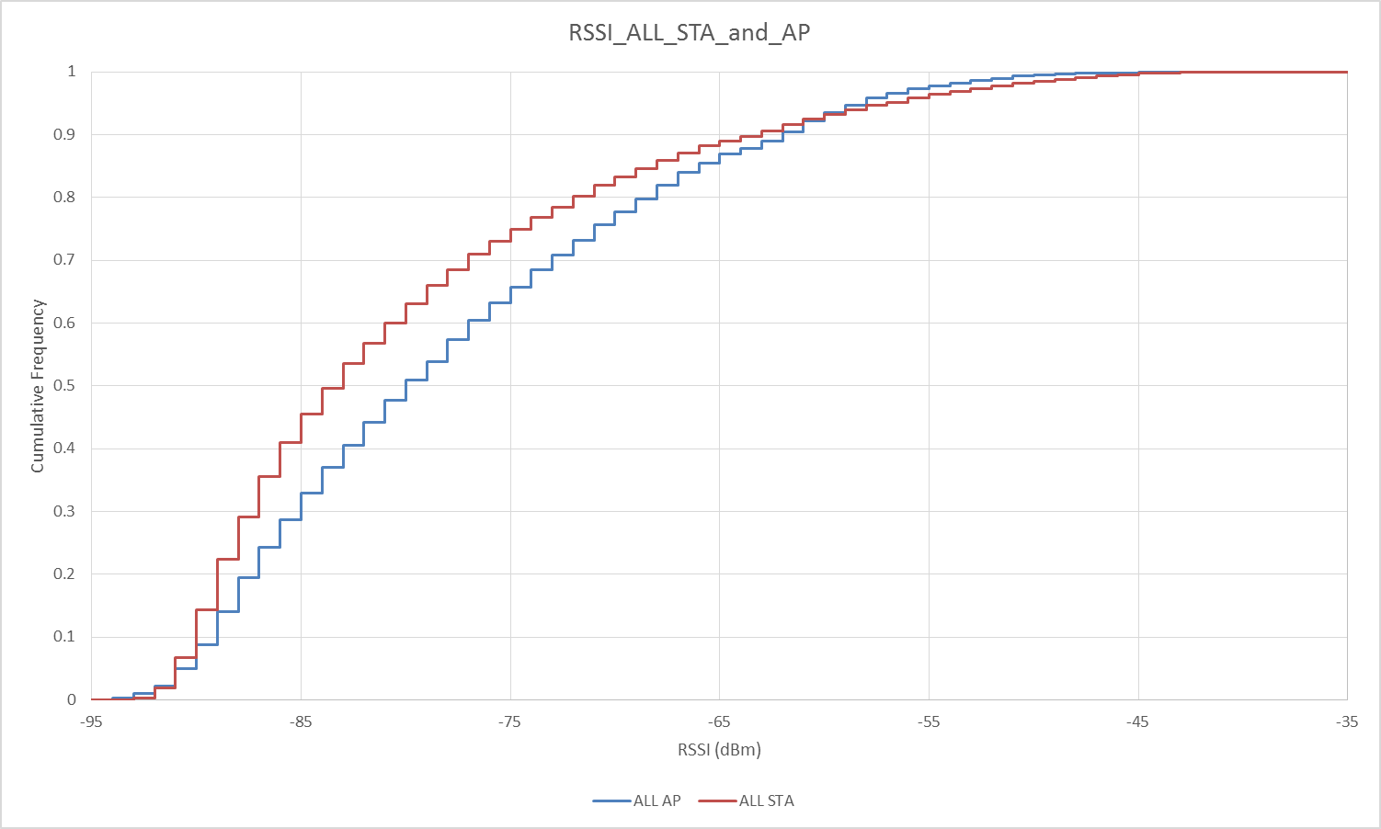
Estimating OBSS Airtime Impact - Enterprise
Real data from a large enterprise customer taken during workday with building full 126 unique APs and 2,836 unique STAs are active
CDF shows 30% of APs and 40% of STAs are < -85 dbm.
65% of APs and 75% of STAs are < -75 dBm.

Slide 12
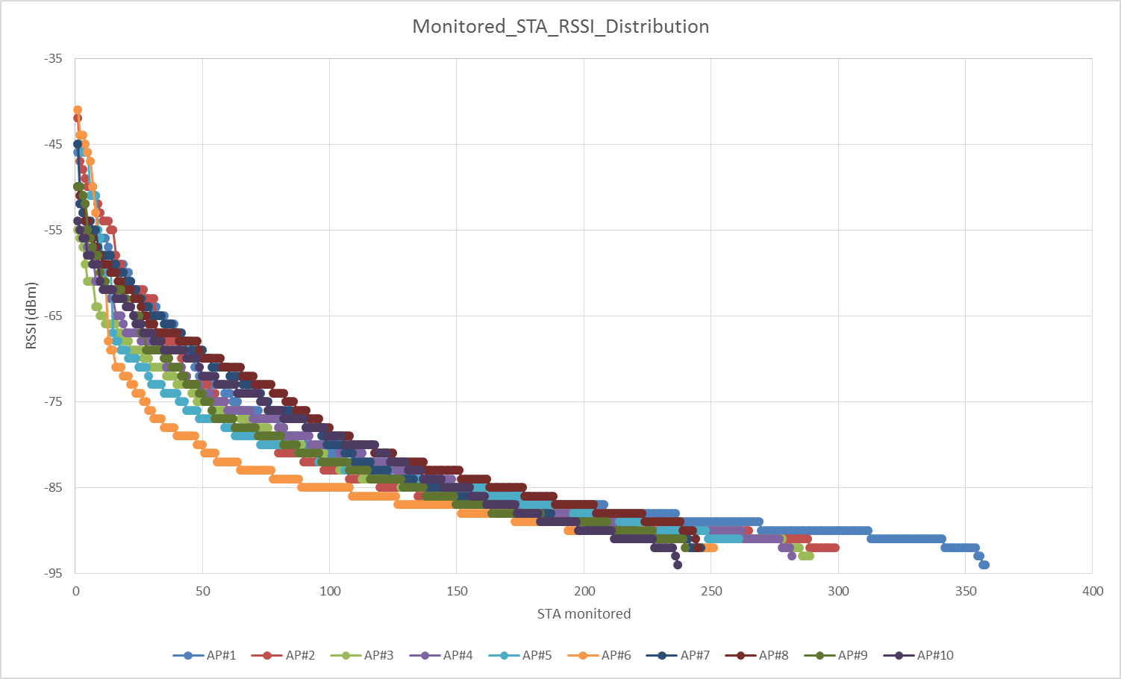
Estimating OBSS Impact – Enterprise (STAs)
Data from 10 most heavily-loaded APs at customer site
Charts show RSSI & SINR for all STAs that are audible from each of the 10 APs (regardless of association).
RSSI chart on left shows 150-300 STAs per AP at < -75 dBm

Slide 13
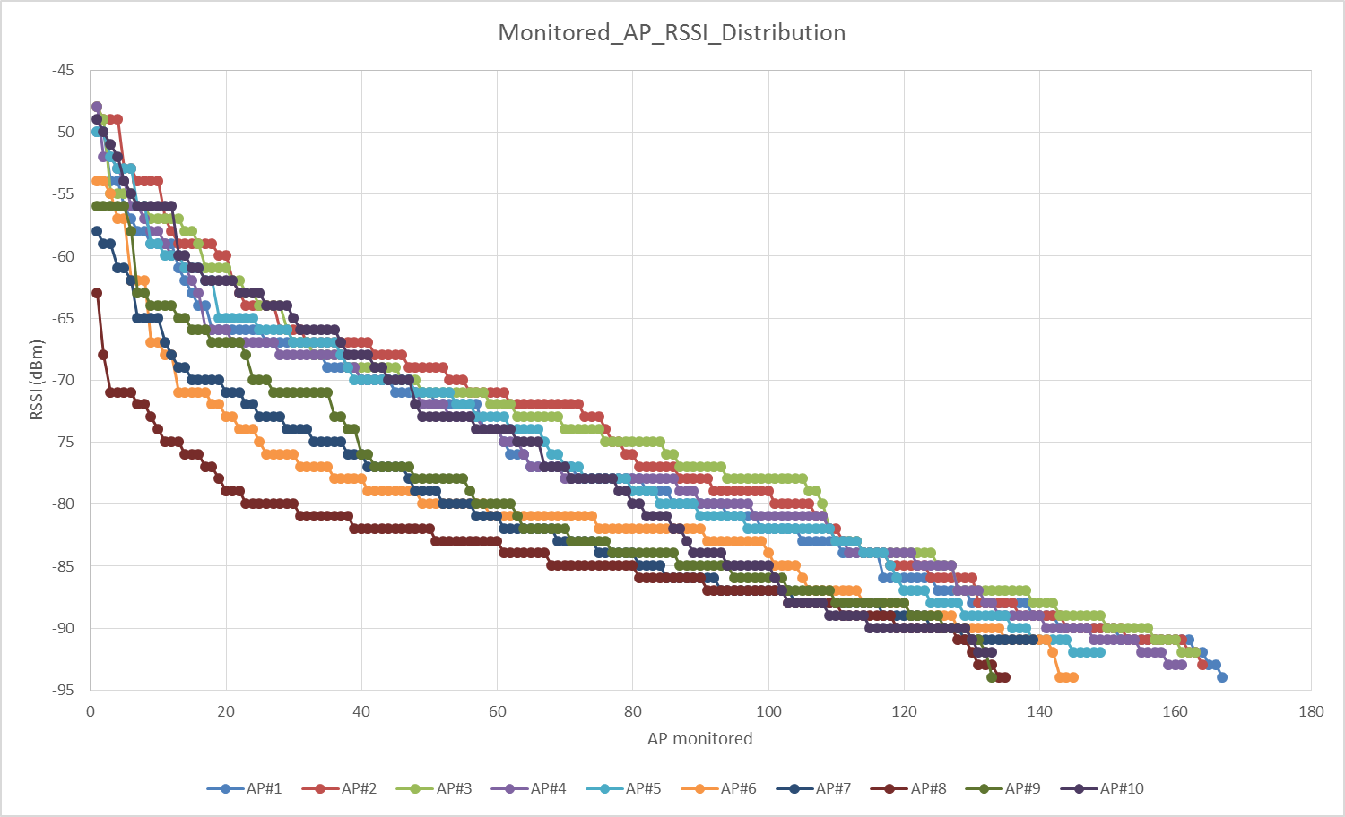
Estimating OBSS Impact – Enterprise (APs)
Data from 10 most heavily-loaded APs at customer site
Charts show SINR & RSSI for all OBSS APs that are audible from each of the 10 APs.
RSSI chart on left shows 65-120 OBSS APs per AP at < -75 dBm

Slide 14
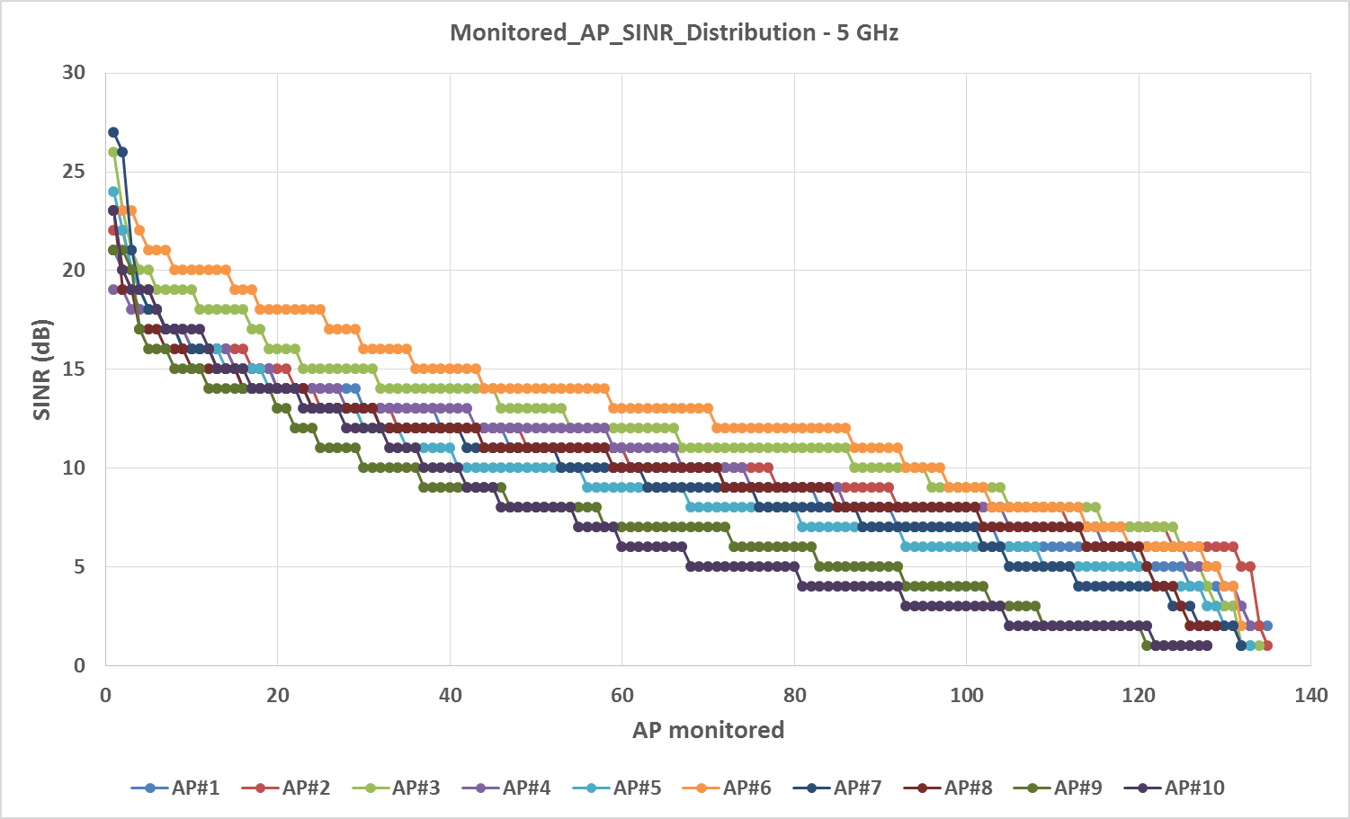
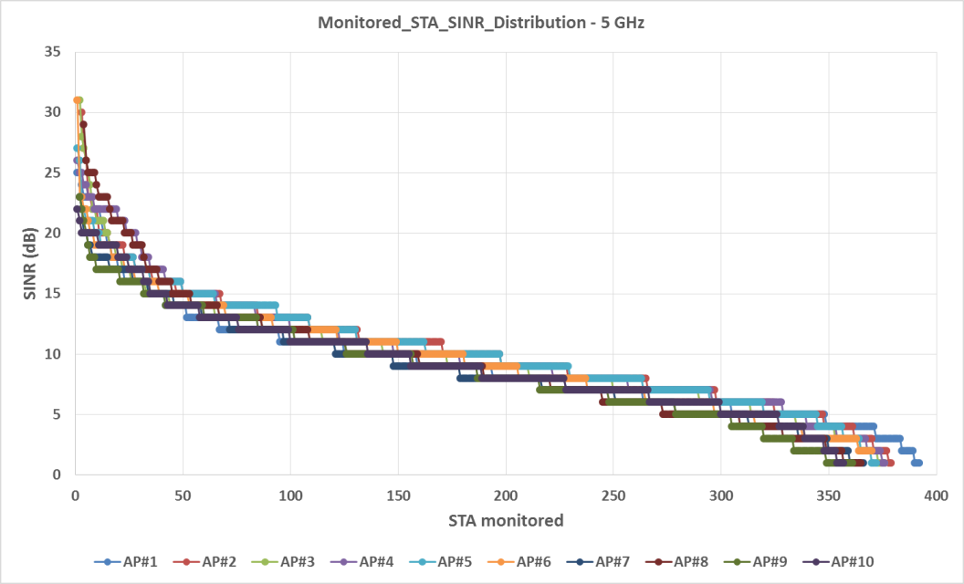
Estimating OBSS Impact – Stadium 5-GHz
Data from 10 most heavily-loaded 5-GHz radios at 70K seat stadium
There are 254 APs with 3,748 unique associated STAs on 5-GHz.
Charts show SINR for all APs (left) and STAs (right) that are audible from each of the APs (regardless of STA association status).
AP chart on left shows up to 100 OBSS APs audible at < 10 dB
  Reinforces need for large BSS color field (minimum 8 bits)
STA chart on right shows > 250 STAs audible each at <10 dB

Slide 15
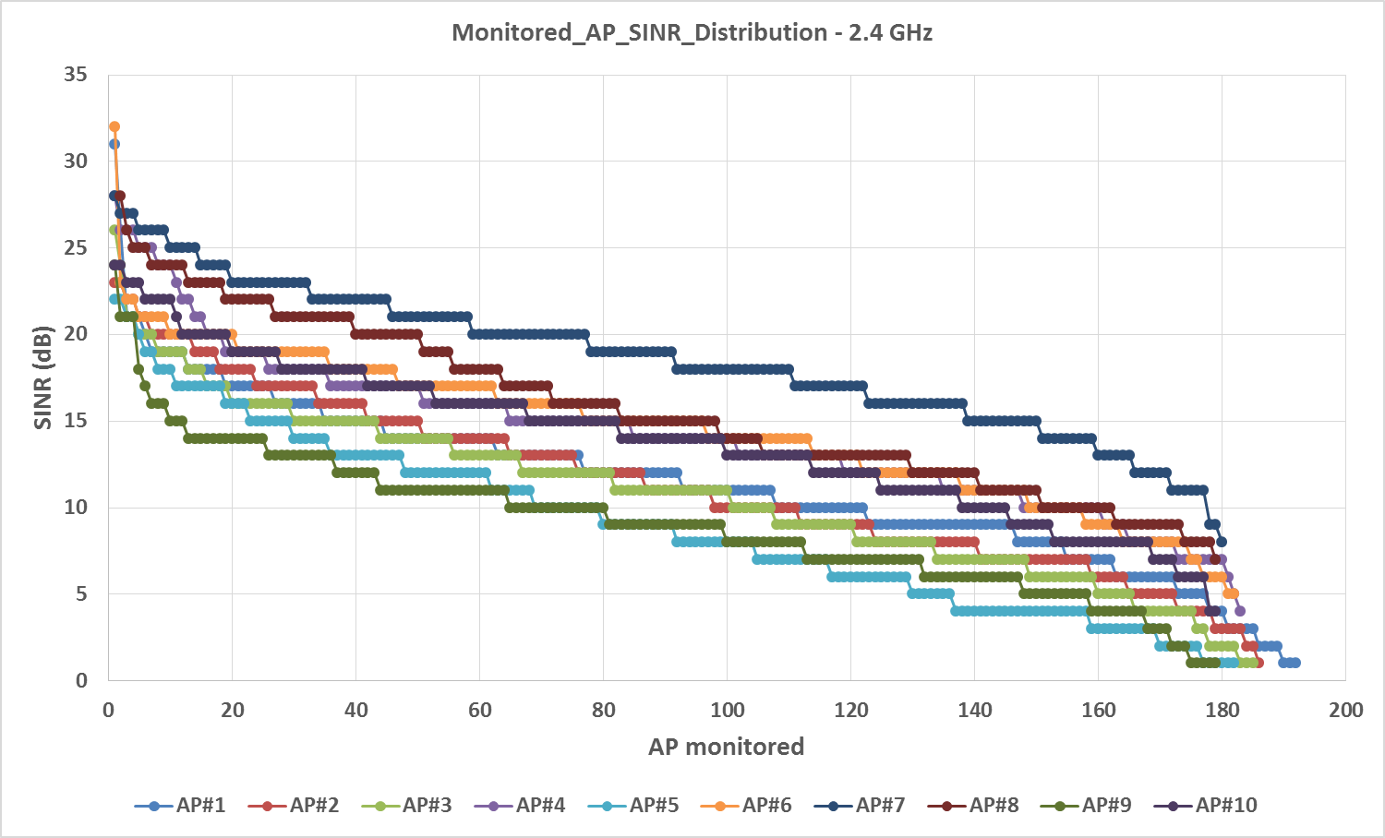
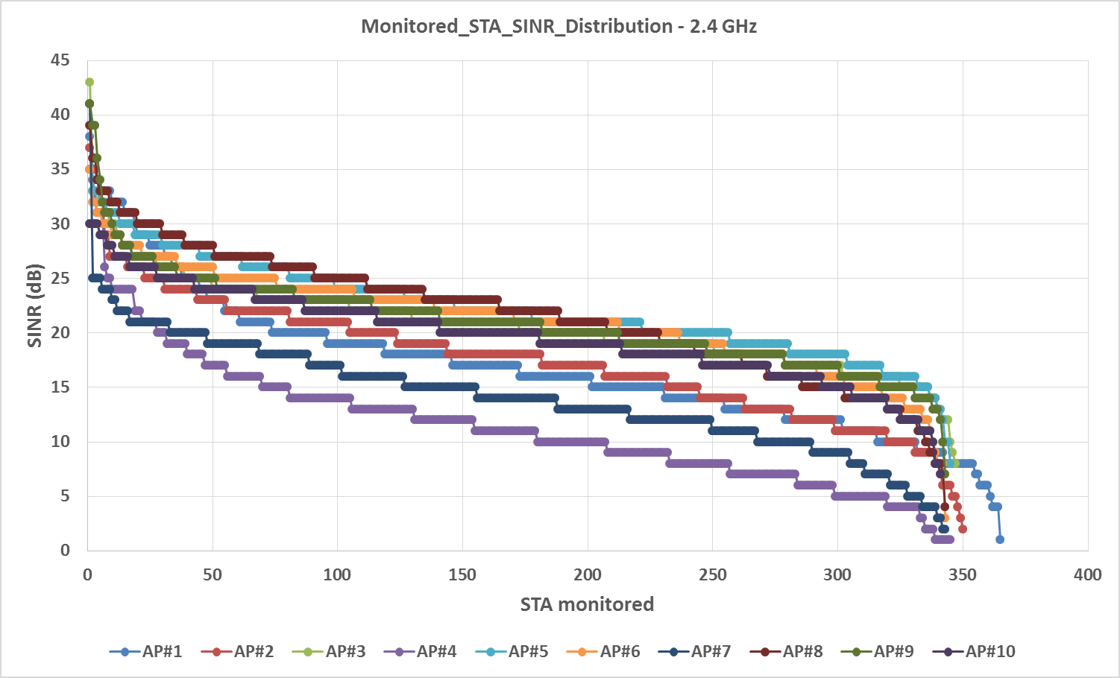
Estimating OBSS Impact – Stadium 2.4-GHz
Data from 10 most heavily-loaded 2.4-GHz radios at 70K seat stadium
There are 254 APs with 3,201 unique associated STAs on 2.4-GHz.
AP chart on left shows up to 100 OBSS APs at < 10 dB
STA chart on right shows higher SINRs than 5-GHz, tail clipping would require higher threshold to be effective.
  But clearly there are hundreds of OBSS STAs within BPSK range

Slide 16
Benefit Statement – Tail Clipping
Tail clipping is the blocking of low-RSSI OBSS signals for reasons other than spatial reuse.
A tail-clipping enabled BSS would advertise that fact, along with an operator-selected or AP-determined threshold:
  Value could not be higher than -75 dBm to avoid conflict with roaming thresholds and to ensure the entire MyBSS is cleared.
  Value could not be lower than about -85 dBm or there would be no benefit.
  Needs to be advertised so that roaming STAs can adjust their behavior
  -82 dBm might be an excellent common value, thereby restoring original intent of 802.11.
The following benefits could be realized:
  Protect AP CPU in high density / dirty RF environments
  Reduce “near/far” backoff impact from OBSS RX
  Improve both AP and STA algorithm performance and user experience by shrinking tables
  Possible energy savings
In addition, unintentional deferral to distant full power LTE-U or LAA eNBs using CTS-to-self could be avoided / “protected”.

Slide 17
Benefit Statement – Energy Savings
Battery-powered nodes (APs or STAs)
  STAs:
    Reduction of arbitrations aborted due to low-RSSI OBSS devices
      Could reduce attempts for RTS, NDP with PM=0/1, probing
    Ability to clear TX buffers faster and get back to sleep sooner
    Reduced CPU compute energy to run certain algorithms
  APs:
    Avoid responding to management frames from distant STAs
  Why APs?
    Some APs are already battery- or solar-powered today. In the future, low-power/industrial/IoT/embedded scenarios could make AP energy consumption savings important.
Powered nodes (APs or STAs)
  Is there a potential benefit for a full-time powered node?

Slide 18
RXS Tuning – Caveats & Limitations
Very small payoff region for SR (30-40% of SR-BSS midpoint).
  “Payoff” decisionmaking is “blind” – no way to know why I/N is spiked.
Requirement for guard zone (2-5 cell diameters) between same-channel SR-BSS to ensure MCS4 or better ESS minimum. No value at short SR-ICD values without walls/floors/crowd. Better to defer.
  Possible incompatibility with bonded channels for same reason.
No ability to separate TX and RX logic – Effect is completely bidirectional with a “hard edge”.
Maximum usable RXS limit must be well below typical client roaming thresholds (-70 dBm - 6 dB margin) unless clients agree to modify their roaming algorithms in SR-ESS. How to negotiate?
Roaming algorithm redesign to handle rapid rolloff, PER superseding RSSI, and improved AP coordination.
Legacy STA fairness issues
How exactly to choose the correct RXS level / margin?

Slide 19
BSS Coloring – Summary
Objectives | Mechanism(s) | Issues
Increase total area RX throughput via SR | Use BSS identifier early in frame (e.g. SIG field) to allow receiver to determine MyBSS, and reset CCA to idle if not. Separate RX/TX decision making. Optional protection of legacy STAs and sticky MyBSS STAs on RX “Smart” TX SR payoff decisions based on OBSS signal level | Same issues as RXS tuning regarding small payoff region, guard zone and wide channel restrictions during SR periods. However, does not need to suffer from roaming or legacy impacts due to “soft” edge and per-frame decision making. How to choose secondary signal threshold for deferring to legacy STAs Competes with RXS tuning for SR Size of color field has to be large enough for very high density deployments (500+ APs per channel) Legacy protection on RX should be operator configurable inside managed ESS perimeters Need to fire interrupt and process preambles for very low-RSSI OBSS frames
Increase total area TX throughput via SR
Objectives | Mechanism(s) | Issues
Increase total area RX throughput via SR | Use BSS identifier early in frame (e.g. SIG field) to allow receiver to determine MyBSS, and reset CCA to idle if not. Separate RX/TX decision making. Optional protection of legacy STAs and sticky MyBSS STAs on RX “Smart” TX SR payoff decisions based on OBSS signal level | Same issues as RXS tuning regarding small payoff region, guard zone and wide channel restrictions during SR periods. However, does not need to suffer from roaming or legacy impacts due to “soft” edge and per-frame decision making. How to choose secondary signal threshold for deferring to legacy STAs Competes with RXS tuning for SR Size of color field has to be large enough for very high density deployments (500+ APs per channel) Legacy protection on RX should be operator configurable inside managed ESS perimeters Need to fire interrupt and process preambles for very low-RSSI OBSS frames
Increase total area TX throughput via SR
Energy savings | Minimize unnecessary collision backoff/EIFS Less time TX, more time sleeping | STA savings likely limited to arbitration periods (STA is asleep otherwise) AP savings likely limited to avoiding control / mgmt TX to distant STAs
Objectives | Mechanism(s) | Issues
Increase total area RX throughput via SR | Use BSS identifier early in frame (e.g. SIG field) to allow receiver to determine MyBSS, and reset CCA to idle if not. Separate RX/TX decision making. Optional protection of legacy STAs and sticky MyBSS STAs on RX “Smart” TX SR payoff decisions based on OBSS signal level | Same issues as RXS tuning regarding small payoff region, guard zone and wide channel restrictions during SR periods. However, does not need to suffer from roaming or legacy impacts due to “soft” edge and per-frame decision making. How to choose secondary signal threshold for deferring to legacy STAs Competes with RXS tuning for SR Size of color field has to be large enough for very high density deployments (500+ APs per channel) Legacy protection on RX should be operator configurable inside managed ESS perimeters Need to fire interrupt and process preambles for very low-RSSI OBSS frames
Increase total area TX throughput via SR
Energy savings | Minimize unnecessary collision backoff/EIFS Less time TX, more time sleeping | STA savings likely limited to arbitration periods (STA is asleep otherwise) AP savings likely limited to avoiding control / mgmt TX to distant STAs
Denser use of wider channels | Increase peak burst rate | Wide channels may be incompatible with SR without mitigation features [1]

Slide 20
Color Field – Minimum Size is 8-10 bits
Color field must scale to size of modern ESS.
  Technique is vital in very high density use cases in open areas, airports and stadiums.
  Large stadiums (80K – 100K seats) commonly have 1,200 – 2,000 total APs with 2-4 virtual APs each. Plus several hundred active My-Fi hotspots.
  For 2.4-GHz, this means 400-700 APs per channel and 800 – 2,800 BSSIDs per channel. (Assumption - virtual APs do not affect color field size.)
  Things are better in 5-GHz, but this still means 60 – 100 APs per channel with 120 – 400 BSSIDs each (exclusive of My-Fis).
Assume color field is unique per channel (e.g. same ESS can re-use entire color space on each channel).
All BSS must have unique color (whether they can hear others or not.)
For multiple-operator overlays (e.g. Thailand malls) how to avoid color collision? Or 1000s of residential networks embedded inside outdoor cable/hotspot network.
  Some kind of PLMN-style ID plus BSS color? Or use PAID? [7]

Slide 21
Color Field – Real World Data
Venue | City | Seats | APs | Seats/AP | 2.4G APs / Channel | Ref
Dodger Stadium | Los Angeles, CA | 56,000 | > 1,000 | 56 | > 333 | [11]
Lambeau Field | Green Bay, WI | 80,735 | > 1,000 | 81 | > 333 | [12]
M&T Bank Stadium | Baltimore, MD | 71,000 | ~ 800 | 89 | ~ 265 | [13]
Levi’s Stadium | San Jose, CA | 70,000 | > 1,200 | 58 | > 400 | [16]
AT&T Stadium | Dallas, TX | 80,000 | > 1,600 | 50 | > 533 | [16]
AT&T Park | San Francisco, CA | 42,000 | 1,700 | 25 | > 566 | [14]
Kaufmann Stadium | Kansas City, KS | 32,903 | 576 | 57 | 192 | [15]
Kyle Field, Texas A&M | College Station, TX | 102,500 | > 1,600 | 64 | > 533 | [17]
Univ. Phoenix Stadium | Phoenix, AZ | 63,400 | > 750 | 85 | > 250 | [18]
Baylor Univ. Stadium | Waco, TX | 45,140 | > 300 | 150 | > 100 | [19]
CenturyLink Field | Seattle, WA | 67,000 | 757 | 89 | ~ 252 | [20]

Slide 22
Transmit Power Control – Summary
Objectives | Mechanism(s) | Issues
Increase total area throughput via SR (both RX and TX) | Reduce interference to OBSS by reducing EIRP to minimum required to achieve maximum data rates to peer within MyBSS. Increase TX/RX airtime / decrease channel busy | Longer list of key issues on next slide. Same issues as RXS tuning regarding small payoff region, guard zone and wide channel restrictions during SR periods. How to choose optimal EIRP level on AP/STA?
Objectives | Mechanism(s) | Issues
Increase total area throughput via SR (both RX and TX) | Reduce interference to OBSS by reducing EIRP to minimum required to achieve maximum data rates to peer within MyBSS. Increase TX/RX airtime / decrease channel busy | Longer list of key issues on next slide. Same issues as RXS tuning regarding small payoff region, guard zone and wide channel restrictions during SR periods. How to choose optimal EIRP level on AP/STA?
Energy savings | Reduce energy used to TX frames by reducing EIRP Minimize unnecessary collision backoff/EIFS Less time TX, more time sleeping | STA savings likely limited to arbitration periods (STA is asleep otherwise) AP savings likely limited to avoiding control / mgmt TX to distant STAs

Slide 23
TPC Gain May be Limited
TPC by itself does not really help us
    Only works at very large SR-ICD scales / or NLOS high-shadowing.
      Must reduce OBSS < PD detect level to help. This is a long way (< -90 dBm!)
    Gain can be neutralized by any 3rd party same-channel BSS overlay
TPC + Coloring or RXS only useful at short range
  Totally desirable to reduce power if not needed for MCS8/9
  Fundamental contradiction – if all APs and STAs reduce EIRP by same amount then there is no advantage because SR-BSS structure is EIRP-invariant. But if nodes choose different power levels, then weak EIRP nodes are penalized. [1]
  Loss of rate is worse than increase interference radius during SR.
  Needs more study – 15/1045r0 suggests otherwise.

Slide 24
Conclusion – Cooperative SR Framework
SR “Payoff” Region
Deferral “Payoff”
Region
“Tail Clip” Payoff
Region
BSS COLORING
BSSC+DSC V2
RXS TUNING
RXS and coloring are mutually exclusive here Coloring allows separate RX/TX decisions Coloring may make smarter per-frame payoff decisions RXS must make “blind” payoff decisions RXS has hard edge with implicit deferral inside
RXS and coloring are mutually exclusive here Coloring allows separate RX/TX decisions Coloring may make smarter per-frame payoff decisions RXS must make “blind” payoff decisions RXS has hard edge with implicit deferral inside | Coloring is superior to RXS. Supports soft edge with optional per-frame legacy and sticky client protection RXS/DSC is not viable on downlink because max usable downlink threshold = ~ -76 dBm. Modified DSC could be used for secondary CCA-PD threshold for OBSS deferral
RXS and coloring are mutually exclusive here Coloring allows separate RX/TX decisions Coloring may make smarter per-frame payoff decisions RXS must make “blind” payoff decisions RXS has hard edge with implicit deferral inside | Coloring is superior to RXS. Supports soft edge with optional per-frame legacy and sticky client protection RXS/DSC is not viable on downlink because max usable downlink threshold = ~ -76 dBm. Modified DSC could be used for secondary CCA-PD threshold for OBSS deferral | RXS with low threshold (-76 to -80 dBm) works well Provides CPU protection and improves algorithm quality Restores the “-82” style intent to interference range Can default off unless operators enable.

Slide 25
Key Issues / Unknowns
How much efficiency hit does coloring suffer relative to RXS due to preamble processing?
Could RXS be made to make “smart” payoff decisions by studying instantaneous NF?
Can STA vendors be convinced to provide adaptive roaming algorithms that would permit higher downlink RXS thresholds?
  But even if they did, this does not solve for legacy fairness!

Slide 26
PART 3: re-engineering dsc

Slide 27
Challenges with Current DSC Proposal
Bidirectional margin: Uplink margin must equal downlink margin
How to choose margin: No algorithm proposals have been contributed.
Designed for short range: High DSC uplink margin values negate the benefit by rapidly converging DSC-enabled cells to normal CCA
  Most DSC contributions have generally used AP-advertised margins >= 20 dB. [8] [9] [10] [many others…]
  However, this level of margin seriously impairs the potential effectiveness of the technique by converging to standard CCA-PD beyond 20 meters.
  Neither large margins nor advertising are required. Much smaller adaptive values can achieve same goal, or even just 3dB margin with RTS/CTS.
Breaks roaming: High downlink margin breaks roaming if AP CCAT is set higher than mobile device roam thresholds. [2]
  Most DSC examples propose combined UL and Margin in -55 to -60 range.
  However, combination of DSC Upper Limit and DSC Margin can never exceed -70 dBm plus a safety margin. Some devices require lower values.

Slide 28
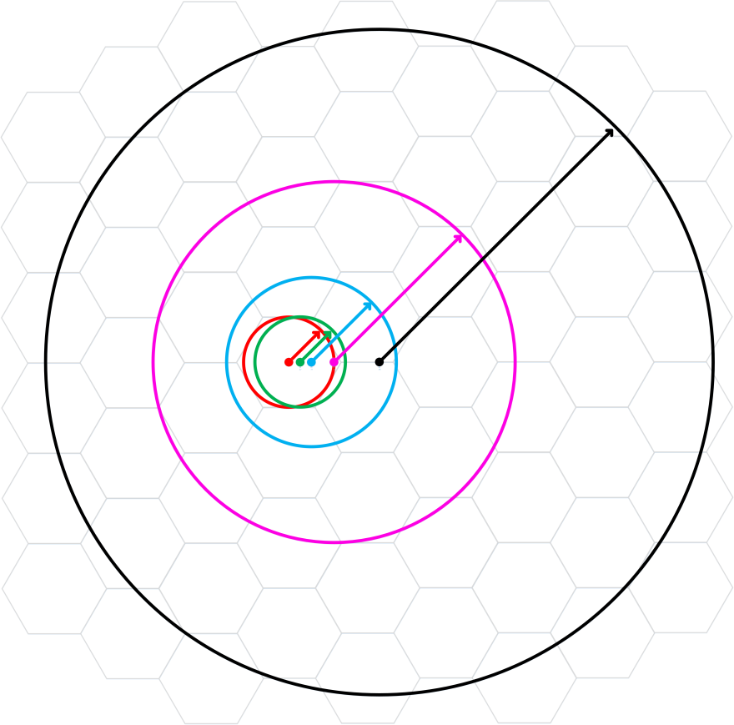
How Uplink Margins Actually Work
Large downlink margin deducted from measured beacon RSSI converges to standard CCA-SD level at typical -65 dBm cell edge.
This is just <=20m - so what is the point of going to all the trouble?
Simplified Cell Model from 14/0779r2
Actual SS#3 PL Model w/Static Margin
UL = -48
Margin = 20
AP CCA = -68
d = 40m
RSSI = -68
RXS = -88
d = 80m
RSSI = -78
RXS = -98
Diagram is incorrect → assumes variable margin

Slide 29
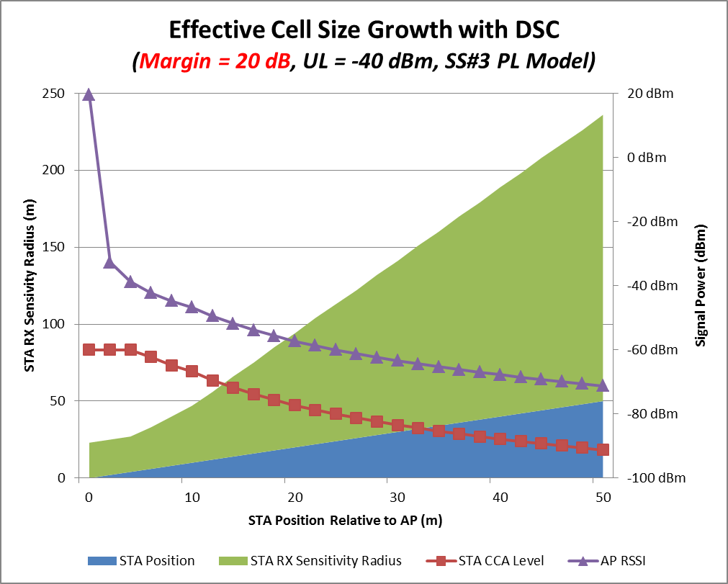
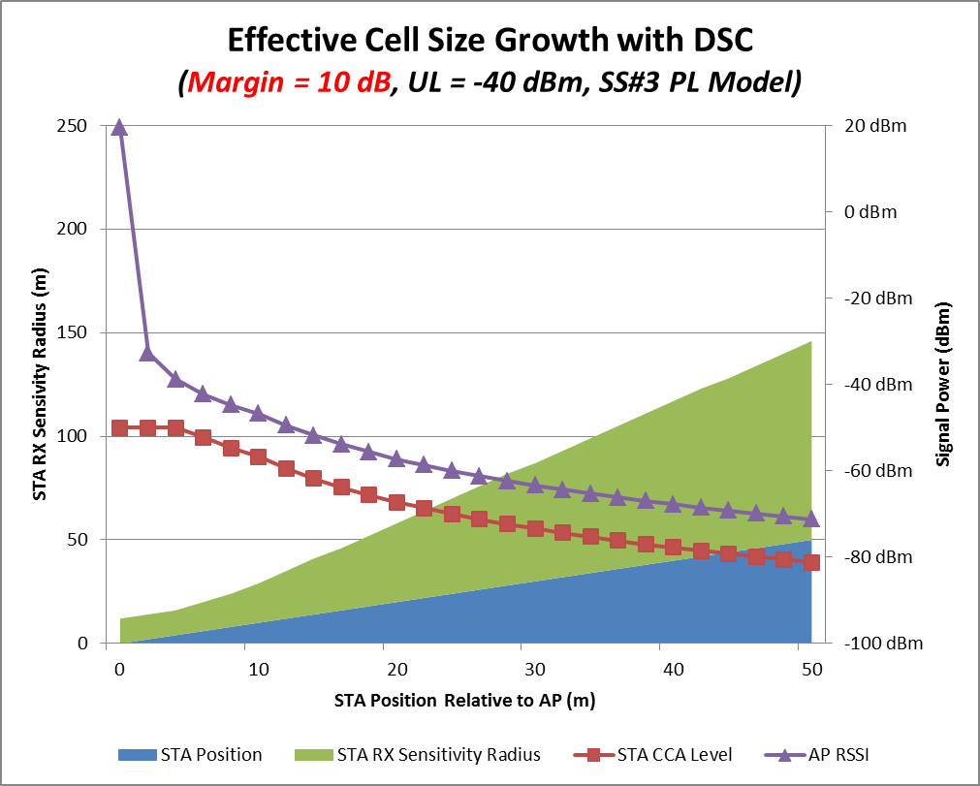
DSC Forces Growth in STA Interference Radius
20 dB margin = 4X distance multiplier for n=3.5 (in free space / LOS conditions).
X axis is not to scale!
180m interference radius at 50m distance!!

Slide 30
Result Is By Design – But is it What We Want?
14/0779r2 states:
  “DSC maintains full sensitivity”
  “The chance of hidden STAs in the home network is greatly reduced”
  “The DSC STA, maintains full range. The sensitivity will move towards lowest value as the STA moves away from the AP.”
This is the opposite of tail clipping for STAs.
Is full sensitivity really necessary for SR?
  Increasing prevalence of RTS / CTS for dynamic bandwidth, LTE/LAA protection, etc.
  Coloring does the same job and is legacy- and sticky client-compatible.
This means that DSC is only targeted to deliver SR at short distances. But there is trouble there…

Slide 31
Downlink Margin: Breaking Roaming
In 14/1416r1, we reported serious problems with STAs roaming between APs with static AP CCAT set higher than device roaming threshold. (e.g. high downlink margin)
  2 major phone OS and 1 major laptop OS were tested
AP CCAT level should never be set higher than:
Device_Roam_Threshold – 3dB
Roam thresholds of major OS range from -70 to low -80s.
Only way to avoid is to make HE clients aware of AP_CCAT
  Concurrent SR-BSS transmission breaks RSSI-based roaming
  Advertising key info needed by client to assess position relative to edge to enable graceful negotiation of cell exit

Slide 32
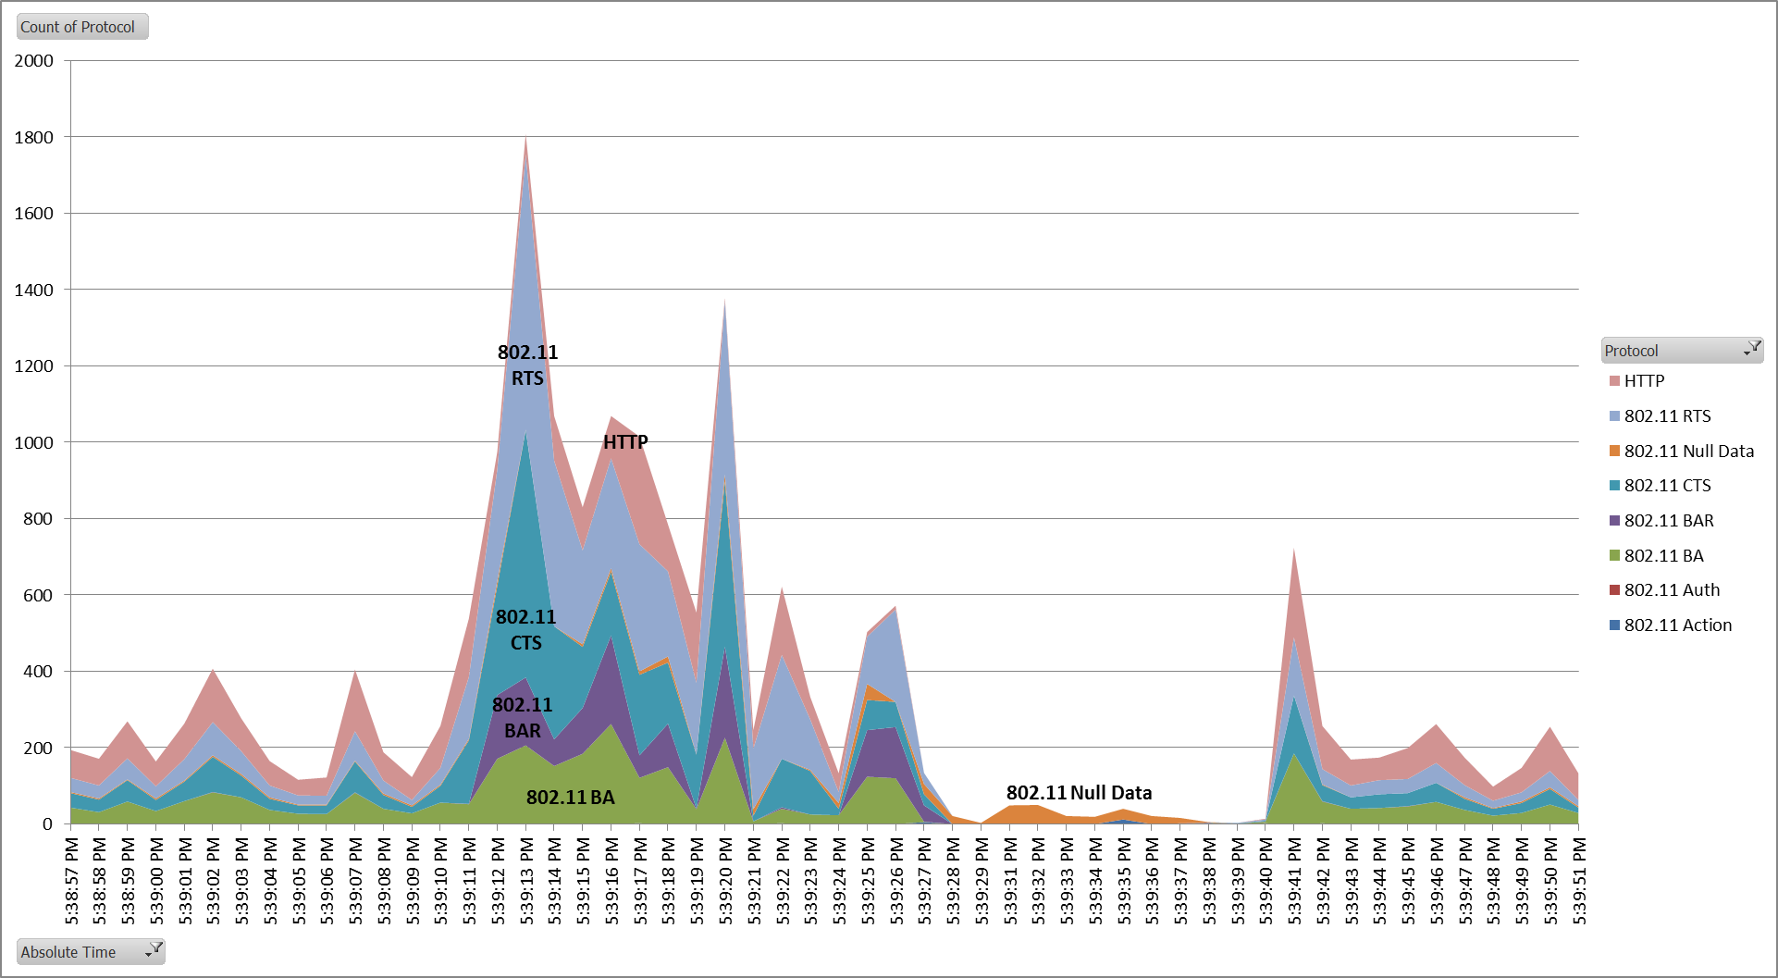
Smartphone #2 Roam (AP2 → AP1)
Protocol Failure Zone
10,000+ frames, 29 sec

Slide 33
Maximum Limit for Downlink AP CCAT
CCAT
max
AP1
AP2
R
R
R
Ch X
Ch Y
Roam
thresh
Roaming threshold must be inside the AP CCAT radius
So Upper Limit + downlink margin must always be lower than the least-capable STA roaming threshold.

Slide 34
Resolving the Conflicts
Separate the downlink and uplink CCAT levels (margins)
For downlink:
  Flip the model. Use tail clipping as primary goal. Do opportunistic short-range SR when uplink margin and STA geometry allow.
  Operator chooses DL CCAT based on system design.
  HE STAs could implement adaptive roaming algorithms using cell configuration signaled by AP, and perhaps negotiated entry/exit
For uplink, combine with BSS coloring:
  Some BSS coloring proposals include a secondary CCA-PD level
  DSC could be reformulated to do this job for STAs
  Leverage RTS/CTS for MyBSS clearing
  If no RTS/CTS, then use CTS-to-self or far-edge path loss estimation

Slide 35
Uplink CCAT: What Margin with RTS/CTS?
For RTS/CTS case, there are 2 methods: Fixed & variable
STA just has to reach AP. Could combine with uplink TPC.
STA should never get here
AP
AP
Method #1 – Fixed
Match Advertised AP CCAT
Method #2 – Variable
AP-RSSI – Safety margin (3-6dB)

Slide 36
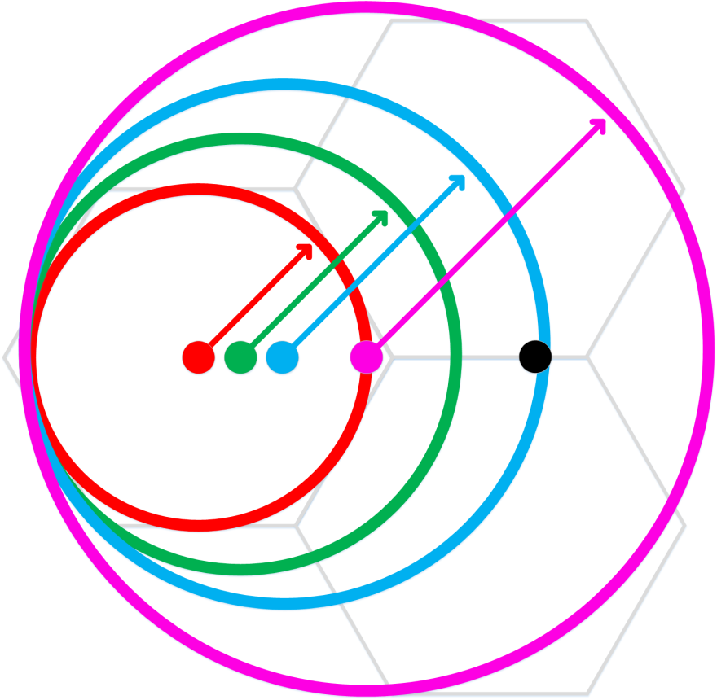
Uplink CCAT: What Margin Without RTS/CTS?
No RTS/CTS is much more complicated.
Must clear entire cell.
Even if STA has estimate of n and knowledge of AP CCAT, no reliable way to estimate required CCA level.
Options are:
  Use default CCAT
  Use CTS-2-self @ full EIRP
  AP advertises estimated n and STA calculates CCAT

Slide 37
Summary – DSC Re-engineering
Core DSC premise #1 of DSC proposal - High downlink CCAT threshold – is currently invalid:
  STA vendors would have to agree to modify roaming algorithms to be CCAT-aware.
  No indication that TGax will standardize roaming
Core premise #2 – large DSC margin values – is unnecessarily conservative for uplink CCAT
  Physical area of SR gain is too small to be useful in many scenarios
  MyBSS clearing can be accomplished other ways
  Coloring could do a better job of legacy protection
DSC concept is ideally suited to solve problem of secondary CCA-PD for BSS coloring

Slide 38
References
15/1082r0 – “Analysis of BSS and ESS Structure During Concurrent SR Transmissions”, C Lukaszewski (Aruba), Sep 2015
14/1416r1 – “Observed protocol violations caused by DSC with roaming STAs”, C Lukaszewski (Aruba), Nov 2014
14/1224r0 – “Link-Aware CCA”, B Hart (Cisco), Sep 2014
14/0372r2 – “System Level Simulations on Increased Spatial Reuse”, Jiang et al (Marvell), Mar 2014
14/1207r1 – “OBSS Reuse Mechanism Which Preserves Fairness”, I Jamil, L Cariou (Orange), Sep 2014
14/0854r0 – “DSC and Legacy Coexistence”, W Carney, Y Morioka et al (Sony), Jul 2014
13/1207r1 – “CID 205 BSSID Color Bits”, M. Fischer et. Al, Sep 2013 (11ah)
14/0779r2 - “Dynamic Sensitivity Control - Practical Usage” , Graham Smith, July 2014
14/0328r2 – “ Dense Apartment Complex Throughput Calculations, “ Graham Smith, Mar 2014
14/0045r1 – “E-Education Analysis,” Graham Smith, Jan 2014

Slide 39
References (continued)
http://www.mobilesportsreport.com/2015/09/stadium-tech-report-los-angeles-dodgers-hit-it-out-of-the-park-with-cisco-aruba-wi-fi/
http://www.mobilesportsreport.com/2015/08/wi-fi-for-the-frozen-tundra-extreme-verizon-bring-wi-fi-to-green-bay-packers-lambeau-field/
http://www.mobilesportsreport.com/2015/08/baltimore-ravens-pick-extreme-networks-for-mt-bank-stadium-wi-fi/
http://www.mobilesportsreport.com/2015/07/stadium-tech-report-world-series-set-new-wireless-records-at-att-park/
http://www.mobilesportsreport.com/2015/06/stadium-tech-report-kauffman-stadium-gets-a-royal-wi-fi-upgrade/
http://www.mobilesportsreport.com/2015/01/stadium-tech-report-att-stadiums-massive-antenna-deployment-delivers-solid-wi-fi-das-performance/
http://www.mobilesportsreport.com/2015/01/stadium-tech-report-corning-ibm-bringing-fiber-based-wi-fi-and-das-to-texas-ams-kyle-field/
http://www.mobilesportsreport.com/2014/12/stadium-tech-report-phoenix-cardinals-get-stadium-ready-for-super-bowl-with-wi-fi-upgrade/
http://www.mobilesportsreport.com/2014/12/stadium-tech-report-phoenix-cardinals-get-stadium-ready-for-super-bowl-with-wi-fi-upgrade/
http://www.geekwire.com/2015/wifi-analytics-seahawks-front-office-sees-gameday/

