Slide 1
Dynamic CCA control and TPC Simulation Results with SS1~SS3
Date: 2015/09/14
Authors:

Slide 2
Abstract
Simulation results of adaptive spatial reuse techniques in defined simulation scenarios (SS1~SS3) are provided
In almost all scenarios, Dynamic CCA control was able to increase the average throughput
Furthermore, if TPC is jointly used, larger gain can be observed without any harm at almost all scenarios
  In some scenarios, larger gain can be observed with negligible degradation

Slide 3
Spatial reuse techniques
In this contribution, 3 spatial reuse techniques and their combinations are evaluated
  BSS COLOR based packet filtering
  Dynamic CCA Control (DCCA)
    Dynamic Sensitivity Control (DSC)
        Changing CCA-SD based on link condition
    Dynamic OBSS CCA (DOCCA)
        Apply OCCA-threshold to decide medium status for Inter-BSS packet after BSS COLOR filtering and changing this OCCA-threshold based on link condition
        CCA-SD isn’t changed
  Transmit power control (TPC)
      Changing transmit power based on link condition
Detailed processes of these techniques are explained in slide #29~35.

Slide 4
SS1
Simulation Setup and Results

Slide 5
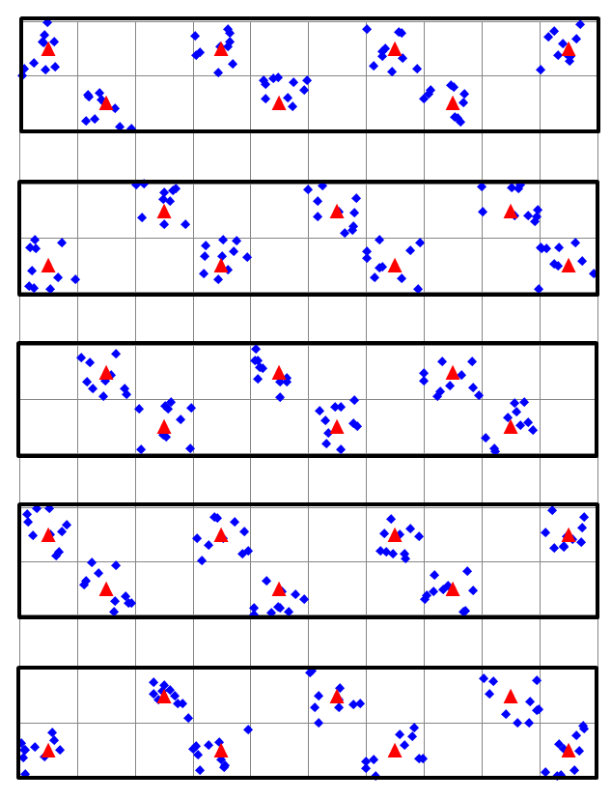
Simulation Setup (SS1)
Based on 14/0980r14 and 15/0571r10
  Selected parameters
    2412MHz, 20MHz BW
    34 APs, 10 STAs per AP
    Max aggregation = 64
    Goodput maximizing MCS selection
    based on Training
Modified parameters
  Channels are assigned uniformly
  Traffic mix is emulated with CBR UDP as next slide
4th Floor
3rd Floor
2nd Floor
1st Floor
Ground Floor
More detailed conditions are shown in slide #36.

Slide 6
Simulation Setup (SS1)
Traffic mix of SSD is approximated as CBR UDP flows reflecting expected traffic bandwidth as follows
SSD description (Traffic model for each apartment) |  |  |  |  | Expected average bandwidth [Mbps]
Sim Traffic Identifier | Traffic Model | Traffic Model Class Identifier | Number of Traffic Services | AC | DL | UL | (Calculation from EMD)
D1 | Buffered Video Streaming | BV6 | 2/2 | VI | 15.6 x 2 |  | Source Rate 15.6Mbps
D2 | Buffered Video Streaming | BV3 | 4/4 | VI | 6.0 x 4 |  | Source Rate 6.0Mbps
D3 | FTP | FTP | 2/2 | BE | 0.089 x 2 |  | 2MByte/180sec
D4 | HTTP | HTTP | 4/4 | BE | 0.015 x 4 |  | (10710 + 7758*5.64)Byte/30sec
D5 | Gaming | GMG | 3/3 | VI | 0.208 x 3 |  | 390Byte/15msec
D6 | VoIP | VOIP | 2/2 | VO | 0.012 x 2 | 0.012 x 2 | Source Rate 12.2Kbps
U1 | Buffered Video Streaming | BV3 | 1/1 | VI |  | 6.0 x 1 | Source Rate 6.0Mbps
U2 | FTP | FTP | 2/2 | BE |  | 0.089 x 2 | 2MByte/180sec
U3 | Gaming | GMG | 3/3 | VI |  | 0.054 x 3 | 158Byte/23.5msec
Total 56.626 6.364
Approximated CBR UDP traffic model
(AC_BE is used in all flows)
DL ... 6.0 Mbps x 10 flow (IP 1000byte)
UL ... 0.8 Mbps x 8 flow (IP 1000byte)

Slide 7
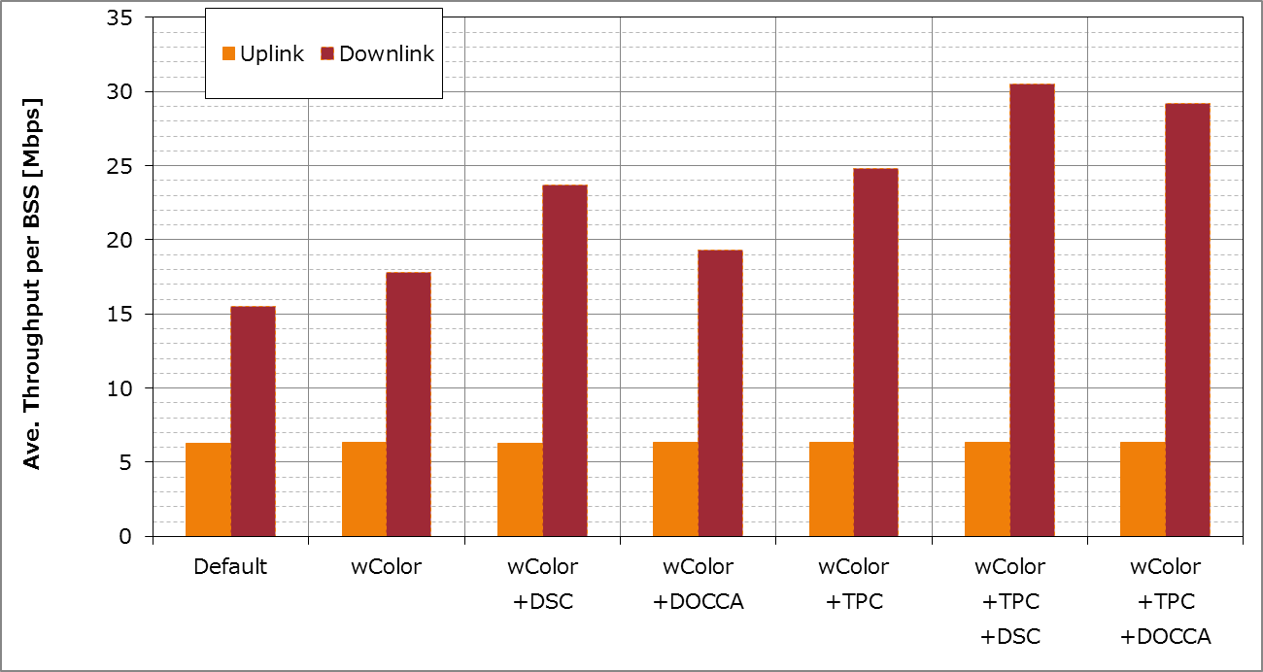
SS1 results
(All of STAs are Ax-STA)
(Offered DL load=60Mbps)
Offered
UL load
When TPC and DCCA(DSC/DOCCA) are used together, larger gain can be obtained than when TPC/DCCA is used alone.

Slide 8
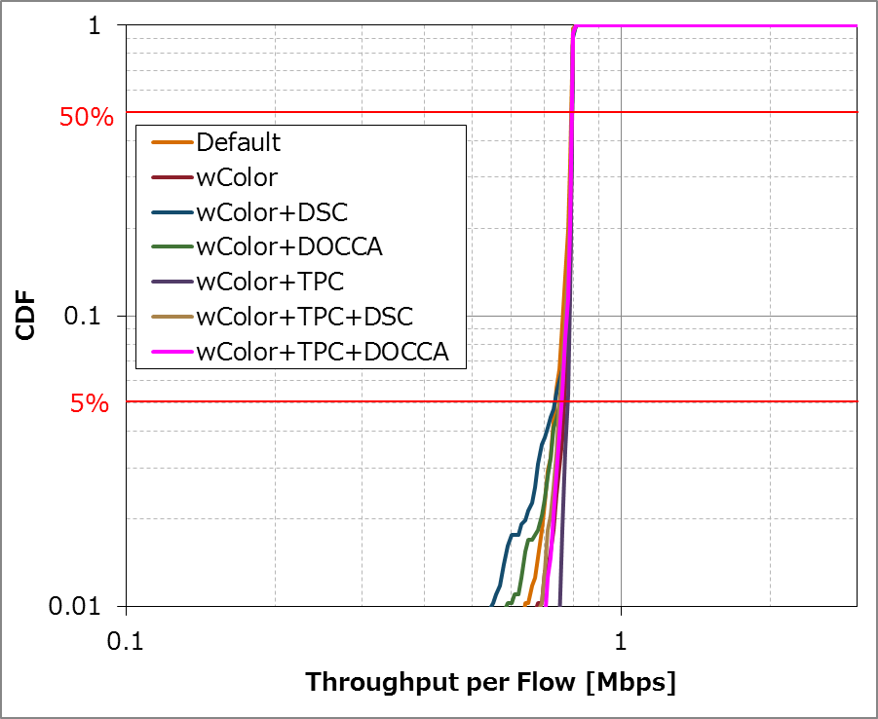
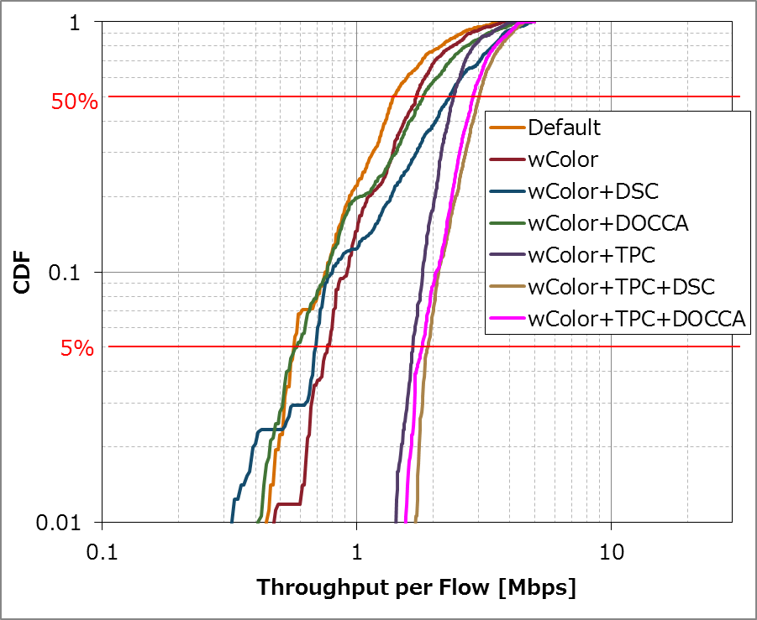
SS1 results
(All of STAs are Ax-STA)
Uplink
Downlink
DCCA(DSC/DOCCA) can deteriorate the 5%tile throughput when used alone.
On the other hand, when TPC is used with DCCA, 5%tile throughput can be improved.

Slide 9
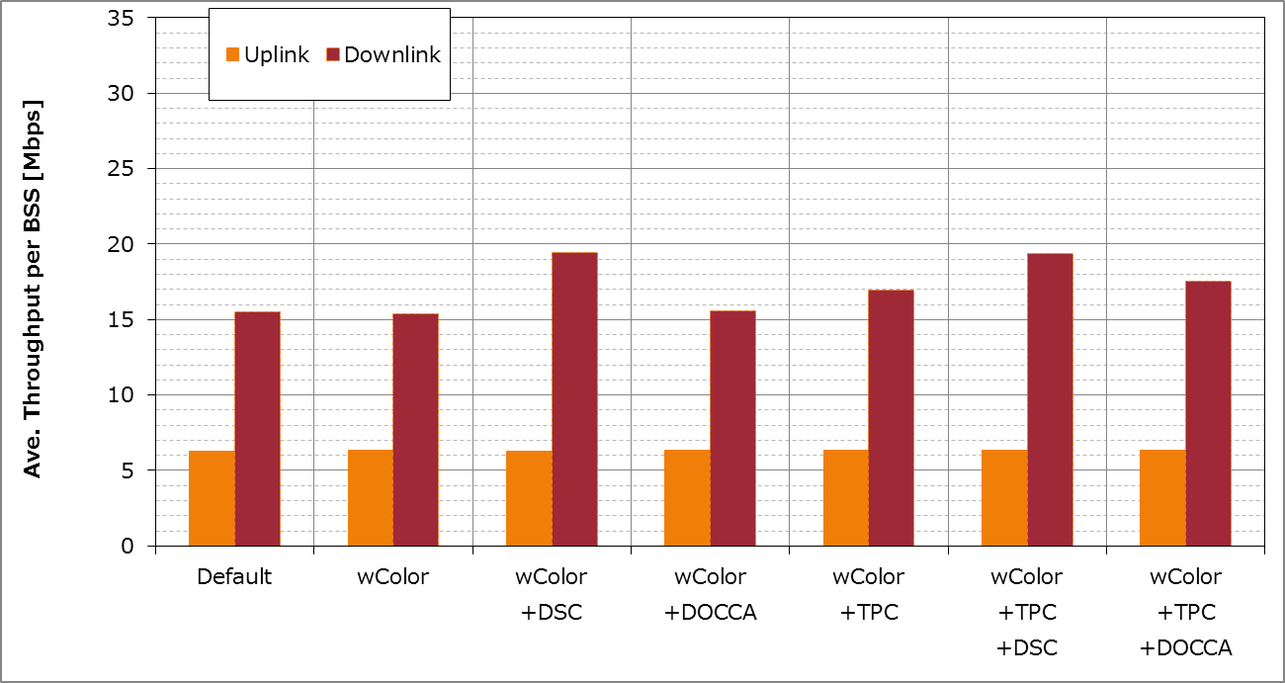
SS1 results
(Half of STAs are Ax-STA)
(Offered DL load=60Mbps)
Offered
UL load
Although performance gain decreases from when all STAs are AX,
the gain remains and there’s no degradation.

Slide 10
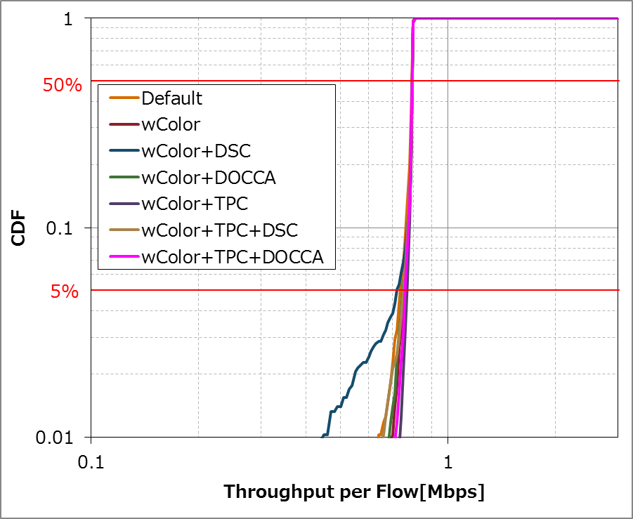
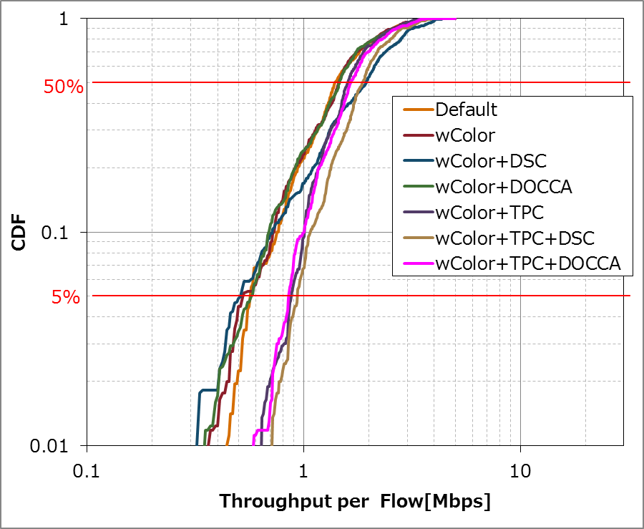
SS1 results
(Half of STAs are Ax-STA)
Uplink
Downlink
When TPC and DCCA(DSC/DOCCA) are used together, 5%tile throughput can be improved
although the gain is less than all Ax STA condition.

Slide 11
SS2
Simulation Setup and Results

Slide 12
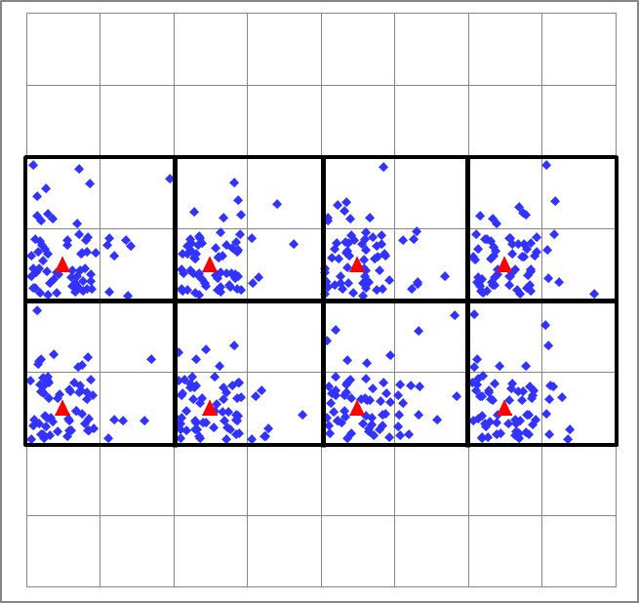
Simulation Setup (SS2)
Based on 14/0980r14 and 15/0571r10
  Selected parameters
    5180MHz, 80MHz BW
      2.4GHz 20MHz operation cannot
      support offered load
    Max aggregation = 64
    Goodput maximizing MCS selection
    based on Training
Modified parameters
  8 APs, 64 STAs per AP
    100% STAs are associated and exactly 64 STAs per an AP
  Traffic mix is emulated with CBR UDP as next slide
More detailed conditions are shown in slide #37.

Slide 13
Simulation Setup (SS2)
Traffic mix of SSD is approximated as CBR UDP flows reflecting expected traffic bandwidth as follows
SSD description (Traffic model for each AP) |  |  |  |  | Expected average bandwidth [Mbps]
Sim Traffic Identifier | Traffic Model | Traffic Model Class Identifier | Number of Traffic Services | AC | DL | UL | (Calculation from EMD)
D1 | Buffered Video Streaming | BV6 | 2/2 | VI | 15.6 x 2 |  | Source Rate 15.6Mbps
D2 | Buffered Video Streaming | BV3 | 6/6 | VI | 6.0 x 6 |  | Source Rate 6.0Mbps
D3 | VDI | VDI | 48/48 | VI | 0.193 x 48 | 0.0025 x 48 | DL...1444byte/60ms UL...16byte/48ms
D4 | VoIP | VOIP | 10/10 | VO | 0.012 x 10 | 0.012 x 10 | Source Rate 12.2Kbps
Total 76.584 0.240
Approximated CBR UDP traffic model
(AC_BE is used in all flows)
DL ... 10.0 Mbps x 8 flow (IP 1000byte)
UL ... 0.024 Mbps x 10 flow (IP 40byte)

Slide 14
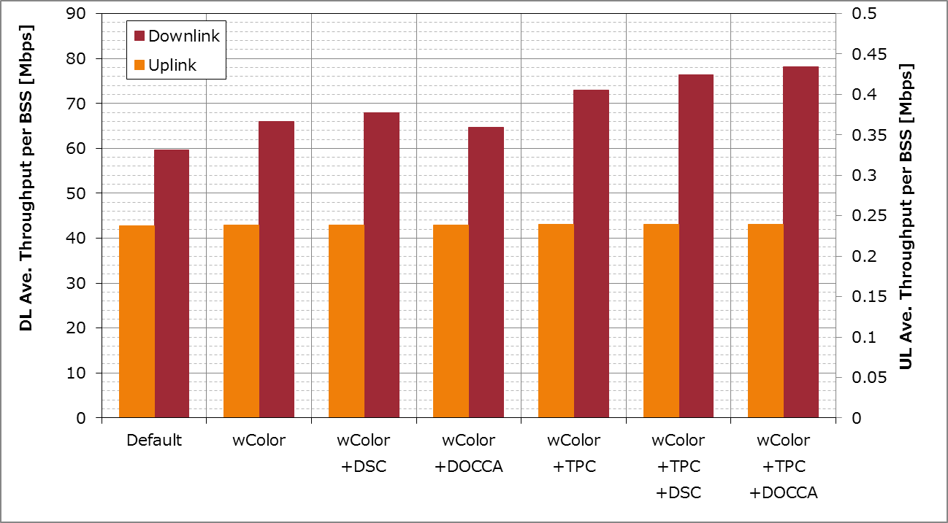
SS2 results
(All of STAs are Ax-STA)
Offered
DL load
Offered
UL load
TPC+DCCA(DSC/DOCCA) can obtain larger gain than TPC/DCCA alone.

Slide 15
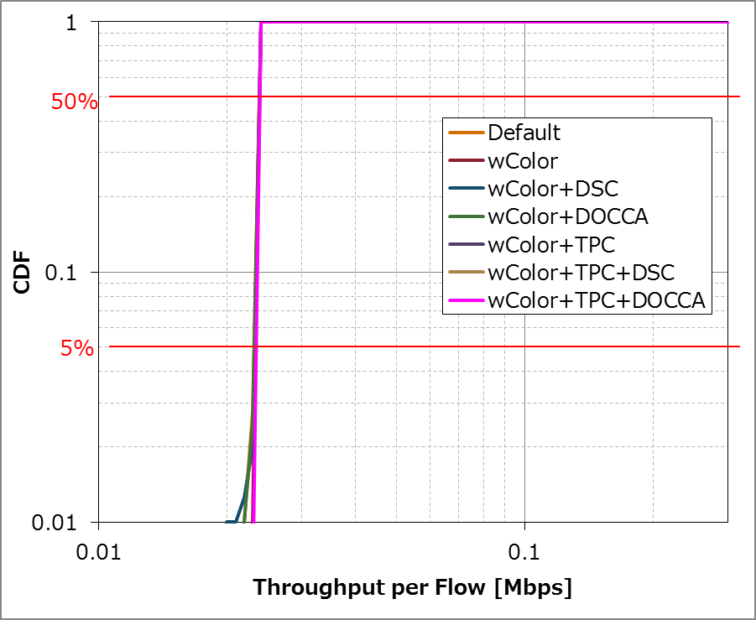
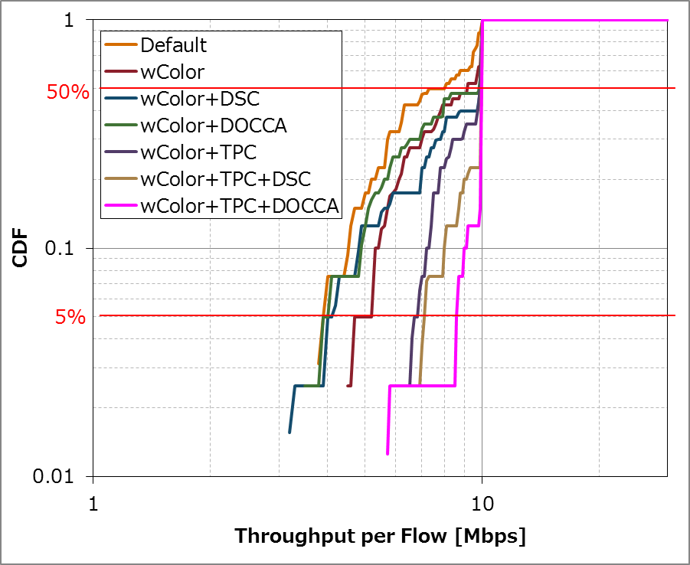
SS2 results
(All of STAs are Ax-STA)
Uplink
Downlink
In terms of 5%tile throughput, DCCA(DSC/DOCCA) can deteriorate the 5%tile throughput, when it used alone.
On the other hand, when TPC is used with DCCA, 5%tile throughput can be improved.

Slide 16
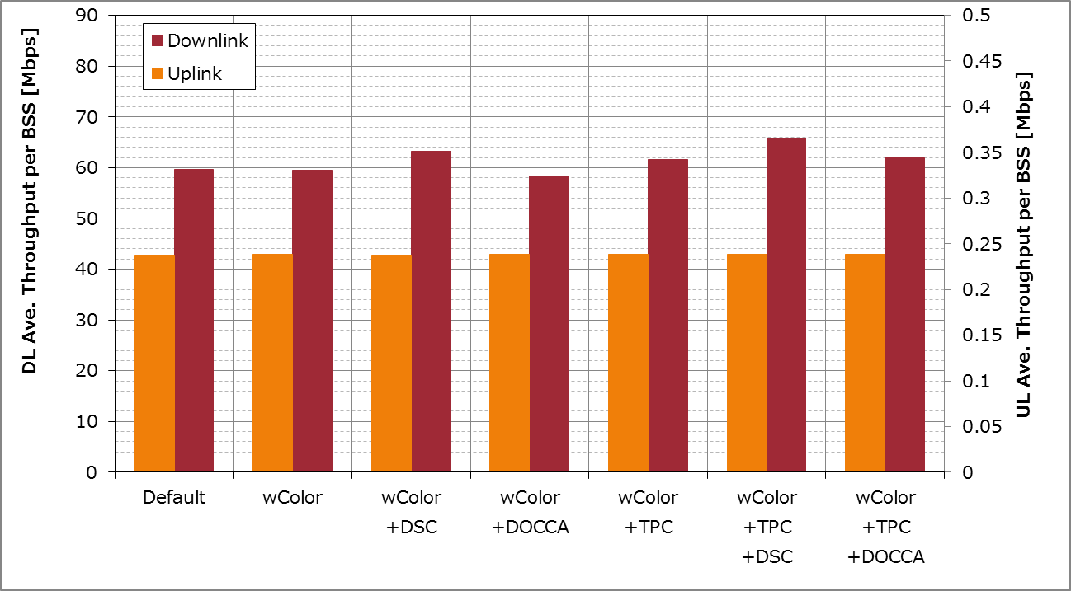
SS2 results
(Half of STAs are Ax-STA)
Offered
DL load
Offered
UL load
Although performance gain decreases from when all STAs are AX,
the gain remains and there’s no degradation except for DL of wColor+DOCCA case.

Slide 17
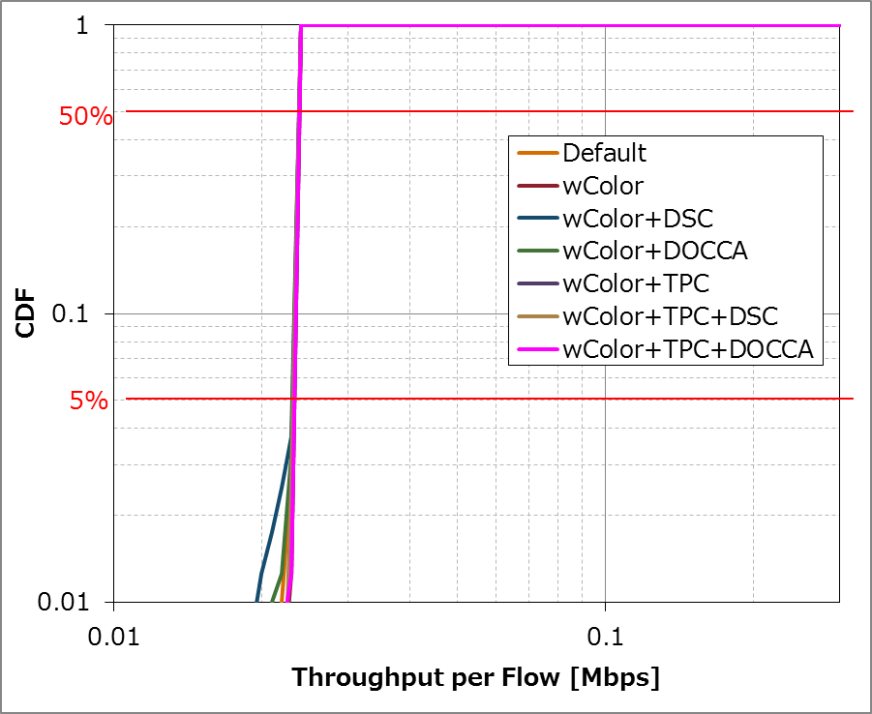
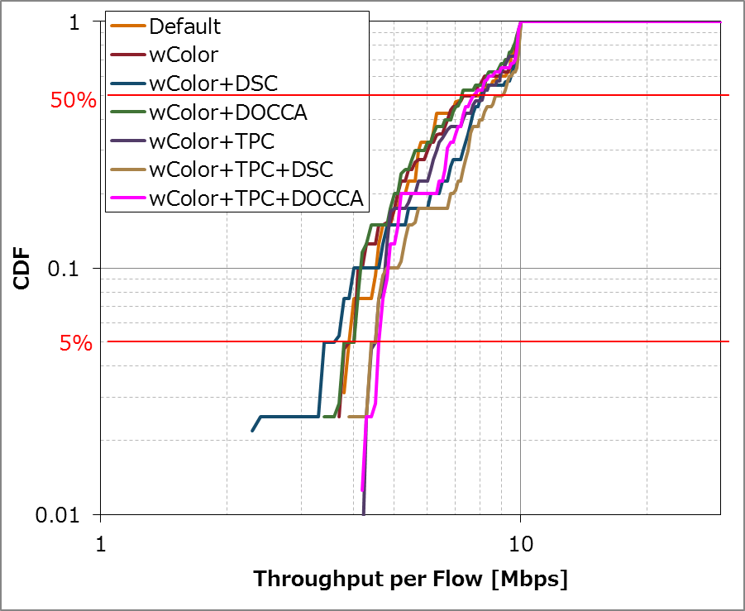
SS2 results
(Half of STAs are Ax-STA)
Uplink
Downlink
When TPC is used with DCCA(DSC/DOCCA), 5%tile throughput can be improved.

Slide 18
SS3
Simulation Setup and Results

Slide 19
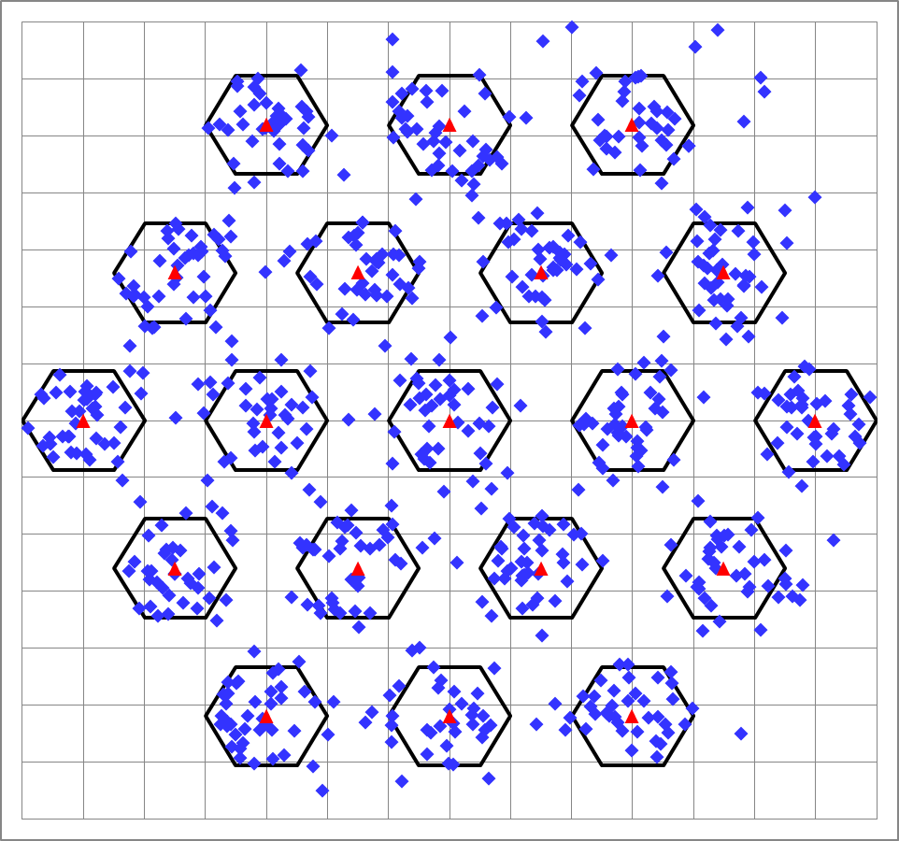
Simulation Setup (SS3)
Based on 14/0980r14 and 15/0571r10
  Selected parameters
    5180MHz, 80MHz BW
      2.4GHz 20MHz operation cannot
      support offered load
    Frequency reuse factor = 3
    No wrap around
    19 APs, 40 STAs per AP
    Max aggregation = 64
    Goodput maximizing MCS selection based on Training
Modified parameters
  Traffic mix is emulated with CBR UDP as next slide
More detailed conditions are shown in slide #38.

Slide 20
Simulation Setup (SS3)
Traffic mix of SSD is approximated as CBR UDP flows reflecting expected traffic bandwidth as follows
SSD description (Traffic model for each BSS) |  |  |  |  | Expected average bandwidth [Mbps]
Sim Traffic Identifier | Traffic Model | Traffic Model Class Identifier | Number of Traffic Services | AC | DL | UL | (Calculation from EMD)
D1 | Buffered Video Streaming | BV6 | 12/12 | VI | 15.6 x 12 |  | Source Rate 15.6Mbps
D2 | Buffered Video Streaming | BV3 | 8/8 | VI | 6.0 x 8 |  | Source Rate 6.0Mbps
D3 | FTP | FTP | 4/4 | BE | 0.089 x 4 |  | 2MByte/180sec
D4 | HTTP | HTTP | 12/12 | BE | 0.015 x 12 |  | (10710 + 7758*5.64)Byte/30sec
D5 | Gaming | GMG | 16/16 | VI | 0.208 x 16 |  | 390Byte/15msec
D6 | VoIP | VOIP | 12/12 | VO | 0.012 x 12 | 0.012 x 12 | Source Rate 12.2Kbps
U1 | Buffered Video Streaming | BV3 | 4/4 | VI |  | 6.0 x 4 | Source Rate 6.0Mbps
U2 | FTP | FTP | 4/4 | BE |  | 0.089 x 4 | 2MByte/180sec
U3 | Gaming | GMG | 16/16 | VI |  | 0.054 x 16 | 158Byte/23.5msec
Total 240.83 25.364
Approximated CBR UDP traffic model
(AC_BE is used in all flows)
DL ... 12.0 Mbps x 20 flow (IP 1000byte)
UL ... 6.5 Mbps x 4 flow (IP 1000byte)

Slide 21
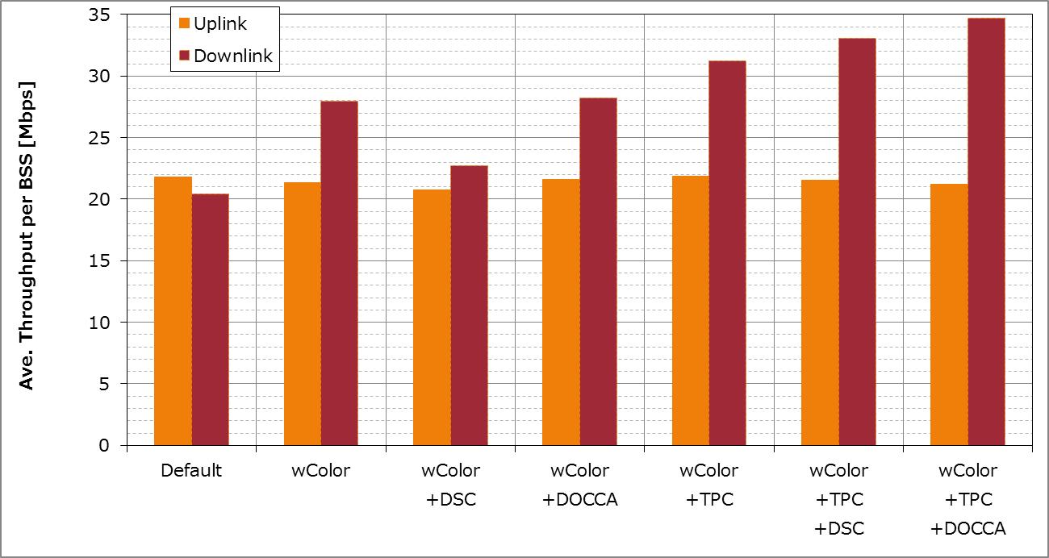
SS3 results
(All of STAs are Ax-STA)
(Offered DL load=240Mbps)
Offered
UL load
TPC+DCCA(DSC/DOCCA) case can obtain larger DL gain than TPC/DCCA alone case.

Slide 22
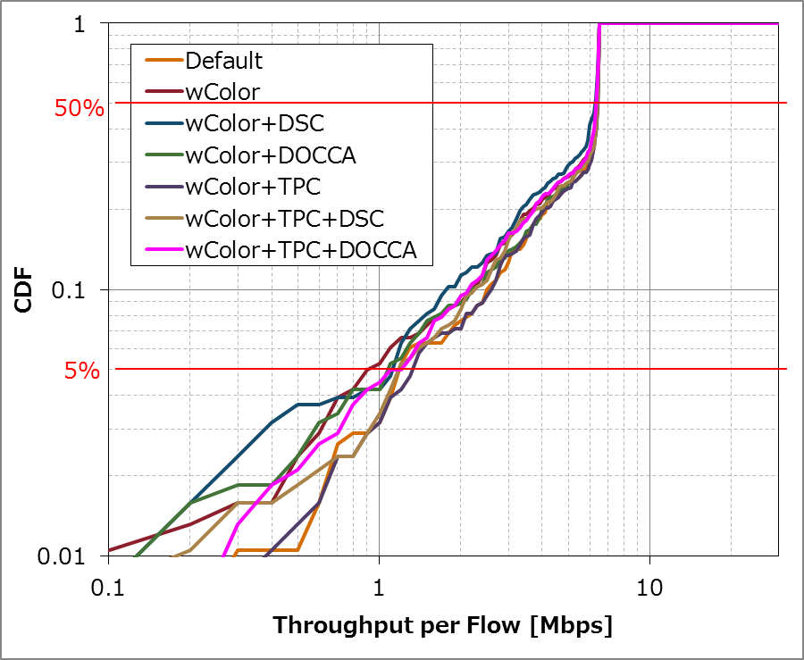
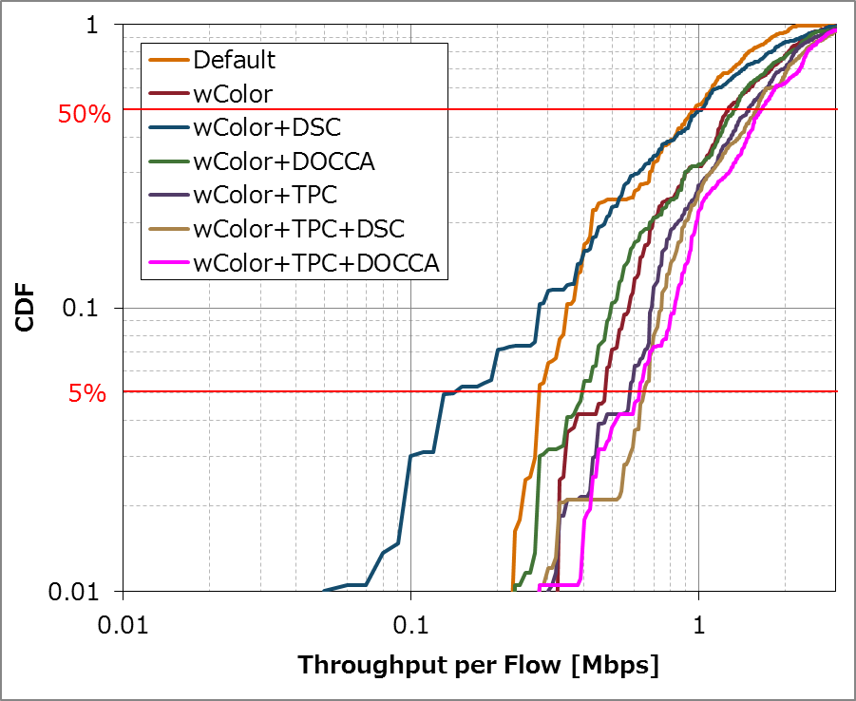
SS3 results
(All of STAs are Ax-STA)
Uplink
Downlink
In terms of 5%tile throughput, DSC can deteriorate when it used alone.
On the other hand, when TPC is used with DSC/DOCCA, 5%tile throughput of DL can be improved.

Slide 23
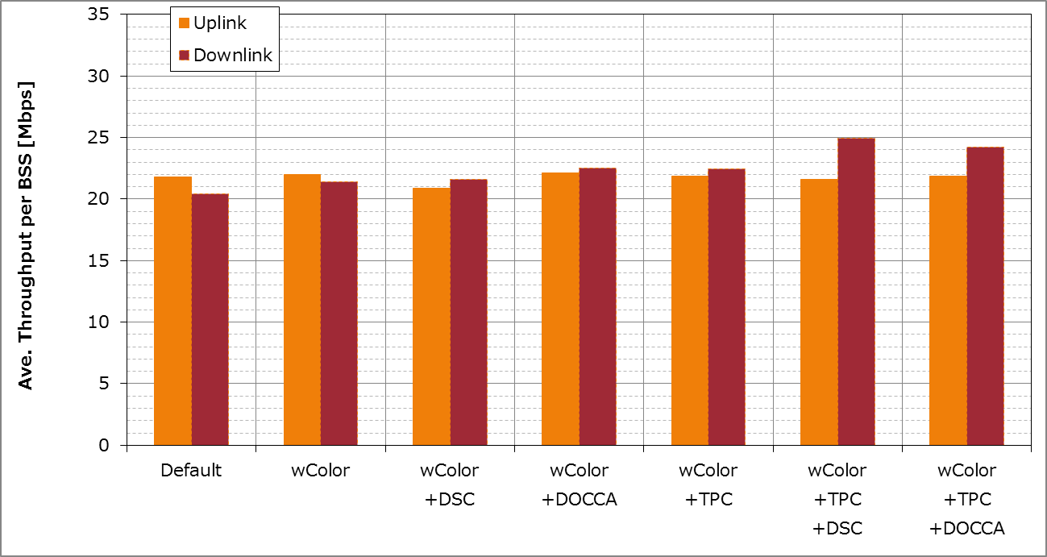
SS3 results
(Half of STAs are Ax-STA)
(Offered DL load=240Mbps)
Offered
UL load
Although performance gain decreases from when all STAs are AX,
the gain remains and there’s no degradation except for UL of wColor+DSC(+TPC) case.

Slide 24
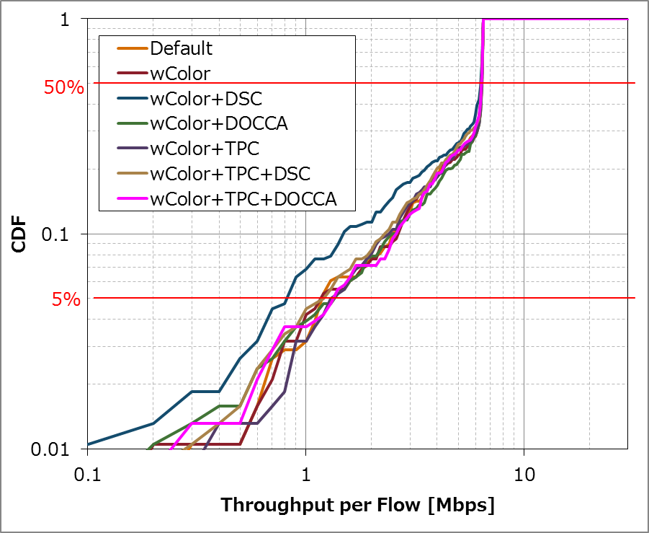
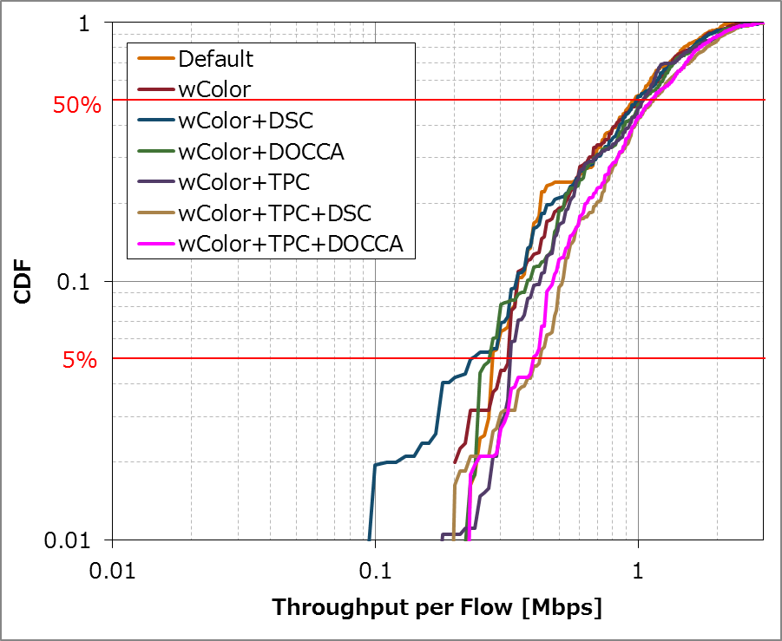
SS3 results
(Half of STAs are Ax-STA)
Uplink
Downlink
When TPC is used with DCCA(DSC/DOCCA), 5%tile throughput can be improved in DL.

Slide 25
Conclusion
We evaluated spatial reuse techniques DCCA/TPC (also Color filtering) and their combinations in practical scenarios
As a result, combination of DCCA and TPC shows well balanced performance
  Average throughput
  5%tile throughput
TPC used with DCCA is effective solution in dense environment
Further optimization of algorithm/parameter may improve more

Slide 27
References
11-14-0980-12-00ax-simulation-scenarios
11-14-0571-09-00ax-evaluation-methodology
11-14-0851-02-00ax-rate-control-for-mac-and-integrated-system-simulations

Slide 28
Appendix
- Detailed processes of evaluated spatial reuse techniques
- Detailed setup for each SS
- Detailed statistics (SINR/Tx Power/CCA threshold)
- List of related contributions

Slide 29
Applied spatial reuse techniques
1. BSS COLOR based packet filtering
Decide whether a packet is from OBSS using BSS COLOR and terminate Rx depend on COLOR
  CCA status is treated BUSY during the PPDU time as far as SIG-CRC passed.
[Note] Assume COLOR information is included in HE-SIG
OBSS STA’s Tx
(with different COLOR)
Preamble
PSDU
detected
COLOR doesn’t match -> abandon Rx
STA that enables
COLOR filtering
Rx Preamble
- Treated as CCA_BUSY -> cannot restart backoff procedure
- Can receive another packet
Possible Impact
Increasing Tx occasion | Cannot improve.
Acquiring Rx opportunity for desired signal | Can improve. (But only when the packet has COLOR)

Slide 30
Applied spatial reuse techniques
2a. Dynamic sensitivity control (DSC)
Raise CCA-SD based on link condition
  In our simulation, Rx Sensitivity is also changed.
  (keep CCA-SD = Rx Sensitivity)
[Note] Assume signal level
of interference packet is lower than
raised CCA-SD
OBSS STA’s Tx
Preamble
PSDU
not detected at all
STA that enables
DSC
- Treated as CCA_IDLE -> can continue backoff procedure
- Can receive another packet
Possible Impact
Increasing Tx occasion | Can improve.
Acquiring Rx opportunity for desired signal | Can improve.

Slide 31
Applied spatial reuse techniques
2a. Dynamic sensitivity control (DSC)
Raise CCA-SD based on RSSI from peer and “DSC Margin” value
    Updated CCA-SD = RSSI - DSC Margin
    In AP side, RSSI of the weakest link is used for this calculation
AP
STA
ex.+23dBm
RSSI
DSC Margin is set to 15dB in this simulation
DSC Margin
Updated CCA-SD
Default CCA-SD
(ex.-82dBm)

Slide 32
Applied spatial reuse techniques
2b. Dynamic OBSS CCA (DOCCA)
Apply OCCA-threshold only if BSS COLOR of received packet is mismatched
  If RSSI < OCCA-threshold, Ax STA goes to CCA_IDLE
  OCCA-threshold can be changed based on link condition
  CCA-SD isn’t changed
[Note] Assume signal level of interference packet is lower than
OCCA-threshold.
[Note] Assume COLOR information is included in HE-SIG
OBSS STA’s Tx
(with different COLOR)
Preamble
PSDU
detected
COLOR doesn’t match -> abandon Rx
STA that enables
DOCCA
Rx Preamble
- Treated as CCA_IDLE -> can restart backoff procedure
- Can receive another packet
Possible Impact
Increasing Tx occasion | Can improve. (But only when the packet has COLOR)
Acquiring Rx opportunity for desired signal | Can improve. (But only when the packet has COLOR)

Slide 33
Applied spatial reuse techniques
2b. Dynamic OBSS CCA (DOCCA)
Set OCCA-threshold based on RSSI from peer and “DOCCA Margin” value
    Updated OCCA-threshold = RSSI – DOCCA Margin
    In AP side, RSSI of the strongest link is used for this calculation
AP
STA
ex.+23dBm
RSSI
DOCCA Margin is set to 15dB in this simulation
DOCCA Margin
OCCA-threshold
Default OCCA-threshold (ex.-82dBm)

Slide 34
Difference of Rx procedure between
DSC and DOCCA
DSC
DOCCA
[NOTE] In this Simulation,
CCA-SD = Rx Sensitivity
No
S >= CCA-SD?
S >=
CCA-SD?
No
Yes
Yes
BUSY & Rx PLCP
BUSY & Rx PLCP
Does PLCP have error?
Does PLCP have error?
IFS=
EIFS
Y
IFS=
EIFS
Yes
(PLCP err)
Yes
(PLCP err)
No
No
Is Color matched?
S+I >=
CCA-ED?
No
No
Yes or
have no color
IFS=
AIFS
Yes
Y
IDLE
BUSY
BUSY＆Rx
S >= OCCA-th?
No
S+I >=
CCA-ED?
No
Yes
BUSY＆Rx
BUSY
Yes
IDLE

Slide 35
Applied spatial reuse techniques
3. Transmit power control (TPC)
Change Tx power based on estimated path loss from peer and “TPC Margin”
  Also perform a lower limitation for Tx Power so that STA doesn’t select too low MCS
  Updated TxPower
  = max(LowerLimitationLevel, Ref-RxSensitivity + TPC Margin + Estimated Path Loss)
AP
STA
ex.+23dBm
Default TxPower(ex.+15dBm)
(2)Calculate updated TxPower
(1)Estimate path loss
Lower Limitation Level
(It depends on Interference level)
TPC Margin
TPC Margin is set to 15dB and
Lower Limitation Level is set to -38dBm
in this simulation
Reference CCA-SD
ex.-82dBm

Slide 36
Combination of TPC and DSC/DOCCA
Control to equalize the amount of reducing TxPower and the amount of CCA-SD/OCCA-threshold
AP
STA
Default TxPower(ex.+15dBm)
D: Amount of reducing TxPower
Updated TxPower
Updated CCA-SD/OCCA-threshold
D
Default CCA-SD/OCCA-threshold
(ex.-82dBm)

Slide 37
Simulation Setup Details (SS1)
Node | (AP x 1, STA x 10) x 34
Num of Drops [times] | 5
Access Category | AC_BE CWmin=15, CWmax=1023, AIFSN=3, TXOP limit=0
Default Tx Power [dBm] | AP: +23, STA: +15
MCS Selection | Goodput maximizing MCS based on Training (MCS0 ~ 7) [3]
Guard Interval | Short
Traffic Model | See slide #6
L2 Retry | 10
Ack Rate | Legacy 6.0Mbps
RTS/CTS | OFF
Max Aggregation number | (A-MPDU, A-MSDU)=(64, NA)
NF [dB] | 7
Channel | TGn Channel D (pathloss, shadowing, fading)
Channel Setting [MHz] | (CenterFreq, BW)=(2412, 20)
Default Rx Sensitivity(=CCA-SD)[dBm] | AP: -82, STA: -82
CCA-ED [dBm] | -62 [NOTE] The term “CCA-ED” represents “20 dB above the minimum modulation and coding rate sensitivity” in this material.
Det. Cancel on PLCP err | Enable (Error performance is based on EMD [2] Appendix 4)
BSS COLOR operation | AP and AX STA can handle COLOR information. (adding/filtering) STAs cannot filter packets that has no COLOR information (i.e. flow from Legacy STAs).

Slide 38
Simulation Setup Details (SS2)
Node | (AP x 1, STA x 64) x 8
Num of Drops [times] | 5
Access Category | AC_BE CWmin=15, CWmax=1023, AIFSN=3, TXOP limit=0
Default Tx Power [dBm] | AP: +26, STA: +15
MCS Selection | Goodput maximizing MCS based on Training (MCS0 ~ 7) [3]
Guard Interval | Short
Traffic Model | See slide #13
L2 Retry | 10
Ack Rate | Legacy 6.0Mbps
RTS/CTS | OFF
Max Aggregation number | (A-MPDU, A-MSDU)=(64, NA)
NF [dB] | 7
Channel | TGn Channel D (pathloss, shadowing, fading)
Channel Setting [MHz] | (CenterFreq, BW)=(5180, 80)
Default Rx Sensitivity(=CCA-SD)[dBm] | AP: -76, STA: -76
CCA-ED [dBm] | -56 [NOTE] The term “CCA-ED” represents “20 dB above the minimum modulation and coding rate sensitivity” in this material.
Det. Cancel on PLCP err | Enable (Error performance is based on EMD [2] Appendix 4)
BSS COLOR operation | AP and AX STA can handle COLOR information. (adding/filtering) STAs cannot filter packets that has no COLOR information (i.e. flow from Legacy STAs).

Slide 39
Simulation Setup Details (SS3)
Node | (AP x 1, STA x 40) x 19
Num of Drops [times] | 5
Access Category | AC_BE CWmin=15, CWmax=1023, AIFSN=3, TXOP limit=0
Default Tx Power [dBm] | AP: +23, STA: +15
MCS Selection | Goodput maximizing MCS based on Training (MCS0 ~ 7) [3]
Guard Interval | Short
Traffic Model | See slide #20
L2 Retry | 10
Ack Rate | Legacy 6.0Mbps
RTS/CTS | OFF
Max Aggregation number | (A-MPDU, A-MSDU)=(64, NA)
NF [dB] | 7
Channel | TGn Channel D (pathloss, shadowing, fading)
Channel Setting [MHz] | (CenterFreq, BW)=(5180, 80)
Default Rx Sensitivity(=CCA-SD)[dBm] | AP: -76, STA: -76
CCA-ED [dBm] | -56 [NOTE] The term “CCA-ED” represents “20 dB above the minimum modulation and coding rate sensitivity” in this material.
Det. Cancel on PLCP err | Enable (Error performance is based on EMD [2] Appendix 4)
BSS COLOR operation | AP and AX STA can handle COLOR information. (adding/filtering) STAs cannot filter packets that has no COLOR information (i.e. flow from Legacy STAs).

Slide 40
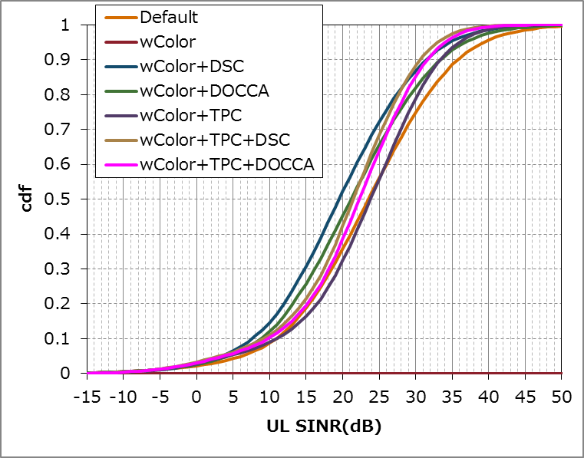
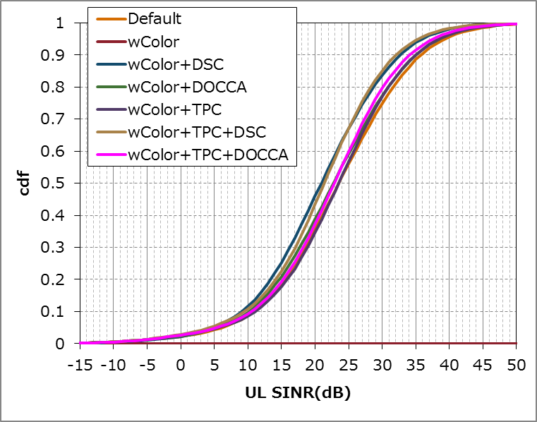
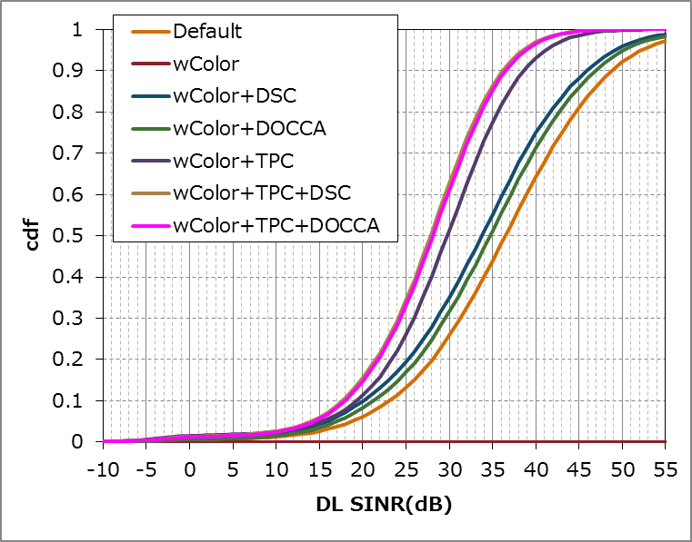
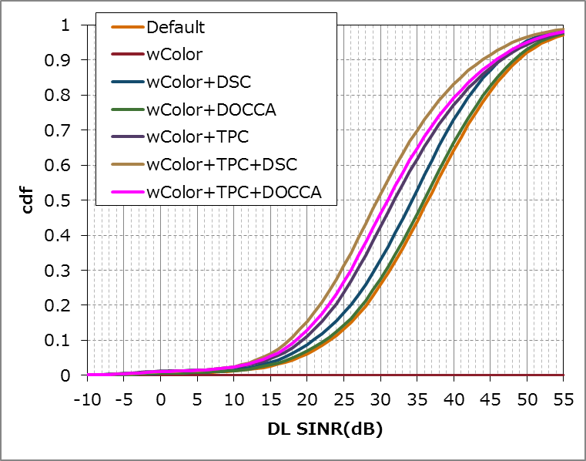
SS1 Detailed statistics (SINR)
Distribution of SINR when all of STA is Ax STA
Distribution of SINR when half of STA is Ax STA
UL
DL

Slide 41
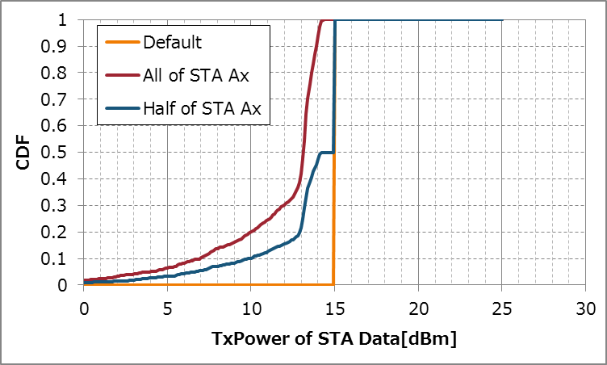
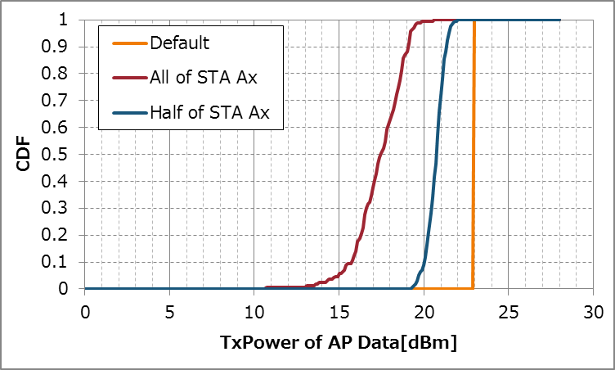
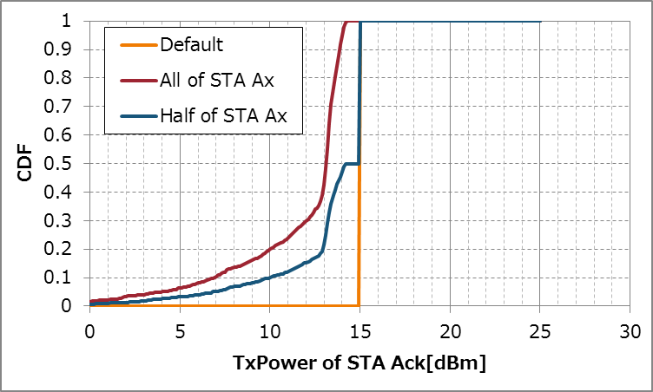
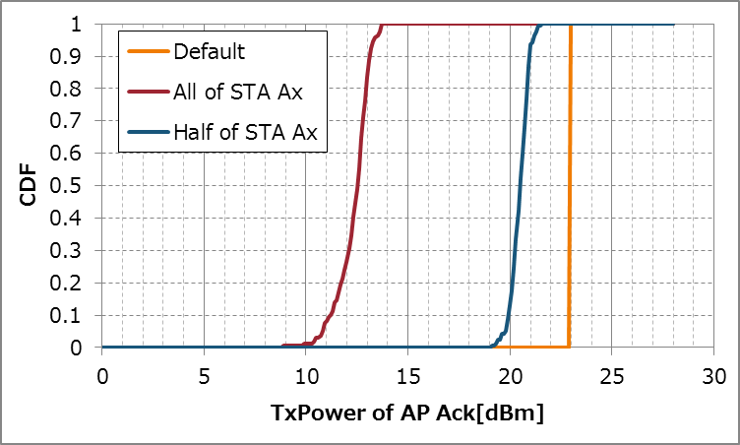
SS1 Detailed statistics
(TxPower)
[NOTE] Distribution when TPC+DSC/DOCCA case was almost same.
Distribution of Tx Power of STA/AP and Data/Ack when TPC is Enabled

Slide 42
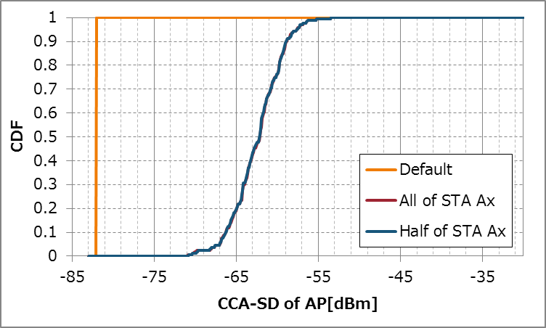
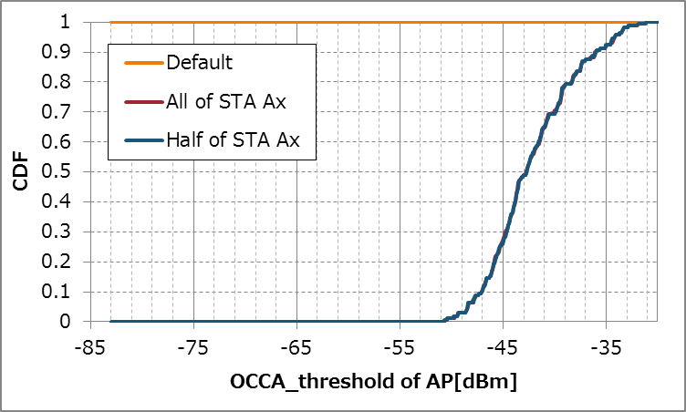
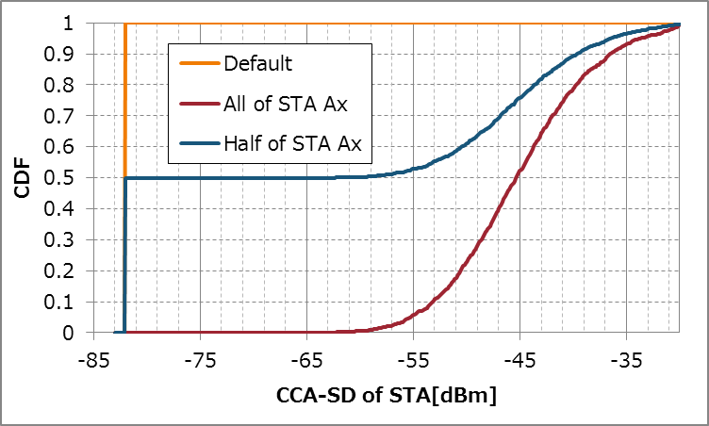
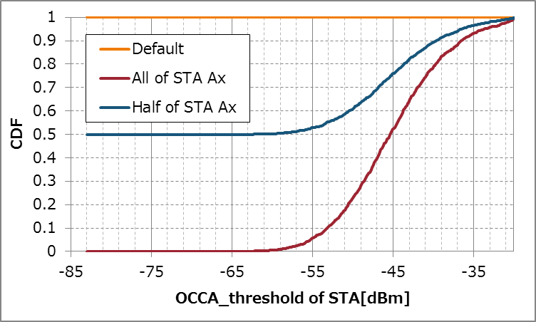
SS1 Detailed statistics
(CCA-SD/OCCA-threshold)
Distribution of CCA-SD when DSC is Enabled
Distribution of OCCA-th when DOCCA is Enabled
AP
STA

Slide 43
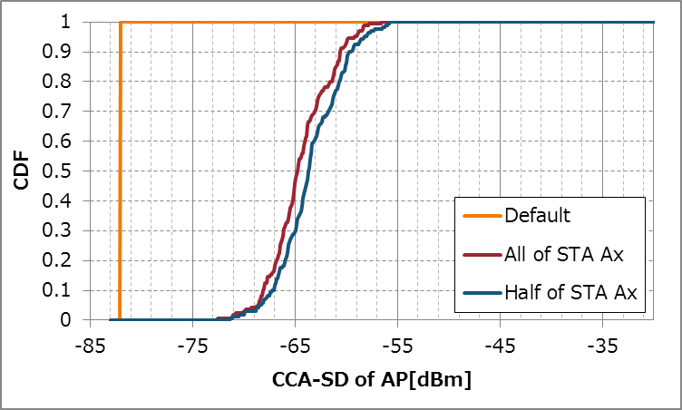
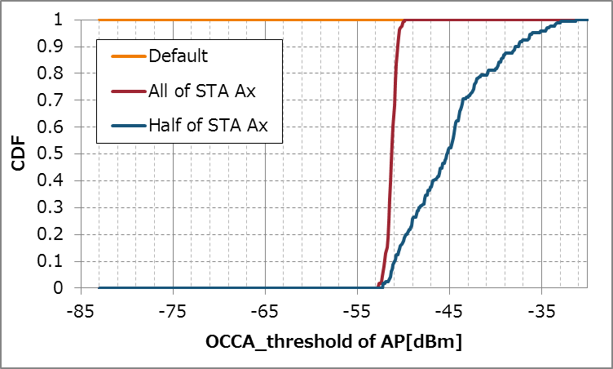
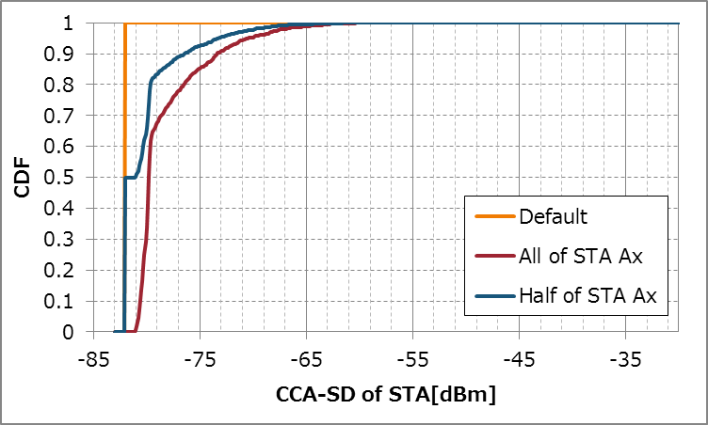
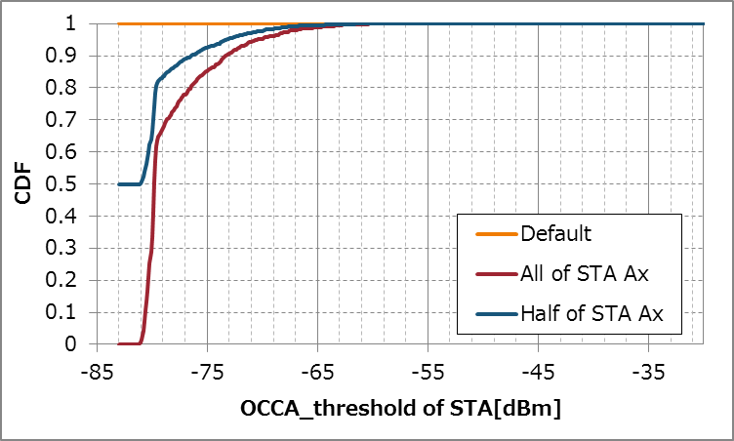
SS1 Detailed statistics
(CCA-SD/OCCA-threshold)
Distribution of CCA-SD when TPC+DSC is Enabled
Distribution of OCCA-th when TPC+DOCCA is Enabled
AP
STA

Slide 44
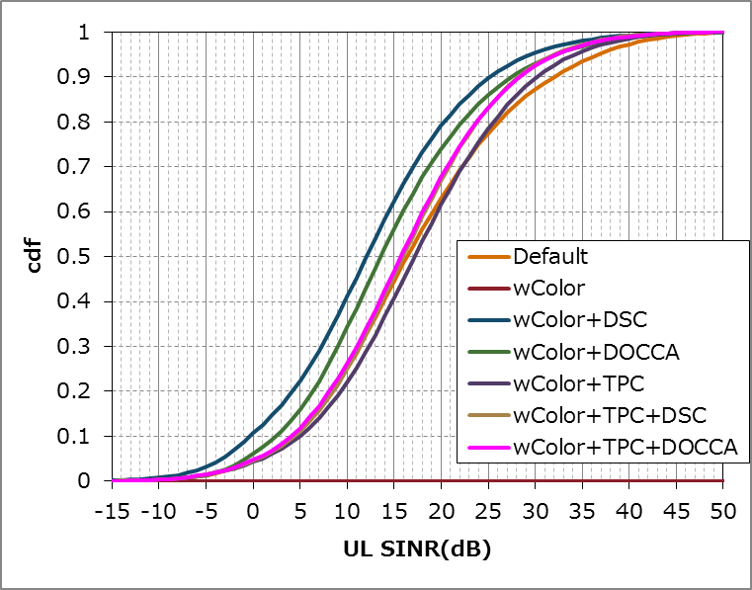
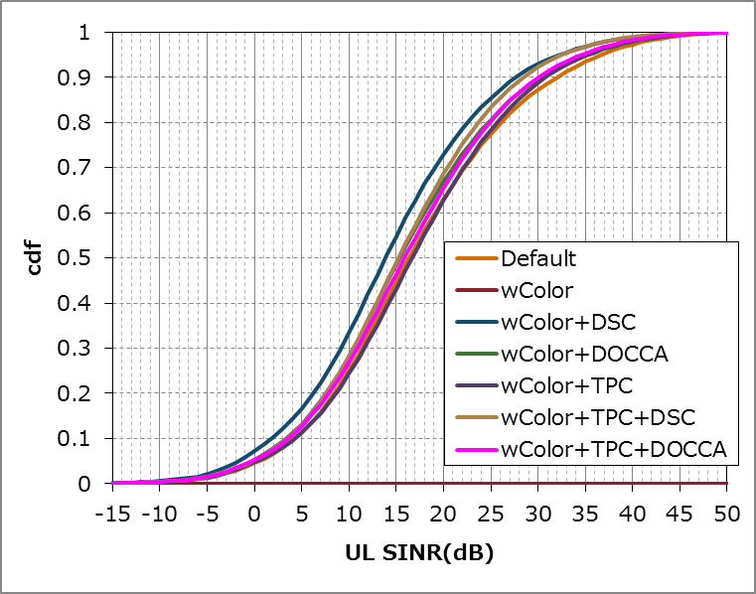
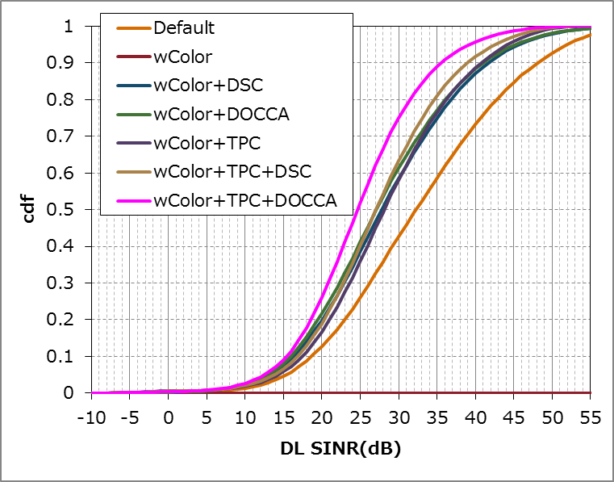
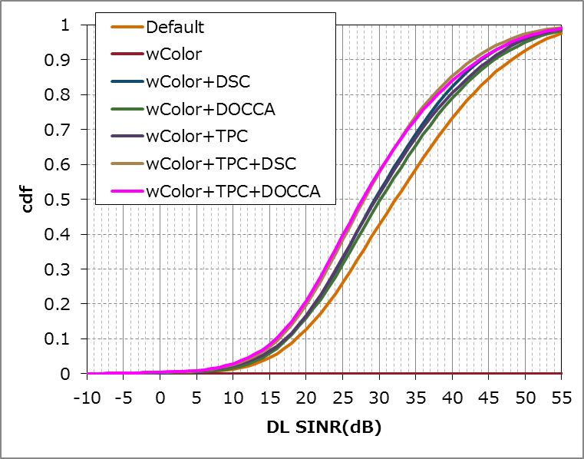
SS2 Detailed statistics (SINR)
Distribution of SINR when all of STA is Ax STA
Distribution of SINR when half of STA is Ax STA
UL
DL

Slide 45
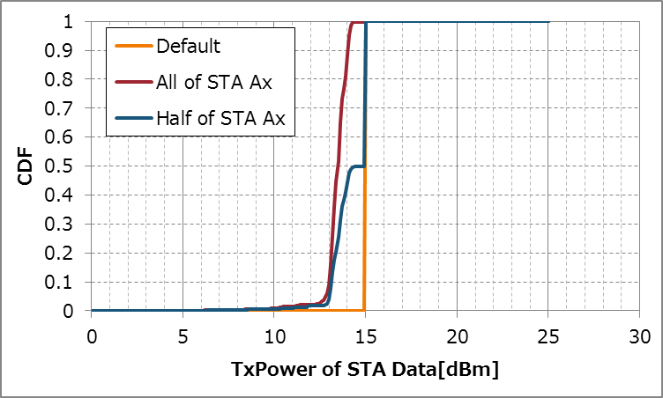
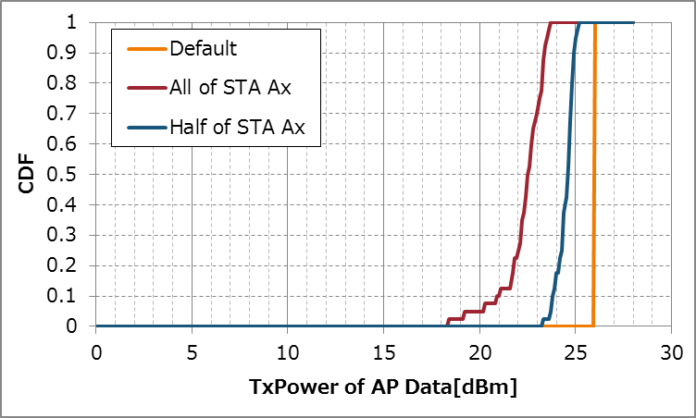
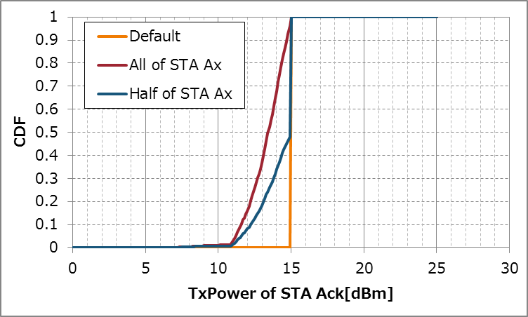
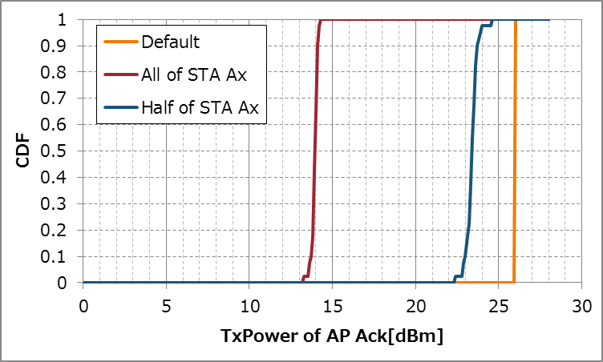
SS2 Detailed statistics
(TxPower)
[NOTE] Distribution when TPC+DSC/DOCCA case was almost same.
Distribution of Tx Power of STA/AP and Data/Ack when TPC is Enabled

Slide 46
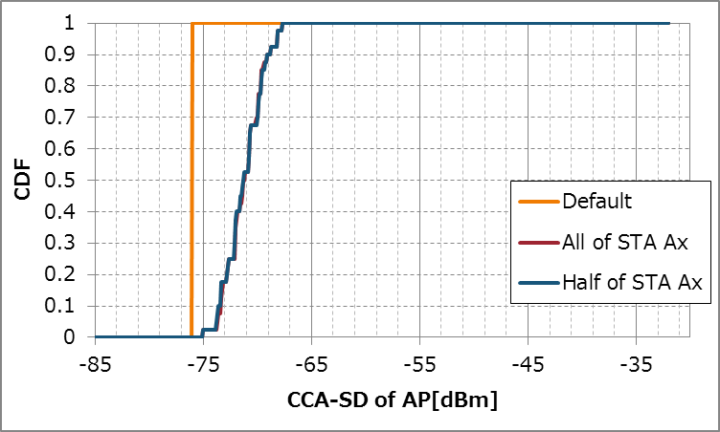
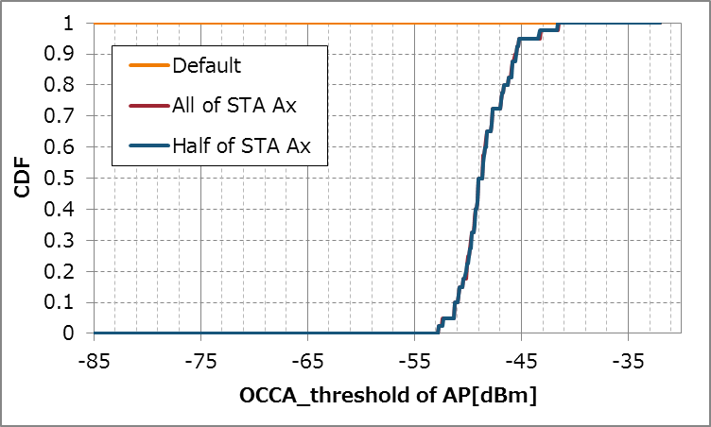
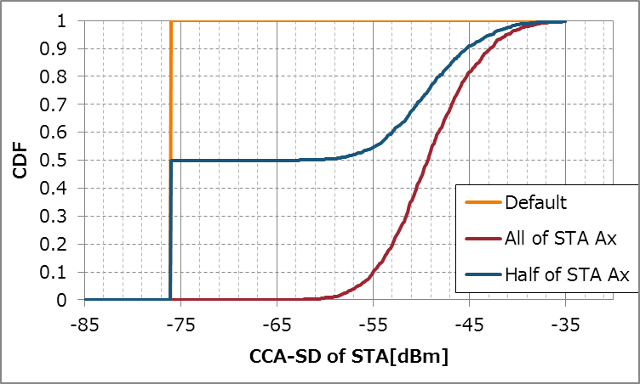
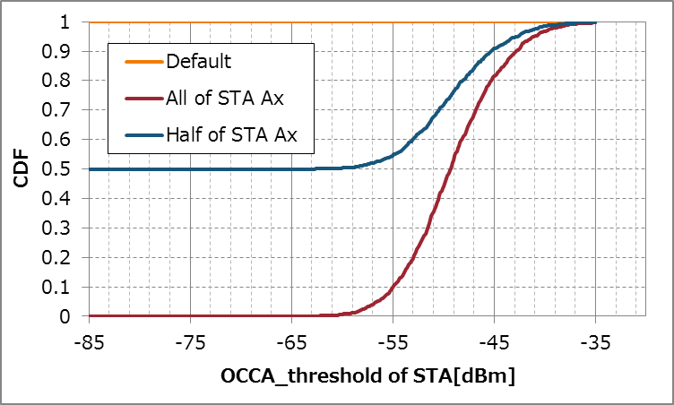
SS2 Detailed statistics
(CCA-SD/OCCA-threshold)
Distribution of CCA-SD when DSC is Enabled
Distribution of OCCA-th when DOCCA is Enabled
AP
STA

Slide 47
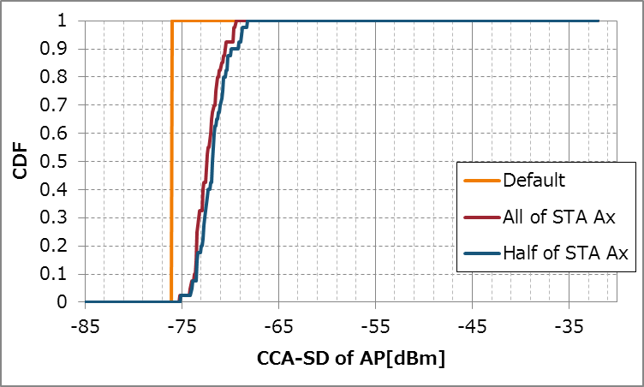



SS2 Detailed statistics
(CCA-SD/OCCA-threshold)
Distribution of CCA-SD when TPC+DSC is Enabled
Distribution of OCCA-th when TPC+DOCCA is Enabled
AP
STA

Slide 48




SS3 Detailed statistics (SINR)
Distribution of SINR when all of STA is Ax STA
Distribution of SINR when half of STA is Ax STA
UL
DL

Slide 49




SS3 Detailed statistics
(TxPower)
[NOTE] Distribution when TPC+DSC/DOCCA case was almost same.
Distribution of Tx Power of STA/AP and Data/Ack when TPC is Enabled

Slide 50




SS3 Detailed statistics
(CCA-SD/OCCA-threshold)
Distribution of CCA-SD when DSC is Enabled
Distribution of OCCA-th when DOCCA is Enabled
AP
STA

Slide 51




SS3 Detailed statistics
(CCA-SD/OCCA-threshold)
Distribution of CCA-SD when TPC+DSC is Enabled
Distribution of OCCA-th when TPC+DOCCA is Enabled
AP
STA

Slide 52
List of CCA control related contributions that shows simulation results
DCN | Title | Author (Affiliation) | Scenario | Traffic | MCS Selection | CCA Control
14/0523r0 | MAC simulation results for DSC and TPC | Laurent Cariou (Orange) | Mod. SS3 | Mixed | Enabled | Dynamic
14/0578r0 | Residential Scenario CCA/TPC Simulation Discussion | Joseph Levy (InterDigital) | SS1 | UL | Fixed | Static
14/0779r2 | DSC Practical Usage | Graham Smith (DSP Group) | Original | UL | ? | Dynamic
14/0832r0 | Performance Evaluation of OBSS Densification | Po-Kai Huang (Intel) | SS1/2/3 | UL | Fixed | Static
14/0833r0 | Residential Scenario Sensitivity and Transmit Power Control Simulation Results | Ron Murias (InterDigital) | SS1 | UL | Fixed | Static
14/0846r1 | CCA Study in Residential Scenario | Gwen Barriac (Qualcomm) | Mod. SS1 | DL | Enabled | Static
14/0854r0 | DSC and Legacy Coexistence | William Carney (SONY) | Original | UL | Fixed | Static
14/0861r0 | Impact of CCA adaptation on spatial reuse in dense residential scenario | Sayantan Choudhury (Nokia) | SS1 | UL/UL | Enabled | Static
14/0868r1 | UL & DL DSC and TPC MAC simulations | Johan Soder (Ericsson) | SS2 | Mixed | ? | Dynamic
14/0889r3 | Performance Gains from CCA Optimiation | Nihar Jindal (Broadcom) | SS1/2/3 | DL | Enabled | Static
14/1171r1 | DSC Simulation Results for Scenario 3 | Masahito Mori (Sony) | SS3 | UL | Enabled | Dynamic
14/1199r1 | CCA Study in Residential Scenario - Part 2 | Gwen Barriac (Qualcomm) | Mod. SS1 | DL | Enabled | Static
14/1207r1 | OBSS Reuse mechanism which preserves fairness | laurent cariou (Orange) | Mod. SS3 | Mixed | Enabled | Dynamic
14/1225r1 | Considerations on CCA for OBSS Opearation in 802.11ax | Jun Luo (Huawei) | SS3 | Mixed | ? | Static
14/1403r0 | Performance Analysis of BSS Color and DSC | Masahito Mori (Sony) | SS3 | UL | Enabled | Dynamic
14/1426r2 | DSC and legacy coexistence | Gustav Wikstrom et al. (Ericsson) | SS2 | Mixed | ? | Static

Slide 53
List of CCA control related contributions that shows simulation results (cont.)
DCN | Title | Author (Affiliation) | Scenario | Traffic | MCS Selection | CCA Control
14/1427r2 | DSC Performance | Gustav Wikstrom et al. (Ericsson) | SS1/2/3/4 | Mixed | Enabled | Static/Dynamic
14/1443r0 | Adapting CCA and Receiver Sensitivity | Esa Tuomaala (Nokia) | SS1 | UL | Fixed | Static
15/0027r1 | Simulation Based Evaluation DSC in residential scenario | M. Shahwaiz Afaqui (UPC) | SS1 | UL | Enabled | Dynamic
15/0045r0 | Performance Analysis of BSS Color and DSC | Masahito Mori (Sony) | SS3 | UL | Enabled | Dynamic
15/0050r0 | Modeling components impacting throughput gain from CCAT adjustment | Yu Wang (Ericsson AB) | SS2 | DL | Enabled | Static
15/0085r1 | Legacy Fairness Issues of Enhanced CCA | John Son (WILUS Institute) | Mod. SS1 | Mixed | Enabled | Static
15/0300r0 | Potential of Modified Signal Detection Thresholds | Gustav Wikstrom (Ericsson AB) | SS2 | Mixed | Enabled | Static
15/0319r1 | Impact of TPC coupled to DSC for legacy unfairness issue | Masahito Mori (Sony) | SS3 | UL | Enabled | Dynamic
15/0357r4 | Scenario 1 CCA Simulation | Knut Odman (Broadcom) | SS1 | DL | Enabled | Static
15/0371r2 | Proposal and simulatin based evaluation of DSC-AP Algorithm | Eduard Garcia-Villegas (UPC) | SS1 | Mixed | Enabled | Dynamic
15/0374r1 | Further Considerations on Legacy Fairness with Enhanced CCA | John Son (WILUS Institute) | Mod. SS1 | Mixed | Fixed | Static
15/0548r0 | Enterprise Scenario and DSC | Graham Smith (SR Technologies) | SS2 | - | - | Dynamic
15/0595r2 | Discussion on the Receiver Behavior for CCAC DSC with BSS Color | Yasuhiko Inoue (NTT) | Mod. SS1 | DL | Fixed | Dynamic

