Slide 1
A Management Interface for Maintenance and Fault Analysis
Date: 2015-09-15
Authors:

Slide 2
Abstract
This document addresses the faults encountered in home network environment investigated by TTC.
Based on the work, a proposal to specify a management interface between IEEE 802.11 and external networks for maintenance and fault analysis is made.

Slide 3
Expect Home WLAN to Perform Well?
Home network (HN) becomes denser
  increased 6.5% year over year in 4Q14
  802.11ac WLAN revenues grew 155.6% year over year, with shipments increasing 206.6% (data from IDC)
carries heavier load and more diverse traffic
  8K UHD Wireless Transfer at Smart Home
  Augmented Reality/Virtual Reality Headsets
  wearables devices
in a more complicated environment
  More channel competitors, such as neighbor’s wireless, appliances, etc
  Complicated indoor scenarios, such as doors, walls and glasses, etc
  Random installation, inappropriate configuration, lack of experience and expertise

Slide 4
Users Complaint about Home WLAN
TR-1057 (TTC, Telecommunication Technology Committee, Japan) summarizes 3 fault scenarios
  Sometimes can’t connect, when connected network speed is low
  Sometimes certain device is disconnected frequently
  Sometimes all devices are disconnected
and 16 fault descriptions of user complaints, for example
  AP can’t find an opportunity to communicate with device, because neighboring AP occupies the same or adjacent channel
  When serving AP is in standby but neighboring AP occupies the same or adjacent channel, devices try to connect to serving AP again and again
  Certain device constantly occupies the channel, therefore AP can’t transmit to this device (a/b/g/n/ac… mixed scenario)
  Certain device constantly occupies the channel, therefore AP and other devices can’t transmit
  ….
Table 2-1 Fault descriptions, TR-1057, original written in Japanese

Slide 5
Major Causes
4 types of causes led to those faults occurred during connection and communication
Table 2-2 fault causes, TR-1057, original written in Japanese
No. | Fault Causes | Description
1 | Wireless channel | problems encountered when using wireless channel, such as too many devices, inside and outside BSS, compete for channel access
2 | Wireless communication | Wireless transmission problems such as the radio propagation between AP and devices, interference, degradation, multipath caused by reflection
3 | Misconfiguration | Initialization mistake, reset to default setting by mistake, etc
4 | Device fault | Hardware problem, power issue, out of battery, etc

Slide 6
How to Analyze the Faults and Causes
Fault diagnosis is difficult, that is even more difficult with too limited information about wireless and internal settings
TR-1057 suggests to implement the following functions in advance to make the analysis easier
  Self check (settings of 802.11 NIC, internal status)
  Network disconnection check for devices
  Pairing information check
  Channel utilization, or channel status check
  Signal strength measurement
  Communication error rate measurement (PER, BER, etc)

Slide 7
Interface for Maintenance and Fault Analysis
Complied with ITU-T Y.2070
App developer/user
Service provider
HN admin
AP for 802.11
HN user
Configuration
Status, settings
Communication statistics
WLAN planning
802.11 data communication
Home gateway (HGW)
AP from
A company
STA
WLAN fault analysis
Management PF
Measurement
report
WLAN radio Measurement
Resource management
Internet
Resource information collector
AP from
B company
STA
Building WLAN monitor
Management
report
Wireless network management
AP from
C company
STA
STA operation
…
Application Interface
Management Interface
802.11 network
external network
Home network

Slide 8
The Merits to Specify the Management Interface by 802.11 Standard
For application developers
  provide various services by programming with the application interface on the management PF.
For HN administrators
  Installing AP or home GW will be as easy as plug-and-play
  No need to concern about wireless connection anymore
For users
  HN becomes truly ‘invisible’
For service providers
  Maintain the whole system and the 802.11 networks remotely
  Low cost costumer support and efficiently handle user complaints
For 802.11
  Unified user experience
  A stronger, securer, authentic ecosystem

Slide 9
Interface on Layers
Application
Management PF
For data storage & analysis engine
HGW
For security, protocol translation
AP
For monitoring 802.11 resources
‘BYOD’ AP
STA
‘BYOD’ STA
Visualize
APP
Fault analysis
Resource management
Resource Information collector
IP interface
IP
Application interface
Management agent
IP interface
Management Interface
Primitives & MIB
Comm statistics
802.11 measurement & management
802.11 protocol
MAC
Config
&
status
Vendor specific values
PHY
802.11 interface

Slide 10
Example of Information Exchange
Management Types | Information Types | Examples of Information | Fault Causes*
Configuration and setting | parameter in primitives | ‘reason code’ in MLME-DEAUTHENTICATE.request | Misconfiguration and device fault
 | Attributes from MIB | dot11BeaconPeriod
Data communication statistics | parameter in primitives | ‘Transmission Status’ in MA-UNITDATA-STATUS.indication | Wireless communication and wireless channel
 | Values defined by specification | CCA threshold
Wireless statistics | Wireless LAN radio measurements results | Channel Usage element | Wireless communication and wireless channel
Network management | Wireless network management | Diagnostic elements | Misconfiguration and Wireless communication and wireless channel
* Refer to Slide 5, defined by TTC report TR-1057, original written in Japanese

Slide 11
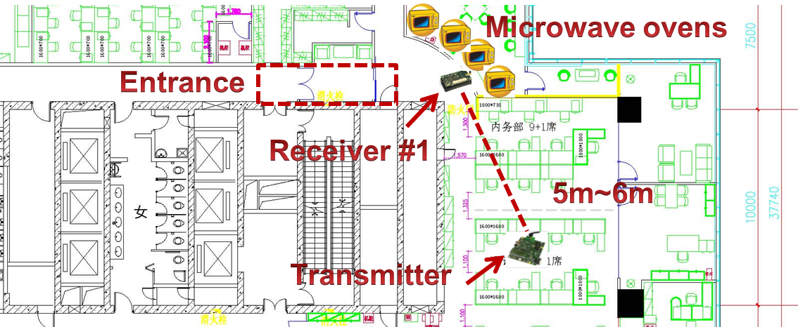
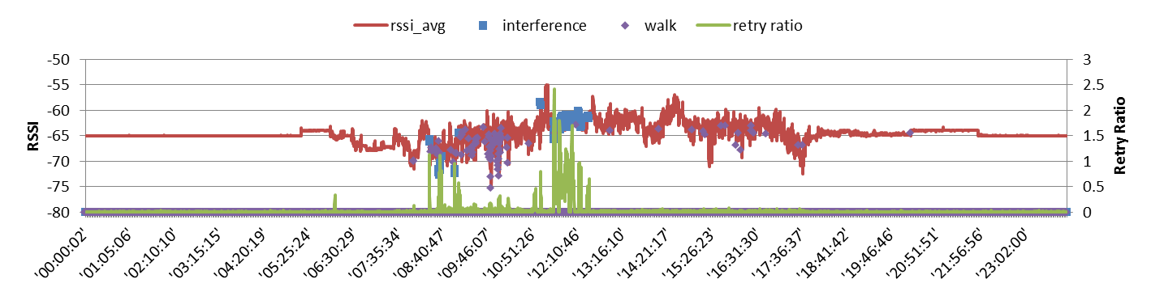
Some Experimental Results
Mid-night, stable RSSI
Morning and noon, microwave used
RSSI and retry ratio
WiFi & people moving all work time

Slide 12
References
11-12-1245-04-00aj-ieee802-11aj-usage-models
11-13-0313-00-0wng-usage-models-for-next-generation-wi-fi
11-15-0625-02-00ay-ieee-802-11-tgay-usage-scenarios
TTC Technical Report TR-1057, “customer support guideline for home network service”
ITU-T Y.2070, “Requirements and architecture of home energy management system and home network services”

