Slide 1
PDF of Spatial Angles Reflected from Ceiling in the Conference Room Channel Model
Date: 2015-09-14
Authors:
Name | Affiliations | Address | Phone | Email
Shouxing Simon Qu | BlackBerry, Ltd. | 1001 Farrar Rd., Ottawa, ON, Canada | 1-613-595-4205 | squ@blackberry.com
James Lepp | BlackBerry, Ltd. | 1001 Farrar Rd., Ottawa, ON, Canada | 1-613-595-4156 | jlepp@blackberry.com

Slide 2
Abstract
This submission presents an analytical expression for the probability density function (PDF) of the spatial angles with 1st-order reflection from the ceiling in the conference room channel model specified in [1].
[1] Alexander Maltsev et al.: “Channel models for 60 GHz WLAN systems”, IEEE 802.11-09/0334r8.

Slide 3
Introduction
The IEEE 802.11ad group has developed a set of channel models in 60 GHz band based on the results of experimental measurements.
The developed models include conference room, living room, and enterprise cubicle environments [1]-[2].
Statistic characteristics of arriving and departure angles were reported in [1] based on experimental results.
No analytical results were available.
As proposed in [3] for NG60, the set of 802.11ad model is to be updated and improved.

Slide 4
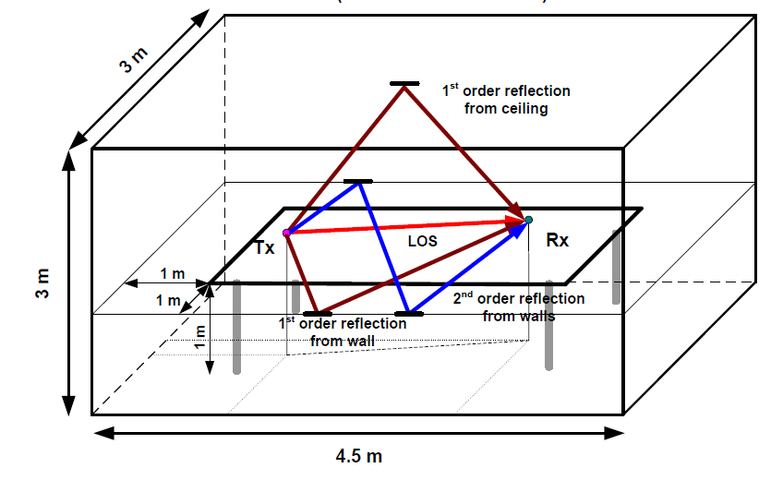
Ray Tracing Model for Conference Room in [1]
(Figure copied from [1])

Slide 5
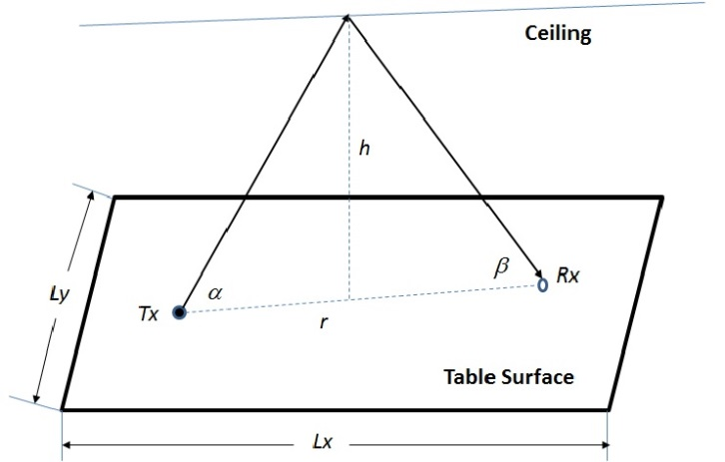
Spatial Angles with 1st-Order Reflection from Ceiling

Slide 6
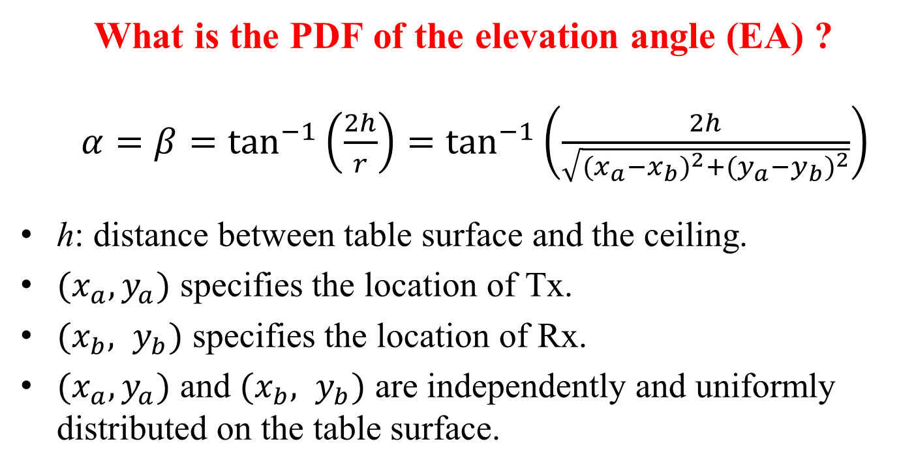
What is the PDF of the elevation angle (EA) ?
$α=β=\tan^{−1}\left(\frac{2h}{r}\right)=\tan^{−1}\left(\frac{2h}{\sqrt{{(x_{a}−x_{b})}^{2}+{(y_{a}−y_{b})}^{2}}}\right)$
h: distance between table surface and the ceiling.
$(x_{a},y_{a})$ specifies the location of Tx.
$(x_{b}, y_{b})$ specifies the location of Rx.
$(x_{a},y_{a})$ and $(x_{b}, y_{b})$ are independently and uniformly distributed on the table surface.
No general and accurate analytical expression for the PDF of EA was available.

Slide 7
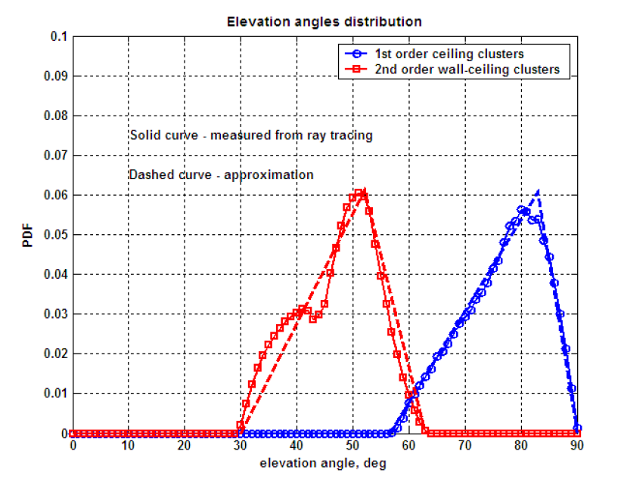
Experimental Result of the PDF Reported in [1]
(Figure copied from [1])

Slide 8

Approximate PDF from Experimental Result [1]
An approximate PDF of EA with 1st-order reflection from ceiling has been proposed in [1].
For L_{x} = 2.5m, L_{y} = 1m, h = 2m only.
$p_{Α}\left(α\right)≈\left\{\begin{aligned} 0.0023α−0.1302 56.6°≤α≤83° \\ −0.0087α+0.7810 83°≤α≤90° \\ 0 otherwise\end{aligned}\right.$

Slide 9
Comments on the Approximate PDF
Piece-wise linear approximation.
Error is relatively large around the peak.
Yielding negative values around α = 90°.

Slide 10
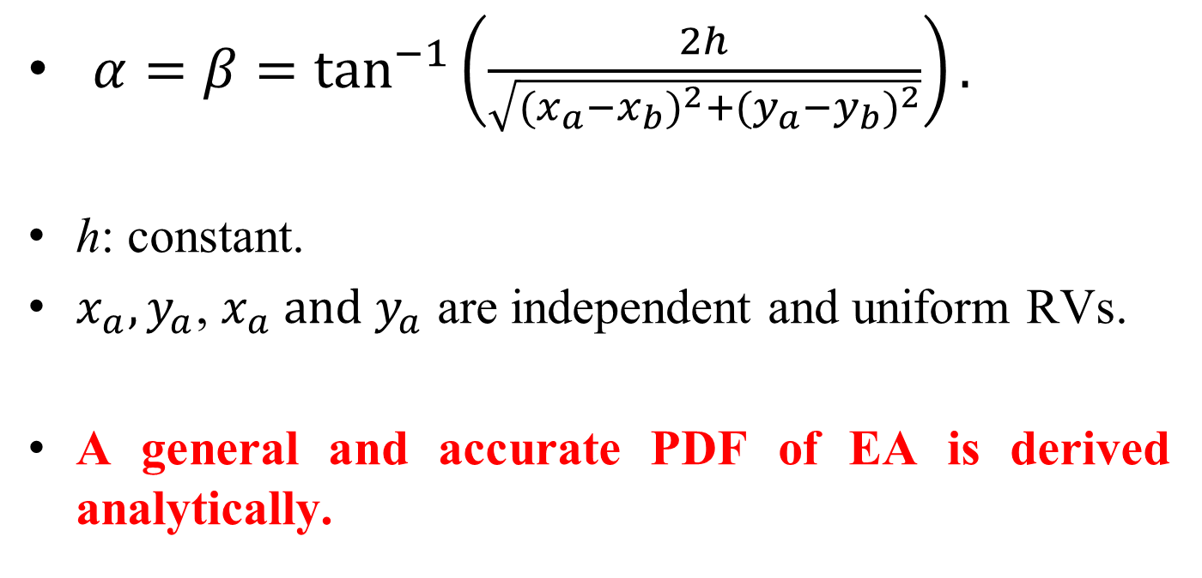
Analysis of General and Accurate PDF of EA
$α=β=\tan^{−1}\left(\frac{2h}{\sqrt{{(x_{a}−x_{b})}^{2}+{(y_{a}−y_{b})}^{2}}}\right).$
h: constant.
$x_{a},y_{a}$, $x_{a} and y_{a}$ are independent and uniform RVs.
A general and accurate PDF of EA is derived analytically.

Slide 11

Analytical PDF Expression for the Elevation Angles
(1) for $\tan^{−1}\left(\frac{2h}{L_{y}}\right)≤α≤\frac{π}{2}$:
${ p}_{Α}\left(α\right)=\frac{8h^{2} }{\sin^{2}(a) L_{x}^{2}L_{y}^{2}\tan{α}}$ ×
$\left[{\left(\frac{2h}{\tan{α}}\right)}^{2}−\frac{4h\left(L_{x}+L_{y}\right)}{\tan{α}}+πL_{x}L_{y}\right]$.

Slide 12

(2) for $\tan^{−1}\left(\frac{2h}{L_{x}}\right)≤α≤\tan^{−1}\left(\frac{2h}{L_{y}}\right)$:
${ p}_{Α}\left(α\right)=\frac{8h^{2} }{\sin^{2}(a) L_{x}^{2}L_{y}^{2}\tan{α}}$ ×
$\left[L_{x}L_{y}\cos^{−1}\left(\frac{2h^{2}−L_{y}^{2}\tan^{2}α}{2h^{2}}\right) −2L_{x}\left(\frac{2h}{\tan{α}}−\sqrt{{\left(\frac{2h}{\tan{α}}\right)}^{2}−L_{y}^{2}}\right)−L_{y}^{2}\right].$

Slide 13

3) for $\tan^{−1}\left(\frac{2h}{\sqrt{L_{x}^{2}+L_{y}^{2}}}\right)≤α≤\tan^{−1}\left(\frac{2h}{L_{x}}\right)$:
${ p}_{Α}\left(α\right)=\frac{8h^{2} }{\sin^{2}(a) L_{x}^{2}L_{y}^{2}\tan{α}}$ ×
$$\left\{L_{x}L_{y}\left[\cos^{−1}\left(\frac{2h^{2}−L_{x}^{2}\tan^{2}α}{2h^{2}}\right)−\cos^{−1}\left(\frac{L_{y}^{2}\tan^{2}α−2h^{2}}{2h^{2}}\right)\right]+2L_{x}\sqrt{{\left(\frac{2h}{\tan{α}}\right)}^{2}−L_{y}^{2}} +2L_{y}\sqrt{{\left(\frac{2h}{\tan{α}}\right)}^{2}−L_{x}^{2}}−{\left(\frac{2h}{\tan{α}}\right)}^{2}−L_{x}^{2}−L_{y}^{2}\right\}\text{.}$$

Slide 14
negative
(L_{x} = 2.5m, L_{y} = 1m, h = 2m)

Slide 15

New Approximate PDF of EA
(L_{x}=2.5m, L_{y}=1m, h=2m)
$p_{Α}\left(α\right)$
$$≈\left\{\begin{aligned} 0.00225338α−0.128168 57°≤α<76° \\ −0.00060672α2+0.097636α−3.87211 76°≤α≤90° \\ 0 otherwise\end{aligned}\right.$$

Slide 16
New Approximate PDF of EA
(L_{x}=2.5m, L_{y}=1m, h=2m)

Slide 17
Conclusions
An accurate analytical expression for the PDF of the spatial angles with first-order reflection from the ceiling in the conference room model specified in [1] is presented.
Only elementary functions are involved. No special function is needed.
While the corresponding statistical distribution obtained from experiment in [1] is consistent with the analytical result for the specific example, the analytical result provides a theoretical, general and accurate PDF for the EA.
A new approximate PDF with higher accuracy is proposed.

Slide 18
References
[1] Alexander Maltsev et al.: “Channel models for 60 GHz WLAN systems”, IEEE 802.11-09/0334r8.
[2] Alexander Maltsev et al.: “Verification of IEEE 802.11ad channel model for enterprise cubical environment”, IEEE 802.11-15/0630r0.
[3] Alexander Maltsev et al.: “NG60 channel modeling plan”, IEEE 802.11-15/0614r1.

