Slide 1
802.11 September 2015 Closing Reports
Date: 2015-09-17
Authors:

Slide 2
Abstract
This document is a digest of the closing reports of all 802.11 sub-groups for presentation at the September 2015 closing plenary meeting. Attendance information and liaison reports are also included.

Slide 3
Attendance

Slide 4
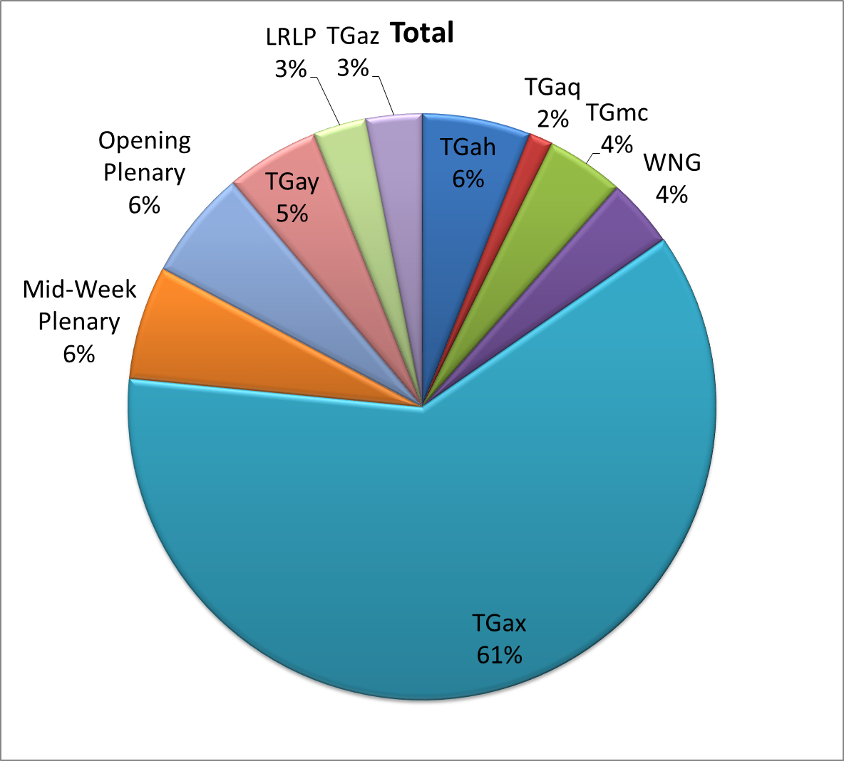
Attendance Total

Slide 5
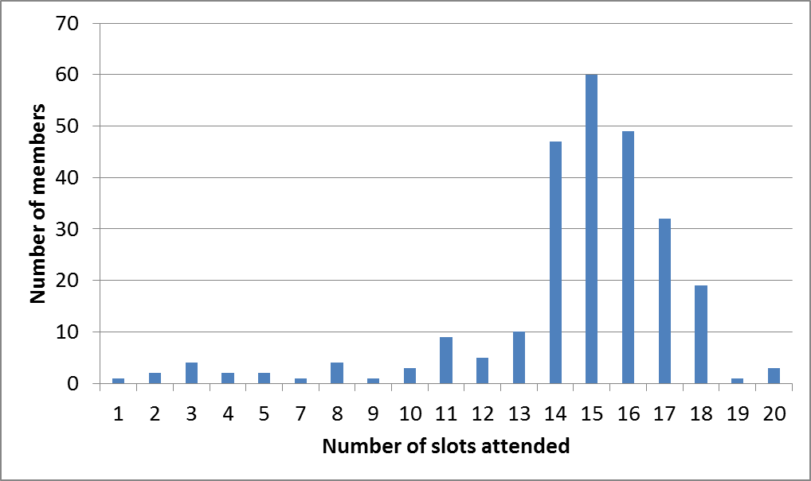
Attendance Histogram (Thu)

Slide 6
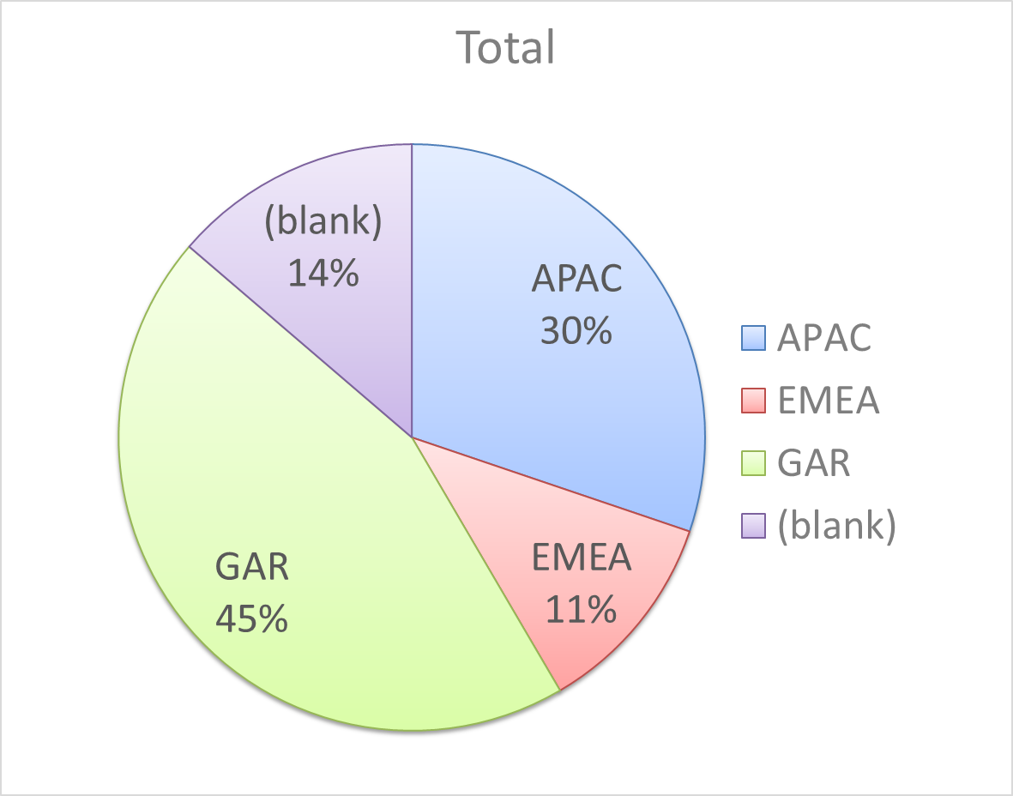
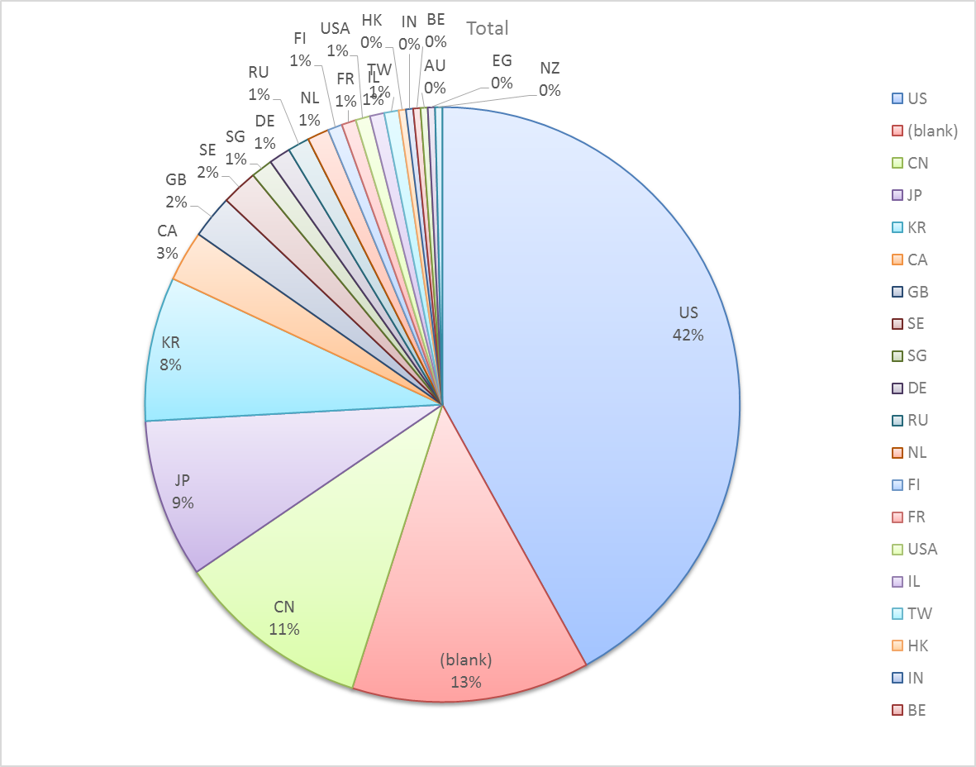
Attendance by Country

Slide 7
Type of Groups
Type of Group | Description
WG | Working Group
SC | Standing Committee
TG | Task Group
SG | Study Group
TIG | Topic Interest Group

Slide 8
Groups
Type | Group | Description | Chair
WG | WG11 | The IEEE 802.11 Working Group | Adrian Stephens
SC | WNG | Wireless Next Generation | Jim Lansford
SC | ARC | Architecture | Mark Hamilton
SC | JTC1 | ISO/IEC/JTC1/SC6 shadow committee | Andrew Myles
SC | PAR | Project Authorization Request | Jon Rosdahl
SC | REG | Regulatory | Richard Kennedy
TG | MC | Maintenance (Revision C) | Dorothy Stanley
TG | AH | Operation in 900 MHz bands | Yongho Seok
TG | AI | Fast Initial Link Setup | Hiroshi Mano
TG | AJ | China Millimeter Wave (CMMW) | Xiaoming Peng
TG | AK | General Link Setup | Donald Eastlake 3rd
TG | AQ | Pre-association Discovery | Stephen McCann
TG | AX | High Efficiency Wireless LAN (HEW) | Osama Aboul-Magd
TG | AY | Next Generation 60 GHz | Edward Au
SG | NGP | Next Generation Positioning | Jonathan Segev
TIG | LRLP | Low Rate Low Power | Tim Godfrey

Slide 9
802.11 WG Editor’s Meeting (Sept ‘15)
Date: 2015-09-17
Authors:
from slide 1/7 of 11-15-1078 by Peter Ecclesine (Cisco Systems)
Notes:
July 2007

Slide 10
Volunteer Editor Contacts
September 2015
TGmc – Adrian Stephens – adrian.p.stephens@intel.com, Edward Au – edwardau@marvell.com, Emily Qi – emily.h.qi@intel.com
TGah – Yongho Seok yongho.seok@gmail.com, Alfred Asterjadhi – aasterja@qti.qualcomm.com
TGai – Lee Armstrong – LRA@tiac.net, Ping FANG Ping.FANG@huawei.com
TGaj – Jiamin CHEN – jiamin.chen@mail01.huawei.com
TGak – Donald Eastlake – d3e3e3@gmail.com, Norm Finn – nfinn@cisco.com
TGaq – Lee Armstrong – LRA@tiac.net
  TGax – Robert Stacey – robert.stacey@intel.com
  TGay – Carlos Cordeiro – carlos.cordeiro@intel.com
Editors Emeritus:
  TGaa – Alex Ashley – alex.ashley@hotmail.co.uk
  TGac – Robert Stacey – robert.stacey@intel.com
  TGad – Carlos Cordeiro – carlos.cordeiro@intel.com
  TGae – Henry Ptasinski – henry@LOGOUT.COM
  TGaf – Peter Ecclesine – pecclesi@cisco.com
  TGaq – Dan Gal – ddrgal@gmail.com
from slide 2/7 of 11-15-1078 by Peter Ecclesine (Cisco Systems)
Notes:
July 2007

Slide 11
Update on numbering process
Diane Lacey (from IEEE-SA) participates and describes the number alignment process in 802.11
Document 11-11/1149r46 rows 131-133 are described
Updating of 1149 happens when a numbered draft is balloted, and occurs in parallel with balloting and comment resolution
from slide 3/7 of 11-15-1078 by Peter Ecclesine (Cisco Systems)

Slide 12
802.11 Style Guide
See 11-09-1034-11-0000-wg11-style-guide.doc
  We updated 802.11 WG Style Guide based on 2012 IEEE Standards Style Manual and consistency changes in final publication of the 802.11 standard
Editor’s responsibility includes checking the 2014 IEEE Standards Style Manual when creating or updating drafts. https://development.standards.ieee.org/myproject/Public/mytools/draft/styleman.pdf
Submissions with draft text should conform to both the WG11 Style Guide and IEEE Standards Style Manual
Note that the Style Guide evolves with our practice
from slide 4/7 of 11-15-1078 by Peter Ecclesine (Cisco Systems)

Slide 13
Editor Amendment Ordering
Data as of Sept 2015
See http://grouper.ieee.org/groups/802/11/Reports/802.11_Timelines.htm
In Nov 2014, Editors changed the running order and will revisit in November 2015, maintaining this order in the interim
Amendment Number | Task Group | Projected REVCOM Date
802.11REVmc | TGmc - 3640 | Jul 2016
802.11-2016 Amendment 1 | TGai - 129 | Mar 2016
802.11-2016 Amendment 2 | TGah - 581 | Mar 2016
802.11-2016 Amendment 3 | TGaq - 15 | Nov 2016
802.11-2016 Amendment 4 | TGak - 48 | Jan 2017
802.11-2016 Amendment 5 | TGaj - 109 | Jun 2016***
802.11-2016 Amendment 6 | TGax | Mar 2019
Amendment numbering is editorial! No need to make ballot comments on these dynamic numbers!
from slide 5/7 of 11-15-1078 by Peter Ecclesine (Cisco Systems)
Notes:
July 2007

Slide 14
Draft Development Snapshot
Sept 2015
TG | Published or Draft Baseline Documents |  |  |  |  |  |  |  | Source | MDR | Style Guide | Editor | Snapshot Date
 | Published | mc | ai | ah | aq | ak | aj | ax
mc | Y | 4.2 |  |  |  |  |  |  | Frame 12.0 | Yes | 2012 | Adrian Stephens Edward Au, Emily Qi | 15-Sept
ai | N | 4.0 | 6.0 |  |  |  |  |  | Frame 12.0 | Yes | 2012 | Lee Armstrong Ping FANG | 13-Sept
ah | N | 4.0 |  | 5.0 |  |  |  |  | Frame 11.0 | Yes | 2012 | Yongho Seok Alfred Asterjadhi | 13-Sept
aq | N |  |  |  | 1.3 |  |  |  | Frame 12.0 | No | 2012 | Lee Armstrong | 13-Sept
ak | N | 4.0 |  |  |  | 1.2 |  |  | Word | No | 2012 | Donald Eastlake Norm Finn | 15-Sept
aj | N |  |  |  |  |  | 0.6 |  | Frame 10.0 | No | 2012 | Jiamin Chen | 15-Sept
ax | Y |  |  |  |  |  |  |  |  | No | 2012 | Robert Stacey | 12-May
Changes from last report shown in red.
Most current doc shaded green.
from slide 6/7 of 11-15-1078 by Peter Ecclesine (Cisco Systems)
Notes:
July 2009
July 2007
Peter Ecclesine (Cisco Systems)
Page 14

Slide 15
MIB style, Visio and Frame practices
I’m going to suggest going forward we use a single style with appropriately set tabs, and use leading Tabs to distinguish the syntax and description parts. (Adrian Stephens Feb 9, 2010)
Figure in an anchored frame within a table, and use a table caption as a figure caption
Keep embedded figures using visio as long as possible
  Near the end of sponsor ballot, turn these all into .wmf (windows meta file) format files (you can do this from visio using “save as”). Keep separate files for the .vsd source and the .wmf file that is linked to from frame. There is likelihood we should use .emf
Frame templates for 11aa, 11ac, 11af
Text version of MIB is available (2012, ae2012, aa2012, ad2012, acD5.0, afD5.0. mcD3.0)
from slide 7/7 of 11-15-1078 by Peter Ecclesine (Cisco Systems)

Slide 16
ARC Closing Report
Date: 2015-09-17
Authors:
from slide 1/6 of 11-15-1185 by Mark Hamilton, Ruckus

Slide 17
Abstract
This document is the closing report for ARC SC,
September 2015, Bangkok meeting
from slide 2/6 of 11-15-1185 by Mark Hamilton, Ruckus

Slide 18
Work Completed
Agenda is here: 11-15-0997-01-0arc-arc-sc-agenda-sep-2015.ppt
IETF concerns about 802.11 multicast
  Reviewed and updated 11-15-1161-02-0arc-802-11-multicast-properties.ppt as background information for IETF-802 coordination meeting Sept 29
802.11 as a component
  Presentation: 11-15-1133-00-0arc-existing-oam-interface-specifications.pptx
  Considerable discussion on this, the WNG presentation, modeling tools, 3GPP LWA’s interface definitions.
  Agreed way forward is to both do top-down (use cases, requirements) and bottom-up (analyze current situation and analysis)
MIB Design Pattern work item: No progress this week
from slide 3/6 of 11-15-1185 by Mark Hamilton, Ruckus

Slide 19
Work Completed
REVmc Figure 5-1: 11-15-0540-03-0arc-updates-to-revmc-5-1-5.docx
  Continued review of Figures 5-1, et seq, in REVmc D4.0, in response to Sponsor Ballot comment, especially AP/DS architecture
  Progress, but still ongoing …
Joint meeting with Tgak: No ARC topics discussed.
from slide 4/6 of 11-15-1185 by Mark Hamilton, Ruckus

Slide 20
Teleconference(s)
None planned.
Will schedule with 10 days notice, if needed
from slide 5/6 of 11-15-1185 by Mark Hamilton, Ruckus

Slide 21
November 2015 Plans
Two standalone meeting slots planned:
  802.11 as a component in a larger eco-system
  Design Pattern for MIB attribute use
  802.11 Architecture topics: Figure 5-1 et seq
  DS/AP/Portal architecture discussions
One joint session with TGak
  802.11ak architecture discussions:
    GLK ESS concept
    What is a “GLK link”?
    “Where are a DS’s brains?”
from slide 6/6 of 11-15-1185 by Mark Hamilton, Ruckus

Slide 22
IEEE 802.11/15 Regulatory SC
Bangkok Closing Report
Date: 2015-09-17
Authors:
from slide 1/6 of 11-15-0989 by Rich Kennedy, MediaTek

Slide 23
Abstract
This presentation is the closing report for the September 2015 IEEE 802.11/15 Regulatory Standing Committee meeting in Bangkok.
from slide 2/6 of 11-15-0989 by Rich Kennedy, MediaTek

Slide 24
Agenda
The regulatory summaries
  FCC 15-105 FCC LTE-U concerns
  FCC 15-92 administrative changes
  Open FCC proceedings
  EU regulatory activities re WLAN/WPAN
Actions required
  Preparation for September ETSI ERM TG11 meeting
  Preparation for October ETSI TC BRAN meeting
  Review FCC administrative changes for device certification
from slide 3/6 of 11-15-0989 by Rich Kennedy, MediaTek

Slide 25
Regulatory Updates
FCC 15-105 re LTE-U
  Seeking information on LTE-U
  FCC: LTE-U device certification requires OET review
  WFA: FCC please wait until impact on Wi-Fi is understood
  Many other comments
FCC 15-92 administrative changes
  Amendment of Parts 0, 1, 2, 15 and 18 of the Commission’s Rules regarding Authorization of Radiofrequency Equipment; and
  Request for the Allowance of Optional Electronic Labeling for Wireless Devices
from slide 4/6 of 11-15-0989 by Rich Kennedy, MediaTek

Slide 26
Actions
Discussed preparations for ETSI ERM TG11 (Sept.) and ETSI TC BRAN#84 (Oct.) meetings
  Reviewed the list of submissions and looked at a few of these
  Did not review TG11 documents due to lack of MOU for ERM TG11
  Documents available in IEEE 802.11 members area
    http://www.ieee802.org/11/private/ETSI_documents/BRAN/05-CONTRIBUTIONS/2015/
Reviewed detailed summary of FCC 15-92
  https://mentor.ieee.org/802.11/dcn/15/11-15-1171-00-0reg-summary-of-fcc-administrative-changes-in-fcc-15-92.ppt
from slide 5/6 of 11-15-0989 by Rich Kennedy, MediaTek

Slide 27
Teleconferences
Bi-weekly on Thursdays, 12:30 to 13:30 ET
from slide 6/6 of 11-15-0989 by Rich Kennedy, MediaTek

Slide 28
Closing Report
Date: 2015-09-18
Authors:
from slide 1/4 of 11-15-1186 by Jim Lansford, Chair (CSR-Qualcomm)

Slide 29
Abstract
Closing report for WNG SC for September 2015, Bangkok, Thailand
from slide 2/4 of 11-15-1186 by Jim Lansford, Chair (CSR-Qualcomm)

Slide 30
Final Agenda
https://mentor.ieee.org/802.11/dcn/15/11-15-1005-02-0wng-agenda-for-wng-2015-09.ppt
Presentations at September 2015 meeting
  1. “Wi-Fi as a Component” by Laurent Cariou (Intel)
    https://mentor.ieee.org/802.11/dcn/15/11-15-1153-00-0wng-follow-up-on-802-11-as-a-component.pptx
    Further discussion in ARC
  2. “Opportunistic Wireless Encryption” by Dan Harkins (Aruba Networks)
    https://mentor.ieee.org/802.11/dcn/15/11-15-1128-01-0wng-owe.ppt
    Straw poll indicated interest in pursuing further
  3. “6LoWPAN over 802.11” by Filip Mestanov (Ericsson)
    https://mentor.ieee.org/802.11/dcn/15/11-15-1085-00-0wng-6lowpan-over-802-11.pptx
  4. “A Management Interface for Maintenance and Fault Analysis” by Wang Hao (Fujitsu)
    https://mentor.ieee.org/802.11/dcn/15/11-15-1042-02-0wng-a-management-interface-for-maintenance-and-fault-analysis.pptx
from slide 3/4 of 11-15-1186 by Jim Lansford, Chair (CSR-Qualcomm)

Slide 31
Additional Information
Minutes
  https://mentor.ieee.org/802.11/dcn/15/11-15-1156-00-0wng-september-2015-wng-meeting-minutes-bangkok.doc
Plans for November 2015
  Vice chair election
  Special WNG session for NGMN panel and discussion
    Probably during Monday evening tutorial slot
from slide 4/4 of 11-15-1186 by Jim Lansford, Chair (CSR-Qualcomm)

Slide 32
IEEE 802 JTC1 SC closing report
(September 2015)
Date: 2015-9-16
Authors:
from slide 1/6 of 11-15-1166 by Peter Yee, NSA/IAD

Slide 33
Abstract
Closing report for IEEE 802 JTC1 SC
for September 2015 in Bangkok
from slide 2/6 of 11-15-1166 by Peter Yee, NSA/IAD

Slide 34
The SC did not have a great deal of work this week and only one session was required
Reviewed status of PSDO pipeline
  No new submissions or results since the July meeting
  Four ballots close between now and the next plenary
from slide 3/6 of 11-15-1166 by Peter Yee, NSA/IAD

Slide 35
IEEE 802 has pushed 16 standards completely through the PSDO ratification process …
These are the 5 most recently ratified
September 2015
IEEE 802 standard | 60 day pre-ballot | 5 month FDIS ballot | Comments resolved by IEEE
802.1AEbw | Passed (Jan 2014) | Passed (Feb 2015) | Liaised in Apr 2015
802.1AEbn | Passed (Jan 2014) | Passed (Feb 2015) | Liaised in Apr 2015
802.3.1 | Passed (Oct 2014) | Passed (Jun 2015) | Liaised in Apr 2015
802.11ac | Passed (Sep 2014) | Passed (Jul 2015) | Liaised in Jul 2015
802.11af | Passed (Sep 2014) | Passed (Jul 2015) | Liaised in Jul 2015
from slide 4/6 of 11-15-1166 by Peter Yee, NSA/IAD

Slide 36
… and has eight standards in the pipeline for ratification under the PSDO
September 2015
IEEE 802 standard | 60 day pre-ballot | 5 month FDIS ballot | Comments resolved
802 | Passed | Closes 11/2/15 | Sent in Feb 2015
802.1Xbx | Closed | Closes 1/28/16 | Sent in Jun 2015
802.1Q-Rev | Closed | Closes 1/28/16 | Sent in Jun 2015
802.1AX | Closed | Closes 11/20/15 | No comments
802.1BA | Closes 9/23/15 | - | -
802.1BR | Closes 9/23/15 | - | -
802.22a | On hold | - | -
802.3bx | On hold | - | -
from slide 5/6 of 11-15-1166 by Peter Yee, NSA/IAD

Slide 37
The SC will focus in Dallas on executing PSDO processes
Continue executing PSDO processes
Review any SC6 activities
Consider any specific submissions for the February 2016 SC6 meeting
from slide 6/6 of 11-15-1166 by Peter Yee, NSA/IAD

Slide 38
IEEE 802.11mc Closing Report for
September 2015
Date: 2015-09-16
Authors:
from slide 1/5 of 11-15-1092 by Dorothy Stanley, HP- Aruba Networks

Slide 39
Abstract
This document contains the TGmc closing report for September 2015.
from slide 2/5 of 11-15-1092 by Dorothy Stanley, HP- Aruba Networks

Slide 40
Status
Continued comment resolution on Initial SB comments
Agenda, includes motions
  https://mentor.ieee.org/802.11/dcn/15/11-15-0980-10-000m-tgmc-agenda-september-2015.pptx
  Comment resolution spreadsheet
  https://mentor.ieee.org/802.11/dcn/15/11-15-0532-17-000m-revmc-sponsor-ballot-comments.xls
  Approximately 1250 comments resolved to date of ~1900
from slide 3/5 of 11-15-1092 by Dorothy Stanley, HP- Aruba Networks

Slide 41
TGmc Plan of Record - modified
20 July 2012 – 12 Sept 2012 – Call for Comment/Input
29-30 Aug 2012 – NesCom, SASB PAR Approval
Sept 2012 – Begin to process CC input, 11aa, 11ae integration
Dec 2012 – March/May 2013 – 11ad integration
Jan 2013 – First WG Letter ballot - without 11ad – on D1.0
Sept 2013 – Letter ballot on D2.0
Dec 2013 – May 2014 – 11ac, 11af integration – D3.0 in May 2014
July 2014 – Mandatory Draft Review
Jan 2015 – D4.0 Recirculation
Form Sponsor Pool: Open Dec 15th or so, close Feb 20, 2015 –good for 6 months (end of July 2015)
Initial Sponsor Ballot 2015-03-27 through 2015-04-26
October 14-16 2015 Cambridge UK meeting planned
Targeting December 2015 SB recirculation
July 2016 – WG/EC Final Approval
September 2016 – RevCom/SASB Approval
from slide 4/5 of 11-15-1092 by Dorothy Stanley, HP-Aruba Networks
Notes:
doc.: IEEE 802.11-10/0503r4
May 2010
Michael Montemurro, Research in Motion
Page 41

Slide 42
Teleconferences and next steps
October - December
  Continue initial Sponsor Ballot comment resolution as Comment Resolution Committee
Conference Calls 10am Eastern (2 hours)
  September 25, Oct 2, 9, 30
BRC meeting October 14-16, Cambridge UK
BRC meeting Dec 7-10, Piscataway NJ
from slide 5/5 of 11-15-1092 by Dorothy Stanley, HP- Aruba Networks

Slide 43
IEEE 802.11ah Closing Report for
September 2015
Date: 2015-09-17
Authors:
from slide 1/8 of 11-15-1187 by Yongho Seok and Alfred Asterjadhi

Slide 44
Abstract
September 2015
This presentation is the closing report for the Bangkok meeting of the IEEE 802.11 TGah.
from slide 2/8 of 11-15-1187 by Yongho Seok and Alfred Asterjadhi

Slide 45
Activity in TGah
Letter Ballot 211 for Draft 5.0 closed April 16th
  107 comments received
TGah has completed all comment resolution of the Letter Ballot 211 for Draft 5.0
  15/525 LB211 Comment Spreadsheet
  Move to forward WG Recirculation LB (unchanged) and approve document 11-15/0526r2 as the report to the IEEE 802 EC for conditional approval to forward P802.11ah D5.0 to sponsor ballot
  Agenda of September 2015 meeting: 11-15/983r3
from slide 3/8 of 11-15-1187 by Yongho Seok and Alfred Asterjadhi

Slide 46
Going forward
If the IEEE 802 EC approves the conditional sponsor ballot, conduct an initial Sponsor Ballot and address comments in November
Otherwise, prepare for EC approval
from slide 4/8 of 11-15-1187 by Yongho Seok and Alfred Asterjadhi

Slide 47
Teleconference
Weekly teleconferences between Oct 7th 2015 and Jan 13th 2016
  Wednesday 8PM ET for 3 hours
from slide 5/8 of 11-15-1187 by Yongho Seok and Alfred Asterjadhi

Slide 48
TGah Timeline – No Change
Internal Task Group Ballot : May 2013
Initial Letter Ballot : September 2013
Initial Recirculation Letter Ballot : September 2014
Initial Sponsor Ballot : November 2015
Initial Recirculation Sponsor Ballot : March 2016
EC Approval : July 2016
Revcom Approval : July 2016
from slide 6/8 of 11-15-1187 by Yongho Seok and Alfred Asterjadhi

Slide 49
Motion 3- Motion for WGLB on P802.11ah D5.0 (Unchanged)
Having approved comment resolutions for all of the comments received from LB211 on P802.11ah D5.0
Approve a 15 day Working Group Recirculation Ballot asking the question “Should P802.11ah D5.0 be forwarded to Sponsor Ballot?”
Moved: Alfred Asterjadhi
Seconded: Bin Tian
Result: Motion Passed (Yes 53 No 0 Abstain 3)
from slide 7/8 of 11-15-1187 by Yongho Seok and Alfred Asterjadhi

Slide 50
Motion 4- Motion for EC Approval on P802.11ah D5.0
Approve document 11-15-0526r2 as the report to the IEEE 802 Executive Committee on the requirements for conditional approval to forward P802.11ah D5.0 to sponsor ballot, granting the chair editorial license and
Request the IEEE 802 Executive Committee to conditionally approve forwarding P802.11ah D5.0 to sponsor ballot.
Moved: Eugene Baik
Seconded: George Calcev
Result: Motion Passed (Yes 53 No 0 Abstain 1)
from slide 8/8 of 11-15-1187 by Yongho Seok and Alfred Asterjadhi

Slide 51
IEEE 802.11aj Sept 2015 Closing Report
Date: 2015-09-18
Author:
from slide 1/8 of 11-15-1173 by Xiaoming Peng (I2R)

Slide 52
Abstract
This document is the TGaj closing report for the Sept 2015 session.
from slide 2/8 of 11-15-1173 by Xiaoming Peng (I2R)

Slide 53
Work Completed
11-15/1036r0 – TGaj Editor Report for CC22 was presented
11-15/1054r0 – Resolution for Comments on IEEE 802.11aj (45GHz) D 0.6 was presented. Revision was made based on the feedback from group discussion
Shiwen HE has been elected as Sub-editor for 45GHz
Timeline of TGaj has been reviewed and updated
from slide 3/8 of 11-15-1173 by Xiaoming Peng (I2R)

Slide 54
Motion 1
To approve the comment resolution for the following CIDs for CC22
  CID 1, 3-35 (from 11-15/1054r6)
Moved: Bo SUN
Seconded: Dejian LI
Results: Y6 N0 A0
Motion passed
from slide 4/8 of 11-15-1173 by Xiaoming Peng (I2R)

Slide 55
Motion 2
To approve the meeting venue for China Interim Meeting on Jan 27-28 2016 from Xi’an to Harbin
Moved: Bo SUN
Seconded: Jiamin CHEN
Approved with no objection
from slide 5/8 of 11-15-1173 by Xiaoming Peng (I2R)

Slide 56
Task Group Sub-Editor Election
Nomination
  Sub-editor for 45GHz: Shiwen HE
Accepted with no objection
from slide 6/8 of 11-15-1173 by Xiaoming Peng (I2R)

Slide 57
Goals for November 2015 Meeting
Resolve the remaining CIDs
TGaj Technical Specification D1.0 ready for WG Initial Letter Ballot
from slide 7/8 of 11-15-1173 by Xiaoming Peng (I2R)

Slide 58
Conference call times
  9pm (ET) Oct 15, 2015
    9am Beijing Time, Oct 16, 2015
  9pm (ET) Oct 22, 2015
    9am Beijing Time, Oct 23, 2015
from slide 8/8 of 11-15-1173 by Xiaoming Peng (I2R)

Slide 59
TGak September Closing Report
Date: 2015-09-17
Authors:
from slide 1/5 of 11-15-1188 by Donald Eastlake, Huawei Technologies

Slide 60
Abstract
Closing Report of IEEE 802.11 Task Group ak at the IEEE 802.11 Meeting, September 2015, held in Bangkok, Thailand.
from slide 2/5 of 11-15-1188 by Donald Eastlake, Huawei Technologies

Slide 61
TGak Closing Report
Accomplishments
  Have now now resolved 282 of our 437 comments from LB212.
  Received and discussed the submissions listed on the next page.
  Met jointly with ARC SC Thursday AM1.
  An annotated agenda is in 11-15/0982.
  The minutes will be in 11-15/1189.
from slide 3/5 of 11-15-1188 by Donald Eastlake, Huawei Technologies

Slide 62
TGak Closing Report
Submissions
  11-15/795, “Addressing Comment Resolutions”, David Kloper (Cisco)
  11-15/796 (doc), “Solutions to some GLK-GCR related Comments (Part 2)”, Ganesh Venkatesan (Intel)
  11-15/931, “MAH Assigned Comments”, Mark Hamilton (Rucks Wireless)
  11-15/1179, “Easy Editorials”, Donald Eastlake (Huawei)
from slide 4/5 of 11-15-1188 by Donald Eastlake, Huawei Technologies

Slide 63
TGak Closing Report
Teleconferences
  Decided to hold 1 ½ hour teleconferences, to be joint with 802.1Qbz if mutually convenient, on Thursday, October 1st, 8th, 15th, 22nd, and 29th, all at 10am Eastern US time.
November 2015 Plans
  Resolve comments from Letter Ballot 212.
  Joint meeting with 802.1 IWK and 802.11 ARC.
from slide 5/5 of 11-15-1188 by Donald Eastlake, Huawei Technologies

Slide 64
TGaq Closing Report
Date: 2015-09-18
Authors:
from slide 1/3 of 11-15-1178 by Stephen McCann, BlackBerry

Slide 65
Abstract
Closing report for TGaq (Pre-Association Discovery) for September 2015, Bangkok, Thailand.
from slide 2/3 of 11-15-1178 by Stephen McCann, BlackBerry

Slide 66
Volunteer for Technical Editor
Letter Ballot 208
  702 comments
  Resolved 43 technical comments this week, so that the comment resolution is now complete.
  Ask the technical editor to prepare D2.0
  Request for 30 day WG Letter Ballot.
Architecture
  Discussion about the future direction for how the pre-association protocol should operate.
1 Teleconference
  Tuesday 29th September 12:00 noon ET for 1 hour
Plans for November 2015
  Start to work on comment resolutions from new letter ballot
from slide 3/3 of 11-15-1178 by Stephen McCann, BlackBerry

Slide 67
TGax September 2015 Closing Report
Date: 2015-09-17
Authors:
from slide 1/6 of 11-15-1190 by Osama Aboul-Magd (Huawei Technologies)

Slide 68
Abstract
This document is the closing report for the TGax for the September 2015 session.
from slide 2/6 of 11-15-1190 by Osama Aboul-Magd (Huawei Technologies)

Slide 69
Work Completed – TG Documents
Passed a number of affecting all aspects of the TG Specification Framework.
  PHY
  MAC
  MU
  SR
Latest revisions of the Specification Framework is available at;
  https://mentor.ieee.org/802.11/dcn/15/11-15-0132-07-00ax-spec-framework.docx
  https://mentor.ieee.org/802.11/dcn/14/11-14-0571-10-00ax-evaluation-methodology.docx
  https://mentor.ieee.org/802.11/dcn/14/11-14-0980-14-00ax-simulation-scenarios.docx
  https://mentor.ieee.org/802.11/dcn/14/11-14-0882-04-00ax-tgax-channel-model-document.docx
  https://mentor.ieee.org/802.11/dcn/14/11-14-1009-02-00ax-proposed-802-11ax-functional-requirements.doc
from slide 3/6 of 11-15-1190 by Osama Aboul-Magd (Huawei Technologies)

Slide 70
Work Completed – Technical Presentations
The TG received 83 technical submissions and finished discussion of all of them.
A list of the submissions is available in the agenda document available at:
  https://mentor.ieee.org/802.11/dcn/15/11-15-0987-06-00ax-tgax-september-2015-meeting-agenda.ppt
from slide 4/6 of 11-15-1190 by Osama Aboul-Magd (Huawei Technologies)

Slide 71
November 2015 Goals
Continue to advance the TG documents based on submissions.
  Priority to the TG Specification Framework document.
Technical presentations.
from slide 5/6 of 11-15-1190 by Osama Aboul-Magd (Huawei Technologies)

Slide 72
Conference Call Times
Thursday October 15 10:00 – 12:00 ET
from slide 6/6 of 11-15-1190 by Osama Aboul-Magd (Huawei Technologies)

Slide 73
Task Group AY
September 2015 Closing Report
Date: 2015-09-18
Authors:
from slide 1/6 of 11-15-1167 by Edward Au (Marvell Semiconductor)

Slide 74
Abstract
This document is the closing report for Task Group AY for the September 2015 session.
from slide 2/6 of 11-15-1167 by Edward Au (Marvell Semiconductor)

Slide 75
Congratulations!
Position(s) | Officer(s)
Vice Chairs | SangHyun Chang, Yan Xin
Secretary | Jeorge Hurtarte
Editor | Carlos Cordeiro
Lead of Usage Model document | Rob Sun
Lead of Channel Model document | Alexander Maltsev
Lead of Functional Requirements document | Rob Sun
Lead of Evaluation Methodology document | Laurent Cariou
from slide 3/6 of 11-15-1167 by Edward Au (Marvell Semiconductor)

Slide 76
Work Completed
10 submissions were covered during the meeting covering areas related to:
  Channel model
  Usage model
  Functional requirements
  Simulation scenario and evaluation methodology
  Technologies
Procedure for the development of specification framework document and draft amendment were discussed
from slide 4/6 of 11-15-1167 by Edward Au (Marvell Semiconductor)

Slide 77
Teleconference Schedule
October 27 (Tuesday), 10:00am ET to 11:00am ET
from slide 5/6 of 11-15-1167 by Edward Au (Marvell Semiconductor)

Slide 78
Goals for November 2015 plenary
Advance on Task Group documents
Technical presentation
from slide 6/6 of 11-15-1167 by Edward Au (Marvell Semiconductor)

Slide 79
TGaz Next Generation Positioning
Sep 2015 Closing Report
Date: 2015-09-17
Authors:
from slide 1/4 of 11-15-1195 by Jonathan Segev (Intel Corporation)

Slide 80
Abstract
This document is the Next Generation Positioning TGaz closing report for the Bangkok meeting, Sep. 2015.
from slide 2/4 of 11-15-1195 by Jonathan Segev (Intel Corporation)

Slide 81
Work Completed
Adopted NGP SG working draft use case document.
Reviewed, discussed and agreed on documentation and development process towards the development of draft amendment.
Reviewed discussed and approved initial timelines.
Continued development of use case document.
Responded to liaison from ATIS (Association for Telecommunication and Industry Solutions).
Total of 10 documents reviewed.
Agenda: See 11-15/1003.
from slide 3/4 of 11-15-1195 by Jonathan Segev, Intel Corporation

Slide 82
Goals for November meeting
Complete use case document development.
Initiate Functional Requirement Document.
Continue review of technical submissions (performance analysis, positioning techniques, challenges etc.).
from slide 4/4 of 11-15-1195 by Jonathan Segev, Intel Corporation

Slide 83
IEEE 802.11 LRLP TIG
Long Range Low Power
September 2015 Closing Report
Date: 2015-09-18
Authors:
from slide 1/6 of 11-15-1191 by Tim Godfrey (EPRI)

Slide 84
Contributions for September
1064r0 Long Range, Low Power Design Criteria Jarkko Kneckt (Nokia)
1108r0 Technical Feasibility for LRLP
Chittabrata Ghosh (Intel)
1112r0 Use Case of LRLP Operation for IoT Chittabrata Ghosh (Intel)
1140r1 LRLP Use Cases for Indoor
Minseok OH (Kyonggi Univ.)
Adrian Stephens, Intel
from slide 2/6 of 11-15-1191 by Tim Godfrey (EPRI)

Slide 85
  TIG Report Outline (see 11-15-1181r1)
PAR: Scope
PAR: Purpose
PAR: Need for project
PAR: Stakeholders
CSD: Technical / Econ Feasibility
CSD: Broad Market potential
CSD: Compatibility
CSD: Coexistence
CSD: Distinct Identity
LRLP requirements and use cases
  Smart Grid
  IoT
Technical feasibility
  Requirements for range
  Power consumption
  Integration with 802.11
  Coexistence with other 802 wireless protocols
Technical material needed to initiate standardization
  Comparative study of all low power technologies in use today
Adrian Stephens, Intel
)
from slide 3/6 of 11-15-1191 by Tim Godfrey (EPRI)

Slide 86
LRLP TIG Timeline
TIG
  September 2015
  November 2015
  January 2016
  March 2016 Motion to Form Study Group
SG
  May 2016
  July 2016 Motion to approve PAR and CSD
TG
  Sept 2016
Adrian Stephens, Intel
)
from slide 4/6 of 11-15-1191 by Tim Godfrey (EPRI)

Slide 87
Between September and November
Teleconferences
  None
Call for Contributions
  Topics
    Contributions for text in TIG Output Document: “Long Range Low Power (LRLP) Operation in 802.11: Use Cases and Functional Requirements: Guidelines for PAR Development” 11-15-1181r1
  CFC to be posted to 802.11 WG reflectors within 2 weeks
November TIG meeting plan
  Request 3 Slots
Adrian Stephens, Intel
from slide 5/6 of 11-15-1191 by Tim Godfrey (EPRI)

Slide 88
Output Documents
Opening Report: 11-15-0998-02-lrlp
Minutes: 11-15-1194-00-lrlp
Draft (outline) TIG Output Report:
  “Long Range Low Power (LRLP) Operation in 802.11: Use Cases and Functional Requirements: Guidelines for PAR Development”
  11-15-1181-01-lrlp
Closing Report: 11-15-1191-01-lrlp
Adrian Stephens, Intel
)
from slide 6/6 of 11-15-1191 by Tim Godfrey (EPRI)

Slide 89
802.24 Vertical Applications
Technical Advisory Group
Liaison Report
Date: 2015-09-18
Author:
Adrian Stephens, Intel
)
from slide 1/3 of 11-15-1177 by Tim Godfrey, EPRI

Slide 90
802.24 Overview
802.24 Vertical Applications TAG
802.24.1 Smart Grid TG
802.24.2 IoT TG
802.24.1 Smart Grid Task Group
  Internal / external coordination in matters related application of IEEE 802 standards for Smart Grid
  802.24.1 TG meets at Plenaries and Wireless Interims
802.24.2 IoT Task Group (did not meet)
Sept Agenda: 24-15-0024r1
Opening/Closing Report 24-15-0025r3
from slide 2/3 of 11-15-1177 by Tim Godfrey, EPRI

Slide 91
802.24 report – Sept 2015
24.1 Smart Grid TG:
  White paper development on Sub 1GHz wireless
    Progressed from outline to first draft : 24-15-0029r0
  ITU-R WP 1A Q236/1 report on Smart Grid - open for comment
    Forwarded to 802.24 from 802.18
    802.24 edited the document “Report ITU-R SM.2351-0 - Smart grid utility management systems.docx” embedded in 802.18 document 18-15-0032-00
    802.24 comments are captured as tracked changes in 24-15-0028-01-sgtg 802.24 TAG Comments on Report ITU-R SM.2351-0 - Smart grid utility management systems.docx
802.24 TAG
  Planning for 802 Student Paper Competition
    To be approved by EC in October, public launch in November
from slide 3/3 of 11-15-1177 by Tim Godfrey, EPRI

Slide 92
IEEE 802.1 OmniRAN TG Status Report to IEEE 802 WGs
Date: 2015-09-17
Authors:
from slide 1/6 of 11-15-1193 by Max Riegel, Nokia Networks

Slide 93
IEEE 802.1 OmniRAN TG Resources
OmniRAN TG maintains a Wiki page on mentor to reflect its status and achievements
  https://mentor.ieee.org/omniran/bp/StartPage
  Also showing meeting announcements and conference call dial-in information
OmniRAN filespace on mentor is used for contributions and meeting documents
  https://mentor.ieee.org/omniran/documents
FYI: OmniRAN P802.1 PAR
  https://development.standards.ieee.org/get-file/P802.1CF.pdf?t=81644900003
from slide 2/6 of 11-15-1193 by Max Riegel, Nokia Networks

Slide 94
OmniRAN TG Achievements
Bangkok (TH) meeting, Sept 14th-17th
Review and discussion of new contribution on Network Setup for unlicensed spectrum
  Several issues identified and revision invited for review and acceptance in next confcall.
Review of draft document for P802.1CF
  Discussion and resolution of 35 technical comments
  Further input requested for upcoming confcall in order to prepare for next revision of draft document.
Special session on OmniRAN support for ‘802.11 as a component’
  2 contributions discussed
  summary of discussion on next two slides
Review of P802.1CF project plan
  Contributions for ‘Functional decomposition and description’ chapters still in development.
  Creation of initial Draft P802.1CF document after Jan 2016 meeting
  Assumed timeline within current scope:
  initial TG ballot March 2016, LB Nov 2016, SB Jul 2017
from slide 3/6 of 11-15-1193 by Max Riegel, Nokia Networks

Slide 95
OmniRAN TG Discussions
‘802.11 as a component’
Special 2hrs session on Sept. 16th
  Well attended by industry (14 organizations)
2 presentations
  WLAN as a Component (WaaC)
    Yonggang Fang (ZTETX)
    https://mentor.ieee.org/omniran/dcn/15/omniran-15-0043-01-CF00-wlan-as-a-component.pptx
    Introduces a new perspective on discussion that essentially a WLAN RAN may be required to successfully introduce 802.11 to 5G
  Radio Interface Component from an OmniRAN perspective
    Max Riegel (Nokia Networks)
    https://mentor.ieee.org/omniran/dcn/15/omniran-15-0044-01-CF00-radio-interface-component.pptx
    Showed that OmniRAN approach provides both, a model for a 802.11 radio component as well as a 802.11 Radio Access Network.
    No consensus on how to treat terminals in the component discussions.
from slide 4/6 of 11-15-1193 by Max Riegel, Nokia Networks

Slide 96
OmniRAN TG Discussions
‘802.11 as a component’
Conclusion of the discussions
  Agreement that there is an opportunity to define a new set of interfaces to address the 5G requirements for inclusion of IEEE 802.11
  This work would result in an 802.11 Radio Access Network (RAN).
  OmniRAN P802.1CF could potentially provide the network architecture (Stage 2) for this RAN.
from slide 5/6 of 11-15-1193 by Max Riegel, Nokia Networks

Slide 97
Looking forward to next F2F meeting in
Dallas, November 9-12, 2015
Envisioned topics:
  Comment resolution on P802.1CF draft text
  Further contributions on open sections
  Continue discussions on 802.11 as a component
    Radio Interface or Radio Access Network?
Conference call:
  September 29th, 10:00 AM ET
    Dial-in details on OmniRAN TG Wiki page on mentor
    https://mentor.ieee.org/omniran/bp/StartPage
  Review contributions invited in Sept meeting to conclude on next draft text revision
from slide 6/6 of 11-15-1193 by Max Riegel, Nokia Networks

Slide 98
IEEE 802.11-IETF Liaison Report
Date: 2015-09-15
Authors:
from slide 1/18 of 11-15-0979 by Dorothy Stanley, HP-Aruba Networks

Slide 99
Abstract
This presentation contains the IEEE 802.11 – IETF liaison report for September 2015.
from slide 2/18 of 11-15-0979 by Dorothy Stanley, HP-Aruba Networks

Slide 100
IETF Meetings
Meetings:
  November 1-6, 2015 – Yokahama
  April 3-8, 2016 – Buenos Aires
  July 17-22, 2016 – Berlin
  November 13-18 – Seoul Korea
http://www.ietf.org
  Newcomer training: https://www.ietf.org/edu/process-oriented-tutorials.html#newcomers
  Tutorials (process and technical); Wireless Tutorial (Donald Eastlake) : https://www.ietf.org/edu/tutorials.html
from slide 3/18 of 11-15-0979 by Dorothy Stanley, HP-Aruba Networks

Slide 101
IETF- IEEE 802 Liaison Activity
Joint meetings, agenda and presentations
  http://www.iab.org/activities/joint-activities/iab-ieee-coordination/
  2015-06-18 teleconference held; No new 802.11 work items
  Next teleconference is Tuesday September 29th, 2015 noon-2pm Eastern
  Possible 2016-01-16 meeting in Atlanta
RFC 7241, “The IEEE 802/IETF Relationship” has been published (RFC4441 update)
  https://datatracker.ietf.org/doc/rfc7241/
IEEE 802 Liaisons list is available
  http://ieee-sa.centraldesktop.com/802liaisondb/FrontPage
802 EC “IETF/IAB/IESG” 802 EC Standing Committee
  Formed March 2014, Pat Thaler as chair
from slide 4/18 of 11-15-0979 by Dorothy Stanley, HP-Aruba Networks

Slide 102
Multicast issues
Multicast issues will be a topic at next IETF-IEEE 802 meeting Sept 29th
  Presentation being developed; Adrian Stephens has contributed material describing 802.11 multicast operation: https://mentor.ieee.org/802.11/dcn/15/11-15-1161-01-0arc-802-11-multicast-properties.ppt is an updated version
  Next steps in IEEE 802.11 and IETF will be discussed
802.11 multicast issues being discussed have been discussed by IETF participants (e.g. in PIM, MBONED WGs and on IETF-802 reflector)
Available internet drafts and related documents
  http://datatracker.ietf.org/doc/draft-mcbride-mboned-wifi-mcast-problem-statement/
  http://www.ipv6council.be/IMG/pdf/20141212-08_vyncke_-_ipv6_multicast_issues-pptx.pdf
  Another document under development
from slide 5/18 of 11-15-0979 by Dorothy Stanley, HP-Aruba Networks

Slide 103
July CAPPORT BOF
CAPtive PORTal interaction: The Captive Portal (CAPPORT) Working Group will define a standard mechanism for clients to interact with Captive Portals, including how to discover and connect, and how to communicate with it to obtain status information such as remaining access time, purchased bandwith class, etc. This working group will seek participation and input from browser / operating system vendors, captive portal developers and operators. One of the known challenges is that some captive portal operators may not want to use a standard interaction protocol, preferring to perform more intrusive interception and interactions. We are hoping that the benefits to CP standardization outlined here are sufficient to not only encourage input from CP developers and operators, but also aid in deployment. https://datatracker.ietf.org/doc/draft-wkumari-capport-icmp-unreach/
See https://tools.ietf.org/html/draft-wkumari-dhc-capport-16
Related presentation in WNG: https://mentor.ieee.org/802.11/dcn/15/11-15-1128-01-0wng-owe.ppt
from slide 6/18 of 11-15-0979 by Dorothy Stanley, HP-Aruba Networks

Slide 104
Of Interest to Smart Grid
6LO
  Working Group website: http://datatracker.ietf.org/wg/6lo/charter/
  Focus: IPv6 over Networks of Resource-constrained Nodes
  See WNG presentation: https://mentor.ieee.org/802.11/dcn/15/11-15-1085-00-0wng-6lowpan-over-802-11.pptx and
  http://datatracker.ietf.org/doc/draft-delcarpio-6lo-wlanah/
ROLL
  Working Group website: http://datatracker.ietf.org/wg/roll/
  Focus: Routing over Low Power and Lossy Networks
CORE
  (Constrained RESTful Environments) Working Group website: http://datatracker.ietf.org/wg/core/
  Focus: framework for resource-oriented applications intended to run on constrained IP networks.
from slide 7/18 of 11-15-0979 by Dorothy Stanley, HP-Aruba Networks

Slide 105
Protocol to Access White Space database (paws) WG
Received request for IEEE 802.11 review of paws protocol draft document: https://datatracker.ietf.org/doc/draft-ietf-paws-protocol/
  Held IEEE 802.11 Call for Comments
  No comments received
Paws Charter and problem statement documents:
  Charter, see https://datatracker.ietf.org/wg/paws/charter/
  Problem Statement, see https://datatracker.ietf.org/doc/draft-patil-paws-problem-stmt/
  Use Cases and requirements, published as RFC 6953: https://datatracker.ietf.org/doc/rfc6953/
Update [September 2015]
  PAWS protocol document published as RFC 7545, https://tools.ietf.org/html/rfc7545
  PAWS WG has been closed (concluded)
from slide 8/18 of 11-15-0979 by Dorothy Stanley, HP-Aruba Networks

Slide 106
RADEXT WG
See http://datatracker.ietf.org/wg/radext/
RADIUS Extensions
  The RADIUS Extensions Working Group will focus on extensions to the
  RADIUS protocol required to define extensions to the standard attribute space as well as to address cryptographic algorithm agility and use over new transports.
  In addition, RADEXT will work on RADIUS Design Guidelines and define new attributes for particular applications of authentication, authorization and
  accounting such as NAS management and local area network (LAN) usage.
Updates [September 2015]
  New: Data Types in the Remote Authentication Dial-In User Service Protocol (RADIUS, see http://datatracker.ietf.org/doc/draft-ietf-radext-datatypes/
  Submitted to IESG for publication: NAI-based Dynamic Peer Discovery for RADIUS/TLS and RADIUS/DTLS, see http://datatracker.ietf.org/doc/draft-ietf-radext-dynamic-discovery/
  RADIUS extensions for IP Port Configuration and Reporting, see http://datatracker.ietf.org/doc/draft-ietf-radext-ip-port-radius-ext/
  Also note individual submission: https://tools.ietf.org/html/draft-harkins-salted-eap-pwd-02 EMU and Security Area review incorporated, IETF Last Call pending
from slide 9/18 of 11-15-0979 by Dorothy Stanley, HP-Aruba Networks

Slide 107
Emergency Context Resolution with Internet Technologies (ECRIT)
Working Group website: http://www.ietf.org/dyn/wg/charter/ecrit-charter.html
Emergency Services
  Framework for Emergency Calling using Internet Multimedia, see http://datatracker.ietf.org/doc/rfc6443/
  Describing boundaries for Civic Addresses, see http://tools.ietf.org/id/draft-thomson-ecrit-civic-boundary-02.txt
Updates [September 2015]
  New version, Submitted to IESG for publication: Additional Data Related to an Emergency Call, see http://datatracker.ietf.org/doc/draft-ietf-ecrit-additional-data/
  Next-Generation Vehicle-Initiated Emergency Calls, see https://datatracker.ietf.org/doc/draft-ietf-ecrit-car-crash/
  Next-Generation Pan-European eCall, see https://datatracker.ietf.org/doc/draft-ietf-ecrit-ecall/
from slide 10/18 of 11-15-0979 by Dorothy Stanley, HP-Aruba Networks

Slide 108
Home Networking (homenet) WG
See https://datatracker.ietf.org/wg/homenet/
This working group focuses on the evolving networking technology
within and among relatively small "residential home" networks
  The task of the group is to produce an architecture document that outlines how to construct home networks involving multiple routers and subnets.
  This document is expected to apply the IPv6 addressing architecture, prefix delegation, global and ULA addresses, source address selection rules and other existing components of the IPv6
  architecture, as appropriate.
  Home Networking Architecture for IPv6, Published as IPv6 Home Networking Architecture Principle: http://datatracker.ietf.org/doc/rfc7368/
Updates [September 2015] Documents of interest:
  Submitted for publication and updated: Distributed Node Consensus Protocol, see http://datatracker.ietf.org/doc/draft-ietf-homenet-dncp/
  Updated and in WGLC: Home Networking Control Protocol: http://datatracker.ietf.org/doc/draft-ietf-homenet-hncp/
  Submitted for publication and updated: Prefix and Address Assignment in a Home Network: http://datatracker.ietf.org/doc/draft-ietf-homenet-prefix-assignment/
  Outsourcing Home Network Authoritative Naming Service , http://datatracker.ietf.org/doc/draft-ietf-homenet-front-end-naming-delegation/
  New: Auto-Configuration of a Network of Hybrid Unicast/Multicast DNS-Based Service Discovery Proxy Nodes, http://datatracker.ietf.org/doc/draft-ietf-homenet-hybrid-proxy-zeroconf/
from slide 11/18 of 11-15-0979 by Dorothy Stanley, HP-Aruba Networks

Slide 109
Operations Area Working Group
http://datatracker.ietf.org/wg/opsawg/
  Area WG processes submissions related to Operations Area WGs that have closed
  Control and Provisioning of Wireless Access Points (CAPWAP) Working Group closed in 2009
Responded to requests from OPSAWG chairs for IEEE 802.11 review
  “Alternate Tunnel Encapsulation for Data Frames in CAPWAP” http://www.ietf.org/id/draft-zhang-opsawg-capwap-cds-02.txt , see Slide 5 in https://mentor.ieee.org/802.11/dcn/14/11-14-0368-01-0000-march-2014-liaison-to-ietf-report.pptx
  “IEEE 802.11 MAC Profile for CAPWAP” https://datatracker.ietf.org/doc/draft-ietf-opsawg-capwap-hybridmac/ , see https://mentor.ieee.org/802.11/dcn/14/11-14-0684-01-0000-capwap-hybridmac-liaison-response.docx
  “CAPWAP extension for 802.11n and Power/channel Autoconfiguration” http://datatracker.ietf.org/doc/draft-ietf-opsawg-capwap-extension/ , see https://mentor.ieee.org/802.11/dcn/14/11-14-0913-01-0000-liaison-response-opsawg-capwap-extension.docx
Updates [September 2015] Operations Area Working Group work group items
  CAPWAP Hybrid MAC published as RFC7494, http://datatracker.ietf.org/doc/rfc7494/
  http://datatracker.ietf.org/doc/draft-ietf-opsawg-capwap-extension/
  Submitted to IESG: http://datatracker.ietf.org/doc/draft-ietf-opsawg-capwap-alt-tunnel/
  Considering adoption of Individual submission: CAPWAP Control and Data Channel Separation for Multi-provider Scenario, see http://datatracker.ietf.org/doc/draft-you-opsawg-capwap-separation-for-mp/
  Of interest: RFC6632, An Overview of the IETF Network Management Protocols, see https://tools.ietf.org/html/rfc6632
from slide 12/18 of 11-15-0979 by Dorothy Stanley, HP-Aruba Networks

Slide 110
Active Queue Management (AQM)
Active Queue Management and Packet Scheduling Working Group website: http://datatracker.ietf.org/wg/aqm/charter/
IETF Recommendations Regarding Active Queue Management to update https://datatracker.ietf.org/doc/rfc2309/
Updates [September 2015]
  RFC 7567 published: IETF Recommendations Regarding Active Queue Management, see https://tools.ietf.org/html/rfc7567
  Updated: The Benefits and Pitfalls of using Explicit Congestion Notification (ECN), see http://datatracker.ietf.org/doc/draft-ietf-aqm-ecn-benefits/
  AQM Characterization Guidelines, see http://datatracker.ietf.org/doc/draft-ietf-aqm-eval-guidelines/
from slide 13/18 of 11-15-0979 by Dorothy Stanley, HP-Aruba Networks

Slide 111
Transport Layer Security (TLS)
Transport Layer Security Working Group website: http://datatracker.ietf.org/wg/tls/charter/
Work underway on a new version of TLS (used in EAP methods): Transport Layer Security Protocol Version 1.3
Updates [September 2015]
  RFC 7568 published: Deprecating Secure Sockets Layer Version 3.0, see http://datatracker.ietf.org/doc/rfc7568/
  Submitted to IESG for publication: Negotiated Finite Field Diffie-Hellman Ephemeral Parameters for TLS, see http://datatracker.ietf.org/doc/draft-ietf-tls-negotiated-ff-dhe/
  Updated: TLS version 1.3 http://datatracker.ietf.org/doc/draft-ietf-tls-tls13/
  Curve25519 and Curve448 for Transport Layer Security (TLS), see http://datatracker.ietf.org/doc/draft-ietf-tls-curve25519/
  Elliptic Curve Cryptography (ECC) Cipher Suites for Transport Layer Security (TLS) Versions 1.2 and Earlier, see http://datatracker.ietf.org/doc/draft-ietf-tls-rfc4492bis/
  Submitted to IESG for publication: A TLS ClientHello padding extension, http://datatracker.ietf.org/doc/draft-ietf-tls-padding/
from slide 14/18 of 11-15-0979 by Dorothy Stanley, HP-Aruba Networks

Slide 112
Extensions for Scalable DNS Service Discovery (dnssd)
Working Group website: http://datatracker.ietf.org/wg/dnssd/charter/
Charter: Develop scalable DNS-SD/mDNS Extension requirements and standard solutions to address problematic use of mDNS and DNS-SD in networks today
  mDNS discovery of services on other links is not possible
  Multicast transmissions over wireless are very expensive
  Addressed with different ad hoc technologies
Of interest to: Homenet, Zero configuration, Enterprise-grade vendors of 802.11 infrastructure, Multi-link mesh networking
Updates [September 2015]
  RFC 7558 published, Requirements for Scalable DNS-Based Service Discovery (DNS-SD) / Multicast DNS (mDNS) Extensions: http://datatracker.ietf.org/doc/rfc7558/
  New: Scalable DNS-SD (SSD) Threats, see http://datatracker.ietf.org/doc/draft-otis-dnssd-scalable-dns-sd-threats/
  On Interoperation of Labels Between mDNS and DNS, http://datatracker.ietf.org/doc/draft-ietf-dnssd-mdns-dns-interop/
from slide 15/18 of 11-15-0979 by Dorothy Stanley, HP-Aruba Networks

Slide 113
Of Interest: Network-Based Mobility Extensions (NETEXT)
NETEXT: http://datatracker.ietf.org/wg/netext/charter/
RFC 7561 published: Mapping PMIPv6 QoS Procedures with WLAN QoS Procedures, see http://datatracker.ietf.org/doc/rfc7561/
Abstract: This document provides guidelines for achieving end to end Quality- of-Service (QoS) in a Proxy Mobile IPv6 (PMIPv6) domain where the access network is based on IEEE 802.11. RFC 7222 describes QoS negotiation between a Mobility Access Gateway (MAG) and Local Mobility Anchor (LMA) in a PMIPv6 mobility domain. The negotiated QoS parameters can be used for QoS policing and marking of packets to enforce QoS differentiation on the path between the MAG and LMA. IEEE 802.11, Wi-Fi Multimedia - Admission Control (WMM-AC) describes methods for QoS negotiation between a Wi-Fi Station (MN in PMIPv6 terminology) and an Access Point. This document provides a mapping between the above two sets of QoS procedures and the associated QoS parameters. This document is intended to be used as a companion document to RFC 7222 to enable implementation of end to end QoS.
from slide 16/18 of 11-15-0979 by Dorothy Stanley, HP-Aruba Networks

Slide 114
Protocols for IP Multicast (PIM)
PIM: http://datatracker.ietf.org/wg/pim/charter/
  The Working Group charter includes: “Optimization approaches for IGMP and MLD to adapt to link conditions in wireless and mobile networks and be more robust to packet loss.”
  And a work item (April 2016) “submit solutions for IGMP and MLD to adapt to wireless link conditions”
Of interest:
  RFC 2236: Internet Group Management Protocol, Version 2 (IPv4), https://tools.ietf.org/html/rfc2236
  RFC 2710: Multicast Listener Discovery (MLD) for IPv6, https://www.ietf.org/rfc/rfc2710.txt
from slide 17/18 of 11-15-0979 by Dorothy Stanley, HP-Aruba Networks

Slide 115
References
RFC 4017 - IEEE 802.11 Requirements on EAP Methods
Jan 2012 report (PAWS, Homenet details), https://mentor.ieee.org/802.11/dcn/12/11-12-0122-01-0000-january-2012-liaison-to-ietf.ppt
from slide 18/18 of 11-15-0979 by Dorothy Stanley, HP-Aruba Networks

