Slide 1
IEEE 802.11™ 25th Anniversary
Marketing and PR Plan
Date: 2015-07-15
Authors:
Name | Affiliations | Address | Phone | email
Shuang Yu | IEEE | 445 Hoes Lane, Piscataway, NJ 08854 | +1 732 981 3424 | shuang.yu@ieee.org
Jeff Pane | IEEE | 445 Hoes Lane, Piscataway, NJ 08854 | +1 732 465 6605 | j.pane@ieee.org

Slide 2

Abstract
Overview
Objectives
Target Audience
Marketing Tactics
Examples
Marketing Team

Slide 3
Overview
In 2015, IEEE 802.11™ is celebrating its 25th anniversary. To commemorate this milestone,
IEEE Standards Association (IEEE-SA)
marketing team is collaborating with
IEEE 802.11 WG to develop a
marketing and PR campaign.
Two-Phase Approach:
  Phase one: support July 15 WG celebration at IEEE 802 Plenary.
  Phase two: launch the external anniversary campaign on 9/10/2015 (9/10/1990 was the 1st IEEE 802.11 study group meeting).

Slide 4

Goals &
objectives

Slide 5

target
audiences

Slide 6
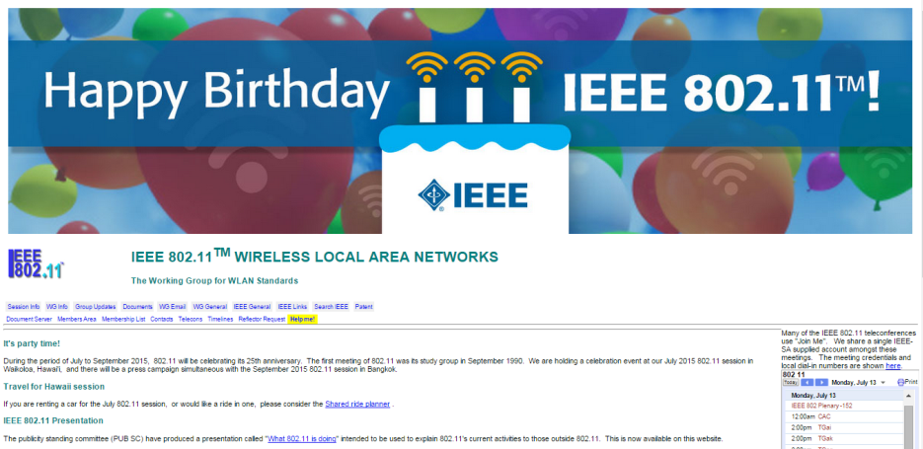

Phase I Deliverables
Notes:
Celebration graphic for IEEE 802.11 WG page
A celebration montage video (interviews with WG)

Slide 7
Phase II
Global campaign
Public Relations
Collateral
Email Marketing & Google AdWords
Web/Social
Collaboration with other IEEE OUs

Slide 8
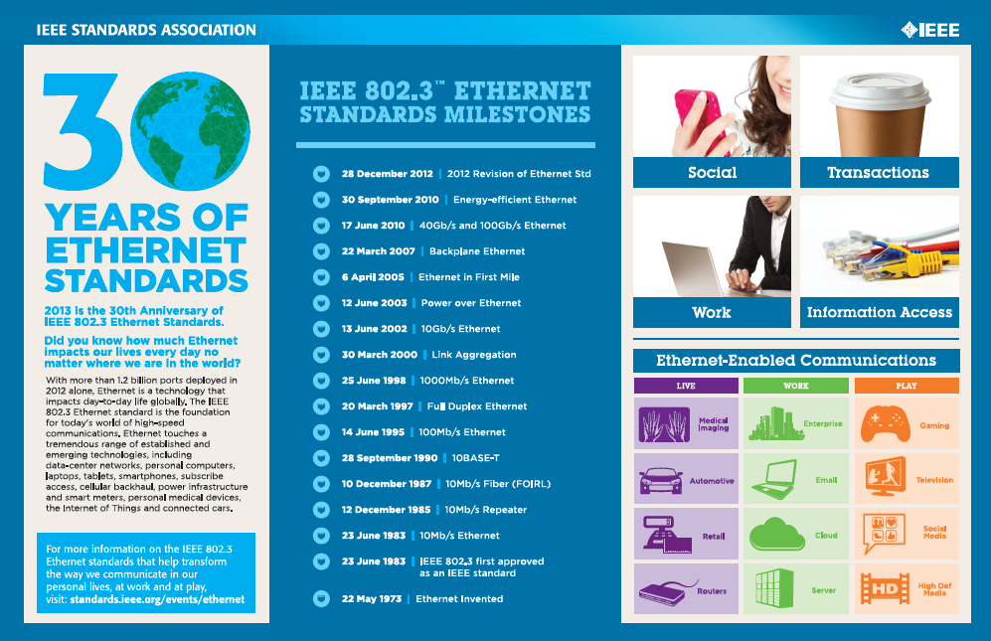
Infographic Example
IEEE 802.3 Anniversary Infographic

Slide 9
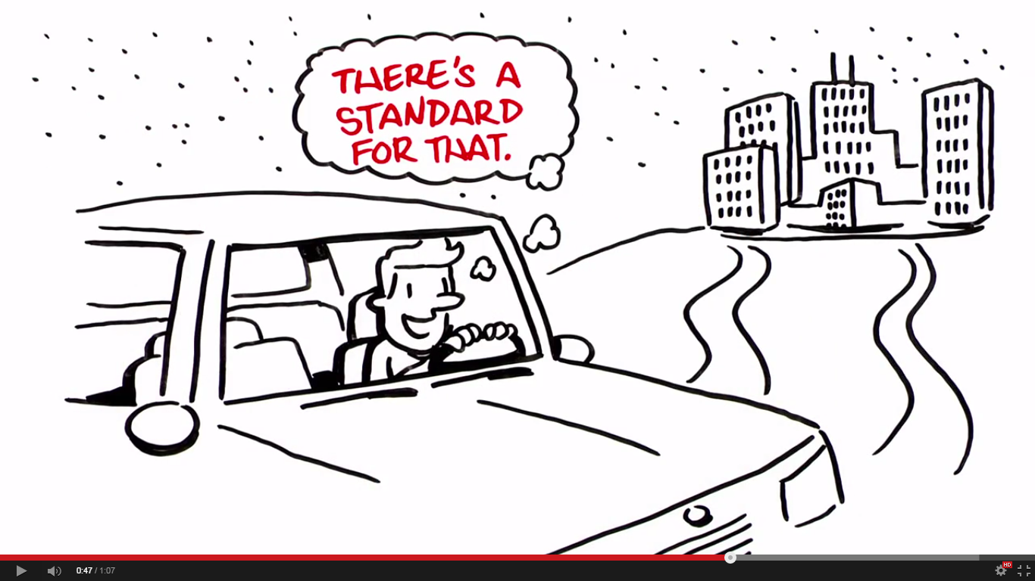
Animation Example:
A World Without Standards
https://www.youtube.com/watch?v=H-sO4OpA9SM

Slide 10
Your Marketing Team
Jeff Pane
Solutions Marketing Specialist
j.pane@ieee.org
+1 732 465 6605
Shuang Yu
Director, Global Standards Solutions & Content Marketing
shuang.yu@ieee.org
+1 732 981 3424

