Slide 1
WG11
25th Anniversary
Date: 14 – July -2015
Authors:
Name
Company
Address
Phone
email
Bruce Kraemer
Marvell
5488 Marvell Lane
+1
-
321
-
4
27
-
bkraemer@
marvell
.com
Santa Clara, CA
4098
95054
Abstract: Chair #3 comments and recollections for 802.11 25th Anniversary event – July 2015 - held in Waikoloa, Hawaii, US

Slide 2
Opening Comments

Slide 3
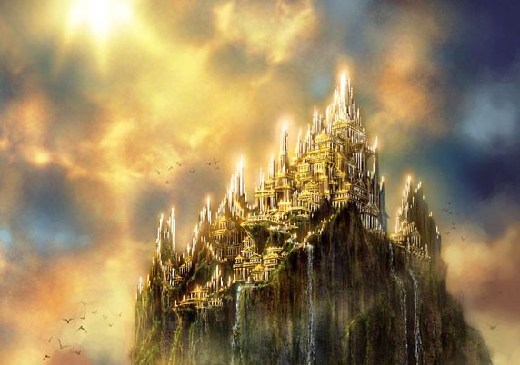
More time in IEEE HQ
http://www.wallpedes.com/castles-wallpaper-hd/fantasy-wallpaper-castle-wallpapers-px.html

Slide 4

Source: http://whowasplato.com/?p=47

Slide 5
Recollections

Slide 6
First Encounter
The quest for
802.11 Lite

Slide 7
MIMO

Slide 8

MIMO-Multiple antennas
Source: http://www.nonstopsystems.com/radio/antennas_home.htm

Slide 9

Source: http://www.shutterstock.com/pic-113576539/stock-photo-cartoon-man-with-antenna-on-his-head-d-illustration.html

Slide 10
Process Diligence

Slide 11
Great Technology finds a home in unexpected places

Slide 12
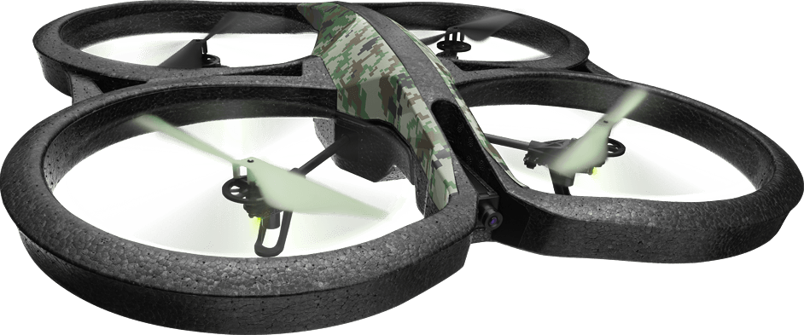
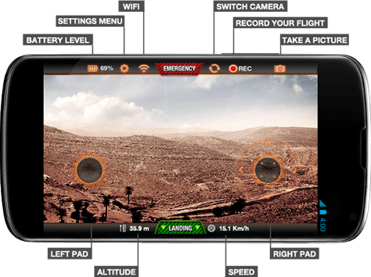
Source: http://ardrone2.parrot.com/

Slide 13

Ubiquity
Source: http://www.yahki.com/LamontMark/stories/20130906/5-important-Yahki-updates

Slide 14
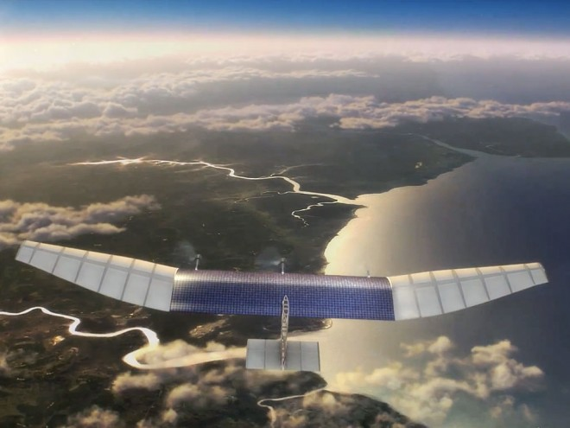
Ubiquity
Source: http://www.wired.com/2014/03/facebook-drones/

Slide 15

Challenges Remain
Source: https://www.nasa.gov/feature/how-big-is-pluto-new-horizons-settles-decades-long-debate

Slide 16
You made
802.11 great

Slide 17
Conclusion
In my new role as President of SA I need to be a promoter of all IEEE standards.
I try to use the experience and insight gained here to help inform and transform the Institute.
I want to emphasize again how substantial your contributions have been to this industry and wish you well on your continued journey. Thanks for the opportunity to have served as your chair.
But being only the third of four 802.11 chairs I need to leave the podium now, as I have before, to make way for the newer generation.

Slide 18
Thanks for the opportunity to work with and for you

