Slide 1
NGP Use Case
Date: 2015-07-15
Authors:

Slide 2
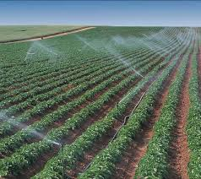
Agricultural IOT
User: Owner of an agricultural land of 100 acres monitors the sprinkler efficiency in irrigation, crop yield, and labor efficiency in his smartphone that has the smart field app installed
Environment: The agricultural land has sprinklers installed every 2 square feet as shown in the figure. The expected AP density is about 1 AP per 1000 sq. ft. Battery-operated smart sensors are deployed in the field distributed in a uniformly random manner for monitoring various parameters of soil/plants health (e.g. crop yield status, soil conditions, moisture/water content/deposition, temperature, heat risks, etc.) and support HT, VHT, and NGP; number of sensors is larger than the number of sprinklers in the agricultural land; the farmer walking through the field with his smartphone notes soil/plant health parameters from the sensors, paying special attention to locations where the sensors detected anomalous data.
Use case:
  Sensors report data at periodic intervals to the AP from where the data is entered into a database.
  Sensors send alarms when thresholds for each observed parameter are breached. The alarm is then relayed by the AP to the farmer.
  The farmer then uses a smartphone application that guides him through the farm to the sensors that raised an alarm and/or reported anomalous data.
  The farmer then takes appropriate corrective action, fix broken sprinklers, selectively spray certain areas for pest/disease control, fix leaks in the greenhouse., etc.

Slide 3
Key Performance and Attributes
Applies only when the farmer is guided to the problem spots via an application running on his/her handheld device
Horizontal accuracy: <0.5 m@90%,
Vertical accuracy: does not apply for open farms; correct rack@99% in greenhouse cases
Latency: <500ms
Refresh Rate: > 1 location/sec
Number of simultaneous users: < 5 depending on the size of the farm and the type of crop
Impact on Network Bandwidth: < 3 additional frames per handheld device/location estimate

Slide 4
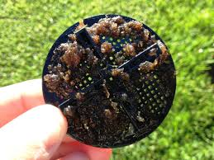
Variations of the Use Case
Locate lost items (cell phones, keys. TV remote, wallet)/tools (pliers, shovels, shears etc., typically used by maintenance personnel) in large homes, apartment complexes, construction sites, etc. Each of these items have a low power tag attached to them.
Track location in a crop field deficient of planted seeds due to use of automation (e.g., airborne sprayers) in random distribution of seed sowing
In locating lost devices within a home, Angle of Arrival (AoA) may be useful in locating the item and/or navigating the user to the location of the lost item.
For power efficiency, battery operated sensors may aggregate sensed data. In these cases micro-location within the range of the aggregator may be needed.
Electronic sweep of medium sized campsites – be alerted when items brought to a campsite are left behind. A smartphone application keeps track of tags on all items brought into the campsite. When an item is left back at the campsite an alert is set and the user is guided to the item.
Tracking a sprinkler with accumulated dirt making it inoperable

Slide 5
Straw Poll
Do you agree to add the following use cases to the NGP working draft?
  Use case “Positioning for Agricultural IOT”

