Slide 1
Commercial UAV Positioning Use Case
Date: 2015-07-15
Authors:
Allan Zhu/Huawei Technologies

Slide 2
Abstract
This contribution briefly introduces the commercial UAV market, the flight control approaches, and intends to apply Wi-Fi for UAV positioning control.
Commercial UAV Positioning use case for NGP is proposed.
Allan Zhu/Huawei Technologies

Slide 3
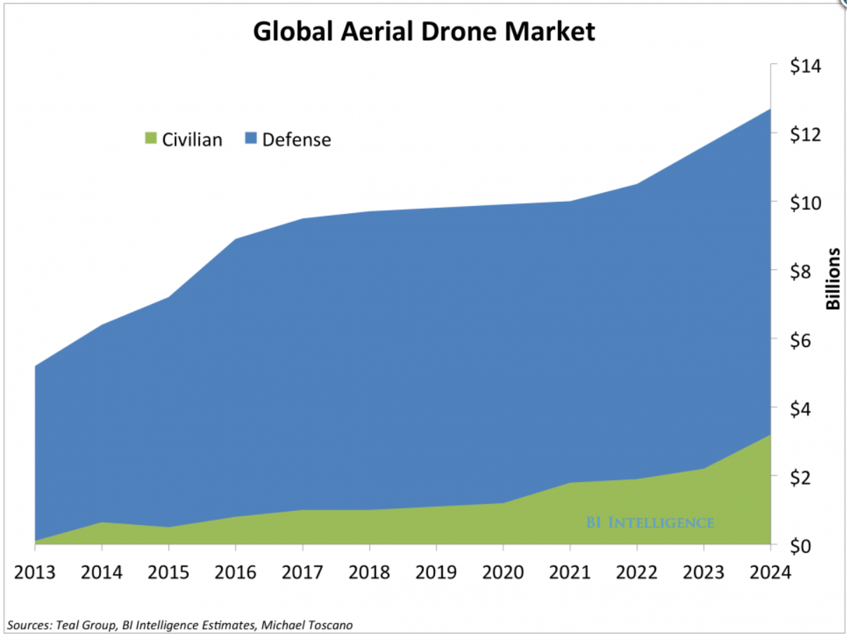
Aerial Drone is a Fast Growing Industry
Source:
BI Intelligence
The market for commercial/civilian drones will grow at a compound annual growth rate (CAGR) of 19% between 2015 and 2020, compared with 5% growth on the military side.
Allan Zhu/Huawei Technologies
Notes:
The commercial-drone industry is still young but has begun to see some consolidation and major investments from large industrial conglomerates, chip companies, and defense contractors.

Slide 4
The Commercial Drone Market
Teal Group Predicts Worldwide UAV Market Will Total $91 Billion in the next 10 years (2014.07.17)
  UAV spending will nearly double over the next decade from current worldwide UAV expenditures of $6.4 billion annually to $11.5 billion, totaling almost $91 billion in the next ten years.
  The 2014 UAV market is at 89% military, 11% civil cumulative for the decade, with the numbers shifting to 86% military and 14% civil by the end of the 10-year forecast.”
According to CEA research, the global market for consumer drones will approach $130 million in revenue in 2015, increasing by 55% from 2014 ($69 million), with unit sales of consumer drones expected to reach 400,000.
  The revenue from drone sales is expected to easily exceed $1 billion in just five years.
Allan Zhu/Huawei Technologies

Slide 5
Major Consumer Drone Manufacturers
There are three consumer drone manufacturers that are considered the industry leaders
  China’s DJI Innovations,
  France’s Parrot, and
  California’s 3D Robotics
According to industry estimates, DJI posted $131 million in annual sales in 2013.
The next closest competitor is France’s Parrot, with $53.35 million in sales in fiscal 2013.
Allan Zhu/Huawei Technologies

Slide 6

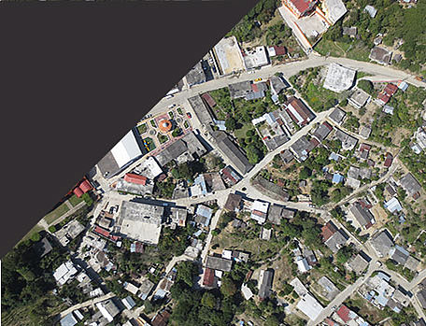

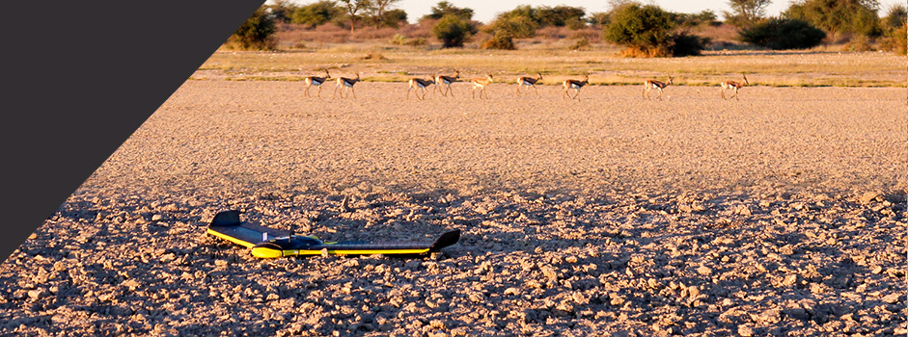
Applications of Commercial Drone
Agriculture
GIS
Land Survey/Management
Environmental protection
Allan Zhu/Huawei Technologies
Notes:
Drones for GIS
Drone technology allows GIS professionals to work more efficiently. With an easy-to-deploy mapping drone you can capture accurate aerial imagery and transform it into 2D orthomosaics (maps) and 3D models of small- and medium-sized sites – all on demand and without needing any piloting skills.
Land Survey/Management
By acquiring raster data from the sky – in the form of geo-referenced digital aerial images, with resolutions as sharp as 1.5 cm (0.6 in) per pixel – you can gather millions of data points in one short flight.
Environmental protection
Drone (or UAV/UAS) technology suits a myriad of conservation and environmental protection applications — offering quick, easy and cost-effective aerial imagery, on demand.

Slide 7
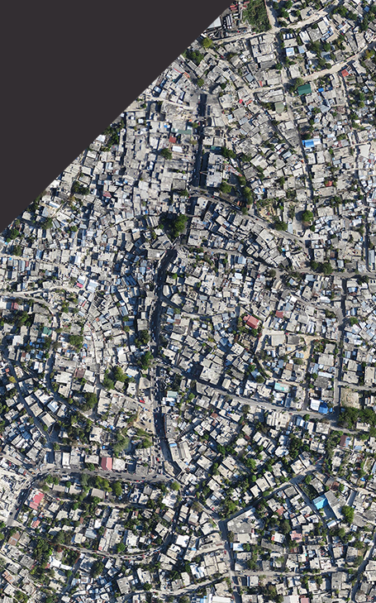
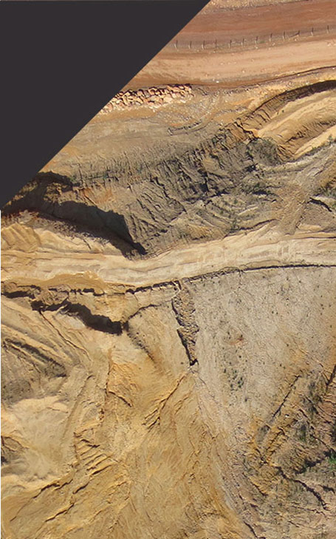
Applications of Commercial Drone (cont.)
Humanitarian Aid
Mining
Allan Zhu/Huawei Technologies
Notes:
Mining
By allowing surveyors to collect accurate spatial data from above, drone or UAV technology can vastly reduce risk by minimising the time mining staff spend on site.
boost productivity; surveying projects that once took days or weeks using traditional surveying techniques are now possible in just a few hours
thanks to a drone’s ability to collect data from above, there is no downtime required while surveyors move around a pit, as can be the case when using terrestrial surveying instruments.
Humanitarian Aid
Aid, development, emergency response or disaster preparedness

Slide 8
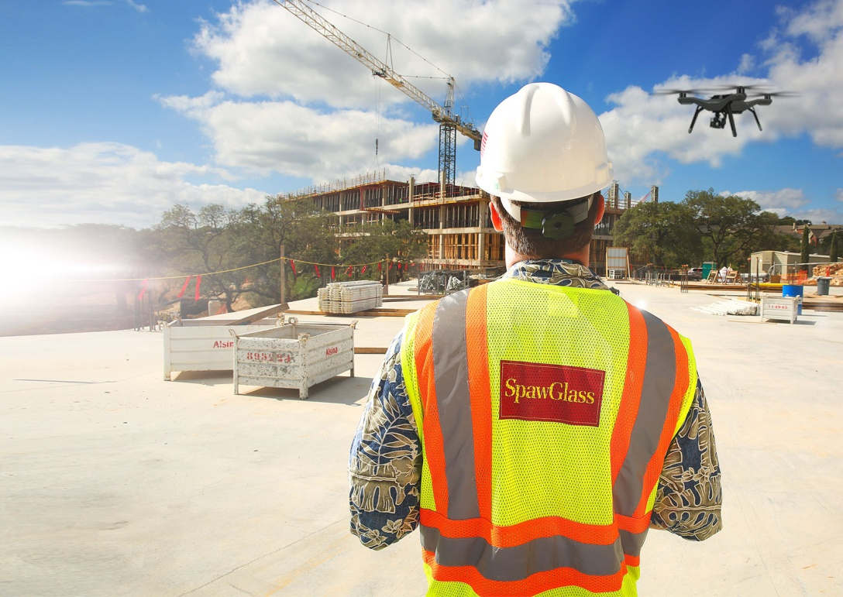
Applications of Commercial Drone (cont.)
Other applications
  energy,
  utilities,
  construction,
  real estate,
  news media, and
  film production
Allan Zhu/Huawei Technologies

Slide 9
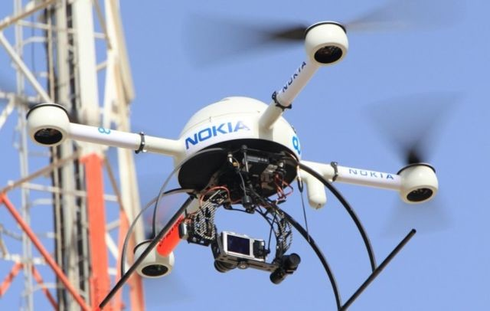
Example #1: Drone for Cellular Network Maintenance
Source: Nokia Looks To Drones For Network Maintenance
Allan Zhu/Huawei Technologies

Slide 10
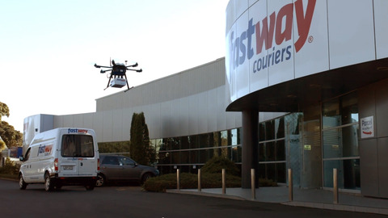
Example #2: Auto Parts Delivery
The drone transported auto parts between Penrose and Mt Wellington in Auckland.
Allan Zhu/Huawei Technologies

Slide 11
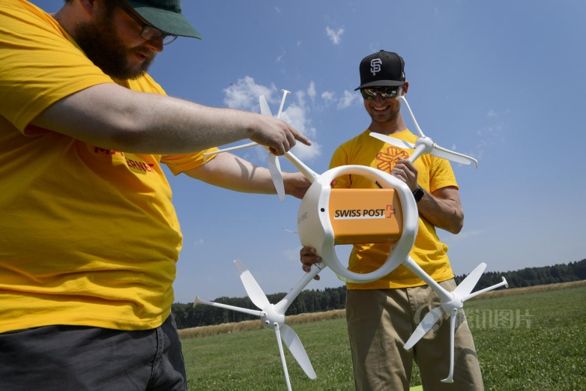
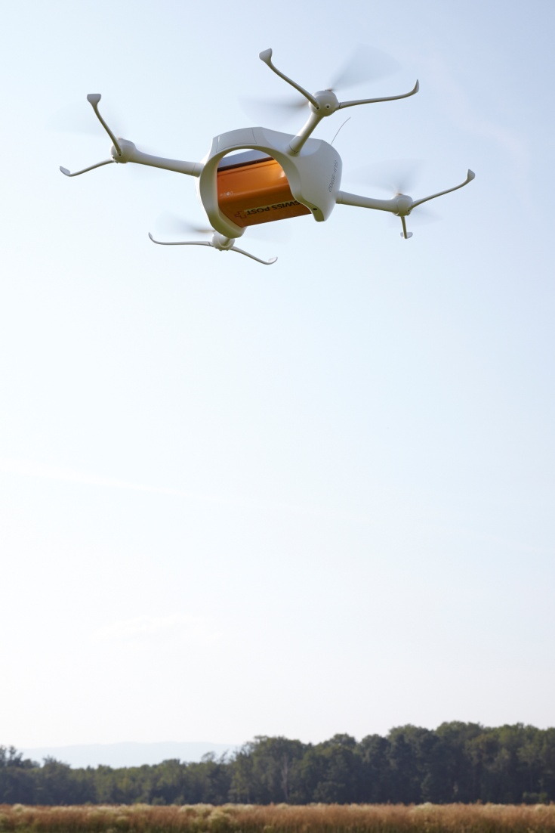
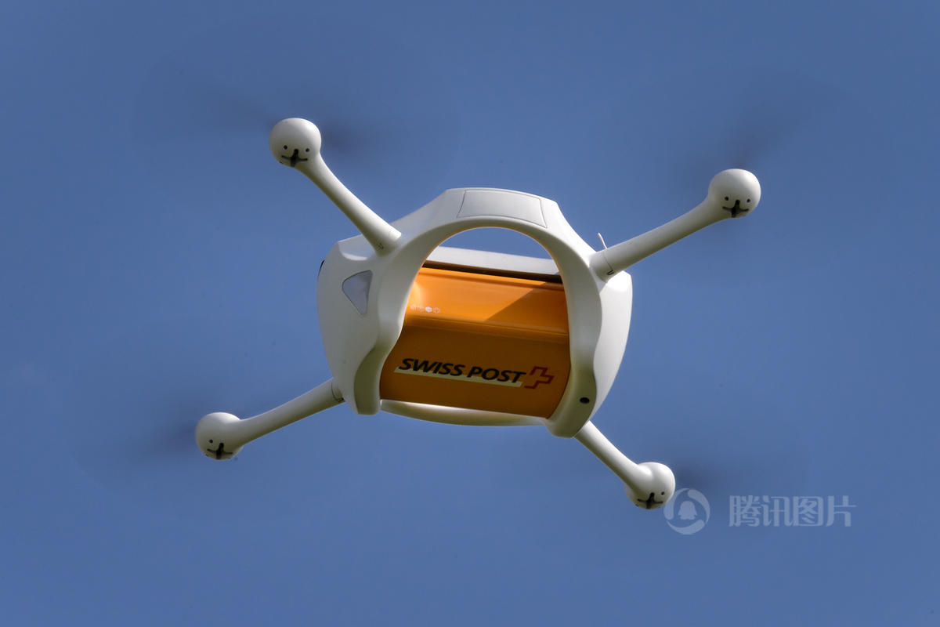
Example #3: Post Office Package Delivery
Allan Zhu/Huawei Technologies

Slide 12
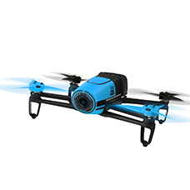
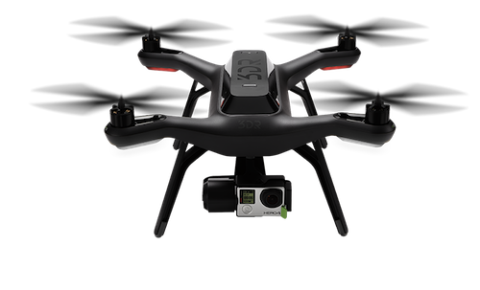
Most Commercial Drones Use GPS for Fly Control
Exceptions being the cheap toys, which have control range of about 30 meters.
Example #1: Parrot Bebop (user manual, page 14)
  “Note: If you are in an area with no GPS reception, the Parrot Bebop Drone position will not be detected. ”
  “Make sure the Parrot Bebop Drone position is detected before taking off to register the starting point correctly.”
Example #2: SDRobotics Solo (in the manual)
  “Solo requires an active GPS signal for flight… Always choose a flying location with a clear view of the sky to improve GPS signal strength. ”
Allan Zhu/Huawei Technologies

Slide 13
Issues when Flying with GPS-Only
In many situations, especially in a city with many skyscrapers like NYC and San Francisco, GPS lock requirements may not be able to achieve.
  Most require receiving GPS signal from 6 different satellites to achieve a GPS lock (e.g., the SDRobotics Solo).
Indoor navigation mechanism is a hot innovation area and one of the key differential factors of drone manufacturers.
Allan Zhu/Huawei Technologies

Slide 14
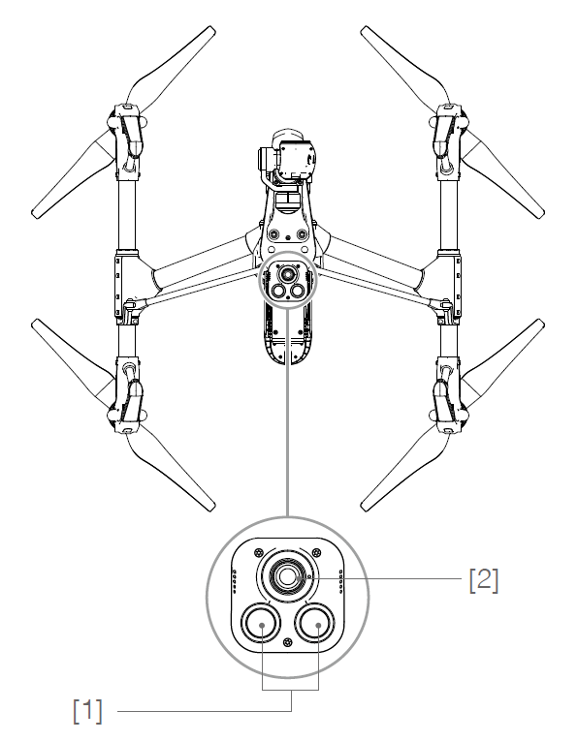
Flying without GPS – the DJI Solution
DJI’s Inspire 1 model (their most advanced model) has three flight modes
P-GPS: GPS + Vision Positioning sensors
P-OPTI: Vision Positioning sensors only
  Used when GPS signal is not available
  Sonar + Camera
P-ATTI: Barometer only
  Used when both of the above are not available, only altitude information is used
[1] Two Sonar Sensors
[2] Monocular Camera
Allan Zhu/Huawei Technologies

Slide 15
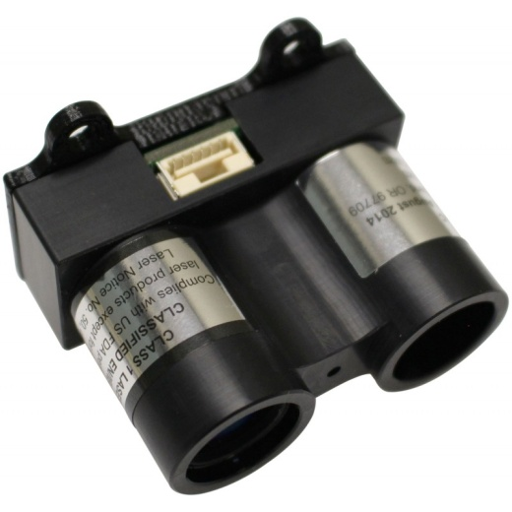
Flying without GPS – the 3DRobotics Solution
3DRobotics Solo uses LiDAR technology for stable indoor flights
  LiDAR (a portmanteau of "light" and "radar") is a remote sensing technology that measures distance by illuminating a target with a laser and analyzing the reflected light (from Wikipedia).
LiDAR module is expensive
  A LIDAR-based Laser Rangefinder costs about $80/piece
Module dimension: 51 x 30 x 39mm
Measuring range: 40m
Transmit power (laser): 1.5Watts peak @ 3amps drive
Allan Zhu/Huawei Technologies

Slide 16
UAV Use Case Description
User: A person controlling a commercial/consumer-level drone, with the controller in his/her hands.
Environment: Indoor and outdoor environment where a commercial- or consumer-level drone is permitted to fly. There is no requirement for APs in the area, but both the drone and the controller need to equip with Wi-Fi.
Use case:
  The user controls his/her drone with a controller using Wi-Fi.
  The user defines an area (e.g. by defining the distance between the drone and the controller) that the drone should fly within;
  The user controls the drone to move 30 degree to the left/right, with the same radius.
  The user controls the drone to circle around him/her with the same radius (Orbit Mode - think of the user as a skier, biker or a surfer);
  The user controls the drone to fly along a straight line, towards him/her (zoom in) or away from him/her (zoom out).
  The user controls the drone to follow him/her at certain distance (Follow Mode)
Allan Zhu/Huawei Technologies

Slide 17
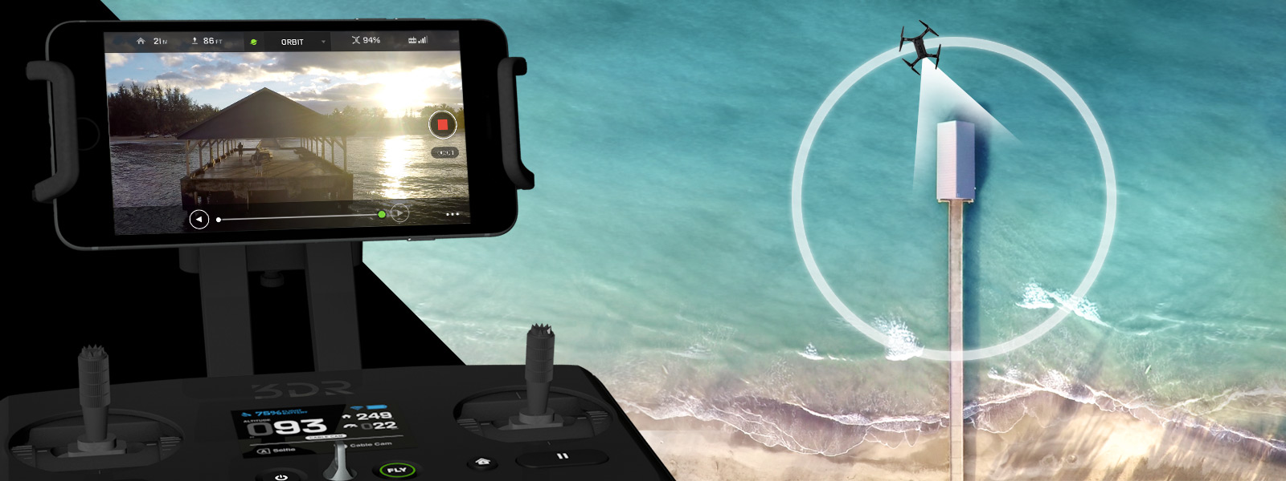
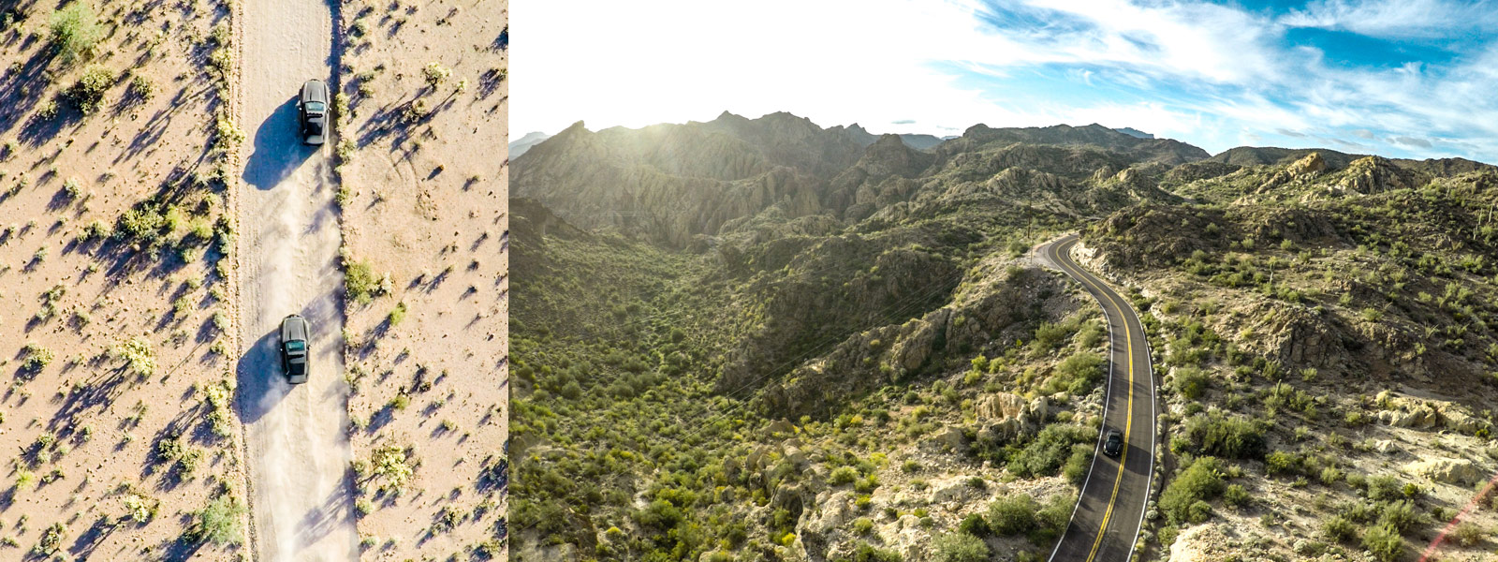
UAV Use Case Description (cont.)
Orbit Mode
Follow Mode
Allan Zhu/Huawei Technologies

Slide 18
UAV Use Case Description (cont.)
Horizontal accuracy: <0.5 m@90%,
Vertical accuracy: <0.5m @90%
Latency: <10ms
  The 3DRobotics Solo can reach top speed of 25m/s. An interval of 10ms translates to 0.25m
  The DJI Inspire 1 can reach top speed of 22m/s. An interval of 10ms translates to 0.22m.
Refresh Rate: <10ms
  This depends on the drone flying speed. For precise control, this can be made smaller.
Number of Simultaneous Users
  1
Impact on the Wireless Network
  No impact – The drone and the controller form their own network.
Allan Zhu/Huawei Technologies

Slide 19
The Wi-Fi Advantages in UAV Positioning
A solution for both indoor and outdoor positioning;
An inexpensive solution
  Wi-Fi is already used in flight control and real-time photo/video transmission between drones and devices on the ground (e.g. smartphones and tablets)
  Wi-Fi modules are cheaper than sonar and cameras used by existing indoor solutions.
Fewer/shorter data packages transmitted
  When GPS is used, drones need to continuously transmit their positions back to the drones.
  Wi-Fi is expected to transmit either fewer position information or the frames are shorter.
Easier implementations for some controls
  Controls like circling 90 degrees will be pretty easy to be implemented using AoA of Wi-Fi signal, but much more complicated using GPS signal.
Save weight, space and power consumption of the drone
  These translate to longer flight times, which is extremely important to the drones.
Allan Zhu/Huawei Technologies

Slide 20
References
Cisco Systems Inc., 11-15-0388-00-0ngp
NGP Use Case Template
Jonathan Segev, Intel, 11-14-1464-02-0wng
NG Positioning Overview and Challenges
Allan Zhu/Huawei Technologies

Slide 21
Backup slides

Slide 22
Some Useful Links
UAV videos
  http://www.smalluavcoalition.org/aerial-photovideo
Drone Racing
  https://youtu.be/bR4Gq9qfpnM
Allan Zhu/Huawei Technologies

Slide 23
The Small UAV Coalition
The Small UAV Coalition
  “Small Unmanned Aerial Vehicles (UAVs) will transform our economy in a multitude of ways, including advances in precision agriculture, fast and environmentally-friendly consumer delivery, assistance to first responders, safe inspection of critical infrastructure such as oil and gas pipelines, and remarkable aerial photography”.
Major member companies
  Airware, Amazon Prime Air, DJI, Google[x], GoPro, Parrot, and 3DR
Allan Zhu/Huawei Technologies

Slide 24
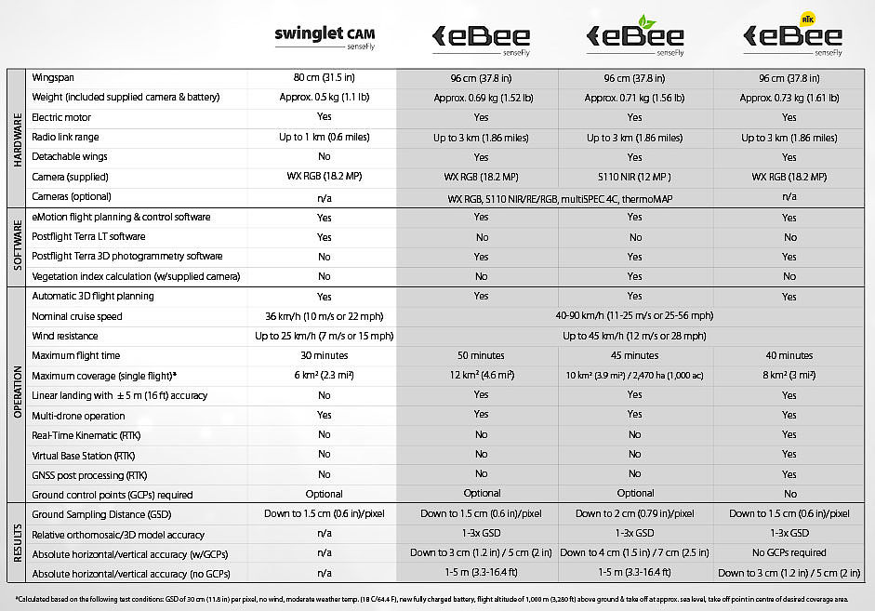

Slide 25
Specs of 3DRobotic Solo
Cameras: Compatible with GoPro® HERO3, 3+ and 4; optimized for HERO3+ and 4
Streaming video quality: 720p
Flight time: 25 minutes; 20 minutes with payload*
Range: .5 miles** (.8 km)
Max speed: 55 mph (89 km/h)
Max ascent speed: 10 m/s in stabilize mode; 5 m/s in “fly” mode
Max descent speed: ditto
Max payload: 420 g
Max altitude: 400 ft per FAA regulation, user adjustable (122 m)
Motors: 880 kV
Propellers: 10″ diameter 4.5″ pitch self-tightening (24 cm diameter 144 cm pitch); glass-reinforced nylon
Autopilot: Pixhawk 2
Software: APM:Copter
Communication: 3DR Link secure WiFi network
Frequency: 2.4 GHz
Weight: 3.3 lbs. (1.5 kg) / 3.9 lbs. (1.8 kg) with GoPro® and Solo Gimbal
Dimensions: 10 in. tall (25 cm), 18 in. (46 cm) motor-to-motor
Flight battery: Lithium polymer 5200 mAh 14.8 Vdc
Battery charge time: ~1.5 hours
Controller battery: 2600 mAh 7.2 Vdc rechargeable lithium ion
App requirements: iOS 8.0 or later / Android 4.3 or later
*Flight time varies with payload, wind conditions, elevation, temperature, humidity, flying style and pilot skill. Listed flight time applies to elevations less than 2,000 ft above sea level.
**Depending on environmental conditions; controller is expandable, allowing us or third parties to amp up the range in the future.

Slide 26
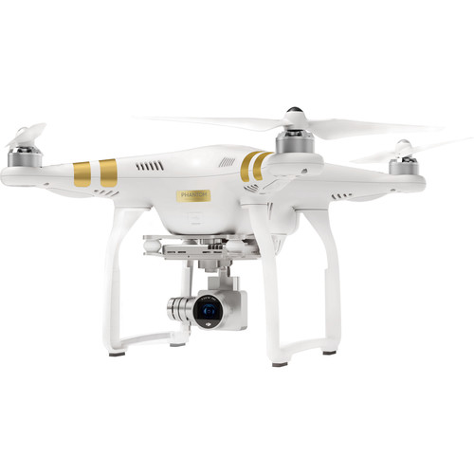
Spec of DJI Phantom III
Hover Accuracy
  Vertical: ±3.9" / 10 cm
  Horizontal: ±3.3' / 1 m
Vision Positioning
  Frequency: 50 Hz
  Velocity Range: Below 26.2 fps / 8 m/s (6.6' / 2 m above the ground)
  Altitude Range: 11.8" to 118.1" / 30 cm to 300 cm
  Operating Range: 11.8" to 118.1" / 30 cm to 300 cm
  Operating Environment: Surface with clear pattern and adequate lighting (> 15 lux)
Frequency 2.400 to 2.483 GHz
Communication Distance 6561.7' / 2000 m (outdoors and unobstructed)

