Slide 1
25 Years of IEEE 802.11
Date: 2015-07-15
Authors:

Slide 2
Abstract
Interesting facts observed during the last 25 years of the continuing existence of the IEEE 802.11 Standards Working Group for Wireless LANs (WLANs)

Slide 3
The Dog Ate My Computer !

Slide 4
“A Humorous Irreverent View …”
Years of Hard Work
…
Late Nights, Head Scratching, Lost Sleep, FAMILY DEPREVATION
…
A Worldwide Standard
Used Widely Everyday
…
A STANDARD TO BE
PROUD OF

Slide 5
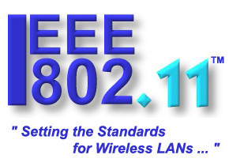
25 Years
1990-2015

Slide 6
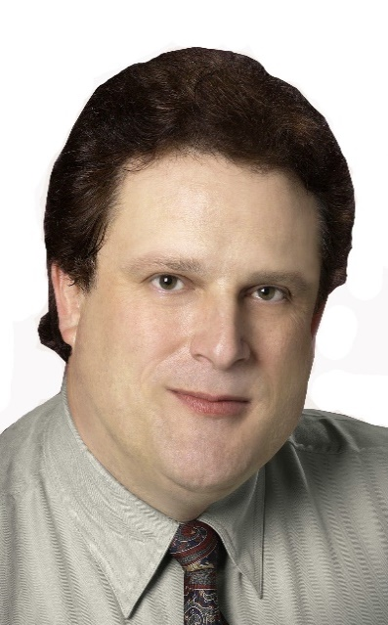
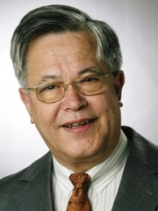
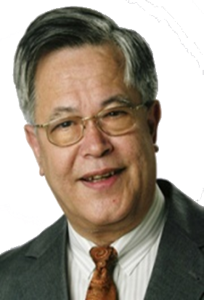
Four IEEE 802.11 WG Chairs
25 Years
1990-2015
Vic Hayes Stuart J. Kerry Bruce P. Kraemer Adrian P. Stephens
1990-2000 2000-2008 2008-2014 2014-to Date

Slide 7
A Million Miles & Counting !!!

Slide 8
IEEE 802.11 Session Locations
25 Years
1990-2015

Slide 9
Our Working Environment !

Slide 10
The VERY FIRST Social - SEP 1990

Slide 11
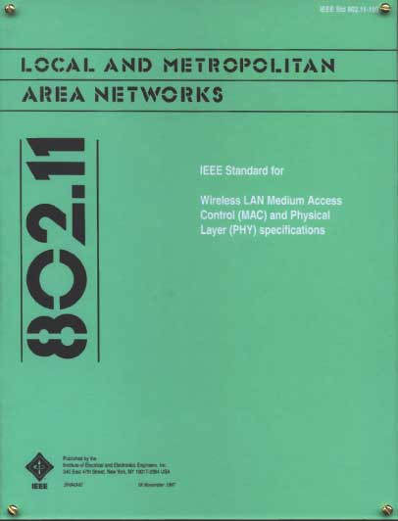
The RESULT
1997
802.11™ Standard

Slide 12
… and it has NOT Stopped EVOLVING !
802.11
-2003
802.11
-2007
802.11
-2012
802.11
-2016 (TBC)
MAC
11k
RRM
11s
Mesh
11aa
Video Transport
11e
QoS
IEEE
Std
802.11
-1999
11h
DFS & TPC
11u
WIEN
11v
Network
Management
11ae
QoS Mgt Frames
11d
Intl roaming
11i
Security
11z
TDLS
11w
Management
Frame
Security
11f
Inter AP
11r
Fast Roam
11n
High
Throughput
(>100 Mbps)
11af
TV Whitespace
11a
54 Mbps
5GHz
11j
JP bands
11ac -VHT
>1 Gbps @ 5GHz
11b
11 Mbps
2.4GHz
11g
54 Mbps
2.4GHz
11p
WAVE
11y
Contention
Based
Protocol
11ad - VHT
>1 Gbps @ 60GHz
MAC
&
PHY

Slide 13
Changes during the “Two-And-A-Half Decades
From paper to electronic document dissemination
From 8 hour lead time to immediate access of documents
From LCD screen on top of Overhead projector to LCD projector
From minimal PC use to full PC use
From non-internet to internet use
Distribution lists
Document server
On-line attendance recording
The form factor of electronics constantly decreased
From batch processing, face-to-face only, to continuous processing using electronic means and teleconferencing way of working

Slide 14
Looking to the future …
It’s Now, it’s Easy, it’s a No Brainer
People Don’t know what it’s name is, but it has to be there
Complements Wired Access
The standard will be there in another 25 years similar to what Ethernet has shown in its continuing long life
Has an growing Future of Innovations and Applications
On-going support of industry and individual engineers for a bright future in the world of global standards

Slide 15
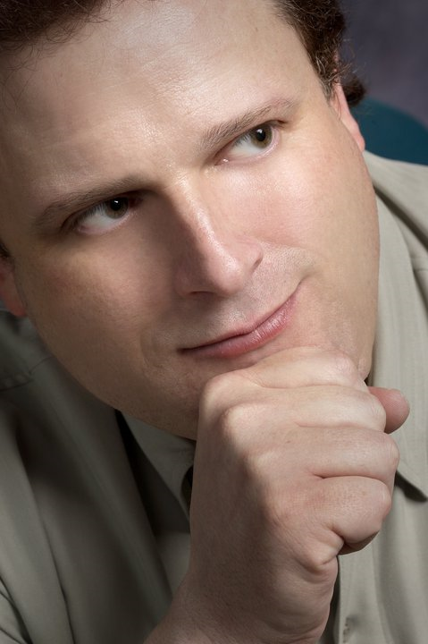
 | "Without the brains, creativity and vision of the 802.11 Working Group, we would still be tied to phone and computer cords, no mobile anything. Productivity as we know it today, on the go, would also be tied to a cord, tethered and held back. Standards carry the burden of being called 'boring' but how can anyone call boring the thing that literally lets our communications fly? The 802.11 Working Group has accomplished amazing things and it isn't done yet. Prepare to be astounded.“ - Stuart J. Kerry, "Lifelong WG Member," IEEE 802.11 WG Ex-Chair 2000 - 2008 and IEEE 802.11 WG Vice-Chair 1994 - 2000

Slide 16
25 Year Perspective
How do you recall 25 years of time passed?
What Milestones or events do you remember?
What will the world look like in 25 years?

Slide 17
Lastly …
THANK YOU
On Behalf of Myself and the Worldwide Users of the IEEE 802.11 Standard (also known as Wi-Fi)
… FOR THE FIRST 25 YEARS
and
THE NEXT 25 YEARS …

