Slide 1
NGP Use Case
doc.: IEEE 802.11-15/0902r0
Date: 2015-07
Authors:

Slide 2
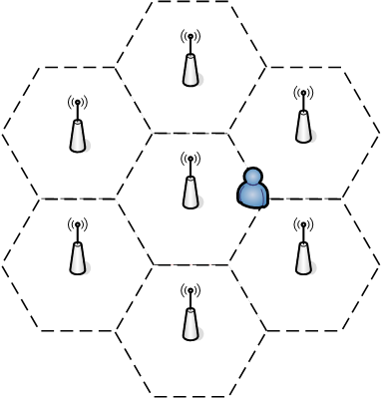
Positioning for Spectrum Management
doc.: IEEE 802.11-15/0902r0
User: Persons with a WiFi-device which has the corresponding app installed.
Environment: An areas (e.g. a large office, an university…) where there multi-APs for 802.11 coverage. The expected AP density is about 1 AP per TBD sq. ft. The APs providing data service to the STAs within their coverage supporting HT, VHT, DMG and NGP.
Use case:
The user enters the area with their WiFi-device.
As soon as user enters this area, the position of the user is determined through the NGP.
With the position information of the user, the APs can suggest the user which AP to associate with and which channel to use, a.k.a. the load balance process, which can greatly improve the user experience especially in high density case.
As the user travels in this area, the APs keep on tracking the position of the user. The traveling path of the user can help a lot in the hand over process, so the service(such as WiFi call, facetime etc.) is not interrupted when user is traveling.

Slide 3
Positioning for Spectrum Management(Cont’d)
doc.: IEEE 802.11-15/0902r0
Key Performance and Attributes:
Horizontal accuracy: <0.5 m@90%, vertical accuracy: same floor@99%
Latency: <500ms
Refresh Rate: > 1 location/sec

Slide 4
Strawpoll
doc.: IEEE 802.11-15/0902r0
Should we add the “Positioning for Spectrum Management” use case to the working draft.
Y:
N:
A:

