Slide 1
DSC Calibration Result
Date: 2015-06-30
Authors:

Slide 2
Abstract
This presentation describes MediaTek’s spatial reuse calibration results based on 15/0652r1.

Slide 3
Calibration Scenario
STA1
STA3
3m
30m
3m
AP1
AP2
STA2
STA4
CCA level and Receiver State Machine for calibration
  Apply CCA-SD threshold of -76, -66, and -56 dBm.
  “Packet reception and preamble detection procedure” shall
    Follow Appendix 4 of Evaluation Methodology document [2]
    Set “PPDU capture window” to 0 ns
    Set “preemption window” to 0 ns
10 drops with random start time
10 seconds simulation time
Start measurement after 5 seconds

Slide 4
PHY Parameters
PHY parameters
BW | All BSSs at 5GHz [80 MHz, no dynamic bandwidth]
Channel model | TGac D NLOS per link
Shadow fading | iid log-normal shadowing (5 dB standard deviation) per link
Data Preamble Type | [5GHz, 11ac], always decoded correctly after successful reception, duration is considered.
STA TX Power | 15 dBm per antenna
AP TX Power | 20 dBm per antenna
AP number of TX/RX antennas | 1/1
STA number of TX /RX antennas | 1/1
AP antenna gain | 0 dBi
STA antenna gain | -2 dBi
Noise Figure | 7dB
CCA threshold | -56/-66/-76 dBm @ 80MHz
Link Adaption | Fixed MCS =5 (234.0 Mbps)
Channel estimation | ideal
PHY abstraction | RBIR, BCC [1, 5]
Path Loss Model | Exponent of 2 up to 10m, exponent of 3.5 beyond (same as SS3)

Slide 5
MAC Parameters
MAC parameters
Access protocol | [EDCA, AC_BE with default parameters] [CWmin = 15, CWmax = 1023, AIFSn=3 ]
Queue length | A single queue for each traffic link is set inside AP/STA sized of 2000 packets
Traffic type | UDP CBR with rate 20^8bps (may not enough to model full buffer)
MPDU size | 1538 Bytes (1472 Data + 28 IP header + 8 bytes LLC + 30 MAC header)
Aggregation | [A-MPDU / max aggregation size / BA window size, No A-MSDU, with immediate BA], Max aggregation: 32 MPDUs with 4-byte MPDU delimiter
Max number of retries | 10
Beacon | Disabled
RTS/CTS | OFF
Traffic direction | UL Only
Output metric | Per non-AP STA throughput (received bits/overall simulation time), measured at MAC SAP (MSDU)

Slide 6
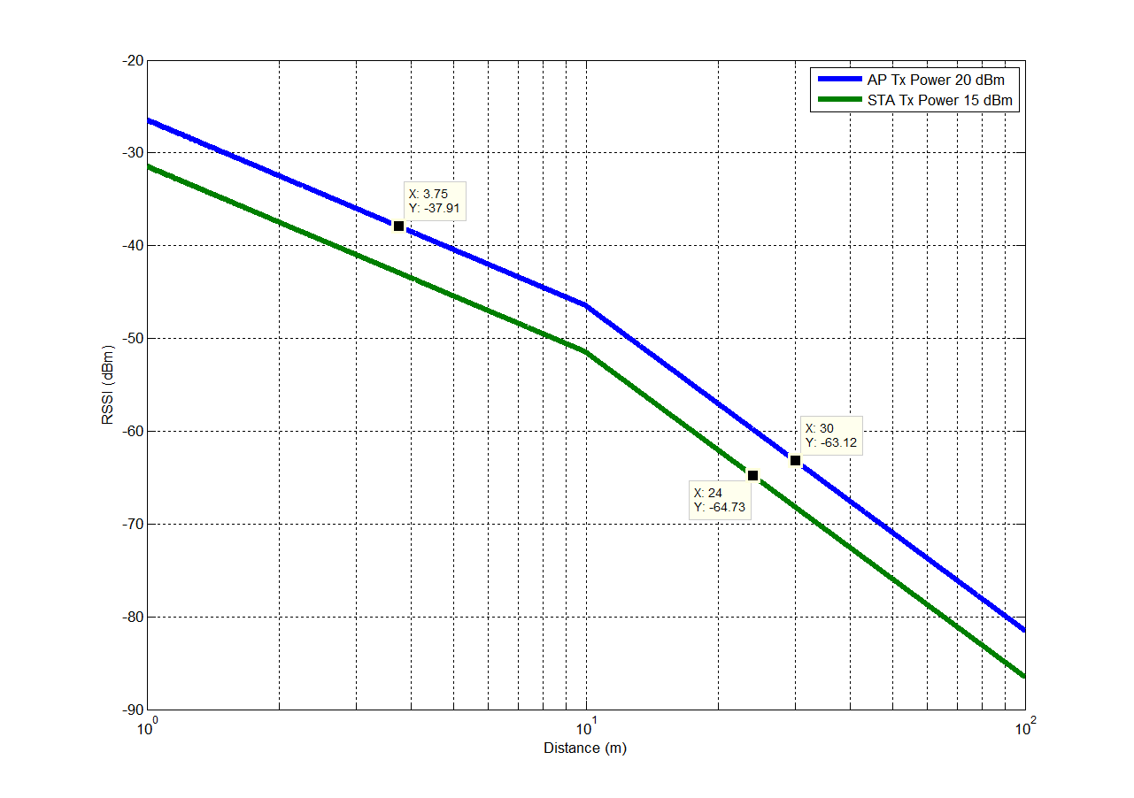
Path Loss Model Calibration
SONY (15/0652r1)
MTK

Slide 7
Calibration Results
CCA-SD (dBm) |  |  | Throughput (Mbps)
-76 | BSS1 | STA1 | 50.35
 |  | STA2 | 51.65
 | BSS2 | STA3 | 51.10
 |  | STA4 | 50.41
-66 | BSS1 | STA1 | 99.57
 |  | STA2 | 99.46
 | BSS2 | STA3 | 99.54
 |  | STA4 | 99.59
-56 | BSS1 | STA1 | 99.83
 |  | STA2 | 99.80
 | BSS2 | STA3 | 99.82
 |  | STA4 | 99.81

Slide 8
Conclusions
Provide MTK’s spatial reuse calibration results based on 15/0652r1.

Slide 9
References
Mori et al, “Reference Simulation Model for Dynamic CCA / DSC Calibration”, IEEE 11-15/625r1.
R. Porat et al, “Evaluation Methodology”, IEEE 11-14/571r9.
S. Merlin et al, “Simulation Scenarios”, IEEE 11-14/980r12.

