Slide 1
Random Access with Trigger Frames using OFDMA
Date: 2015-07-13
Authors:
Name | Affiliation | Address | Phone | Email
Chittabrata Ghosh | Intel | 2200 Mission College Blvd., Santa Clara, CA 95054, USA | +1-415-244-8904 | chittabrata.ghosh@intel.com
Robert Stacey |  |  |  | robert.stacey@intel.com
Eldad Perahia |  |  |  | eldad.perahia@intel.com
Shahrnaz Azizi |  |  |  | shahrnaz.azizi@intel.com
Po-Kai Huang |  |  |  | po-kai.huang@intel.com
Qinghua Li |  |  |  | quinghua.li@intel.com
Laurent Cariou |  |  |  | laurent.cariou@intel.com
Xiaogang Chen |  |  |  | xiaogang.c.chen@intel.com
Rongzhen Yang |  |  |  | rongzhen.yang@intel.com

Slide 2
Authors (continued)
Name | Affiliation | Address | Phone | Email
Albert Van Zelst | Qualcomm | Straatweg 66-S Breukelen, 3621 BR Netherlands |  | allert@qti.qualcomm.com
Alfred Asterjadhi |  | 5775 Morehouse Dr. San Diego, CA, USA |  | aasterja@qti.qualcomm.com
Bin Tian |  | 5775 Morehouse Dr. San Diego, CA, USA |  | btian@qti.qualcomm.com
Carlos Aldana |  | 1700 Technology Drive San Jose, CA 95110, USA |  | caldana@qca.qualcomm.com
George Cherian |  | 5775 Morehouse Dr. San Diego, CA, USA |  | gcherian@qti.qualcomm.com
Gwendolyn Barriac |  | 5775 Morehouse Dr. San Diego, CA, USA |  | gbarriac@qti.qualcomm.com
Hemanth Sampath |  | 5775 Morehouse Dr. San Diego, CA, USA |  | hsampath@qti.qualcomm.com
Menzo Wentink |  | Straatweg 66-S Breukelen, 3621 BR Netherlands |  | mwentink@qti.qualcomm.com
Richard Van Nee |  | Straatweg 66-S Breukelen, 3621 BR Netherlands |  | rvannee@qti.qualcomm.com
Rolf De Vegt |  | 1700 Technology Drive San Jose, CA 95110, USA |  | rolfv@qca.qualcomm.com
Sameer Vermani |  | 5775 Morehouse Dr. San Diego, CA, USA |  | svverman@qti.qualcomm.com
Simone Merlin |  | 5775 Morehouse Dr. San Diego, CA, USA |  | smerlin@qti.qualcomm.com
Tevfik Yucek |  | 1700 Technology Drive San Jose, CA 95110, USA |  | tyucek@qca.qualcomm.com
VK Jones |  | 1700 Technology Drive San Jose, CA 95110, USA |  | vkjones@qca.qualcomm.com
Youhan Kim |  | 1700 Technology Drive San Jose, CA 95110, USA |  | youhank@qca.qualcomm.com

Slide 3
Authors (continued)
Name | Affiliation | Address | Phone | Email
Ron Porat | Broadcom |  |  | rporat@broadcom.com
Matthew Fischer |  |  |  | mfischer@broadcom.com
Sriram Venkateswaran
Tu Nguyen
Vinko Erceg
Kiseon Ryu | LG Electronics | 19, Yangjae-daero 11gil, Seocho-gu, Seoul 137-130, Korea | +82-1023566164 | kiseon.ryu@lge.com
Jinyoung Chun |  |  |  | jiny.chun@lge.com
Jinsoo Choi |  |  |  | js.choi@lge.com
Jeongki Kim |  |  |  | jeongki.kim@lge.com
Suhwook Kim |  |  |  | suhwook.kim@lge.com
Hyeyoung Choi |  |  |  | hy0117.choi@lge.com
Dongguk Lim |  |  |  | dongguk.lim@lge.com
Eunsung Park |  |  |  | esung.park@lge.com
Jinmin Kim |  |  |  | jinmin1230.kim@lge.com
HanGyu Cho |  |  |  | hg.cho@lge.com

Slide 4
Authors (continued)
Name | Affiliation | Address | Phone | Email
Phillip Barber | Huawei | The Lone Star State, TX |  | pbarber@broadbandmobiletech.com
Peter Loc |  |  |  | peterloc@iwirelesstech.com
Le Liu |  | F1-17, Huawei Base, Bantian, Shenzhen | +86-18601656691 | liule@huawei.com
Jun Luo |  | 5B-N8, No.2222 Xinjinqiao Road, Pudong, Shanghai |  | jun.l@huawei.com
Yi Luo |  | F1-17, Huawei Base, Bantian, Shenzhen | +86-18665891036 | Roy.luoyi@huawei.com
Yingpei Lin |  | 5B-N8, No.2222 Xinjinqiao Road, Pudong, Shanghai |  | linyingpei@huawei.com
Jiyong Pang |  | 5B-N8, No.2222 Xinjinqiao Road, Pudong, Shanghai |  | pangjiyong@huawei.com
Zhigang Rong |  | 10180 Telesis Court, Suite 365, San Diego, CA 92121 NA |  | zhigang.rong@huawei.com
Rob Sun |  | 303 Terry Fox, Suite 400 Kanata, Ottawa, Canada |  | Rob.Sun@huawei.com
David X. Yang |  | F1-17, Huawei Base, Bantian, Shenzhen |  | david.yangxun@huawei.com
Yunsong Yang |  | 10180 Telesis Court, Suite 365, San Diego, CA 92121 NA |  | yangyunsong@huawei.com
Zhou Lan |  | F1-17, Huawei Base, Bantian, SHenzhen | +86-18565826350 | Lanzhou1@huawei.com
Junghoon Suh |  | 303 Terry Fox, Suite 400 Kanata, Ottawa, Canada |  | Junghoon.Suh@huawei.com
Jiayin Zhang |  | 5B-N8, No.2222 Xinjinqiao Road, Pudong, Shanghai | +86-18601656691 | zhangjiayin@huawei.com

Slide 5
Authors (continued)
Name | Affiliation | Address | Phone | Email
Hongyuan Zhang | Marvell | 5488 Marvell Lane, Santa Clara, CA, 95054 | 408-222-2500 | hongyuan@marvell.com
Yakun Sun |  |  |  | yakunsun@marvell.com
Lei Wang |  |  |  | Leileiw@marvell.com
Liwen Chu |  |  |  | liwenchu@marvell.com
Mingguan Xu |  |  |  | mxu@marvell.com
Jinjing Jiang |  |  |  | jinjing@marvell.com
Yan Zhang |  |  |  | yzhang@marvell.com
Rui Cao |  |  |  | ruicao@marvell.com
Jie Huang |  |  |  | jiehuang@marvell.com
Sudhir Srinivasa |  |  |  | sudhirs@marvell.com
Saga Tamhane |  |  |  | sagar@marvell.com
Mao Yu |  |  |  | my@marvel..com
Edward Au |  |  |  | edwardau@marvell.com
Hui-Ling Lou |  |  |  | hlou@marvell.com
Thomas Derham | Orange |  |  | thomas.derham@orange.com
Brian Hart | Cisco | 170 W Tasman Dr, San Jose, CA 95134 |  | brianh@cisco.com
Pooya Monajemi |  |  |  | pmonajem@cisco.com

Slide 6
Authors (continued)
Name | Affiliation | Address | Phone | Email
Fei Tong | Samsung | Innovation Park, Cambridge CB4 0DS (U.K.) | +44 1223 434633 | f.tong@samsung.com
Hyunjeong Kang |  | Maetan 3-dong; Yongtong-Gu Suwon; South Korea | +82-31-279-9028 | hyunjeong.kang@samsung.com
Kaushik Josiam |  | 1301, E. Lookout Dr, Richardson TX 75070 | (972) 761 7437 | k.josiam@samsung.com
Mark Rison |  | Innovation Park, Cambridge CB4 0DS (U.K.) | +44 1223 434600 | m.rison@samsung.com
Rakesh Taori |  | 1301, E. Lookout Dr, Richardson TX 75070 | (972) 761 7470 | rakesh.taori@samsung.com
Sanghyun Chang |  | Maetan 3-dong; Yongtong-Gu Suwon; South Korea | +82-10-8864-1751 | s29.chang@samsung.com
Yasushi Takatori | NTT | 1-1 Hikari-no-oka, Yokosuka, Kanagawa 239-0847 Japan |  | takatori.yasushi@lab.ntt.co.jp
Yasuhiko Inoue |  |  |  | inoue.yasuhiko@lab.ntt.co.jp
Yusuke Asai |  |  |  | asai.yusuke@lab.ntt.co.jp
Koichi Ishihara |  |  |  | ishihara.koichi@lab.ntt.co.jp
Akira Kishida |  |  |  | kishida.akira@lab.ntt.co.jp
Akira Yamada | NTT DOCOMO | 3-6, Hikarinooka, Yokosuka-shi, Kanagawa, 239-8536, Japan |  | yamadaakira@nttdocomo.com
Fujio Watanabe |  | 3240 Hillview Ave, Palo Alto, CA 94304 |  | watanabe@docomoinnovations.com
Haralabos Papadopoulos |  |  |  | hpapadopoulos@docomoinnovations.com

Slide 7
Authors (continued)
Name | Affiliation | Address | Phone | Email
James Yee | Mediatek | No. 1 Dusing 1st Road, Hsinchu, Taiwan | +886-3-567-0766 | james.yee@mediatek.com
Alan Jauh |  |  |  | alan.jauh@mediatek.com
Chingwa Hu |  |  |  | chinghwa.yu@mediatek.com
Frank Hsu |  |  |  | frank.hsu@mediatek.com
Thomas Pare | Mediatek USA | 2860 Junction Ave, San Jose, CA 95134, USA | +1-408-526-1899 | thomas.pare@mediatek.com
ChaoChun Wang |  |  |  | chaochun.wang@mediatek.com
James Wang |  |  |  | james.wang@mediatek.com
Jianhan Liu |  |  |  | Jianhan.Liu@mediatek.com
Tianyu Wu |  |  |  | tianyu.wu@mediatek.com
Russell Huang |  |  |  | russell.huang@mediatek.com
Bo Sun | ZTE | #9 Wuxingduan, Xifeng Rd., Xi’an, China |  | sun.bo1@zte.com.cn
Kaiying Lv |  |  |  | lv.kaiying@zte.com
Yonggang Fang |  |  |  | yfang@ztetx.com
Ke Yao |  |  |  | yao.ke5@zte.com.cn
Weimin Xing |  |  |  | xing.weimin@zte.com.cn

Slide 8
Authors (continued)
Name | Affiliation | Address | Phone | Email
Joonsuk Kim | Apple | Cupertino, CA | +1-408-974-5967 | joonsuk@apple.com
Aon Mujtaba |  |  |  | mujtaba@apple.com
Guoqing Li |  |  |  | guoqing_li@apple.com
Eric Wong |  |  |  | ericwong@apple.com
Chris Hartman |  |  |  | chartman@apple.com

Slide 9
Abstract
In this contribution, we present a random access mechanism for UL MU transmissions
We propose that the Trigger frame supports the allocation of resource units for random access
  STAs can randomly select among these resources for their UL MU PPDU transmissions

Slide 10
UL MU features in 11ax PAR and SFD
In the 11ax PAR [1],
  This project may include the capability to handle multiple simultaneous communications in both the spatial and frequency domains, in both the UL and DL.
Chapter 4 Multi-user (MU) features of 11ax SFD [2] mentions:
  An UL MU PPDU (MU-MIMO or OFDMA) is sent as an immediate response (IFS TBD) to a Trigger frame (format TBD) sent by the AP
UL MU procedure [3] is proposed in March IEEE meeting
  The Trigger frame indicates the STA ID and allocated resource unit
However, several scenarios exist where the AP is unaware that a particular STA has traffic to send
  Associated 802.11ax devices waking up from sleep state
  Unassociated STAs intending to reach an AP

Slide 11
Motivation for Random Access for UL MU Transmissions
OFDMA supports more flexibility on packet transmission:
  Closing the link with significant asymmetry (>=10dB) in transmit power between AP and STAs located far away
  STAs use the Trigger frame allowing random access (TF-R) for UL transmissions on narrow bandwidth
Unassociated STAs intending to send UL frames to an AP
  STAs use TF-R for UL management frames (Association Request, Probe Request, etc.)
  Reduces SU UL transmissions from unassociated STAs
UL MU transmissions using TF-Rs reduce number of SU UL transmissions in conventional EDCA-based access
  Efficient, specially for short packet transmissions with bursty traffic

Slide 12
TF-R for MU UL Transmissions
We propose to define a Trigger Frame for Random access (TF-R) which includes at least one allocation for a resource unit that can be randomly accessed by more than one STA
An STA decodes the TF-R and detects the identifiers and corresponding assigned resource units
An access probability, P_{a} is defined
Each STA chooses a random number, N_{r} between 0 and 1
If N_{r} ≥ P_{a} , then the STA selects an RU randomly from allowed RUs for UL transmission
Otherwise, the STA is not allowed to access any of the resource units assigned for random access in the TF-R

Slide 13
Illustration of Random Access with TF-R with Existing UL MU Procedure
Trigger Frame (TF-R)
(random access)
RU 1 AID 0
T_{tp} ≥ T_{sp} for STA 2, selects RU 1 randomly
RU 2 AID 0
RU 3 AID 0
T_{tp} ≥ T_{sp} for STA 1, selects RU 3 randomly
UL MU PPDU
(STA 2)
RU 4 AID 0
RU 5 AID 0
UL MU PPDU
(STA 1)
ACK

Slide 14
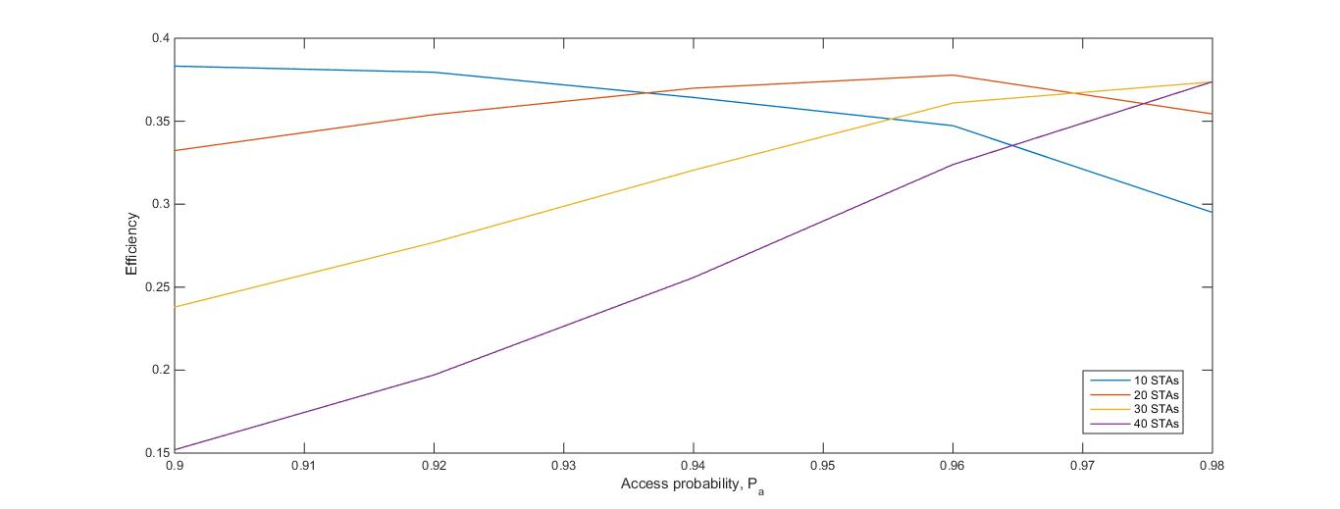
Efficiency Analysis of Random Access Mechanism
Efficiency is defined as the number of successful TF-Rs over total number of TF-Rs
P_{a} is varied from 0.9 to 0.98 for efficiency analysis
8 resource units in each TF-R for random access
Number of STAs varied from 10 to 40

Slide 15
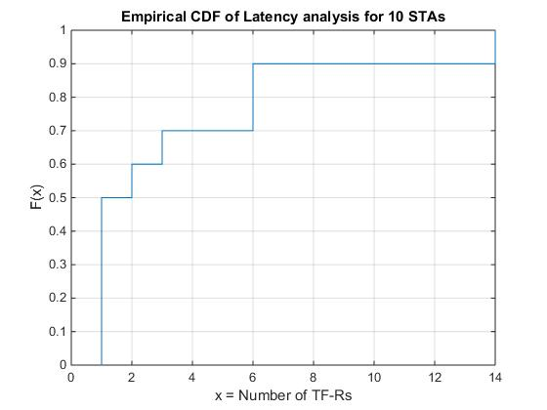
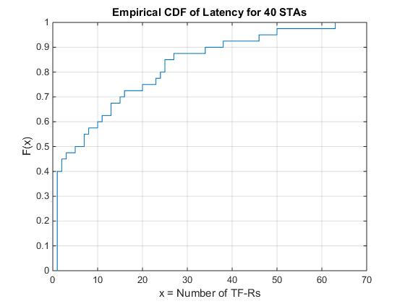
Latency Analysis of Random Access Mechanism
Latency for each STA is defined as the number of TF-Rs needed for each of its successful
transmission

Slide 16
Summary
In this presentation, we proposed a random access mechanism with Trigger frames for UL MU transmissions
We have also presented efficiency and latency analysis for the random access mechanism

Slide 17
References
[1] IEEE 802.11-14/0165r1 “802.11 HEW SG Proposed PAR”
[2] IEEE 802.11-15/0132r2 “Specification Framework for Tax”
[3] IEEE 802.11-15/0365r0 “UL MU Procedure”

Slide 18
Straw-poll
Do you agree to add to the spec framework?
The spec shall define a Trigger frame that allocates resources for random access.
Yes:
No:
Abstain

