Slide 1
A mechanism for incremental updates to MU precoding
Date: 2015-07-13
Authors:

Slide 2
Problem statement
MU precoding matrices are calculated based on channel information at time of sounding
MU precoding loses its effectiveness as the channel changes
  Interference no longer canceled
Regular re-sounding and re-calculation of precoding matrices is needed
  Based on time interval
  Based on performance/interference observation

Slide 3
Updating the MU precoding without sounding
A previous presentation [1] addressed ways to optimize the sounding based on receiver feedback
This presentation introduces a possible different approach to keeping MU-precoding up to date
  No sounding
  Incremental updates directly to precoding matrix
  Based on information about interference channels at the receivers

Slide 4
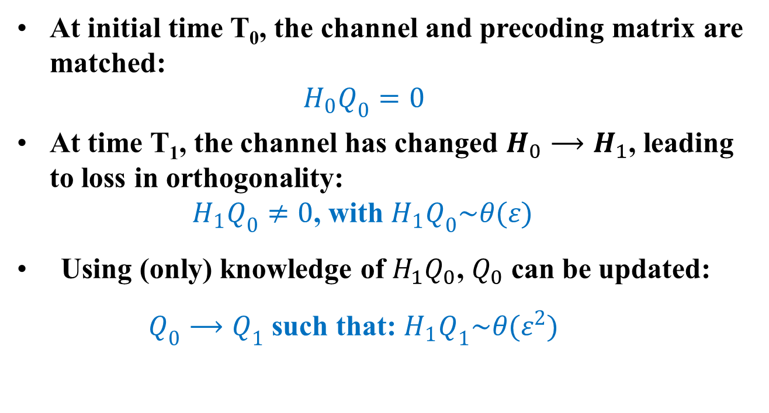
Summary of the principle
At initial time T₀, the channel and precoding matrix are matched:
$H_{0}Q_{0}=0$
At time T₁, the channel has changed $H_{0}⟶H_{1}$, leading to loss in orthogonality:
$H_{1}Q_{0}≠0$, with $H_{1}Q_{0}\sim θ(ε)$
Using (only) knowledge of $H_{1}Q_{0}$, $Q_{0}$ can be updated:
$Q_{0}⟶Q_{1}$ such that: $H_{1}Q_{1}\sim θ(ε^{2})$

Slide 5
Summary of the principle
Using knowledge of the interference channels allows a direct update of the precoding matrix that restores orthogonality (to first order)
This incremental update can be repeated as often as desired
  NOTE: since this is a linear approximation, divergence will eventually happen
  Combine with lower frequency of sounding

Slide 6
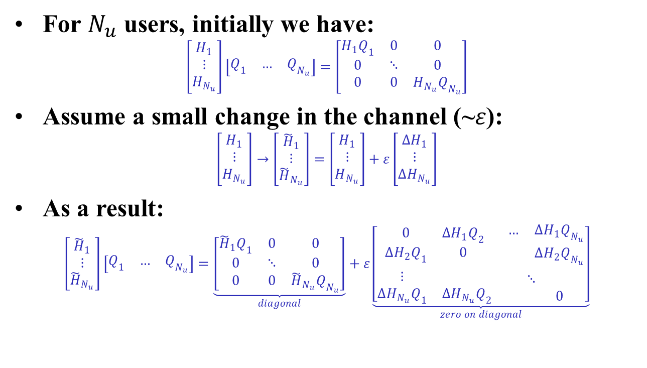
Mathematical derivation
For $N_{u}$ users, initially we have:
$\left[\begin{matrix}H_{1} \\ ⋮ \\ H_{N_{u}}\end{matrix}\right]\left[\begin{matrix}Q_{1} & … & Q_{N_{u}}\end{matrix}\right]=\left[\begin{matrix}H_{1}Q_{1} & 0 & 0 \\ 0 & ⋱ & 0 \\ 0 & 0 & H_{N_{u}}Q_{N_{u}}\end{matrix}\right]$
Assume a small change in the channel (~$ε$):
$\left[\begin{matrix}H_{1} \\ ⋮ \\ H_{N_{u}}\end{matrix}\right]→\left[\begin{matrix}{\tilde{H}}_{1} \\ ⋮ \\ {\tilde{H}}_{N_{u}}\end{matrix}\right]=\left[\begin{matrix}H_{1} \\ ⋮ \\ H_{N_{u}}\end{matrix}\right]+ε\left[\begin{matrix}{∆H}_{1} \\ ⋮ \\ {∆H}_{N_{u}}\end{matrix}\right]$
As a result:
$\left[\begin{matrix}{\tilde{H}}_{1} \\ ⋮ \\ {\tilde{H}}_{N_{u}}\end{matrix}\right]\left[\begin{matrix}Q_{1} & … & Q_{N_{u}}\end{matrix}\right]=\underset{diagonal}{\underbrace{\left[\begin{matrix}{\tilde{H}}_{1}Q_{1} & 0 & 0 \\ 0 & ⋱ & 0 \\ 0 & 0 & {\tilde{H}}_{N_{u}}Q_{N_{u}}\end{matrix}\right]}}+ε\underset{zero on diagonal}{\underbrace{\left[\begin{matrix}\begin{matrix}0 & {∆H}_{1}Q_{2} \\ {∆H}_{2}Q_{1} & 0\end{matrix} & \begin{matrix}… & {∆H}_{1}Q_{N_{u}} \\ & {∆H}_{2}Q_{N_{u}}\end{matrix} \\ \begin{matrix}⋮ & \\ {∆H}_{N_{u}}Q_{1} & {∆H}_{N_{u}}Q_{2}\end{matrix} & \begin{matrix}⋱ & \\ & 0\end{matrix}\end{matrix}\right]}}$

Slide 7
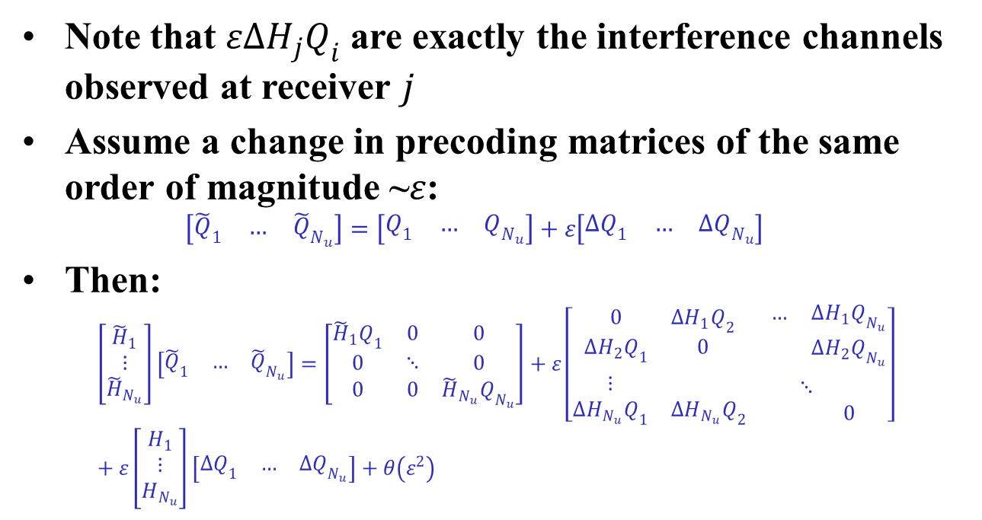
Mathematical derivation (2)
Note that ${ε∆H}_{j}Q_{i}$ are exactly the interference channels observed at receiver $j$
Assume a change in precoding matrices of the same order of magnitude ~$ε$:
$\left[\begin{matrix}{\tilde{Q}}_{1} & … & {\tilde{Q}}_{N_{u}}\end{matrix}\right]=\left[\begin{matrix}Q_{1} & … & Q_{N_{u}}\end{matrix}\right]+ε\left[\begin{matrix}{∆Q}_{1} & … & {∆Q}_{N_{u}}\end{matrix}\right]$
Then:
$\left[\begin{matrix}{\tilde{H}}_{1} \\ ⋮ \\ {\tilde{H}}_{N_{u}}\end{matrix}\right]\left[\begin{matrix}{\tilde{Q}}_{1} & … & {\tilde{Q}}_{N_{u}}\end{matrix}\right]=\left[\begin{matrix}{\tilde{H}}_{1}Q_{1} & 0 & 0 \\ 0 & ⋱ & 0 \\ 0 & 0 & {\tilde{H}}_{N_{u}}Q_{N_{u}}\end{matrix}\right]+ε\left[\begin{matrix}\begin{matrix}0 & {∆H}_{1}Q_{2} \\ {∆H}_{2}Q_{1} & 0\end{matrix} & \begin{matrix}… & {∆H}_{1}Q_{N_{u}} \\ & {∆H}_{2}Q_{N_{u}}\end{matrix} \\ \begin{matrix}⋮ & \\ {∆H}_{N_{u}}Q_{1} & {∆H}_{N_{u}}Q_{2}\end{matrix} & \begin{matrix}⋱ & \\ & 0\end{matrix}\end{matrix}\right]$
$+ ε\left[\begin{matrix}H_{1} \\ ⋮ \\ H_{N_{u}}\end{matrix}\right]\left[\begin{matrix}{∆Q}_{1} & … & {∆Q}_{N_{u}}\end{matrix}\right]+θ\left(ε^{2}\right)$

Slide 8
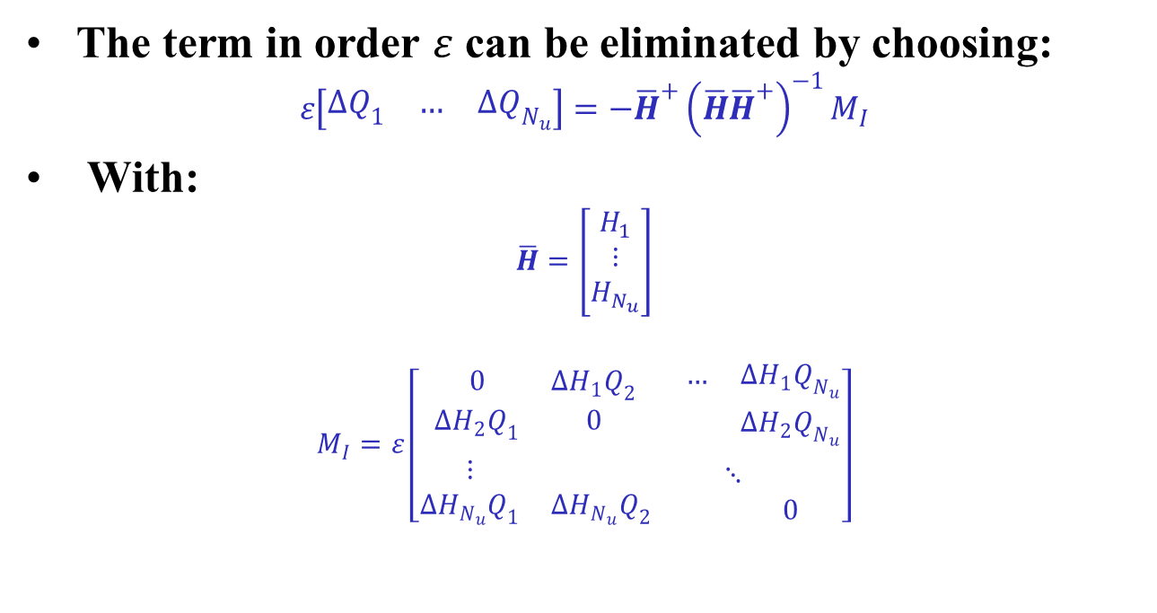
Mathematical derivation (3)
The term in order $ε$ can be eliminated by choosing:
$ε\left[\begin{matrix}{∆Q}_{1} & … & {∆Q}_{N_{u}}\end{matrix}\right]=−{\overline{H}}^{+}{\left(\overline{H}{\overline{H}}^{+}\right)}^{−1}M_{I}$
With:
$\overline{H}=\left[\begin{matrix}H_{1} \\ ⋮ \\ H_{N_{u}}\end{matrix}\right]$
$$M_{I}=ε\left[\begin{matrix}\begin{matrix}0 & {∆H}_{1}Q_{2} \\ {∆H}_{2}Q_{1} & 0\end{matrix} & \begin{matrix}… & {∆H}_{1}Q_{N_{u}} \\ & {∆H}_{2}Q_{N_{u}}\end{matrix} \\ \begin{matrix}⋮ & \\ {∆H}_{N_{u}}Q_{1} & {∆H}_{N_{u}}Q_{2}\end{matrix} & \begin{matrix}⋱ & \\ & 0\end{matrix}\end{matrix}\right]$$

Slide 9
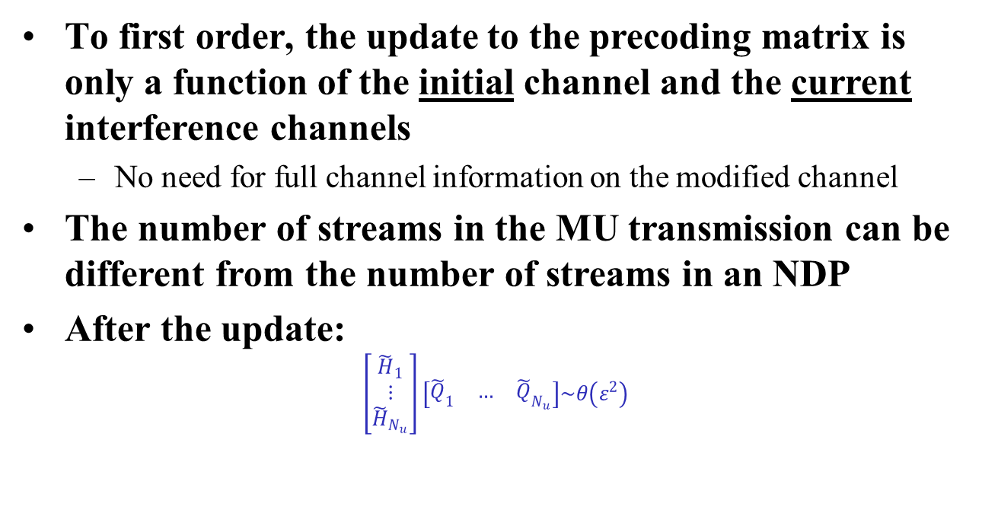
Notes
To first order, the update to the precoding matrix is only a function of the initial channel and the current interference channels
  No need for full channel information on the modified channel
The number of streams in the MU transmission can be different from the number of streams in an NDP
After the update:
$\left[\begin{matrix}{\tilde{H}}_{1} \\ ⋮ \\ {\tilde{H}}_{N_{u}}\end{matrix}\right]\left[\begin{matrix}{\tilde{Q}}_{1} & … & {\tilde{Q}}_{N_{u}}\end{matrix}\right]\sim θ\left(ε^{2}\right)$

Slide 10
Simulation setup
Channel is modeled as a complex-valued matrix
  Equivalent to frequency-domain analysis of single tone
The changing channel is modeled as a gradual transformation from an initial to a final channel realization (see [1])
Results are compared with “ideal” precoding
  i.e. ideal reference where the precoding is always up to date relative to the latest channel state

Slide 11
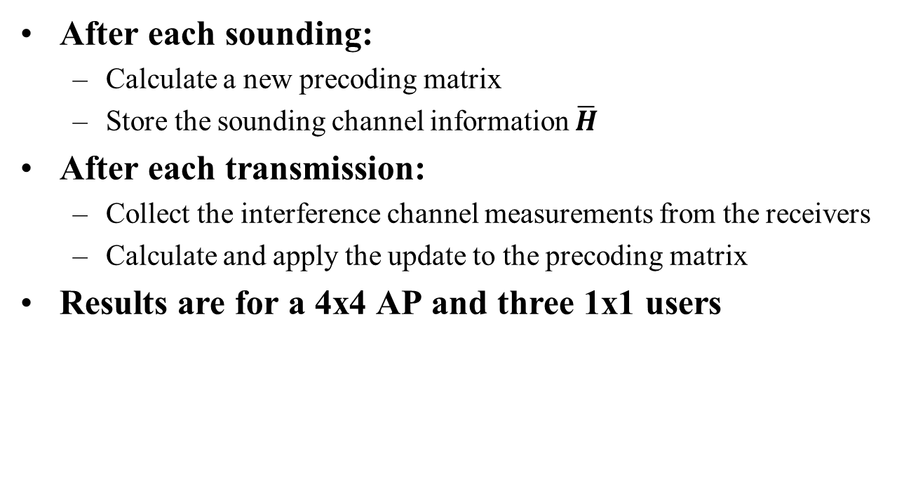
Simulation assumptions
After each sounding:
  Calculate a new precoding matrix
  Store the sounding channel information $\overline{H}$
After each transmission:
  Collect the interference channel measurements from the receivers
  Calculate and apply the update to the precoding matrix
Results are for a 4x4 AP and three 1x1 users

Slide 12
Results
No precoding update
Loss of precoding gain
Incremental updates to precoding
Precoding gain maintained
Gradual degradation for longer time

Slide 13
Results – combined with re-sounding
No precoding update
Loss of precoding gain
Incremental updates to precoding
Precoding gain maintained

Slide 14
Observations
Incremental changes can keep precoding matrices up-to-date for much longer without re-sounding
Behavior of SINR is much smoother, even as divergence sets in
  Re-sounding shows “saw-tooth” behavior
Analysis is admittedly simplified and further study is required

Slide 15
Open issues: overhead
  The goal is to reduce the overhead
  The overhead involved in the incremental update approach should be less than that of frequent sounding
Overhead is function of the amount of information and the messaging needed to convey the information
Amount of information can be reduced:
  Quantization (we expect small numbers)
  Tone grouping
  Feedback on selected packets only (decimate in time)
  How low can overhead be and still be effective?
Messaging information can be reduced
  E.g. Piggy-back feedback on ACK frame
Format of channel information
  Simulation are based on full channel info. Current 11ac provides only Sigma and V
More realistic simulations
  Specifically deal with phase changes due to symbol alignment

Slide 16
Open issues: OFDM
The analysis presented here is a matrix analysis
  Only single tone frequency-domain presented here
OFDM may add to the complexity
Avoid phase jumps between different transmissions due to different symbol alignment
  Some reference phase needs to be established

Slide 17
Open issues: format of channel information
Simulations are based on full channel info
  Current 11ac provides only ΔSNR and V in response to channel sounding
  Not clear if ΔSNR and V alone are sufficient
  Maybe U-matrix is needed
  U-matrices are small for 1x1 and 2x2 clients
  Further analysis needed

Slide 18
Conclusions
Re-sounding is the current mechanism to bring precoding matrices up to date
We presented a different mechanism based on incremental updates of the precoding:
  Interference channel measurements contain all the information that is needed for a first-order update
  Information is available “for free” at the MU receivers
Initial results show incremental changes can keep precoding matrices up-to-date for much longer without sounding
A combination of infrequent sounding and incremental updates could be an alternative to frequent sounding

Slide 19
References
[1] MU BFee Interference channel feedback , Sigurd Schelstraete, IEEE 802.11-15/0858

