Slide 1
MU BFee Interference channel feedback
Date: 2015-07-12
Authors:

Slide 2
Problem statement
MU-MIMO and TxBF precoding are based on channel information obtained during sounding
  Snapshot in time
The natural variability of the wireless channel causes the channel information and hence the precoding matrices to “age”
  Loss of BF gain over time
  Loss of interference cancellation over time
Channel information and precoding matrices need to be “refreshed” at an appropriate rate

Slide 3
Summary
Illustrate effect of precoding loss through simple matrix model
Show how receiver feedback can help in optimizing sounding frequency
  Since sounding implies overhead, it should be used carefully

Slide 4
Simple model for changing channel
A simple matrix model
  Choose two independent channel matrix realizations
  Perform precoding based on the initial channel values
  “Morph” the channel from its initial value to the other realization

Slide 5
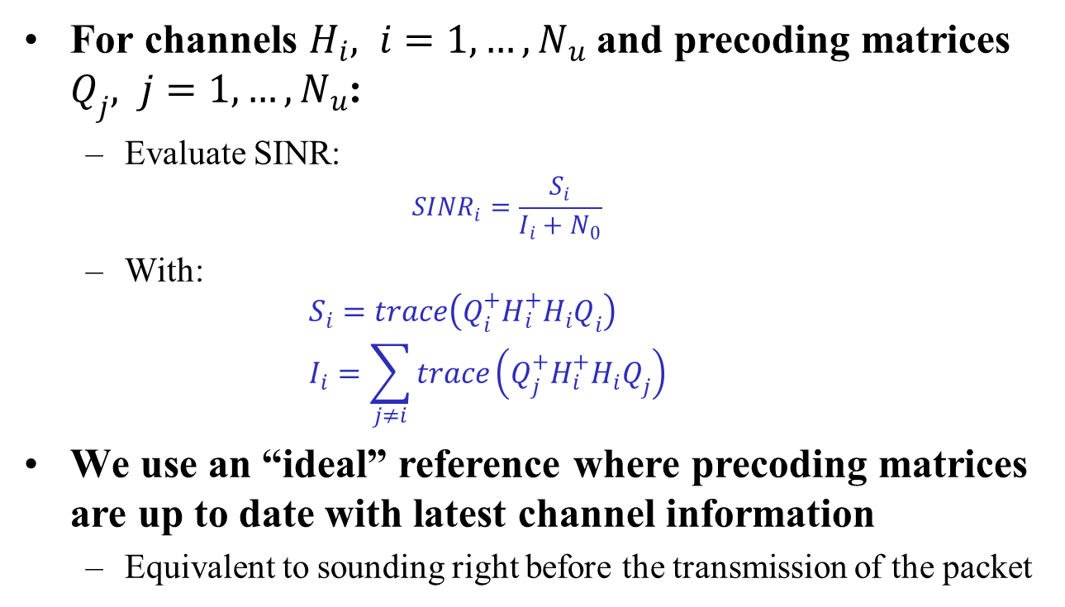
Simulating precoding loss
For channels $H_{i}, i=1, …, N_{u}$ and precoding matrices $Q_{j}, j=1, …, N_{u}$:
  Evaluate SINR:
  ${SINR}_{i}=\frac{S_{i}}{I_{i}+N_{0}}$
  With:
  $S_{i}=trace\left(Q_{i}^{+}H_{i}^{+}H_{i}Q_{i}\right)$
  $I_{i}=\sum_{j≠i}{trace\left(Q_{j}^{+}H_{i}^{+}H_{i}Q_{j}\right)}$
We use an “ideal” reference where precoding matrices are up to date with latest channel information
  Equivalent to sounding right before the transmission of the packet

Slide 6
Loss of precoding in changing channel
4x4 AP, three 1x1 users

Slide 7
Sounding
Updating channel information implies overhead
  Protocol overhead from sounding and sounding feedback
Resources should be managed carefully
  Excessive sounding wastes channel capacity without benefit
  Too few soundings degrade performance, especially for MU-MIMO
MU-MIMO needs more frequent updates than BF
  Depends on environment and can change over time
How to find the right sounding frequency?
  Too frequent sounding increases overhead
  Too infrequent sounding increases interference

Slide 8
Illustration with sounding
Regular sounding interval

Slide 9
Illustration with sounding (2)
Sounding triggered by 3dB SINR degradation

Slide 10
How to optimize sounding overhead?
Rate adaptation alone can not distinguish between effects of interference and other effects
Only the STA has a direct view of the interference
  MU-preamble provides ability to do channel estimate for all streams, including streams intended for other users in the MU group

Slide 11
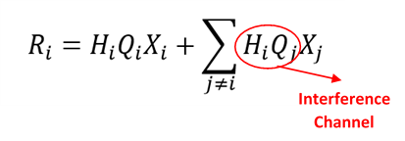
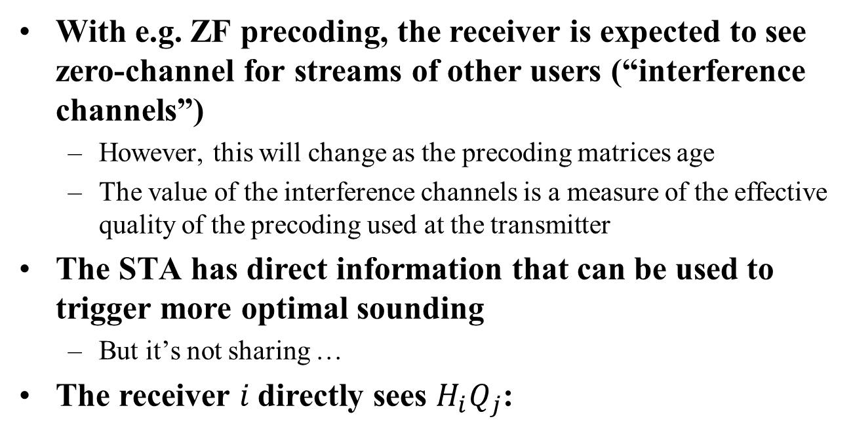
What information can the STA provide?
With e.g. ZF precoding, the receiver is expected to see zero-channel for streams of other users (“interference channels”)
  However, this will change as the precoding matrices age
  The value of the interference channels is a measure of the effective quality of the precoding used at the transmitter
The STA has direct information that can be used to trigger more optimal sounding
  But it’s not sharing …
The receiver $i$directly sees $H_{i}Q_{j}$:

Slide 12
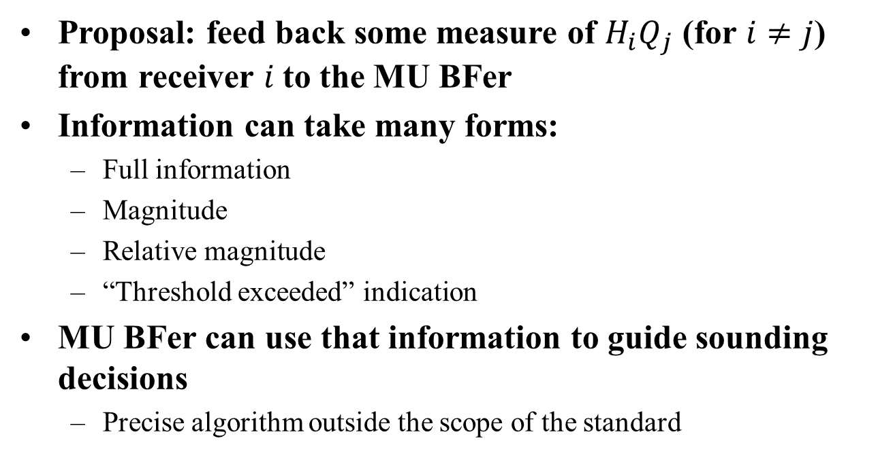
Proposal
Proposal: feed back some measure of $H_{i}Q_{j}$ (for $i≠j$) from receiver $i$to the MU BFer
Information can take many forms:
  Full information
  Magnitude
  Relative magnitude
  “Threshold exceeded” indication
MU BFer can use that information to guide sounding decisions
  Precise algorithm outside the scope of the standard

Slide 13
Keep overhead low
Information can be quantized in low # bits
  We expect small values
Information can be provided on a subset of tones
  We don’t expect huge tone-to-tone variations
Information can possibly be piggy-backed on the regular ACK frame
  Data frame will be followed by ACK anyway (mostly …)
  This avoids separate exchange

Slide 14
Summary
MU needs frequent sounding to maintain precoding
  Function of environment
STAs have information of the effectiveness of precoding
Feedback from the MU BFee allows BFer to make more informed decision on sounding
  Reducing protocol overhead
Provide a mechanism to enable interference channel measurement from BFee to BFer

Slide 15
Straw Poll
Should 11ax define a mechanism to feed back information on the interference channel measured at the receiver to the transmitter?

