Slide 1
Compressed Uplink Trigger Frame
Date: 2015-07-12
Authors:

Slide 2
Abstract
An UL MU transmission has been defined as a sequence of UL-TR frame, UL MU PPDU and ACK
  An UL MU PPDU (MU-MIMO or OFDMA) is sent as an immediate response (IFS TBD) to a Trigger frame (format TBD) sent by the AP. [1]
  The amendment shall define a mechanism for multiplexing DL acknowledgments sent in response to UL MU transmissions. [1]
UL MU transmission extension in one TXOP

Slide 3
Option 1: A TR schedules all uplink transmissions
TXOP
AP
UL TR
ACK/BA
ACK/BA
STA 1
Padding
STA 4
Padding
STA 2
Padding
STA 5
Padding
STA 3
Padding
STA 6
Padding
time
Pros:
  Nodes can go to the sleep mode
  Less TR overhead
  Useful for periodic traffic
Cons:
  Synchronization problem
  Padding overhead for aperiodic traffic
    (since AP should know about STAs queue status)

Slide 4
Option 2: More than one TR can be transmitted during UP link TXOP (1/2)
TXOP
UL TR
ACK/BA
UL TR
ACK/BA
AP
STA 1
Padding
STA 4
Padding
STA 2
Padding
STA 5
Padding
STA 3
Padding
STA 6
Padding
time
Pros:
  No synchronization problem
Cons:
  Nodes cannot go to the sleep mode
  TR over head can be high
  Padding overhead for aperiodic traffic, since AP doesn't know the buffer status of STA

Slide 5
Option 2: More than one TR can be transmitted during UP link TXOP (2/2)
Padding overhead for aperiodic traffics can be solved with polling and with multiple transmission per group of users
TXOP
Polling
Polling
UL TR
ACK/BA
UL TR
ACK/BA
UL TR
ACK/BA
UL TR
ACK/BA
AP
STA 1
STA 4
STA 1
STA 4
STA 2
STA 5
STA 2
STA 5
STA 3
STA 6
STA 3
STA 6
time
Pros:
  Scheduling is simpler for aperiodic traffics
  Synchronization is simpler
Cons:
  TR Overhead is high

Slide 6
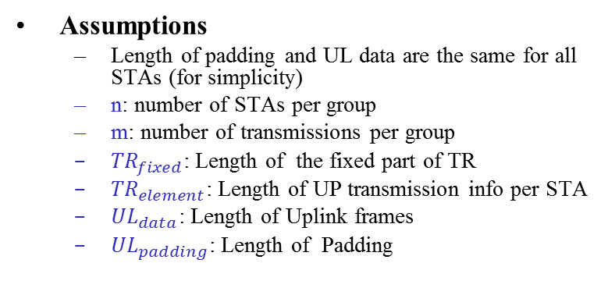
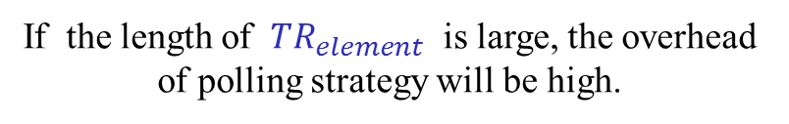

A simple comparison
Case 1:
Case 2:
TXOP
TXOP
UL TR
BA
UL TR
BA
UL TR
BA
AP
AP
STA 1
STA 1
STA 1
STA 2
STA 2
STA 2
STA 3
STA 3
STA 3
time
time
Assumptions
  Length of padding and UL data are the same for all STAs (for simplicity)
  n: number of STAs per group
  m: number of transmissions per group
  ${TR}_{fixed}$: Length of the fixed part of TR
  ${TR}_{element}$: Length of UP transmission info per STA
  ${UL}_{data}$: Length of Uplink frames
  ${UL}_{padding}$: Length of Padding
$${ {TransmissionTime}_{1}= TR}_{fixed}+n {TR}_{element}+ {UL}_{data}+{UL}_{padding}$$
$${ {TransmissionTime}_{2} =m∗ TR}_{fixed}+m∗n {TR}_{element}+ {UL}_{data}$$
Therefore
$${ TransmissionTime}_{2} > {TransmissionTime}_{1}$$
$$m∗ {TR}_{fixed}+m∗n {TR}_{element} > {UL}_{padding }$$
if
If the length of ${TR}_{element}$ is large, the overhead of polling strategy will be high.

Slide 7
Solution: Avoiding retransmitting TR_{elements}
Compressed Trigger Frame
AP
UL
TR
ACK/BA
ACK/BA
UL
TR
ACK/BA
UL
TR
ACK/BA
STA1
STA 4
STA 1
STA 4
STA2
STA5
STA 2
STA 5
STA3
STA6
STA 3
STA 6
time
STAs can use information from previous TR to transmit its uplink frames.

Slide 8
Compressed Trigger Frame (option 1)
Same resource allocation is repeated for the same group of STAs.
If “More elements” field has NOT been set, it means the trigger frame dose NOT contain resource allocation elements.
STA shall save the information of TRs per TXOP.
  If the identifier of compressed TR is same as the identifier of the saved TR, then STA shall use the saved information for uplink transmission.

Slide 9
Compressed Trigger Frame (Option 2)
A subset of assigned group transmits with the same uplink transmission information but on different sub-channels.
AP by setting “previous assignment” filed in BA per STA notifies that STA shall use the previous uplink transmission settings after receiving a compressed TR. AP may assign new sub-channel range in BA.
STA shall use the saved information for transmitting an uplink frames, if the the identifier of the compressed TR is same as identifier of the regular TR.

Slide 10
Straw Poll
Do you agree to add the following sentence SFD:
  Per-user information in the Trigger Frame may be omitted for scheduled STA(s).

Slide 11
Reference
[1] IEEE 802.11-15/0132r5 Specification Framework for TGax

