Slide 1
How to collect STAs’ Tx demands for UL MU
Date: 2015-07-13
Authors:

Slide 2
Abstract
This presentation breaks down the issues of how to collect STAs’ Tx demands for UL-MU from the feedbacks given in the previous meeting.

Slide 3
An approach to collect STAs’ Tx demands
A need of a rough way to grasp or estimate STAs’ TX demands was suggested [1].
STA-oriented way of notification, where TX demand is shown in a field something like a More Data field, was proposed and its concept was shown to be acceptable by a straw poll [2]
  Straw Poll 5: For an AP to send the trigger frame for UL MU TX, do you think it is useful if a STA is able to notify the AP of its TX demand by a field something like a More Data field in a frame sent from its side? – no objections

Slide 4
Recalling STA-oriented way of Tx demand notification [2]
STA 1 to AP
STA 3 to AP
Data
BA/ACK
Data
BA/ACK
…
…
same from STA 4 and 6
data
data
notification of remaining data
in MAC header
notification of remaining data
in MAC header
collected by AP
AP recognizes STAs 1, 3, 4, and 6 have MSDUs to transmit*
AP sends the trigger frame to STAs 1, 3, 4, and 6
* may also need to consider group IDs for selecting STAs

Slide 5
“More Data” field may not be enough
From the discussions related to the trigger initiating UL-MU Tx which took place in the May session, an AP may want the following info besides each STA’s Tx demands:
  amount of buffered MSDUs/A-MSDUs in order to specify PPDU duration
    straw poll 3 in [2]: What kind of information should be specified in a trigger frame? PPDU duration (TBD, may be exact or maximum)
    – no objections

Slide 6
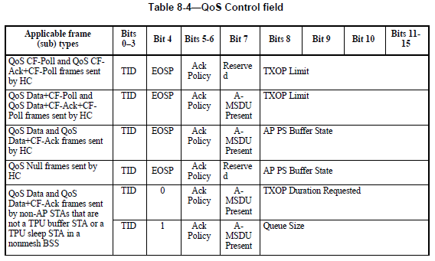
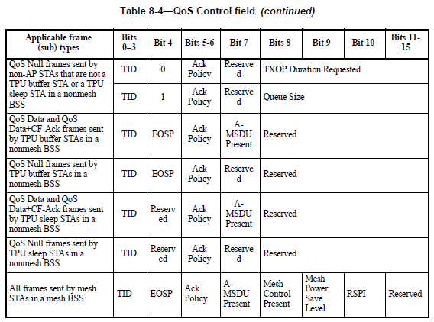
Consideration on QoS control field
There were opinions to use QoS control field.
QoS control field (IEEE Std 802.11-2012):

Slide 7
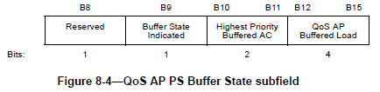
Consideration on QoS control field
AP PS Buffer State subfield
  “The AP Buffered Load subfield is 4 bits in length and is used to indicate the total buffer size, rounded up to the nearest multiple of 4096 octets and expressed in units of 4096 octets, of all MSDUs and A-MSDUs buffered at the QoS AP (excluding the MSDU or A-MSDU of the present QoS data frame).”
TXOP Duration Requested subfield
  “The Queue Size subfield is an 8-bit field that indicates the amount of buffered traffic for a given TC or TS at the STA sending this frame.”
Queue Size subfield
  “The TXOP Duration Requested subfield is an 8-bit field that indicates the duration, in units of 32 μs, that the sending STA determines it needs for its next TXOP for the specified TID.”
to be precise, it is the QoS AP Buffered Load subfield…
→ AP PS Buffer State subfield has the best fit to what we want

Slide 8
Discussion points on AP PS buffer State subfield
From the current baseline, this can be used only at APs.
  We want such info from non-AP STAs but there are other definitions already for non-AP STAs
    Withdraw the current definition for non-AP STAs and re-specify for HEW STAs?
      Thinking about the relation between mesh STAs, this seems to be difficult.
    Extend HT Control field to further include HE variant?
      Use B1 of VHT variant which is currently reserved for distinction? Can we throw over the current VHT params?
    Create a new HEW control field?
    Other solution?

Slide 9
Discussion points on AP PS buffer State subfield
Although if we can re-use the current subfield…
The AP Buffered Load subfield inside expresses the total buffer size in units of 4096 octets.
  OFDMA shows higher performance for short packets, say up to 1k octets. Won’t units of 4096 octets be too rough to express the demands of short packets? – more small units preferred?
The AP Buffered Load subfield value of 15 indicates that the buffer size is greater than 57 344 octets.
  On the other hand, thinking of the aggregation size increased by 11ac and the possibility of being increased more, especially for MU-MIMO (and more higher MCSs added?), upper limit may need to be more larger. – more than the current 4 bits preferred? or enlarge unit size?

Slide 10
One idea to make the unit size of the AP Buffered Load subfield flexible
set a field that expresses the unit size in use
  ex.
B8-9 as Unit Size subfield (2 bits) | definition
00 | total buffer size is expressed in units of 256 octets
01 | total buffer size is expressed in units of 4096 octets
10 | total buffer size is expressed in units of 8192 octets
11 | reserved

Slide 11
Other candidate info to collect
triggered cycle request?
  STAs having short lifetime data may want to request triggered cycle.
  However, TSPEC element has the following parameters :
    Minimum Service Interval, Maximum Service Interval,
    Minimum Data Rate, Mean Data Rate, Peak Data Rate
    these info collected from the non-AP STAs prior to data exchange may be reflected to schedule the trigger frame.

Slide 12
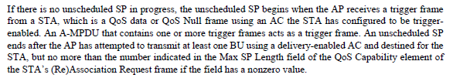
My two cents on the trigger frame
Reviewing the baseline, we already use the term “trigger frame”… so we need to reconsider the frame name.
Will the “trigger frame” need to be a unified format for both UL-MU-MIMO and UL-OFDMA? Do we allow their combination?
  A frame to trigger UL-MU-MIMO needs to allocate spatial streams to STAs. A frame to trigger UL-OFDMA needs to allocate resource units to STAs.

Slide 13
Summary
For the trigger frame to specify the PPDU duration of UL-MU, AP may want amount of buffered data at STAs and 1 bit “More Data” field is not enough.
Reviewing QoS Control field, AP PS Buffer State subfield has the best fit, but in the current definition, that can’t be used for non-AP STAs. Also the current unit size and its upper limit was questioned.

Slide 14
References
[1] 802.11-15/0064r1 “Consideration on UL-MU overheads”
[2] 802.11-15/0608r1 “Regarding trigger frame in UL MU”

Slide 15
Straw poll 1
Do you think we should withdraw the current definition of Bits 8-15 in QoS Control field for non-AP STAs and re-specify for HEW STAs to indicate buffer load?
  Y:N:A=

Slide 16
Straw poll 2
Do you think we should extend HT Control field to further include HE variant and indicate buffer load there?
  Y:N:A=

Slide 17
Straw poll 3
Do you think we should create a new HEW control field to indicate buffer load there?
  Y:N:A=

Slide 18
SP
Which option do you prefer for indicating the buffer load?
Modifying the current definition of the QoS Control field (bits 8-15) - 15
HEW-Variant of the HT Control field -1
New HEW Control field -3
Abstain - 49

