Slide 1
DL OFDMA Signalling
Date: 2015-07-13
Authors:

Slide 2
Abstract
This presentation breaks down the issues of how to allocate resource units and inform them in DL-OFDMA.

Slide 3
Points of this presentation
As OFDMA Numerology and Structure [1] now being approved, a question whether AP allocates non-contiguous multiple resource units (RUs) for each user will arise.
  Non-contiguous RUs allocation was shown in [2].
This presentation also questions how to inform RU allocation for DL OFDMA.
  Reusing Group ID concept in SIG-A field for 802.11ac DL-MU-MIMO is one possibility but current SIG-A field is not enough for DL-OFDMA.

Slide 4
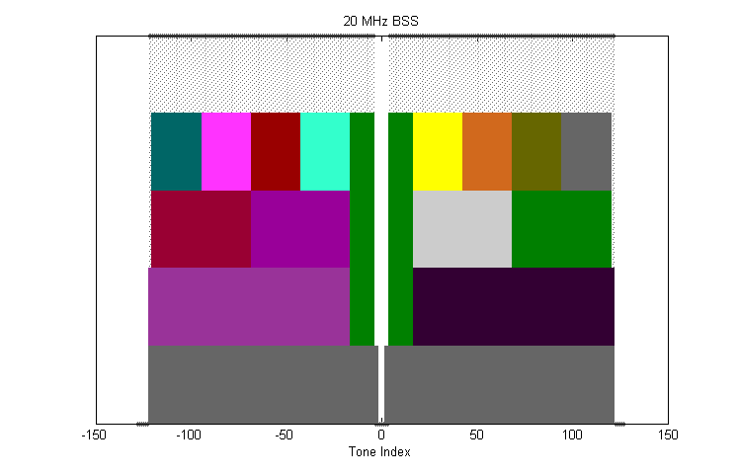
Contiguous or non-contiguous?
[1] shows the variety of RU patterns. For example, AP may send with one 52 tone RU or with two 26 tone RUs. It is possible to select non-contiguous RUs in this case. (Ex. Select pink and yellow RUs for one user.)
  Frequency diversity can be enhanced in non-contiguous case.
Allocate non-contiguous
RUs for user #n.
26 tone RUs
Allocate contiguous
RUs for user #n.
52 tone RUs
+ one 26-tone
[1] 802.11-15/0330r5

Slide 5
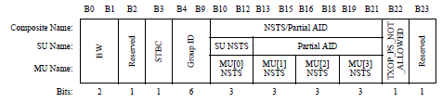
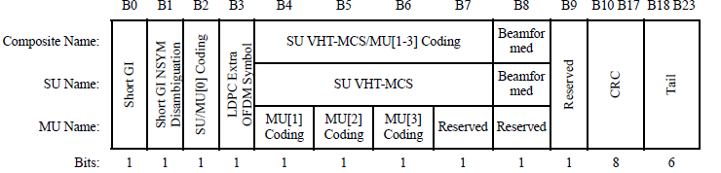
How to inform RU allocation for DL-OFDMA?
In 802.11ac DL-MU-MIMO case,
multiple user information is set in SIG-A and Group ID is used to signal potential recipient users
AP informs Group ID and NSTS for each user position
Number of space time streams for each user position
VHT-SIG-A in IEEE Std 802.11ac-2013

Slide 6
Approach to use same Group ID concept
If applying the same concept for DL-OFDMA, then NSTS field means position of each RU.
  Current field can set only up to 4 users or 8 RUs, though up to maximum 9 users or 9 RUs are considered in the case of 20 MHz channel. The field length is not enough.
  It cannot support allocation of non-contiguous RUs for one user.
    If each MU[u] field is substituted to RU position, only one RU can be allocated to a user
    ex. either R1 or RU3 can be allocated to user A, but not both.
    Instead, another expression may be such that the relative orders of RU positions are fixed and the number of successive RUs can be changed
    ex. RU1 & 2 can be allocated to user A by MU[0]=2, but not RU1 & RU3
GID table
RU1 for user A is good.
→GID1 is OK
To allocate both RU1 and RU3, how can it be informed?
Is it necessary to use other GID? (ex. New GID = A B A D)
UP
0 1 2 3
GID1
A | B | C | D
A | B | E | F
SNR
user A
SNR
user A
GID2
user B
GID <1> | MU[0] #RU | MU[1] #RU | MU[2] #RU | MU[3] #RU
user B
RU1
f
RU1
RU3
f

Slide 7
Other discussion points on RU allocation
In OFDMA, there are maximum of 9 RUs for 20 MHz but this becomes 18 in case of 40 MHz and more in case of 80 or 160 MHz.
  How can the allocation of each RU be described when number of RUs changes?
  Do we always need to express user positions up to the maximum number of RUs?
Do we want a format that is capable of expressing the combination of MU-MIMO and OFDMA?
  Do we think of the possibility of sending a PPDU in the combination of MU-MIMO and OFDMA?

Slide 8
Summary
The way to inform RU allocation in DL-OFDMA was considered.
The authors want to confirm group’s intention toward some of the points, such as
  possibility of non-contiguous RU allocation
  how to cope with the large number of RUs

Slide 9
References
[1] 802.11-15/0330r5 “OFDMA Numerology and Structure”
[2] 802.11-15/ 586r1 “Frequency Diversity Options in OFDMA”

Slide 10
Straw Poll 1
Do you think we should be able to express non-contiguous RU allocation?
  Y:N:A =

Slide 11
Straw Poll 2
Do you think we need to re-define SIG-A field for DL-OFDMA from the current format specified for DL-MU-MIMO?
  Maximum number of RUs cannot be expressed in 3 bits of the current MU[u] NSTS field.
  Y:N:A =

Slide 12
Straw Poll 3
Do you think the Group ID concept in 802.11ac is still applicable for 802.11ax?
  Y:N:A =

Slide 13
Straw Poll 4
Do you think we always need to express user position up to the maximum number of RUs?
  In [1], there are 37 RUs at maximum for 80 MHz channel. Thinking that there will 74 RUs for 80+80 or 160 MHz channel, when a BSS supports 80+80 or 160 MHz channel, will fixed 74 spaces to express each RU required all the time?
  Y:N:A =

Slide 14
Straw Poll 5
Do you think the combination of MU-MIMO and OFDMA within 20 MHz should be allowed?
  Y:N:A =

