Slide 1
LTF Design for Uplink MU-MIMO
Date: 2015-07-13
Authors:

Slide 2
LTF Sequence for Uplink MU-MIMO
LTF Sequence masking with orthogonal codes was proposed for Uplink MU-MIMO operation [1].
The idea is to allow full channel estimation within a symbol to allow phase/frequency offset tracking.
There are two issues with the proposal
Orthogonal code masking does not create orthogonal codes due to CSD application in different spatial streams.
May require complex receivers for tracking frequency/phase
Code masking to the entire LTF sequence results in very high PAPR sequence.

Slide 3
Non-Orthogonality of P matrix Masking
[ 1 1 1 1 1 1 1 1 ]
CSD for SS#1
x
HE LTF Sequence 1
[ 1 -1 1 1 ][ 1 -1 1 1 ]
Row 1 of P matrix
x
L₁
L₂
L₃
L₄
L₅
L₆
L₇
L₈
L₁
–L₂
L₃
L₄
L₅
– L₆
L₇
L₈
[ 1 e^{j2πθ} e^{j2π2θ} e^{j2π3θ} e^{j2π4θ} e^{j2π5θ} e^{j2π6θ} e^{j2π7θ} ]
NOT ORTHOGONAL
CSD for SS#2
x
[ 1 1 -1 1 ][ 1 1 -1 1 ]
Row 2 of P matrix
x
L₁
L₂
L₃
L₄
L₅
L₆
L₇
L₈
L₁
ωL₂
-ω²L₃
ω³L₄
ω⁴L₅
ω⁵L₆
-ω⁶L₇
ω⁷L₈
HE LTF Sequence 2

Slide 4
Cross Correlation between LTF Spatial Streams
To quantify the non-orthogonality between different LTF spatial streams, we have computed cross correlation between them.
When spatial stream are completely orthogonal cross correlation terms would be zero.
Not all LTF spatial streams are equal, some stream pair have worse interference between each other than other stream pairs.
 | SS #1 | SS #2 | SS #3 | SS #4 | SS #5 | SS #6 | SS #7 | SS #8
SS #1 |  | 0.002406 | 0.049069 | 0.29361 | 0.343407 | 0.000507 | 0.000301 | 0.033816
SS #2 |  |  | 0.098141 | 0.049069 | 2.31E-07 | 0.245362 | 0.00542 | 0.003688
SS #3 |  |  |  | 0.002406 | 0.000678 | 0.01219 | 0.09817 | 0.000307
SS #4 |  |  |  |  | 0.003764 | 7.53E-05 | 0.000231 | 0.147246
SS #5 |  |  |  |  |  | 0.001354 | 0.061323 | 0.196079
SS #6 |  |  |  |  |  |  | 0.269276 | 0.024541
SS #7 |  |  |  |  |  |  |  | 0.00634
SS #8

Slide 5
Residual Frequency/Phase Offset Compensation with P matrix masked LTF symbols
Received LTF symbols (freq-domain)
N_{ss} x 242
perform de-spreading per stream
‘K’ de-spreaded tones used for residual frequency/phase offset
D
N_{ss} x K
N_{ss} x K
estimate residual
frequency/phase offset
f_{o} &θ per STA
Note:
We have performed tests with various K.
Obviously high K values means higher complexity at the AP receiver.
(The chosen tones were evenly spaced across frequency for diversity effects)
N_{ss} x 242
Compensated LTF symbols for time domain de-spreading processing

Slide 6
P-Matrix De-spreading
Freq.
LTF sequence w/ CSD
L₁ e^{jθ}
L₂ e^{j2θ}
-L₃ e^{j3θ}
L₄ e^{j4θ}
L₅ e^{j5θ}
L₆ e^{j6θ}
-L₇ e^{j7θ}
L₈ e^{j8θ}
L₉ e^{j9θ}
L₁₀ e^{j10θ}
-L₁₁ e^{j11θ}
…
x
x
…
L₁* e-^{jθ}
L₂* e-^{j2θ}
-L₃* e-^{j3θ}
L₄* e-^{j4θ}
L₅* e-^{j5θ}
…
L₁₀* e-^{j10θ}
L₁₁* e-^{j11θ}
In total ‘M’ number of potential channel coefficient estimates from de-spreading
h₁
h₂
…
…
h₁₀
Selectively compute
(sub-sample)
h₂
h₆
h₁₀
…
Total of ‘K’ number of channel coefficient estimates for frequency/phase tracking

Slide 7
Simulation Setup
Simulation Assumption
BW: 20MHz
Channel Model: TGac Channel D
Configuration:
4 Rx AP with FOUR of 1 Tx STA
8 Rx AP with SIX of 1 Tx STA
Transmit timing spread among users: spread uniformly within 0us, 0.5us, and 1us
Identical SNR among STAs
MCS 6, Payload Size 1000 Bytes
IPN: -41dBc (both at Tx and Rx)
Real frequency/phase offset tracking
‘K’ de-spread channel coefficients in frequency domain was used in tracking
de-spread channel coefficients in time domain (after frequency/phase compensation) used in data symbol equalization
Real channel estimation
To compare the effect of non-orthogonality, we have also compared with applying block CSD (i.e. phase is rotated every 8 tones) [see APPENDIX]

Slide 8
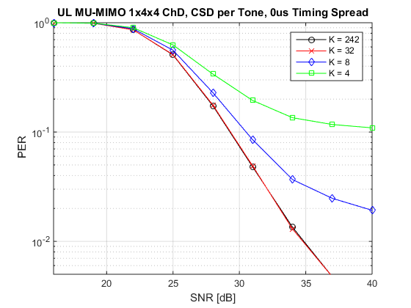
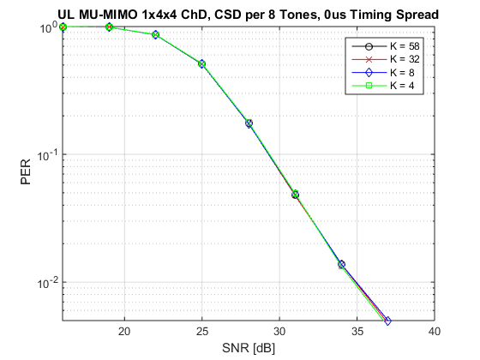
Performance with LTF P matrix masking (1/5)
4 Rx AP
1Tx, 4 STA w/ 1 SS
0us transmit time spread among STAs
In order to combat non-orthogonality of the P matrix with CSD, residual frequency/phase offset compensation MUST be performed with MANY tones
We can see that if P matrix is perfectly orthogonal freq./phase offset tracking works even with 4 values (i.e. tones)

Slide 9
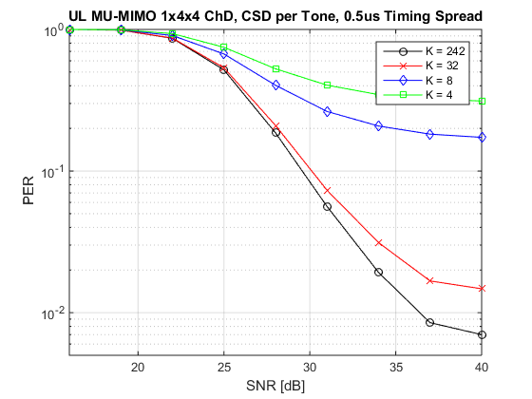
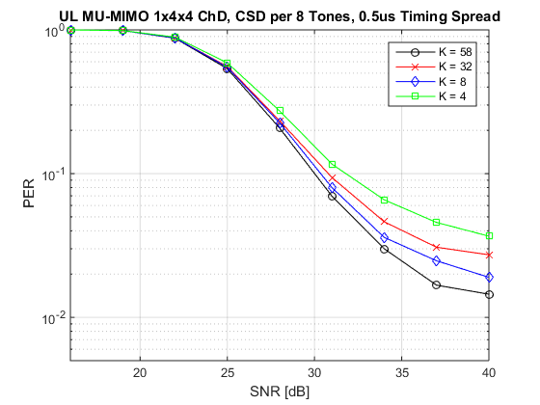
Performance with LTF P matrix masking (2/5)
4 Rx AP
1Tx, 4 STA w/ 1 SS
0.5us transmit time spread among STAs
Similar trend can be observed with transmit time dispersion among STAs

Slide 10
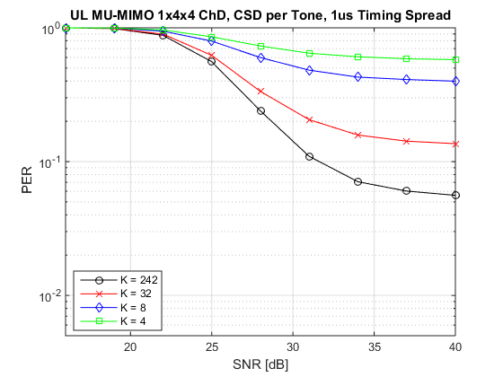
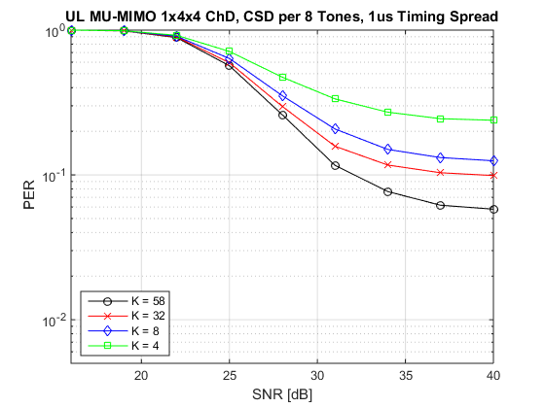
Performance with LTF P matrix masking (3/5)
4 Rx AP
1Tx, 4 STA w/ 1 SS
1us transmit time spread among STAs
Similar trend can be observed with transmit time dispersion among STAs

Slide 11
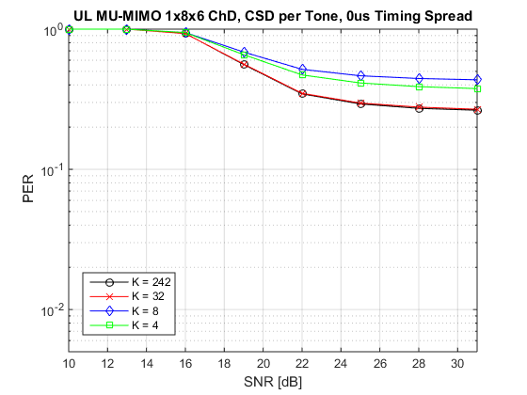
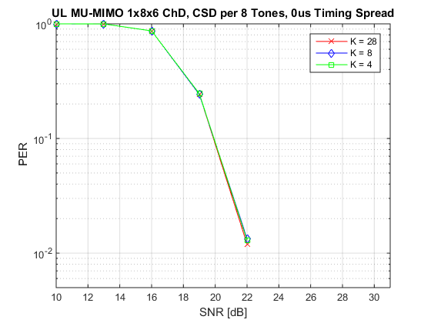
Performance with LTF P matrix masking (4/5)
8 Rx AP
1Tx, 6 STA w/ 1 SS
0us transmit time spread among STAs
Non-orthogonality issue impacts performance more critically when more spatial streams are used.

Slide 12
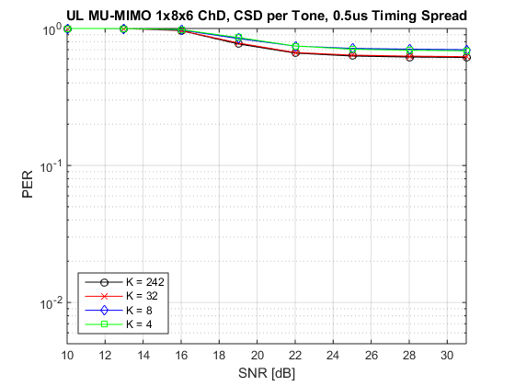
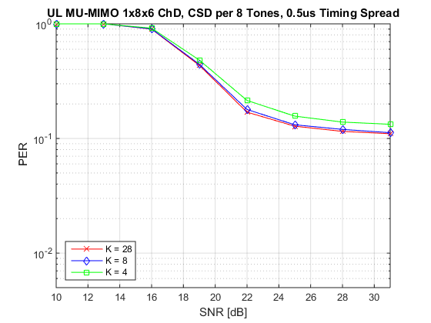
Performance with LTF P matrix masking (5/5)
8 Rx AP
1Tx, 6 STA w/ 1 SS
0.5us transmit time spread among STAs
Similar trend

Slide 13
PAPR issue with P matrix masking
PAPR effects implementation complexity/cost of the transmit RF components.
PAPR of the LTF symbols used for channel estimation should be sufficiently lower than data PAPR.
LTF sequences are typically designed such that low PAPR property is met.
Multiplication of P matrix across the ENTIRE transmitted tones, completely destroys nice PAPR property of LTF sequences.

Slide 14
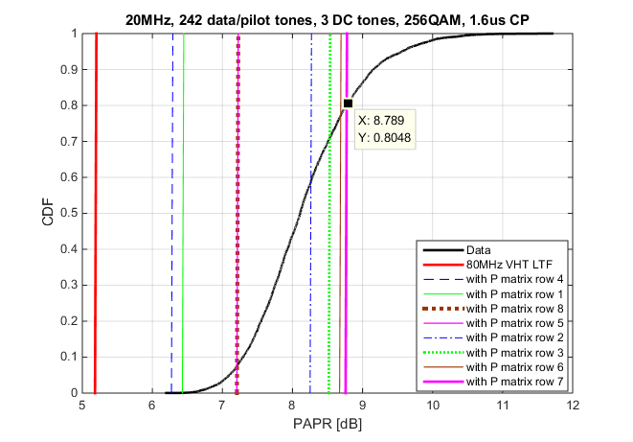
PAPR of LTF Symbols with P matrix Masking
Observation:
P matrix masked LTF can have up to 8.8 dB PAPR
There is 80% probability that data OFDM symbols have less than 8.8dB PAPR.
P matrix masked LTF OFDM symbols have higher mean/median PAPR than data OFDM symbols

Slide 15
Conclusion
We have identified significant issues with LTF masked with P matrix for Uplink MU-MIMO as proposed in [1].
The proposal creates several implementation challenges and requires highly complex receiver implementation.
We urge that further study to be performed on LTF design for uplink MU-MIMO as it has critical impact to performance and implementation.

Slide 16
Strawpoll
Do you agree that more analysis of implementation complexity and performance on various scenarios is needed for uplink MU-MIMO LTF design?
Y/N/A:

Slide 17
References
[1] IEEE802.11-15/0602r1, “HE-LTF Sequence for UL MU-MIMO,” May 2015.

Slide 18
Appendix: Example of Block CSD vs Regular CSD
Regular CSD (every tone)
Block CSD (every 4 tones)
Phase of CSD changed every tone
Phase of CSD changed every few tones
[ 1 e^{j2πθ} e^{j2π2θ} e^{j2π3θ} e^{j2π4θ} e^{j2π5θ} e^{j2π6θ} e^{j2π7θ} ]
CSD for SS #m
[e^{j2πθ} e^{j2πθ} e^{j2πθ} e^{j2πθ} e^{j2π5θ} e^{j2π5θ} e^{j2π5θ} e^{j2π5θ} ]
x
x
[ 1 1 -1 1 ][ 1 1 -1 1 ]
Row ‘m’ of P matrix
[ 1 1 -1 1 ][ 1 1 -1 1 ]
x
x
L₁
L₂
L₃
L₄
L₅
L₆
L₇
L₈
LTF sequence
L₁
L₂
L₃
L₄
L₅
L₆
L₇
L₈
Final Output Sequence
Final Output Sequence
Not Orthogonal
Orthogonal

