Slide 1
NIST Preliminary Channel Measurements at 83 GHz
doc.: IEEE 802.11-15/0840-01-00ay
Date: 2015-07-14
Authors:
Notes:
So four months ago in Berlin, I first presented the NIST mmWave channel sounders
After four months, we’ve had some time to play around with the system and take some preliminary channel measurements
The intention is here is to necessarily show the measurements, but rather to show the kinds of measurements we can take

Slide 2
Abstract
doc.: IEEE 802.11-15/0840-01-00ay
We have conducted a number of measurement campaigns 83 GHz using NIST mm-wave channel sounders. The purpose of this presentation is to show the measurement capabilities we can provide to task group IEEE 802.11ay for channel modelling.

Slide 3
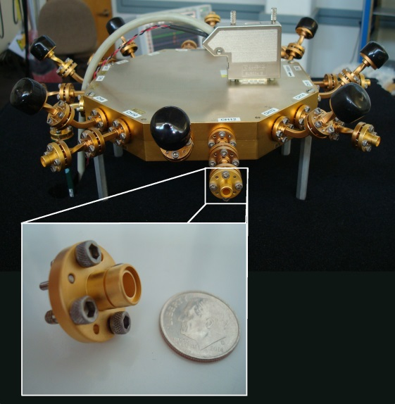
28 / 83 GHz Channel Sounder Characteristics
doc.: IEEE 802.11-15/0840-01-00ay
1 TX antenna
  Omni-directional in azimuth
  45º beamwidth in elevation
16-antenna RX array
  8 elements every 45º in azimuth at 0º elevation (no cap)
  8 elements every 45º in azimuth at 45º elevation (black cap)
  Can extract double-directional angle-of-arrival
  Each horn antenna has 45º beamwidth
2 GHz null-to-null bandwidth
Robot-guided navigational system
  Can collect hundreds of GB of data in just minutes
Can support use cases with high mobility
  Complete channel measurement sweep in 65 μs
  Untethered synchronization through rubidium clocks
RX array

Slide 4

Measurement Setup
July 2015
Wall
$$θθ$$
(θ,ϕ)
Ground-truth azimuth and elevation angle-of-arrival of direct path are known
  Since TX and RX at same height, elevation angle is always 0º
Ground-truth robot velocity is known

Slide 5
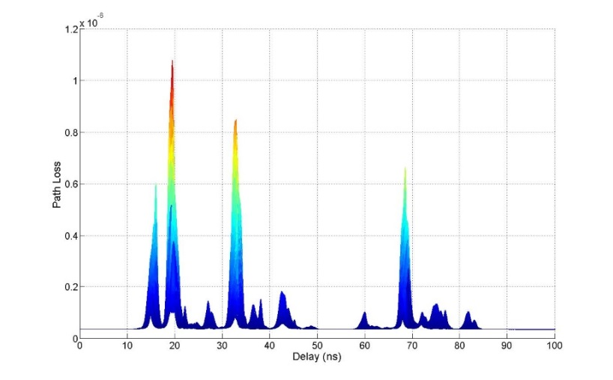
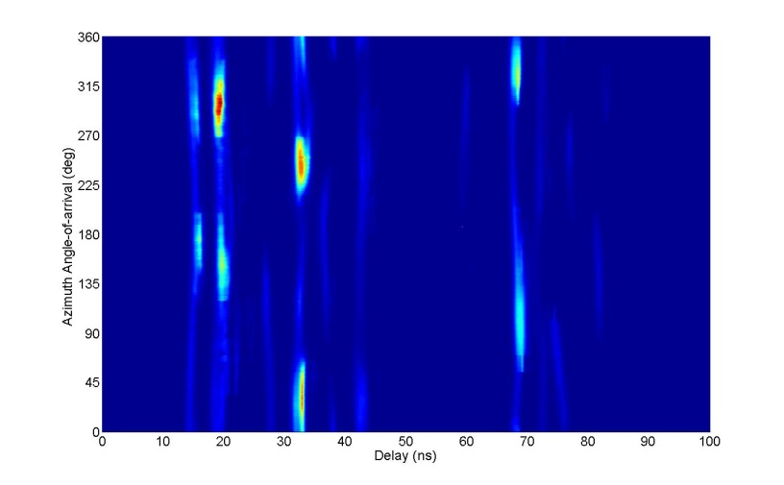


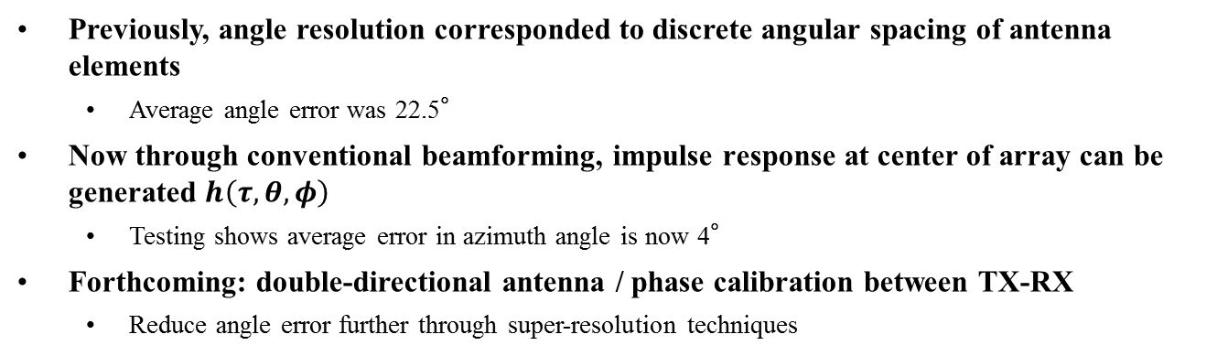
${\left|h\left(τ,θ=0°,φ=0°\right)\right|}^{2}$
doc.: IEEE 802.11-15/0840-01-00ay
Multidimensional Power Profiles
${\left|h\left(τ,θ,φ=0°\right)\right|}^{2}$
Previously, angle resolution corresponded to discrete angular spacing of antenna elements
  Average angle error was 22.5°
Now through conventional beamforming, impulse response at center of array can be generated $h\left(τ,θ,φ\right)$
  Testing shows average error in azimuth angle is now 4°
Forthcoming: double-directional antenna / phase calibration between TX-RX
  Reduce angle error further through super-resolution techniques

Slide 6
Path Loss
doc.: IEEE 802.11-15/0840-01-00ay
Path-loss exponent of transmitter-facing antenna is computed as 2.0
  Discrepancy from free-space loss is because antenna patterns not yet deconvolved from measurements
Path-loss exponent of opposite-facing antenna is about -0.25
  As the robot moves towards wall, position-dependent reflections from wall observed
  In conference room, distance up to 12 m
Notes:
Distance only up to 6 meters here, but up to

Slide 7
RMS Delay Spread
doc.: IEEE 802.11-15/0840-01-00ay
Transmitter-facing antennas (0º and 45º off-axis azimuth) at elevation 0º experience the smallest delay spreads because they contain the most dominant paths
Transmitter-facing antennas at elevation 45º have slightly longer delays per antenna compared to elevation 0º because the dominant paths are relatively weaker
Opposite-facing antennas (135º, 180º off-axis azimuth) experience the second shortest delay spreads because they have strong reflections from walls
The side-facing antennas (90º off-axis azimuth) experience the longest delay spreads because they have the weakest dominant paths
Notes:
At elevation 45’, dominant paths are less dominant, so diffuse paths carry relatively stronger weights

Slide 8
Small-scale Fading: Measurements
doc.: IEEE 802.11-15/0840-01-00ay
Antennas with 0º elevation
Antennas with 45º elevation
Antennas with 0º elevation pick up stronger paths (Ch13 picks up direct path)
Rician K-factor of antennas with stronger paths much larger
Ch12 has same azimuth angle as Ch13, but has 45º elevation

Slide 9
Small-scale Fading: Statistics
doc.: IEEE 802.11-15/0840-01-00ay
4% Rayleigh
83% Rician
13% TWDP
For one location, each of the 16 antennas considered separately
For each antenna, the delay profile was divided into 1-ns bins
The amplitude of each bin over 128 time snapshots was fit to a distribution
KS-test with 95% confidence used to determine best fit
Example distributions shown above

Slide 10
Doppler Frequency Spectrum
doc.: IEEE 802.11-15/0840-01-00ay
WALL
RX
TX
Direct and reflected paths only
All paths
Example Doppler spectrum at a single location
Direct and reflected paths have opposite Doppler shifts
Other paths have Doppler shifts in between the direct and reflected, but less dominant
Coherence time computed from the inverse of the RMS spread

Slide 11
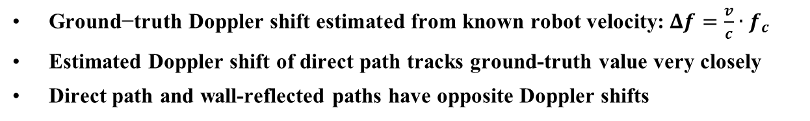
Doppler Frequency Shift:
Estimated vs. Ground-truth
doc.: IEEE 802.11-15/0840-01-00ay
WALL
RX
TX
$\text{Ground}\text{−}\text{tru}\text{th} \text{Doppler} \text{shift} \text{estimated} \text{from} \text{known} \text{robot} \text{velocity}\text{:} Δf=\frac{v}{c}∙f_{c}$
Estimated Doppler shift of direct path tracks ground-truth value very closely
Direct path and wall-reflected paths have opposite Doppler shifts

Slide 12
Upcoming Work
doc.: IEEE 802.11-15/0840-01-00ay
Measurements in other areas at 83 GHz
  Conference room (complete)
  Living room
  Server room
  Stadium
60 GHz channel sounder should be ready for measurements in October 2015
  Has 8 elements at TX and 16 elements at RX
  Will likely have 4 GHz null-to-null bandwidth

