Slide 1
NIST Preliminary Channel Measurements at 83 GHz
doc.: IEEE 802.11-15/0840-00-00ay
Date: YYYY-MM-DD
Authors:

Slide 2
Abstract
doc.: IEEE 802.11-15/0840-00-00ay
We have conducted a number of measurement campaigns at 28 GHz and 83 GHz using NIST mm-wave channel sounders. The purpose of this presentation is to show the measurement data we can provide to task group IEEE 802.11ay for channel modelling.

Slide 3
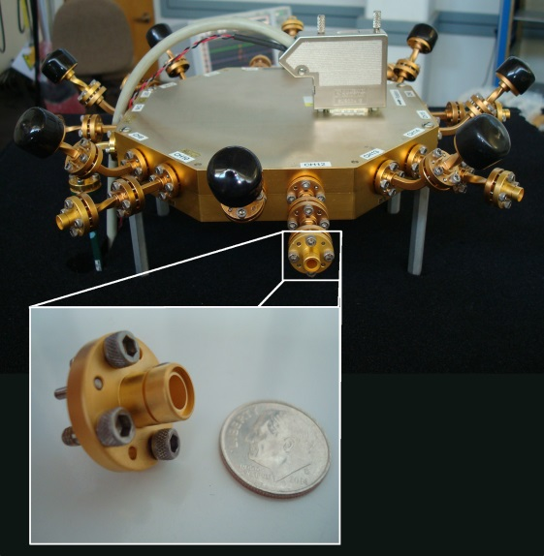
28 / 83 GHz Channel Sounder Characteristics
doc.: IEEE 802.11-15/0840-00-00ay
1 TX antenna
  Omni-directional in azimuth
  45°beamwidth in elevation
16-antenna RX array
  8 elements every 45°in azimuth at 0°elevation (no cap)
  8 elements every 45°in azimuth at 45°elevation (black cap)
  Each horn antenna has 45°beamwidth
  Can extract double-directional angle-of-arrival
2 GHz null-to-null bandwidth
Robot-guided navigational system
  Can collect hundreds of GB of data in just minutes
Can support use cases with high mobility
  Untethered synchronization through rubidium clocks
  Complete channel measurement sweep in 65 μs
RX array

Slide 4
Measurement Setup
July 2015
Backwall

Slide 5
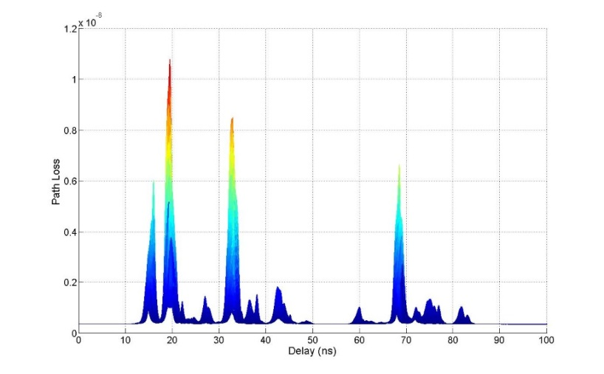
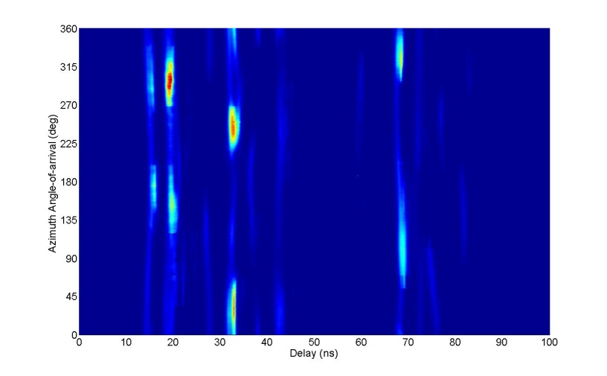


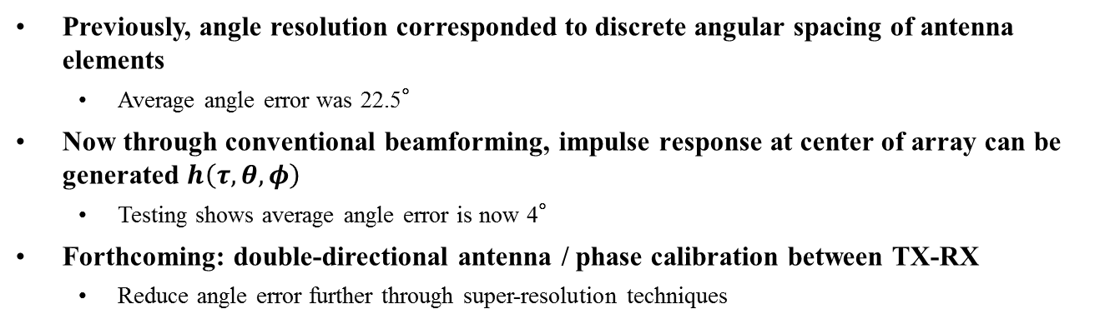
${\left|h\left(τ,θ=0°,φ=0°\right)\right|}^{2}$
doc.: IEEE 802.11-15/0840-00-00ay
Multidimensional Power Profiles
${\left|h\left(τ,θ,φ=0°\right)\right|}^{2}$
Previously, angle resolution corresponded to discrete angular spacing of antenna elements
  Average angle error was 22.5°
Now through conventional beamforming, impulse response at center of array can be generated $h\left(τ,θ,φ\right)$
  Testing shows average angle error is now 4°
Forthcoming: double-directional antenna / phase calibration between TX-RX
  Reduce angle error further through super-resolution techniques

Slide 6
Path Loss
doc.: IEEE 802.11-15/0840-00-00ay
Path-loss exponent of transmitter-facing antenna is computed as 2.0
  Discrepancy from free-space loss is because antenna patterns not yet deconvolved from measurements
Path-loss exponent of opposite-facing antenna is about -0.25
  As the robot moves towards wall, waveguiding from backwall observed
In conference room, distance up to 12 m
Notes:
Distance only up to 6 meters here, but up to

Slide 7
RMS Delay Spread
doc.: IEEE 802.11-15/0840-00-00ay
Transmitter-facing antennas (0º and 45º off-axis azimuth) at elevation 0º experience the smallest delay spreads because they contain the most dominant paths
Transmitter-facing antennas at elevation 45º have slightly longer delays per antenna compared to elevation 0º because the dominant paths are relatively weaker
Opposite-facing antennas (135º, 180º off-axis azimuth) experience the second shortest delay spreads because they have strong reflections from backwalls
The side-facing antennas (90º off-axis azimuth) experience the longest delay spreads because they have the weakest dominant paths
Notes:
At elevation 45’, dominant paths are less dominant, so diffuse paths carry relatively stronger weights

Slide 8
Small-scale Fading: Measurements
doc.: IEEE 802.11-15/0840-00-00ay
Antennas with 0°elevation
Antennas with 45°elevation
Antennas with 0°elevation pick up stronger paths (Ch13 picks up direct path)
Ch12 has same azimuth angle as Ch13, but has 45°elevation
Rician K-factor of antennas with stronger paths much larger

Slide 9
Small-scale Fading: Statistics
doc.: IEEE 802.11-15/0840-00-00ay
4% Rayleigh
83% Rician
13% TWDP
For one location, each of the 16 antennas considered separately
For each antenna, the delay profile was divided into 1-ns bins
The amplitude of each bin over 128 time snapshots was fit to a distribution
KS-test with 95% confidence used to determine best fit
Example distributions shown above

Slide 10
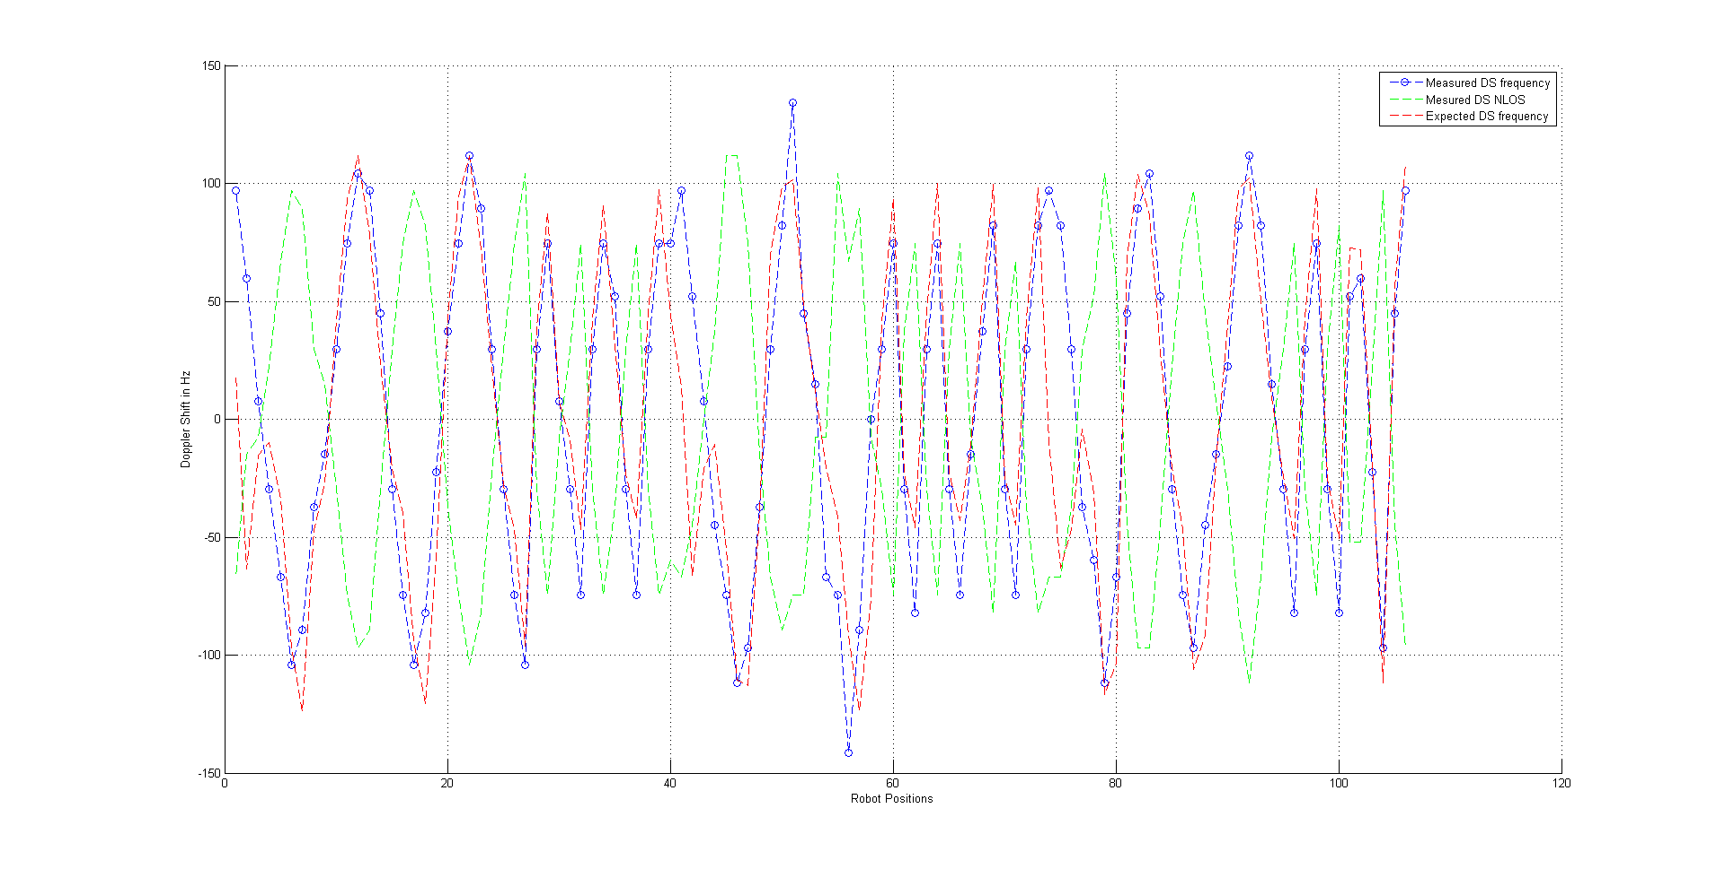
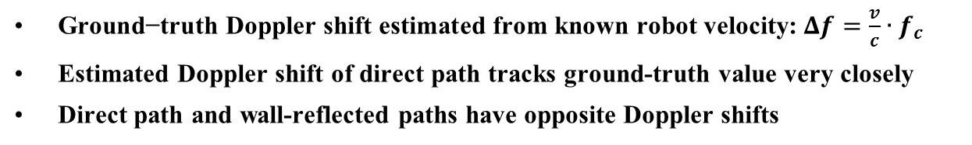
Doppler Frequency Shift:
Estimated vs. Ground-truth
doc.: IEEE 802.11-15/0840-00-00ay
Ground-truth Direct Path
Estimated Direct Path
Estimated Reflected Path
WALL
RX
Doppler-frequency Shift (Hz)
TX
Robot-position Index
$\text{Ground}\text{−}\text{tru}\text{th} \text{Doppler} \text{shift} \text{estimated} \text{from} \text{known} \text{robot} \text{velocity}\text{:} Δf=\frac{v}{c}∙f_{c}$
Estimated Doppler shift of direct path tracks ground-truth value very closely
Direct path and wall-reflected paths have opposite Doppler shifts

Slide 11
Doppler Frequency Spectrum
doc.: IEEE 802.11-15/0840-00-00ay
Example Doppler spectrum at a single location
Doppler shift for all arrivals on all antennas synthesized into a single spectrum
Although there are 128 shift bins in the spectrum, all arrivals appear in only 13 bins
  All arrivals incident on an individual antenna have the same shift
  3 antennas are not picking up any significant paths
Coherence time computed from the inverse of the RMS spread

Slide 12
Upcoming Work
doc.: IEEE 802.11-15/0840-00-00ay
Measurements in other areas at 28 GHz and 83 GHz
  Conference room (complete)
  Living room
  Server room
60 GHz Channel Sounder should be ready for measurements in October 2015
  Has 8 elements at TX and 16 elements at RX
  Will likely have 4 GHz null-to-null bandwidth

