Slide 1
NGP AOA Use Cases
Date: 2015-06-16
Authors:

Slide 2
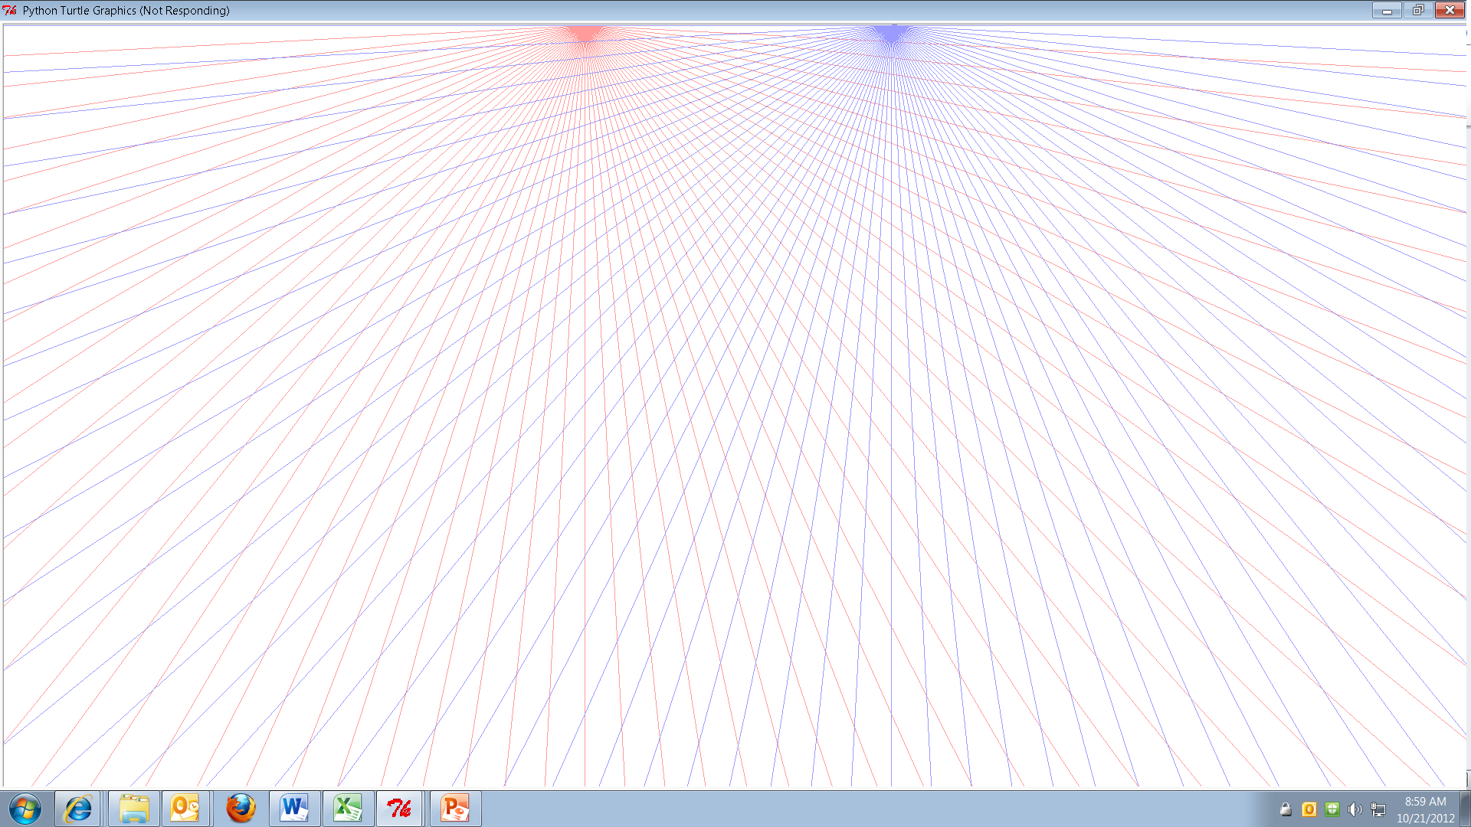

Use Case 1: Indoor Location with Single AP in one channel
Providing indoor location to multiple users in a Mall via single AP with multi-antenna device
AOD/AOA complimentary to FTM
  (x,y) -> polar coord R, θ
Diagram shows simple use cases:
  2x FTM (TOF) – 2-AP devices (Middle)
  2xAOD - 2-AP devices (Left)
  1xAOD + 1x FTM/TOF (Right)
    single AP – measurement in same channel
Higher resolution than FTM method possible – depending on configuration
E.g. in 2.4GHz/ 20MHz ~2m accuracy with FTM
AOD in same band allows ~ 1-foot resolution; 1/20 radian = 3 degrees = Δ θ = 1-foot / 20 feet; Such resolution not possible in 20MHz with FTM
AOD new capability to add in NGP
AP2
AP1
AOD + TOF
2x AOD
2x TOF

Slide 3

Use Case 2: AoD Positioning in Mall, simultaneously to many users
Providing indoor location to multiple users in a Mall floor via single multi-antenna device (example shows 3x3 MIMO)
Two independent AOD measurements possible with single packet
  1) with respect to orientation of ANT0-ANT1
  2) with respect to orientation of ANT1-ANT2
  3) With multiple devices – can locate position ; One device possible, but ambitious
For AOD, the transmitter is required to have multiple antennas, receivers are required to have only one antenna
Let us consider Beacon like Broadcast packets that have the phase information (e.g. NDP) with sequential LTRN or VHT-LTRN from each antenna. Such frames are used in sounding. [TBD]
Antenna location and orientation information is exchanged a-priori
Each user can compute 2x AOD by measuring the phase deltas observed at its own 1x1 antenna; After computation of AoD, users may optionally share it with beacon devices, or other users and peers in same neighborhood
Much more efficient than current FTM; No channel change/1-device sufficient
AP/DF Beaconer
User1
User3
User2

Slide 4
Comments
Angular information is complimentary and orthogonal to TOF (e.g. in polar coordinates) Wifi has phase and amplitude information between antennas; Impulse response is complex; we have both measurements together
Can be related to/re use FTM framework if we adopt transmission of multi-antenna (MIMO) MCS, and VHT-LTF (TBD)
Even if Beacon device doesn’t know its position, we can enable exchanging relative positions between devices/mobile users
One mobile, and two-fixed devices use case is common for locating printers, (AP, and Printer fixed; user mobile) etc. on a floor by mobile users

Slide 5
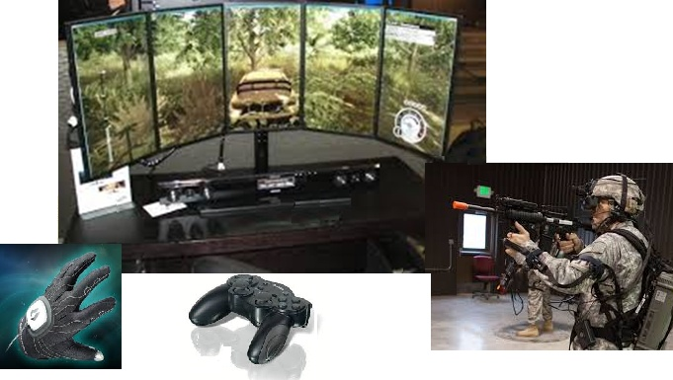
Use Case 3: Interactive Gaming Gestures
AP with multiple antenna platform is deployed inside the gaming console or inside the display unit.
User with handheld controller or a headset is equipped with DF module.
User may have more one antenna, so that orientation of the user device relative to AP can be known
In this use-case both AoA and AoD measurements may be performed
DF positioning is used to detect user gesture and/or helmet movement which provides control information to the interactive gaming applications
Probing with multiple antennas can be used to improve measurement accuracy
AOA/AOD has higher resolution when length scales are smaller
Much less multipath in such a LOS based gameplay

Slide 6
Comments
In this use-case, packets can be exchanged at few millisec interval (DF signals), allowing the ability to track the user movement with high precision
User gestures can be interpreted by tracking successive measurements. Multiple antenna’s mounted in 3-D can track movements in the plane perpendicular to LOS direction, as well as movements along LOS direction
Independently probing at different frequencies/channels can be used to remove spatial aliases and arrive at true relative location and orientation

Slide 7
Use Case 4 – Asset Tracking and GeoFence Enforcement with AOA
One or multiple APs equipped with multiple antennas are deployed in a venue.
STA continue to transmit signal to APs. The signals can be plain/simple packets of FTM frames; or any packets
The AP’s are coordinated in a measurement epoch. One or multiple APs tracks STA’s position via AoA measurements.
In addition, APs may exchange TDOA information (Time difference of arrival)
APs may determine when STA is in/out of a particular geo-fence region, by locating AP at strategic locations with respect to venue coordinates
Tracking Movement with AOA
AP1
AoA
STA1
AoA
AP2
GeoFence Enforcement with AOA
Outside
-ve AOA
Inside
+ve AOA

Slide 8
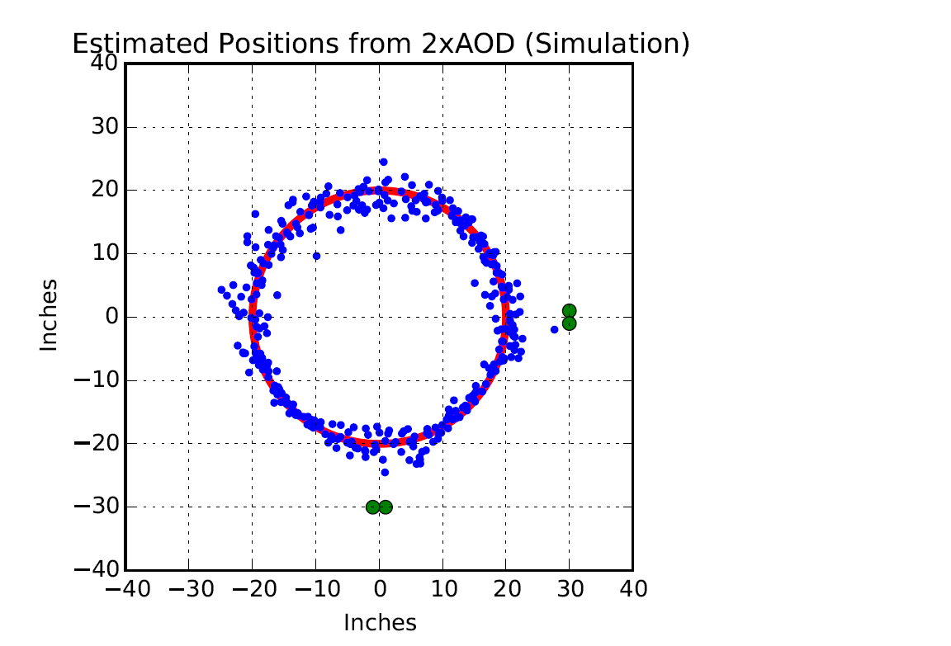
Use Case 5 – Very High Resolution Positioning (Robotics/Machine Vision)
Use case is position/move robotic apparatus/ machine vision systems – in factory etc. with 5GHz WiFi
The diagram to the left is to scale – with 5GHz simulation; Assume AOA accuracy is ±2º
It is easy to see we can track within a few inch accuracy
Full position calculation with 2x AOD by 2-APs using LOS assumption
Note: FTM minimum resolution patch (1-meter Green circle) > area of interest
AP1
TAG 1x1 moves on red
circle
AP2
AP2

Slide 9
Strawpoll
Should we include AOA and AOD usecases for NGP
  Y:
  N:
  A:

