Slide 1
Potential of Non-Uniform Constellations with Peak Power Constraint
Date: 2015/07/15
Authors:

Slide 2
Abstract
This contribution outlines the potential of non-uniform constellations (NUCs) for single carrier (SC) modulation
  NUCs with 64 signal points are considered
  The NUCs are designed for maximum coding gain at a given constraint on the peak-to-average power ratio (PAPR)
    Several PAPR constraint categories are investigated
  The NUCs are shown to have significant overall gain of up to
  1.7 dB compared to rect. uniform constellations (UCs)

Slide 3
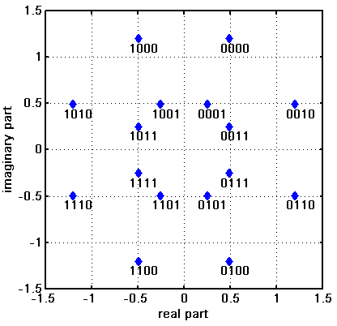
Motivation
Higher order QAMs discussed in e.g. [1]-[4] as potential technology for 802.11ay
  OFDM: 128-QAM, 256-QAM (up to 64-QAM in ad)
  SC: 64-QAM (up to 16-QAM in ad)
Non-uniform constellations (NUCs) provide increased performance compared to uniform constellations (UCs)
NUCs provide
  Coding gain
    up to 0.7dB for 256-QAM (OFDM) [3]
  Improved robustness against phase noise [4]
  Reduced PAPR and (small) coding gain
    APSK for 64-QAM (SC) [5]
  A moderate increase in demapper complexity [3-5]
    2D NUCs feature quadrant symmetry

Slide 4
Introduction
NUCs presented in [3,4] have originally been designed for OFDM
Nonetheless, those NUCs feature gains in SC too
  Compared to UCs, those NUCs feature
    A coding gain of up to 0.4 dB [3]
    An additional gain of 0.1 dB in presence of phase noise [4]
      i.e. 0.5 dB in total
      A even higher gain can be achieved with a phase noise aware demapper
  However, optimization for PAPR has not been performed
In this contribution, we outline the potential of NUCs which have been optimized with various PAPR constraints
  Those NUCs are in particular applicable for SC modulation

Slide 5
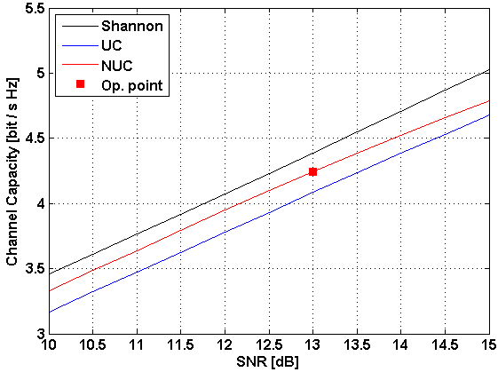
Coding Gain of NUCs
NUCs feature a coding gain
  UCs not optimal in the sense of channel capacity, results in a SNR gap
  NUCs can partly exploit this gap with a small complexity increase
  Example: rect. 64-UC and 64-NUC of [3,4] for CR=1/2
~ 0.5dB gain
Small gap remains mainly due to discrete signal pts.

Slide 6
PAPR requirements OFDM vs. SC
OFDM
  PAPR of the constellation unimportant since the OFDM modulator determines the envelope of the transmit signal
    NUCs of [3,4] have been designed for maximum coding gain
SC
  PAPR of the constellation directly influences the envelope of the transmit signal
    NUCs for SC modulation require PAPR consideration
  However, coding gain and PAPR not independent
    Large coding gain means large PAPR and vice versa

Slide 7
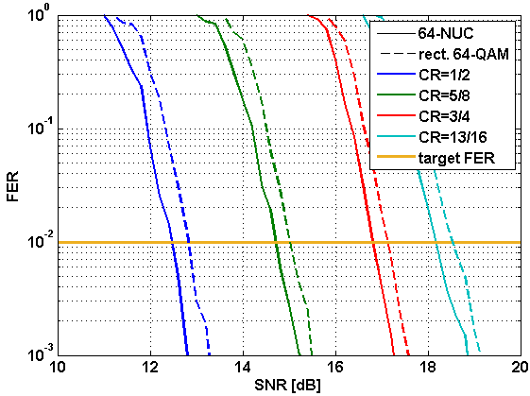
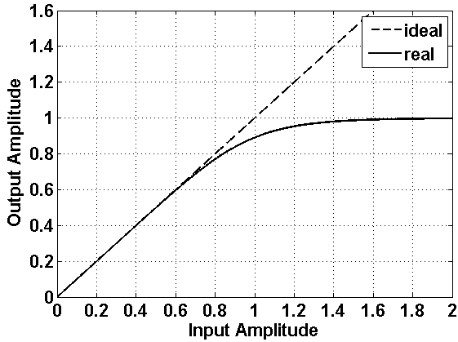
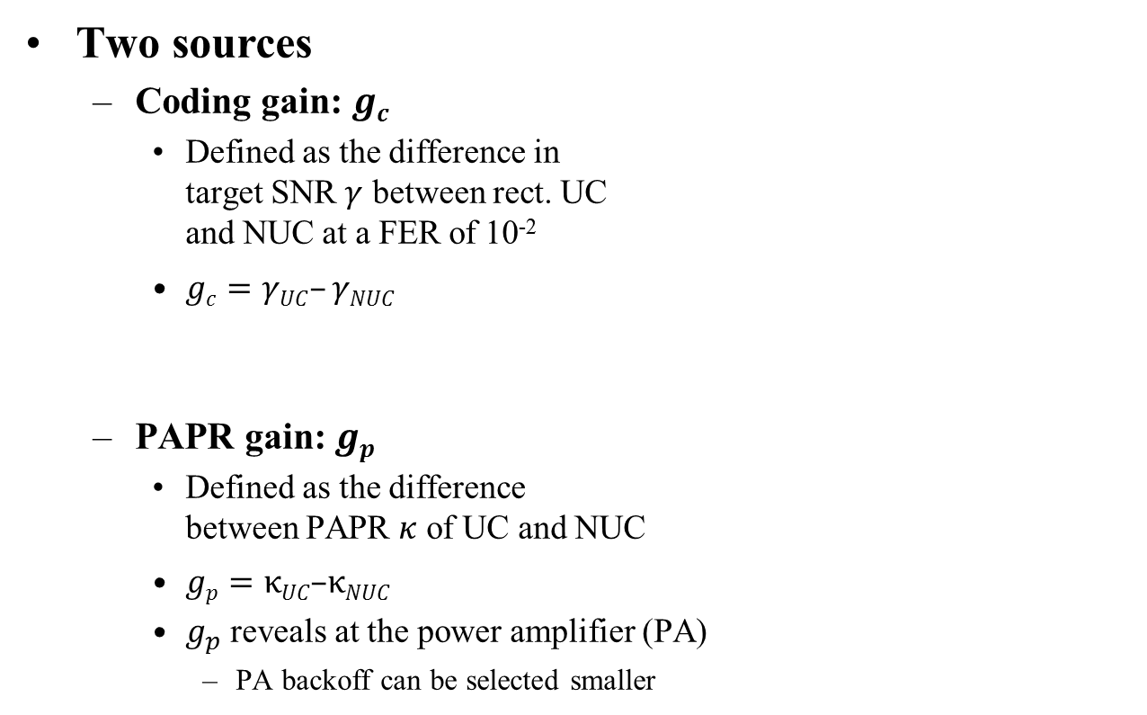
Quantifying the gain of SC NUCs
Two sources
  Coding gain: $gc$
    Defined as the difference in
    target SNR $γ$ between rect. UC
    and NUC at a FER of 10⁻²
    $gc=γUC–γNUC$
  PAPR gain: $gp$
    Defined as the difference
    between PAPR $κ$ of UC and NUC
    $gp=κUC\text{–}κNUC$
    $g_{p}$ reveals at the power amplifier (PA)
      PA backoff can be selected smaller
NUC
Indicates the sqrt of
the average Tx power
UC

Slide 8
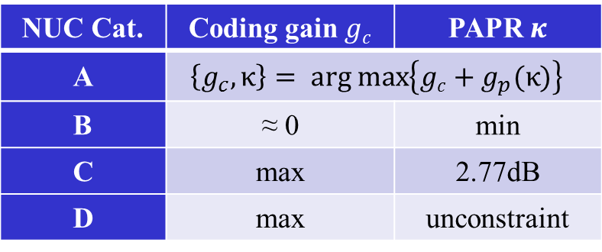
SC NUC parameters
We optimized various NUCs for different parameters
Annotation
  maximized overall gain, i.e. sum of PAPR and coding gain
  same performance as UC but minimum PAPR
  maximum coding gain at 2.77dB PAPR (same PAPR value as 64-APSK of [5])
  NUCs for OFDM [3,4]
NUC Cat. | Coding gain $gc$ | PAPR $κ$
A | $$\left\{g_{c},κ\right\}= \text{arg} \text{max}\left\{gc+g_{p}(κ)\right\}⁡$$
B | ≈ 0 | min
C | max | 2.77dB
D | max | unconstraint

Slide 9
Simulations Parameters
Focus on constellations with 64 signal points
  .11ad LDPC with code rates (CR): ¹/₂, ⁵/₈, ³/₄, ¹³/₁₆
SC modulation
Message Length: 1000 bytes
AWGN channel
Benchmarks
  Regular rect. 64-QAM
  64-APSK of [5]

Slide 10
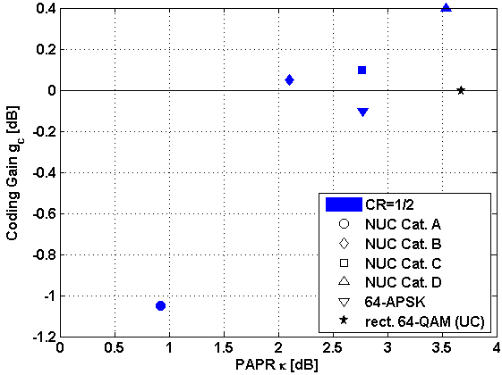

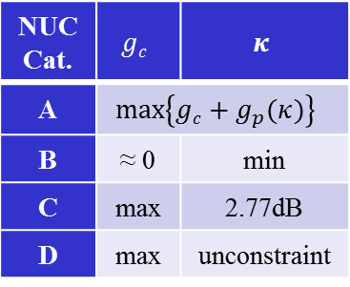
Results: Coding Gain vs. PAPR for rate 1/2
Coding gain and PAPR are clearly dependent
  Tradeoff between
  $g_{c}$ and $κ$ required
  Cat. A requires
  $g_{c}<\text{0 }\text{dB}$
  UC has poorest
  performance
impr.
perf.
NUC Cat. | $$gc$$ | $$κ$$
A | $$\text{max}\left\{gc+g_{p}(κ)\right\}⁡$$
B | ≈ 0 | min
C | max | 2.77dB
D | max | unconstraint
impr.
perf.

Slide 11
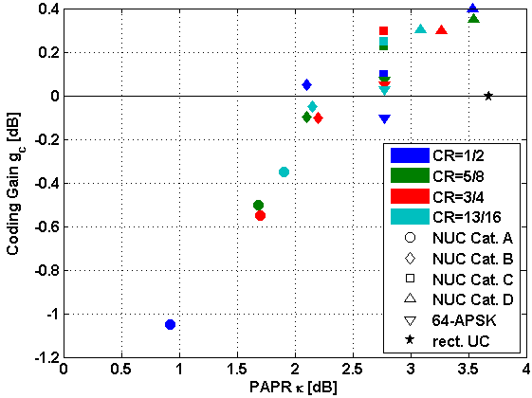

Results: Coding Gain vs. PAPR for all rates
Coding gain and PAPR are clearly dependent
  Performance
  slightly dependent
  on code rate
  Cat. A criterion
  yields strong
  variation in $g_{c}$
NUC Cat. | $$gc$$ | $$κ$$
A | $$\text{max}\left\{gc+g_{p}(κ)\right\}⁡$$
B | ≈ 0 | min
C | max | 2.77dB
D | max | unconstraint

Slide 12
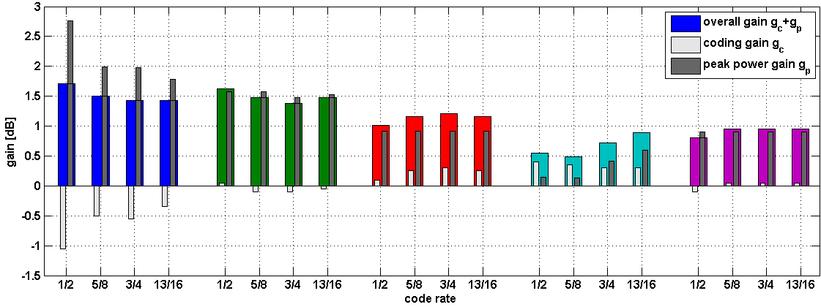
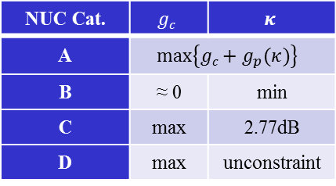
Results: Overall Gain
Cat. A
Cat. B
Cat. C
Overall gain in decreasing order (holds for all rates):
Cat. A, B, C, 64-APSK, D
Overall gain of Cat. A and B comparable
Cat. D
64-APSK
NUC Cat. | $$gc$$ | $$κ$$
A | $$\text{max}\left\{gc+g_{p}(κ)\right\}⁡$$
B | ≈ 0 | min
C | max | 2.77dB
D | max | unconstraint

Slide 13
Conclusion
Investigation of NUCs with PAPR constraint
  There is a huge potential for NUCs with limited PAPR
  64-NUCs with 4 different constraints considered
  Overall gain depending on code rate and optimization constraint
    1.4 dB to 1.7 dB gain compared to uniform 64-QAM (Cat. A)
NUCs are a promising technology for .11ay
  Significant performance gains
    Gains are in the order of a code rate SNR spacing
  Only a moderate complexity increase
Further aspects under consideration
  E.g. performance in fading channels, influence of impairments, evaluation of quantization effects

Slide 14
References
11-14-1378-00-ng60 PHY rate for NG60
11-14-0652-01-0wng-wng Next Generation 802.11ad
11-15-0096-01-ng60 Non-uniform Constellations for higher Order QAMs
11-15-0601-00-00ay Non-uniform Constellations for 64QAM
11-15-0339-00-ng60 SC-64APSK for 11ay

Slide 15
Appendix

Slide 16
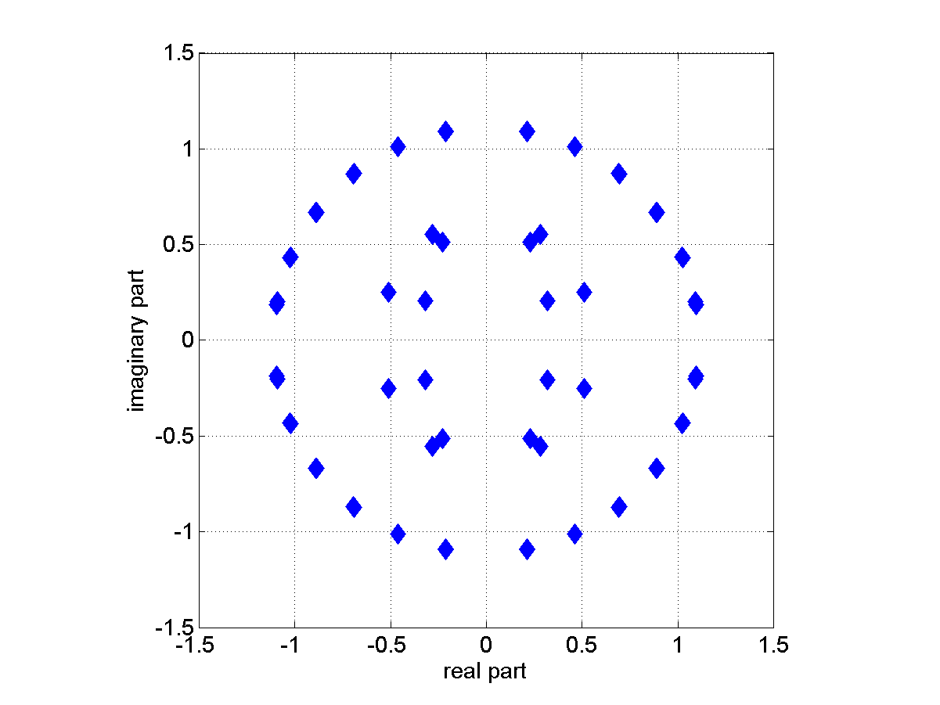
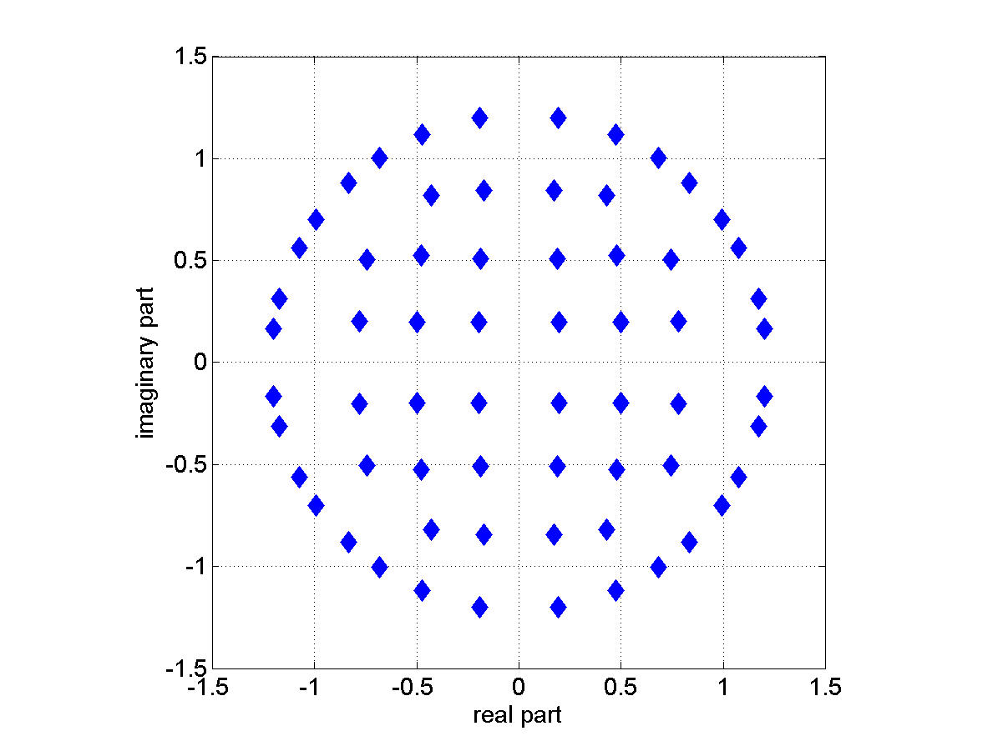
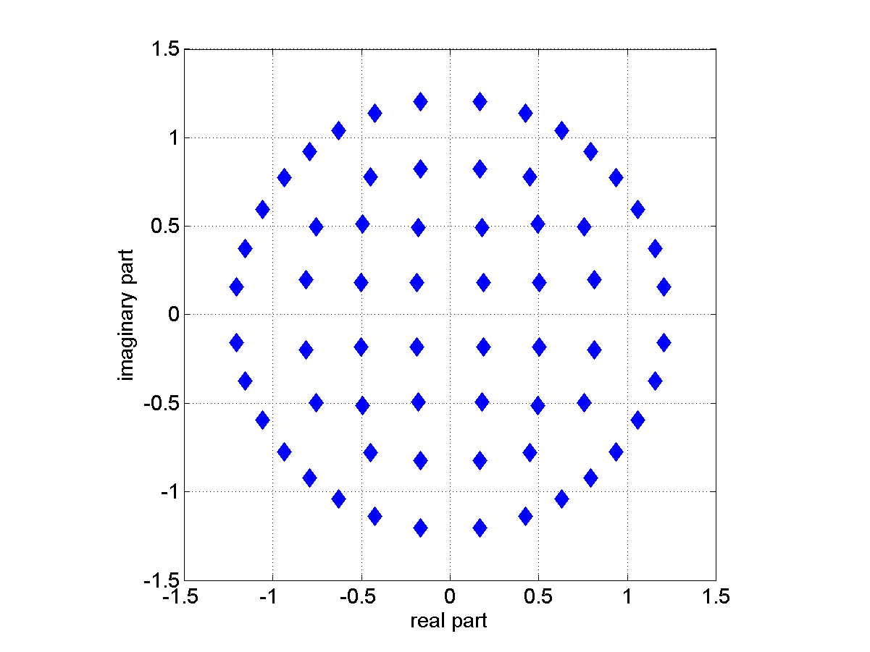
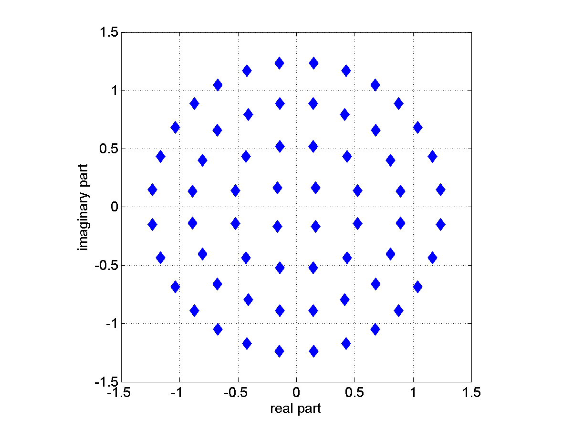
NUCs of Cat. A
CR ¹/₂
CR ⁵/₈
CR ³/₄
CR ¹³/₁₆

Slide 17
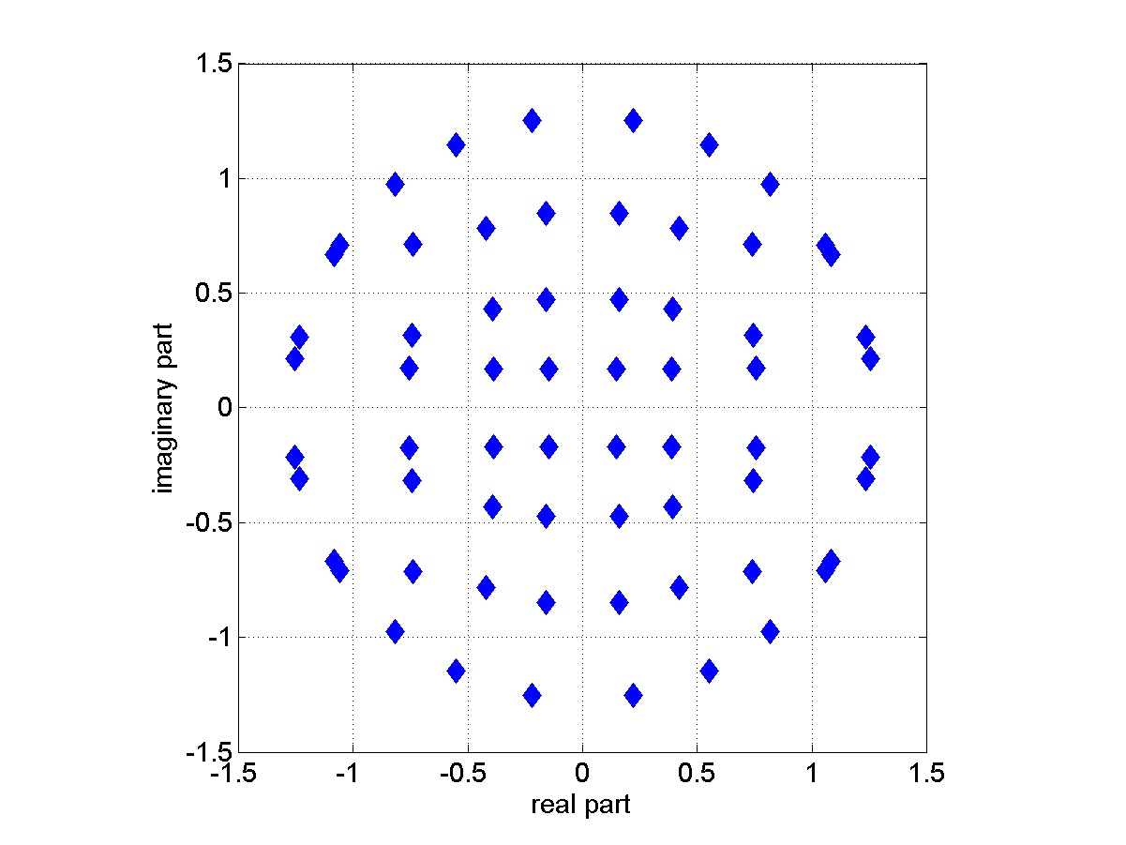
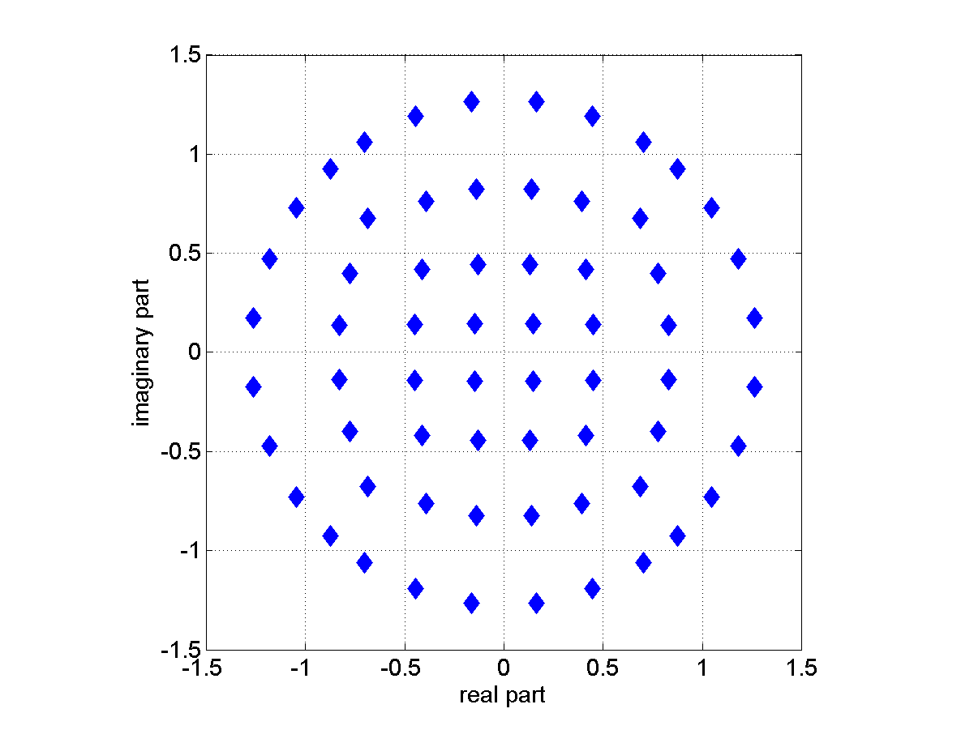
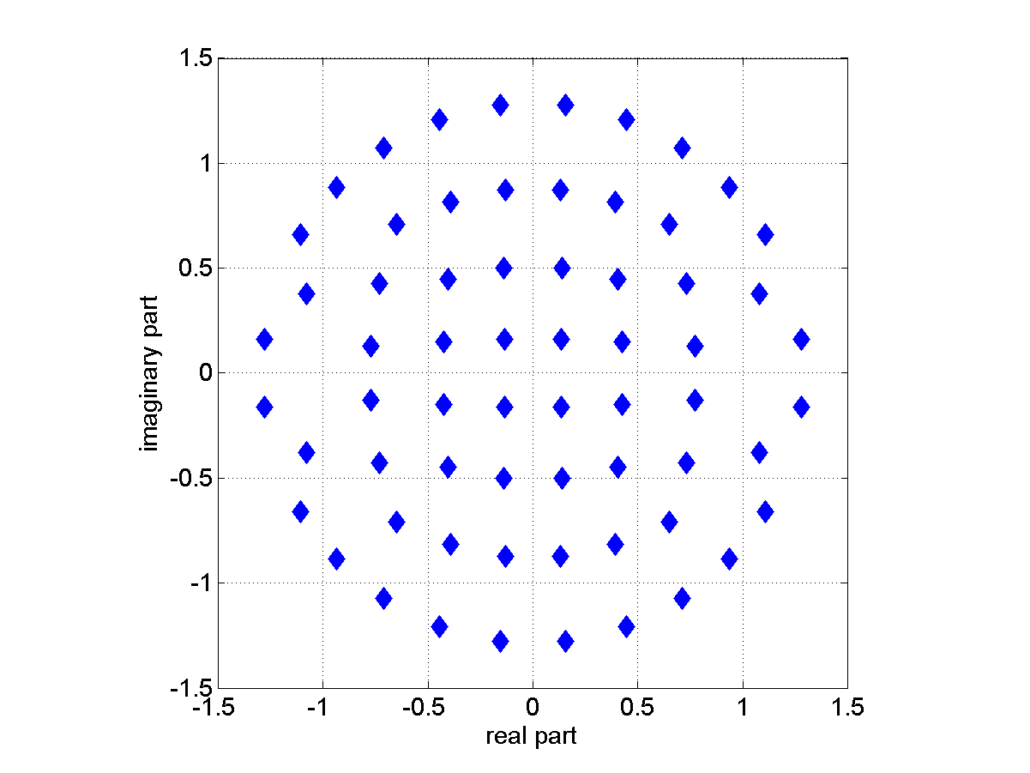
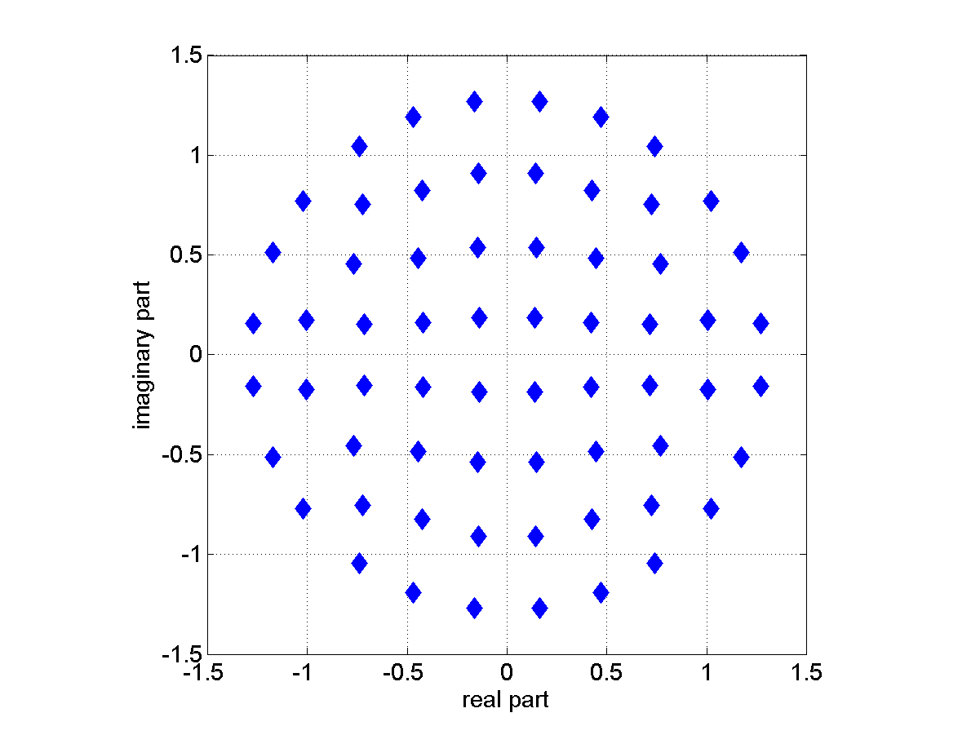
NUCs of Cat. B
CR ¹/₂
CR ⁵/₈
CR ³/₄
CR ¹³/₁₆

Slide 18
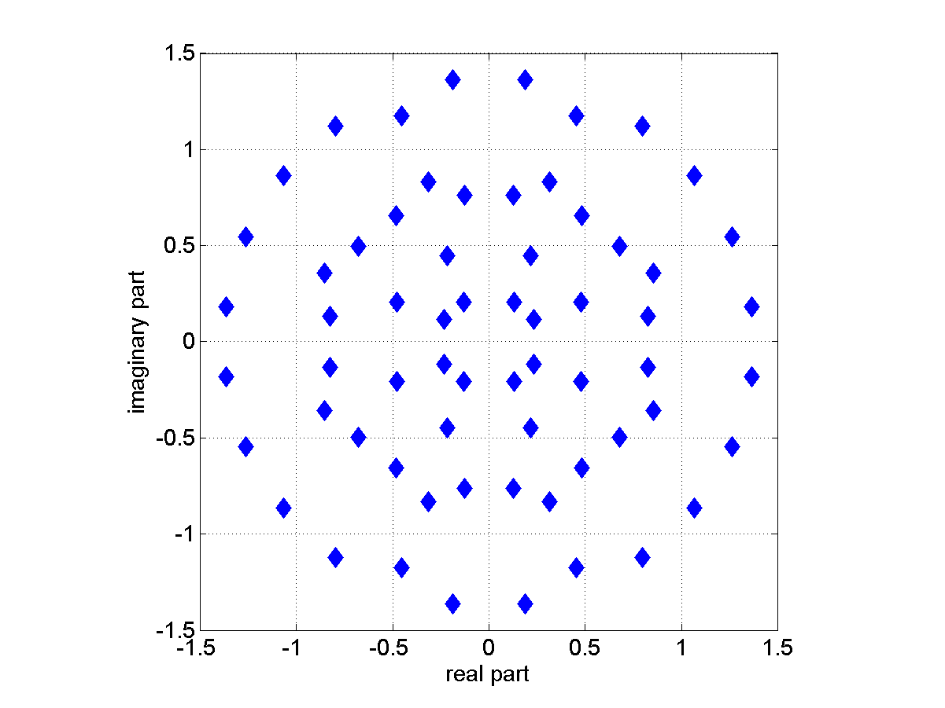
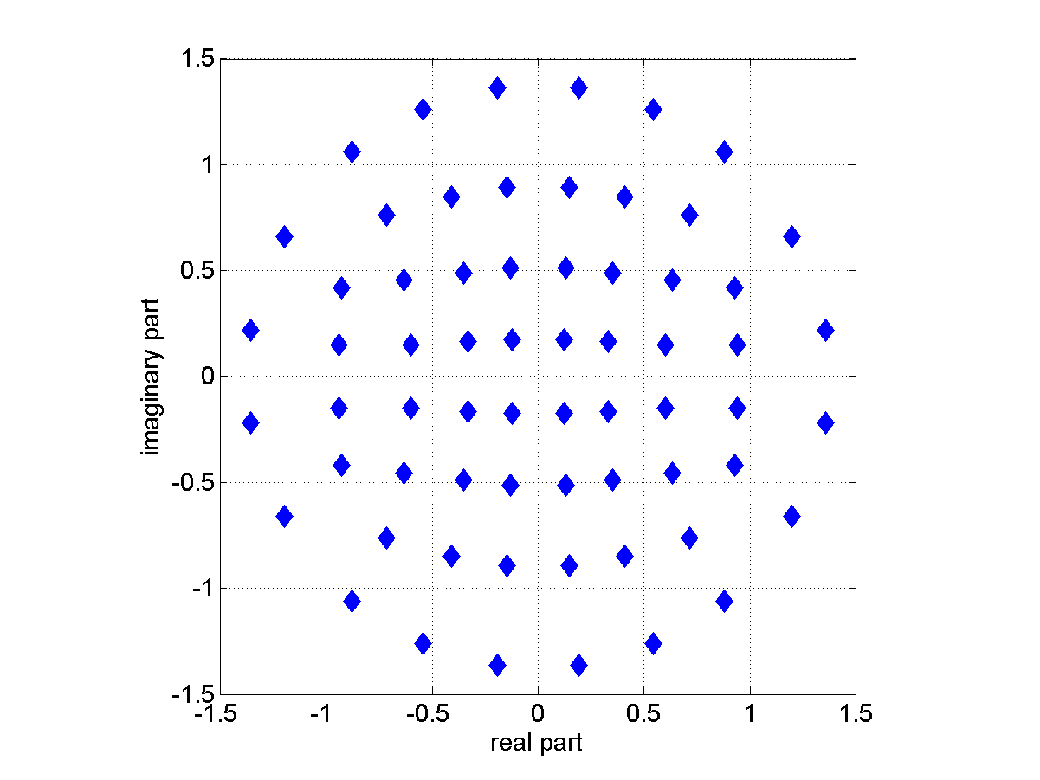
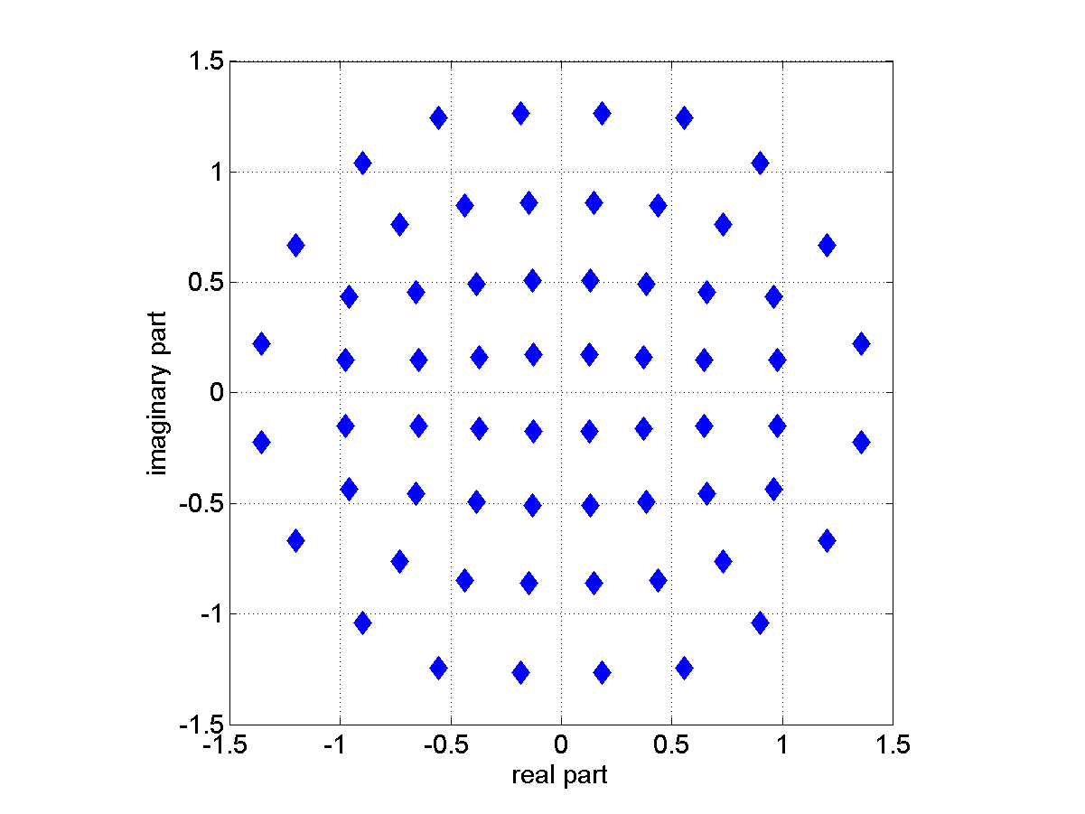
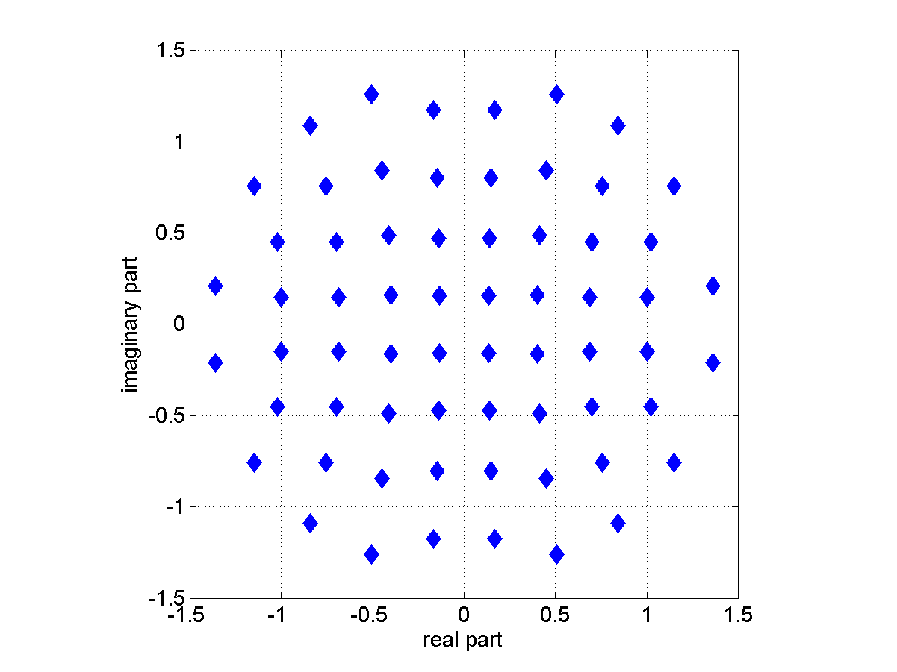
NUCs of Cat. C
CR ¹/₂
CR ⁵/₈
CR ³/₄
CR ¹³/₁₆

Slide 19
NUCs of Cat. D
See [4]

