Slide 1
Potential of Non-Uniform Constellations with Peak Power Constraint
Date: 2015/07/16
Authors:

Slide 2
Abstract
This contribution outlines the potential of non-uniform constellations (NUCs) for single carrier (SC) modulation
NUCs with 64 signal points are considered
The NUCs are designed for maximum coding gain at a given constraint on the peak-to-average power ratio (PAPR)
Several PAPR constraint categories are investigated
The NUCs are shown to have significant overall gain of up to 1.7 dB compared to rect. uniform constellations (UCs)

Slide 3
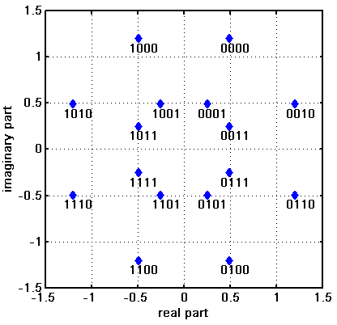
Motivation
Higher order QAMs discussed in e.g. [1]-[4] as potential technology for 802.11ay
OFDM: 128-QAM, 256-QAM (up to 64-QAM in ad)
SC: 64-QAM (up to 16-QAM in ad)
Non-uniform constellations (NUCs) provide increased performance compared to uniform constellations (UCs)
NUCs provide
Coding gain
up to 0.7dB for 256-QAM (OFDM) [3]
Improved robustness against phase noise [4]
Reduced PAPR and (small) coding gain
APSK for 64-QAM (SC) [5]
A moderate increase in demapper complexity [3-5]
2D NUCs feature quadrant symmetry

Slide 4
Introduction
NUCs presented in [3,4] have originally been designed for OFDM
Nonetheless, those NUCs feature gains in SC too
Compared to UCs, those NUCs feature
A coding gain of up to 0.4 dB [3]
An additional gain of 0.1 dB in presence of phase noise [4]
i.e. 0.5 dB in total
A even higher gain can be achieved with a phase noise aware demapper
However, optimization for PAPR has not been performed
In this contribution, we outline the potential of NUCs which have been optimized with various PAPR constraints
Those NUCs are in particular applicable for SC modulation

Slide 5
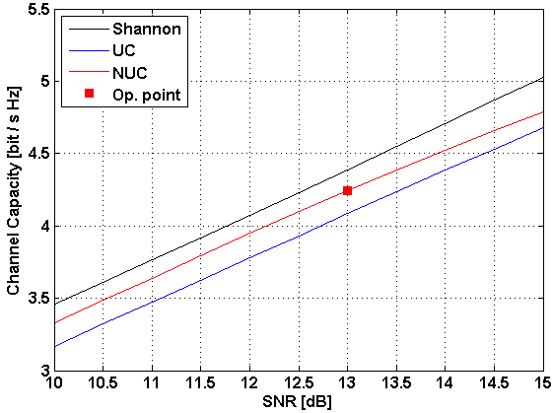
Coding Gain of NUCs
NUCs feature a coding gain
UCs not optimal in the sense of channel capacity, results in a SNR gap
NUCs can partly exploit this gap with a small complexity increase
Example: rect. 64-UC and 64-NUC of [3,4] for CR=1/2
~ 0.5dB gain
Small gap remains mainly due to discrete signal pts.

Slide 6
PAPR requirements OFDM vs. SC
OFDM
PAPR of the constellation unimportant since the OFDM modulator determines the envelope of the transmit signal
NUCs of [3,4] have been designed for maximum coding gain
SC
PAPR of the constellation directly influences the envelope of the transmit signal
NUCs for SC modulation require PAPR consideration
However, coding gain and PAPR not independent
Large coding gain means large PAPR and vice versa

Slide 7
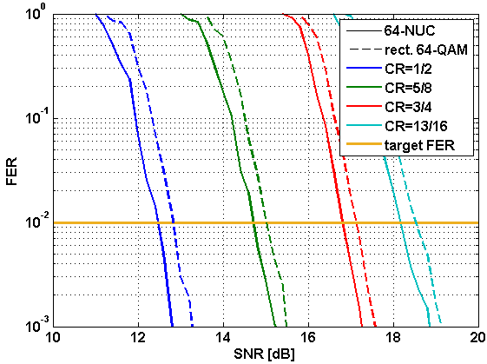
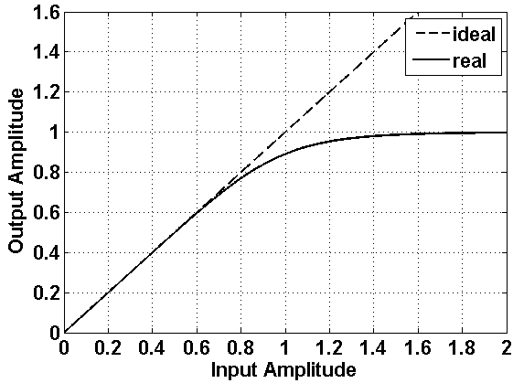
Quantifying the gain of SC NUCs
Two sources
Coding gain: $gc$
Defined as the difference in target SNR $γ$ between rect. UC and NUC at a FER of 10⁻²
$gc=γUC–γNUC$
PAPR gain: $gp$
Defined as the difference between PAPR $κ$ of UC and NUC
$gp=κUC\text{–}κNUC$
$g_{p}$ reveals at the power amplifier (PA)
PA backoff can be selected smaller
NUC
Indicates the sqrt of the average Tx power
UC

Slide 8
SC NUC parameters
We optimized various NUCs for different parameters
Annotation
maximized overall gain, i.e. sum of PAPR and coding gain
same performance as UC but minimum PAPR
maximum coding gain at 2.77dB PAPR (same PAPR value as 64-APSK of [5])
NUCs for OFDM [3,4]
NUC Cat. | Coding gain $gc$ | PAPR $κ$
A | $$\left\{g_{c},κ\right\}= \text{arg} \text{max}\left\{gc+g_{p}(κ)\right\}⁡$$
B | ≈ 0 | min
C | max | 2.77dB
D | max | unconstraint

Slide 9
Simulations Parameters
Focus on constellations with 64 signal points
.11ad LDPC with code rates (CR): ¹/₂, ⁵/₈, ³/₄, ¹³/₁₆
SC modulation
Message Length: 1000 bytes
AWGN channel
Benchmarks
Regular rect. 64-QAM
64-APSK of [5]

Slide 10
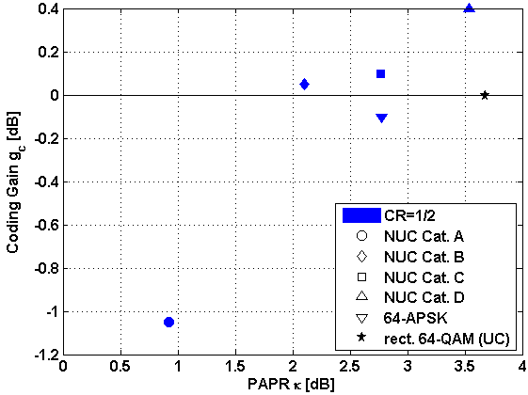
Results: Coding Gain vs. PAPR for rate 1/2
Coding gain and PAPR are clearly dependent
Tradeoff between $g_{c}$ and $κ$ required
Cat. A requires $g_{c}<\text{0 }\text{dB}$
UC has poorest performance
impr. perf.
NUC Cat. | $$gc$$ | $$κ$$
A | $$\text{max}\left\{gc+g_{p}(κ)\right\}⁡$$
B | ≈ 0 | min
C | max | 2.77dB
D | max | unconstraint
impr. perf.

Slide 11
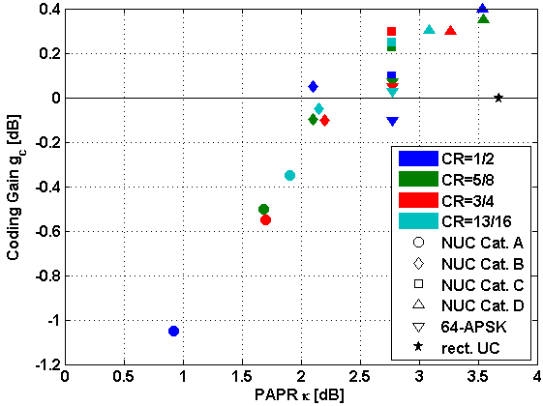
Results: Coding Gain vs. PAPR for all rates
Coding gain and PAPR are clearly dependent
Performance slightly dependent on code rate
Cat. A criterion yields strong variation in $g_{c}$
NUC Cat. | $$gc$$ | $$κ$$
A | $$\text{max}\left\{gc+g_{p}(κ)\right\}⁡$$
B | ≈ 0 | min
C | max | 2.77dB
D | max | unconstraint

Slide 12
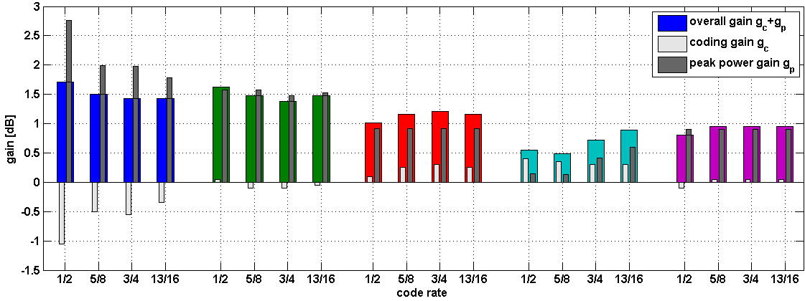
Results: Overall Gain
Cat. A
Cat. B
Cat. C
Overall gain in decreasing order (holds for all rates): Cat. A, B, C, 64-APSK, D
Overall gain of Cat. A and B comparable
Cat. D
64-APSK
NUC Cat. | $$gc$$ | $$κ$$
A | $$\text{max}\left\{gc+g_{p}(κ)\right\}⁡$$
B | ≈ 0 | min
C | max | 2.77dB
D | max | unconstraint

Slide 13
Conclusion
Investigation of NUCs with PAPR constraint
There is a huge potential for NUCs with limited PAPR
64-NUCs with 4 different constraints considered
Overall gain depending on code rate and optimization constraint
1.4 dB to 1.7 dB gain compared to uniform 64-QAM (Cat. A)
NUCs are a promising technology for .11ay
Significant performance gains
Gains are in the order of a code rate SNR spacing
Only a moderate complexity increase
Further aspects under consideration
E.g. performance in fading channels, influence of impairments, evaluation of quantization effects

Slide 14
References
11-14-1378-00-ng60 PHY rate for NG60
11-14-0652-01-0wng-wng Next Generation 802.11ad
11-15-0096-01-ng60 Non-uniform Constellations for higher Order QAMs
11-15-0601-00-00ay Non-uniform Constellations for 64QAM
11-15-0339-00-ng60 SC-64APSK for 11ay

Slide 15
Appendix

Slide 16
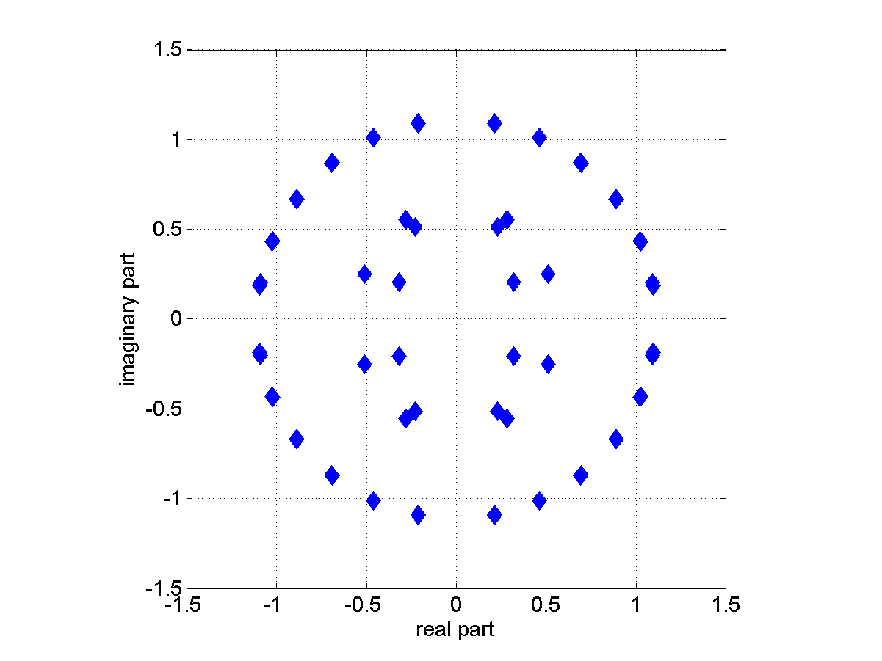
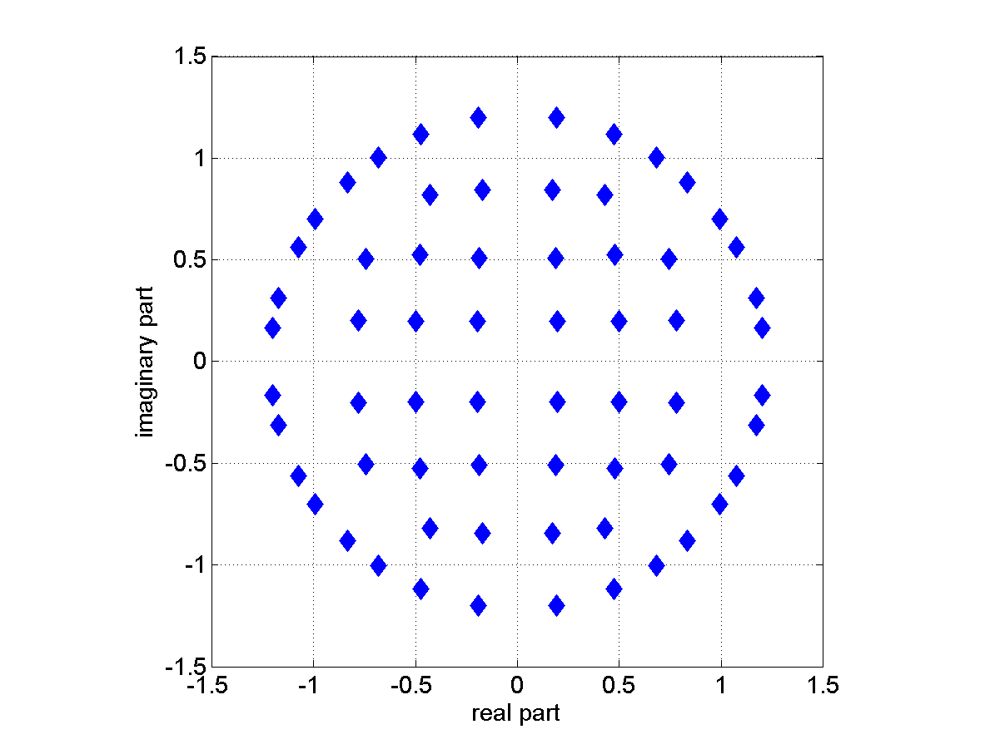
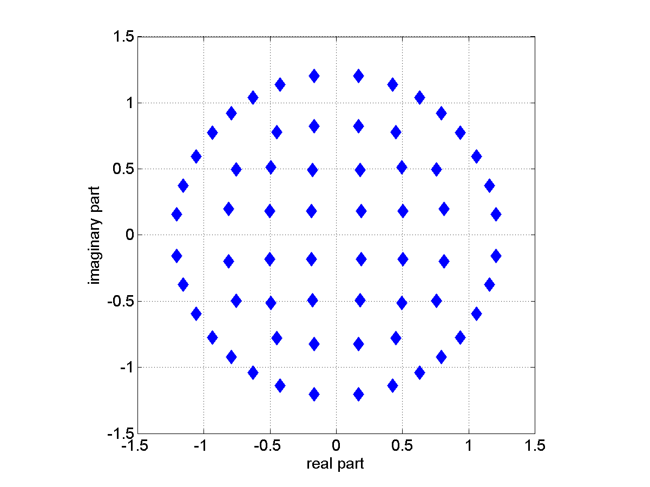
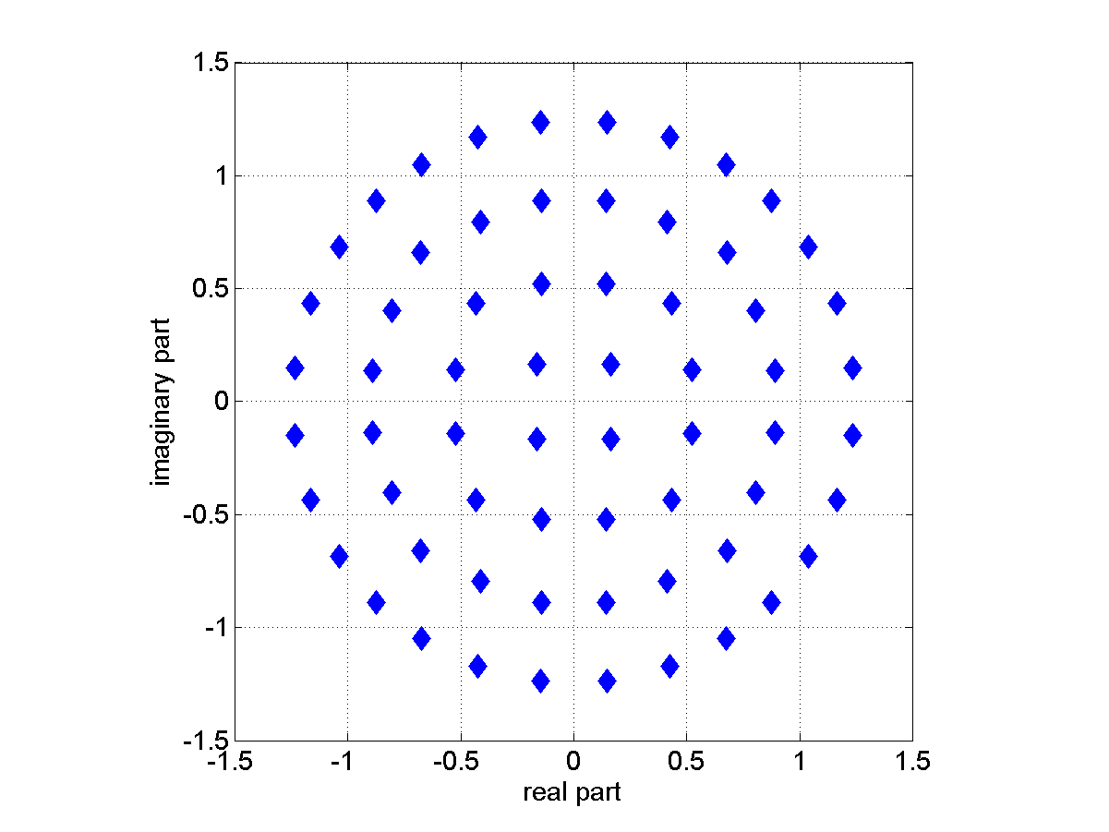
NUCs of Cat. A
CR ¹/₂
CR ⁵/₈
CR ³/₄
CR ¹³/₁₆

Slide 17
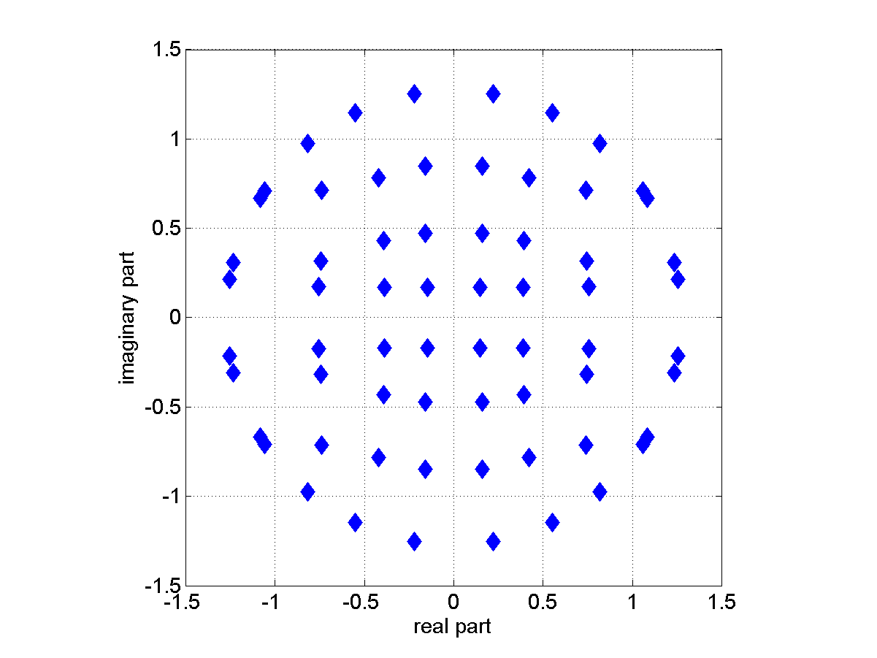
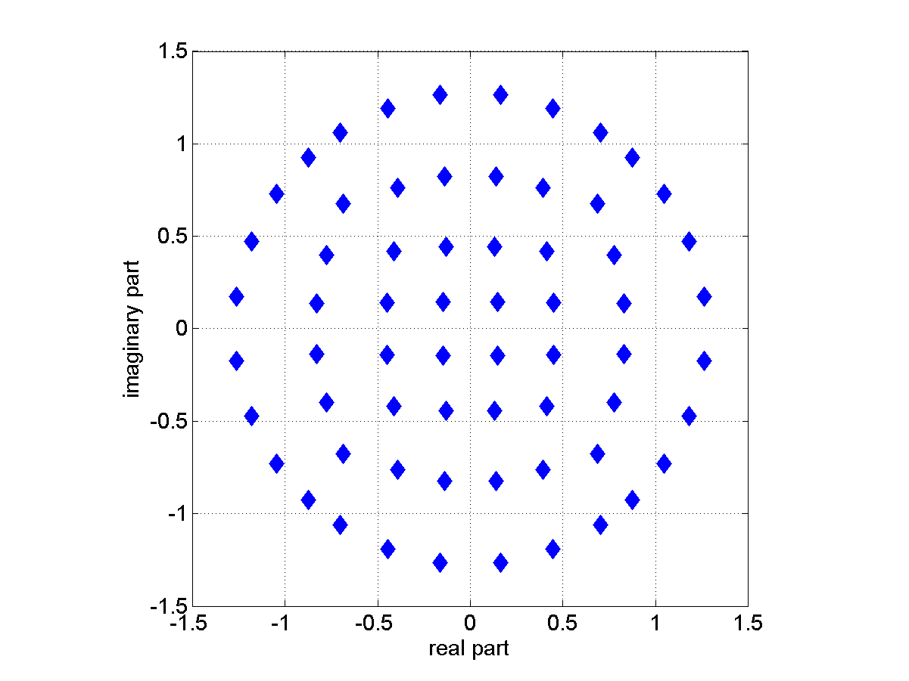
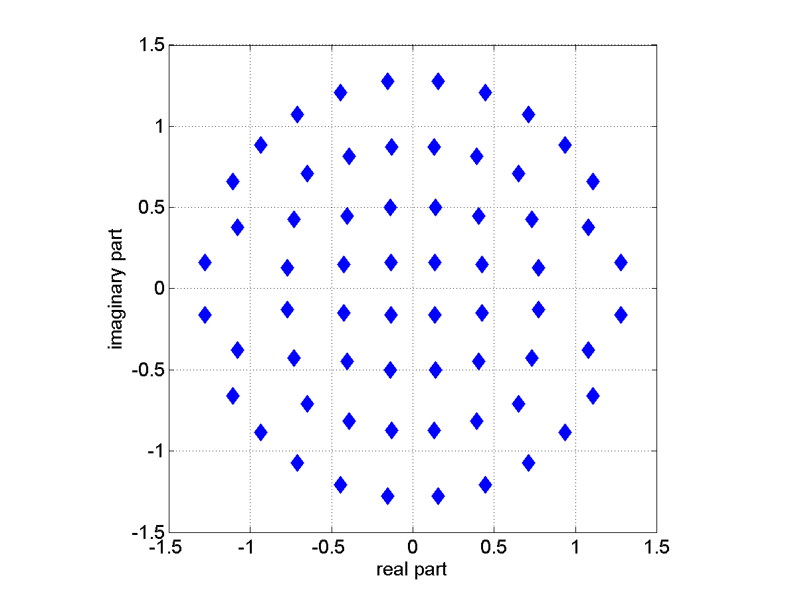
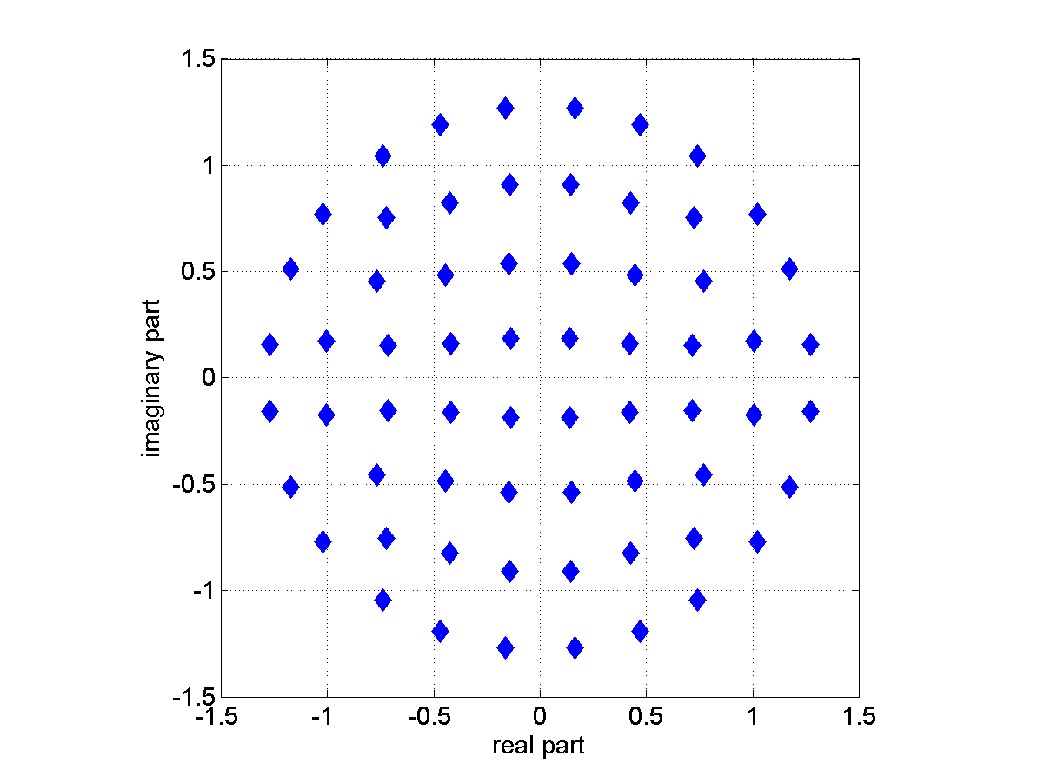
NUCs of Cat. B
CR ¹/₂
CR ⁵/₈
CR ³/₄
CR ¹³/₁₆

Slide 18
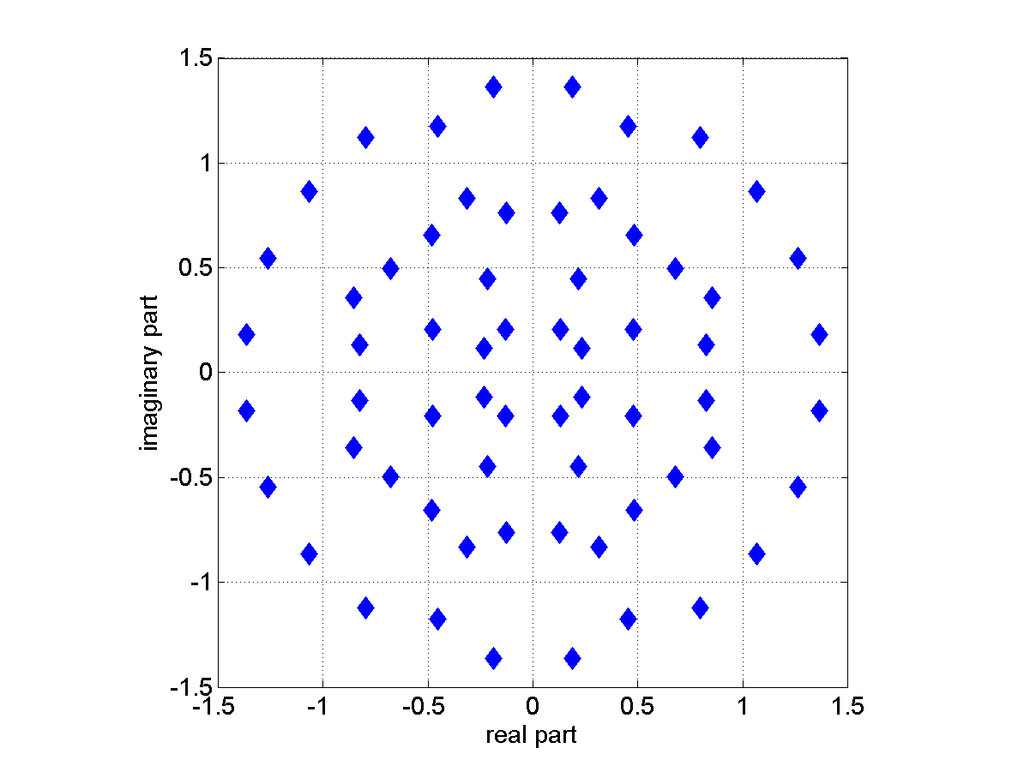
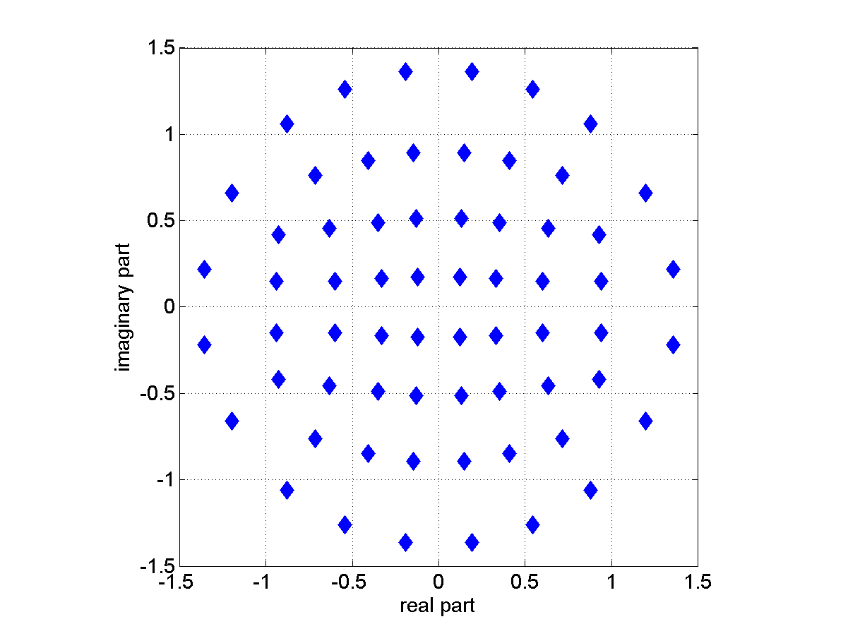
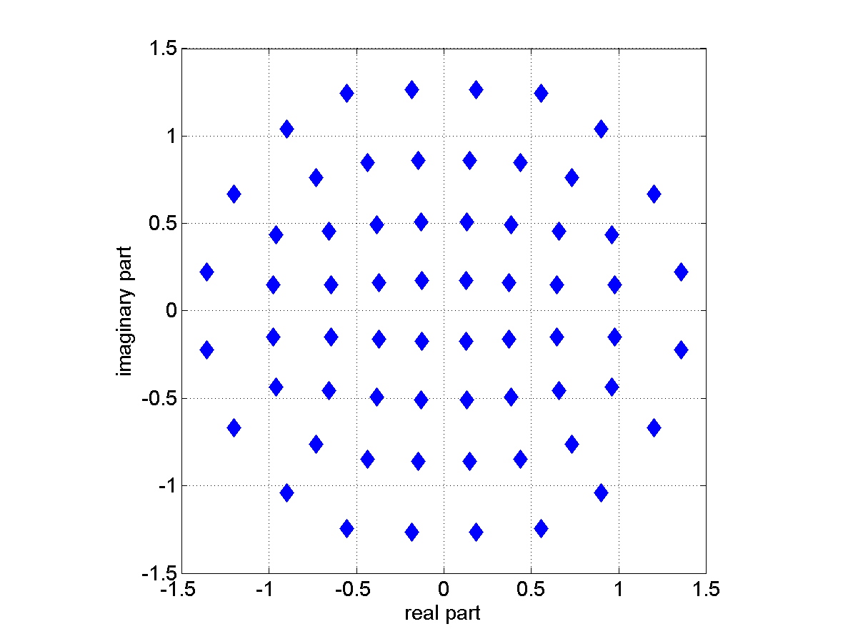
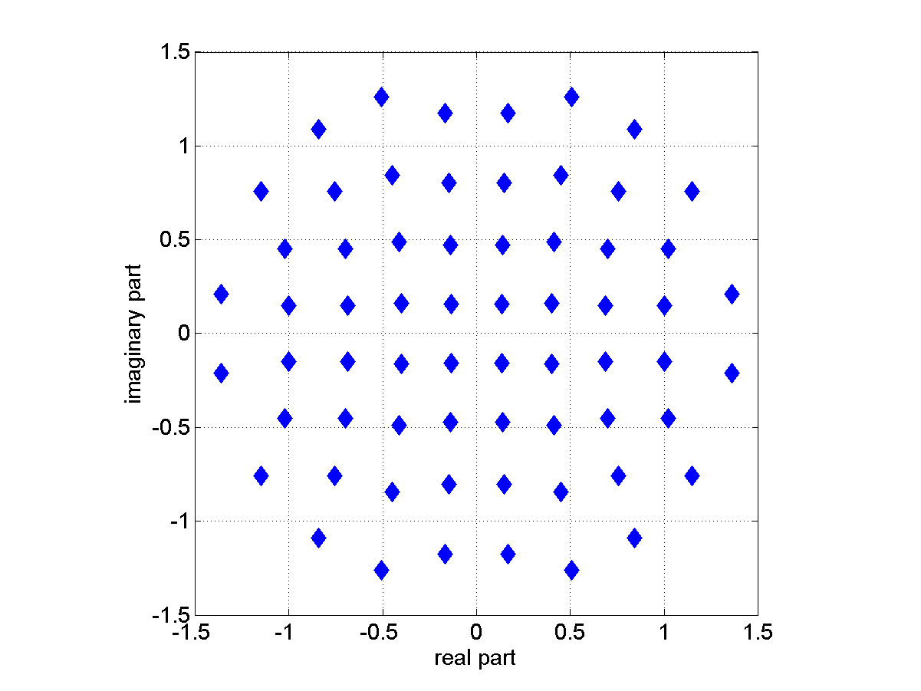
NUCs of Cat. C
CR ¹/₂
CR ⁵/₈
CR ³/₄
CR ¹³/₁₆

Slide 19
NUCs of Cat. D
See [4]

