Slide 1
Further Use Cases for Next Generation Positioning
Date: 2015/07/13
Authors:

Slide 2
Abstract
This document provides several use cases for next generation positioning (NGP)
The use cases are supported with estimates on required
  accuracy
  latency
  refresh rate
  number of simultaneous users (within AP coverage)
The terminology is as defined in document
11-15/0388r0

Slide 3
1. Positioning for Medical Applications
User: Patient under medical surveillance in a hospital or care home.
Environment: Building with 802.11 coverage. The expected AP environment is
  1 AP per < 100 users or < 400m² / 4000 sq. ft.
  APs support .11n, .11ac, .11ax, and NGP
Use case:
  Patient is connected to a portable medical device with WLAN interface (e.g. heart rate monitor) which continuously monitors medical parameters.
  When the patient moves around, his/her position is tracked and recorded.
  If monitored medical parameters get severe, a nurse or a doctor is informed including the patient’s position for first aid assistance.
  The medical parameters can be linked with an activity profile which is retrieved from the tracked data.
  If the patient leaves a certain area, a nurse gets informed (fencing feature).
Positioning requirements:
  Horizontal accuracy: < 1m @ 90%
  Vertical accuracy: same floor @ 99.9%
  Latency: < 200ms
  Refresh rate: > 2 locations/s
  Expected number of simultaneous users: < 10 (within AP coverage area)
  Impact on Network Bandwidth: low, the impact should be independent on the number of users

Slide 4
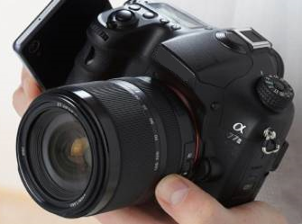
2. Indoor Geotagging
User: Person with digital camera, smart phone, tablet, or smart eyeglasses
Environment: Building (e.g. museum, exhibits, fair, restaurant) with 802.11 coverage. The expected AP environment is
  1 AP per < 100 users or < 400m² / 4000 sq. ft. (large buildings)
  1 AP per floor, optional: multiple APs from neighboring apartments (small buildings)
  APs support .11n, .11ac, .11ax, and NGP
Use case:
  Person takes a picture with a digital camera.
  Digital camera estimates its position using NGP and tags the picture with its geolocation (like GPS geotagging for outdoor applications)
Positioning requirements:
  Horizontal accuracy: < 1 to 2m @ 75%
  Vertical accuracy: < 1 to 2m @ 75%
  Latency: < 400ms
  Refresh rate: < 1 locations/s
  Expected number of simultaneous users: < 1 to 10
  (within AP coverage area)
  Impact on Network Bandwidth: low

Slide 5
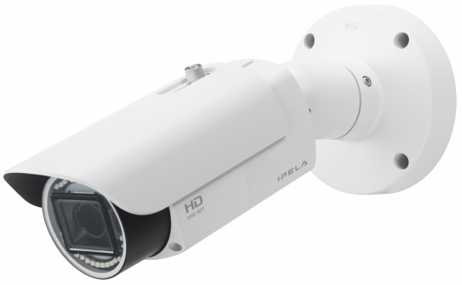
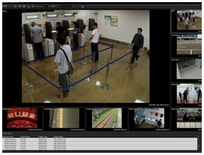
3. Positioning for Video Cameras
User: Enterprise (e.g. shop) installing video surveillance cameras with WLAN connection capability
  WLAN is employed for video transmission, camera control, and positioning of the camera
Environment:
  Building with 802.11 infrastructure. The expected AP environment is
    1 AP per < 10 cameras or < 400m² / 4000 sq. ft.
  In some environments P2P is applied
  APs and STAs support .11n, .11ac, and NGP
Use case:
  A technician installs the surveillance cameras at arbitrary positions.
  After the setup is done, each camera is triggered to determine its position.
  The absolute (infrastructure) or relative (P2P) position is fed back to the control room, where the position of all cameras is denoted on a map of the building.
  The camera position data is also crucial for a continuous tracking of moving persons.
  The position of single cameras can be monitored for detecting camera movements.
Positioning requirements:
  Horizontal / Vertical accuracy: both < 1m @ 90% (infrastructure)
  Distance / Angular accuracy: < 1m @ 90% / < 2° @ 90% (P2P)
  Latency: < 1s
  Refresh rate: < 0.1 to 1 locations/s
  Impact on Network Bandwidth: as low as possible, video dominates

Slide 6
References
Cisco Systems Inc., 11-15-0388-00-0ngp
NGP Use Case Template
Jonathan Segev, Intel, 11-14-1464-02-0wng
NG Positioning Overview and Challenges

Slide 7
BAckup

Slide 8
Terminology of doc. 11-15/0388r0
  User – The end entity (human) who would use this technology
  Use case – A use case is task oriented. It describes the specific step by step actions performed by a user or device. One use case example is a user starting and stopping a video stream.
  Environment – The type of place in which a network is deployed, such as home, outdoor, hot spot, enterprise, metropolitan area, etc.
    Frequency bands of interest (FBoI): The 802.11 operating frequency bands relevant to this use case. Eg. for a shopping mall’s enterprise wireless it will be 2.4GHz and 5GHz
    AP density: Density of AP deployment, e.g. APs deployed every 4000 sq.ft.
    AP height: Height, above the floor, at which the APs are deployed, e.g. for shopping mall APs deployed approximately 15-25 ft above the floor
Key Location Requirement-
    Expected Horizontal Accuracy: XY accuracy expected for the use case to succeed, <1m@90% is a requirement is that the computed location be within 1m horizontally of the actual location 90% of the time
    Expected Vertical Accuracy: Z accuracy expected for the use case to succeed, “same floor@99%” is a requirement is that the computed location be on the same floor as the actual location 99% of the time. “0.5m@90%” is a requirement is that the computed location be within 0.5m vertically of the actual location 90% of the time
    Expected Latency: Expected time taken to complete a single atomic location process. The location process begins with initiating a location request, then computing location, and ends with returning the computed location. E.g. 10 ms latency would indicate that it takes 10 ms after the request is transmitted to gather measurements, compute a location, and transfer any parameters such that the requester has a location within 10 ms.
    Expected Refresh Rate: This defines how frequently is the computation expected when client moving. E.g. a refresh rate of 10 locations per second would indicate that location needs to be refreshed 10 times in a second
    Expected number of simultaneous users

