Slide 1
Docking usage model
Date: 11-Jul-15
Authors:

Slide 2
Abstract
Usage model for office docking

Slide 3
Usage Model XYZ: Office docking
Pre-Conditions:
Office docking enables a wireless docking experience for office and home. Mobile device (Notebook, tablet, smartphone, small form factor) may communicate wirelessly with multiple peripheral devices - monitors, camcorders, web cameras, hard drives, printers, Internet AP/Router, etc. and/or another mobile device,
Scenarios include a single device in a home scenario as well as in a dense office environment with multiple mobile devices where each mobile device has its own or shared dock/peripherals, or multiple mobile devices sharing a dock. A single wireless link that connects a mobile device with its dock, where the dock is wire-connected to multiple other devices, as well as multiple wireless links to connect the mobile with many devices should be supported.
Application:
Productivity applications
Support of two monitors of 8K resolution
Wireless support of USB devices with different traffic characteristics: isochronous, human interface and others
Gigabit Ethernet
Mass storage devices
3D webcams
Dynamic composition
Connecting mobile to 2-5 peripheral devices
Mobile device should be able to sustain full working day w/o recharging battery
Connecting multiple mobile source devices to dock
Environment:
Typical office scenarios - open space, cubicles, meeting room, and standalone home office usage. Range between mobile and dock and peripherals will typically be < 3m. Dense environment with multiple docking may or may not be wall isolated. Most of the devices are semi-static that may be moved intentionally or unintentionally.
Traffic Conditions:
Typically one to one and one to many links, many to one links (multiple source devices to one dock with shared peripheral devices)
Multiple simultaneous high performance links, some with low latency requirements, others with best-effort rates.
Some flows are unidirectional and others are bidirectional.
- Multiple uncoordinated ad hoc networks
Use Case:
Mobile device is wirelessly connected to a docking station, and/or wirelessly connected to multiple wireless peripherals directly
Mobile device may be wirelessly connected to other mobile devices separately or simultaneously with (1)
Mobile device may be simultaneously connected to wireless LAN
Devices may be simultaneously connected to Bluetooth and other radio
Dense office environment with multiple mobile devices where each one may be docked simultaneously with different docks
Some data flows have significant latency, throughput and QoS requirements (monitors under productivity applications, Dynamic composition, HID)
Multiple mobile devices (for example a PC and a smartphone) wirelessly connected to a docking station and sharing the peripherals that are connected to dock.

Slide 4
Usage Model XYZ: Office docking
Per device wireless link | Average throughput (Gbps) | Peak throughput (Gbps) | MAC/PHY Latency for productivity applications (ms)
Monitor 4K lightly compressed | 0.3 | 1.5 | 10
Monitor 5K lightly compressed | 0.5 | 2.7 | 10
Monitor 8K lightly compressed | 1.6 | 8.0 | 10
USB HID | 0.1 | 0.1 | 10
USB total | 8.0 | 8.0 | NA
Ethernet | 2.0 | 2.0 | NA
Mobile to mobile | 8.0 | 8.0 | NA
Combined wireless link | Max Throughput (Gbps)
Two Monitors 8K+USB+Ethernet | 13.2

Slide 5
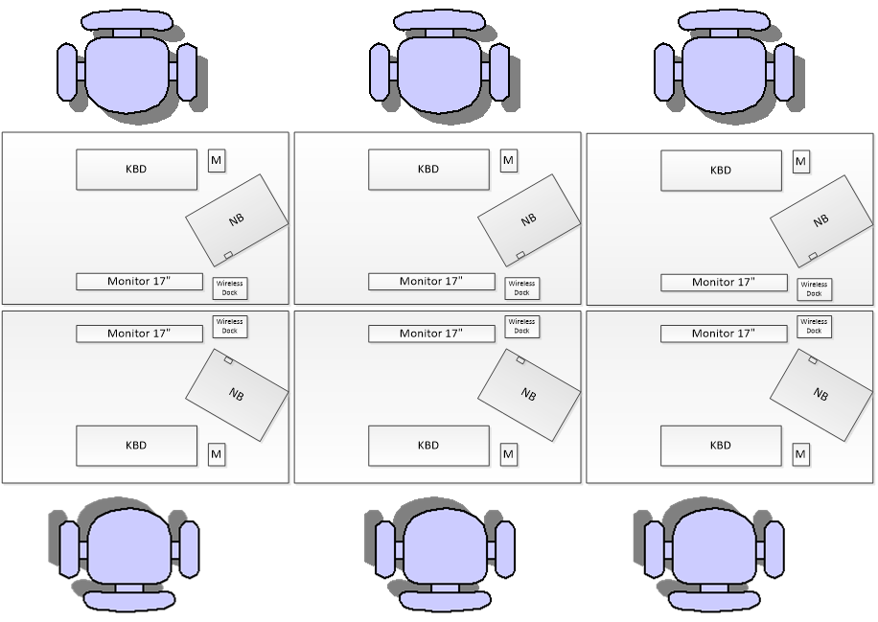
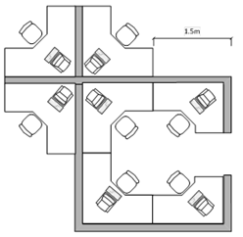
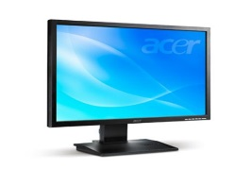

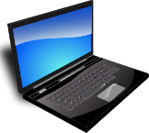



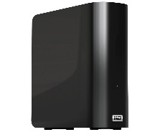


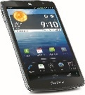
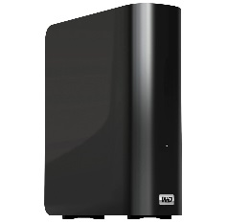
Usage Model XYZ: Office docking
Open space example 2
Open space example 1
Office docking with
single wireless link
Dock
Office docking with multiple wireless links

