Slide 1
Preamble Design and Auto-Detection for 11ax
Date: 2015-07-13
Authors:

Slide 2
Abstract
In the same platform, the previously proposed repeated L-SIG[1] and signature symbol schemes[2] are evaluated
The repeated L-SIG scheme needs optimization efforts for repetition threshold considering a trade-off between false detection and mis-detection probabilities
The signature symbol scheme shows reasonable performance in both mis-detection and false detection
For a simple implementation and future extension, the signature symbol scheme is more preferred than the repeated L-SIG scheme

Slide 3
Introduction
Repeated L-SIG (RL-SIG) [1]
  Modulating the RL-SIG (L-SIG repetition ) symbol with BPSK and rate ½ BCC.
  Detection from both a repetition check and an L-SIG validity check
Signature symbol (SS) [2]
  One symbol, MCS 0, separately encoded
    Signature of 10~12 fixed bits
    Additional info. of 6~8 bits
  Detect from checking a known signature after decoding
BPSK
BPSK
BPSK
L-SIG 4us
R-LSIG 4us
HE-SIGA
…
BPSK
BPSK
BPSK
L-SIG 4us
Signature
4us
HE-SIGA
…

Slide 4
Simulation Environments
Bandwidth : 20MHz
Multi-antenna transmission with CSD: 1x1, 2x1, and 4x1
Wireless channel: TGac D and UMi
Carrier frequency offset (CFO): fixed at 40 ppm (@ 5GHz)
Phase noise (both at Tx/Rx): -41dBc
Real timing estimation & synchronization
Signature symbol configuration [2]
  12 bits for signature, 6 bits for tail, and 6 bits for random information
11ax detection algorithms
  Explain in the following pages
SIG-A assumption: 34 payload + 6 tail + 8 CRC bits (2 OFDM symbol)

Slide 5
Detection Algorithm for 11ax
: Repeated L-SIG (RL-SIG)
L-STF
Timing/CFO compensation
The same detection algorithm in [1]
Repetition threshold, α
  Cross-correlation value btw. L-SIG and RL-SIG
L-SIG validity check
  Parity = OK
  L-Rate = 6Mbps
  L-Length (mod 3) = 0
L-LTF
Equalization
L-SIG
Repetition Threshold > α
N
RL-SIG
Y
MRC &
L-SIG Validity Check
N
Legacy
Detection
Y
t
11ax detect
11n
11ac
11a

Slide 6
Detection Algorithm for 11ax
: Signature Symbol (SS)
The same detection algorithm in [2]
Signature check
  After decoding with the tail bits, the 12 bits are matched with the known signature
L-STF
Timing/CFO compensation
L-LTF
Equalization
L-SIG
Signature Check
SIGNATURE
N
Legacy
Detection
Y
t
11ax detect
11n
11ac
11a

Slide 7
Mis-Detection & False Detection
Mis-detection in the 11ax receiver
  When an 11ax PPDU is transmitted, an 11ax device detects it as other types of PPDUs
Two types of false detections
  Type 1 (to see impacts to legacy devices): When an 11ax PPDU is transmitted, a probability that an 11ac (or 11n) device detects it as an 11ac (or 11n) PPDU
    It should be checked if a new 11ax PPDU has unusual modulations in the position of 11n/11ac SIG-A symbols
  Type 2 (to see impacts from legacy PPDUs): When an 11ac (or 11n or 11a) PPDU is transmitted, a probability that an 11ax device detects it as an 11ax PPDU
In this contribution, the type 2 false detection is considered.
  Type 1 false detection has minimal system impact

Slide 8
Mis-Detection Performance
The RL-SIG shows 1.0~1.5 dB gain compared to the SS scheme due to MRC combining of two L-SIG symbols
  The both schemes shows similar mis-detection curves to each of L-SIG errors
  1.0 dB
  1.5 dB
  L-SIG and mis-detection of RL-SIG
  L-SIG and mis-detection of SS
  Both schemes show error floors in UMi

Slide 9
Mis-Detection Performance (cont’d)
Both schemes show no serious degradation or other noticeable aspects in multi-antenna transmissions
  Compared to 1x1 in TGac D, the 2x1 has approximately 1.0 dB gain @ 10⁻¹
  Compared to 1x1 in UMi, the 4x1 has approximately 1.7dB gain @ 10⁻¹
  1.0 dB
  1.7 dB

Slide 10
False Detection for RL-SIG
The false detection increases as SNR increases for 11ac/11a PPDUs
Even at a high SNR, over 4% of 11ac PPDUs are detected as 11ax PPDU due to the high false detection
  The same trend is verified in AWGN (Appendix A)
11ac PPDU
…
L-SIG
(BPSK)
SIG-A1
(BPSK)
…
Correctly Detected
as others
11ax Receiver
About 4%
false detection
11n PPDU
…
L-SIG
(BPSK)
SIG-A1
(QBPSK)
…
11a PPDU
Falsely Detected
as 11ax
…
L-SIG
(BPSK)
Data
(QAM)
…
Most of 11n PPDUs can be filtered out in the repetition check since it has QBPSK symbol

Slide 11
False Detection for RL-SIG (cont’d)
  In high SNR, 11ac PPDUs are falsely detected as 11ax
  L-SIG validity check does not work properly in high SNR
  HE STA combines 11ac L-SIG and VHT-SIG-A1 (in MRC) for decoding
  If cross-correlation is high enough (according to our simulations, above 0), combined L-SIG + VHT-SIG-A1 successfully decodes as L-SIG.
    VHT-SIG-A1 is not trellis terminated and acts as interference to L-SIG.
    If combined second OFDM symbol (e.g. VHT-SIG-A1) is self-decodable (i.e. trellis terminated), the combined signal can be decoded either as L-SIG or the second OFDM symbol. (Appendix B)
    L-SIG at 0dB (AWGN) can be decoded with 99.7% probability (Appendix C)

Slide 12
False Detection for RL-SIG (cont’d)
False detection and mis-detection probabilities trade-off
  With a large repetition threshold α (= tight repetition check), the false detection is reduced
  But the mis-detection increases (more 11ax PPDUs are filtered out in the repetition check stage)
Mis-detection is worse than Non-Combined L-SIG PER
Mis-detection
increases with α
False detection
decreases with α

Slide 13
False Detection in the Signature Symbol
Good false detection probabilities in both indoor and outdoor channels
  Always lower than 10⁻³ (regardless of SNR and PPDU types)
  False detection that also checks SIG-A CRC is below 10⁻⁴
  Not seen above 10⁻⁴ when SIG-A CRC is checked
  Not seen above 10⁻⁴ when SIG-A CRC is checked

Slide 14
Potential Issues in the RL-SIG
The false detection probability increases with SNR
  Worst case: 11ac PPDU or 11a PPDU with BPSK data (e.g. management or control packet)
  False detection results in loss of 11ac or 11a packet entirely
False detection can be mitigated with HE-SIG-A CRC check
  Results in more complex receiver architecture (due to potential 11n/11ac AGC symbol)
  Benefits of early detection (right after L-SIG) lost
Complex receiver architecture & optimization
  In order to get any MRC gains (from duplication), complex adaptive cross-correlation detection algorithms is needed.
  Implementation margin is likely to eat up any MRC gain.
  Robustness of the adaptive cross-correlation detection algorithm is questionable.
    Detection algorithm must take into account channel characteristics, SNR, potential PPDU types, etc.

Slide 15
Conclusion
Repeated L-SIG scheme, has high false detection probability for 11ac PPDUs and 11a BPSK PPDUs.
  Requires complex receiver architecture to cope with false detection issues.
1 dB MRC gain of L-SIG is washed away when taking into account false detection issues.
  With wrong parameter configuration, even worst performance than single L-SIG decoding
Future extension of PPDU formats is important and should be addressed
  Extension of repeated L-SIG will be limited and may cause even more miss-detection/false detection issues.
Signature symbol scheme is preferred
  Simple implementation (no additional optimization needed)
  Robust performance under any scenario
  Great future extension ability (additional 6~8 bits for 11ax and future use)

Slide 16
Straw Poll
Do you agree that auto-detection design (e.g. HE PPDU preamble design) shall take into account mis- and false detection probabilities together with optimization complexity in the implementation?

Slide 17
References
[1] 11-15-0579r2, Preamble Design and Autodetection
[2] 11-15-0643r0, Autodetection with Signature Symbol

Slide 18
Appendix A: Verification in AWGN
Simple bit-level realization of 11ac PPDUs
False detection prob. (= C/A)
  As SNR increases, the increase in the false detection can be seen as well in AWGN
  This increase comes from the L-SIG validity check (See the ratio C/B the next page)
L-SIG(1:24)
SIG-A(1:48)
Encoding
Encoding
AWGN
AWGN
(1:48)
(1:48 )
take the first 48 modulated symbol
A
Repetition Threshold > α
N
B
Y
Combine two symbols
MRC &
L-SIG Validity Check
N
C
Y

Slide 19
Appendix A: Verification in AWGN (cont’d)
Repetition check pass ratio = B/A
  It is mostly independent to SNR and varies significantly with α value
Validity check pass ratio = C/B
  For all SNRs, it has over 80% pass ratio and increases with an increase in α value

Slide 20
Appendix B: Effect from SIG-A Encoding
Assuming the interfered symbol (SIG-A1) is a self-decodable (i.e. trellis terminated within the symbol) (Blue curve),
  With some chances, the decoding Trellis of the combined signal (L-SIG + SIG-A1) can follow SIG-A1’s because it is also self-decodable
However, the current 11a/11ac/11n
SIG-A1 is a portion of longer
encoded information (Red curve),
  SIG-A1 is not self-decodable
  Therefore, highly likely to be decoded
  as L-SIG and pass the L-SIG validity
  check
Therefore, the L-SIG content
check of the combined L-SIG
is not useful
  50% chance of L-SIG validity check pass

Slide 21
Appendix C: L-SIG PER in AWGN
Approximately 99.7% of L-SIG symbols can be decoded correctly even at 0 dB
  The 0 dB is almost equivalent to the condition combining an L-SIG symbol with the same powered random symbol without noise

Slide 22
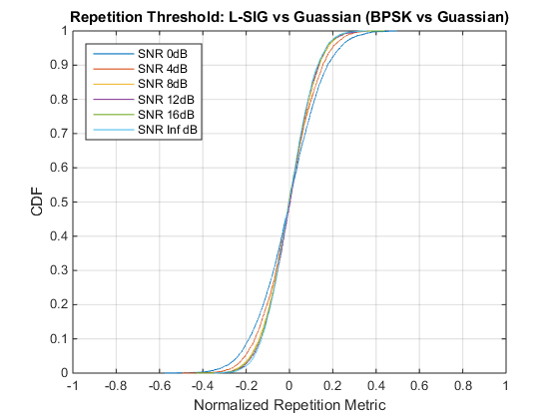
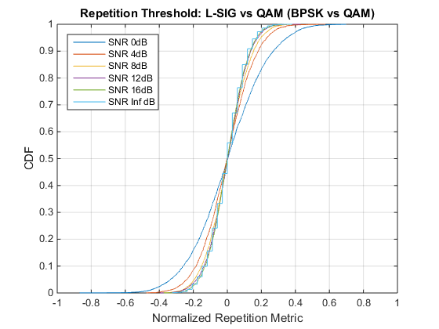
Appendix D: Repetition Check (1/2)
Note:
Hamming distance of 8 corresponds to -0.67 normalized cross correlation

Slide 23
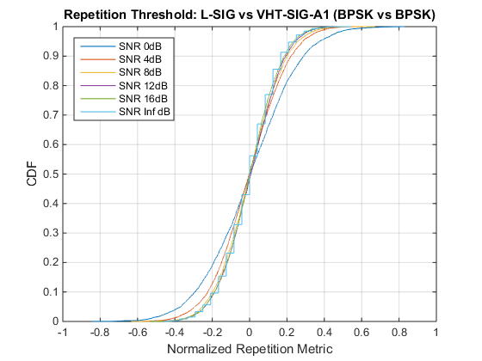
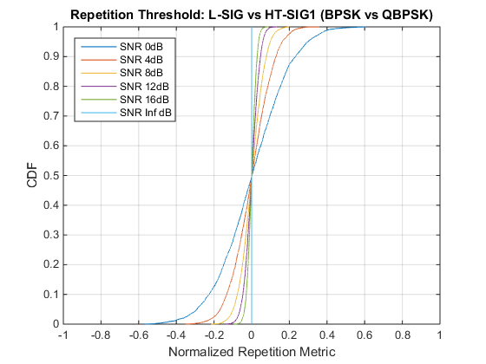
Appendix D: Repetition Check (2/2)

