Slide 1
Topics for Consideration for Spatial Reuse
Date: 2015-07-12
Authors:

Slide 2
Abstract
In this contribution, we discuss a number of topics that may be considered by TGax in the area of spatial reuse, in addition to sensitivity and TPC adjustments.

Slide 3
Table of Contents
Introduction
Spatial reuse topics
Conclusions

Slide 4
Introduction
Spatial reuse is considered as a very important feature for TGax
  An Ad Hoc group is dedicated to this feature
  A substantial number of HEW/TGax contributions focuses on simulation and improvement of spatial reuse designs
Many spatial reuse contributions so far focused on sensitivity and TPC adjustment
  Dozens of sensitivity control contributions are listed in [2]
  Majority of the contributions presented in March and May Spatial Reuse Ad Hoc is related to sensitivity control [3][4]
In this contribution, we highlight additional methods to enhance spatial reuse
  Topics Discussed previously in HEW/TGax
  Features included by other 802.11 standards, such as 11ah and11ad

Slide 5
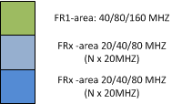

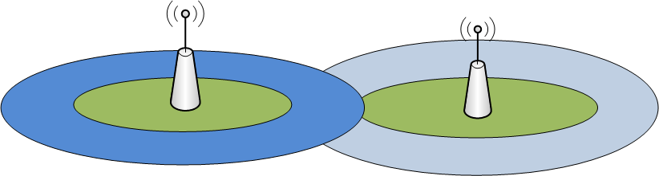
OBSS-Interference based Frequency Reuse
Discussed previously in HEW [5]
BSS is divided to two regions (downlink coverage is illustrated)
  FR1 area: Frequency reuse factor 1
    Considered as ‘OBSS free’ area
  FRx area where x notes frequency reuse factor of 2/4/8
DL / UL transmissions may use different bandwidths
e.g. AP may use FR1 but a STA may need to use FR>1

Slide 6
Sector Based Transmission (802.11ah)
Group sectorization operation is based on the AP transmitting a sectorized beacon.
  A sectorized beacon is a beacon transmitted through a sectorized beam which covers a specific sector of the BSS
  STAs of a particular sector are allowed to access medium following the sectorized beacon
Potential enhancement:
  Sectors between BSSs may be coordinated to improve spatial reuse

Slide 7
Spatially Orthogonal Transmission (11ah) (802.11ah)
TXOP-based sectorization operation is based on an AP transmitting or receiving through the sectorized beam within a TXOP
In TXOP-based sectorization operation, during a frame exchange between the AP employing sectorized beamforming and a non-AP STA, spatial re-use by OBSS APs or OBSS non-AP STAs sharing the same wireless medium is allowed

Slide 8
Beamforming and Spatial Sharing (802.11ad)
Spatial sharing mechanisms allow Service Periods belonging to different STAs in the vicinity to be scheduled concurrently on the same channel.
Training and measurement are conducted prior to scheduled SPs to ensure that two concurrent transmissions don’t interfere with each other.

Slide 9
Conclusion
In this presentation, we highlighted a few spatial reuse topics that may be considered for TGax
Would like to receive feedback from the group whether these or other topics are worth considering by the Spatial Reuse Ad Hoc, in addition to sensitivity and TPC adjustment schemes

Slide 10
Straw Poll 1
Should spatial sharing methods, other than sensitivity and TPC adjustment, be considered in 802.11ax to improve spatial reuse?
y/n/a

Slide 11
Straw Poll 2
Should any of the spatial sharing techniques in the following categories be considered in 802.11ax to improve spatial reuse?
OBSS-interference based frequency reuse design [5]: y/n/a
Sector-based transmission (11ah): y/n/a
Spatially orthogonal transmission (11ah): y/n/a
Beamforming and spatial sharing (11ad): y/n/a
Other topics: y/n/a

Slide 12
References
11-15/0132r5, Specification Framework for Tgax, May 2015
11-14/1580r0, Perspectives on Spatial Reuse in 11ax, Dec. 2014
11-15/0398r2, 802.11ax Spatial Reuse Ad Hoc Group Agenda, Mar. 2015
11-15/0650r2, 802.11ax Spatial Reuse Ad Hoc Group Agenda, May 2015
11-13/0871r0, Discussion on Potential Techniques for HEW, Jul. 2013
IEEE P802.11ah™/D5.0, Mar. 2015
IEEE Std 802.11ad™, Dec. 2012

