Slide 1
Frequency-independent Digital Precoder for Hybrid MIMO Precoding
Date: 2015-07-13
Authors:

Slide 2
Abstract
In hybrid beamforming [1], precoding is performed two stages:
  Digital (baseband) precoding and Analog (RF) precoding
Typically, the same analog precoder is used for all subcarriers (Frequency-independent).
On the other hand, the optimal digital precoder can be selected for each subcarrier, yielding the best performance [2]; however it requires extensive feedback.
In this presentation, we investigate how suboptimal choices (with reduced feedback) affect the performance.

Slide 3
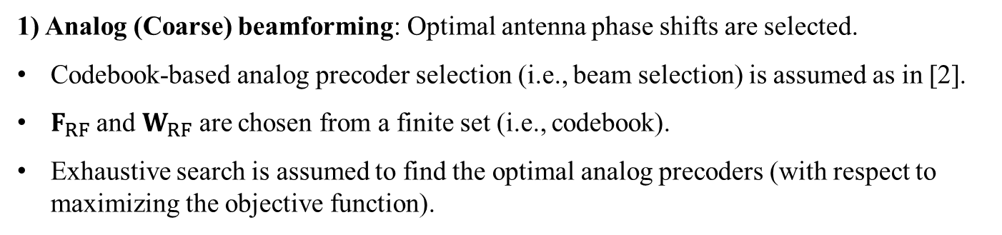




Hybrid Beamforming
$F_{RF}$
$$y=H x+n$$
$F_{BB}$
RF
RF
s
BB
BB
$${x=Fs=F}_{RF}F_{BB}s$$
RF
RF
1) Analog (Coarse) beamforming: Optimal antenna phase shifts are selected.
Codebook-based analog precoder selection (i.e., beam selection) is assumed as in [2].
$F_{RF}$ and $W_{RF}$ are chosen from a finite set (i.e., codebook).
Exhaustive search is assumed to find the optimal analog precoders (with respect to maximizing the objective function).

Slide 4
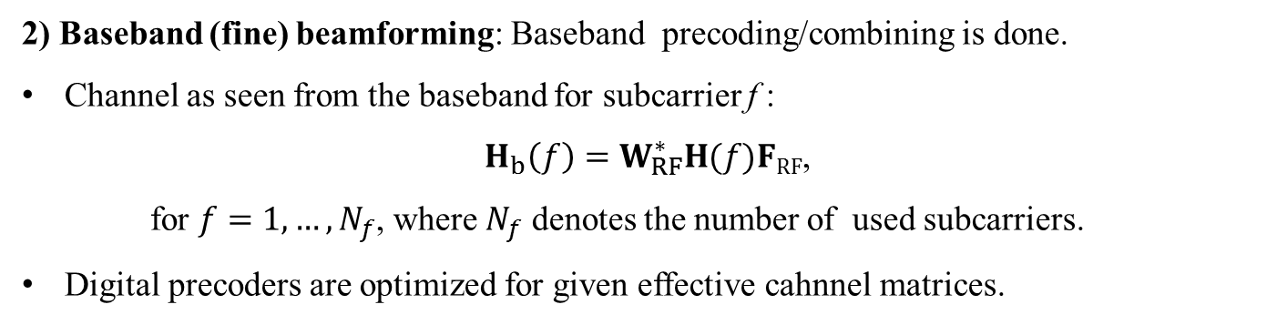
Hybrid Beamforming
$F_{RF}$
$$y=H x+n$$
$F_{BB}$
RF
RF
s
BB
BB
$${x=Fs=F}_{RF}F_{BB}s$$
RF
RF
2) Baseband (fine) beamforming: Baseband precoding/combining is done.
Channel as seen from the baseband for subcarrier f :
${ H}_{b}\left(f\right)=W_{RF}^{∗}H(f)FRF$,
  for $f=1,…,N_{f}$, where $N_{f}$ denotes the number of used subcarriers.
Digital precoders are optimized for given effective cahnnel matrices.

Slide 5
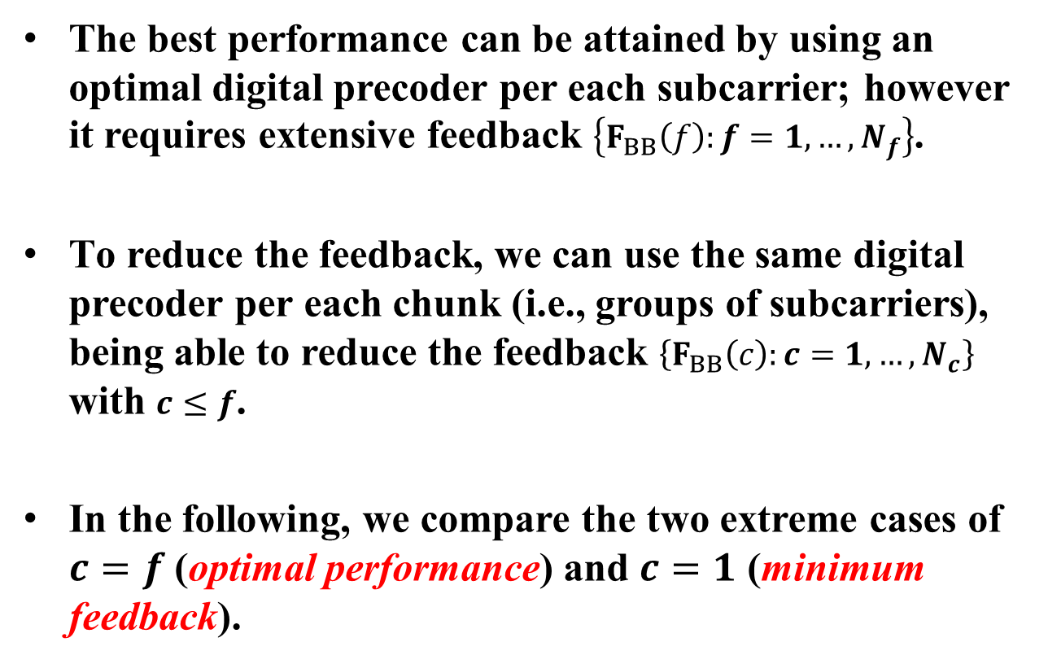
Optimizing the Digital Precoders
The best performance can be attained by using an optimal digital precoder per each subcarrier; however it requires extensive feedback $\left\{F_{BB}\left(f\right):f=1,…,N_{f}\right\}$.
To reduce the feedback, we can use the same digital precoder per each chunk (i.e., groups of subcarriers), being able to reduce the feedback $\left\{F_{BB}\left(c\right):c=1,…,N_{c}\right\}$ with $c≤f$.
In the following, we compare the two extreme cases of $c=f$ (optimal performance) and $c=1$ (minimum feedback).

Slide 6
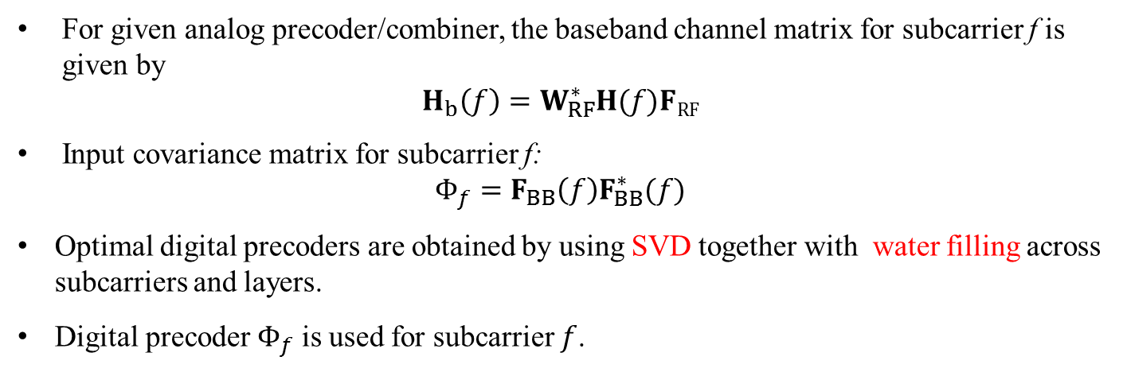
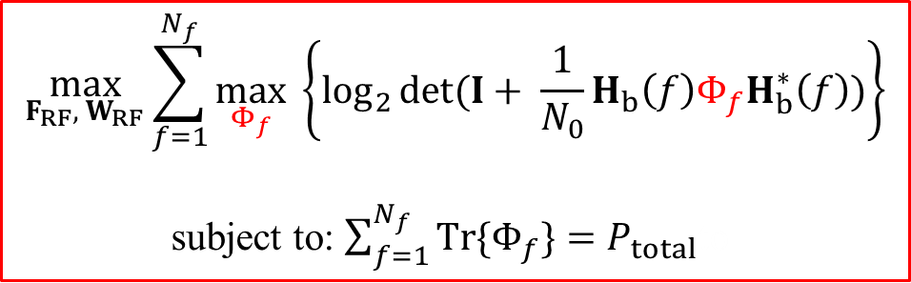
Optimal Digital Precoder
$$\max_{F_{RF}, { W}_{RF}}\sum_{f=1}^{N_{f}}{\begin{aligned} \\ \max_{Φ_{f}} \left\{\log_{2}\det{(I+ \frac{1}{N_{0}}H_{b}\left(f\right)Φ_{f}H_{b}^{∗}\left(f\right))}\right\}\end{aligned}}$$
subject to: $\sum_{f=1}^{N_{f}}{Tr\{Φ_{f}\}}=P_{total}$to
For given analog precoder/combiner, the baseband channel matrix for subcarrier f is given by
$$H_{b}\left(f\right)=W_{RF}^{∗}H(f)FRF$$
Input covariance matrix for subcarrier f:
$$Φ_{f}=F_{BB}\left(f\right)F_{BB}^{∗}(f)$$
Optimal digital precoders are obtained by using SVD together with water filling across subcarriers and layers.
Digital precoder $Φ_{f}$ is used for subcarrier $f$.
Notes:
This provides optimal performance but may require extensive feedback. In the case of a single precoder, the problem becomes the following

Slide 7
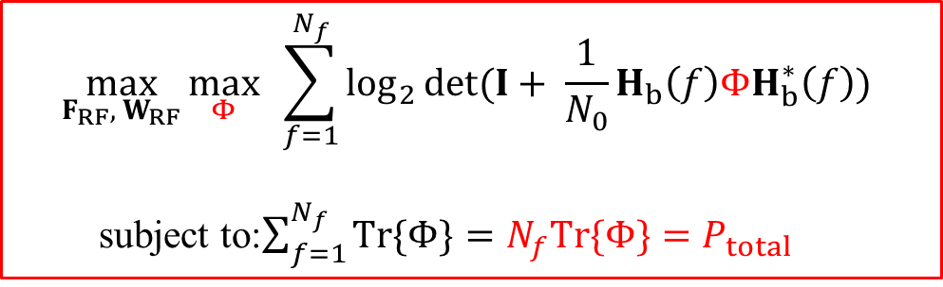
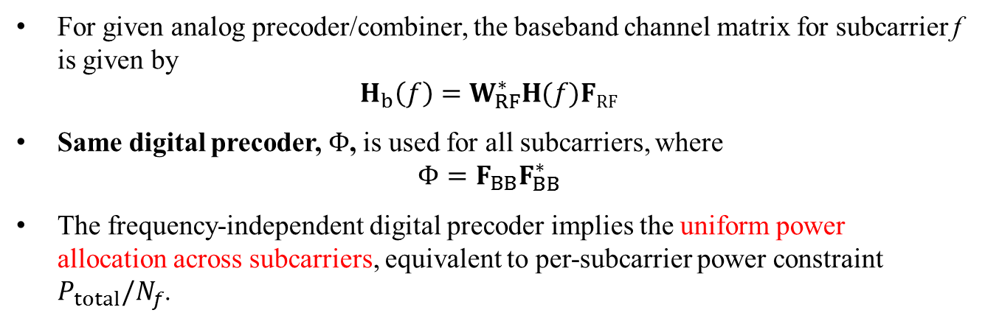
Frequency-independent Digital Precoder
$$\max_{F_{RF}, { W}_{RF}}\max_{Φ}{\sum_{f=1}^{N_{f}}{\log_{2}\det{(I+ \frac{1}{N_{0}}H_{b}\left(f\right)ΦH_{b}^{∗}\left(f\right))} }}$$
subject to:$\sum_{f=1}^{N_{f}}{Tr\{Φ\}}=N_{f}Tr\{Φ\}=P_{total}$to
For given analog precoder/combiner, the baseband channel matrix for subcarrier f is given by
$$H_{b}\left(f\right)=W_{RF}^{∗}H(f)FRF$$
Same digital precoder, $Φ$, is used for all subcarriers, where
$$Φ=F_{BB}F_{BB}^{∗}$$
The frequency-independent digital precoder implies the uniform power allocation across subcarriers, equivalent to per-subcarrier power constraint $P_{total}/N_{f}$.

Slide 8
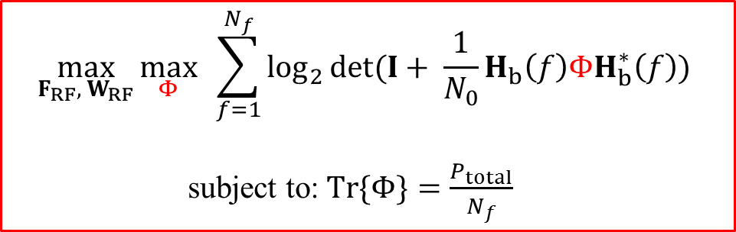
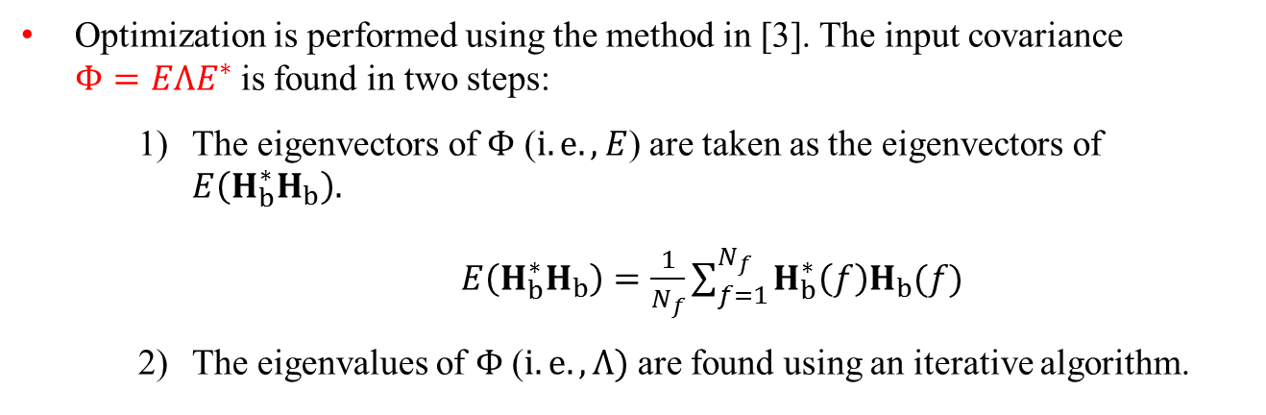
Frequency-independent Digital Precoder
$$\max_{F_{RF}, { W}_{RF}}\max_{Φ}{\sum_{f=1}^{N_{f}}{\log_{2}\det{(I+ \frac{1}{N_{0}}H_{b}\left(f\right)ΦH_{b}^{∗}\left(f\right))} }}$$
subject to:$Tr\{Φ\}=\frac{P_{total}}{N_{f}}$to
Optimization is performed using the method in [3]. The input covariance $Φ=EΛE^{∗}$is found in two steps:
  The eigenvectors of $Φ$ ($i.e., E$) are taken as the eigenvectors of $E\left(H_{b}^{∗}H_{b}\right).$
  $E\left(H_{b}^{∗}H_{b}\right)=\frac{1}{N_{f}}\sum_{f=1}^{N_{f}}{H_{b}^{∗}\left(f\right)H_{b}(f)}$
  The eigenvalues of $Φ$($i.e., Λ)$ are found using an iterative algorithm.

Slide 9
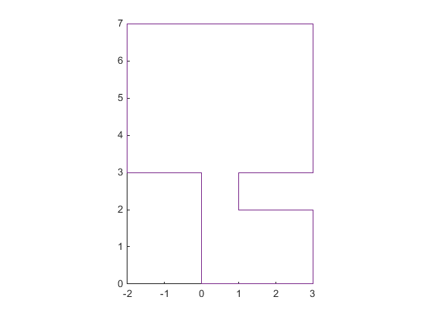
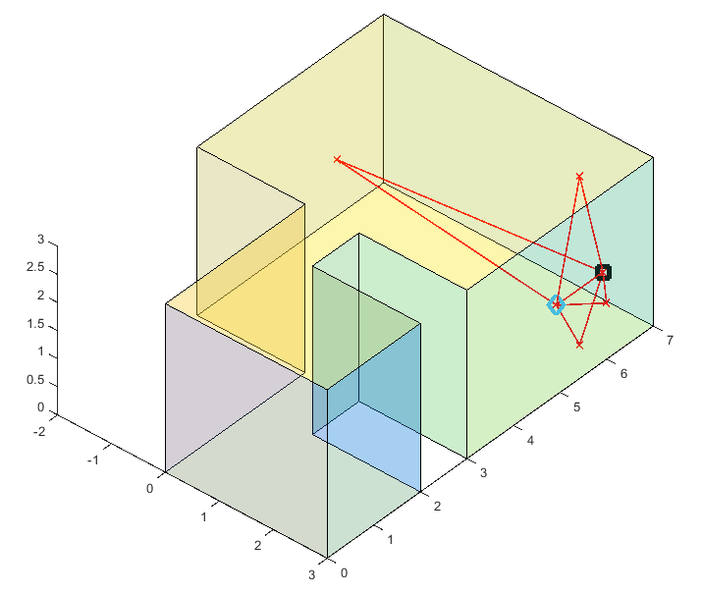
Simulation Details
Receiver fixed at one location.
Several transmitter locations tested.
Both transmitter and receiver have two antenna arrays → 2x2 MIMO.
Antenna arrays are 1x8 linear arrays.
For each transmitter location, full channel matrix (16x16) is generated by ray tracing.
Studio apartment room plan:
Rx
3
1
Tx
2
4
5

Slide 10
Simulation Details
Studio apartment room plan:
Rx
For each location, two rate values are calculated: Rates achieved with solving Optimization Problem 1 and 2 (frequency-dependent and frequency-independent digital precoder).
Results are generated for varying total transmit power values.
3
1
Tx
2
4
5

Slide 11
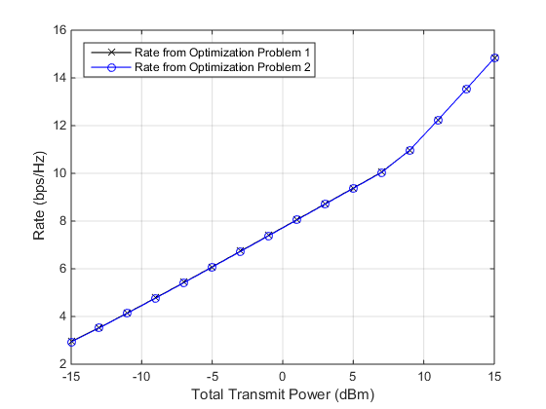
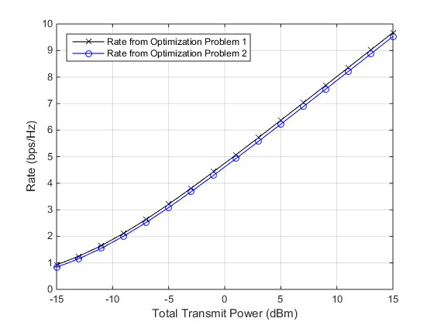
Simulation Results
1
2

Slide 12
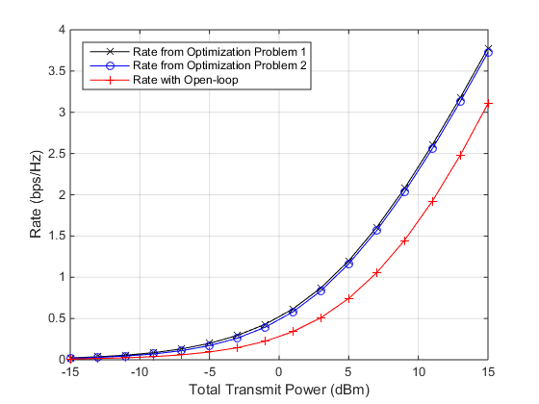
Simulation Results
In all locations, the loss is minimal: a single digital precoder performs very close to an optimized digital precoder per subcarrier.
This is mostly due to the frequency selectivity of the channel being low enough so that power allocation across subcarriers is not crucial.
In Open-loop MIMO (no precoding at Tx), we observed that there is a performance loss (about 0.5 bits/subcarrier).
5

Slide 13
Summary and Conclusions
We studied the design of the digital precoder for hybrid beamforming in 11ay.
For a simple studio apartment room scenario, we have noticed minimal performance loss when all subcarriers use the same digital precoder that is optimized using the method in [3].
The performance gap might be larger when frequency selectivity of the channel is higher (for example, shopping mall scenario).

Slide 14
References
11-14/0606r0, “Next Generation 802.11ad: 30+ Gbps WLAN”
11-15/0627r0, “Beam Selection for Hybrid MIMO Precoding”
A. Tulino, A. Lozano, and S. Verdu, “Capacity-achieving input covariance for single-user multi-antenna channels,” IEEE Transactions on Wireless Communications, vol. 5, no. 3, pp. 662-671, March 2006.
11-09/0334r8, “Channel Models for 60 GHz WLAN Systems”

