Slide 1
Box1 and Box2 calibration results
Date: 2015/07/12
Authors:

Slide 2
Abstract
Provide calibration result of following tests.
  Box1 tests
    Test1~5 for SS1 ~ SS4
  Box2 tests
    Test1~3 for SS1 ~ SS4
Our results follows documents [1], [2] and [3].
These results are aligned with other companies.
  This results will be merged to [4].

Slide 3
Box1 tests

Slide 4
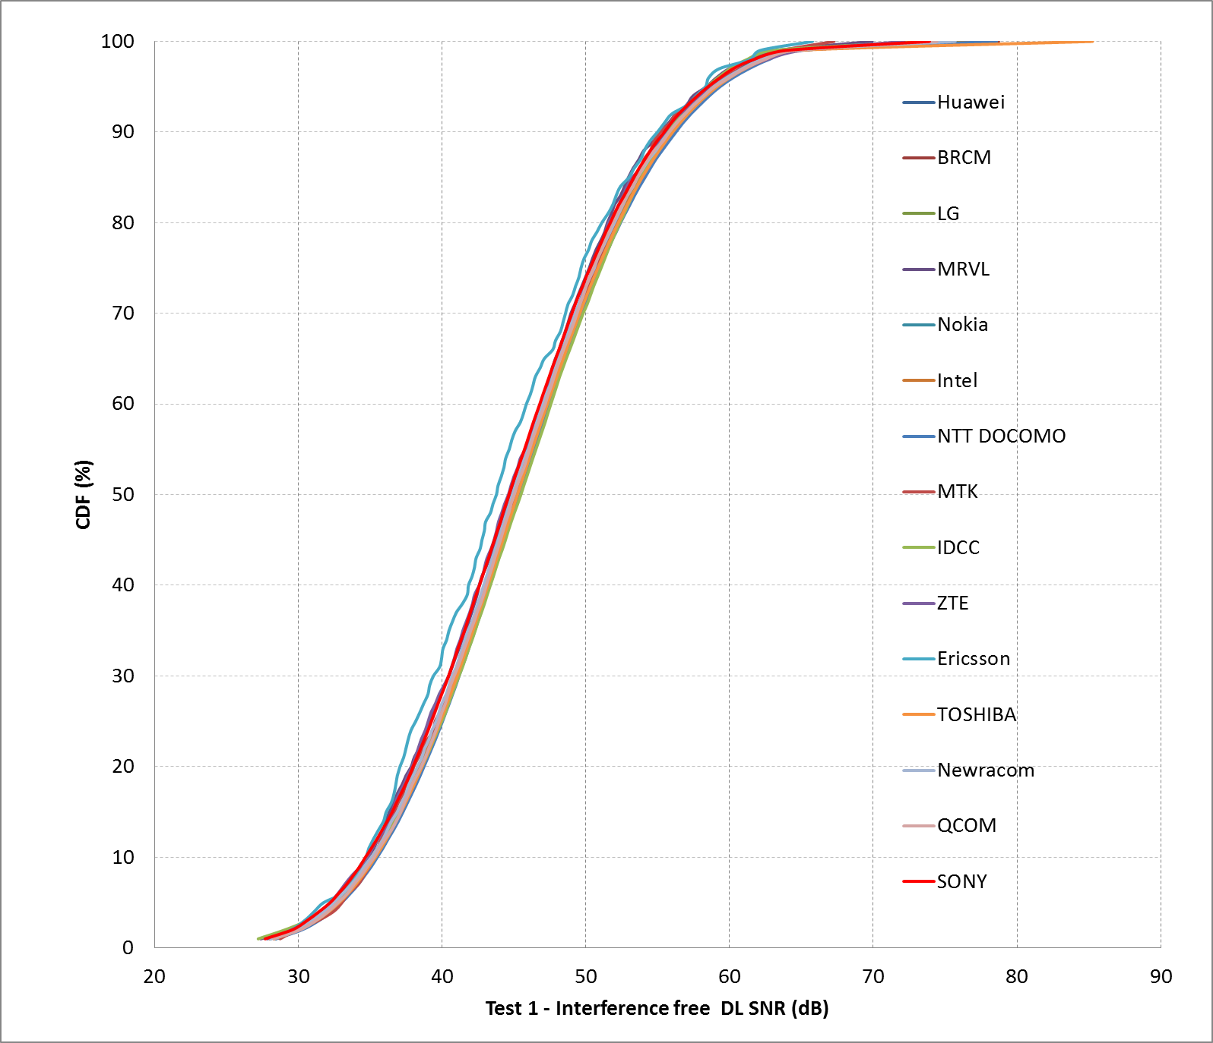
Box1 SS1 (Residential) Test1

Slide 5
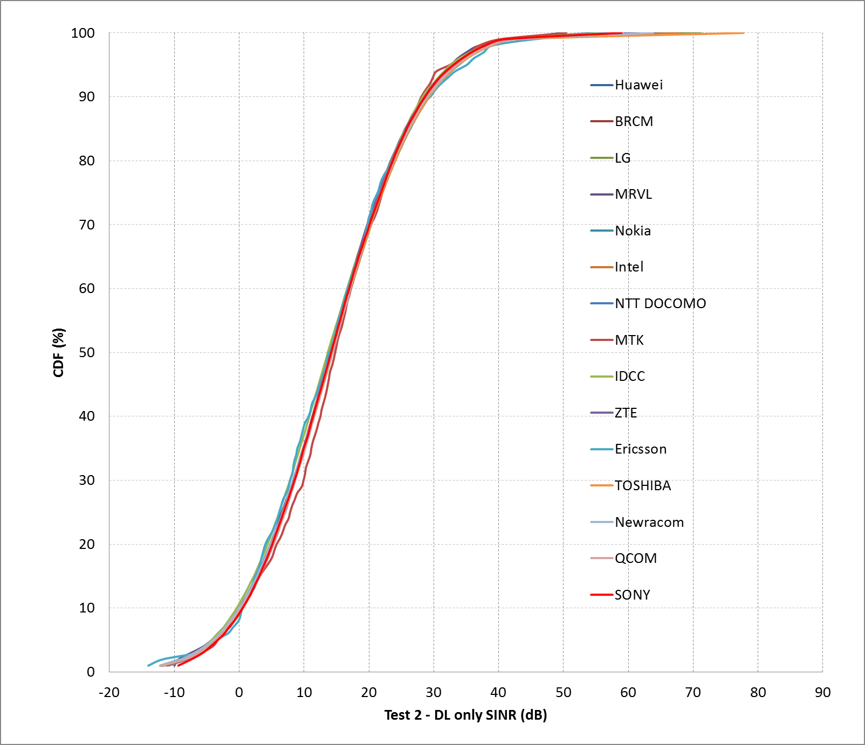
Box1 SS1 (Residential) Test2

Slide 6
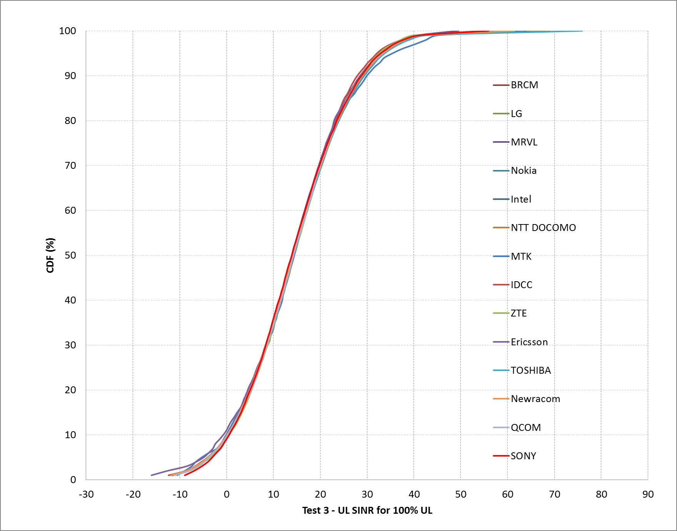
Box1 SS1 (Residential) Test3

Slide 7
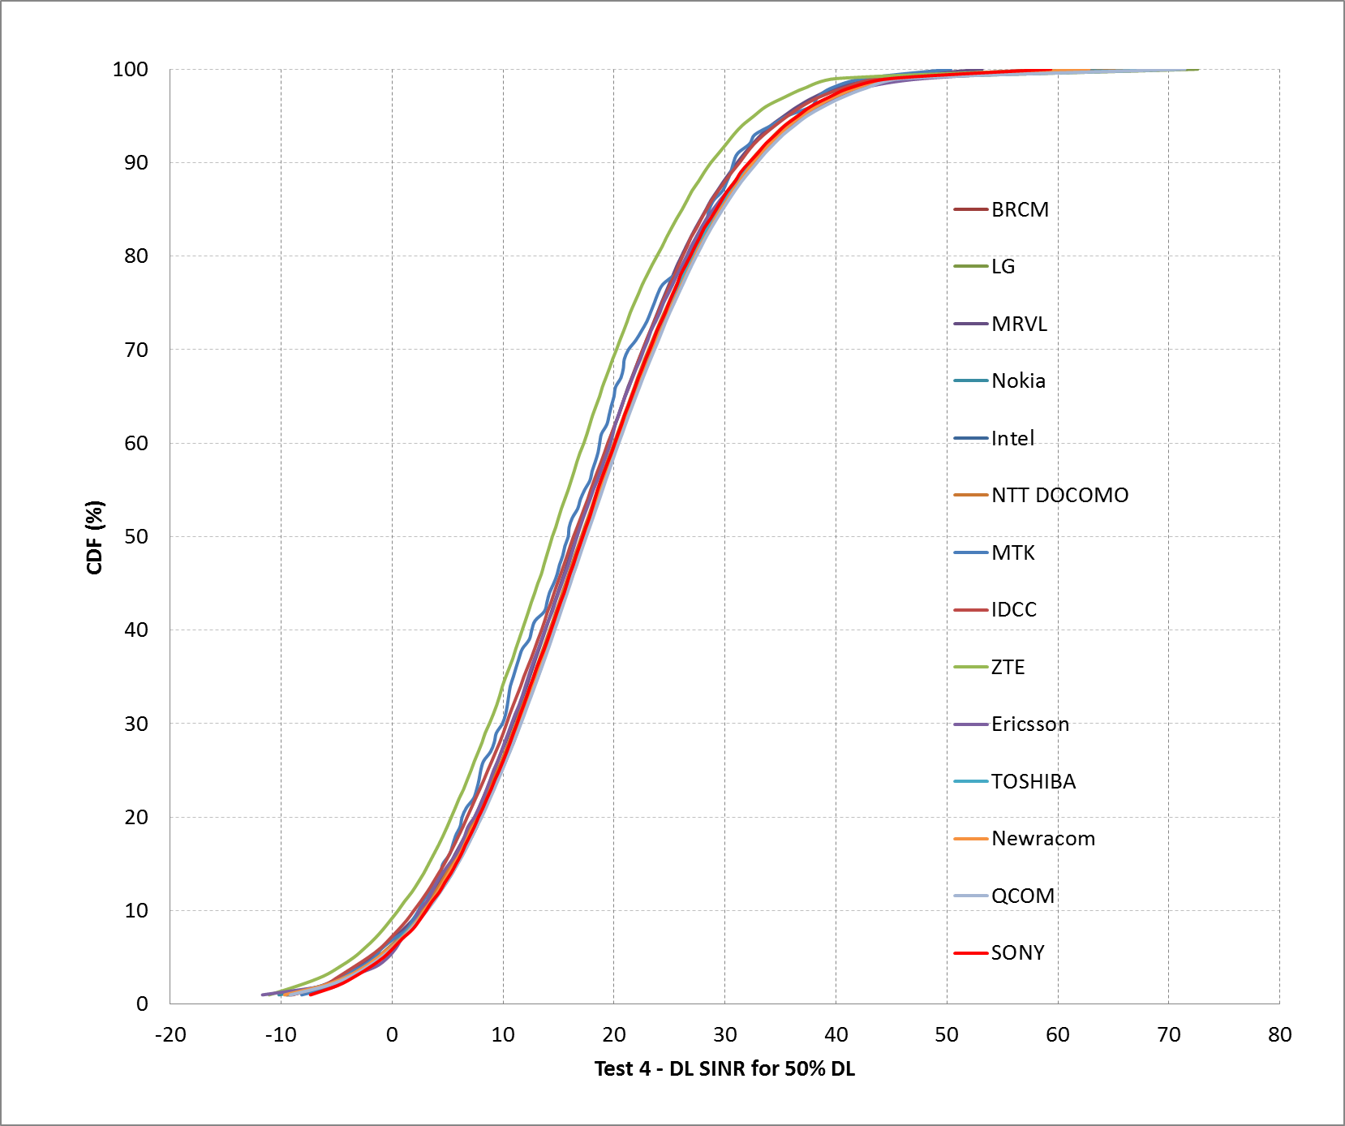
Box1 SS1 (Residential) Test4 DL

Slide 8
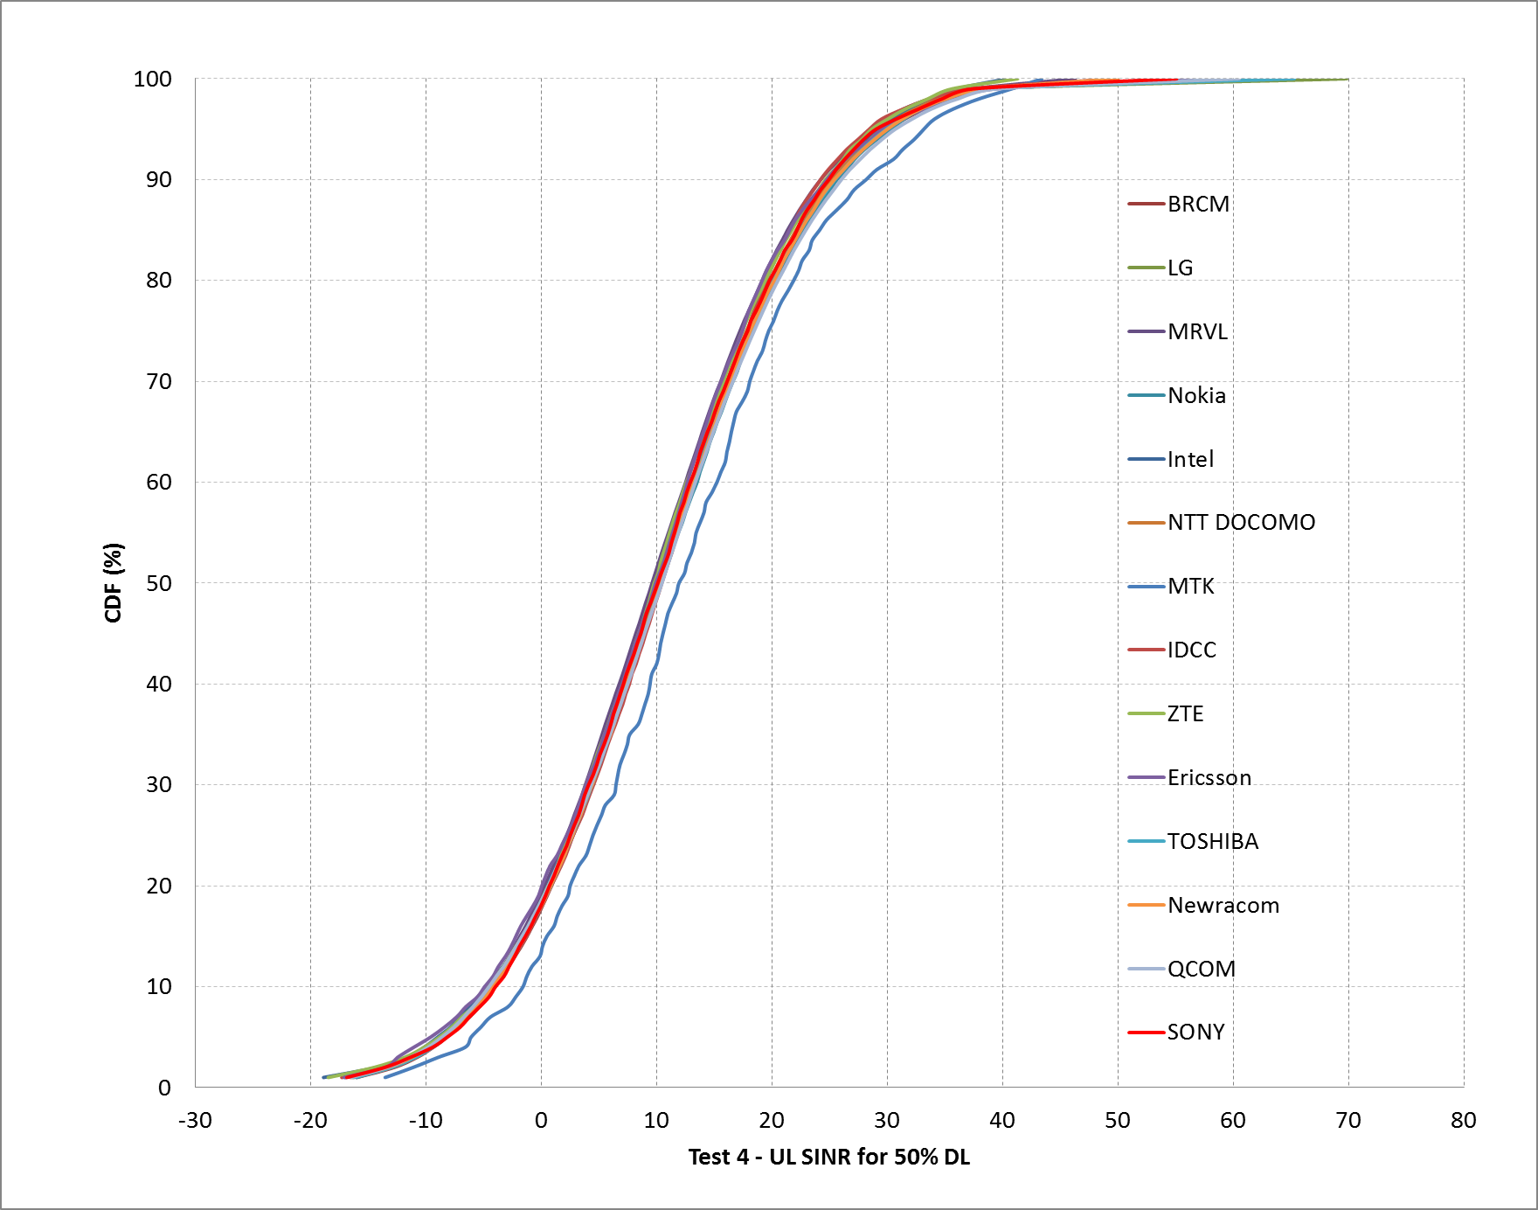
Box1 SS1 (Residential) Test4 UL

Slide 9
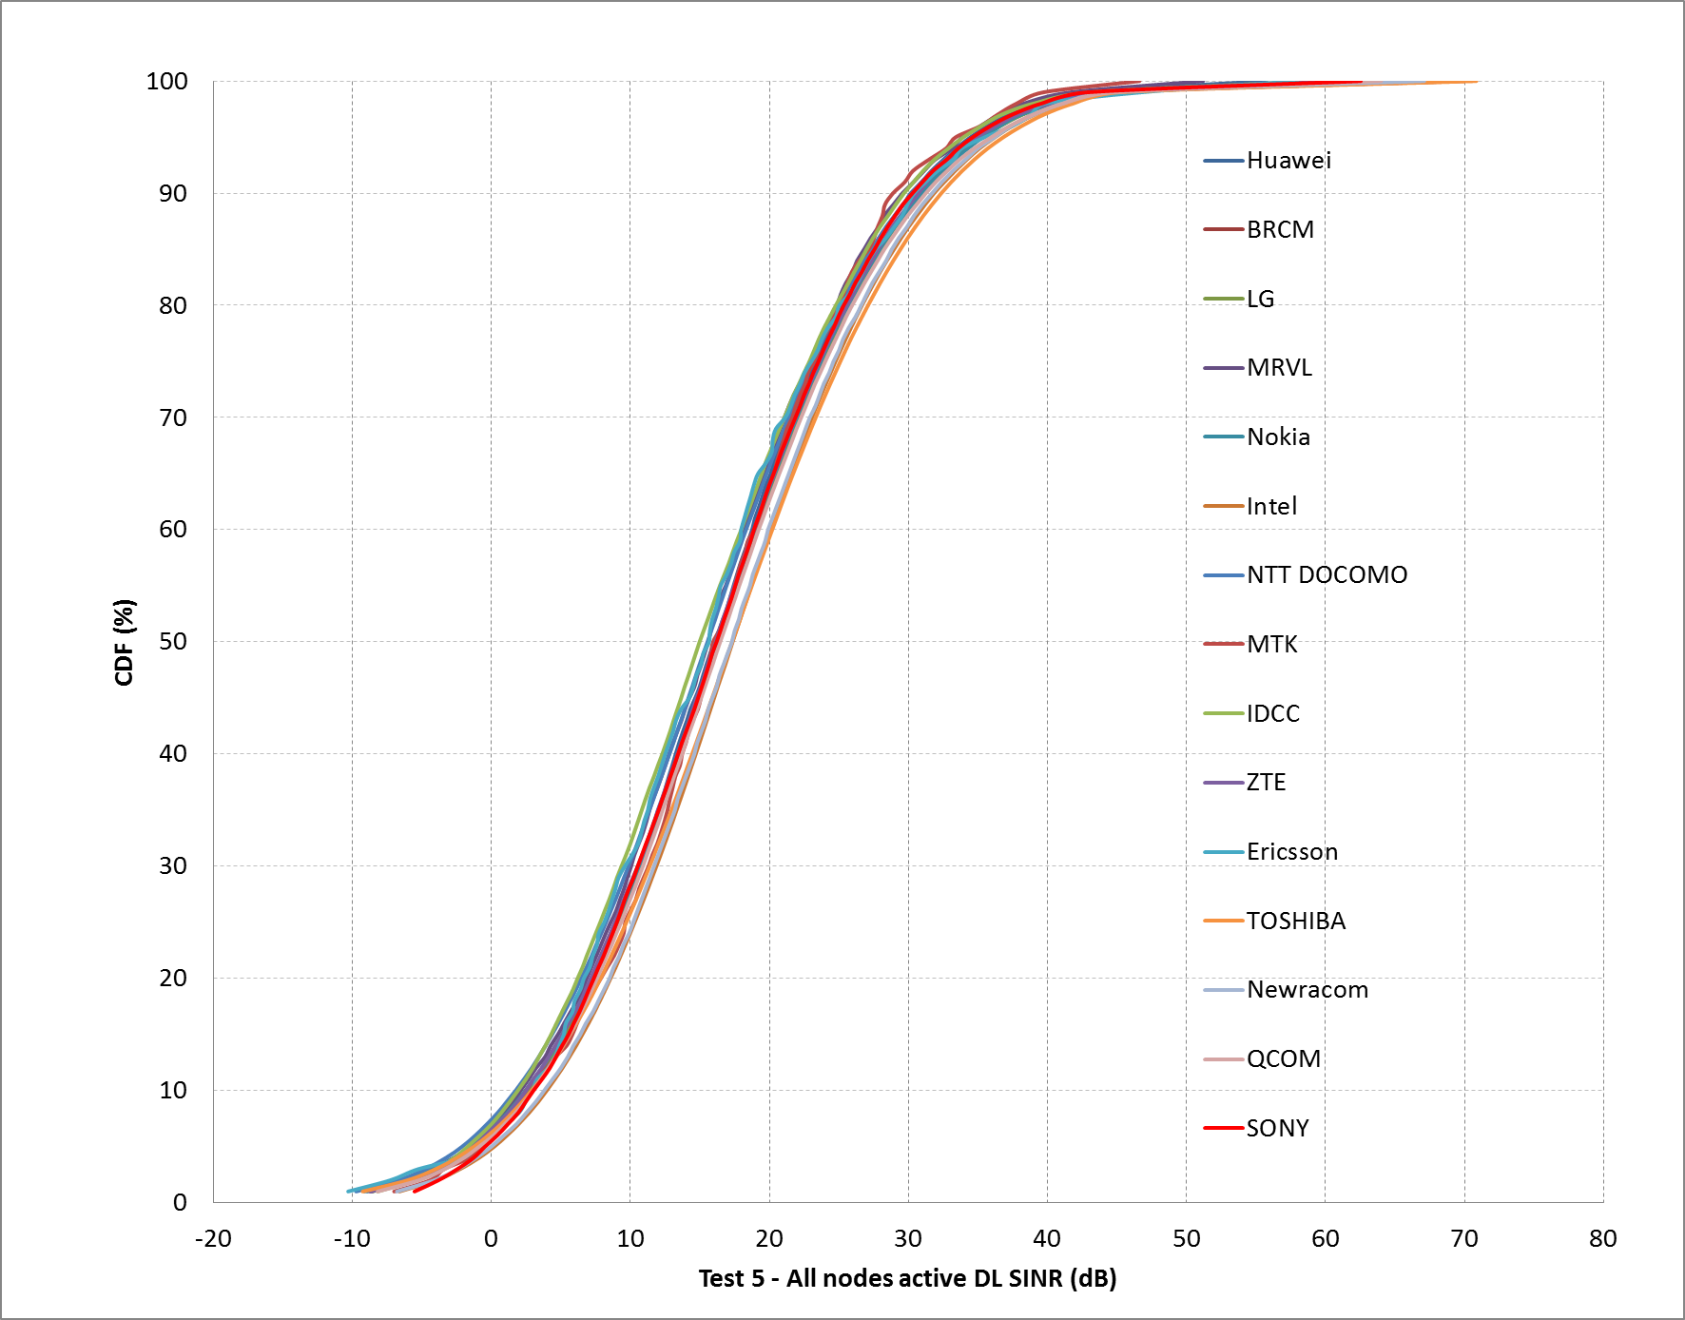
Box1 SS1 (Residential) Test5 DL

Slide 10
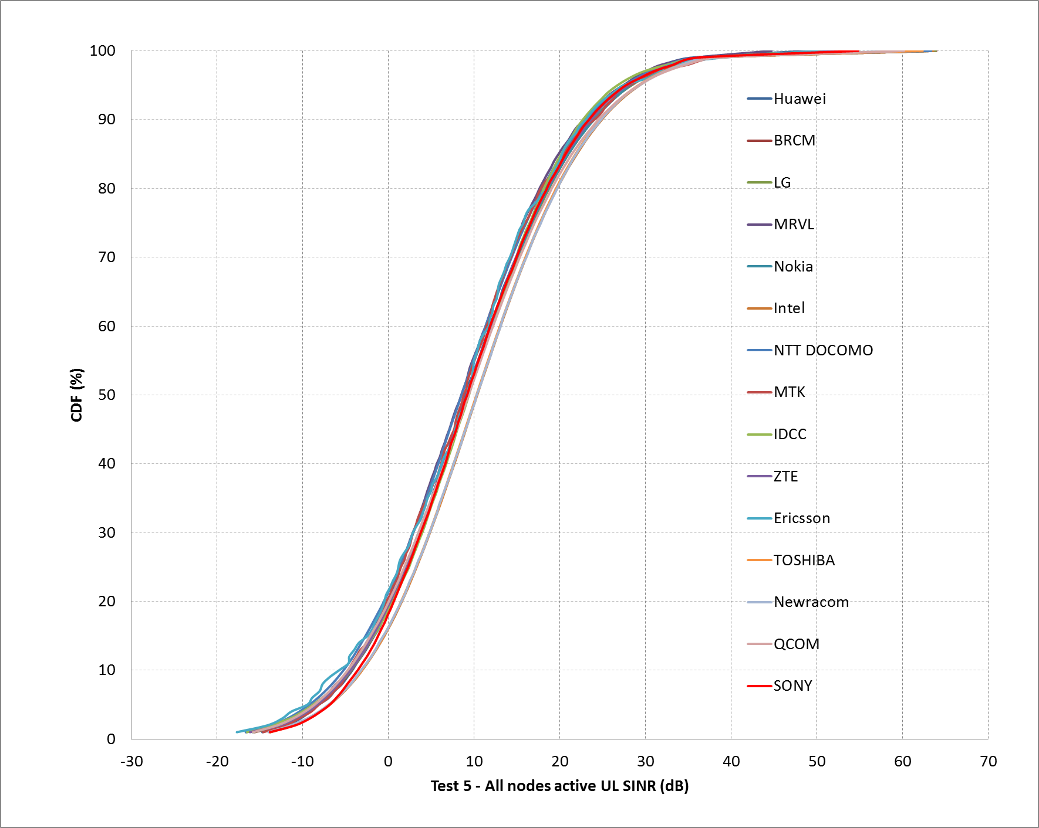
Box1 SS1 (Residential) Test5 UL

Slide 11
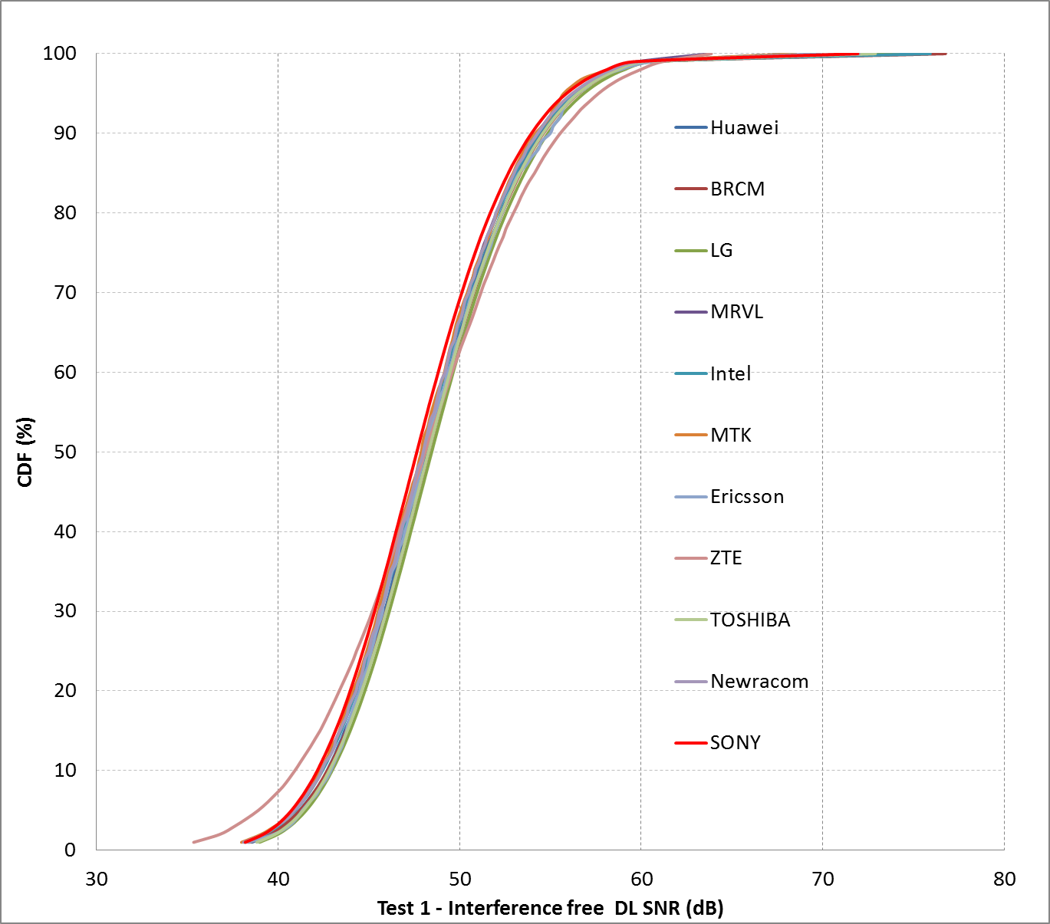
Box1 SS2 (Enterprise) Test1

Slide 12
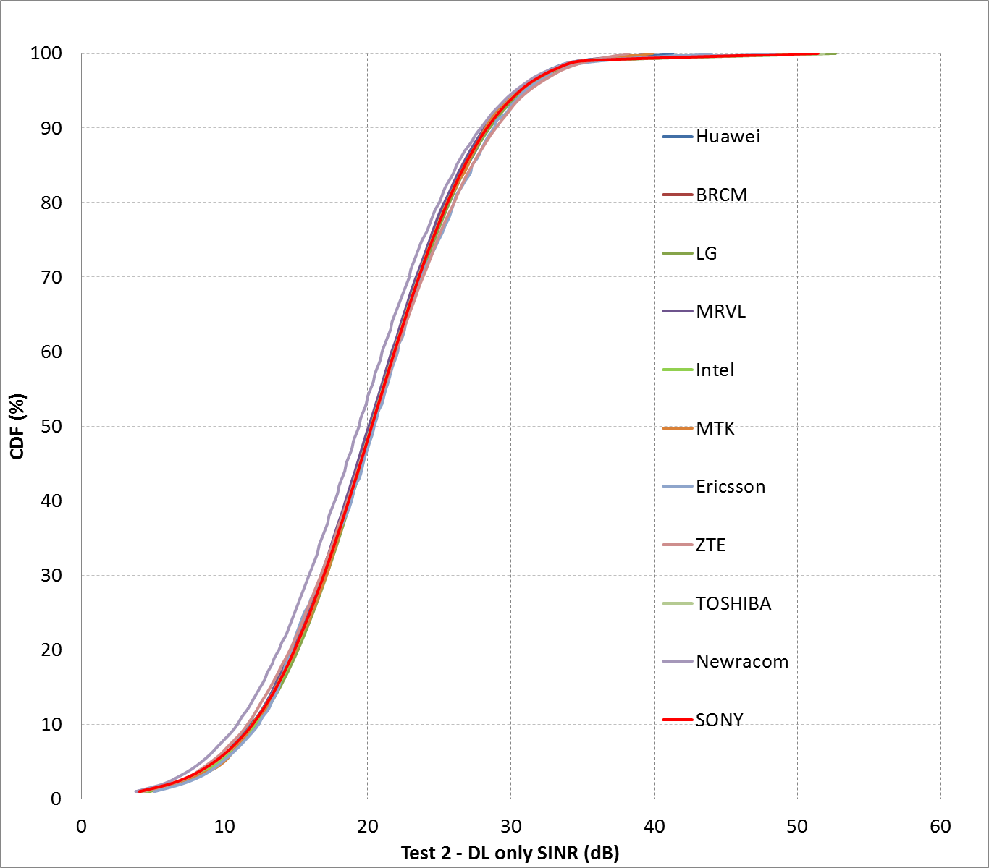
Box1 SS2 (Enterprise) Test2

Slide 13
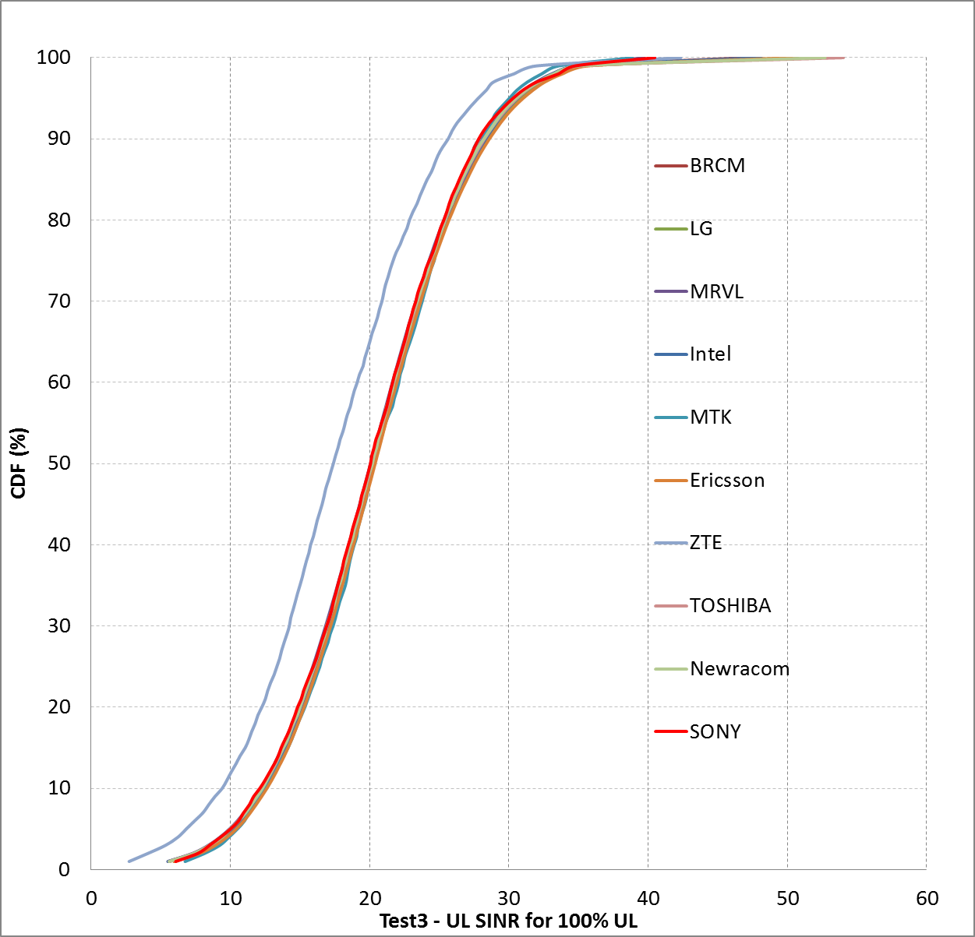
Box1 SS2 (Enterprise) Test3

Slide 14
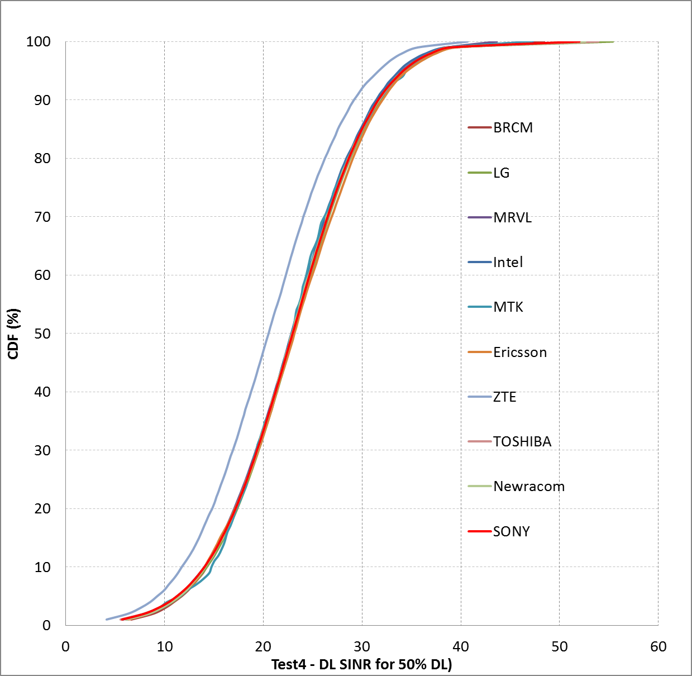
Box1 SS2 (Enterprise) Test4 DL

Slide 15
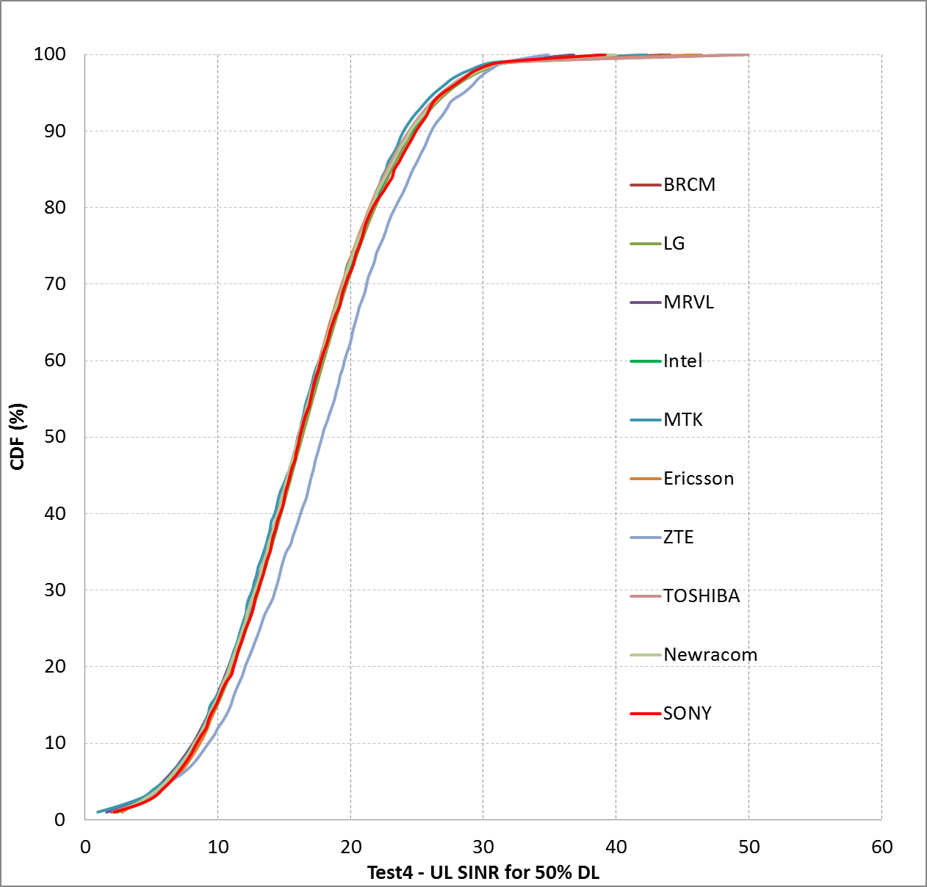
Box1 SS2 (Enterprise) Test4 UL

Slide 16
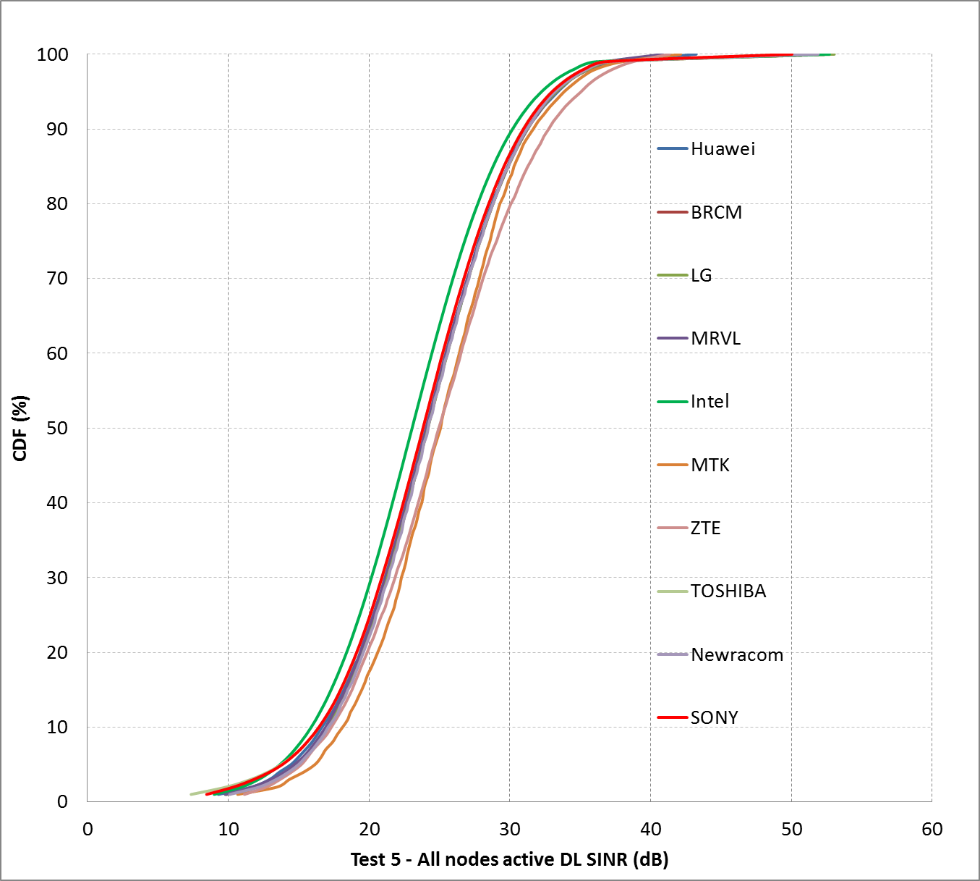
Box1 SS2 (Enterprise) Test5 DL

Slide 17
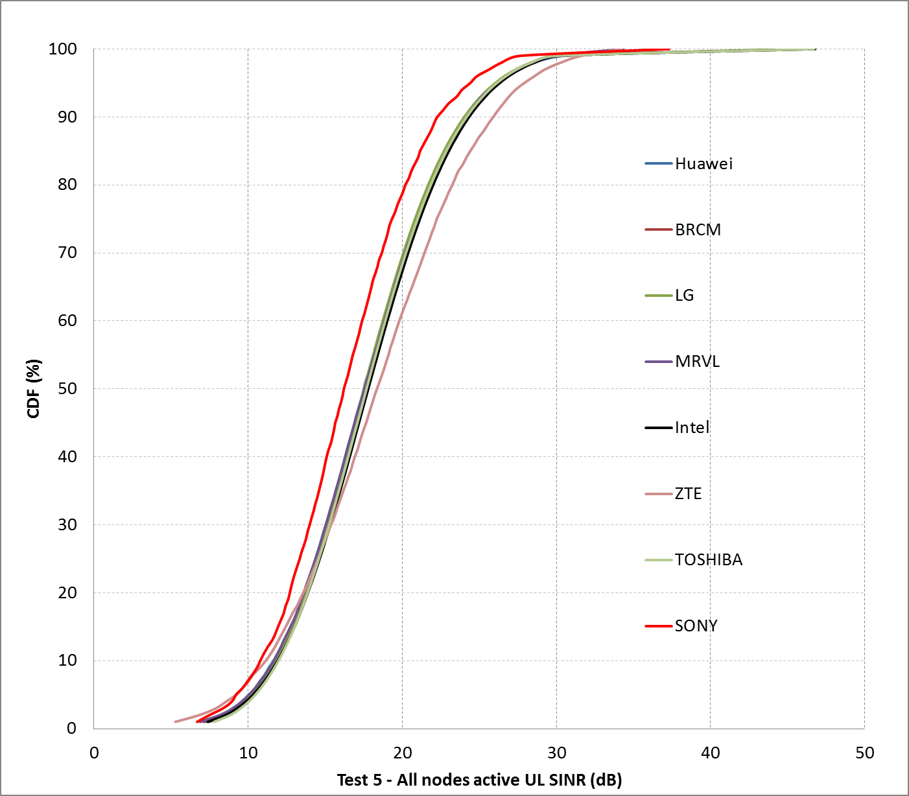
Box1 SS2 (Enterprise) Test5 UL

Slide 18
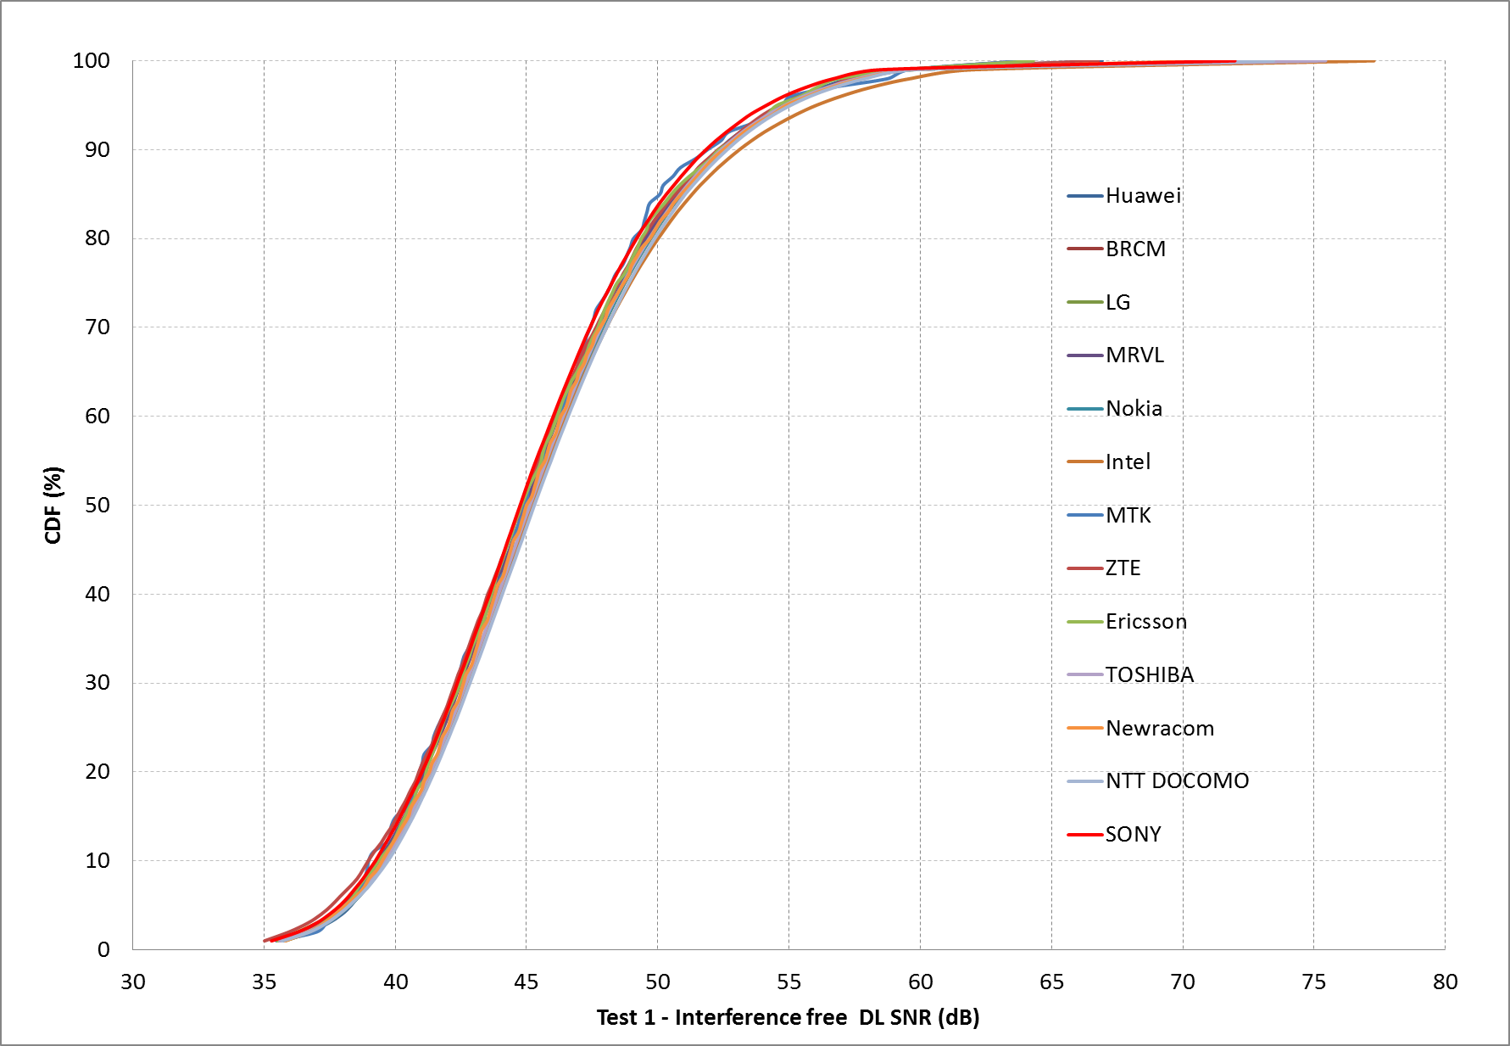
Box1 SS3 (Indoor small BSSs)Test1

Slide 19
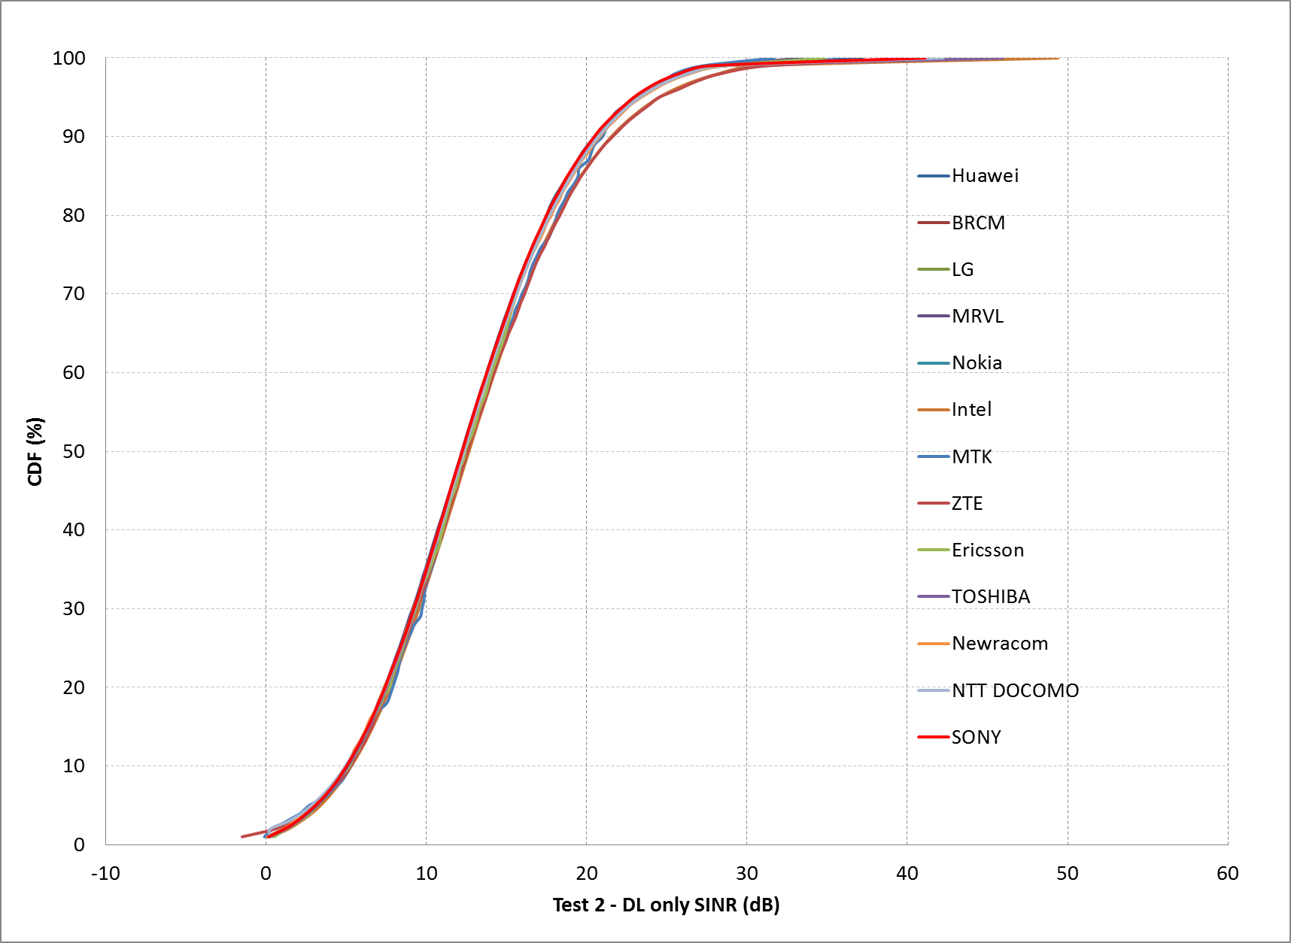
Box1 SS3 (Indoor small BSSs)Test2

Slide 20
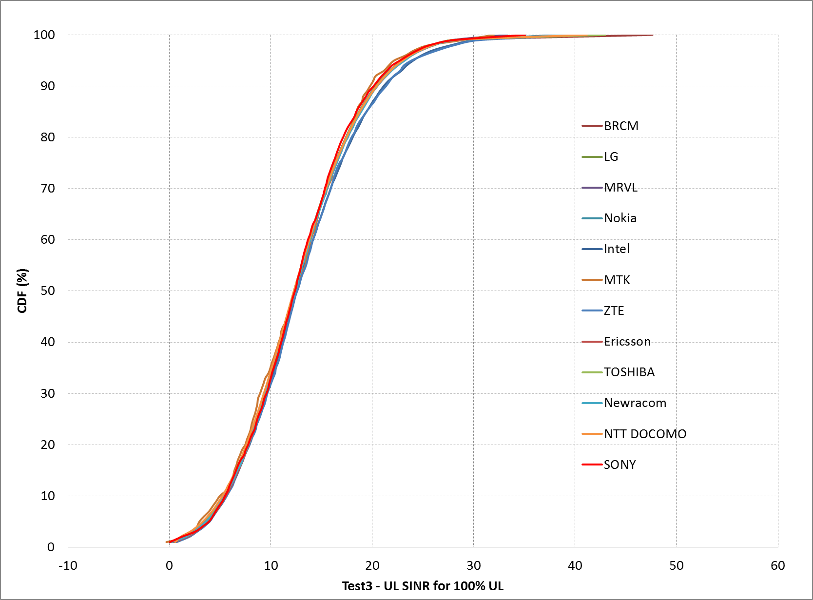
Box1 SS3 (Indoor small BSSs)Test3

Slide 21
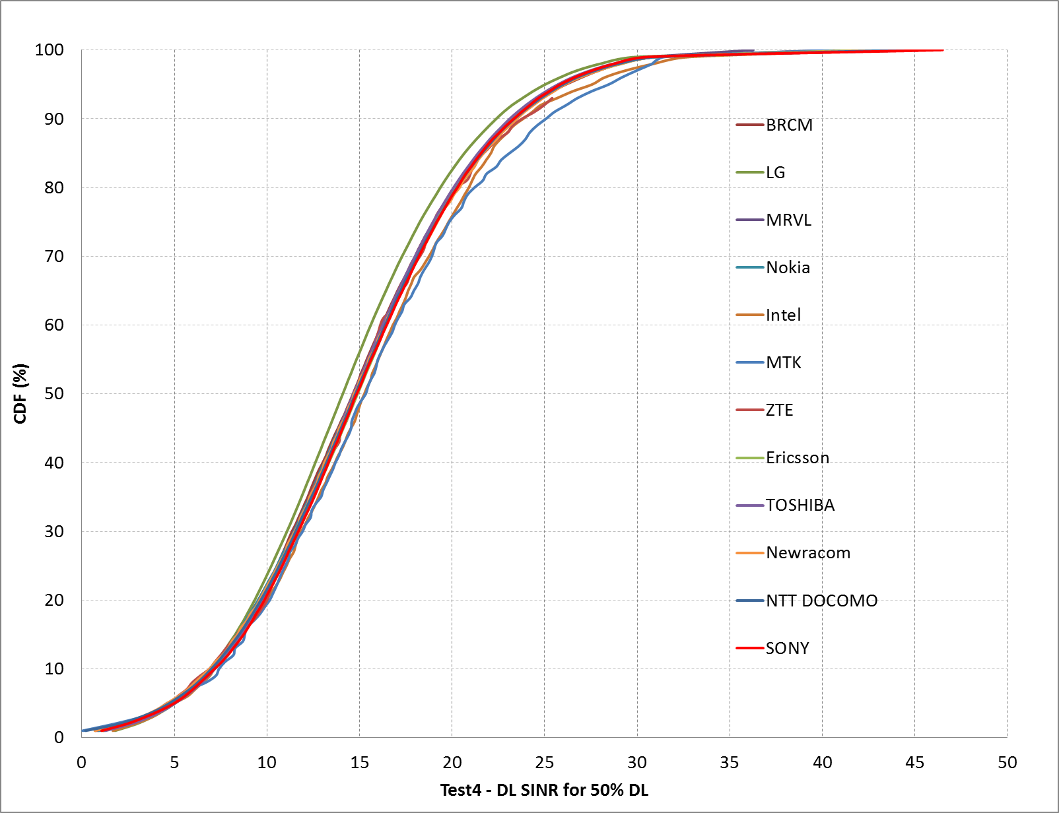
Box1 SS3 (Indoor small BSSs)Test4 DL

Slide 22
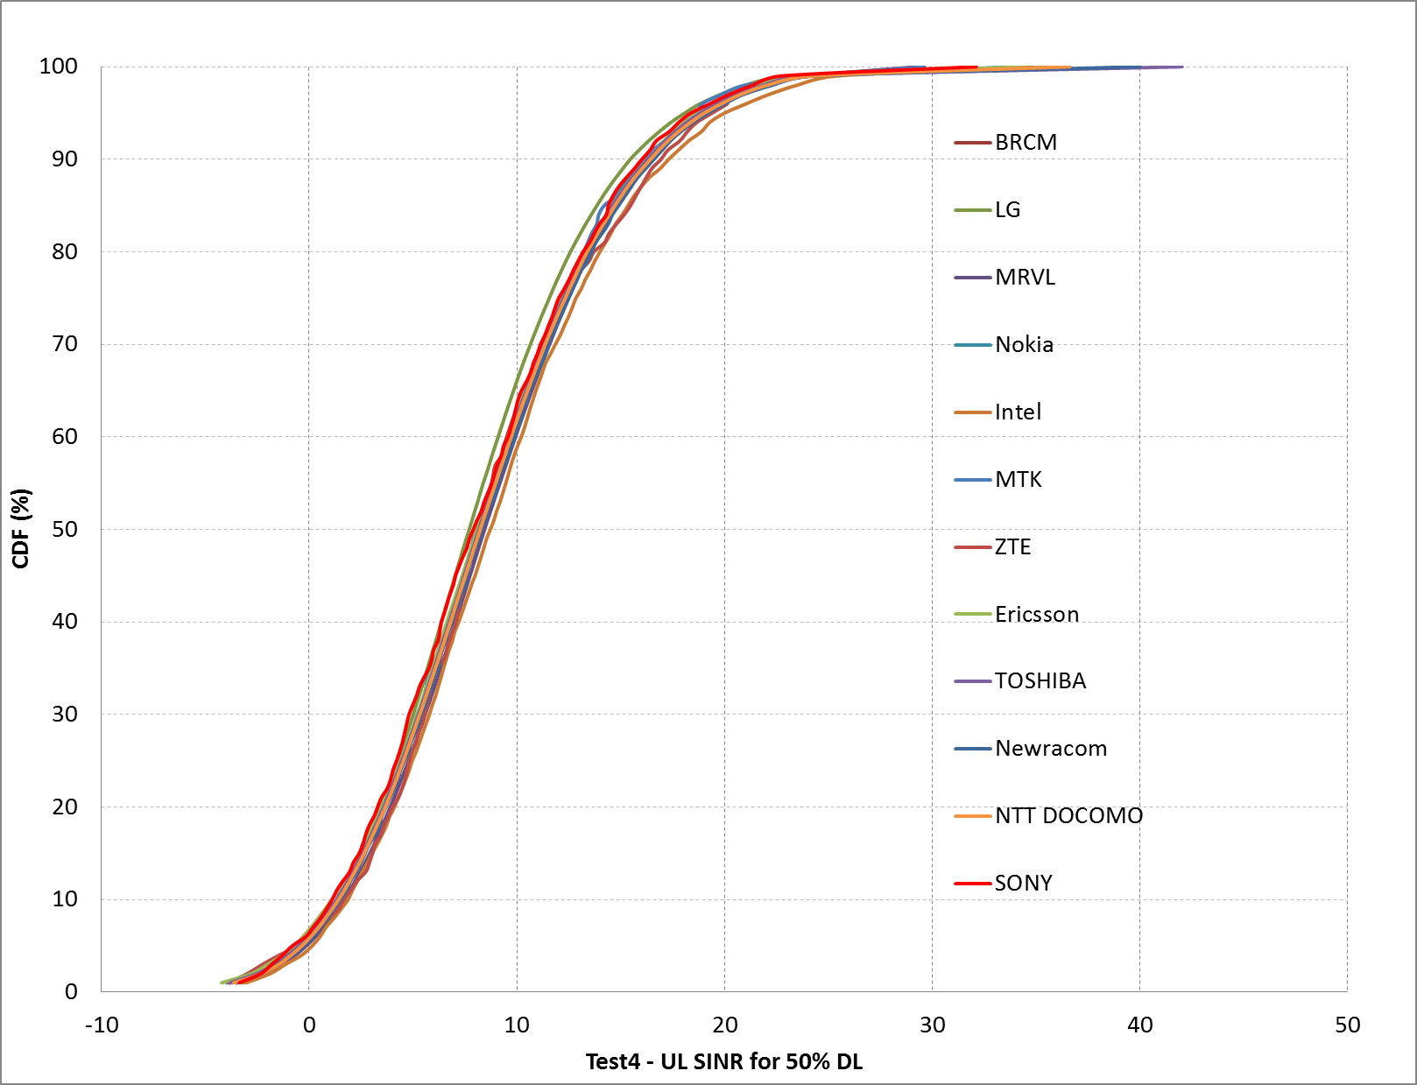
Box1 SS3 (Indoor small BSSs)Test4 UL

Slide 23
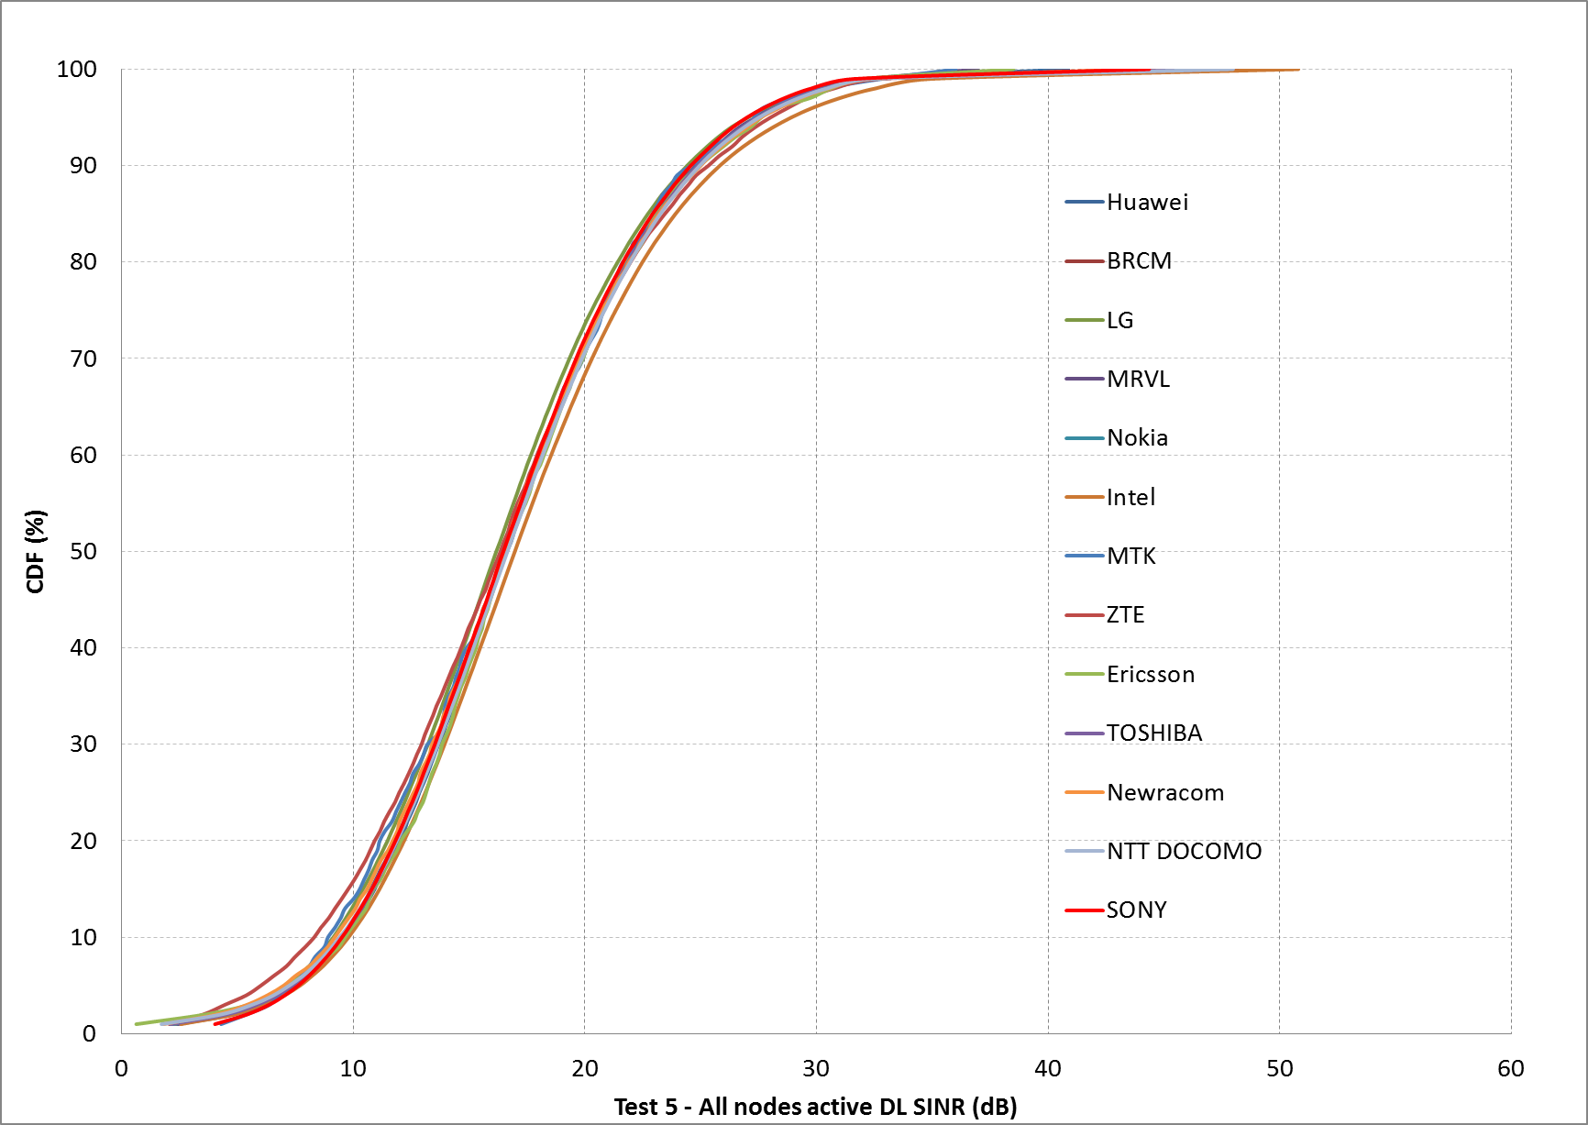
Box1 SS3 (Indoor small BSSs)Test5 DL

Slide 24
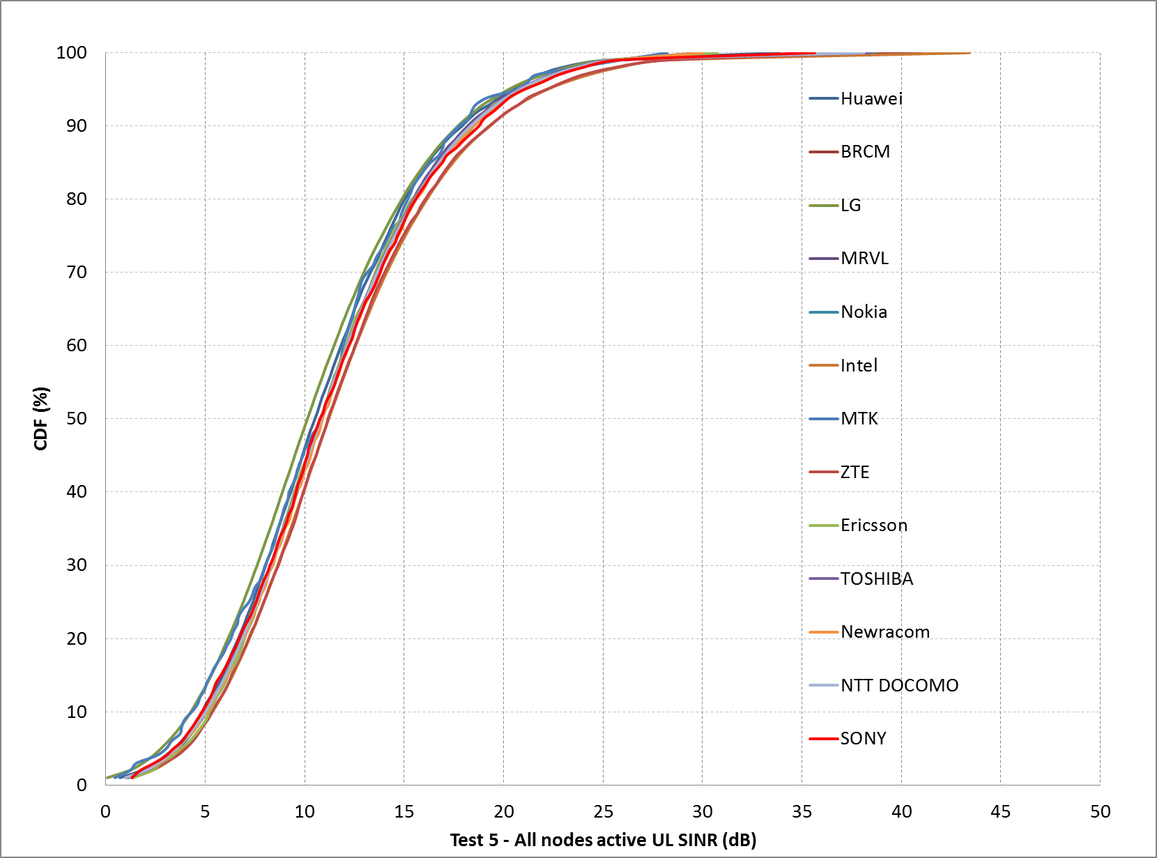
Box1 SS3 (Indoor small BSSs)Test5 UL

Slide 25
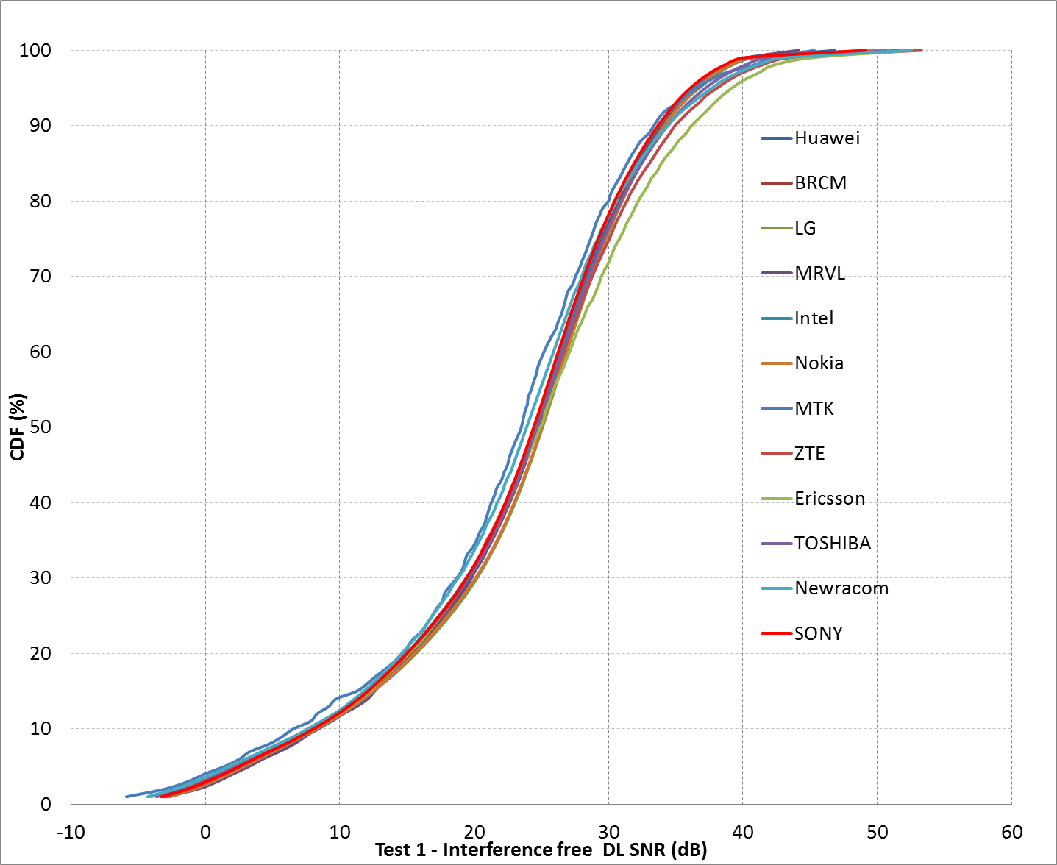
Box1 SS4 (Outdoor large BSS)Test1

Slide 26
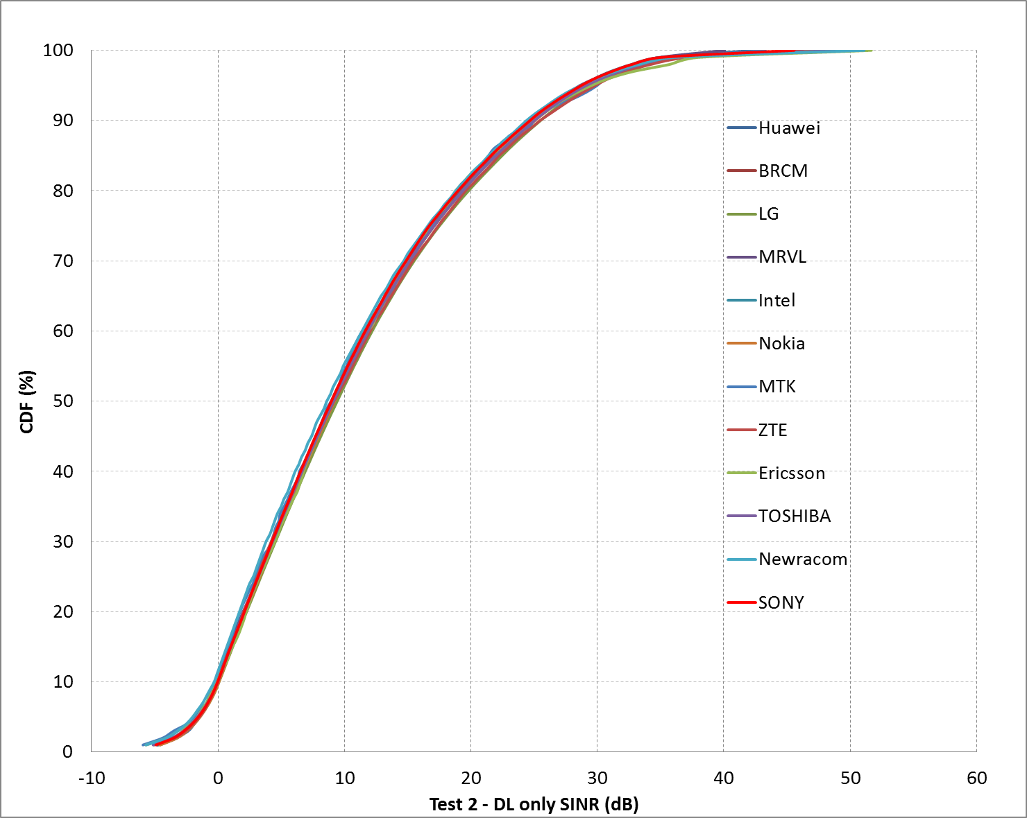
Box1 SS4 (Outdoor large BSS)Test2

Slide 27
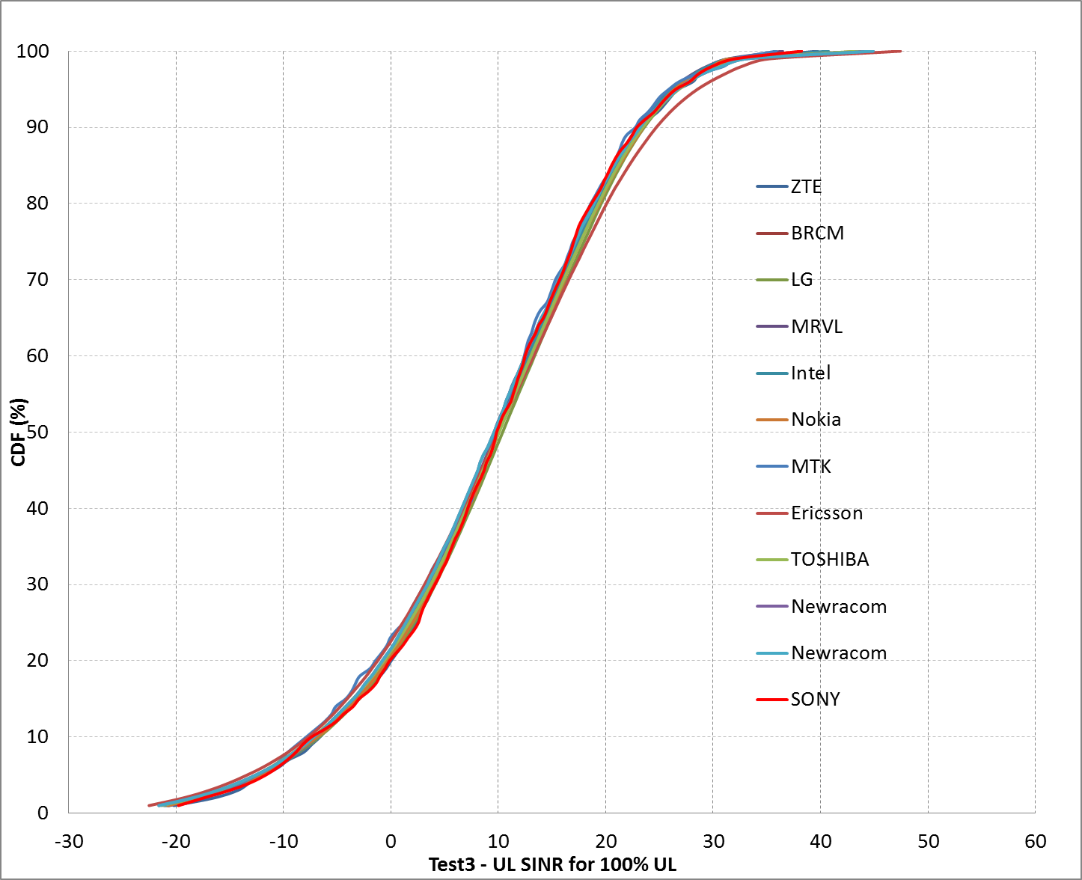
Box1 SS4 (Outdoor large BSS)Test3

Slide 28
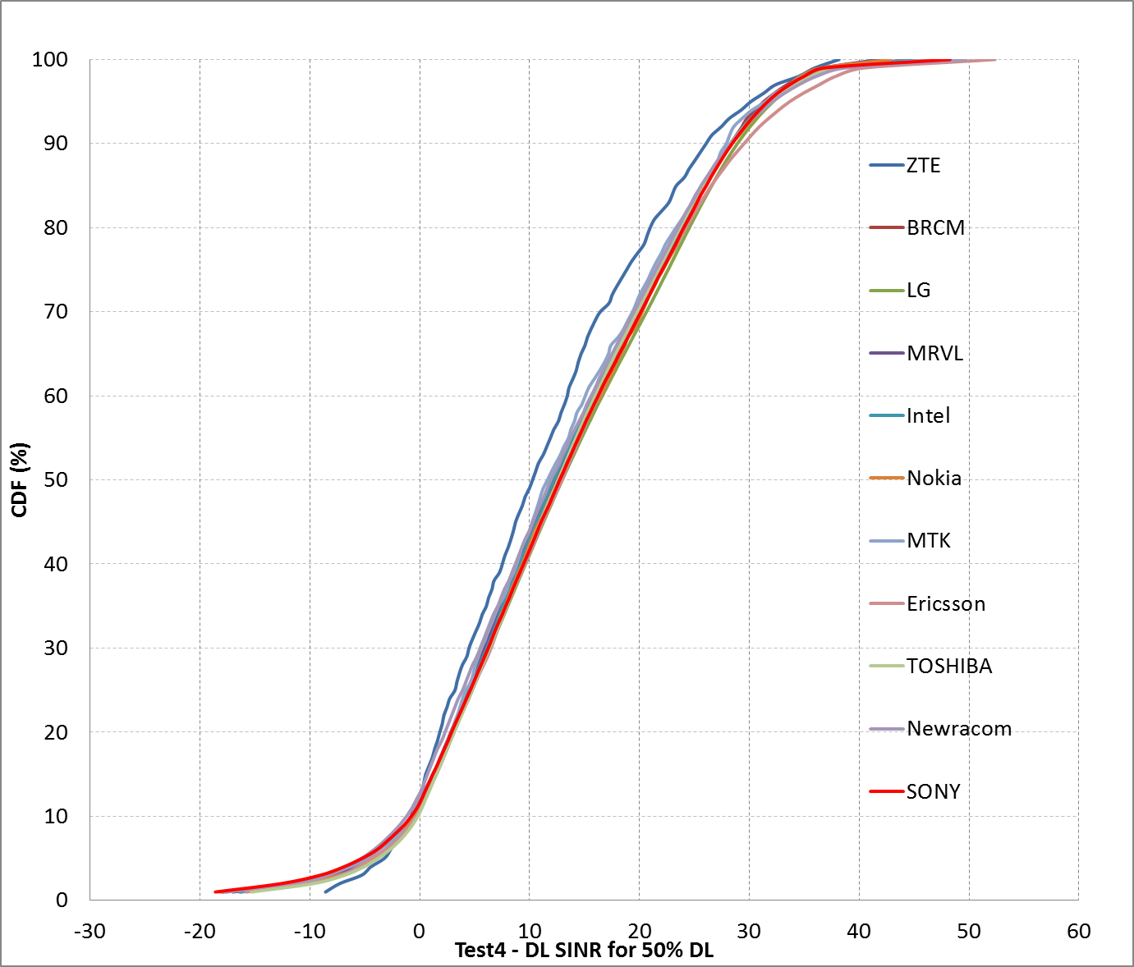
Box1 SS4 (Outdoor large BSS)Test4 DL

Slide 29
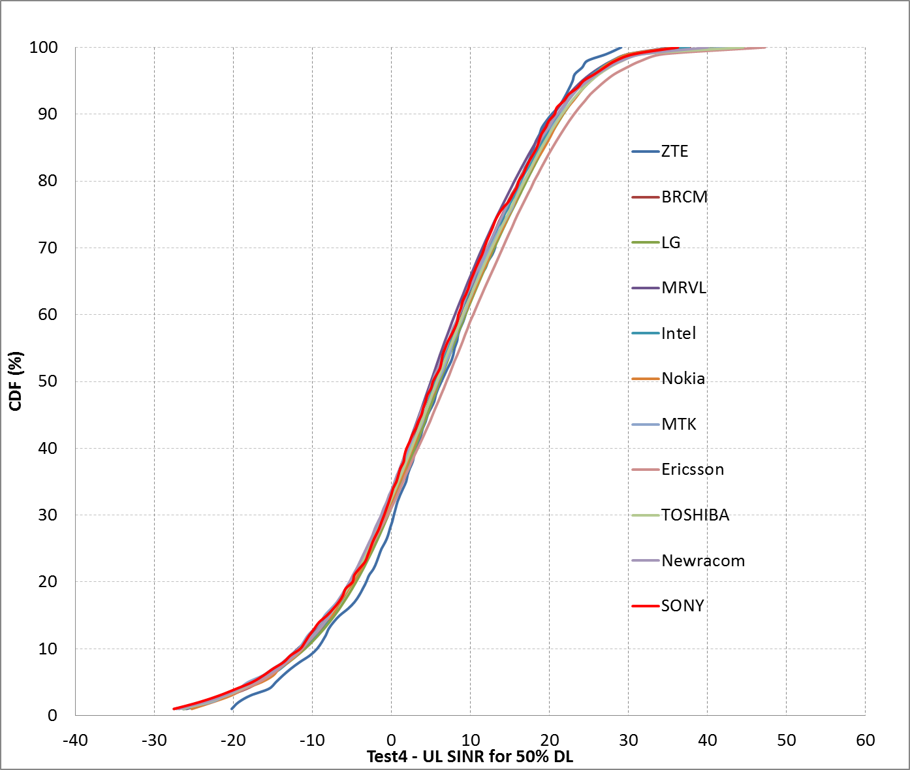
Box1 SS4 (Outdoor large BSS)Test4 UL

Slide 30
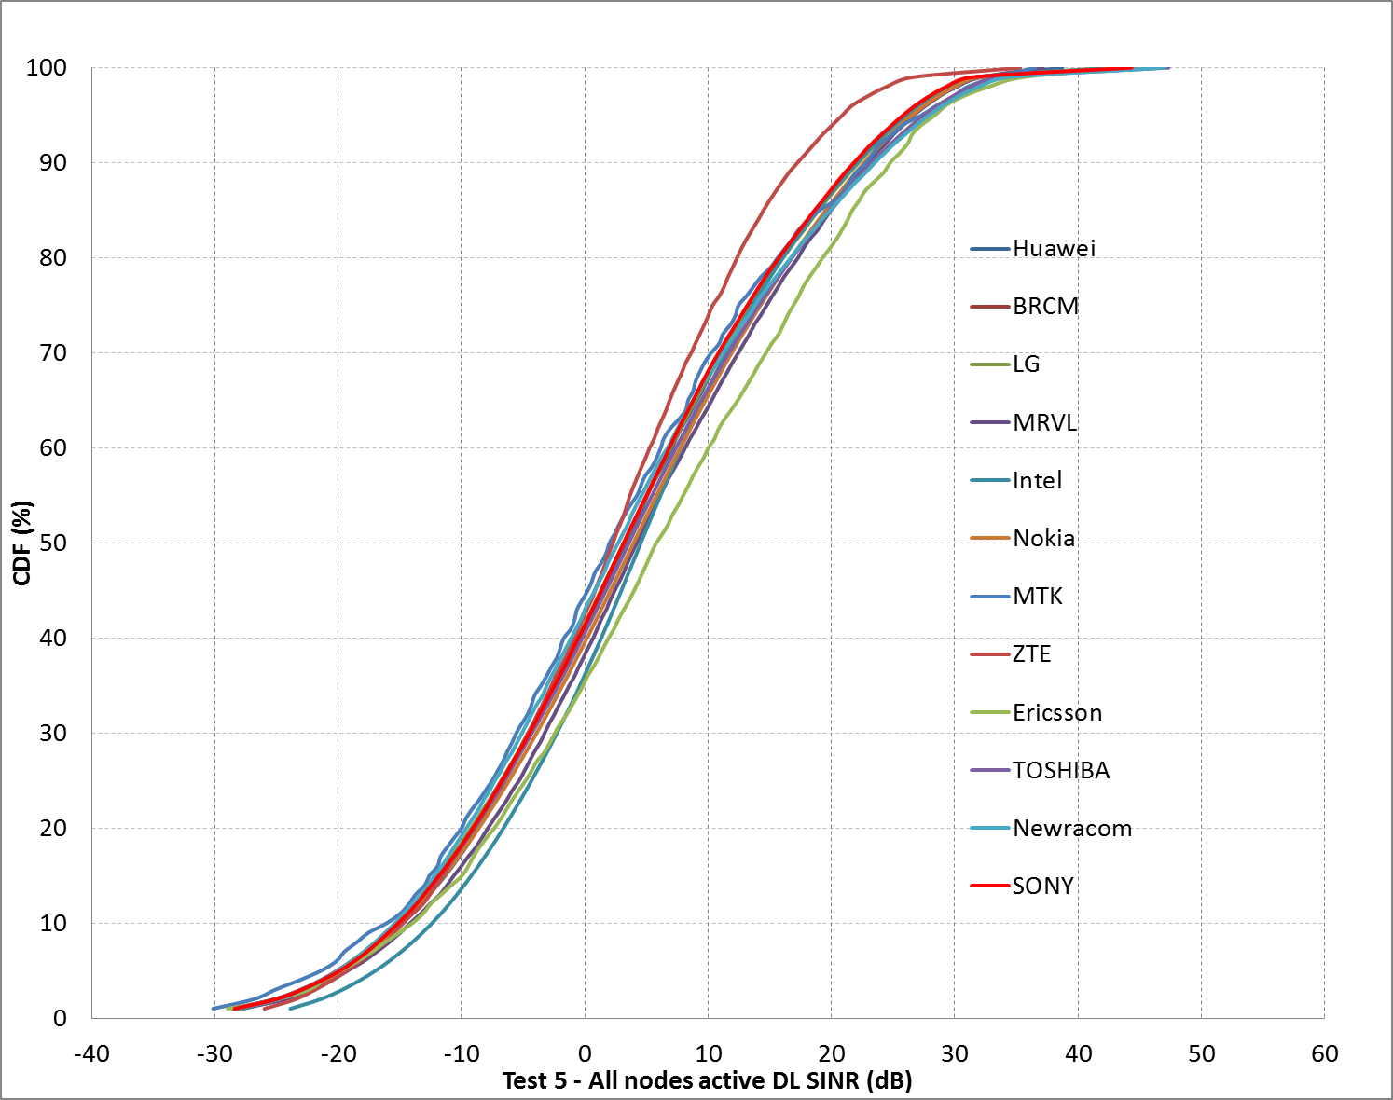
Box1 SS4 (Outdoor large BSS)Test5 DL

Slide 31
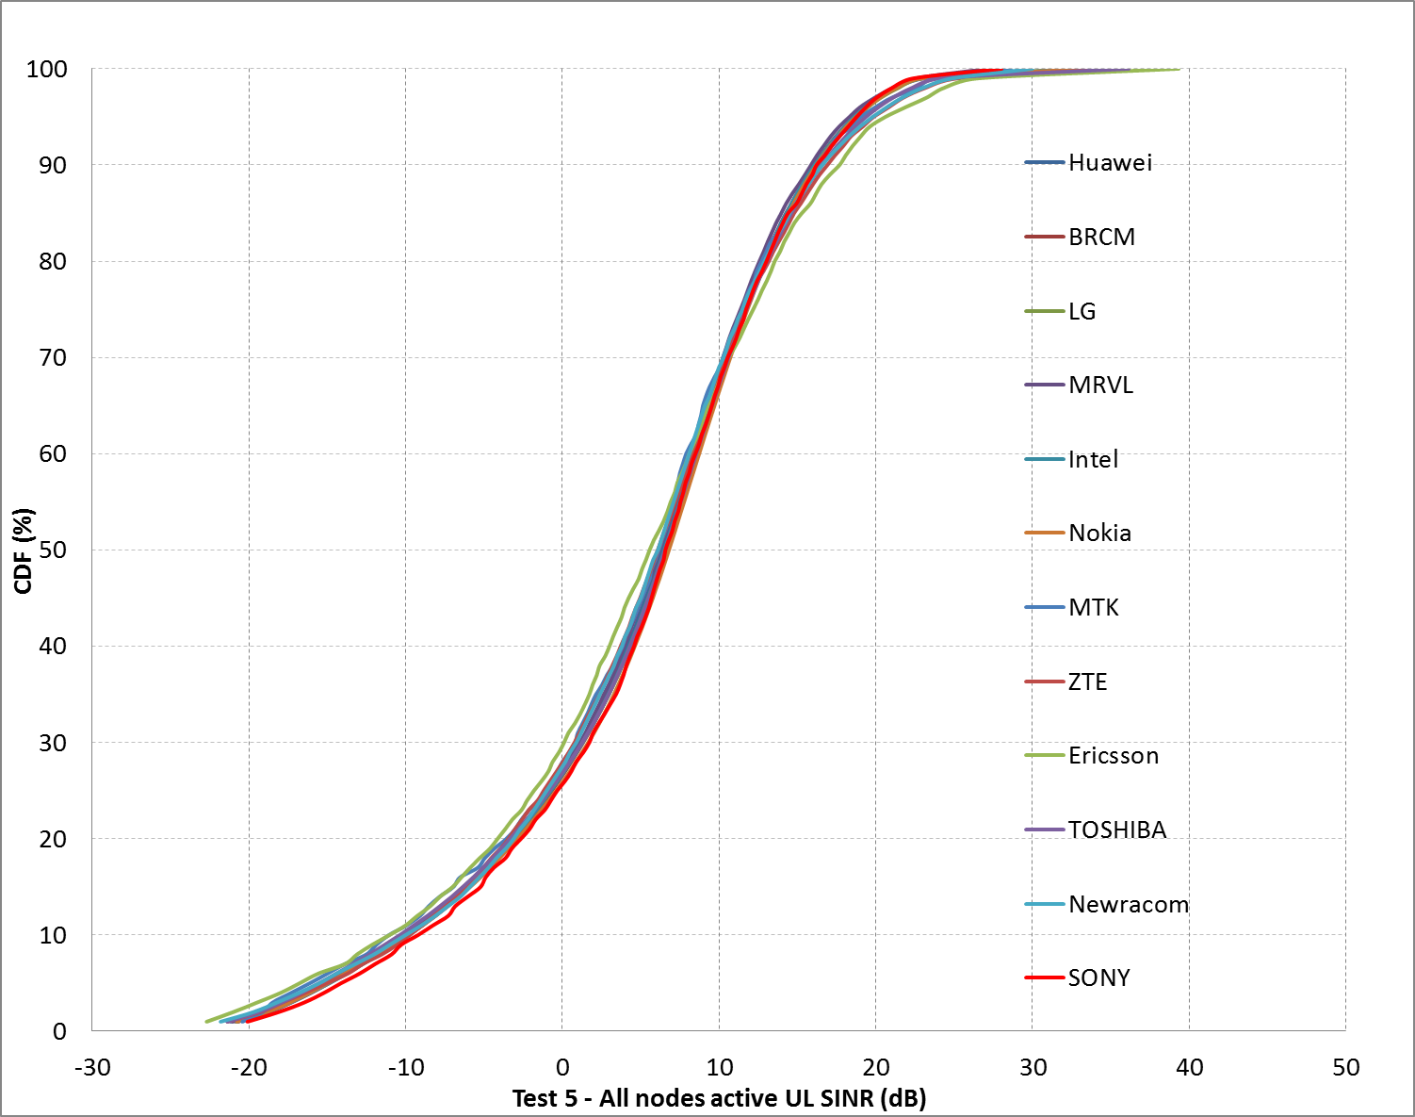
Box1 SS4 (Outdoor large BSS)Test5 UL

Slide 32
Box2 tests

Slide 33
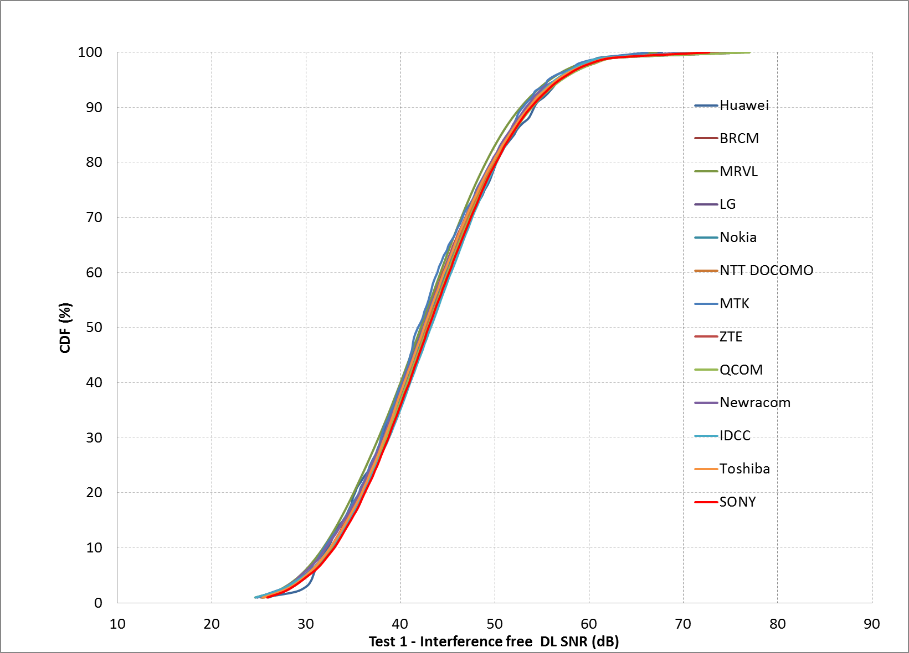
Box2 SS1 (Residential) Test1

Slide 34
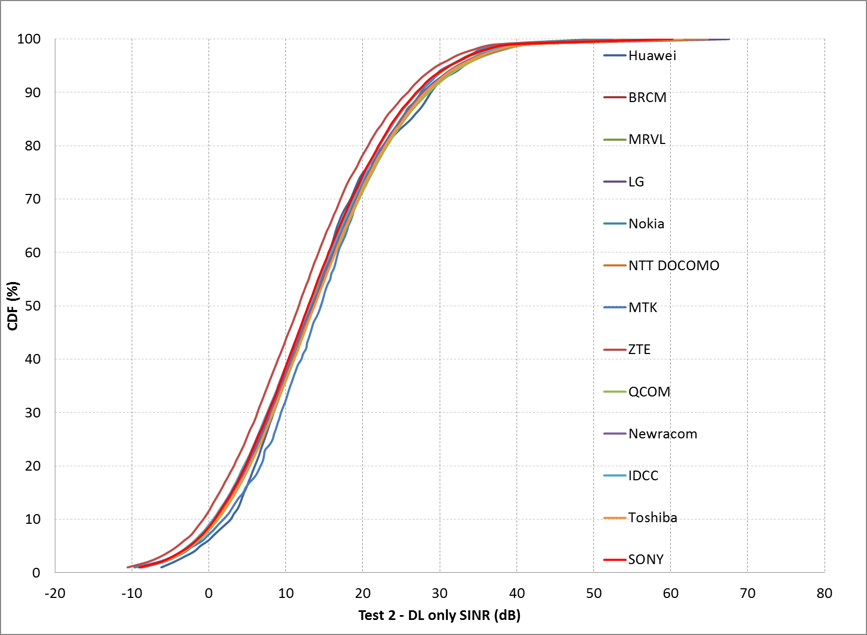
Box2 SS1 (Residential) Test2

Slide 35
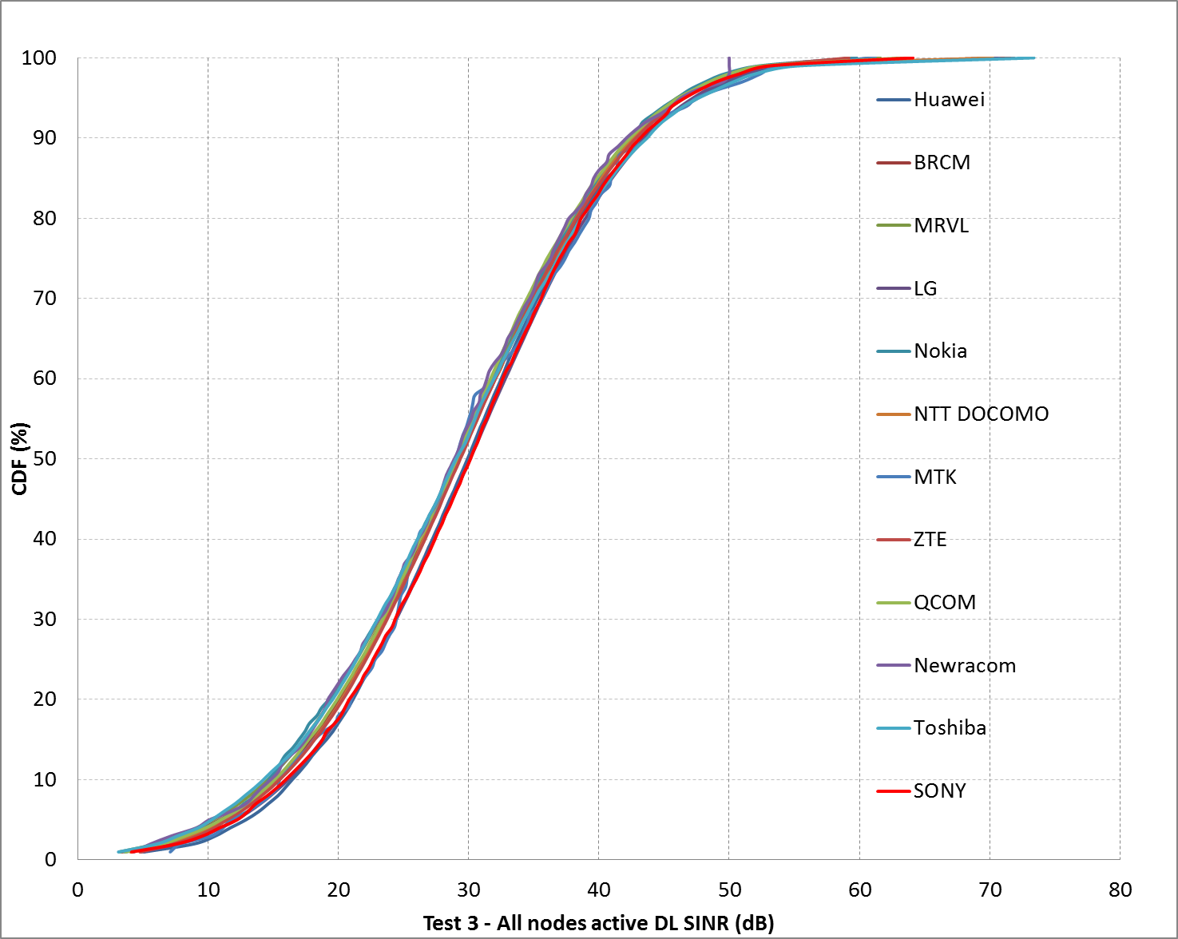
Box2 SS1 (Residential) Test3 DL

Slide 36
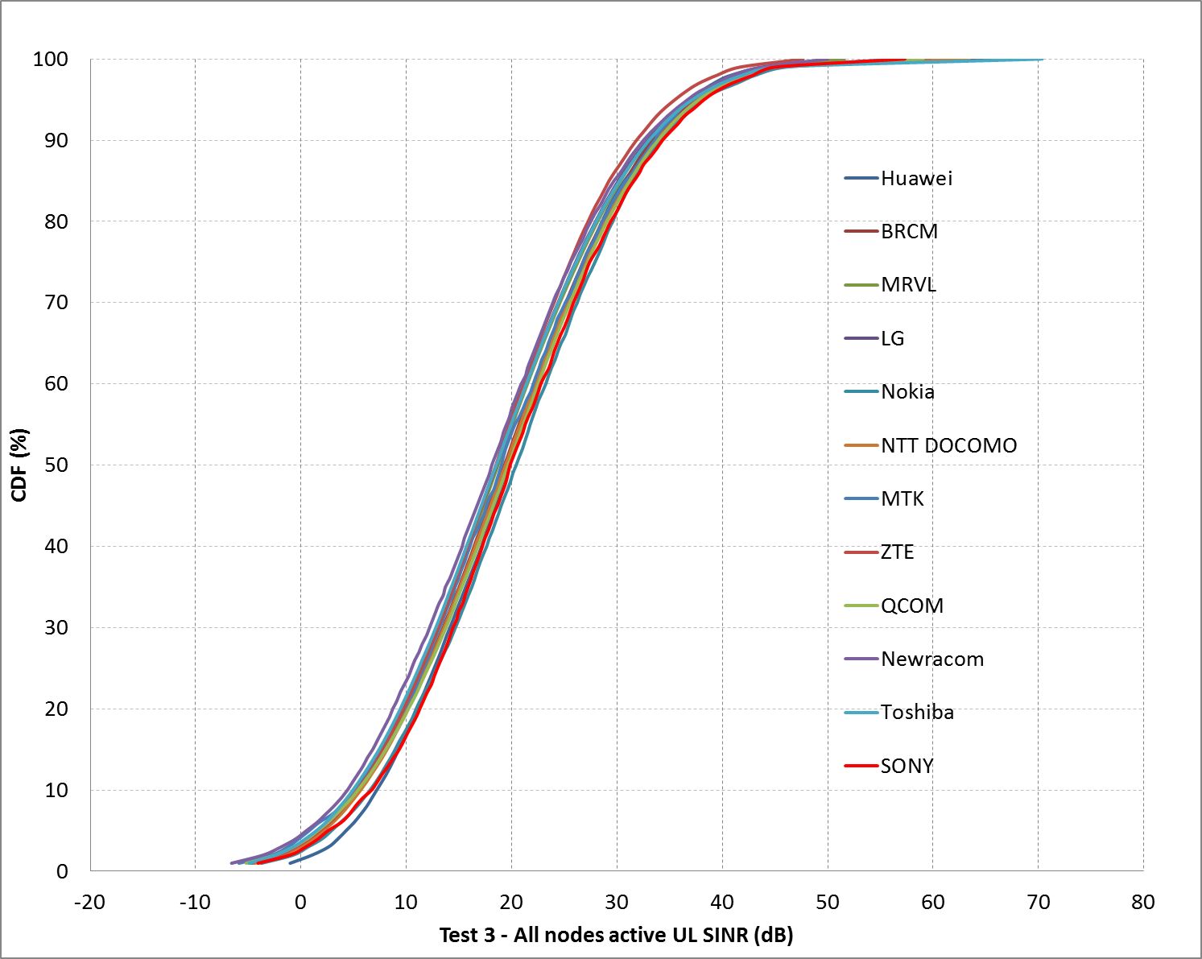
Box2 SS1 (Residential) Test3 UL

Slide 37
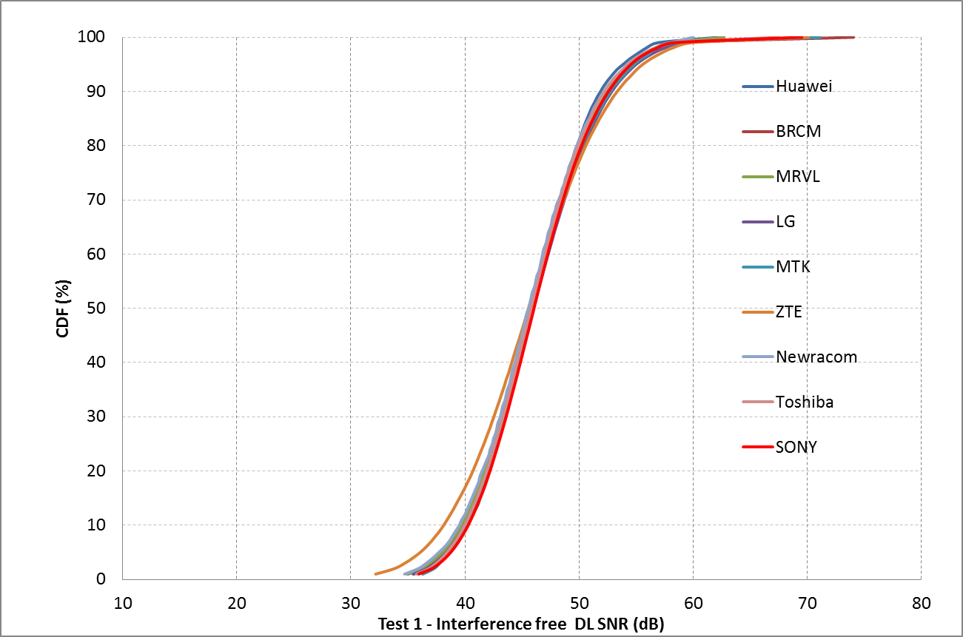
Box2 SS2 (Enterprise) Test1

Slide 38
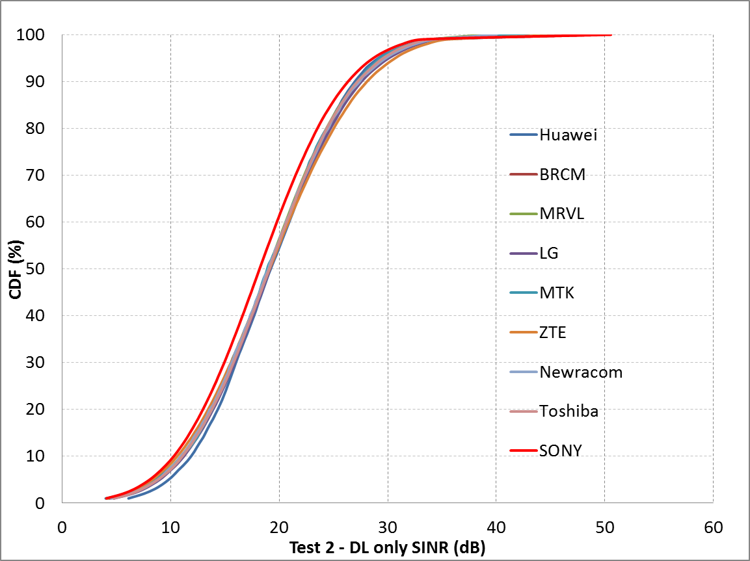
Box2 SS2 (Enterprise) Test2

Slide 39
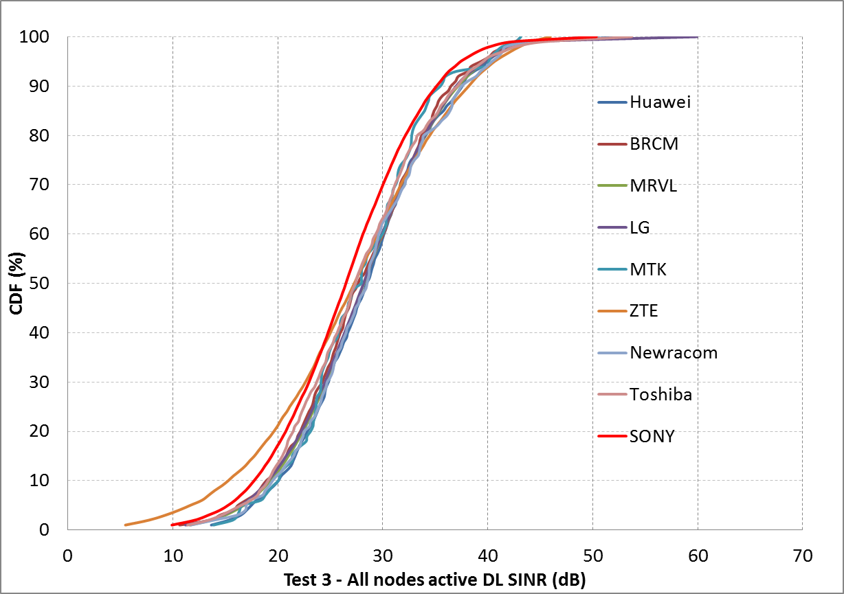
Box2 SS2 (Enterprise) Test3 DL

Slide 40
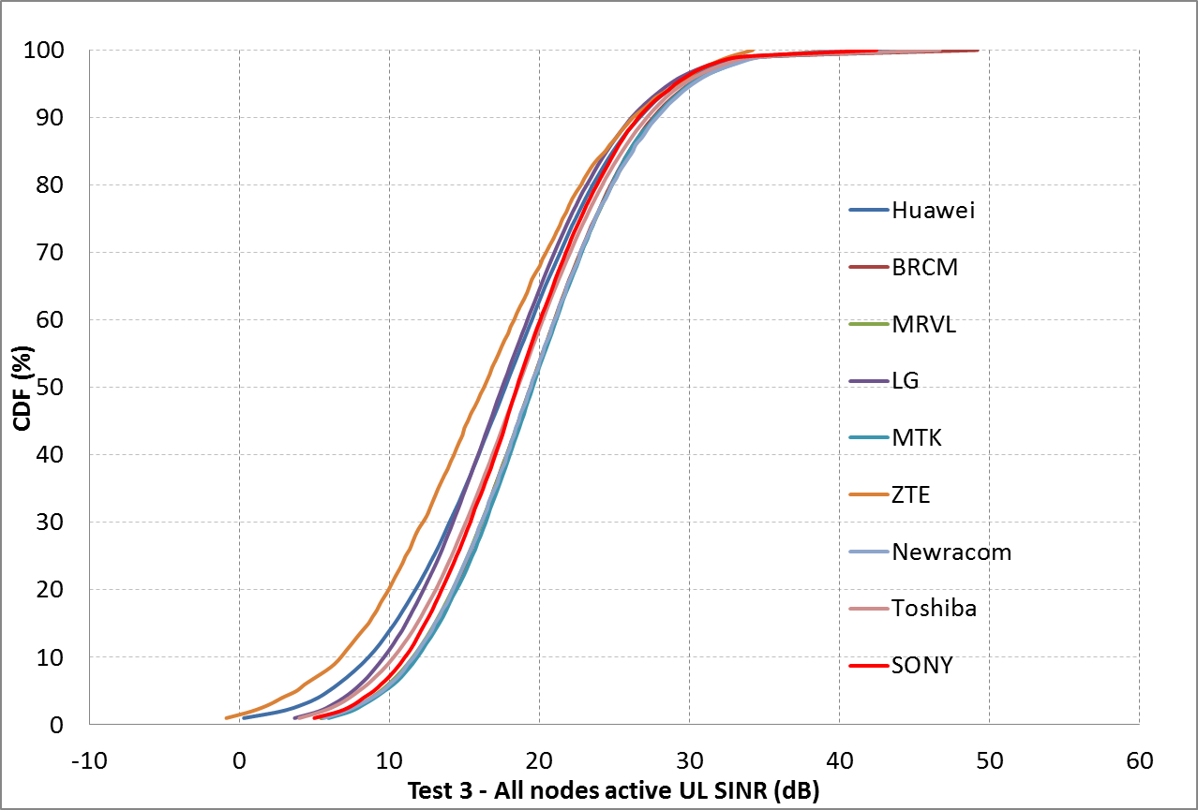
Box2 SS2 (Enterprise) Test3 UL

Slide 41
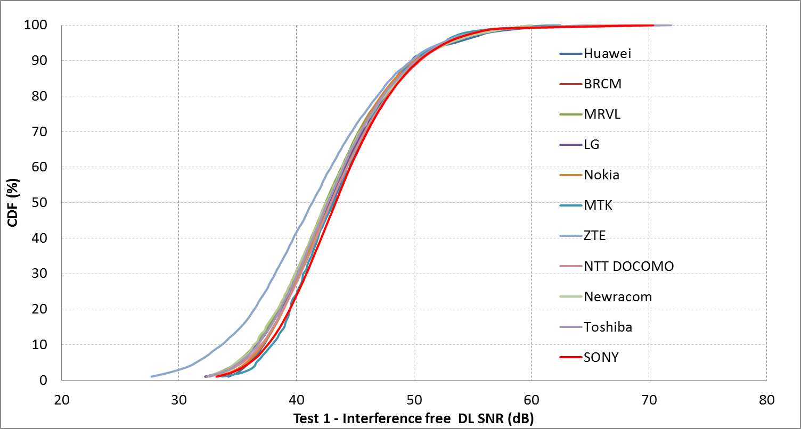
Box2 SS3 (Indoor small BSSs)Test1

Slide 42
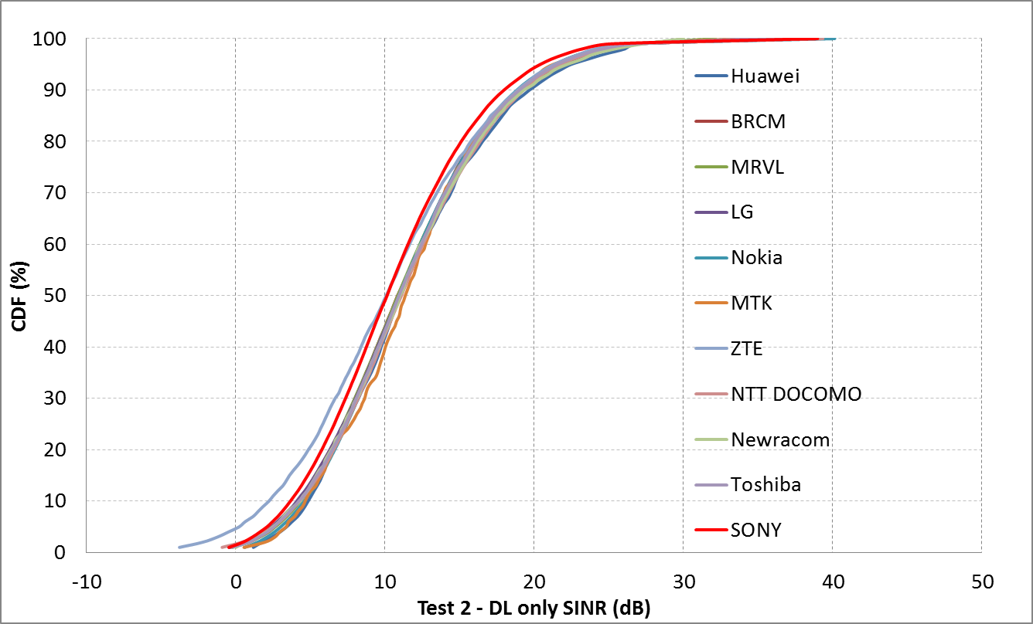
Box2 SS3 (Indoor small BSSs)Test2

Slide 43
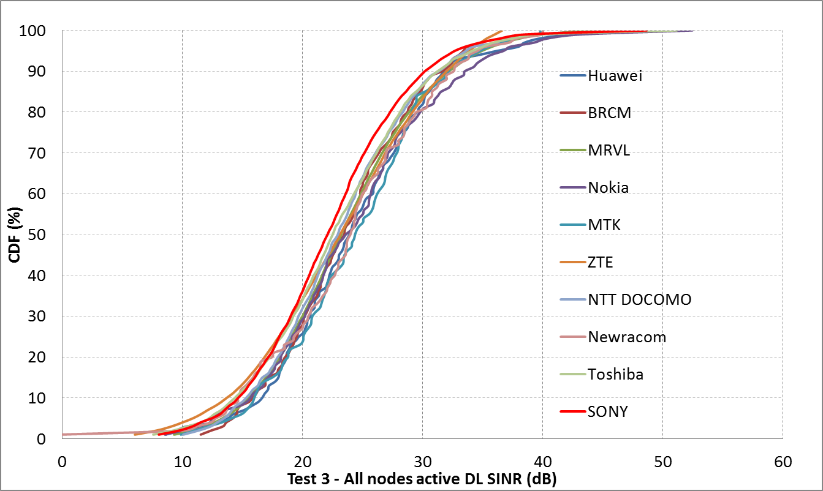
Box2 SS3 (Indoor small BSSs)Test3 DL

Slide 44
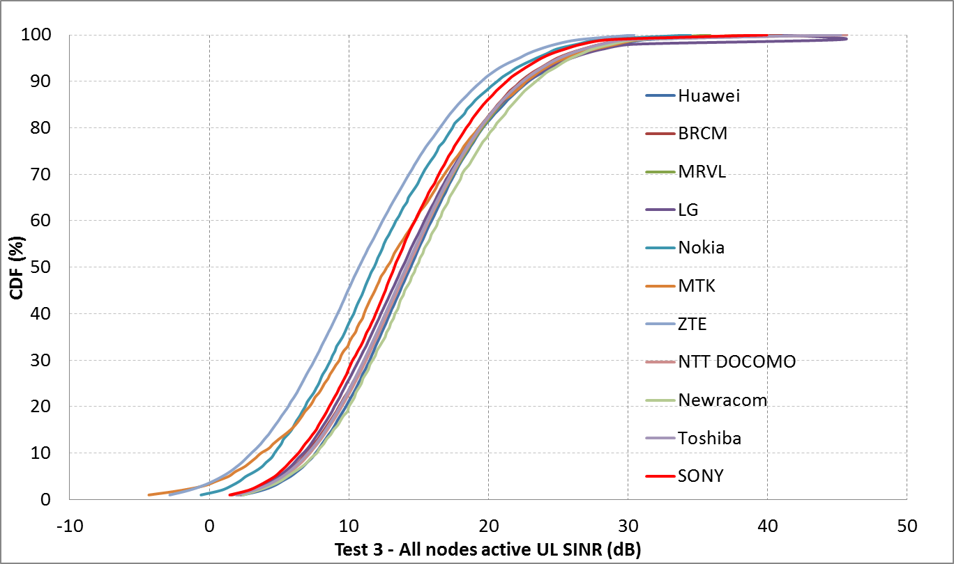
Box2 SS3 (Indoor small BSSs)Test3 UL

Slide 45
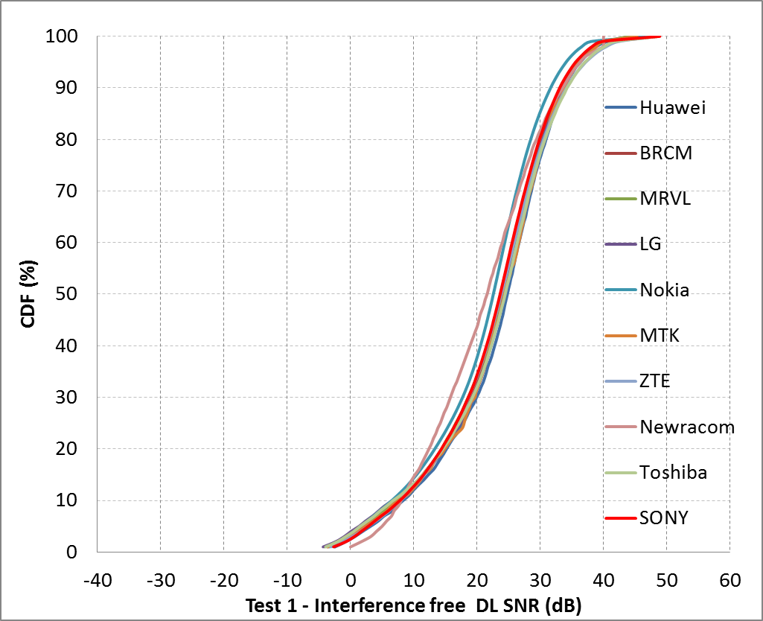
Box2 SS4 (Outdoor large BSS)Test1

Slide 46
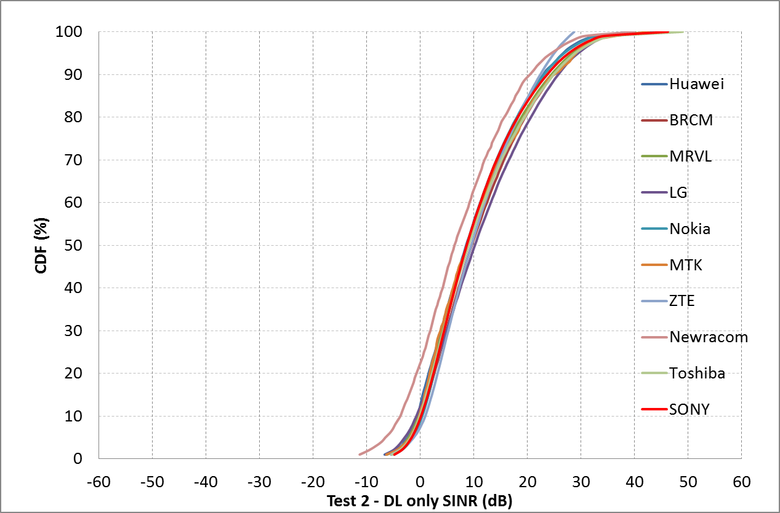
Box2 SS4 (Outdoor large BSS)Test2

Slide 47
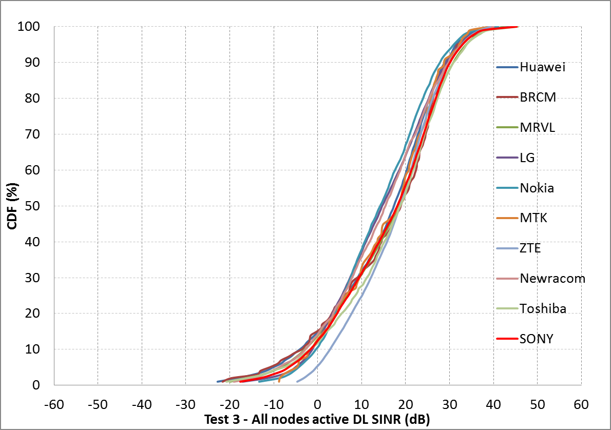
Box2 SS4 (Outdoor large BSS)Test3 DL

Slide 48
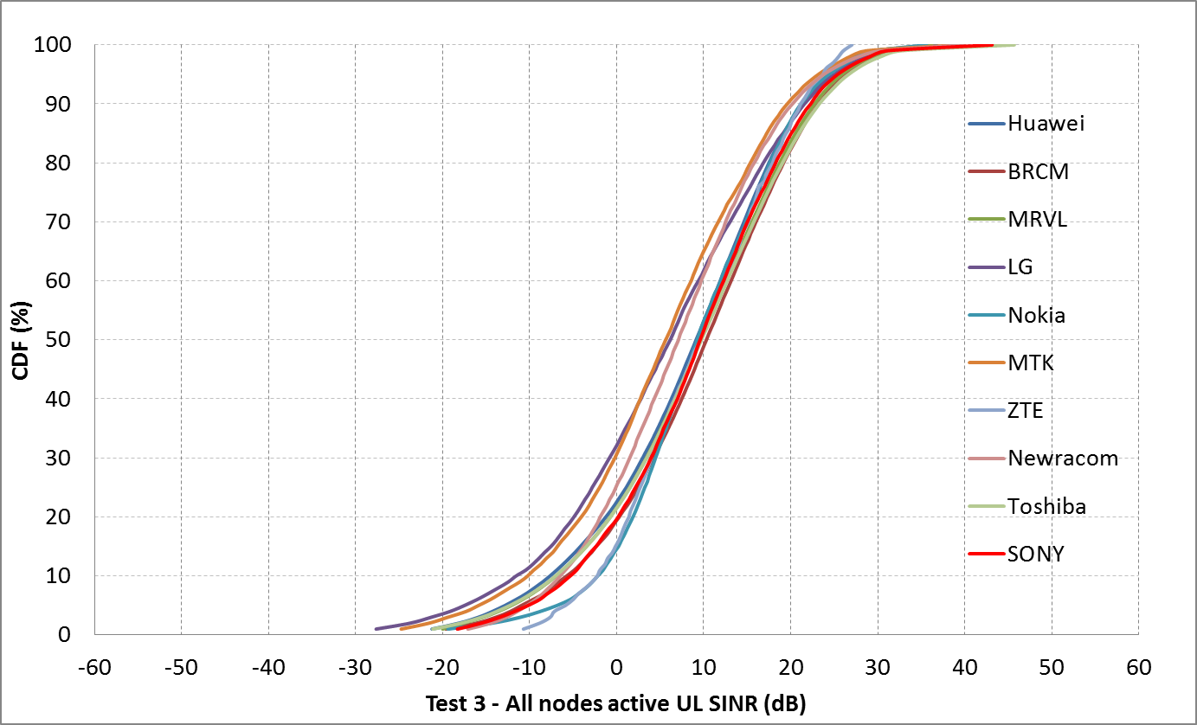
Box2 SS4 (Outdoor large BSS)Test3 UL

Slide 49
Conclusion
Box1 tests results
  Performed simulations for Tests 1 – 5
Box2 tests results
  Performed simulations for Tests 1 – 3
These results are aligned with other calibrating companies.

Slide 50
References
11-14-0980-12-00ax-simulation-scenarios
11-14-0571-09-00ax-evaluation-methodology
11-14-0799-02-00ax-modifications-to-simulation-scenarios-and-calibration-process
11-15-0125-02-00ax-box-1-and-box-2-calibration-results

