Slide 1
Preliminary Simulation Results for AoA Accuracy in 2.4 GHz using IEEE 802.11n channel models
Date: 2015-07-12
Authors:

Slide 2
Background
NGP’s goals include providing mechanism for improved location estimation accuracy.
We have run preliminary simulations of AoA with IEEE 802.11n channel models and show results in various environments.
Our conclusions show that current 11n channel models don’t support AoA and new channel models appropriate for AoA may be required.

Slide 3
NGP Improvements from PAR
Robust, Accurate and Precise Location
Dense deployments
Peer to Peer

Slide 4
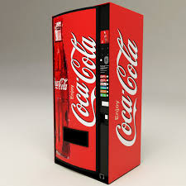

What does AoA provide ?
Improves Performance: Augmented with FTM, AoA improves performance, 20x in some deployments
Improves user density: One beacon provides direction for multiple users in a stadium. Again can be augmented with FTM
P2P: Enables P2P bearing information which allows some additional use cases.
AP

Slide 5
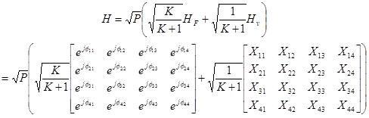
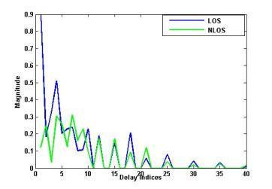
IEEE 802.11n/ac Channel Model
IEEE 802.11n channel models: Channel matrix is given as,
X_{ij} (i-th receiving and j-th transmitting antenna) are correlated zero-mean, unit variance, complex Gaussian random variables as coefficients of the variable NLOS (Rayleigh) matrix H_{V}.
exp(jϕ_{ij}) are the elements of the fixed LOS matrix H_{F}.
K is the Ricean K-factor, and P is the power of each tap.
K factor applies only for the first tap of the impulse response and is 0 for the rest

Slide 6
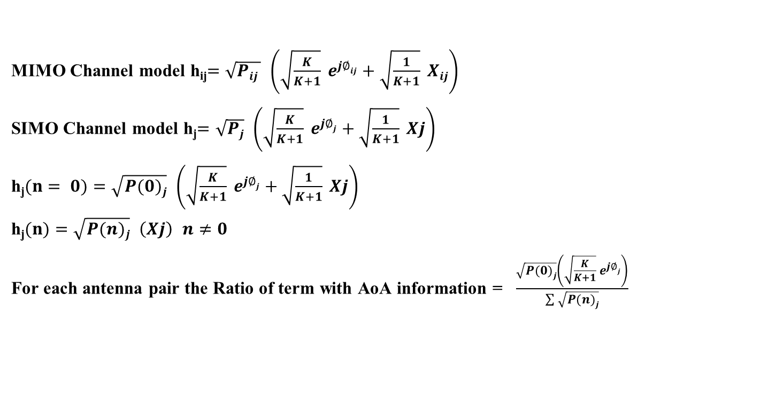
IEEE 802.11n/ac Channel Model for SIMO
MIMO Channel model h_{ij}$=\sqrt{Pij }$ $\left(\sqrt{\frac{K}{K+1}} e^{j∅ij}+\sqrt{\frac{1}{K+1}} Xij\right)$
SIMO Channel model h_{j}$=\sqrt{Pj}$ $\left(\sqrt{\frac{K}{K+1}} e^{j∅j}+\sqrt{\frac{1}{K+1}} Xj\right)$
h_{j}$(n= 0)=\sqrt{P(0)j}$ $\left(\sqrt{\frac{K}{K+1}} e^{j∅j}+\sqrt{\frac{1}{K+1}} Xj\right)$
h_{j}$(n)=\sqrt{P(n)j}$ $\left(Xj\right)$ $n≠0$
For each antenna pair the Ratio of term with AoA information = $\frac{\sqrt{P(0)j}\left(\sqrt{\frac{K}{K+1}} e^{j∅j}\right)}{\sum{\sqrt{P(n)j}}}$
The LOS K-factor is applicable only to the first tap while all the other taps K-factor remain at -∞ dB

Slide 7
LoS Wireless Channel Models in IEEE 802.11n
Model | Spread (ns) | K factor (LOS, Tap -1) | Number of Clusters | Environment | Ratio LoS_Tap(1)/sum(h) (dB)
B | 15 | 1 | 2 | Residential | -6.7
C | 30 | 1 | 2 | Residential/small office | -8.2
D | 50 | 2 | 3 | Typical office | -9.2
E | 100 | 4 | 4 | Large office | -11.2
F | 150 | 4 | 6 | Large space (indoors/outdoors) | -12.9

Slide 8
Simulation Results: Channel Model B & E LoS
Channel model B
Number of Antennas: 4
Linear Array
SNR = 20 dB
Channel model E
Number of Antennas: 4
Linear Array
SNR = 20 dB

Slide 9
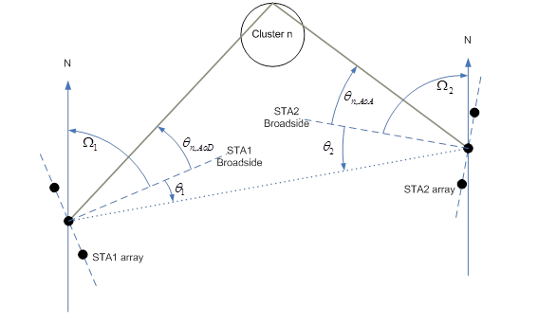
IEEE 802.11n/ac Channel Model
Only the first Tap of the channel impulse response has the source’s AoA information.
Cluster 1 has a fixed AoA information which is used for all the taps of the cluster.
As shown earlier the angular information of the source in the 11n channel models (B-F) is poor.
NGP should develop the channel models for the use cases where AoA will work and would be applicable.
 | Tap index | 1 | 2 | 3 | 4 | 5 | 6 | 7 | 8 | 9
 | Excess delay [ns] | 0 | 10 | 20 | 30 | 40 | 50 | 60 | 70 | 80
Cluster 1 | Power [dB] | 0 | -5.4 | -10.8 | -16.2 | -21.7
AoA | AoA [°] | 4.3 | 4.3 | 4.3 | 4.3 | 4.3
AS (receiver) | AS [°] | 14.4 | 14.4 | 14.4 | 14.4 | 14.4
AoD | AoD [°] | 225.1 | 225.1 | 225.1 | 225.1 | 225.1
AS (transmitter) | AS [°] | 14.4 | 14.4 | 14.4 | 14.4 | 14.4
Cluster 2 | Power [dB] |  |  | -3.2 | -6.3 | -9.4 | -12.5 | -15.6 | -18.7 | -21.8
AoA | AoA [°] |  |  | 118.4 | 118.4 | 118.4 | 118.4 | 118.4 | 118.4 | 118.4
AS | AS [°] |  |  | 25.2 | 25.2 | 25.2 | 25.2 | 25.2 | 25.2 | 25.2
AoD | AoD [°] |  |  | 106.5 | 106.5 | 106.5 | 106.5 | 106.5 | 106.5 | 106.5
AS | AS [°] |  |  | 25.4 | 25.4 | 25.4 | 25.4 | 25.4 | 25.4 | 25.4

Slide 10
Simulation Results: Channel Model B & E LoS with higher LoS component
Channel model B with 10 dB higher LoS
Number of Antennas: 4
Linear Array
SNR = 20 dB
Channel model E with 15 dB higher LoS
Number of Antennas: 4
Linear Array
SNR = 20 dB

Slide 11
Summary/Recommendations
AoA performance in Traditional WLAN channels as defined by Channel models B-F is not adequate.
AoA under good LoS conditions performs well, this could enable new use cases
NGP should investigate new channel models with good LoS conditions.

Slide 12
References
  11-14-1464 NG Positioning Overview and Challenges
  11-14-1193 Beyond Indoor Navigation
  11-14-1235 Scalable location
  Simulation results on AoA accuracy in 2.4/5GHz bands

