Slide 1
Integrated Long Range Low Power Operation for IoT
Date: 2015-07-15
Author:

Slide 2
Integrated Longer Range and Lower Power
Develop new MCS or PHY for long range low power (LRLP)
  Integrated in air interface: Able to operate concurrently with existing network without adverse effect on existing devices
  Integrated into mainstream devices: Does not require additional hardware and components for implementation.
  Assumes new silicon (aligned with 802.11ax introduction)
    More than a “firmware upgrade” for existing products
Range improvement objective
  10 dB, 20dB stretch goal
  Nominal range of 500m
Provide similar level of lower power requirements
  Average power consumption: 50uW
  Battery life longer than 5 years

Slide 3
Results from May WNG Discussion
Straw Poll:
  “Would you support the formation of a Study Group to develop a PAR for Long Range mode intended for broad-market 802.11 products?”
  Y: 15 N: 0 Needs more discussion: 35 No opinion: 2
Requests
  Articulate the use cases
  Detailed set of requirements.

Slide 4
Description of Use Cases
Applications focused on M2M and IoT
  Not bulk data transfer
    UL data of 5-32bytes
    Communication interval ranging from 500ms to 10 minutes
    Delay less than communication interval
  Devices may be AC line connected, or battery powered
  Scheduled or Coordinated medium access compliant
IoT, Energy management, sensors
  Fixed location
  Out of way location (hot water heater, pool pump)
  Poor propagation – e.g. side of White Goods appliance
Indoor and outdoor applications
  Premises or property scale – not a neighborhood area network
  Eliminate need for “range extenders”
Possibly usable by general WLAN user (with manual enablement)
  When slow connection is better than no connection – in very marginal connection conditions

Slide 5
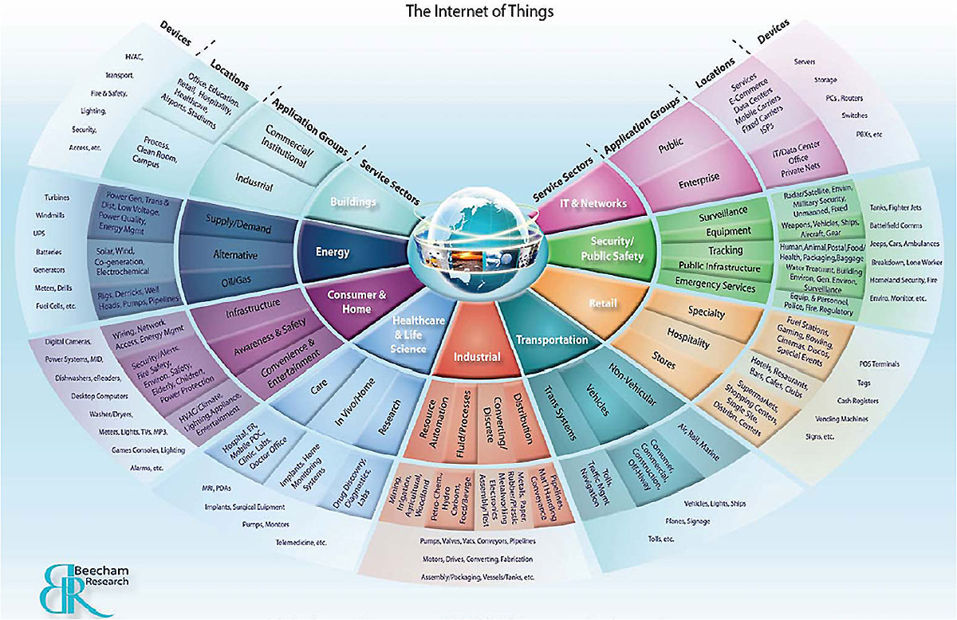
Thrust Areas of IoT
Smart buildings
Energy and Utility
Consumer and connected home
Healthcare
Industrial Automation
Transportation
Security/Public Safety
IT Networks
Retail

Slide 6
Requirements
“Zero” marginal cost for implementation
  Available in “all” next-generation 802.11 chipsets
Possible to define “LRLP only” STA
  Implemented a lower cost: similar to S1G sensor STA
  AP is based on “standard” silicon
10 dB link margin improvement
Low energy consumption (average consumption of 50uW) for battery operated devices
Relatively low aggregate data rate ~ 512Kbps
  Actual PHY data rate may be higher
Coexistence and limited impact on primary BSS
  Protection mechanisms, media occupancy limit, duty cycle limit, etc.

Slide 7
Why is LRLP needed when we have 802.11ah?
Although targeting 2.4 GHz, LRLP should be band-agnostic
Long range functionality supported by 11ah needs to be extended to higher bands
This capability is intended for entry-level implementations
  Would operate on existing network, on mass market APs and routers
  Energy and M2M desire to leverage existing customer broadband using 802.11
Objective: LRLP would eventually become available on all mainstream consumer and enterprise WLAN devices
  Ideally every AP would support this capability in "next generation" silicon

Slide 8
Why not 802.11b?
Goal of > 10dB range improvement exceeds what is achievable with 802.11b at 1 Mbps
802.11b doesn’t take advantage of newer techniques like MIMO and beamforming
  Can MIMO be leveraged for range instead of rate?
  Beam Forming Transmission advantages for LRLP
802.11b waveform and bandwidth puts a floor on achievable energy reduction
802.11b protection mechanisms have an adverse affect on BSS throughput
  Can we use newer MAC techniques for lower impact (and more control) on overall BSS throughput?

Slide 9
Pathloss, Regulatory Limits and Spectrum considerations of 900MHz and 2.4GHz
Region | 11ah/900MHz Power | 2.4GHz Power
China | 5mW | 100mW
USA | 1000mW | 1000mW
South Korea (917-923MHz) | 10mW | 100mW
Europe (863-869MHz) | 25mW | 100mW
Singapore (920-925MHz) | 500mW | 200mW
Japan (920.5-923.5MHz) | 250mW | 10mW/MHz
Pathloss advantage ~(1/f^2); (2.4/.9)^2 = 7 = 8.4dB advantage for ideal antennas;
The advantage comes from larger ideal antenna aperture; hard to realize full benefit because of antenna size; 2.4 Antennas are always smaller
Most countries except Singapore and Japan, 2.4 Power is larger
Some countries both powers are larger than needed for IOT (100mW)
Many countries 900MHz allowed spectrum smaller (few MHz) compared to 85MHz or more of 2.4GHz availability

Slide 10
Long Range / Low Power Optimization
LRLP operation can be parameterized to optimize for range or power, depending on use case and link
  Provides benefits even at limits: e.g. even at the “low power” end, the range is better than legacy, and the power is lower than legacy at the “higher power” end.
Shorter Range
Longer Range
Higher Power
Parameter Variations
Lower Power

Slide 11
Consider benefits of narrower channel
A potential approach:
  A reduced channel width for LRLP may be effective to accomplish both goals of long range and lower power.
    2 MHz is a basic channel width for 802.11ah
    2 MHz is proposed as 802.11ax UL-OFDMA allocation block ^{[1]}
  APs and Full-function STAs support both 2 MHz and 20 MHz
  LRLP-only STA may be designed with a total receiver BW of 2 MHz
    Power consumption benefits come from the ELIMINATION of the requirement to receive in a 20MHz (or wider) channel far more than from the ABILITY to receive in a 2MHz channel.
    Adding a 2MHz mode to an OFDM PHY would not meet this objective.
[1] “15/0354r1 Bandwidth granularity on UL-OFDMA data allocation”.

Slide 12
Potential Integration Approach
Define PHY operation that provides both long range and low power
  Devices don’t have to take advantage of long range
  They choose the best TX power, modulation and coding based on link conditions. Use link adaptation.
Able to leverage MU-MIMO with 10 simultaneous LRLP users in 20 MHz channel for lowest power
  Compatibility with the smallest OFDMA channel proposed in 802.11ax
  Wideband operation for longest range
    If range is limited by multipath, 20 MHz gives better performance
    If range is limited by attenuation, narrow channel can be better
    If range is limited by frequency selective fading, wider channel is better
    If range is limited by adjacent channel, narrow is better
    If range is interference limited, narrow is better
    Easier to increase TX power in narrow channel
      Narrow channel at legal limit is more cost effective and power efficient

Slide 13
Potential Low Power Approach
2 MHz Bandwidth at the STA
Support standardized operation of next generation billion IoT devices
  Includes remote sensors with coin cell batteries
Design of a narrowband, specifically 2MHz transceiver will provide reduced power consumption when compared to 20MHz transceiver
  25%-52% reduction in RF domain during RX depending on MCS
  4 times reduction in digital domain during RX
  Not significant gain in terms of power consumption in TX

Slide 14
Potential Protection Approach
Beacons transmitted in 20MHz for legacy compatibility
  LRLP devices unable to decode legacy Beacon (due to range or BW)
  Restructure LRLP beacons – shorter, maybe less frequent
    Only include elements relevant to LRLP PHY. Minimum of information on BSS and basic capability. Everything else the station requires may be obtained using the Request Element in Probe frames.
    The LRLP should have a DTIM in every one of its beacons, with an appropriately longer LRLP beacon interval. The Listen Interval, or something like it, would be available for stations that do not want to wake up for every LRLP beacon
Trigger frames in 802.11ax planned to be sent in 20MHz
  11ax uses trigger frames for MU UL frames
  Specialized trigger frames for UL from LRLP devices
AP supervises heterogeneous network of conventional and LRLP (IoT) STAs

Slide 15
Limitation of Impact on Network
Specify Medium Occupancy Limit for LRLP operation
  Comparable to full rate packets
  Additionally, specify a maximum average time on air (duty cycle).
Intended applications are focused on M2M and IoT
  Not for bulk data transfer
  Low offered load is assumed
    Doesn’t require a low data rate – could be high rate low duty cycle
    Use best available rate for link and power constraints

Slide 16
Summary
Longer Range operation
  In mainstream 802.11
Lower Power operation
  Enable battery powered IoT
Integrated with mainstream networks
  Interoperable in mixed BSS case
Integrated with mainstream products
  Negligible incremental cost for implementation at an AP
  Acceptable to have a specialized low-cost silicon for LRLP STA, but the AP should be based on standard silicon.
Intended for M2M – managed impact on existing network.
  Medium Occupancy Limit, average occupancy limit
  Other mechanisms as appropriate

Slide 17
Distinct Identity
When defining a PAR, is there a concern with “Distinct Identity” and overlap with scope of 802.15?
  LRLP is built around “entry level” 802.11 infrastructure and does not require hardware for a new band or a new radio.
  No, because a basic requirement is the ability to integrate with existing WLAN infrastructure
  The LRLP flavor of 802.11 is manageable using the existing (enterprise-oriented and carrier-oriented) 802.11 network management facilities, AND can leverage the enormous deployed internet access infrastructure available from residential/soho/hotspot/public 802.11 networks.
    Neither of these are true of 802.15 networks.

Slide 18
Straw Poll
Straw Poll:
  “Would you support the formation of a Study Group to develop a PAR for Long Range Low Power operation, intended for broad-market 802.11 products?”

