Slide 1
802.11 July 2015 WG Motions
Date: 2015-07-17
Authors:

Slide 2
Abstract
This document is a composite of all 802.11 sub-group motions that are brought to the July 2015 802.11 WG plenary meetings.
Revisions
  R0: motions for Monday
  R1: at conclusion of Monday WG11 plenary
  R2: containing motions for Wednesday WG11 plenary
  R3: at conclusion of Wednesday WG11 plenary
  R4: containing motions for Friday WG11 plenary
  R5: at conclusion of Friday WG11 plenary
  R6: containing motions for Friday EC meeting (Plenary session only)
  R7: containing motions for Friday EC meeting (Plenary session only)

Slide 3
MONday

Slide 4
FCC 15-47 Response (Personal Motion)
Motion:
  Move to approve transmission of document 11-15/683r6 (https://mentor.ieee.org/802.11/dcn/15/11-15-0683-06-0reg-comments-in-fcc-15-47.docx ) to the FCC as a letter in response to FCC docket 15-47, granting the WG Chair editorial license.
Moved by: Richard Kennedy
Seconded by: Peter Ecclesine
Result: 106-0-2 Passes

Slide 5
TGaj Vice Chair Confirmation
Motion:
  Confirm Jiamin Chen as TGaj Vice chair
Moved by: Dorothy Stanley
Seconded by: Stephen McCann
Result: Unanimous approval
802.11 OM 4.3: TG Vice-Chair is elected by a TG majority approval and confirmed by a WG majority approval. Jiamin Chen elected as TGaj Vice chair in May 2015 11aj interim, see 11-15-0717 Page 11

Slide 6
Wednesday

Slide 7
TGai Motion WG Recirculation LB
Having approved comment resolutions for all of the comments received from WGLB213 on TGai D5.0 as contained in document 11-15/0772r6,
  Instruct the editor to incorporate the resolutions with the D5.0 and create D6.0.
  Approve a 15 day Working Group Recirculation Ballot asking the question “Should TGai D6.0 be forwarded to Sponsor Ballot?”.
Moved: Hiroshi Mano on behalf of the TG
Result: Unanimous
TG result: Moved: Ping Fang, Seconded: Lee Armstrong, Result: 11-0-0

Slide 8
Motion – NGP PAR
Believing that the PAR contained in the document referenced below meets IEEE-SA guidelines,
Request that the PAR contained in 11-15/0030r9 be posted to the IEEE 802 Executive Committee (EC) agenda for EC approval to submit to NesCom.
Moved by: Jonathan Segev
Seconded: Ganesh Venkatesan
Result: 118-0-1 Passes
NGP SG vote: Moved: Ganesh Venkatesan, 2nd: Allan Zhu, Results: 20-0-0

Slide 9
Motion – NGP CSD
Believing that the CSD contained in the document referenced below meets IEEE-SA guidelines,
Request that the CSD contained in 11-15/0262r4 be posted to the IEEE 802 Executive Committee (EC) agenda for EC approval.
Moved by: Jonathan Segev
Seconded: Ian Sherlock
Result: 123-0-2 Passes
NGP SG vote: Moved: Ganesh Venkatesan, 2nd: Allan Zhu, Results: 20-0-0

Slide 10
Friday

Slide 11
Teleconferences
Group | Date(s) | Start | Duration
CAC | Mon August 10, Tues Sept 8 | 12:00 ET | 1 hr
REG SC | Bi-weekly Thursdays July 23 through Nov 30th | 12:30 ET | 1 hr
TGaj | Sept 3 | 9:00 ET | 1 hr
TGah | Sept 8 | 20:00 ET | 2 hrs
TGai | Weekly Tuesday, Aug 11 through Nov 18 | 10:30 ET | 1 hr
TGak | Monday Aug 3, 10, 24, 31 | 10:00 ET | 1.5 hrs
TGaq | Fri Aug 7, 14, 21, Sept 4 | 12:00 ET | 1.5 hrs
TGmc | July 31, August 7, 14, 28 | 10:00 ET | 2 hrs
TGax | Thursday August 20 | 10:00 ET | 2 hrs
TGay | Tuesday Sept 1 | 10:00 ET | 1 hr
NGP | Wednesday Sept 2 | 10:00 ET | 1 hr
Motion to approve: Moved: Marc Emmelman, Seconded: Rich Kennedy, Result: Unanimous

Slide 12
TGay Chair Confirmation
Motion:
  Confirm Edward Au as TGay Chair
Moved by: Guido Hiertz
Seconded by: Lei Wang
Result: Unanimous
802.11 OM 4.2: The TG Chair shall be appointed by the WG Chair and confirmed by a WG majority approval. TGay result: Edward Au as candidate recommendation

Slide 13
WNG Chair Confirmation
Motion:
  Confirm Jim Lansford as WNG Chair
Moved by: Stuart Kerry
Seconded by: Tim Godfrey
Result: Unanimous
802.11 OM 6.6: The Standing Committee Chair is appointed by the WG Chair and is re-affirmed by the WG majority approval.

Slide 14
802.11 Operations Manual (OM) changes
Accept document 11-14/0629r11 as the 802.11 operations manual.
Moved: Dorothy Stanley
Seconded: Michael Fischer
Result: 47-0-2 Passes
(Revision 12 will also be uploaded containing tracked changes accepted).

Slide 15
PAR Rebuttal Motion
Move to approve the Rebuttal to 802.15 regarding the 802.15.3 Revision PAR as shown on slide 18 of doc 11-15/753r3.
Moved: Jon Rosdahl on behalf of the SC
Seconded: Stephen McCann
Result: 48-0-0 Passes
In the SC: Move to approve the Rebuttal to 802.15 regarding the 802.15.3 Revision PAR as shown on slide 18 of doc 11-15/753r3.
Moved: Stuart KERRY 2nd: Adrian STEPHENS
PAR Review SC Results: 3-0-0

Slide 16
802.11 25th Anniversary Press Release Motion
Approve the press release contained in https://mentor.ieee.org/802.11/dcn/15/11-15-0844-01-0000-draft-25th-anniversary-press-release.docx
Moved: Stephen McCann on behalf of the Publicity SC
Seconded: Stuart Kerry
Result: 46-0-2 Passes
In the SC: Adrian Stephens, Seconded: Stuart Kerry. Yes: 7, No: 0, Abstain: 0

Slide 17
JTC1 SC Resolutions for the FDIS comments on 802.11ac & 802.11af
Motion: The IEEE 802.11 WG recommends to the IEEE 802 EC that the resolutions of comments in the FDIS ballots as documented in IEEE 802.11-15/0958r0 be forwarded to ISO/IEC JTC1/SC6.
Moved: Stephen McCann
Seconded: Jim Lansford
Result: 48-0-0 Passes

Slide 18
Motion for EC Approval on P802.11ai D6.0
Approve document 11-15-0926r2 as the report to the IEEE 802 Executive Committee on the requirements for conditional approval to forward Draft P802.11ai/D6.0 to sponsor ballot, granting the chair editorial license and
Request the IEEE 802 Executive Committee to conditionally approve forwarding Draft P802.11ai/D6.0 to sponsor ballot.
Moved: Hiroshi Mano on behalf of the TG
Seconded: Marc Emmelmann
Result: 50-0-0 Passes
TG motion result: Moved: Peter Yee, Seconded: Lee Armstrong, Result: 9-0-0

Slide 19
NGP Study Group extension (second)
Request the IEEE 802 LMSC to extend the IEEE 802.11 NGP Study Group.
Moved: Jonathan Segev on behalf of the SG
Second: Edward Au
Result: 48-0-1 Passes
SG result: Move: Ganesh Venkatesan 2nd: Santosh Pandey results: 20-0-1

Slide 20
Long Range Low Power TIG Motion
WG Motion: Form an 802.11 Long Range Low Power (LRLP) Topic Interest Group (TIG) to accomplish the following tasks:
  Specify LRLP requirements and use cases
  Establish technical feasibility of achieving the requirements for range, power consumption, and integration with 802.11 and coexistence with other 802 wireless protocols
  Generate the technical material needed to initiate standardization
  The TIG will generate a report containing the results of these tasks within four 802.11 sessions.
Mover: Tim Godfrey Seconder: Michael Fischer
Result: 43-0-7 Passes

Slide 21
LRLP TIG Chair Confirmation
Motion:
  Confirm Tim Godfrey as LRLP Chair
Moved by: Stuart Kerry
Seconded by: Michael Fischer
Result: Unanimous

Slide 22
Friday – EC Motions

Slide 23
4.09 Approve FedEx Shipping Charge
Approve the payment of FedEx shipping charges related to the 802.11 anniversary give-aways not to exceed $400.
Moved: Adrian Stephens
Seconded: Jon Rosdahl
Result: Unanimous

Slide 24
5.031 TGai Conditional Approval Motion
As defined in IEEE LMSC Operations Manual (7 Nov 2014), clause 12, conditionally approve sending IEEE P802.11ai /D6.0 to Sponsor Ballot.
Moved: Adrian Stephens
Seconded: Jon Rosdahl
Result: Unanimous
In the WG: Moved: Hiroshi Mano on behalf of the TG, Seconded: Marc Emmelmann, Result: 50-0-0 Passes
See https://mentor.ieee.org/802.11/dcn/15/11-15-0926-02-00ai-p802-11ai-report-to-ec-on-conditional-approval-to-go-to-sponsor-ballot.pptx and pdf of remaining unsatisfied comments:

Slide 25
5.033 Next Generation Positioning to NesCom Motion
Approve sending the PAR in the PAR document cited below for P802.11az to NesCom
And confirm the PAR and CSD cited below
  PAR document: https://mentor.ieee.org/802.11/dcn/15/11-15-0030-09-0ngp-ngp-par-draft.docx
  CSD document: https://mentor.ieee.org/802.11/dcn/15/11-15-0262-04-0ngp-csd-working-draft.docx
  In the WG: PAR approval result: 118-0-1 Passes, CSD approval result: 123-0-2
Moved: Adrian Stephens
Seconded: Jon Rosdahl
Result: Unanimous

Slide 26
Why 802.11 Based Positioning?
Positioning has symbiotic relation with data connectivity:
  Positioning means nothing without contextual information.
  Data connectivity improves with the addition of positioning.
802.11 based WLAN is almost ubiquitous in many indoor environments (malls, retail chains).
Building on existing technology enables reuse:
  Many of the use cases revolve around the smartphone (already packed with radios, reuse keeps complexity of actual device in check).
  Reuse of connectivity technology shortens and simplifies technology development.
Symbiotic relationship between data and
positioning services
Notes:
Making development effort easier.
time to market shorter which provide an opportunity for cost efficient strong penetration real world products.
Using existing connectivity technology also promotes interoperability as it uses existing SDOs and ITOs.
the Swiss army knife of modern days – the smartphone,
Vendor reluctant to add radios.

Slide 27
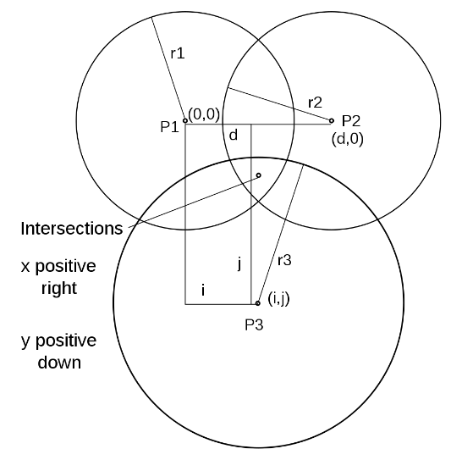
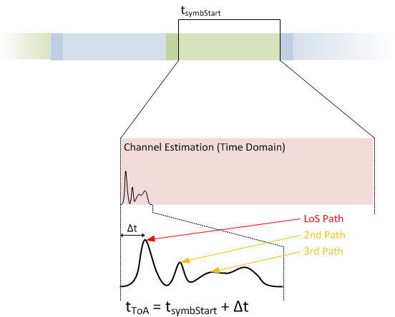
What do we have today?
Main items addressed by FTM introduction to REVmc:
  1:N operation - AP STA: non AP STA lead usage model.
  Multi channel operation: APs STA have a fixed operating channel while non AP STA move between AP STA’s channels.
  Non associated operation mode, multiple ranges are required to obtain single fix.
  Support for AP Location DB protocol.
We already start seeing industry interest as ITA such as the WFA develop certification program for this technology.

Slide 28
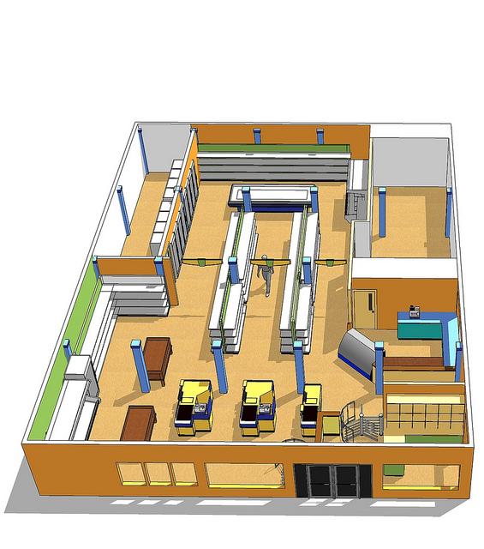
New Positioning Usages
  The NGP SG identified several areas of focus beyond that available by the REVmc protocol:
    Micro geo-fencing (sub 1m accuracy and below).
    Direction finding.
    Efficient support for dense deployments, e.g. sports stadium
  * 11-14-1193/01 – Beyond Indoor Navigation by Jonathan Segev, Carlos Aldana et-al
  11-14-1235/r0 – Scalable Location by Brian Hart, Peter Thornycroft and Mark Rison.
  11-14-1263/r0 – Direction Finding Positioning by James Wang, Gabor Bajko et-al

Slide 29


New Positioning Usages
  The NGP SG identified several areas of focus beyond that available by the REVmc protocol:
    Efficient support for dense deployments, e.g. sports stadium.
    High accuracy positioning for LOS environments (e.g. gaming <0.01m).
  * 11-14-1193/01 – Beyond Indoor Navigation by Jonathan Segev, Carlos Aldana et-al
  11-14-1235/r0 – Scalable Location by Brian Hart, Peter Thornycroft and Mark Rison.
  11-14-1263/r0 – Direction Finding Positioning by James Wang, Gabor Bajko et-al

Slide 30
6.031 NGP Extension (second)
Extend the 802.11 Next Generation Positioning (NGP) study group
Moved: Adrian Stephens
Seconded: Jon Rosdahl
Result: Unanimous
In the WG: Moved: Jonathan Segev on behalf of the SG, Second: Edward Au, Result: 48-0-1 Passes

Slide 31
NGP SG Progress Summary
Interest continues to be high in the Study Group
  An average of 3 meeting slots assigned every F2F meeting
Completed
  PAR and CSD approved by the Working Group in May 2015
  The documents are now under review by 802 EC and NesCom
In Progress
  Discussions related to PAR, CSD, usage scenarios
Justification for SG Extension
  In case extra time is necessary to respond to comments from 802 EC and NesCom

Slide 32
7.031 802.11 25th Anniversary Press Release Motion
Approve the press release contained in https://mentor.ieee.org/802.11/dcn/15/11-15-0844-01-0000-draft-25th-anniversary-press-release.docx
Moved: Adrian Stephens
Seconded: Jon Rosdahl
Result: 13-1-1 Motion passes
In the WG: Moved: Stephen McCann on behalf of the Publicity SC, Seconded: Stuart Kerry, Result: 46-0-2 Passes

Slide 33
7.033 Resolutions for the FDIS comments on 802.11ac & 802.11af
Motion: IEEE 802 EC to forward the resolutions of comments in the FDIS ballots as documented in IEEE https://mentor.ieee.org/802.11/dcn/15/11-15-0958-00-0jtc-response-11ac-11af-fdis.pptx to ISO/IEC JTC1/SC6.
Moved: Adrian Stephens
Seconded: Jon Rosdahl
Result: Unanimous
In the WG: Moved: Stephen McCann, Seconded: Jim Lansford, Result: 48-0-0 Passes

Slide 34
References

