Slide 1
Discussion of CID 5879
Date: 2015-11-13
Authors:

Slide 2
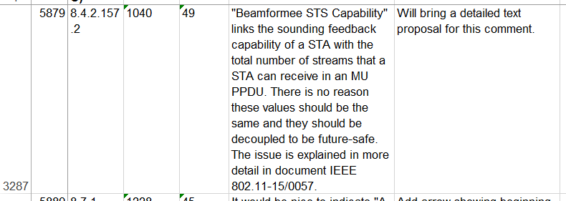
CID 5879
This submission provides further background and invites discussion

Slide 3
Background
A VHT non-AP STA indicates the following MU-related capabilities in the VHT Capabilities element:
  Beamformee capable:
    Whether it can receive frames in MU format
  “Beamformee STS capability”
    One value indicating:
        Maximum number of streams it can receive in an NDP, AND
        Maximum number of rows in Compressed feedback, AND
        Maximum value of N_sts_total it can receive in a VHT MU PPDU
With the current signaling, 1, 2 and 3 are forced to the same value

Slide 4
What’s the issue?
By indicating these capabilities, vendors can dimension the complexity of the STA → Good
However:
  1 and 2 relate to sounding capabilities
  3 relates to reception capability of MU data frames
These capabilities incur different complexities in different blocks
  E.g.: sounding feedback requires SVD
  Processing of MU frames mostly affects processing of VHT-LTF
  Different operations and complexity at play
It is not natural to force these capabilities (#streams) to be the same

Slide 5
Example
An AP receives 4SS feedback from four 2x2 devices and manages to form an 8-stream precoding matrix
Optimal use of MU could allow sending 2 streams to each of the four users
However:
  The AP can not send a 4-users MU frame with N_STS_total = 8 (2+2+2+2 MU) even if each of the STAs could receive N_STS_total = 8
  Instead it can only address two users at a time (2+2 MU) to comply with N_STS_total ≤ 4
  Under the current definitions only STAs providing 8SS feedback could receiver N_STS_total = 8

Slide 6
Example - conclusion
Decoupling the capabilities for sounding and MU reception allows for better efficiency of MU-MIMO
Decoupling allows vendors to better “mix and match” functionality related to MU
Under the current protocol, use of MU-MIMO and MU grouping is needlessly constrained

Slide 7
Proposal
Decouple the signaling of both capabilities
  One value for sounding capabilities
    Max number of streams in NDP
    Max number of rows (per tone) in compressed feedback
  One value for MU PPDU max N_sts_total capability
This maintains maximum flexibility in operation and design
  STAs is no longer forced to implement both extended sounding capabilities and PPDU processing capabilities
  No new mandatory requirements
  Full backwards interoperability can be guaranteed

Slide 8
Implementation
Previous proposal [1, 2] used reserved bits in the “Supported VHT-MCS and NSS Set” field of the VHT Capabilities Element
  Some of these bits were also claimed in an unrelated proposal (see [3])
A different approach is to use the extensible nature of the “Supported VHT-MCS and NSS Set” field

Slide 9
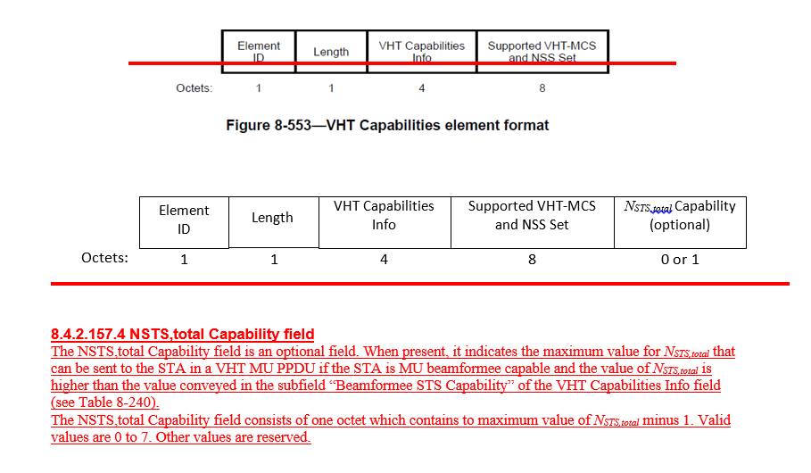
Example implementation (2)

Slide 10
Conclusion
MU MIMO is a very promising method to further exploit spatial diversity
  Decoupling the sounding and MU reception capabilities allows for low-complexity enhancements to MU-MIMO
Minor change to 802.11
  No backwards compatibility issues
  No new mandatory requirements
  Low-complexity
  increases efficiency of MU-MIMO

Slide 11
References
[1] MU Beamformee capabilities indication in VHT, IEEE 802.11 submission 802.11-15/0057
[2] Text proposal for Beamformee STS Capabilities, IEEE 802.11 submission 802.11-15/0058
[3] LB202 CID3297 NSS support partitioning, IEEE 802.11 submission 802.11-14/0793r9

