Slide 1
Ad Hoc Meeting Kaua‘i, Hawai‘i
Date: 2015-05-13
Authors:
Name | Affiliations | Address | Phone | Email
Donald Eastlake | Huawei Technologies | 155 Beaver Street, Milford, MA 01757 USA | +1-508-333-2270 | d3e3e3@gmail.com

Slide 2
Abstract
This presentation is a proposal for a Task Group ad hoc in July before the Waikoloa WG meeting.

Slide 3
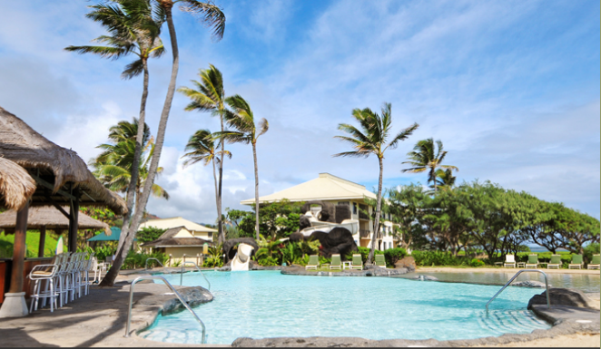
Kaua‘i Beach Resort
4331 Kauai Beach Drive
Lihue, HI 96766

Slide 4
Venue
Kaua‘i Beach Resort, Hawai‘i
  http://www.hawaiirevealed.com/resort-reviews/kauai-beach-resort/
  http://www.kauaibeachresorthawaii.com
Venue of three previous successful meetings:
  12-14 September 2007, 802.11 TGs &TGr Ad Hoc
  3-5 September 2008, 802.11 TGn, TGs, & TGu Ad Hoc
  10-13 January 2011, 802.1 Interim Meeting

Slide 5
Basic Data
Available Dates:
  Wednesday-Friday, 8-10 July 2015
Free shuttle from airport
Room Rate (excluding tax)
  $171 single/double
Registration rates (includes lunch & snacks):
  Early bird $395 until May 29, 2015
  Regular $475 until June 26, 2015
  At the door $565
  (Companion rate, lunch & snacks, $95)
Questions?
eastlake@pothole.com

Slide 6

Transport
Airport LIH, Service by: Alaskan, American, Delta, go!, Hawaiian, Island Air, United, US Airways, and West Jet.

Slide 7
More Data
Room Rate (excluding tax totaling 13.416%)
  $171 single/double, +$40 for additional adult, children under 17 in same room free.
  Rate applies for 4 days before and 4 days after meeting dates
  Includes
    Parking
    Wi-Fi throughout the resort
    24 hour fitness center
    DVD movie and PS3 game rentals
    Complimentary Beverage and 1-hour Polynesian show on Tuesdays 5pm-6pm
  There is a porterage charge of $7.29 if the hotel handles your baggage.

Slide 8

Kaua‘i Beach Resort, Hawai‘i
4331 Kauai Beach Drive
Lihue, HI 96766

