Slide 1
Autodetection with Signature Symbol
Date: 2015-05-11
Authors:

Slide 2
Outline
We propose a solution to the problem of classifying a packet as 11ax/11a/11n/11ac, which has previously been investigated in [1], [2]
Classification strategy:
  In 11ax packets, encode the symbol after L-SIG separately and insert a known, fixed sequence of bits into the symbol
  The sequence of bits is called the signature sequence and the symbol is called the signature symbol
  Decode the symbol after L-SIG. If the decoded bits match the signature sequence, declare 11ax packet. Otherwise, proceed with rotation checks as in the past
We explain the attractive features of the proposal and provide simulation results

Slide 3
Signature symbol based autodetection
Signature symbol
HE-SIG
Sym1
L-STF
L-LTF
L-SIG
BPSK
Signature symbol: one symbol, MCS 0, separately encoded (64 FFT, 0.8 us GI)
Bits going into encoder
  10-12 known, fixed bits: signature sequence (in general, S signature bits).
  6 tail bits
    These bits are also effectively known
    The number of tail bits can be reduced to 4 with slight reduction in performance or consider tail biting code
  6-8 information bits: for e.g., bandwidth, BSS Color, CP of SIG fields that follow (in general, 18-S information bits)
  Known bits can include a CRC to cover the LSIG bits and the 18-S bits
Classification rule
  Run Viterbi decoder on symbol after L-SIG: no change from today
  Trace back from all-zero state and return most likely bits
  If decoded bits, at appropriate locations, match the signature sequence, declare 11ax. Else, proceed with rotation checks to classify 11a/11n/11ac

Slide 4
Features
Signature symbol
HE-SIG
Sym1
L-STF
L-LTF
L-SIG
BPSK
Efficiency: Signature symbol conveys 18-S bits while doing autodetection.
Early autodetection: 11ax/not decision is made 1 symbol after L-SIG. Further, the 18-S information bits are available early in the packet
Minimal changes to architecture: Viterbi decoder already runs on symbol after L-SIG. Needs only one extra traceback
Classification in future standards made easy: pick a different signature sequence
False alarms: Go down exponentially (2^{-S}) with the number of bits S in the signature sequence. With S = 10, false alarm rate ~ 10⁻³ . False alarms can be decreased further by including a CRC in HE-SIG or by taking advantage of the 6 known tail bits

Slide 5
Simulation setup
Signature Symbol
L-STF
L-LTF
L-SIG
3 SIG symbols
11ax LTF
Payload
Signature symbol
  64 FFT, 0.8 us GI, MCS0, separately encoded
  10 signature bits
  8 information bits, 6 tail bits
11ax LTF & Payload
  Payload: 44 Bytes (3 symbols), 256 FFT, 3.2 uS GI , MCS 0
  11ax LTF: 1 symbol, 256 FFT, MCS 0
SIG symbols: to ensure that payload performance curves are accurate (enough pilots + phase tracking)
Channel estimation, timing, CFO estimation, phase tracking: all real. Phase noise added

Slide 6
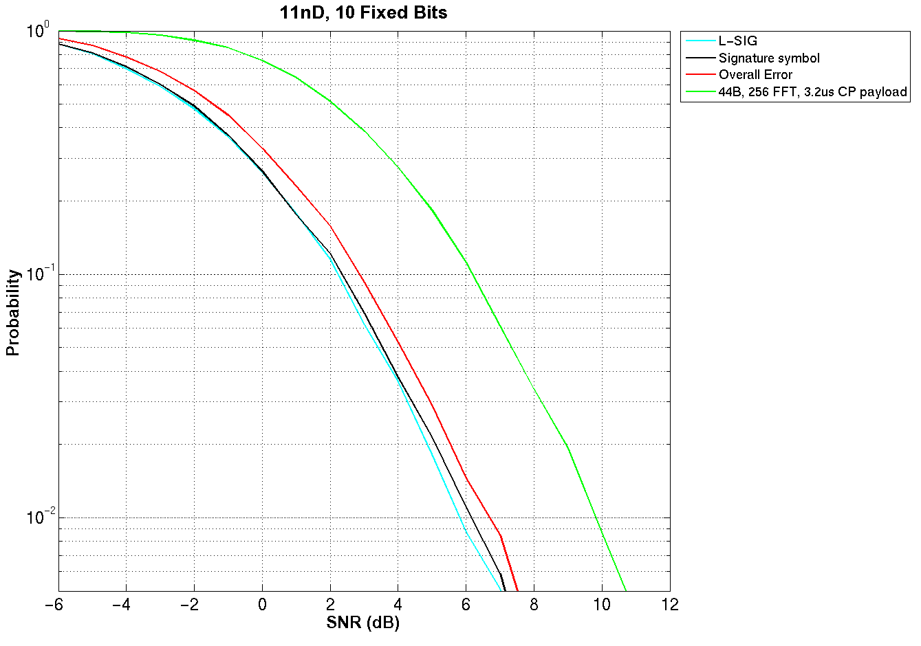
11nD
Overall error =
Error in decoding L-SIG
(or)
Error in decoding signature symbol
Probability of false alarm = 1e-3 (not shown)
Classification is not the bottleneck in decoding packets

Slide 7
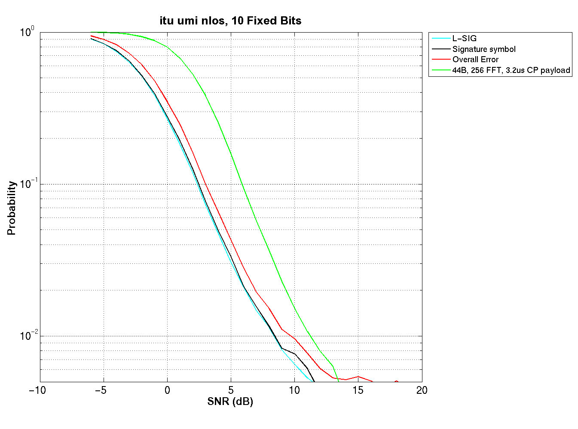
UMi-NLoS
Overall error =
Error in decoding L-SIG
(or)
Error in decoding signature symbol
Probability of false alarm = 1e-3 (not shown)
Classification is not the bottleneck in decoding packets

Slide 8
Conclusions
Proposed an autodetection scheme using a signature sequence in the symbol after L-SIG with many attractive features
  Efficient: Conveys about 8 information bits while classifying the packet
  Early decisions: In only 1 symbol after L-SIG, 11ax/not decision is made and information bits are conveyed
  Minimal changes to hardware architecture
  Simplifies classification in future standards

Slide 9
References
        [802.11-15/0360r1] Preamble Auto-Detection in 802.11ax
        [802.11-14/0081r1] Considerations on 11ax Auto-detection Methods

