Slide 1
Channel Sounding for 802.11ay
Date: 2015-05-12
Authors:

Slide 2
Abstract
In this presentation, we show the next options for 60 GHz channel sounding scenarios. For the next measurements we present 6 possible scenarios (living room, classroom/meeting, dinning hall, lecture hall, entrance hall, street canyon). We like to discuss the requirements of the measurement campaigns to make the results comparable and useful for channel modeling at 802.11ay.

Slide 3
Outline
Motivation
Proposed measurement scenarios
Measurement requirement
Conclusion

Slide 4
Motivation
ISM-band at 60 GHz
Free and wide bandwidth available (up to 7 GHz)
WLAN/WiGig (.11ad) and WPAN (.15.3.c)
Extension of IEEE 802.11ad regarding use cases and requirements/performance
Requires extensive channel measurement of new scenarios/use cases
Larger coverage, higher bandwidth, higher mobility/channel dynamic
Channel measurement should support advanced system concepts
MIMO/Beam-forming → large spatial bandwidth
Adaptive beam-forming /switching (to mitigate shadowing)
Channel bonding to have large bandwidth
…
Channel measurements requirements
Ultra wide bandwidth
Double directional measurements are needed to characterized the full channel
Polarization is an important aspect
High dynamic range are essential to measure the different propagation effects
…

Slide 5
Proposed measurement scenarios

Slide 6
List of Proposed Scenarios
Living room
HD entertainment centers, video games, etc
Small Room
Many Reflection
Class room / Meeting room scenario
Provide access to students / users with tablets, notebooks, electronic devices, etc.
Wireless office
Dinner Hall
Provide video distribution
Provide access to students / users with tablets, notebooks, electronic devices, etc
Entrance Hall
Provide access to a large number users
Modern buildings full of metal and glass
Lecture Hall
Provide access to a large number users
Provide access to users with tablets, notebooks, electronic devices, etc.
Street Canyon: Mobile Offloading and Fronthauling
Transmissions are mostly LOS. Distance between far corners of the room are <100m
Notes:
5G systems at mm-wave require SNR optimisation → and this will be only done with dual polarisation

Slide 7
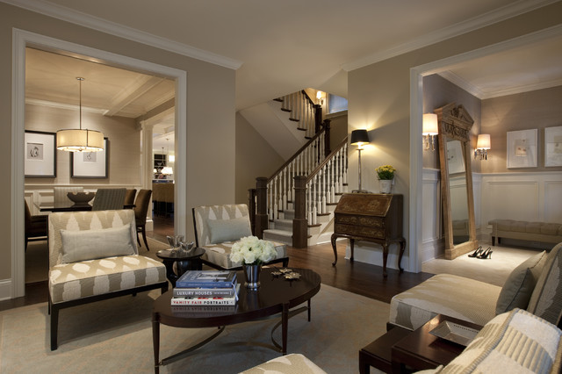
Living Room
Dimensions:
4m x 5m x 3m
Charateristics:
HD entertainment centers, video games, etc
Small Room
Many Reflection

Slide 8
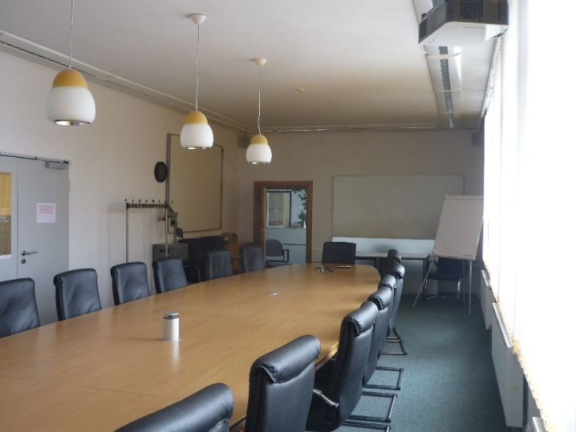
Class room / Meeting room scenario
Dimensions:
4m x 12m x 3m
Part disguised wood
Charateristics:
Provide access to students / users with tablets, notebooks, electronic devices, etc.
Wireless office

Slide 9
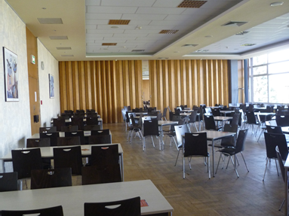
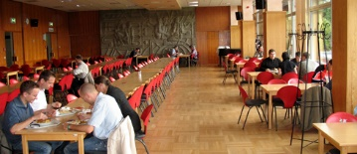
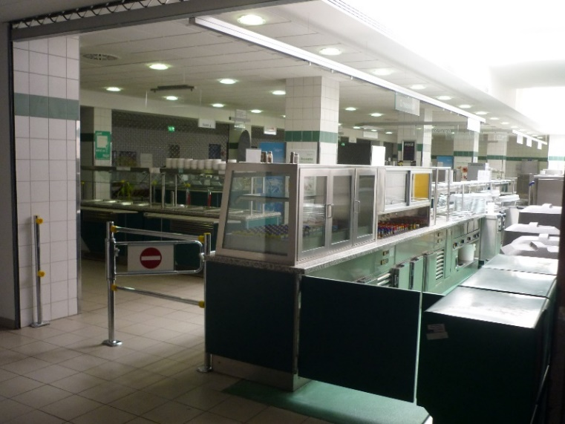
Dinning Hall
Dimensions:
9m x 20 m x 3m
Part disguised wood
Charateristics:
Provide video distribution
Provide access to students / users with tablets, notebooks, electronic devices, etc

Slide 10
Entrance Hall
Dimensions:
7 x 25m x 9m
Glass and metal
3 different floors
Charatersitics:
Provide access to a large number users
Modern buildings full of metal and glass

Slide 11
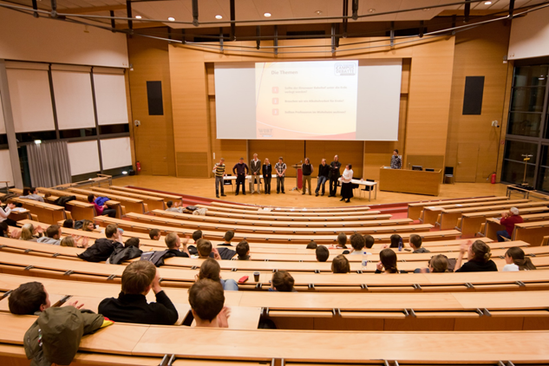
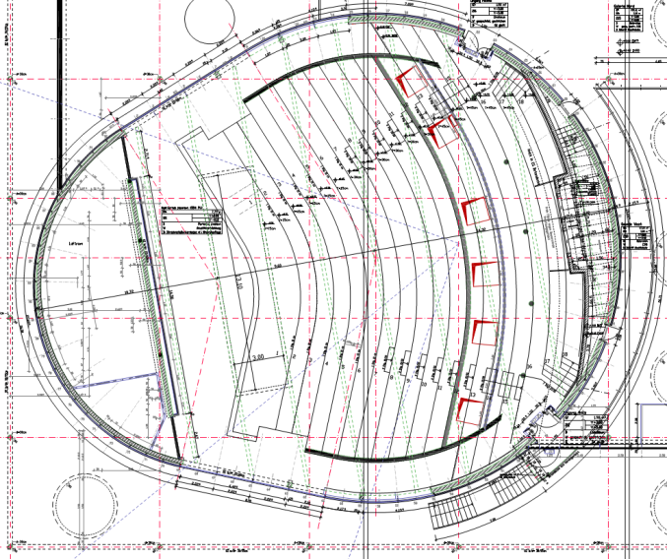
Lecture Hall
Dimensions:
22m x 36m x 7m
Chamfered
Part disguised wood
Charateristics:
Provide access to a large number users
Provide access to users with tablets, notebooks, electronic devices, etc.

Slide 12
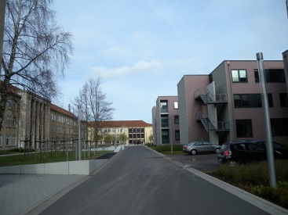
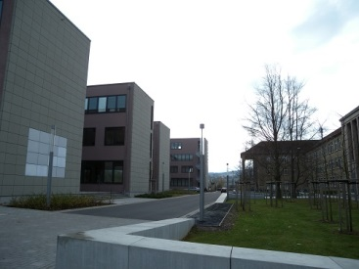
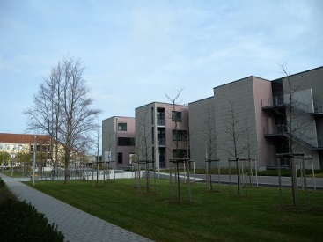
Street Canyon
Charateristics:
The height of the building is 13m-15m
Distances of more than 50 m possible
Transmissions are mostly LOS. Distance between far corners of the room are <100m

Slide 13
Mapping Use Cases and Scenarios
UC # | Indoor (I)/ Outdoor (O) | bne | Topology | Proposed Scenario's
 |  | LOS/ NLOS
1 Ultra Short Range (USR) Communications | I | <10cm | P2P
2 8K UHD Wireless Transfer at Smart Home | I | <5m | P2P
3 Augmented Reality and Virtual Reality | I | <10m | P2P | Living room
4 Data Center NG60 Inter-Rack Connectivity | I | <10m | P2P/P2MP
5 Video/Mass-Data Distribution/Video on Demand System | I | <100m | P2P/P2MP | Class room/ Meeting room; Dinning Hall; Lecture Hall; Entrance Hall;
6 Mobile Offloading and Multi-Band Operation (MBO) | I/O | <100m | P2P/P2MP | Street Canyon
7 Mobile Fronthauling | O | <200m | P2P/P2MP | Street Canyon
8 Wireless Backhauling with Single Hop | O | <1km | P2P/P2MP | Street Canyon
9 Wireless Backhauling with Multi-hop | O | <150m | P2P/P2MP | Street Canyon
*: Multi-hop will build up on the scope of the DMG Relay defined in IEEE 802.11ad

Slide 14
Challenges in mm-Wave Channel Sounding for 802.11ay
The analysis of mm-Wave propagation need more than “bandwidth”
3D analysis of indoor and outdoor scenarios
Full polarimetric propagation measurement
Analysis of time-variant scenarios
Multi–link channel analysis
Min. Bandwidth of 4 GHz for channel bonding at 802.11ay
Notes:
Multi–link channel analysis

Slide 15
Dual Polarimetric Ultra-Wideband Channel Sounder (DP-UMCS)
TX Module
PA min. 27 dBm
RX Module
Step
Attenuator
LNA
Gain : 40 dB
H Pol.
CH 1
UWB Sounder TX
0 – 3.5 GHz
3.5 GHz - 10.5 GHz
H Pol.
Switch
UWB Sounder RX
0 – 3.5 GHz
3.5 GHz - 10.5 GHz
56 - 66 GHz
56 - 66 GHz
V Pol.
Step
Attenuator
CH 2
LNA
Gain : 40 dB
V Pol.
PA min.
27 dBm
Multiplier
X8
Multiplier
X8
Optical link
7 GHz
Oscillator
Optical link
7 GHz BW up to 10 GHz measurable bandwidth
Maximum excess delay of 585 ns (175m) in CS version 1 and 4.7 µs (1410m) CS version 2
Dual polarization measurement capability
Compact Size → the complete system can be attached to the positioner
High instantaneous dynamic range: up to 75 dB
Multi-Link and Massive MIMO capabilities
Double directional measurements (with 1 TX and 2 RX) feasible

Slide 16
Measurement Setup of the DP-UMCS
H Pol.
mmWave
RX Module
CH 1
UWB Sounder RX
0 – 3.5 GHz
3.5 GHz - 10.5 GHz
UWB Sounder RX
0 – 3.5 GHz
3.5 GHz - 10.5 GHz
H Pol.
Control PC
mmWave
TX Module
CH 2
V Pol.
Control PC
V Pol.
Optical RX
Optical RX
H Pol.
mmWave
RX Module
CH 1
UWB Sounder RX
0 – 3.5 GHz
3.5 GHz - 10.5 GHz
Control PC
V Pol.
CH 2
Optical RX
Optical link
Optical link
7 GHz
Oscillator
and
Optical TX
Optical link
Controlling per Ethernet or Wlan

Slide 17
Conclusion/Discussion
We present 6 scenarios as options for different usage cases
Living room, classroom/meeting, dinning hall, lecture hall, entrance hall, street canyon
Which are useful scenarios for the 802.11ay group?
How many measurement points are required/meaningful? → measuring time
Which resolution for the azimuth and elevation scan?→ measuring time
Which range for the azimuth and elevation for the different scenarios are useful? → measuring time
We revise the current 60 GHz Channel Sounder
Measurement bandwidth of 7 GHz → analysis of channel bonding possible
The capability of MIMO measurements
End of 2015: A fast measurement CS system with the capability of 10000 CIR/s per RX channel → Doppler resolution of around 40 km/h
Notes:
5G systems at mm-wave require SNR optimisation → and this will be only done with dual polarisation

