Slide 1
Regarding trigger frame in UL MU
Date: 2015-05-10
Authors:

Slide 2
Abstract
This presentation questions what kind of info should be specified in the trigger frame for UL MU and what kind of info should be collected ahead at an AP.
It was considered that one of the useful info to be collected should be on STAs’ TX demands, and to collect this, a passive way at the AP was proposed.

Slide 3
A trigger frame for UL MU
On March, TGax approved to add the following to SFD [1]:
  x.y.z The spec shall define the following mode of operation:
  An UL MU PPDU (MU-MIMO or OFDMA) is sent as an immediate response (IFS TBD) to a Trigger frame (format TBD) sent by the AP.
But for an AP to send such a trigger frame, it needs to collect information in advance.
  Information depends on what will be specified in the trigger frame.
  Not to waste resource, at least it is better for the AP to figure out which STAs have TX data.

Slide 4
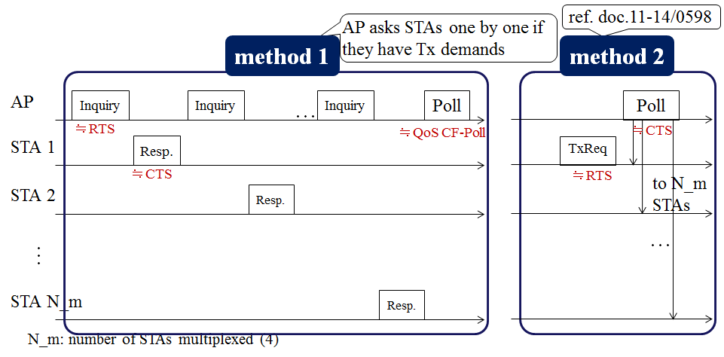
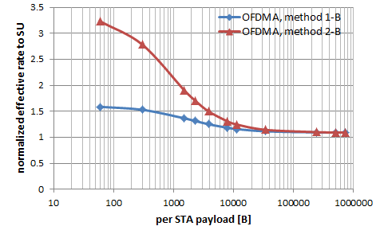
Recalling initial phase methods in [2]
It was shown in [2] that asking STAs one by one to find out their TX demands gives large overhead and a need of a more rough way to grasp or estimate STAs’ TX demands was suggested.

Slide 5
Approach to gathering TX demands
Even if an inquiring sequence is immediately before the trigger frame, lifetime may expire for some of the frames and it cannot be always accurate.
Then a rough estimate may be useful.
AP
Inquiry
Inquiry
Inquiry
Inquiry
trigger
multi-STA BA/ACK
STA 1
lifetime expires
UL MU
Resp.
(YES!)
NO…
STA 2
Resp.
(YES!)
STA 3
Resp.
(YES!)
STA 4
Resp.
(YES!)

Slide 6
When a STA has data to transmit…
It will try to access the medium by itself, anyway.
If the STA is able to transmit a frame, the frame can be used to notify the AP of other remaining data in its queues.
– STA-oriented notification
The idea is something similar to the use of a More Data field.

Slide 7
Outline of STA-oriented notification
STA 1 to AP
STA 3 to AP
Data
BA/ACK
Data
BA/ACK
…
…
same from STA 4 and 6
data
data
notification of remaining data
in MAC header
notification of remaining data
in MAC header
collected by AP
AP recognizes STAs 1, 3, 4, and 6 have MSDUs to transmit*
AP sends the trigger frame to STAs 1, 3, 4, and 6
* may also need to consider group IDs for selecting STAs

Slide 8
“More Data” field level enough?
The More Data field is only 1 bit length.
If the proposed field is just the same with the More Data field, then notification will be limited very simple.
  1: Yes, I have remaining data.
  0: No, I don’t have remaining data.
If there are other kinds of information needed to be collected to generate the trigger frame, the concept may be extended to collect those, too.

Slide 9
What should be specified in trigger frame?
Parameters on
  target STAs (partial MAC Address? AID? Group ID?)
  resource allocation (in space/frequency)
  PPDU duration? (maximum?)
    To be able to specify PPDU duration at the AP, the AP may want parameters such as amount of buffered data from STAs beforehand.
  access category?
    802.11ac has a loose restriction (“primary AC”) for DL-MU-MIMO.

Slide 10
Summary
The trigger frame should specify necessary info to have STAs start UL MU TX.
AP needs to collect info to generate such specifying info, so the specifying info in the trigger frame was questioned.
Info on STAs’ TX demands is suggested to be at least one of those collected and STA-oriented way of notification was considered.
  TX demand shown in a field something like a More Data field.

Slide 11
References
[1] 802.11-15/0365r0 “UL MU procedure for 11ax system”
[2] 802.11-15/0064r1 “Consideration on UL-MU overheads”

Slide 12
Straw Poll 1
What kind of information should be specified in a trigger frame?
  target STAs (TBD, could be MAC address/AID/Group ID)
  Y:N:A=
  (no objections)

Slide 13
Straw Poll 2
What kind of information should be specified in a trigger frame?
  resource allocation per STA (also vote yes if you think it will be addressed by Group ID)
  Y:N:A=
  (no objections)

Slide 14
Straw Poll 3
What kind of information should be specified in a trigger frame?
  PPDU duration (TBD, may be exact or maximum)
  Y:N:A=
  (no objections)

Slide 15
Straw Poll 4
What kind of information should be specified in a trigger frame?
  access category
  Y:N:A=5:17:many

Slide 16
Straw Poll 5
For an AP to send the trigger frame for UL MU TX, do you think it is useful if a STA is able to notify the AP of its TX demand by a field something like a More Data field in a frame sent from its side?
  Y:N:A=
  (no objections)

