Slide 1
Non-Uniform Constellations for 1024-QAM
Date: 2015/05/11
Authors:

Slide 2
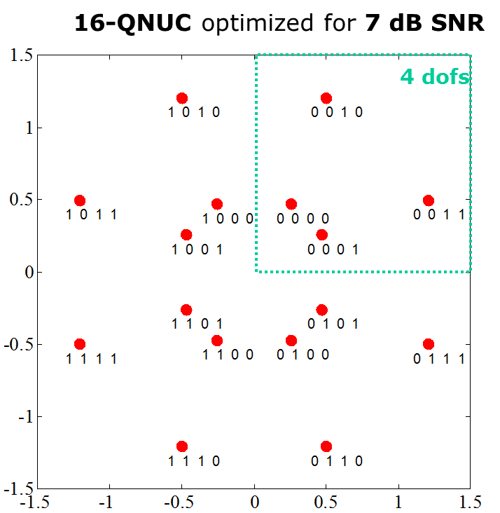
Motivation
1024-QAM discussed as potential technology for ax to increase peak data rate (indoor and in-room), e.g. [1,2]
  25% increase in spectral efficiency compared to 256-QAM
  1Gbit/s with 1 spatial stream (160MHz, code rate 5/6, short GI)
Non-uniform constellations (NUCs) show increased performance compared to uniform constellations (UCs) [2]
  Especially for higher order QAMs
  1024-QAM:
    gain up to 0.7dB for 1D NUC
    gain up to 0.9dB for 2D NUC
  Moderate (2D) or no (1D) increase
  in demapper complexity
1-D NUC: 16-QAM
2-D NUC: 16-QAM

Slide 3
Outline
Details on the proposed NUCs for 1024-QAM
Performance Results
  AWGN channel with and without phase noise

Slide 4
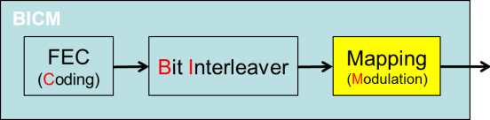
Proposed NUCs for 1024-QAM
1-dimenionsal (1D) NUCs
  Good trade-off between performance gain and demapper complexity [2]
  Demapper has basically the same complexity as for uniform constellations
Different NUCs for each code rate
  Optimized for operating point of FEC with specific code rate
Optimized bit labeling
  Matches optimally to existing .11 WLAN system
    No changes at FEC or other blocks required
    No need for a dedicated bit interleaver

Slide 5








Proposed NUCs for 1024-QAM
$${−u}_{15}$$
$$u_{15}$$
Figure shows example
for code rate 2/3
I/Q symmetry
pos. / neg. symmetry
NUC defined by
amplitudes $u_{1},…,u_{15}$
($u_{0}=1$ assumed)
Details on amplitudes
and bit labeling see
Appendix
$$u_{15}$$
$$u_{0}=1$$
$${−u}_{0}$$
$${−u}_{1}$$
$${−u}_{15}$$

Slide 6
Simulations: Parameters
Regular UC and NUC
1024-QAM
FEC: LDPC
Message Length: 1000bytes
Channel: AWGN
RF impairments: with and without phase noise
  Phase noise model according to evaluation methodology [3]
Gain compared to UC evaluated at FER=10⁻²
1D and 2D NUC
modulation | bit/symbol | coderate
1024-QAM | 10 | 2/3
1024-QAM | 10 | 3/4
1024-QAM | 10 | 5/6

Slide 7
Simulations: Results
Influence of phase noise
NUCs have similar degradation as UC under phase noise influence

Slide 8
Simulations: Results
Influence of phase noise
NUC gain is independent on phase noise

Slide 9
Conclusions
Investigation of non-uniform constellations (NUCs) for 1024-QAM
  1-dimensional NUCs
    Up to 0.6dB gain compared to uniform constellation
  2-dimensional NUCs
    Up to 0.9dB gain compared to uniform constellation
Simulations in the presence of phase noise
  NUC gain is maintained
Basically same complexity as uniform constellations
(1D NUC)

Slide 10
References
11-14-0624-00-00ax Investigation on 1024 QAM feasibility in 11ax
11-15-0048-00-00ax Non-uniform Constellations for higher Order QAMs
11-09-0451-15-00ac-tgac Functional requirements and evaluation methodology

Slide 11
APPENDIX

Slide 12
NUC: 1-D vs 2D
1-D NUC: 16-QAM
1-D NUC
  I/Q symmetry
  1-D demapping as for uniform
  constellations (UC), i.e. same order
  of demapping complexity
2-D NUC
  Symmetric quadrants
  Higher gain compared to 1-D NUC
  2-D demapping required
2-D NUC: 16-QAM

Slide 13
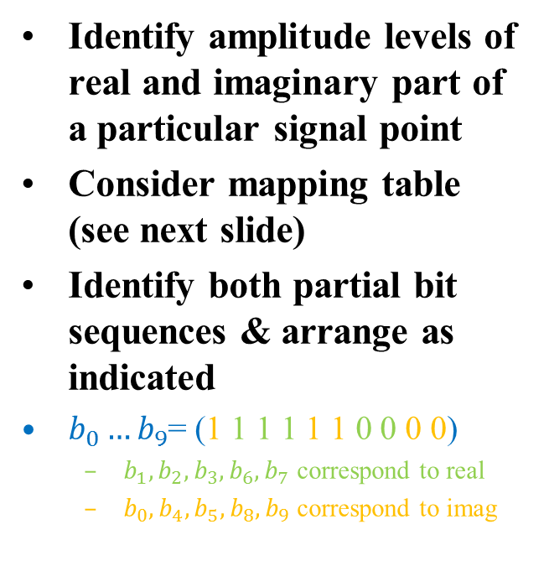



Example: How to get the bit labeling
$b_{0}…b_{9}$= (1 1 1 1 1 1 0 0 0 0)
Real part: ${−u}_{2}$
Identify amplitude levels of real and imaginary part of a particular signal point
Consider mapping table (see next slide)
Identify both partial bit sequences & arrange as indicated
$b_{0}…b_{9}$= (1 1 1 1 1 1 0 0 0 0)
  $b_{1},b_{2},b_{3},b_{6},b_{7}$ correspond to real
  $b_{0},b_{4},b_{5},b_{8},b_{9}$ correspond to imag
Imag.
part: $u_{13}$

Slide 14
Example: How to get the bit labeling (cont.)
b1 b2 b3 b6 b7 | 0 0 0 0 0 | 1 0 0 0 0 | 1 0 1 0 0 | 0 0 1 0 0 | 0 0 1 0 1 | 1 0 1 0 1 | 1 0 0 0 1 | 0 0 0 0 1 | 0 1 0 0 1 | 1 1 0 0 1 | 1 1 1 0 1 | 0 1 1 0 1 | 0 1 1 0 0 | 1 1 1 0 0 | 1 1 0 0 0 | 0 1 0 0 0
Re(zq) | -31 | -29 | -27 | -25 | -23 | -21 | -19 | -17 | -15 | -13 | -11 | -9 | -7 | -5 | -3 | -1 | Uniform
 | ‑u₁₅ | ‑u₁₄ | ‑u₁₃ | ‑u₁₂ | ‑u₁₁ | ‑u₁₀ | ‑u₉ | ‑u₈ | ‑u₇ | ‑u₆ | ‑u₅ | ‑u₄ | ‑u₃ | ‑u₂ | ‑u₁ | -1 | NUC
b1 b2 b3 b6 b7 | 0 1 0 1 0 | 1 1 0 1 0 | 1 1 1 1 0 | 0 1 1 1 0 | 0 1 1 1 1 | 1 1 1 1 1 | 1 1 0 1 1 | 0 1 0 1 1 | 0 0 0 1 1 | 1 0 0 1 1 | 1 0 1 1 1 | 0 0 1 1 1 | 0 0 1 1 0 | 1 0 1 1 0 | 1 0 0 1 0 | 0 0 0 1 0
Re(zq) | 1 | 3 | 5 | 7 | 9 | 11 | 13 | 15 | 17 | 19 | 21 | 23 | 25 | 27 | 29 | 31 | Uniform
 | 1 | u₁ | u₂ | u₃ | u₄ | u₅ | u₆ | u₇ | u₈ | u₉ | u₁₀ | u₁₁ | u₁₂ | u₁₃ | u₁₄ | u₁₅ | NUC
real part
b0 b4 b5 b8 b9 | 0 0 0 0 0 | 1 0 0 0 0 | 1 1 0 0 0 | 0 1 0 0 0 | 0 1 0 1 0 | 1 1 0 1 0 | 1 0 0 1 0 | 0 0 0 1 0 | 0 0 0 1 1 | 1 0 0 1 1 | 1 1 0 1 1 | 0 1 0 1 1 | 0 1 0 0 1 | 1 1 0 0 1 | 1 0 0 0 1 | 0 0 0 0 1
Im(zq) | -31 | -29 | -27 | -25 | -23 | -21 | -19 | -17 | -15 | -13 | -11 | -9 | -7 | -5 | -3 | -1 | Uniform
 | ‑u₁₅ | ‑u₁₄ | ‑u₁₃ | ‑u₁₂ | ‑u₁₁ | ‑u₁₀ | ‑u₉ | ‑u₈ | ‑u₇ | ‑u₆ | ‑u₅ | ‑u₄ | ‑u₃ | ‑u₂ | ‑u₁ | -1 | NUC
b0 b4 b5 b8 b9 | 0 0 1 0 1 | 1 0 1 0 1 | 1 1 1 0 1 | 0 1 1 0 1 | 0 1 1 1 1 | 1 1 1 1 1 | 1 0 1 1 1 | 0 0 1 1 1 | 0 0 1 1 0 | 1 0 1 1 0 | 1 1 1 1 0 | 0 1 1 1 0 | 0 1 1 0 0 | 1 1 1 0 0 | 1 0 1 0 0 | 0 0 1 0 0
Im(zq) | 1 | 3 | 5 | 7 | 9 | 11 | 13 | 15 | 17 | 19 | 21 | 23 | 25 | 27 | 29 | 31 | Uniform
 | 1 | u₁ | u₂ | u₃ | u₄ | u₅ | u₆ | u₇ | u₈ | u₉ | u₁₀ | u₁₁ | u₁₂ | u₁₃ | u₁₄ | u₁₅ | NUC
imaginary part

Slide 15
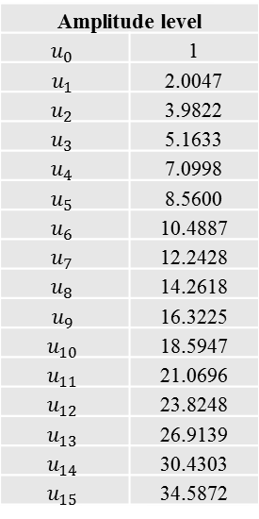
NUC for code rate 2/3
b1 b2 b3 b6 b7 | 0 0 0 0 0 | 1 0 0 0 0 | 1 0 1 0 0 | 0 0 1 0 0 | 0 0 1 0 1 | 1 0 1 0 1 | 1 0 0 0 1 | 0 0 0 0 1 | 0 1 0 0 1 | 1 1 0 0 1 | 1 1 1 0 1 | 0 1 1 0 1 | 0 1 1 0 0 | 1 1 1 0 0 | 1 1 0 0 0 | 0 1 0 0 0
Re(zq) | -31 | -29 | -27 | -25 | -23 | -21 | -19 | -17 | -15 | -13 | -11 | -9 | -7 | -5 | -3 | -1 | Uniform
 | ‑u₁₅ | ‑u₁₄ | ‑u₁₃ | ‑u₁₂ | ‑u₁₁ | ‑u₁₀ | ‑u₉ | ‑u₈ | ‑u₇ | ‑u₆ | ‑u₅ | ‑u₄ | ‑u₃ | ‑u₂ | ‑u₁ | -1 | NUC
b1 b2 b3 b6 b7 | 0 1 0 1 0 | 1 1 0 1 0 | 1 1 1 1 0 | 0 1 1 1 0 | 0 1 1 1 1 | 1 1 1 1 1 | 1 1 0 1 1 | 0 1 0 1 1 | 0 0 0 1 1 | 1 0 0 1 1 | 1 0 1 1 1 | 0 0 1 1 1 | 0 0 1 1 0 | 1 0 1 1 0 | 1 0 0 1 0 | 0 0 0 1 0
Re(zq) | 1 | 3 | 5 | 7 | 9 | 11 | 13 | 15 | 17 | 19 | 21 | 23 | 25 | 27 | 29 | 31 | Uniform
 | 1 | u₁ | u₂ | u₃ | u₄ | u₅ | u₆ | u₇ | u₈ | u₉ | u₁₀ | u₁₁ | u₁₂ | u₁₃ | u₁₄ | u₁₅ | NUC
Amplitude level
$$u_{0}$$ | 1
$$u_{1}$$ | 2.0047
$$u_{2}$$ | 3.9822
$$u_{3}$$ | 5.1633
$$u_{4}$$ | 7.0998
$$u_{5}$$ | 8.5600
$$u_{6}$$ | 10.4887
$$u_{7}$$ | 12.2428
$$u_{8}$$ | 14.2618
$$u_{9}$$ | 16.3225
$$u_{10}$$ | 18.5947
$$u_{11}$$ | 21.0696
$$u_{12}$$ | 23.8248
$$u_{13}$$ | 26.9139
$$u_{14}$$ | 30.4303
$$u_{15}$$ | 34.5872
real part
b0 b4 b5 b8 b9 | 0 0 0 0 0 | 1 0 0 0 0 | 1 1 0 0 0 | 0 1 0 0 0 | 0 1 0 1 0 | 1 1 0 1 0 | 1 0 0 1 0 | 0 0 0 1 0 | 0 0 0 1 1 | 1 0 0 1 1 | 1 1 0 1 1 | 0 1 0 1 1 | 0 1 0 0 1 | 1 1 0 0 1 | 1 0 0 0 1 | 0 0 0 0 1
Im(zq) | -31 | -29 | -27 | -25 | -23 | -21 | -19 | -17 | -15 | -13 | -11 | -9 | -7 | -5 | -3 | -1 | Uniform
 | ‑u₁₅ | ‑u₁₄ | ‑u₁₃ | ‑u₁₂ | ‑u₁₁ | ‑u₁₀ | ‑u₉ | ‑u₈ | ‑u₇ | ‑u₆ | ‑u₅ | ‑u₄ | ‑u₃ | ‑u₂ | ‑u₁ | -1 | NUC
b0 b4 b5 b8 b9 | 0 0 1 0 1 | 1 0 1 0 1 | 1 1 1 0 1 | 0 1 1 0 1 | 0 1 1 1 1 | 1 1 1 1 1 | 1 0 1 1 1 | 0 0 1 1 1 | 0 0 1 1 0 | 1 0 1 1 0 | 1 1 1 1 0 | 0 1 1 1 0 | 0 1 1 0 0 | 1 1 1 0 0 | 1 0 1 0 0 | 0 0 1 0 0
Im(zq) | 1 | 3 | 5 | 7 | 9 | 11 | 13 | 15 | 17 | 19 | 21 | 23 | 25 | 27 | 29 | 31 | Uniform
 | 1 | u₁ | u₂ | u₃ | u₄ | u₅ | u₆ | u₇ | u₈ | u₉ | u₁₀ | u₁₁ | u₁₂ | u₁₃ | u₁₄ | u₁₅ | NUC
imaginary part

Slide 16
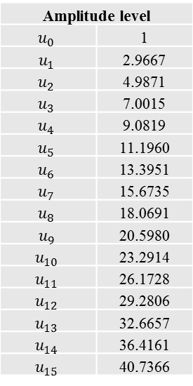
NUC for code rate 3/4
b3 b4 b5 b8 b9 | 0 0 0 0 0 | 1 0 0 0 0 | 1 0 1 0 0 | 0 0 1 0 0 | 0 1 1 0 0 | 1 1 1 0 0 | 1 1 0 0 0 | 0 1 0 0 0 | 0 1 0 0 1 | 1 1 0 0 1 | 1 1 1 0 1 | 0 1 1 0 1 | 0 0 1 0 1 | 1 0 1 0 1 | 1 0 0 0 1 | 0 0 0 0 1
Re(zq) | -31 | -29 | -27 | -25 | -23 | -21 | -19 | -17 | -15 | -13 | -11 | -9 | -7 | -5 | -3 | -1 | Uniform
 | ‑u₁₅ | ‑u₁₄ | ‑u₁₃ | ‑u₁₂ | ‑u₁₁ | ‑u₁₀ | ‑u₉ | ‑u₈ | ‑u₇ | ‑u₆ | ‑u₅ | ‑u₄ | ‑u₃ | ‑u₂ | ‑u₁ | -1 | NUC
b3 b4 b5 b8 b9 | 0 0 0 1 1 | 1 0 0 1 1 | 1 0 1 1 1 | 0 0 1 1 1 | 0 1 1 1 1 | 1 1 1 1 1 | 1 1 0 1 1 | 0 1 0 1 1 | 0 1 0 1 0 | 1 1 0 1 0 | 1 1 1 1 0 | 0 1 1 1 0 | 0 0 1 1 0 | 1 0 1 1 0 | 1 0 0 1 0 | 0 0 0 1 0
Re(zq) | 1 | 3 | 5 | 7 | 9 | 11 | 13 | 15 | 17 | 19 | 21 | 23 | 25 | 27 | 29 | 31 | Uniform
 | 1 | u₁ | u₂ | u₃ | u₄ | u₅ | u₆ | u₇ | u₈ | u₉ | u₁₀ | u₁₁ | u₁₂ | u₁₃ | u₁₄ | u₁₅ | NUC
Amplitude level
$$u_{0}$$ | 1
$$u_{1}$$ | 2.9667
$$u_{2}$$ | 4.9871
$$u_{3}$$ | 7.0015
$$u_{4}$$ | 9.0819
$$u_{5}$$ | 11.1960
$$u_{6}$$ | 13.3951
$$u_{7}$$ | 15.6735
$$u_{8}$$ | 18.0691
$$u_{9}$$ | 20.5980
$$u_{10}$$ | 23.2914
$$u_{11}$$ | 26.1728
$$u_{12}$$ | 29.2806
$$u_{13}$$ | 32.6657
$$u_{14}$$ | 36.4161
$$u_{15}$$ | 40.7366
real part
b0 b1 b2 b6 b7 | 0 0 0 0 0 | 1 0 0 0 0 | 1 0 1 0 0 | 0 0 1 0 0 | 0 1 1 0 0 | 1 1 1 0 0 | 1 1 0 0 0 | 0 1 0 0 0 | 0 1 0 1 0 | 1 1 0 1 0 | 1 1 1 1 0 | 0 1 1 1 0 | 0 0 1 1 0 | 1 0 1 1 0 | 1 0 0 1 0 | 0 0 0 1 0
Im(zq) | -31 | -29 | -27 | -25 | -23 | -21 | -19 | -17 | -15 | -13 | -11 | -9 | -7 | -5 | -3 | -1 | Uniform
 | ‑u₁₅ | ‑u₁₄ | ‑u₁₃ | ‑u₁₂ | ‑u₁₁ | ‑u₁₀ | ‑u₉ | ‑u₈ | ‑u₇ | ‑u₆ | ‑u₅ | ‑u₄ | ‑u₃ | ‑u₂ | ‑u₁ | -1 | NUC
b0 b1 b2 b6 b7 | 0 0 0 1 1 | 1 0 0 1 1 | 1 0 1 1 1 | 0 0 1 1 1 | 0 1 1 1 1 | 1 1 1 1 1 | 1 1 0 1 1 | 0 1 0 1 1 | 0 1 0 0 1 | 1 1 0 0 1 | 1 1 1 0 1 | 0 1 1 0 1 | 0 0 1 0 1 | 1 0 1 0 1 | 1 0 0 0 1 | 0 0 0 0 1
Im(zq) | 1 | 3 | 5 | 7 | 9 | 11 | 13 | 15 | 17 | 19 | 21 | 23 | 25 | 27 | 29 | 31 | Uniform
 | 1 | u₁ | u₂ | u₃ | u₄ | u₅ | u₆ | u₇ | u₈ | u₉ | u₁₀ | u₁₁ | u₁₂ | u₁₃ | u₁₄ | u₁₅ | NUC
imaginary part

Slide 17
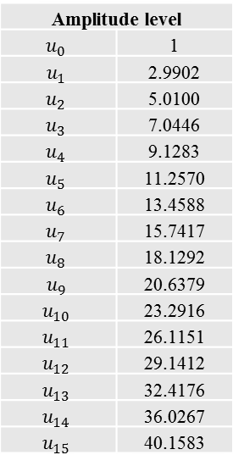
NUC for code rate 5/6
b0 b3 b5 b7 b8 | 0 0 0 0 0 | 1 0 0 0 0 | 1 0 1 0 0 | 0 0 1 0 0 | 0 0 1 0 1 | 1 0 1 0 1 | 1 0 0 0 1 | 0 0 0 0 1 | 0 1 0 0 1 | 1 1 0 0 1 | 1 1 1 0 1 | 0 1 1 0 1 | 0 1 1 0 0 | 1 1 1 0 0 | 1 1 0 0 0 | 0 1 0 0 0
Re(zq) | -31 | -29 | -27 | -25 | -23 | -21 | -19 | -17 | -15 | -13 | -11 | -9 | -7 | -5 | -3 | -1 | Uniform
 | ‑u₁₅ | ‑u₁₄ | ‑u₁₃ | ‑u₁₂ | ‑u₁₁ | ‑u₁₀ | ‑u₉ | ‑u₈ | ‑u₇ | ‑u₆ | ‑u₅ | ‑u₄ | ‑u₃ | ‑u₂ | ‑u₁ | -1 | NUC
b0 b3 b5 b7 b8 | 0 1 0 1 0 | 1 1 0 1 0 | 1 1 1 1 0 | 0 1 1 1 0 | 0 1 1 1 1 | 1 1 1 1 1 | 1 1 0 1 1 | 0 1 0 1 1 | 0 0 0 1 1 | 1 0 0 1 1 | 1 0 1 1 1 | 0 0 1 1 1 | 0 0 1 1 0 | 1 0 1 1 0 | 1 0 0 1 0 | 0 0 0 1 0
Re(zq) | 1 | 3 | 5 | 7 | 9 | 11 | 13 | 15 | 17 | 19 | 21 | 23 | 25 | 27 | 29 | 31 | Uniform
 | 1 | u₁ | u₂ | u₃ | u₄ | u₅ | u₆ | u₇ | u₈ | u₉ | u₁₀ | u₁₁ | u₁₂ | u₁₃ | u₁₄ | u₁₅ | NUC
Amplitude level
$$u_{0}$$ | 1
$$u_{1}$$ | 2.9902
$$u_{2}$$ | 5.0100
$$u_{3}$$ | 7.0446
$$u_{4}$$ | 9.1283
$$u_{5}$$ | 11.2570
$$u_{6}$$ | 13.4588
$$u_{7}$$ | 15.7417
$$u_{8}$$ | 18.1292
$$u_{9}$$ | 20.6379
$$u_{10}$$ | 23.2916
$$u_{11}$$ | 26.1151
$$u_{12}$$ | 29.1412
$$u_{13}$$ | 32.4176
$$u_{14}$$ | 36.0267
$$u_{15}$$ | 40.1583
real part
b1 b2 b4 b6 b9 | 0 0 0 0 0 | 0 0 0 0 1 | 0 0 0 1 1 | 0 0 0 1 0 | 0 1 0 1 0 | 0 1 0 1 1 | 0 1 0 0 1 | 0 1 0 0 0 | 1 1 0 0 0 | 1 1 0 0 1 | 1 1 0 1 1 | 1 1 0 1 0 | 1 0 0 1 0 | 1 0 0 1 1 | 1 0 0 0 1 | 1 0 0 0 0
Im(zq) | -31 | -29 | -27 | -25 | -23 | -21 | -19 | -17 | -15 | -13 | -11 | -9 | -7 | -5 | -3 | -1 | Uniform
 | ‑u₁₅ | ‑u₁₄ | ‑u₁₃ | ‑u₁₂ | ‑u₁₁ | ‑u₁₀ | ‑u₉ | ‑u₈ | ‑u₇ | ‑u₆ | ‑u₅ | ‑u₄ | ‑u₃ | ‑u₂ | ‑u₁ | -1 | NUC
b1 b2 b4 b6 b9 | 1 0 1 0 0 | 1 0 1 0 1 | 1 0 1 1 1 | 1 0 1 1 0 | 1 1 1 1 0 | 1 1 1 1 1 | 1 1 1 0 1 | 1 1 1 0 0 | 0 1 1 0 0 | 0 1 1 0 1 | 0 1 1 1 1 | 0 1 1 1 0 | 0 0 1 1 0 | 0 0 1 1 1 | 0 0 1 0 1 | 0 0 1 0 0
Im(zq) | 1 | 3 | 5 | 7 | 9 | 11 | 13 | 15 | 17 | 19 | 21 | 23 | 25 | 27 | 29 | 31 | Uniform
 | 1 | u₁ | u₂ | u₃ | u₄ | u₅ | u₆ | u₇ | u₈ | u₉ | u₁₀ | u₁₁ | u₁₂ | u₁₃ | u₁₄ | u₁₅ | NUC
imaginary part

