Slide 1
Discussion on The Receiver Behavior for DSC/CCAC with BSS Color
Date: 2015-05-11
Authors:

Slide 2
Abstract
DSC/CCAC is proposed as the promising technique to gain system throughput in OBSS scenario. Two types of threshold controls have been mainly discussed in TGax.
  DSC/CCA control with BSS color for 11ax frame
  Rx sensitivity control
As suggested in [1-3], we think it is good idea to use the BSS color scheme originally discussed in 802.11ah.
Since the use of BSS color in 802.11ax will be different from the 802.11ah, we think the rules of BSS color should be re-defined for spatial reuse.
This document discusses the receiver behavior of DSC/CCAC with BSS color and simulation results of simple residential scenario.

Slide 3
The receiver behavior with BSS color for
Assuming that BSS color is contained in somewhere in preamble part,
STA/APs start the following receive process when they detect legacy preamble.
  Step 0: make sure that the frame is 11ax format.
  Step 1: Then evaluate whether BSS color contained in the preamble matches with the color of the BSS which the receiver is associated.
  Step 2-1: If matched, continue decoding.
  Step 2-2: If not matched, the receiver stops receiving process and wait for the next signal no matter what the channel status (BUSY/IDLE) is.
The case studies are shown in the next slides.

Slide 4
Case study: NOT terminate decoding
Source STA of BSS1
hidden
Source STA of BSS2
CCA-SD < RSSI
Destination STA of BSS1
Data
Source of BSS1
IDLE
11ax Data (BSS1)
Destination of BSS1
← NOT terminate decoding since RSSI > CCA-SD
Cannot lock onto desired frame
Source of BSS2
11ax Data (BSS2)

Slide 5
Case study: Terminate decoding
Source STA of BSS1
hidden
Source STA of BSS2
Destination STA of BSS1
CCA-SD < RSSI
Data
Source of BSS1
IDLE
11ax Data (BSS1)
Destination of BSS1
Terminate decoding even though channel status is BUSY because of BSS color mismatch.
Lock onto desired frame !
(if SINR is enouth)
Source of BSS2
11ax Data (BSS2)

Slide 6

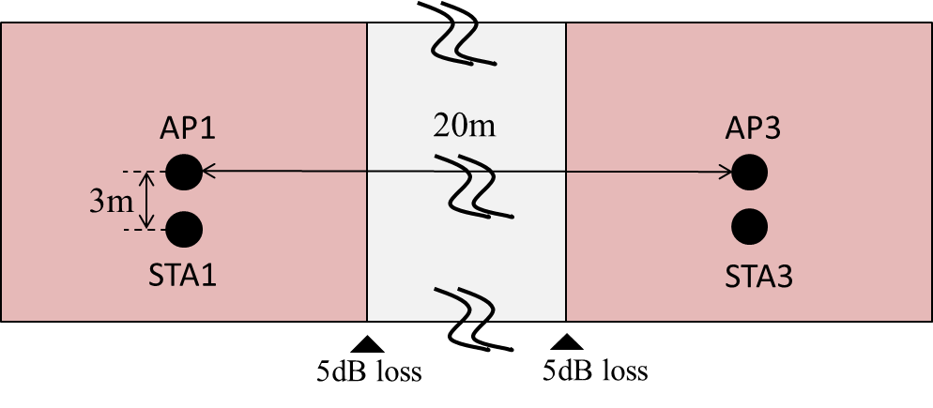
Simulation
The efficient of termination is examined by simulation.
  Simple scenario with 2 BSSs in residential scenario
  Traffic is downlink only
Floor layout of residential scenario
10m
10m
RSSI of each link (dBm)
Receiver
 | AP1 | STA1 | AP3 | STA3
AP1 | - | -38.34 | -71.85 | -74.02
STA1 | -43.34 | - | -79.02 | -80.85
AP3 | -71.85 | -74.02 | - | -38.34
STA3 | -79.02 | -80.85 | -43.34 | -
Transmitter

Slide 7
PHY parameters
BW | All BSSs at 5GHz [80 MHz, no dynamic bandwidth]
Channel model | TGac D NLOS per link
Shadow fading | No fading
Data Preamble Type | [5GHz, 11ac], duration is considered.
STA TX Power | 15 dBm per antenna
AP TX Power | 20 dBm per antenna
AP number of TX/RX antennas | 1/1
STA number of TX/RX antennas | 1/1
AP antenna gain | 0 dBi
STA antenna gain | -2 dBi
Noise Figure | 7dB
CCA-SD threshold | default value is -76dBm/80MHz
CCA-ED (for any signal) threshold | -56dBm/80MHz
Rx sensitivity | -76dBm/80MHz (a packet with lower rx power is dropped)
Link Adaption | Fixed MCS =7
PHY abstraction | RBIR, BCC
Channel correlation | Same as defined in the used channel model

Slide 8
MAC parameters
Access protocol | [EDCA, AC_BE with default parameters] [CWmin = 15, CWmax = 1023, AIFSn=3 ]
Queue length | A single queue for each traffic link is set inside AP/STA sized of 2000 packets
Traffic type | Full Buffer
MPDU size | 1540 Bytes (1472 Data + 28 IP header + 40 MAC header)
Aggregation | [A-MPDU / max aggregation size / BA window size, No A-MSDU, with immediate BA], Max aggregation: 64 MPDUs with 4-byte MPDU delimiter
Max number of retries | 10
Beacon | Disabled
RTS/CTS | OFF
Traffic direction | DL only
Throughput metric | Histogram of per non-AP STA throughput (received bits/overall simulation time)
Simulation run time: 10sec
Simulation run number: 50times
Controlled CCA level when BSS color does not match: RSSI from destination - 15dB

Slide 9
Simulation results (1)
The results of average throughput and data send (all data packets transmitted by AP, including the re-transmission)
Mbit/s
(just for reference)
“Conventional” method does not use BSS color and uses only default CCA value
If Not terminate decoding when BSS color is not matched and channel status is BUSY, the asynchronous interference causes the frame collision and decrease throughput.
If terminate decoding, transmission opportunity and throughput become about double compared to conventional method.

Slide 10
Simulation results (2)
CDF of throughput in one BSS
The above figure shows that the variance of “Not terminate decoding” is larger than conventional method
5%tile of throughput of “Not termination decoding” degraded compared to conventional method even if the average value is similar

Slide 11
Summary
DSC/CCAC technique has big potential to improve the throughput in OBSS environment
In order to take advantage of DSC/CCAC technique, it is important to define the behavior of a receiver.
One of the point is termination of receive process when the BSS color contained in the received frame doesn’t match with the one used in the BSS.
Simulation results show that DSC/CCAC technique using BSS color and termination of receive process improves the system throughput.

Slide 12
References
[1] Matthew Fischer, “CID 205 BSSID Color Bit,” doc.: IEEE 802.11-13/1207r1
[2] Masahito Mori, “Performance Analysis of BSS Color and DSC,” doc.: IEEE 802.11/14-1403r0
[3] Takeshi Itagaki, “Performance Analysis of BSS Color and DSC,” doc.: IEEE 802.11-15/0045r0
[4] Graham Smith, “Dynamic Sensitivity Control Practical Usage,” doc.: IEEE 802.11-14/0779r2
[5] Nihar Jindal, “Performance Gains from CCA Optimization,” doc.: IEEE 802.11-14/0889r3
[6] Koichi Ishihara, “Consideration of asynchronous interference in OBSS environment,” IEEE 802.11-14/1148r1

Slide 13
Straw Poll
Do you agree to have a model of receiver behavior to evaluate the performance of DSC/CCAC technique?
  Y:
  N:
  Need more information:

