Slide 1
Power Consumption and Latency Values in State Transitions for IEEE 802.11ax Simulation Scenarios
Date: 2015-05-13
Authors:

Slide 2
Abstract
The Simulation Scenarios document [1] has mentioned about modeling power consumption in various state transitions of three considered power save mechanisms
Two sleep states have been introduced in [2] namely, shallow sleep and deep sleep
In this contribution, we discuss the latency and power consumption values for every possible state transition
Transmit to Listen and vice versa
Receive to Listen and vice versa
Receive to Shallow Sleep
Listen to Shallow Sleep and vice versa
Listen to Deep Sleep and vice versa

Slide 3
Various Power States Definition
Simulation Scenarios document [1] of IEEE 802.11ax specifies the following common power model parameters for all simulation scenarios
Sleep power state is defined as the state when the STA is in Doze state and receiver is off
Power State | Average Current Consumption [mA]
Transmit [mA] | 280
Receive [mA] | 100
Listen [mA] | 50
Shallow Sleep [mA] | 0.9
Deep Sleep [mA] | 0.003
Deep Sleep [2] power state is defined as a sleep state with the least (non-zero) power consumed and the longest transition time to Listen state.
Shallow Sleep [2] power state is defined as a sleep state when the STA consumes more power but transitions faster to Listen state when compared to the Deep Sleep power state

Slide 4
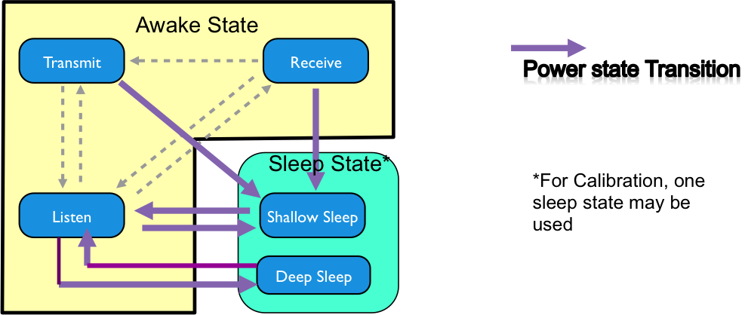
State Transitions in 11ax Simulation Scenarios Document [1]

Slide 5
Existing Table of State Transitions within 11ax Simulation Scenarios document
Existing Table under Common Power Model Parameters for all simulation Scenarios in Simulation Scenarios document doc. IEEE 802.11-14/0980r6 [1]
Power Transition parameters
State Transitions | Transition Time (ms) | Average Power Consumption (mW)
Transmit ⬄ Listen | 0 | 0
Receive ⬄ Listen | 0 | 0
Receive ⬄Transmit | T_{RT} | e.g., 209 mW (P_{RT}=(280+100)*1.1/2)
Transmit ⬄ Shallow Sleep | T_{TS} | e.g., 154.5 mW (P_{TS}=(280+0.9)*1.1/2)
Receive ⬄Shallow Sleep | T_{RS} | e.g., 55.5 mW (P_{RS}=(100+0.9)*1.1/2)
Listen ⬄ Shallow Sleep | T_{LS} | e.g., 28 mW (P_{LS}=(50+0.9)*1.1/2)
Shallow Sleep ⬄Listen | 0.5 ms (T_{SL})
Listen ⬄Deep Sleep | T_{DS} | e.g., 0.5 mW (P_{DS}=(0.9+0.003)*1.1/2)
Deep Sleep⬄Listen | 3 ms (T_{SD})

Slide 6
Power and Latency Transitions Between States in IEEE 802.11ax
We propose to replace the existing Table under Common Power Model Parameters for all simulation Scenarios in Simulation Scenarios document doc. IEEE 802.11-14/0980r6 [1] with the Table below
Power Consumption and Latency Values in State Transitions
State Transitions | Transition Time (ms) | Power Consumption (mW)
Transmit ⬄ Listen | T_{TL} = 0.010ms | 75mW
Receive ⬄ Listen | 0ms | 55mW
Receive Transmit | T_{RT} = 0.004ms | P_{RT} = 100mW
Transmit Shallow Sleep | T_{TS} = 0.01ms | P_{TS} = 15mW
Receive Shallow Sleep | T_{RS} = 0.2ms | P_{RS} = 15mW
Listen Shallow Sleep | T_{LS} = 0.2ms | P_{LS} = 5mW
Shallow Sleep Listen | T_{SL} = 0.5ms
Listen Deep Sleep | T_{LD} = 0.01ms | P_{DS} = 5mW
Deep Sleep Listen | T_{SDL}= 3ms

Slide 7
Summary
We have proposed to modify the Simulation Scenarios by including a table specifying the power and latency parameters for enhanced state transition modeling

Slide 8
References
[1] IEEE 11-14/0980r6: “TGax Simulation Scenarios”
[2] IEEE 11-15/0314r1: “Sleep States in IEEE 802.11ax Simulation Scenarios”

Slide 9
Straw poll 1
Do you agree to include the Table on Power and Latency Transitions Between States discussed in Slide 6 under Common Power Model Parameters for all simulation Scenarios in the Simulation Scenarios document?

