Slide 1
Multi-STA BA for SU Transmissions
Date: 2015-05-10
Authors:

Slide 2
Abstract
In this contribution we evaluate the potential MAC efficiency gain when using multi-STA BA to acknowledge UL SU transmissions.

Slide 3
Table of Contents
Introduction
Legacy BA/ACK
Multi-STA BA for SU Transmissions
MAC Efficiency Analysis Results
Conclusions

Slide 4
Introduction
A HE STA may send SU transmissions, particularly, in the uplink direction
  HE STAs may have many packets buffered
  HE STAs may not be capable of UL MU transmissions, e.g., a HE STA may be capable of receiving DL MU-MIMO frames, but not capable of transmitting UL MU-MIMO frames
BA/ACK for each individual STA causes high overhead
Multi-STA BA may be used to provide higher MAC efficiency for SU transmissions
  Multi-STA BA has been accepted into SFD [1]
  Proposed in [2] for acknowledging UL MU transmissions

Slide 5
Legacy Immediate SU BA/ACKs
Legacy ACK:
  ACK sent SIFS after each packet
HT-Immediate BA
  BA sent SIFS after A-MPDU
STA1
Data
STA2
Data
ACK
ACK
STA1
A-MPDU
STA2
A-MPDU
BA
BA

Slide 6
Legacy Delayed SU BA
HT-Delayed BA:
  BAR included in A-MPDU
  BA sent with unspecified delay
ACK/BA to individual STAs still represent significant overhead
May be optimized for higher MAC efficiency
STA1
A-MPDU
ACK
STA2
A-MPDU
ACK
BAR
BAR
BA
BA

Slide 7
Multi-STA BA for SU Transmissions
Multi-STA BA has been introduced to acknowledge UL MU transmissions [2]
The same multi-STA BA may be used to acknowledge UL SU transmissions to provide higher MAC efficiency
When compared to Legacy Delayed SU BA, multi-STA BA is more efficient due to
  Less inter frame spaces
  Less medium access contention
  More compact frame design
STA1
A-MPDU
STA2
A-MPDU
STA3
A-MPDU
STA4
A-MPDU
Multi-STA
ACK/BA

Slide 8
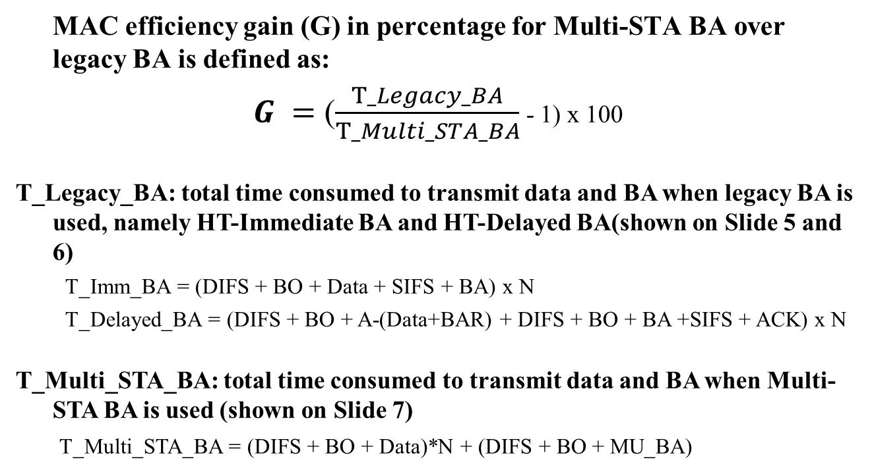
MAC Efficiency for Multi-STA BA
MAC efficiency gain (G) in percentage for Multi-STA BA over legacy BA is defined as:
$G =$ ($\frac{T_Legacy_BA}{T_Multi_STA_BA}$ - 1) x 100
T_Legacy_BA: total time consumed to transmit data and BA when legacy BA is used, namely HT-Immediate BA and HT-Delayed BA(shown on Slide 5 and 6)
  T_Imm_BA = (DIFS + BO + Data + SIFS + BA) x N
  T_Delayed_BA = (DIFS + BO + A-(Data+BAR) + DIFS + BO + BA +SIFS + ACK) x N
T_Multi_STA_BA: total time consumed to transmit data and BA when Multi-STA BA is used (shown on Slide 7)
    T_Multi_STA_BA = (DIFS + BO + Data)*N + (DIFS + BO + MU_BA)

Slide 9
MAC Efficiency Analysis Assumptions
Assumptions for UL SU Data transmissions:
  All the users have the same data packet size and the same amount of data
  All UL SU data transmissions are A-MPDUs
  All the users use the same MCS
  Control frames, i.e., BA, ACK, Multi-STA BA use MCS0
Assumptions for DL BA transmissions:
  Scenario 1: HT-Immediate BA (Slide 5)
  Scenario 2: HT-Delayed BA (Slide 6)
  Scenario 3: Multi-STA BA (Slide 7)

Slide 10
MAC Efficiency Analysis Assumptions
Description | Value
Contention duration | 27 µs (3 time slots)
Preamble duration | 48 µs
Block ACK duration | 96 µs
# of users | 2, 4 , 6 , 8
OFDM symbol duration (including CP) | 16 µs
# of data sub carriers | 234
Multi_STA BA duration (2/4/6/8 users) | 112/128/160/192 µs
Preamble duration 48us [1]
L-STF | L-LTF | L-SIG | HE-SIG-A | HE-LTF
8µs | 8µs | 4µs | 12µs | 16µs

Slide 11
MAC efficiency gain (G) for Multi-STA BA over legacy BA
Observations:
MAC efficiency gain (G) increases when a Multi-STA BA is used to acknowledge higher number of SU transmissions
MAC efficiency gain of up to 76% for 8 users compared to legacy HT-Delayed BA, and MAC efficiency gain of up to 39% for 8 users when compared to legacy HT-Immediate BA

Slide 12
MAC efficiency gain (G) for Multi-STA BA over legacy BA
Observations:
MAC efficiency gain (G) for Multi-STA BA decreases when the packet size increases
When Multi-STA BA is used to acknowledge 4 UL SU transmissions, a MAC efficient gain of up to 91% can be achieved when compared to HT-Delayed BA, and a MAC efficiency gain of up to 38% can be achieved when compared to using HT-Immediate BA

Slide 13
Other Design Considerations
Multi-STA BA may cause higher delay
  Evaluation may depend on the types of delay
    PHY Delay
    MAC Delay/Queueing delay
    End-to-End delay

Slide 14
Conclusion
Using Multi-STA BA to acknowledge UL SU transmission can significantly improve MAC efficiency
Trade off may be needed between MAC efficiency gain and delay in designing such a Multi-STA BA algorithm

Slide 15
References
11-15/0132r4, Specification Framework for Tgax
11-15/0366r2, Multi-STA Acknowledgement

