Slide 1
Selected Use Cases for Next Generation Positioning
Date: 2015/07/13
Authors:

Slide 2
Abstract
This document provides several use cases for next generation positioning (NGP)
The use cases are supported with estimates on required
accuracy
latency
refresh rate
number of simultaneous users (within AP coverage)
The terminology is as defined in document 11-15/0388r0

Slide 3
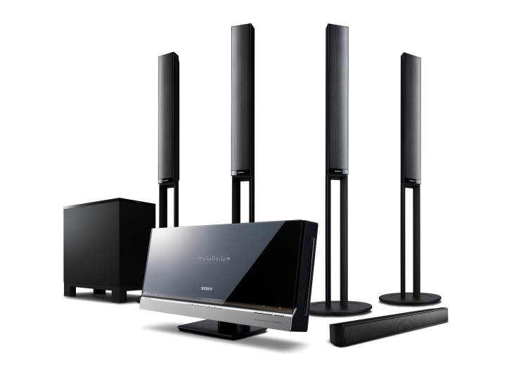
1. Positioning for Home Audio
Background: Advanced audio formats with immersive sound experience require exact position estimates of listener and speakers
User: Person with WLAN based home audio system
WLAN is employed for both sound transfer and positioning
Environment: Smart home with 802.11 coverage.
1 AP per floor supporting .11n, .11ac, and NGP
1 AP in close vicinity supporting .11ad, .11ay, and NGP
Optional: multiple APs from neighboring apartments
Use case “speaker system calibration”
The user installs his home audio system including various WLAN speakers
The speaker placement and position is automatically determined
The home audio system adjusts the speaker settings for best sound experience
Use case “follow-me sound”
The user has a wearable WLAN device
The device’s position is continuously monitored
The home audio system adjusts the speaker settings according to the user’s position and movement for immersive sound experience
In a simple case, the sound may only follow in neighboring rooms

Slide 4
1. Positioning for Home Audio (cont.)
Positioning requirements
The user may accept further APs for high fidelity
¹) orientation between wearable device and ear must be known (e.g. smart eyeglasses)
Use case | ”speaker system calibration” | “follow-me sound”
Horizontal accuracy | < 10cm @ 90% | same room @ 99% (simple)
 |  | < 50cm @ 90% (typ.)
 |  | < 10cm @ 90% (high fidelity) ¹
Vertical accuracy | not required | same floor @ 99% (simple)
 |  | < 50cm @ 90% (typ.) ¹
 | < 10cm @ 90% (high fidelity) | < 10cm @ 90% (high fidelity) ¹
Latency | < 10ms | < 10ms
Refresh rate | < 0.1 locations/s | > 2 … > 10 locations/s (depending on accuracy)
Exp. number of simultaneous users | 1 | <= 5

Slide 5
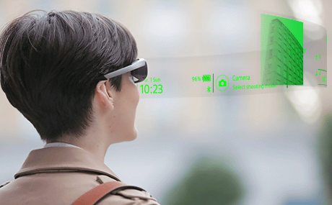
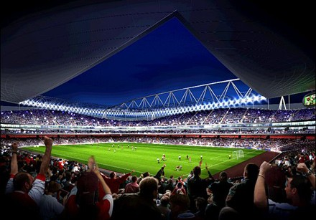
2. Navigation in Public Buildings
User: Person with smartphone, smart wear, smart eyeglasses with navigation app
Environment: Public building with 802.11 coverage. The expected AP environment is
1 AP per < 200 users or < 400m² / 4000 sq. ft.
APs support .11n, .11ac, .11ax, and NGP
Use case
The user enters a public building like stadium, concert hall, airport, museum, fair, parking deck
The smart device navigates the user to a particular seat, gate, point of interest, contact person, or empty parking spot

Slide 6
2. Navigation in Public Buildings (cont.)
Positioning requirements:
Horizontal accuracy: < 1m @ 90%
Vertical accuracy: same floor/tier @ 99%
Latency: < 250ms
Refresh rate: > 1 locations/s
Expected number of simultaneous users: < 1000 (within AP coverage area)
Impact on Network Bandwidth: low, the impact should be independent on the number of users

Slide 7
References
Cisco Systems Inc., 11-15-0388-00-0ngp NGP Use Case Template
Jonathan Segev, Intel, 11-14-1464-02-0wng NG Positioning Overview and Challenges

Slide 8
BAckup

Slide 9
Terminology of doc. 11-15/0388r0
User – The end entity (human) who would use this technology
Use case – A use case is task oriented. It describes the specific step by step actions performed by a user or device. One use case example is a user starting and stopping a video stream.
Environment – The type of place in which a network is deployed, such as home, outdoor, hot spot, enterprise, metropolitan area, etc.
Frequency bands of interest (FBoI): The 802.11 operating frequency bands relevant to this use case. Eg. for a shopping mall’s enterprise wireless it will be 2.4GHz and 5GHz
AP density: Density of AP deployment, e.g. APs deployed every 4000 sq.ft.
AP height: Height, above the floor, at which the APs are deployed, e.g. for shopping mall APs deployed approximately 15-25 ft above the floor
Key Location Requirement-
Expected Horizontal Accuracy: XY accuracy expected for the use case to succeed, <1m@90% is a requirement is that the computed location be within 1m horizontally of the actual location 90% of the time
Expected Vertical Accuracy: Z accuracy expected for the use case to succeed, “same floor@99%” is a requirement is that the computed location be on the same floor as the actual location 99% of the time. “0.5m@90%” is a requirement is that the computed location be within 0.5m vertically of the actual location 90% of the time
Expected Latency: Expected time taken to complete a single atomic location process. The location process begins with initiating a location request, then computing location, and ends with returning the computed location. E.g. 10 ms latency would indicate that it takes 10 ms after the request is transmitted to gather measurements, compute a location, and transfer any parameters such that the requester has a location within 10 ms.
Expected Refresh Rate: This defines how frequently is the computation expected when client moving. E.g. a refresh rate of 10 locations per second would indicate that location needs to be refreshed 10 times in a second
Expected number of simultaneous users

Slide 10
Straw Poll
Do you agree to add the following use cases to the NGP working draft?
Use case “1. Positioning for Home Audio”
Use case “2. Navigation in Public Buildings”
Y/N/A:

