Slide 1
NGP Use Case Template
Date: 2015-08-28
Authors:
Revision 1: Motions included from 11-15-0970r01

Slide 2
Abstract
This document is a proposed template to describe use cases, and some location requirements per use case, for Next Generation Positioning
In this initial version, only one sample use case is included. Additional use cases are expected to be added in future versions of this document
Location requirements are included with each use case to drive focus for the study group
The goal is to come up with a superset of everything potentially needed and then narrow down the field from there on

Slide 3
Terminology
  User – The end entity (human) who would use this technology
  Use case – A use case is task oriented. It describes the specific step by step actions performed by a user or device. One use case example is a user starting and stopping a video stream.
  Environment – The type of place in which a network is deployed, such as home, outdoor, hot spot, enterprise, metropolitan area, etc.
    Frequency bands of interest (FBoI): The 802.11 operating frequency bands relevant to this use case. Eg. for a shopping mall’s enterprise wireless it will be 2.4GHz and 5GHz
    AP density: Density of AP deployment, e.g. APs deployed every 4000 sq.ft.
    AP height: Height, above the floor, at which the APs are deployed, e.g. for shopping mall APs deployed approximately 15-25 ft above the floor
Key Location Requirement-
    Expected Horizontal Accuracy: XY accuracy expected for the use case to succeed, <1m@90% is a requirement is that the computed location be within 1m horizontally of the actual location 90% of the time
    Expected Vertical Accuracy: Z accuracy expected for the use case to succeed, “same floor@99%” is a requirement is that the computed location be on the same floor as the actual location 99% of the time. “0.5m@90%” is a requirement is that the computed location be within 0.5m vertically of the actual location 90% of the time
    Expected Latency: Expected time taken to complete a single atomic location process. The location process begins with initiating a location request, then computing location, and ends with returning the computed location. E.g. 10 ms latency would indicate that it takes 10 ms after the request is transmitted to gather measurements, compute a location, and transfer any parameters such that the requester has a location within 10 ms.
    Expected Refresh Rate: This defines how frequently is the computation expected when client moving. E.g. a refresh rate of 10 locations per second would indicate that location needs to be refreshed 10 times in a second
    Expected number of simultaneous users

Slide 4
1. Micro location in store
User: Person with a smartphone which has the store app installed
Environment: A store has APs for 802.11 coverage. The store may have APs at the store entrance. The expected AP density is about 1 AP per 4000 sq. ft. with APs supporting HT, VHT and NGP
Use case:
  The user enters the store with their phone
  As soon as user enters, the phone notifies the user about the store promotions
  The user can query details about a product on the app
  The app and smartphone can then help the user navigate to the particular shelf containing the product
  The user stands in queue and as they reaches the checkout counter, their loyalty number is brought up on the system
Expected:
  Horizontal accuracy: <0.5 m@90%, vertical accuracy: same floor@99%
  Latency: <500ms
  Refresh Rate: > 1 location/sec

Slide 5
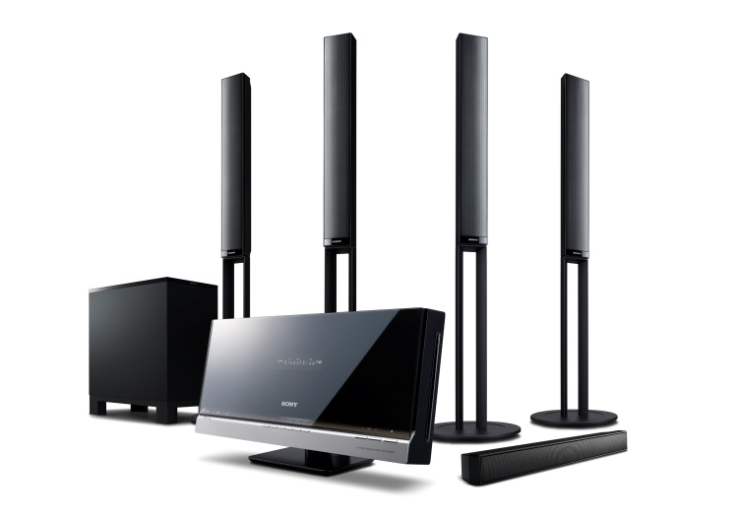
2. Positioning for Home Audio
Background: Advanced audio formats with immersive sound experience require exact position estimates of listener and speakers
User: Person with WLAN based home audio system
  WLAN is employed for both sound transfer and positioning
Environment: Smart home with 802.11 coverage.
  1 AP per floor supporting .11n, .11ac, and NGP
  1 AP in close vicinity supporting .11ad, .11ay, and NGP
  Optional: multiple APs from neighboring apartments
Use case “speaker system calibration”
  The user installs his home audio system including various WLAN speakers
  The speaker placement and position is automatically determined
  The home audio system adjusts the speaker settings for best sound experience
Use case “follow-me sound”
  The user has a wearable WLAN device
  The device’s position is continuously monitored
  The home audio system adjusts the speaker settings according to the user’s position and movement for immersive sound experience
  In a simple case, the sound may only follow in neighboring rooms

Slide 6
2. Positioning for Home Audio (cont.)
Positioning requirements
  The user may accept further APs for high fidelity
  ¹) orientation between wearable device and ear must be known (e.g. smart eyeglasses)
Use case | ”speaker system calibration” | “follow-me sound”
Horizontal accuracy | < 10cm @ 90% | same room @ 99% (simple)
 |  | < 50cm @ 90% (typ.)
 |  | < 10cm @ 90% (high fidelity) ¹
Vertical accuracy | not required | same floor @ 99% (simple)
 |  | < 50cm @ 90% (typ.) ¹
 | < 10cm @ 90% (high fidelity) | < 10cm @ 90% (high fidelity) ¹
Latency | < 10ms | < 10ms
Refresh rate | < 0.1 locations/s | > 2 … > 10 locations/s (depending on accuracy)
Exp. number of simultaneous users | 1 | <= 5

Slide 7
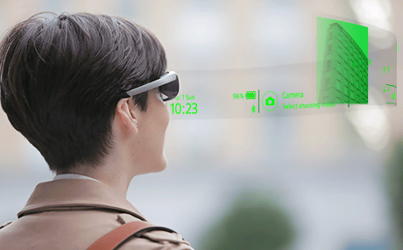
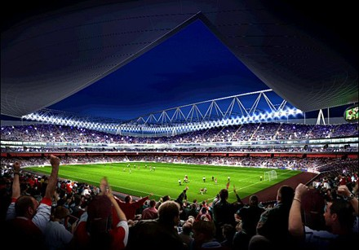
3. Navigation in Public Buildings
User: Person with smartphone, smart wear, smart eyeglasses with navigation app
Environment: Public building with 802.11 coverage. The expected AP environment is
  1 AP per < 200 users or < 400m² / 4000 sq. ft.
  APs support .11n, .11ac, .11ax, and NGP
Use case
  The user enters a public building like
  stadium, concert hall, airport, museum, fair, parking deck
  The smart device navigates the user to a particular
  seat, gate, point of interest, contact person, or empty parking spot

Slide 8
3. Navigation in Public Buildings (cont.)
Positioning requirements:
  Horizontal accuracy: < 1m @ 90%
  Vertical accuracy: same floor/tier @ 99%
  Latency: < 250ms
  Refresh rate: > 1 locations/s
  Expected number of simultaneous users: < 1000
  (within AP coverage area)
  Impact on Network Bandwidth: low, the impact should be independent on the number of users

Slide 9
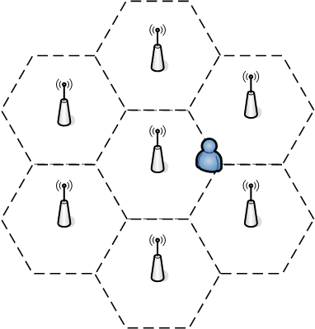
4. Positioning for Spectrum Management
User: Persons with a WiFi-device which has the corresponding app installed.
Environment: An areas (e.g. a large office, an university…) where there multi-APs for 802.11 coverage. The expected AP density is about 1 AP per TBD sq. ft. The APs providing data service to the STAs within their coverage supporting HT, VHT, DMG and NGP.
Use case:
  The user enters the area with their WiFi-device.
  As soon as user enters this area, the position of the user is determined through the NGP.
  With the position information of the user, the APs can suggest the user which AP to associate with and which channel to use, a.k.a. the load balance process, which can greatly improve the user experience especially in high density case.
  As the user travels in this area, the APs keep on tracking the position of the user. The traveling path of the user can help a lot in the hand over process, so the service(such as WiFi call, facetime etc.) is not interrupted when user is traveling.

Slide 10
4. Positioning for Spectrum Management(Cont’d)
Key Performance and Attributes:
  Horizontal accuracy: <0.5 m@90%, vertical accuracy: same floor@99%
  Latency: <500ms
  Refresh Rate: > 1 location/sec

Slide 12
References
11-07-2988-04-0000-liaison-from-wi-fi-alliance-to-802-11-regarding-wfa-vht-study-group-consolidation-of-usage-models.ppt
11-14-1464-02-0wng-ng-positioning-overview-and-chalanges.pptx
Use case 2 and 3: 11-15-561r2
Use case 4: 11-15-902r0

