Slide 1
UL-MU MAC Throughput under Non-Full Buffer Traffic
Date: 2015-03-10
Authors:
Name | Affiliations | Address | Phone | Email
Tatsumi Uwai | Radrix co.ltd | 〒820-8502 Incubation Facilities, Kawazu 680-4, Iizuka City, Fukuoka Japan | +81-948-29-7937 | uwai@radrix.com
Yuhei Nagao |  |  |  | nagao@radrix.com
Tran Thi Thao Nguyen | Kyushu Institute of Technology |  |  | nguyen@dsp.cse.kyutech.ac.jp
Leonardo Lanante |  |  |  | leonardo@cse.kyutech.ac.jp
Hiroshi Ochi |  |  |  | ochi@cse.kyutech.ac.jp

Slide 2
Abstract
  UL-MU is considered as a technique to increase the efficiency which meets the requirement in 802.11ax.
  In previous contributions, the need for a low overhead UL-MU protocol was discussed [1] [2].
Another discussion is to decide who and when to initiate UL-MU protocol [1] [2] [3].
    AP initiated
    STA initiated
[1] 11-15/0064r1
[2] 11-14/0598r0
[3] 11-15/0091r0

Slide 3
Consideration on UL-MU
In previous contributions, full buffer traffic was assumed where STAs always have UL frame to send.
In this presentation, we evaluate the effect of non-full buffer traffic in the MAC efficiency of several protocol types.

Slide 4
UL-MU protocol
AP Initiated
  Advantage: Possibility to adjust UL-MU transmission timing depending on all STAs’ TX demand [1].
  Disadvantage: Possibility of no transmission after initiating UL-MU transmission.
STA Initiated
  Advantage: STAs can initiate UL-MU sequence without waiting AP initiation. It means at least one UL frame can be transmitted.
  Disadvantage: cannot adjust UL-MU transmission timing depending on all STAs’ TX demand.

Slide 5
UL-MU Protocol list
We consider several protocol types as following,
AP initiated | STA initiated | Comment
(1). A1 | (3). S1 | TX demand response is transmitted to AP as SU
(2). A2 | (4). S2 | TX demand response is transmitted to AP as MU
 | (5). S3 | No TX demand response to any STA

Slide 6
AP Initiated UL-MU protocol
Protocol A1 [1]
Advantage
  AP has knowledge of complete CSI and TX demand for all STAs.
Disadvantage
  Overhead to find out STAs’ TX demand is large. AP needs to balance UL MU cycle time for high throughput and low latency.
UL MU cycle time

Slide 7
AP Initiated UL-MU protocol cont.
Protocol A2 [3]
Advantage
  Overhead is small
Disadvantage
  AP cannot obtain complete CSI from response frames resulting in suboptimum scheduling. AP needs to balance UL MU cycle time for high throughput and low latency.
UL MU cycle time

Slide 8
STA Initiated UL-MU protocol
Protocol S1
Advantage
  AP has knowledge of complete CSI and TX demand for all STAs.
Disadvantage
  Overhead become large to find out STAs’ TX demand.
Overhead

Slide 9
STA Initiated UL-MU protocol cont.
Protocol S2
Advantage
  Overhead is small
Disadvantage
  AP cannot obtain complete CSI from response frames resulting in suboptimum scheduling.
Overhead

Slide 10
STA Initiated UL-MU protocol cont.
Protocol S3 [2]
Advantage
  Overhead is comparable with UL legacy RTS/CTS access mechanism.
Disadvantage
  Scheduling is only based on long term statistics.
Overhead

Slide 11
Evaluation Condition
N : Number of STAs multiplexed = 1 – 4 STAs
80 MHz bandwidth, 1SS, MCS 8
  Resource is equally distributed to all transmitting STAs
  The Subcarrier design is the same as in 11ac.
Assumes OFDMA using short GI for UL-MU transmission
TXOP limit = 0
Block ACK
Error free
Non-full buffer traffic model
  Video Conferencing Traffic Model [4]
  Only the uplink traffic is considered.
$$MAC Throughput\left[Mbps\right]= {MU frame size[bit]}/{Total transmission time[us]}$$
  MU frame size : Total number of bit sent by all STAs

Slide 12
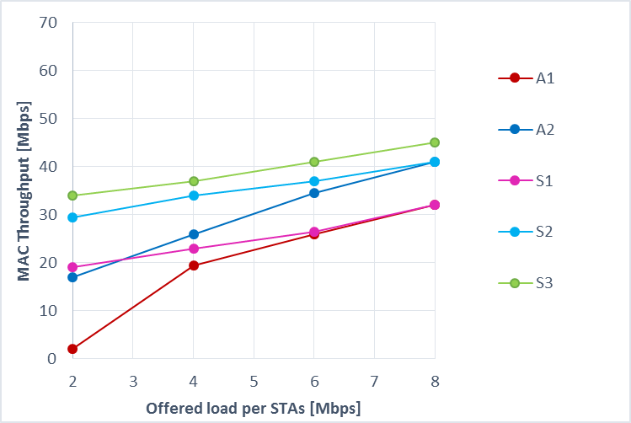
Evaluation Result : MAC Throughput
with Min cycle time
with Min cycle time
Min cycle time is same with protocol duration.
  S3 has best performance regardless of offered load.
  S1 and S2 has better performance compared to A1 and A2 with min cycle time at lower offered load.
  The difference becomes smaller and smaller as offered load increases.

Slide 13
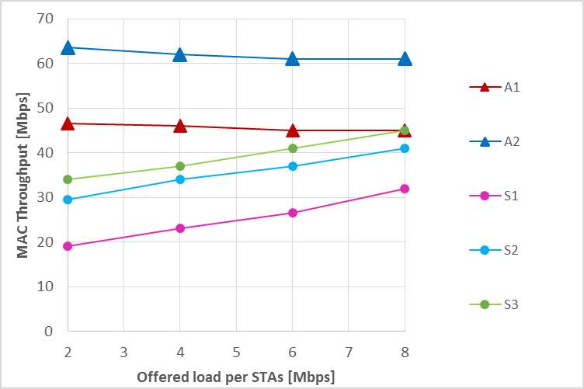
Evaluation Result : MAC Throughput
with Max cycle time
with Max cycle time
Max cycle time is the longest possible UL-MU cycle time such that the STAs’ buffer contents doesn’t increase infinity.
  A1 and A2 with max cycle time has better performance than all STA initiated protocols. However, latency for both is very high.

Slide 14
Summary
From this result,
  Both AP and STA initiated UL-MU protocol have advantages.
  AP initiated UL-MU protocol (protocol A1, A2) can have the best throughput by controlling UL-MU transmission timing depending on all STAs’ TX demand at the expense of latency.
  STA initiated UL-MU protocol has the best performance in terms of latency, and also good throughput without other STA coordination.

Slide 15
Straw Poll #1
Do you agree to add to the TGax Specification Framework:
x.y.z The amendment shall define a mechanism for both AP and non-AP STA to initiate a UL MU transmission.
Y
N
A

Slide 16
Reference
[1]Tomoko Adachi, Hiroki Mori, Brian Hart, Sean Coffey, Sigurd Schelstraete, Yuichi Morioka, Guido Hiertz, “Consideration on UL-MU overheads”, 11-15/0064r1, Toshiba Corporation, Toshiba Corporation, Cisco Systems, Realtek, Quantenna , Sony, Ericsson
[2] Tran Thi Thao Nguyen, Leonardo Lanante, Hiroshi Ochi, Tatsumi Uwai, Yuhel Nagao, “Uplink multi-user MAC protocol for 11ax”, 11-14/0598r0, Kyushu Institute of Technology, Radrix co. ltd
[3] Woojin Ahn, Jinsoo Ahn, Ronny Yonho Kim, “UL-OFDMA procedure in IEEE 802.11ax”, 11-15/0091r0, Yonsei Univ., KNUT
[4] 11ax Evaluation Methodology, 11-14-0571-07-00ax-evaluation-methodology.docx

Slide 17
Appendix

Slide 18
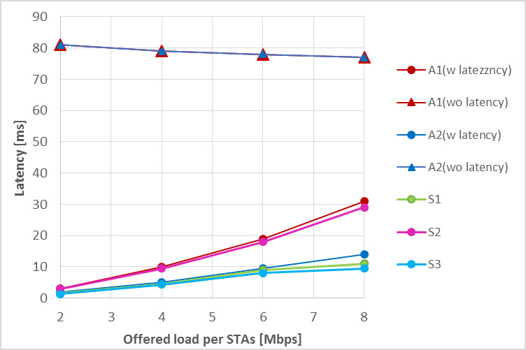
Evaluation Result : Latency
Min cycle time is same with protocol duration.
Latency become large
Max cycle time is the longest possible UL-MU cycle time such that the STAs’ buffer contents doesn’t increase infinity.
  When protocol A1 and A2 use Max cycle time, latency can become as large as 80ms.

