Slide 1
11ax Preamble design: training sequence
Date: 2015-03-05
Authors:

Slide 2
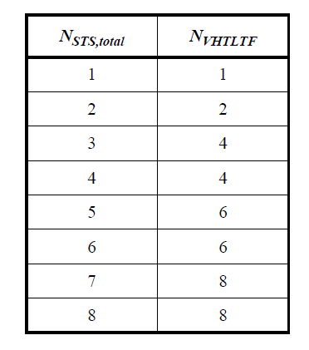
Introduction
MIMO Channel estimation is done using dedicated training sequence
HT-LTF in 11n
VHT-LTF in 11ac
HE-LTF in 11ax?
In 11ac, the length of the training sequence is the minimum needed to estimate N_{RX} x N_{STS,total} channel

Slide 3
Considerations for channel estimation
Channel estimation is affected by the same noise level that is present during data reception
The channel estimate is noisy
Equalizer coefficients derived from the noisy channel estimate propagate the noise to the equalized constellation points
This effectively leads to a doubling of the noise – or a 3dB reduction in post-equalizer SNR compared to noise-free channel estimate

Slide 4
Some math …
Received training signal is: ($N_{T}$ is Gaussian with variance σ²)
The channel can be derived as: ($\hat{N}$ is Gaussian with variance σ²)
Received data signal is:
This can be equalized as:
This can be rewritten as:
$$Y_{T}=HX_{T}+N_{T}$$
$$\hat{H}=Y_{T}X_{T}^{∗}=H+N_{T}X_{T}^{∗}=H+ \hat{N}$$
$$Y=HX+N$$
$$\hat{X}=WY=\frac{{\hat{H}}^{∗}}{{\hat{H}}^{∗}\hat{H}}HX+WN$$
$$with W=\frac{{\hat{H}}^{∗}}{{\hat{H}}^{∗}\hat{H}}$$
$${SNR}_{Rx}=\frac{{\left|H\right|}^{2}}{σ^{2}}$$
$$\hat{X}=\frac{{\hat{H}}^{∗}}{{\hat{H}}^{∗}\hat{H}}\left(\hat{H}−\hat{N}\right)X+WN \\ = X+W\underset{\begin{aligned}noise with \\ variance {2σ}^{2} \end{aligned}}{\underbrace{(N−\hat{N}X)}}$$
3 dB Loss
$${SNR}_{postEq}=\frac{{\left|H\right|}^{2}}{2σ^{2}}$$

Slide 5
Simulation result
Noisy channel estimate vs. Noise-free channel estimate

Slide 6
How too improve the channel estimate?
Channel smoothing can be used
Not for precoded signals
Data-driven Equalizer adaptation
Doesn’t provide improvement for “early” symbols
Channel estimate can be improved by averaging
Averaging becomes possible if training sequences are increased
N symbols: noise variance on channel estimate is $σ^{2}$/N instead of $σ^{2}$
Total noise after Equalizer becomes $σ^{2}$(1+1/N) instead of ${2σ}^{2}$
N | Theoretical SNR improvement
2 | 1.25 dB
4 | 2.04 dB
8 | 2.5 dB

Slide 7
Example: one-stream performance
Compare performance of one-stream MCS with 1, 2, 4 or 8 VHT-LTF symbols
N | ΔSNR
2 | 1.1 dB
4 | 1.8 dB
8 | 2.0 dB

Slide 8
Complexity
A small additional overhead can provide 1.5-2 dB improvement in EVM
4 microsec for 2 training symbols (NOTE: based on 11ac preamble structure)
12 microsec for 4 training symbols
The same overhead that is already incurred for multi-stream transmissions
Straightforward extension of current VHT-LTF coding (at Tx and Rx)
Overall: very low complexity

Slide 9
How to use this technique in 11ax?
Several possibilities:
Use fixed training length, independent of number of streams (e.g. 4 symbols)
MCS with lower number of streams can improve channel estimate
MCS with higher number of streams don’t increase overhead relative to 11ac
Keep it configurable and indicate training length in HE-SIG
Configurable mapping of number of streams to number of training symbols
Increase training sequence length for all MCS
Fixed mapping, but more training symbols than comparable 11ac case

Slide 10
Conclusion
Increased training lengths are a very efficient and low-complexity way to gain 1.5-2 dB in EVM
In practice, there are several ways to implement increased training lengths

Slide 11
Strawpoll
Do you support investigating the use of longer training signal lengths during HE-LTF to allow averaging when estimating the channel?

